Slide 1
Oil Spill Classification Using CNN

Slide 2
Introduction
Oil spills are generally characterized as the release of liquid petroleum hydrocarbons into the environment due to human activities.
Diverse studies have highlighted the usefulness of Synthetic Aperture Radar images (SAR) obtained by satellites for the detection of oil spills.
Due to large amount of satellite images, we can use machine learning techniques or deep learning models to monitor sea conditions automatically.

Slide 3
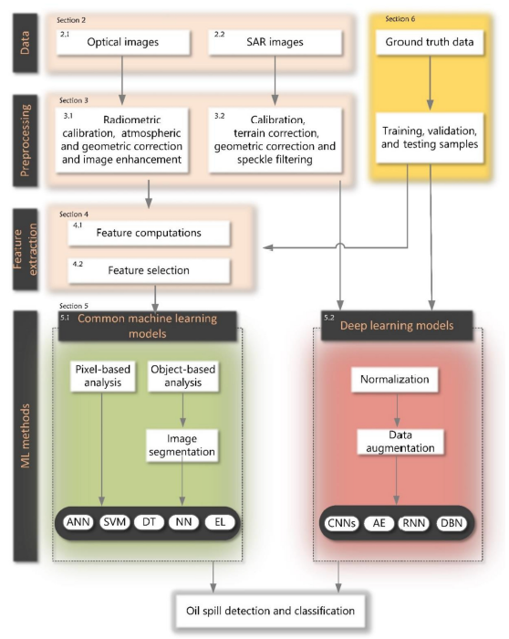
Research Background
Oil spills can be detected by different sensors.
SAR images has better performance.
Ground truth data is needed.
Pre processing stage is necessary.

Slide 4
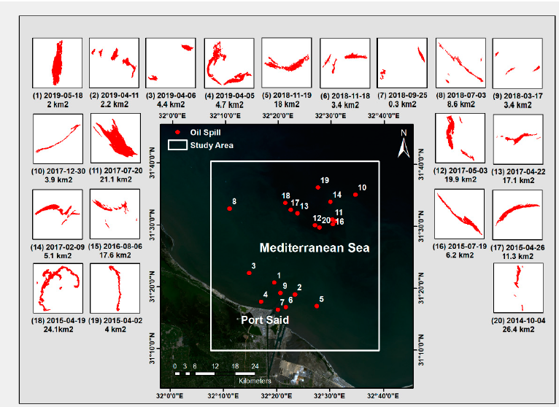
Ground Truth & Study Area
Oil spills in this study is based on a work by Islam Abou El-Magd et al. Which is published in MDPI remote sensing article.
Study area is near port Said in Mediterranean sea (31°30‘ N , 32°30‘ E).

Slide 5
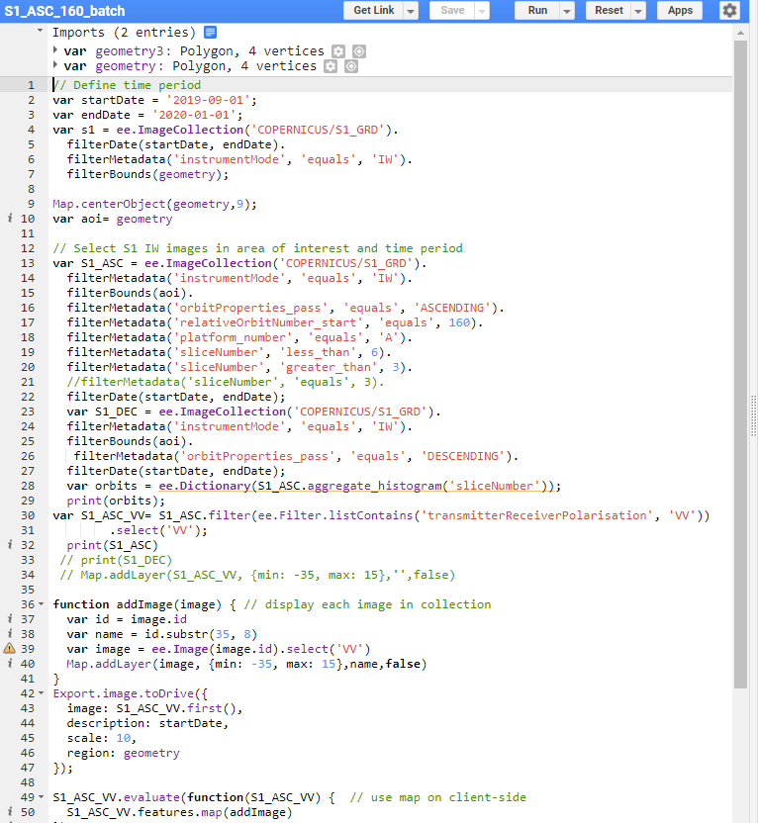
Google Earth Engine (GEE)
To reduce download size and processing time, we can use google earth engine.
Sentinel 1 images with relative orbit number of 160 from 2014 to 2021 is croped to ROI and saved to google drive in geoTiff format.
Some of the preprocessing steps such as calibrations, is already done on GEE datasets

Slide 6
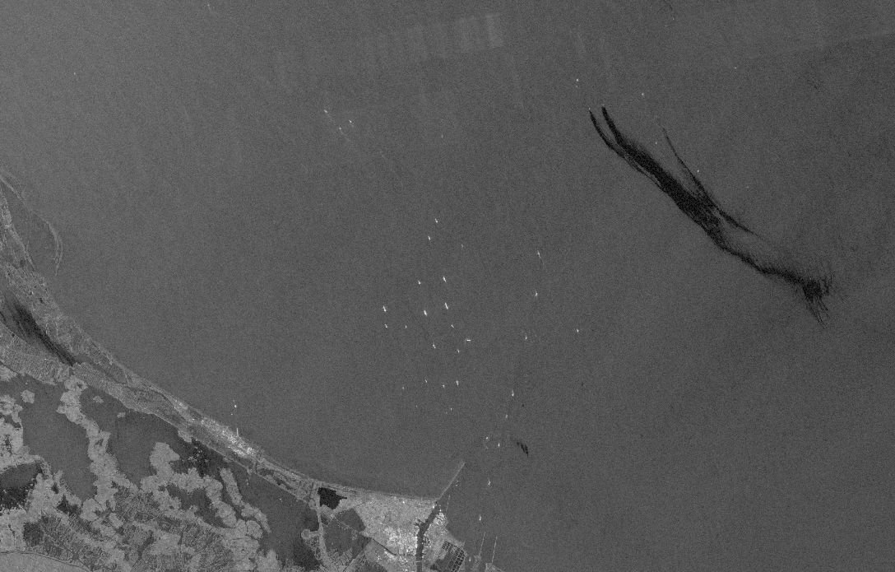
Example of SAR Images
Land & Sea
Bulid up area
Ships
Oil platforms
Oil spills

Slide 7
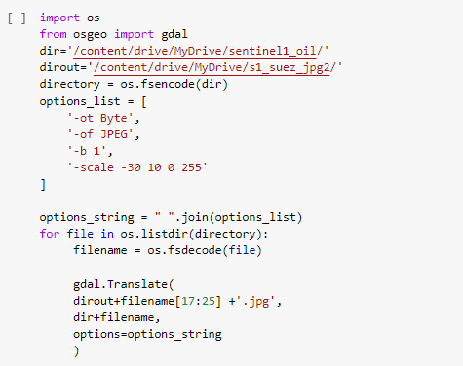
Pre Processing
Convert GeoTiff files to Jpeg
Transform a certain range of backscatter

Slide 8
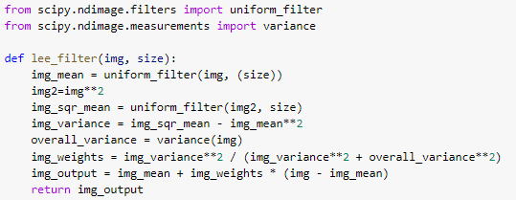
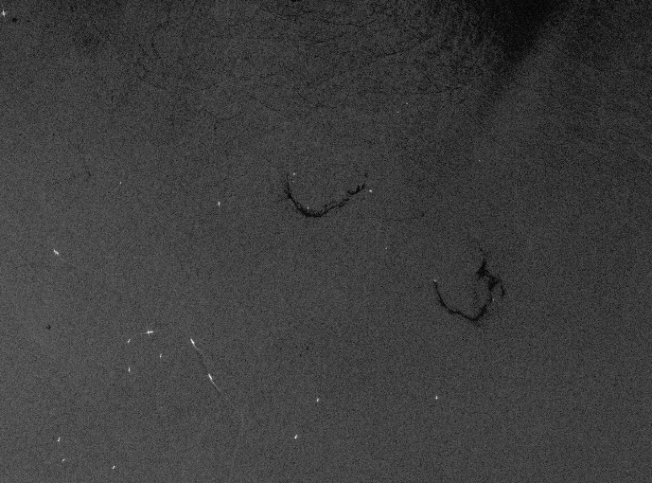

Pre Processing
To reduce speckle noise of SAR images we can apply lee filter with differnet window sizes.
One example is shown below with 9*9 window size.
Noise reduction is more visible after resizing the images.

Slide 9
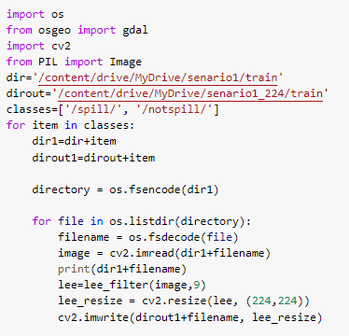
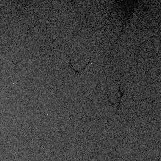
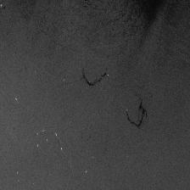
Pre Processing
The input dimension of pre trained models are usually 224*224 pixels. So a resize step is needed.
As mentioned before the effect of lee filter is clear after resizing.

Slide 10
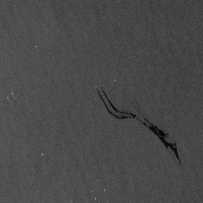
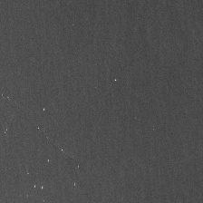
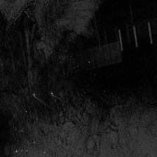
Categorizing
After appling all the pre processings, we should categorize the images based on the previous works and experience.
Three categories of spill and not spill and lookalikes are considered.
Spill Not spill Lookalikes

Slide 11
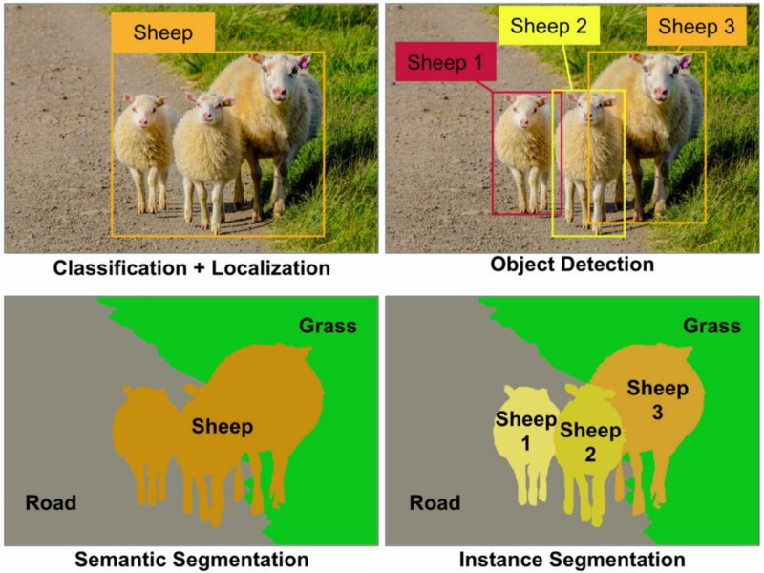
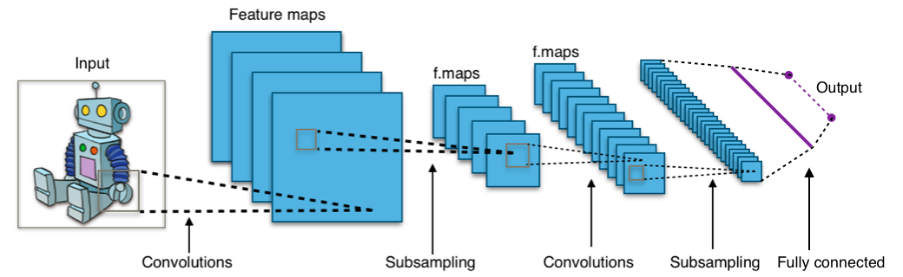
Convolutional Neural Network (CNN)
A class of deep neural networks
Most commonly applied to analyzing visual imagery
Image classification & Image segmentation

Slide 12
CNN Layers
Input layer: RGB Image
Convolutional Layers: contain the learned kernels (weights), which extract features that distinguish different images from one another.
Padding
Kernel size
Stride
Pooling Layers: gradually decreases the spatial extent of the network.
Flatten Layer: converts a three-dimensional layer in the network into a one-dimensional vector to fit the input of a fully-connected layer for classification.

Slide 13
Data
6 Year of Sentinel 1 SAR images
Categorised in 3 classes ( spill & water & lookalikes)
Two scenario of classification investigated
Scenario 1: water & oil spills
Scenario 2: water and lookalikes as not spill & oil spills as spill
Scenario 1 Table
Category/Type | Training | Validation | Test | Total
Spill | 43 | 6 | 3 | 52
Not spill | 70 | 20 | 10 | 100
Total | 113 | 26 | 13 | 152
Scenario 2 Table
Category/Type | Training | Validation | Test | Total
Spill | 43 | 6 | 3 | 52
Not spill | 77 | 22 | 12 | 111
Total | 120 | 28 | 15 | 163

Slide 14
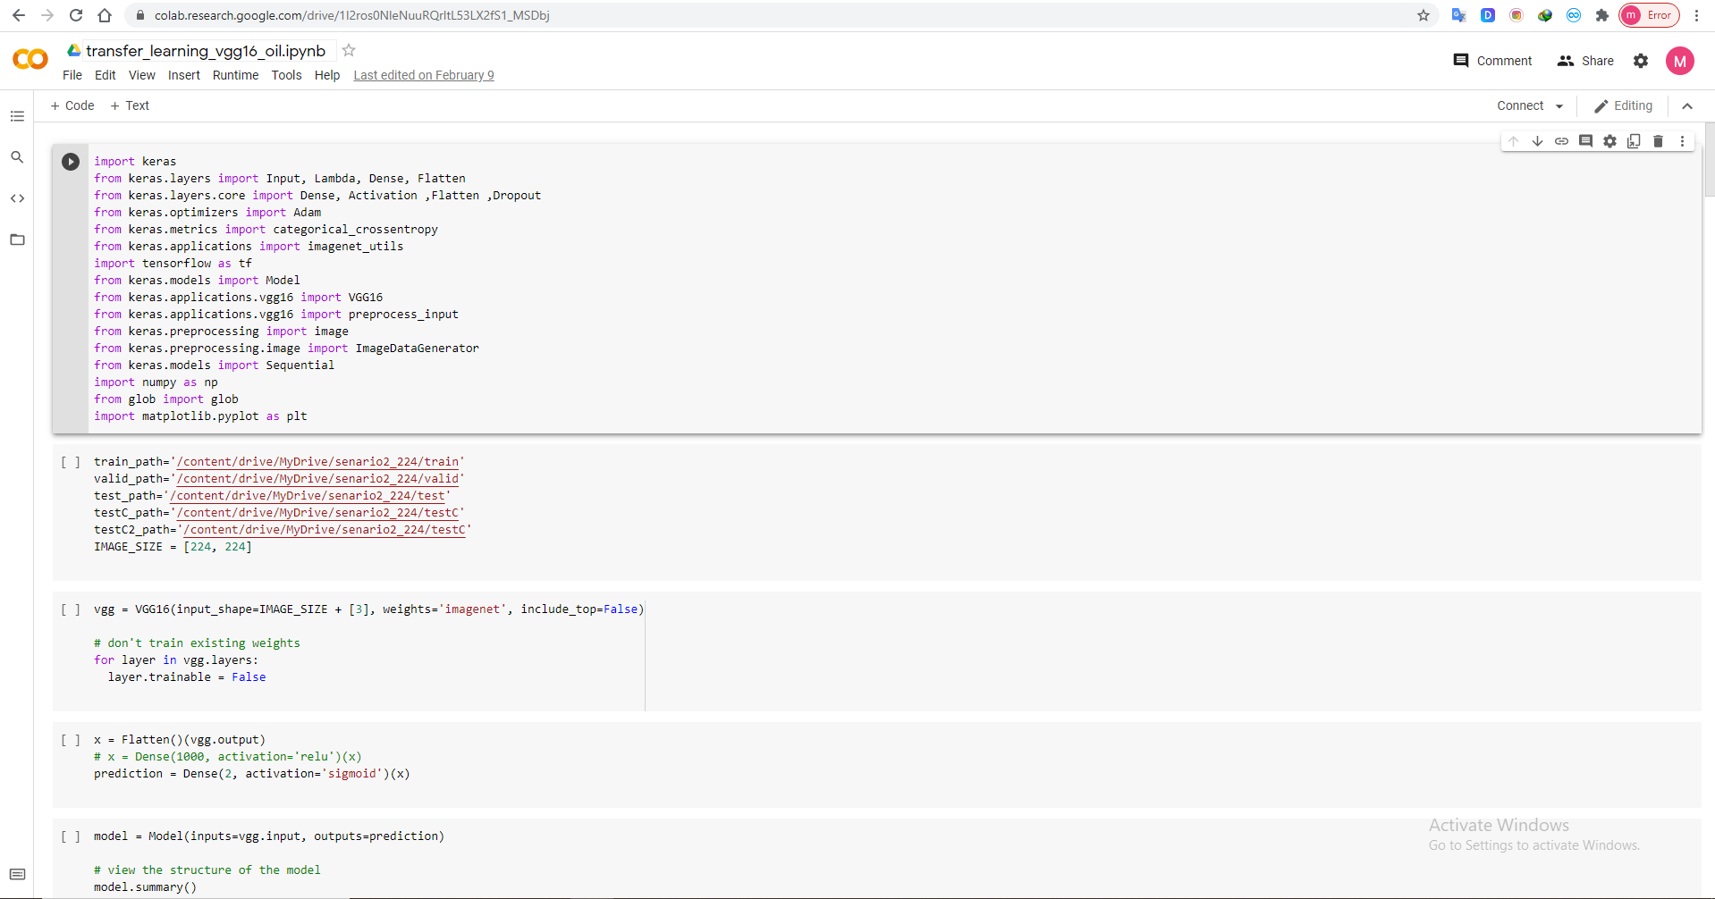
Google Colab
allows you to write and execute Python in your browser
Zero configuration
Free access to GPUs
Easy sharing

Slide 15
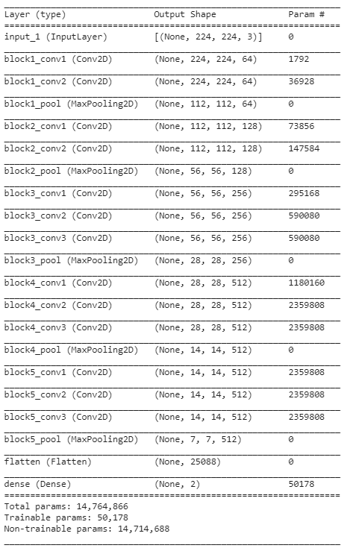
Pre Trained Model
Transfer learning: use a pre-trained model on a different simillar dataset
Fine-tuning: use parts of the pre-trained model and train some other parts of it, for another dataset

Slide 16
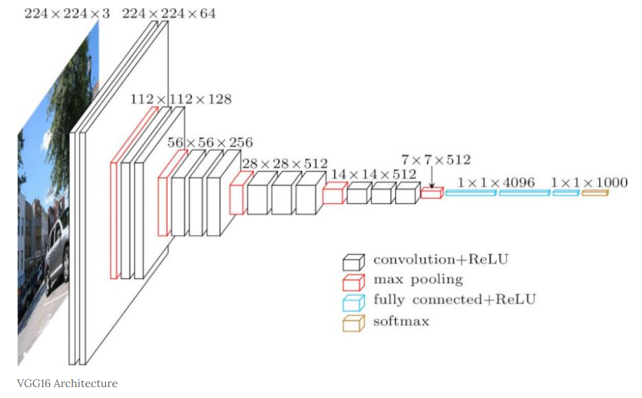
Fine Tunning Pre Trained Models
Removed the dense layer and replaced it with a 2 class dense layer in all models.
Fine tuned models are:
VGG-16
ResNet50 V2
MobileNet
Inception V3
Item/Model | MobileNet | ResNet50V2 | VGG-16 | InceptionV3
Total Parameters | 2,383,426 | 23,765,506 | 14,764,866 | 21,905,186
Trainable Parameters | 125,442 | 200,706 | 50,178 | 102,402
Trainable to Total Percent | 5.3 | 0.8 | 0.3 | 0.5

Slide 17
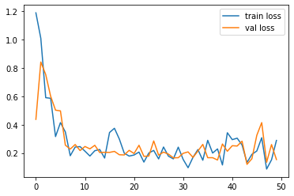
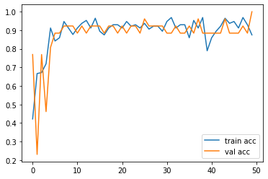
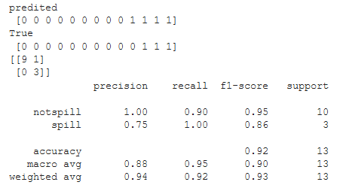
Model Training Example
50 epoch is used to train all models.
Batch size of training in each epoch is 8 and for validation is 4.
Adam optimizer with 0.001 learning rate is used.
Loss & Accuracy & Confusion Matrix of each model is drawn at the end.

Slide 18
Results
Scenario 1
 | Tarining accuracy |  |  |  |  | Validation accuracy |  |  |  |  | Test accuracy
 | MobileNet | ResNet50 V2 | VGG-16 | InceptionV3 |  | MobileNet | ResNet50 V2 | VGG-16 | InceptionV3 |  | MobileNet | ResNet50 V2 | VGG-16 | InceptionV3
1 | 0.9912 | 0.9823 | 0.9558 | 0.982 |  | 0.8846 | 0.9615 | 0.9615 | 0.923 |  | 0.8125 | 0.923 | 0.81 | 0.937
2 | 0.9558 | 0.9823 | 0.9558 | 0.9912 |  | 0.6154 | 0.9231 | 0.9615 | 0.923 |  | 0.5625 | 0.923 | 0.88 | 0.937
3 | 0.9823 | 0.9823 | 0.9558 | 0.9646 |  | 0.7308 | 0.9231 | 0.9231 | 0.9615 |  | 0.5 | 0.8462 | 0.88 | 0.937
4 | 0.9558 | 0.9823 | 0.9292 | 0.9912 |  | 0.8846 | 0.8846 | 0.8846 | 0.9231 |  | 0.937 | 0.8462 | 0.81 | 1
5 | 0.9823 | 0.9646 | 0.9558 | 0.9912 |  | 0.8846 | 0.8846 | 0.9231 | 0.8846 |  | 0.75 | 0.8462 | 0.88 | 0.875
6 | 0.9735 | 0.9823 | 0.9204 | 0.8584 |  | 0.8846 | 0.9231 | 0.8846 | 0.7308 |  | 0.9375 | 0.8462 | 0.88 | 0.6875
7 | 0.9646 | 1 | 0.9469 | 0.9823 |  | 0.8846 | 0.8846 | 0.8846 | 0.8846 |  | 0.75 | 0.8462 | 0.88 | 0.875
8 | 1 | 1 | 0.9823 | 0.9735 |  | 0.884 | 0.9231 | 0.9615 | 0.7692 |  | 0.812 | 1 | 0.81 | 0.875
9 | 0.973 | 0.9823 | 0.9292 | 0.9912 |  | 0.884 | 0.9231 | 1 | 0.8846 |  | 0.75 | 0.846 | 0.81 | 1
10 | 0.991 | 0.9912 | 0.9469 | 0.9735 |  | 0.923 | 0.9231 | 0.9231 | 0.923 |  | 0.75 | 0.9231 | 0.81 | 0.9735
Average | 0.977 | 0.985 | 0.948 | 0.970 |  | 0.846 | 0.915 | 0.931 | 0.881 |  | 0.756 | 0.885 | 0.845 | 0.910
STD | 0.014 | 0.010 | 0.017 | 0.038 |  | 0.091 | 0.023 | 0.038 | 0.070 |  | 0.132 | 0.052 | 0.035 | 0.087

Slide 19
Results
Scenario 1

Slide 20
Results
Scenario 2
 | Tarining accuracy |  |  |  |  | Validation accuracy |  |  |  |  | Test accuracy
 | MobileNet | ResNet50 V2 | VGG-16 | InceptionV3 |  | MobileNet | ResNet50 V2 | VGG-16 | InceptionV3 |  | MobileNet | ResNet50 V2 | VGG-16 | InceptionV3
1 | 0.983 | 1.000 | 0.958 | 0.992 |  | 0.857 | 0.929 | 0.893 | 0.893 |  | 0.938 | 0.938 | 0.940 | 1.000
2 | 0.980 | 0.975 | 0.942 | 0.967 |  | 0.964 | 0.893 | 0.893 | 0.857 |  | 1.000 | 0.875 | 0.940 | 0.938
3 | 0.958 | 0.983 | 0.942 | 0.983 |  | 0.929 | 0.929 | 0.893 | 0.679 |  | 0.938 | 0.938 | 0.940 | 0.875
4 | 0.975 | 0.975 | 0.925 | 1.000 |  | 0.750 | 0.929 | 0.893 | 0.893 |  | 0.813 | 0.938 | 0.880 | 1.000
5 | 0.983 | 0.992 | 0.958 | 0.917 |  | 0.929 | 0.893 | 0.893 | 0.821 |  | 0.938 | 1.000 | 0.940 | 0.938
6 | 0.950 | 0.983 | 0.925 | 0.925 |  | 0.857 | 0.893 | 0.893 | 0.893 |  | 0.938 | 0.813 | 1.000 | 0.938
7 | 0.983 | 0.975 | 0.942 | 0.975 |  | 0.857 | 0.929 | 0.857 | 0.893 |  | 0.875 | 1.000 | 0.940 | 1.000
8 | 0.975 | 0.975 | 0.950 | 0.958 |  | 0.893 | 0.893 | 0.893 | 0.750 |  | 1.000 | 1.000 | 0.940 | 0.938
9 | 0.967 | 0.958 | 0.942 | 0.992 |  | 0.929 | 0.929 | 0.893 | 0.929 |  | 0.938 | 0.813 | 0.940 | 1.000
10 | 0.942 | 0.958 | 0.917 | 0.958 |  | 0.393 | 0.893 | 0.893 | 0.643 |  | 0.438 | 0.938 | 0.940 | 0.750
Average | 0.970 | 0.977 | 0.940 | 0.967 |  | 0.836 | 0.911 | 0.889 | 0.825 |  | 0.881 | 0.925 | 0.940 | 0.938
STD | 0.014 | 0.012 | 0.013 | 0.027 |  | 0.158 | 0.018 | 0.011 | 0.095 |  | 0.157 | 0.067 | 0.027 | 0.074

Slide 21
Results
Scenario 2

Slide 22
Conclusion
Training the model with lookalikes as notspill class increases all the test accuracies.
Highest accuracies in test data is for InceptionV3 model in both scenaios.
Repetition of 100% test accuracy is highest in InceptionV3 model (4 out of 10 trainings).
Stability of the training and validation accuracies is higher in VGG-16 model.

