Slide 1
Case study: predicting who will sunscribe to Term Deposit
By: Shima Ghasemi

Slide 2

Overview
Problem statement:
Marketing team is trying to maximize the number of customers subscribing to Term Deposit.
There is too much manual effort with too little result since mostly the customers are randomly contacted. The team needs help to identify customers with the maximum chance of committing.
Goal statement:
help the marketing team to identify customers with highest probability of subscribing.
Dataset:
We have data from previous campaigns with features recorded for customers who subscribed at the end for the specific product.

Slide 3
Approach
The approach in solving such cases usually consists of the followings:
1- exploration and visualization of data
imbalanced class has been noticed in dependent variables
2-Modelling :
training the logistic regression and random forest
Tune the hyperparameters
3-data preparation
4-evaluation
Finalize evaluation metric
F1score,
Recall
Precision
Accuracy
Confusion matrix

Slide 4

Summary of the results
evaluation was done with logistic regression and random forest
Dataset was imbalanced (majority class: minority class=89:11) thus evaluation metric had to be chosen with care (F1score, confusion matrix, recall, accuracy and precision)
Models with best results:
Compare the performance of the Random Forest, the logistic model, the Naive Bayes and Decision Tree
1- Accuracy score for selected features when we use logistic model is 0.93, when we use Random forest model is 0.97, when we use Naive Bayes model is 0.86 and when we use Decision Tree model is 0.88
2- Precision score for selected features when we use logistic model is 0.9409, when we use Random forest model is 0.9931, when we use Naive Bayes model is 0.8405 and when we use Decision Tree model is #### 0.8406
3- recall for selected features when we use logistic model is 0.9098 and when we use Random forest model is 0.9502, when we use Naive Bayes model is 0.89 and when we use Decision Tree model is 0.9315

Slide 5
Summary of the results
Evaluation metric chosen:
The next step after implementing a machine learning algorithm is to find out how effective is the model based on metric and datasets. Different performance metrics are used to evaluate different Machine Learning Algorithms. For example a classifier used to distinguish between images of different objects; we can use classification performance metrics such as, Precision score,accuracy score , recall score and Cross val score etc.
The machine learning model cannot be simply tested using the training set, because the output will be prejudiced, because the process of training the machine learning model has already tuned the predicted outcome to the training dataset. Therefore in order to estimate the generalization error, the model is required to test a dataset which it hasn’t seen yet; giving birth to the term testing dataset.
The machine learning model cannot be simply tested using the training set, because the output will be prejudiced, because the process of training the machine learning model has already tuned the predicted outcome to the training dataset. Therefore in order to estimate the generalization error, the model is required to test a dataset which it hasn’t seen yet; giving birth to the term testing dataset.

Slide 6

Summary of results
Which model has better performance on the test set?
To benchmark and comparing classification scores between Random Forest, the logistic model, the Naive Bayes and Decision Tree, metrics such as accuracy, area under the curve, true positive rate, false positive rate, and precision were analysed.
To provide statistical quantification as to whether a difference in model performance is conclusive enough to state the difference is significant or if the observed difference is by random chance
Random forest has got better accuracy score compared to logistic, Naive Bayes and Decision Tree hence we can say that it has better performance

Slide 7
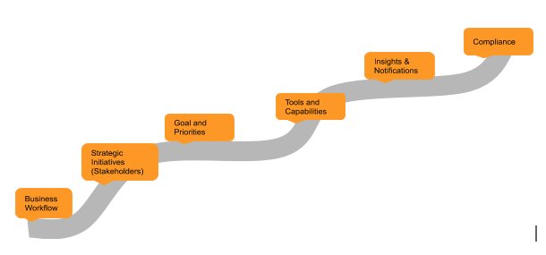
Analytical roadmap
a holistic data centric approach in all aspects of system
In other words the solutions that often include customized applications need to be data driven for superior results.
A data centric process transformation would improve managing and leveraging information in order to drive key initiatives.
It is a good idea to think in terms of a road map to attain specific goals to achieve from underlying data, so that an analytics system could be operationalized within the organization.
Driving insights from data and analyses, testing hypothesis, checking if the analyses of the results is aligned with the hypothesis
Data cleaning,
Building required infrastructure, identifying tools,
Compliance checking
Compliance and auditing the project, entire data and analyses system should be subject to compliance
Choosing tools, identifying gaps for required tools, making downstream of data possible smoothly
Understanding gaps that can be resolved with data strategy and data science and required data and tools
Is the analyses aligned with main strategies of the organization? It should be aligned with main strategies

Slide 8
Business impact
From every 4000 customers around 500 will commit (12.5% chance)
Assuming we need 10 minutes for calling every customer this means 4000*10=40000 minutes equal to 667 hrs of work aprox.
Imagine the hourly rate of marketing guys is 25 euros per hour thus it will cost 25*667=16,675 euros only the cost of man labour with very low chance of success
By applying the predictive analyses, we can identify the customers with higher chance of buying the product, imagine contacting 1000 customers, from every 100 person 75 of them will commit thus it is a huge cost saving both on time and money, marketing team can reach out to more new customers to open new markets
Another business impact is increasing customer satisfaction and reputation of the bank thus increasing market share price probably if this process is automatized to all products
Better customer service since the human labour can be assigned to this sector
Another point is increasing the quality of product based on customer needs since we can design targeted customer surveys

