Slide 1
RocketMQ存储系统概要设计
陈厚道

Slide 2
e
回顾上次分享
Queue1
Broker Server A
Queue2
NameServer…
协调Brokers
Topic_A
Queue3
Producer
Broker Server B
Queue4
Queue5
Roundbin方式，轮询发送消息
MQ集群

Slide 3
e
思考题
当topic数量增多到100+时，kafka的单个broker的TPS降低了1个数量级，而RocketMQ在海量topic的场景下，依然保持较高的TPS？
CommitLog的”随机读”对性能的影响？

Slide 4
e
消息存储技术选型
分布式KV存储(LevelDB、RocksDB、Redis)
NewSQL存储(TiDB)
文件系统(RocketMQ、Kafka、RabbitMQ)

Slide 5
CommitLog
Message1
Message2
Message3
Message…n
Share Log
RocketMQ
Producer
Topic1-Queue1
Message1
Message2
Message3
Message…n
Private Log
Topic1-Queue2
Message1
Message2
Message3
Message…n
Private Log
Topic1-Queue3
Message1
Message2
Message3
Message…n
Private Log
Kafka
Producer
Topic1-Queue4
Message1
Message2
Message3
Message…n
Private Log

Slide 6
RocketMQ存储架构图
e
CommitLog中图示的
几种含义
CommitLogOffSet
MessageSize、TagHashCode
ConsumeQueue中
图示的几种含义
ConsumeQueue
已经消费的消息
已写入的消息
未消费的消息
待写入的消息
doDispatch
异步构建 逻辑队列
待dispatch
构建的逻辑
队列元素
minOffset
consumeOffset
maxOffset
CommitLogOffSet
MessageSize、TagHashCode
ConsumeQueue
Producer
minOffset
consumeOffset
maxOffset
Consumer
CommitLogOffSet
MessageSize、TagHashCode
ConsumeQueue
CommitLog
minOffset
consumeOffset
maxOffset

Slide 7
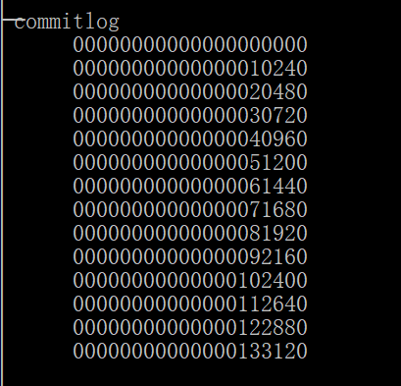
CommitLog
CommitLog
MappedFile
本案例是按照10240大小切割
CommitLog
MappedFileQueue

Slide 8
CommitLog之Message格式
字段 | 字段含义 | 字段大小
msgSize | 代表这个消息的大小 | 4
MagicCode | 魔数 | 4
BodeCRC | 消息体 BODY CRC | 4
queueId | 消息队列ID | 4
flag | 可能是为了兼容老版本的Message格式 | 4
QueueOffset | 消息队列的逻辑偏移 | 8
PhysicalOffset | 消息的物理存储位置 | 8
Sysflag | Compressed/MultiTags/prepared/commit /rollback | 4
BornTimeStamp | 消息产生端(producer)的时间戳 | 8
BornHost | 消息产生端(producer)地址(address:port) | 8
StoreTimeStamp | 消息在broker存储时间 | 8
StoreHostAddress | 消息存储端(broker)地址(address:port) | 8
ReconsumeTimes | 消息被某个订阅组重新消费的次数 | 8
PreparedTransaction Offset | 表示是prepared状态的事物消息 | 8
messagebodyLength | 消息体大小值 | 4
messagebody | 消息体内容 | bodyLength
topicLength | topic名称内容大小 | 1
topic | topic的内容值 | topicLength
propertiesLength | 属性值大小 | 2
properties | propertiesLength大小的属性数据 | propertiesLength
Notes:
rollback

Slide 9
SendMessageProcessor
QueryMessageProcessor
业务层
DefaultMessageStore
CommitLog
ConsumeQueue
IndexService
IndexFile
存储逻辑层
MappedFileQueue
TransientStorePool
存储I/O层
MappedFile
MappedByteBuffer
9

Slide 10
SendMessageProcessor sendProcessor = new SendMessageProcessor(this);
this.remotingServer.registerProcessor(RequestCode.SEND_MESSAGE,
sendProcessor, this.sendMessageExecutor);
this.sendMessageExecutor = new BrokerFixedThreadPoolExecutor( this.brokerConfig.getSendMessageThreadPoolNums(), this.brokerConfig.getSendMessageThreadPoolNums(), 1000 * 60, TimeUnit.MILLISECONDS, this.sendThreadPoolQueue, new ThreadFactoryImpl("SendMessageThread_"));
10

Slide 11
SendMessageProcessor.processRequest
DefaultMessageStore.putMessage(MessageExtBrokerInner msg)
CommitLog.putMessage(MessageExtBrokerInner msg)
存储到MapedFileQueue的MapedFile
同步刷盘：GroupCommitService(独立的线程)
异步刷盘：CommitRealTimeService/FlushCommitLogService(独立的线程)

Slide 12
ConsumeQueue
CommitLogOffset（8）
Size（4）
TagHashCode（8）
消息的原始物理位置偏移
消息的大小
消息的Tag的HashCode
Queue1
Queue2
RocketMQ
Consumer
Queue3
Queue4

Slide 13
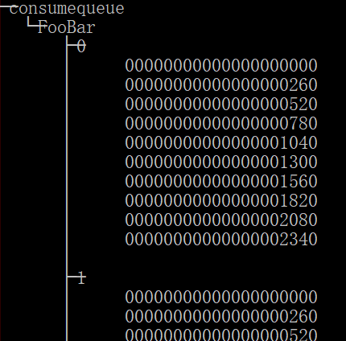
ConsumeQueue
ConsumeQueue
Topic名字
MappedFile
QueueId
MappedFileQueue
本案例按照260大小切割
ConsumeQueue

Slide 14
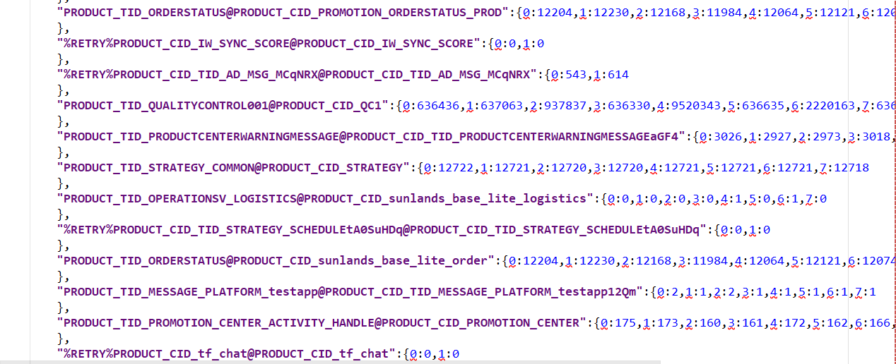
ConsumeQueue
Config/consumeOffset.json
QueueId
消费进度

Slide 15
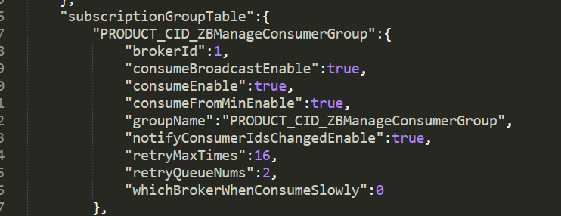
ConsumeQueue
Config/subscription.json

Slide 16
SendMessageProcessor
QueryMessageProcessor
业务层
DefaultMessageStore
CommitLog
ConsumeQueue
IndexService
IndexFile
存储逻辑层
MappedFileQueue
TransientStorePool
存储I/O层
MappedFile
MappedByteBuffer
16

Slide 17
e
ConsumeQueue
ReputMessageService.doReput(独立线程)
CommitLogDispatcherBuildConsumeQueue.dispatch(DispatchRequest request)
ConsumeQueue.putMessagePositionInfo
构建供消费端使用的逻辑队列数据
FlushConsumeQueueService.doFlush()
独立线程异步刷盘

Slide 18
CommitLog
MappedFile
本案例按照10240大小切割
CommitLog
MappedFileQueue
ConsumeQueue
Topic名字
MappedFile
QueueId
MappedFileQueue
本案例按照260大小切割
ConsumeQueue

Slide 19
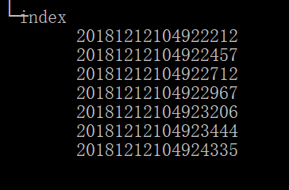
Index
Index
MappedFile
按时间命名
文件大小固定

Slide 20
BeginTimestamp
EndTimestamp
beginPhyOffset
IndexHeader
40
EndPhyOffset
HashSlotCount
IndexCount
SlotTable0
Index(4)
SlotTable1
Index(4)
SlotTable..n
Index(4)
KeyHash
PhyOffset
TimeOffset
Index
KeyHash % n

Slide 21
SendMessageProcessor
QueryMessageProcessor
业务层
DefaultMessageStore
CommitLog
ConsumeQueue
IndexService
IndexFile
存储逻辑层
MappedFileQueue
TransientStorePool
存储I/O层
MappedFile
MapedByteBuffer
21

Slide 22
e
Index
ReputMessageService.doReput(独立线程)
CommitLogDispatcherBuildIndex.dispatch(DispatchRequest request)
IndexService.buildIndex(DispatchRequest req)
构建供消息查询系统使用的消息索引数据

Slide 23
消息查询
e
broker生成的消息ID
客户端SDK生成的UniqueKey

Slide 24
消息查询
e
按照MessageID查询(依赖CommitLog)
MQAdminImpl.viewMessage(String MessageId)
MQAdminImpl.viewMessage(final String addr, final long phyoffset, final long timeoutMillis)
QueryMessageProcessor.viewMessageById(ChannelHandlerContext ctx, RemotingCommand request)
按照uniqueKey/Keys查询(依赖Index和CommitLog)
MQAdminImpl.queryMessage(String topic, String key, int maxNum, long begin, long end,boolean isUniqKey)
MQAdminImpl.queryMessage(final String addr,final QueryMessageRequestHeader requestHeader,final long timeoutMillis,final InvokeCallback invokeCallback,final Boolean isUnqiueKey)
QueryMessageProcessor.queryMessage(ChannelHandlerContext ctx, RemotingCommand request)

Slide 25
e
其他文件
lock
DefaultMessageStore.start()
abort
getAbortFile
checkpoint
StoreCheckpoint

Slide 26
e
思考题
当topic数量增多时，kafka的单个broker的TPS降低了1个数量级，而RocketMQ在海量topic的场景下，依然保持较高的TPS？
CommitLog的”随机读”对性能的影响？

Slide 27

e
Thanks
Apache RocketMQ官微公众号

Slide 28
e
附录

