Slide 1

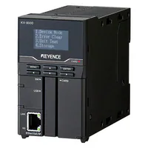
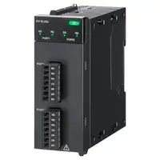
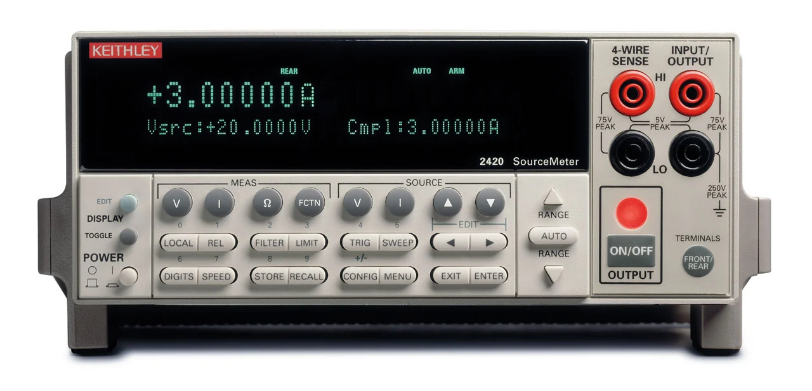
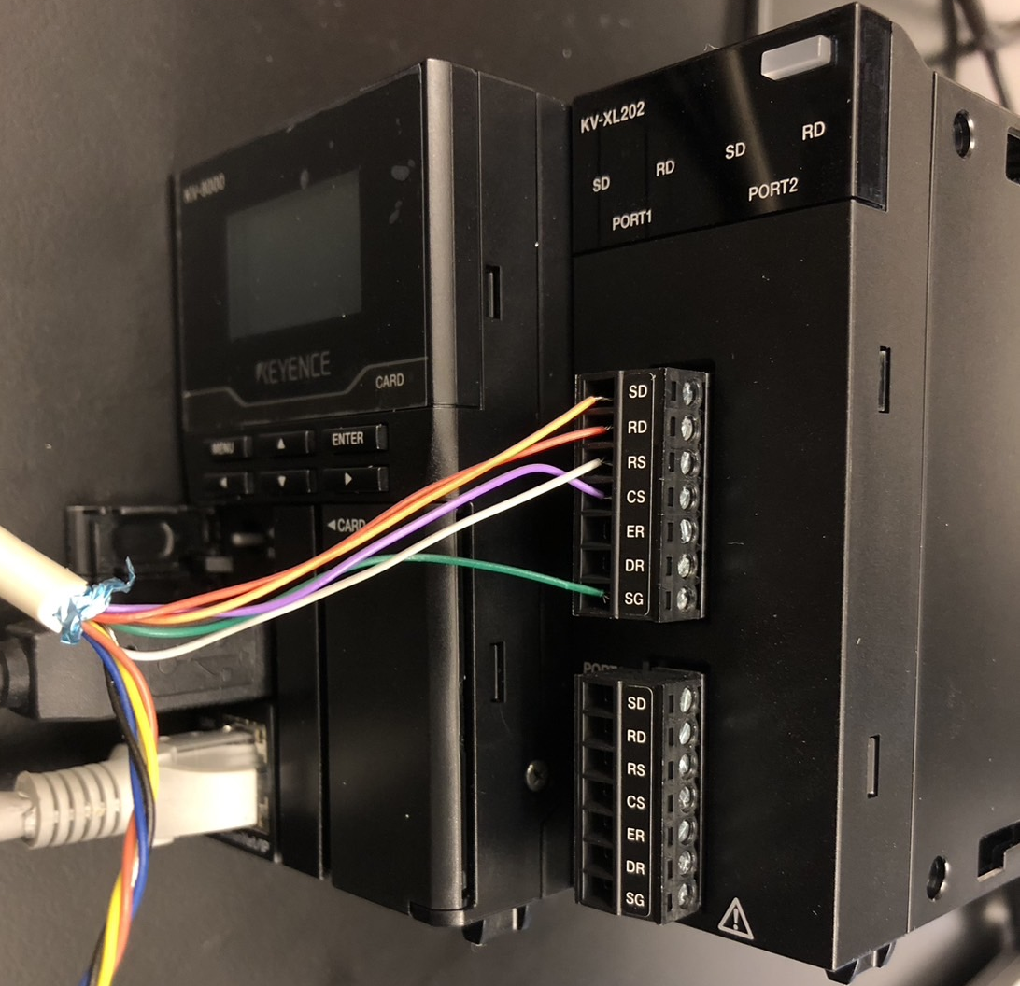
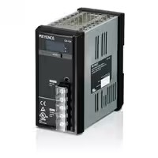

PC
KV-8000
KV-XL202
2400s
USB
mounting
RS-232c
Ethernet
RS-232c
(Connection)
CA-U4 (Output)
DC 24V, 6.5A
CA-U4
SD
RD
RS
CS
ER
DR
SG
Not
TXD
RXD
Not
GND
Not
RTS
CTS
Not

Slide 2
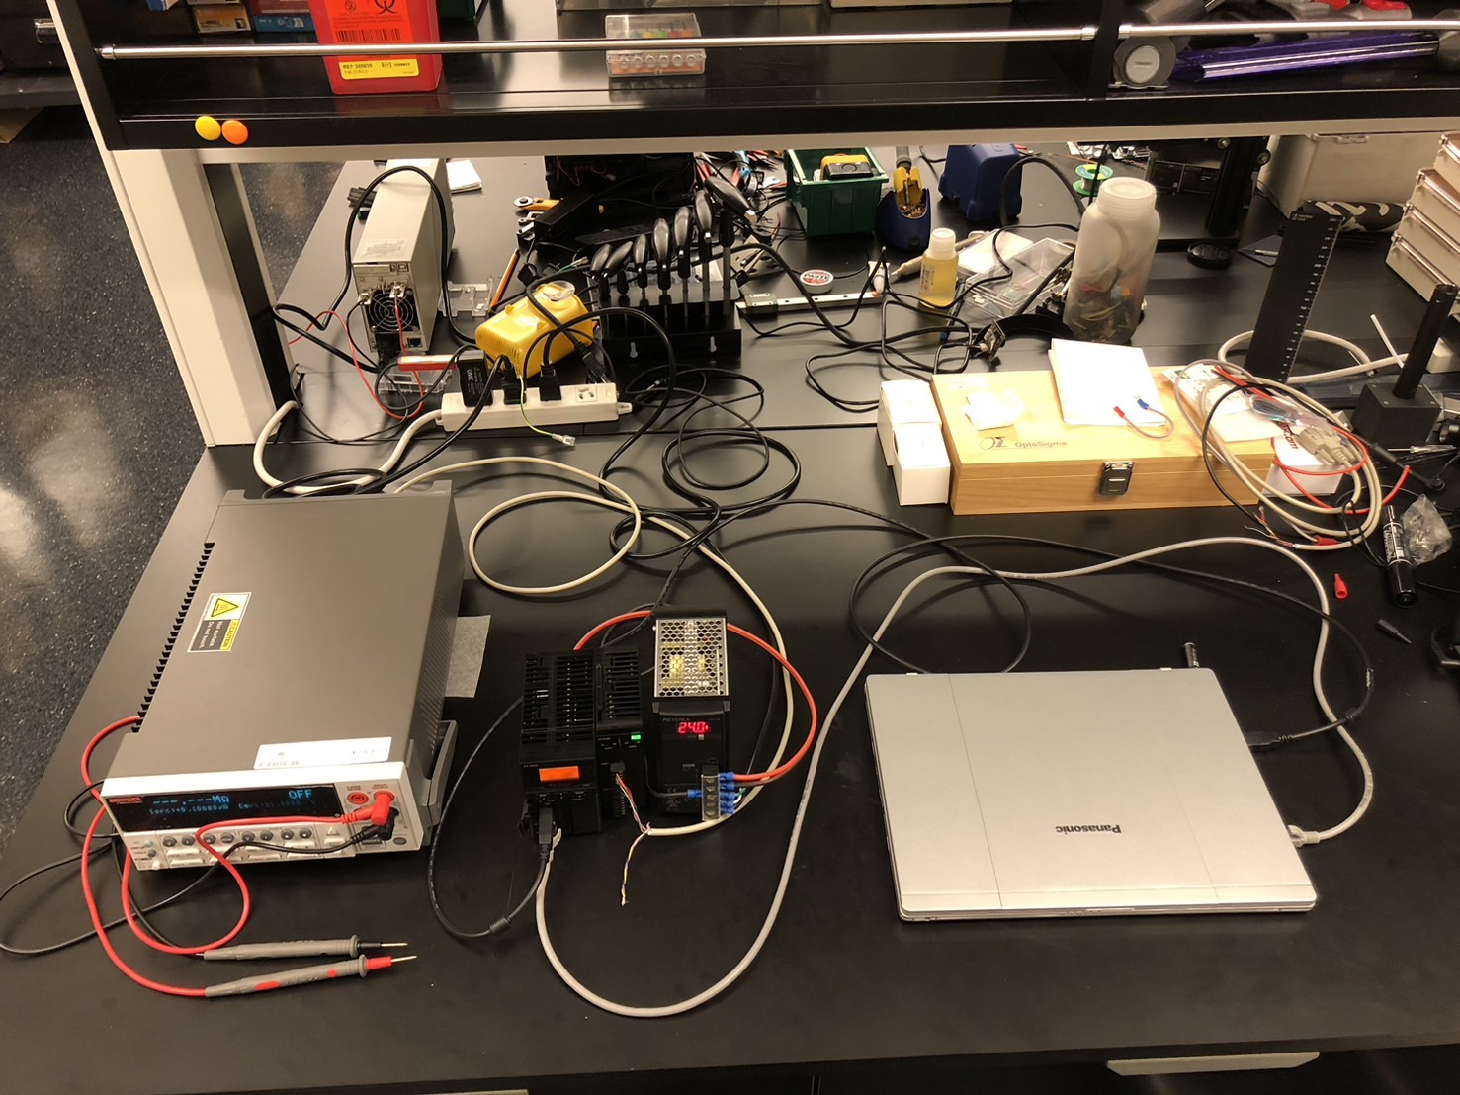

Slide 3
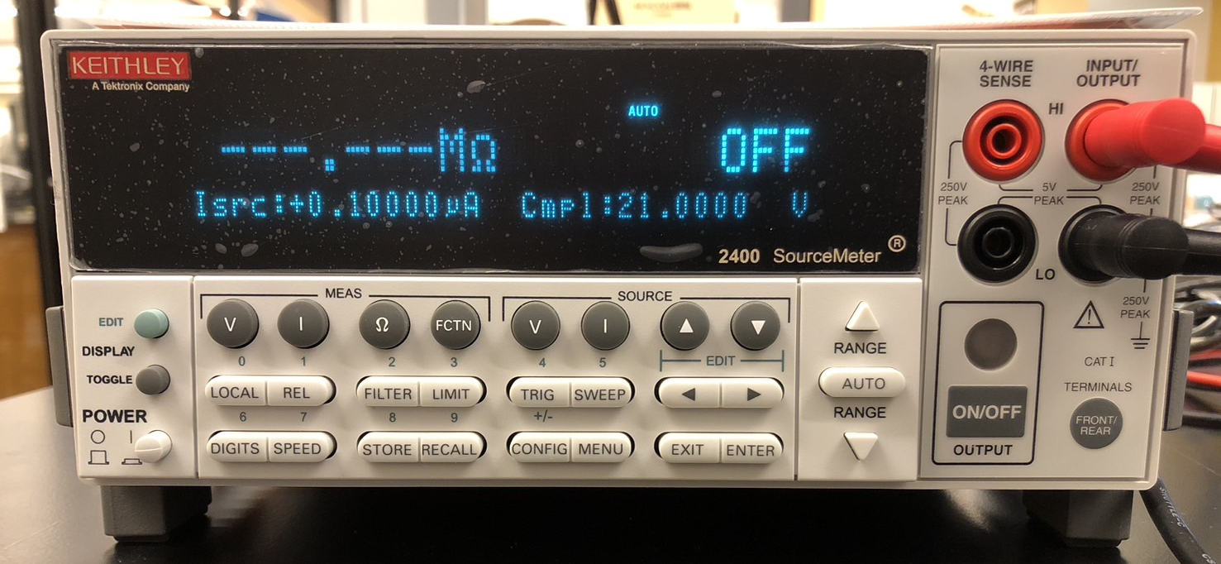
Menu button
Exit button
Enter button
Local: Can be unlocked by remote control.
Select button

Slide 4
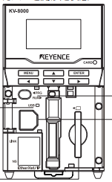
Mode switch
USB port
Ethernet port

Slide 5
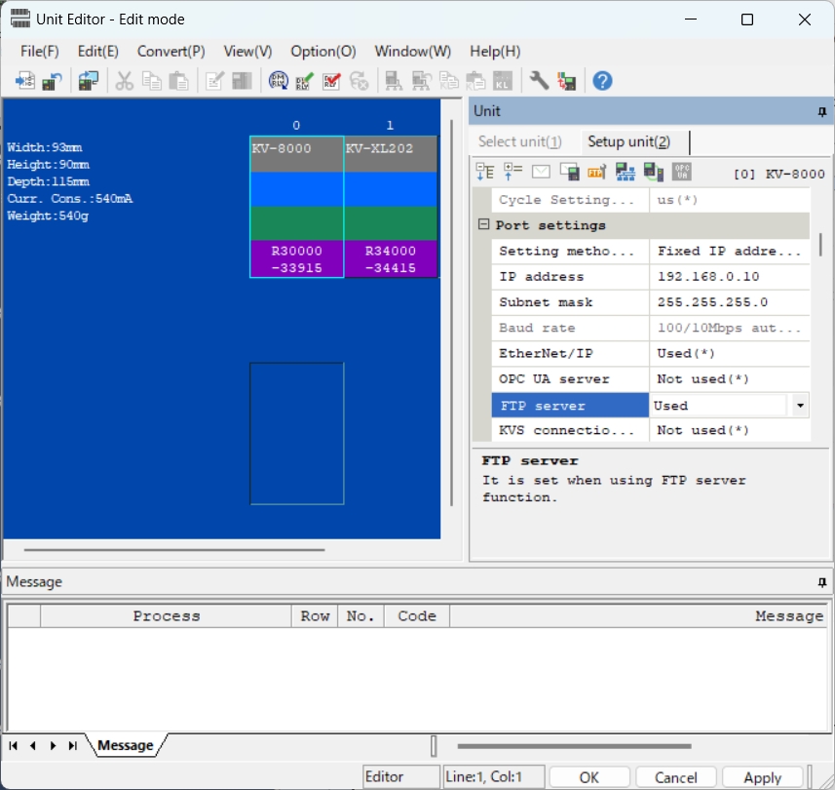
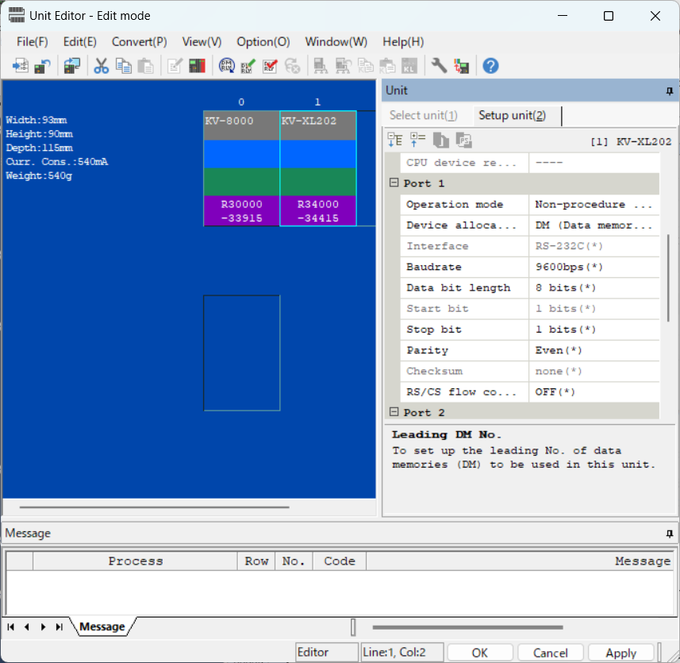

Slide 6
