Slide 1
PLC Explanation

Slide 2
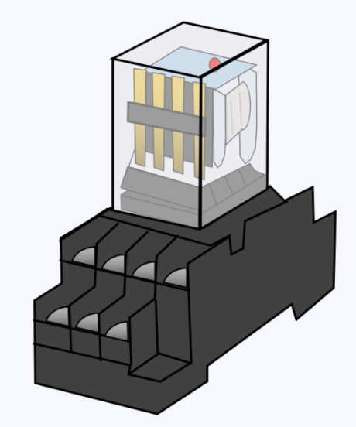
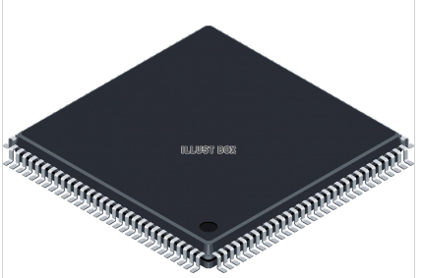
History of PLC
Developed as control device for industrial equipment.
It originally consisted of mechanical relay.
⇒ Complicated and large circuits.
It became an MCU type sequencer.
⇒ Easy system implementation.
⇒ The control panel is compact.

Slide 3
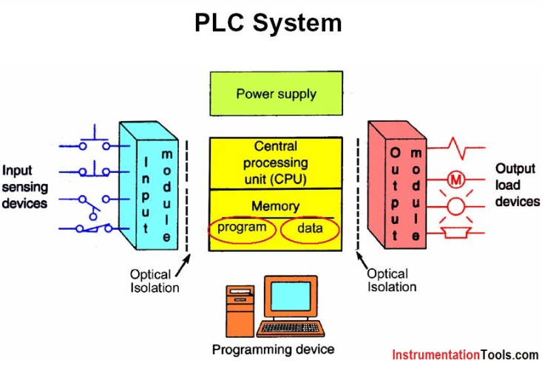
Structure of PLC
[Function]
R (Relay)
DM (Data Memory)
T (Timer)
C (Counter)
Etc..
KV-8000 has CPU and memory .
IO functions are held by expansion units.

Slide 4
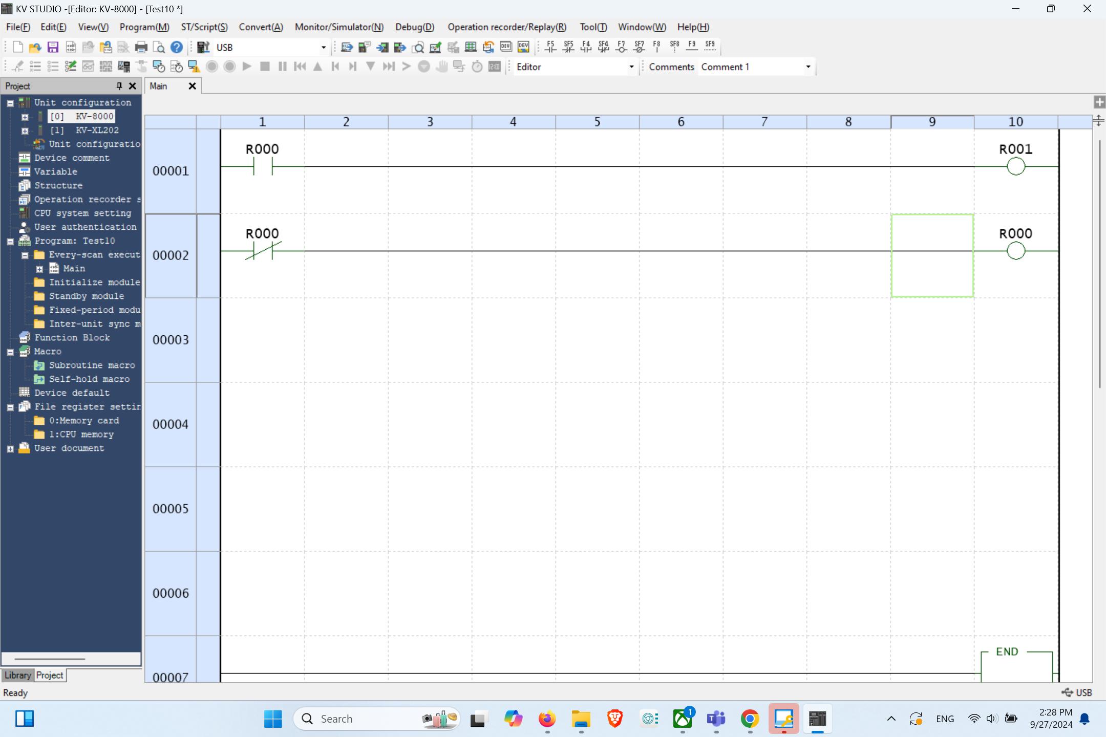
Relay in the ladder program
Coil
⇒ Memorize the state of logic.
⇒ Used for the following logic controls.
A contact (Normally Open contact)
⇒ High when Coil is High
B contact (Normally Closed contact)
⇒ High when Coil is Low

Slide 5

Examples of ladder programs
[Format]
Describe the operating conditions on the left side.
Describe the process on the right side.

Slide 6
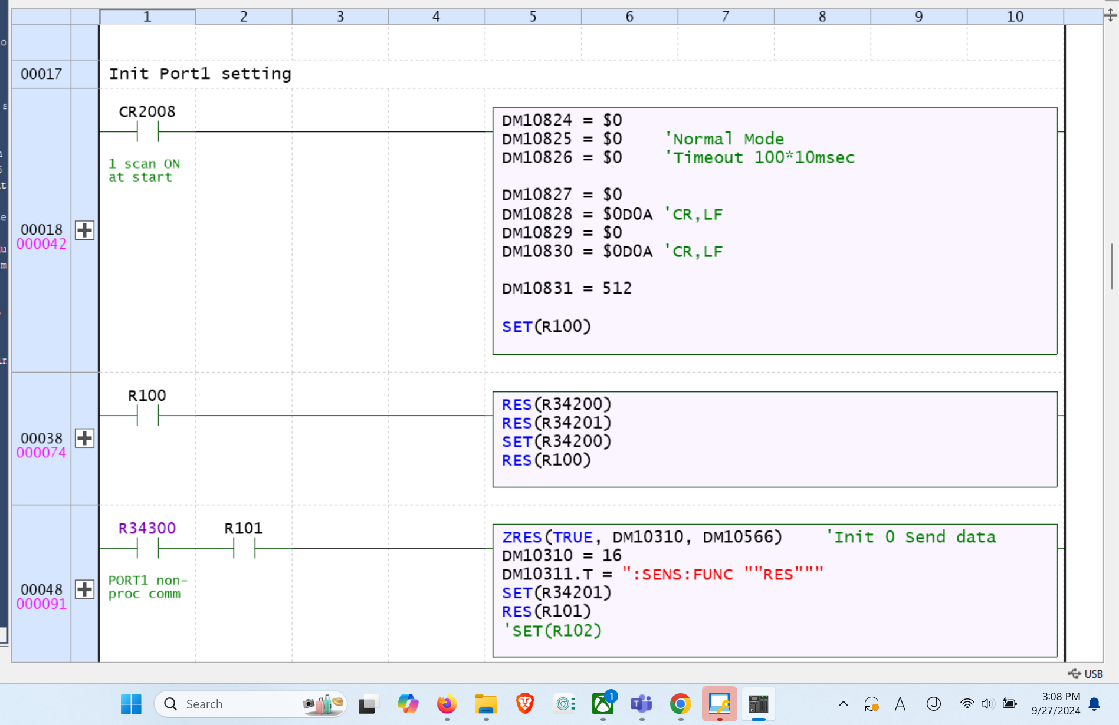
KV script
Keyence’s own script language.
Easily write complex programs.

Slide 7
Communication by RS232c (Connection)
[2400 SourceMeter]
Not used
TXD, transmit data
RXD, receive data
Not used
GND, signal ground
Not used
RTS, ready to send
CTS, clear to send
Not used
[KV-XL202]
SD, send data
RD, receive data
RS, ready send
CS, clear send
ER, Error ready
DR, Data set ready
SG, signal ground

Slide 8
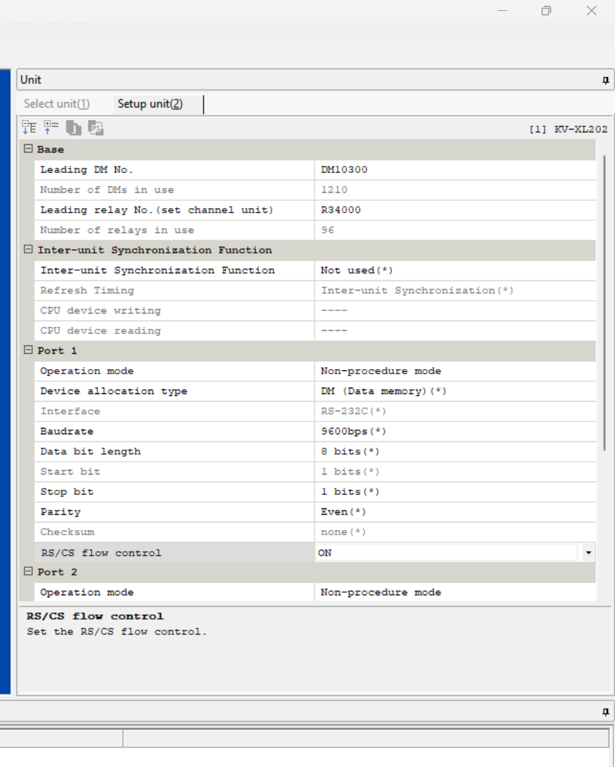
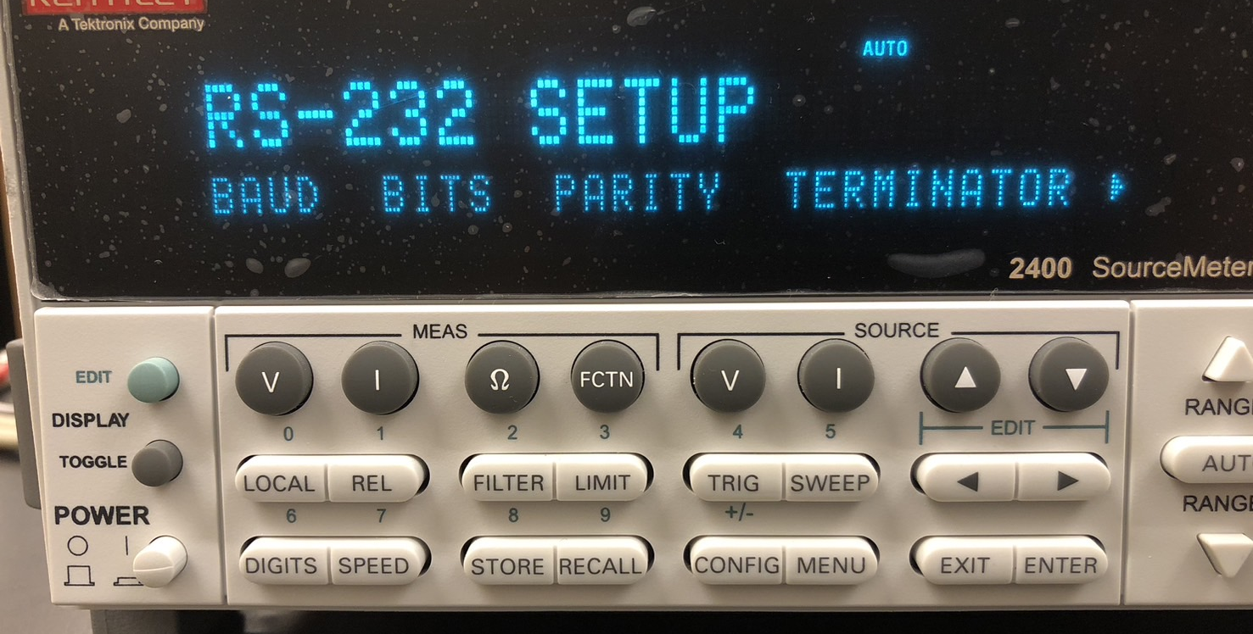
Communication by RS232c (Init Setting)
Band rate：9600
Bits：8
Parity：Even
Flow-Ctrl：ON
Terminator：<CR+LF>
⇒ Programmatically configured
Unit editor

Slide 9
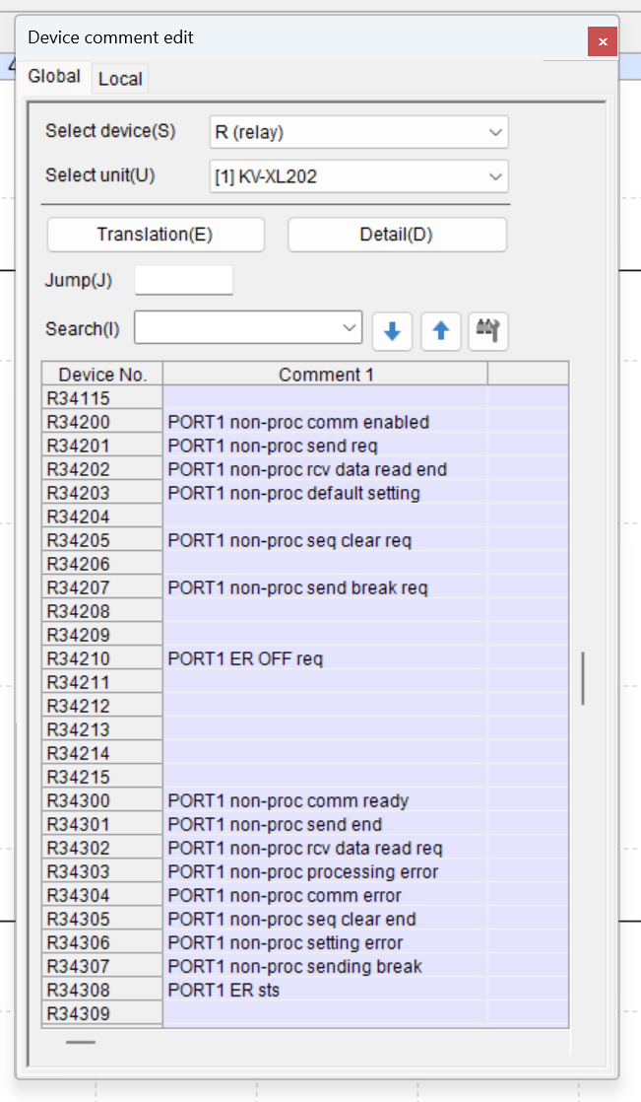
KV-XL202 Communication process
[Space is allocated inside the KV-8000]
User write Relay
⇒ User can control and communicate.
Read only Relay
⇒ The status of the communication function is displayed.
Communication Data & status Memory
⇒ Stores transmission data.
⇒ Received data and communication status are stored.

Slide 10
KV-XL202 Communication process
Communication permission relay：ON
Reset DM for transmission and receive
Set DM for transmission
Transmission Relay：ON
Transmission Relay：OFF
Communication permission relay：OFF
Check receive data

