Slide 1

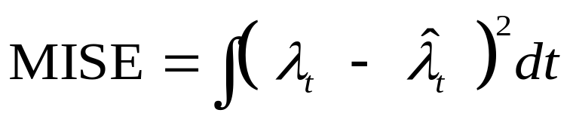

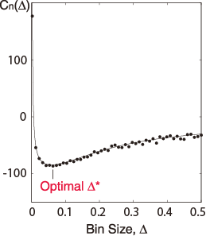

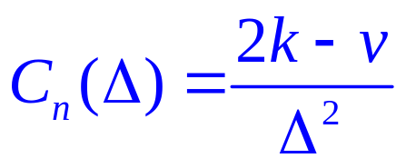


3
Unknown
4
1
Underlying Rate
Histogram
Data
Estimate
5
2
6

Slide 2
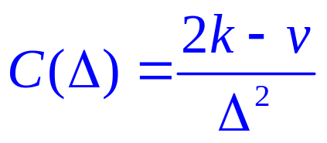
1
Unknown
4
2
Underlying Rate
Histogram
Data
Estimate
5
3
6

