Slide 1
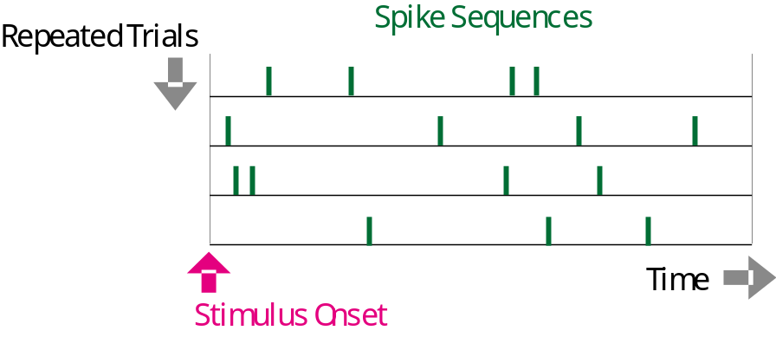

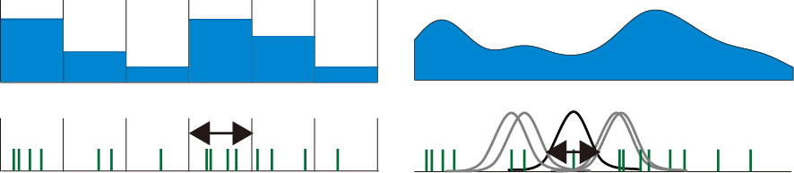
Spike-density Estimation
Histogram Method
Kernel Method
Binwidth optimization
Bandwidth optimization
Shimazaki & Shinomoto
Neural Computation, 2007
Shimazaki & Shinomoto
J. Comput. Neurosci. 2010

Slide 2
Abstract
Histogram and kernel method have been used as standard tools for capturing the instantaneous rate of neuronal spike discharges in Neurophysiological community.
These methods are left with one free parameter that determines the smoothness of the estimated rate, namely a binwidth or a bandwidth.
In most of the neurophysiological literature, however, the binwidth or the bandwidth that critically determines the goodness of the fit of the estimated rate to the underlying rate has been selected by individual researchers in an unsystematic manner.
Here we established a method for optimizing the histogram binwidth as well as the kernel bandwidth, with which the estimated rate best approximates the unknown underlying rate.

Slide 3

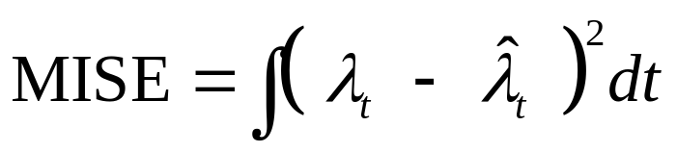

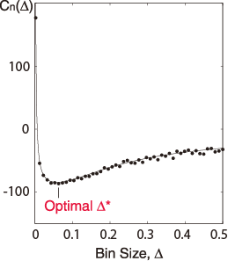

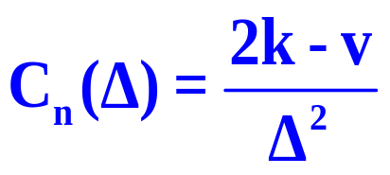


Histogram Optimization
Unknown
Underlying Rate
Histogram
Data
Estimate

Slide 4
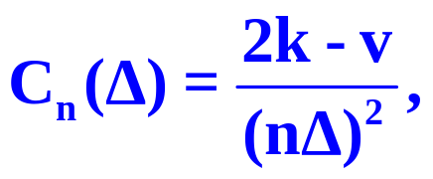


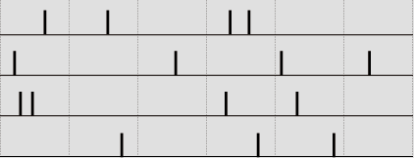
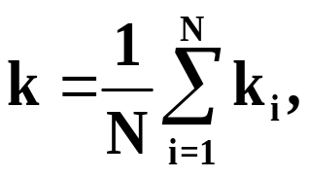
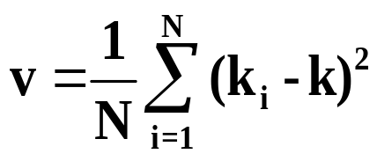


Method for Selecting the Bin Size
Divide the data range into N bins of width Δ.
Count the number of events ki in the i th bin.
Compute the cost function
while changing the bin size Δ.
Find Δ* that minimize the cost function.
Mean
Variance
4
2
1
4
3
1
Shimazaki & Shinomoto Neural Computation, 2007

Slide 5
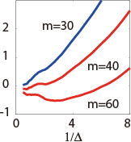

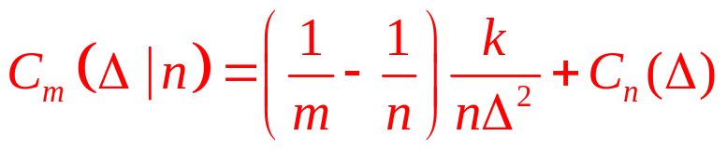
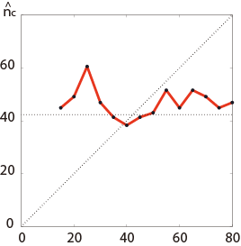
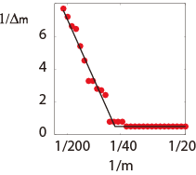
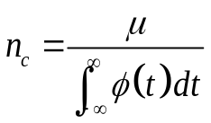

Extrapolation Method
Original:
Optimal bin size diverges
We have n=30 Sequneces
Extrapolated:
Finite optimal bin size
Optimal bin size v.s. m
Required # of trials
Required # of sequences
(Estimation)
Data Size Used
# of sequences used

Slide 6
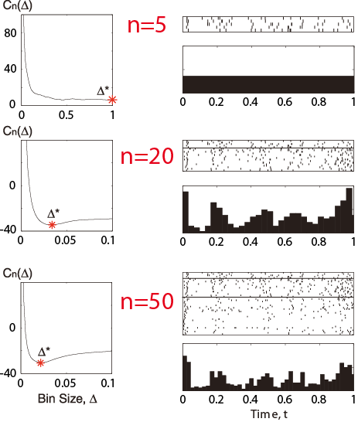
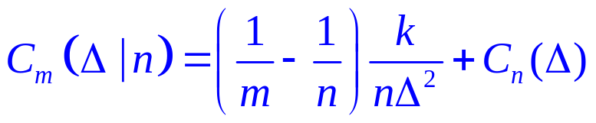
Extrapolation Method
Too few to make
a Histogram !
Optimized Histogram
Extrapolation
Estimation:
At least 12 trials are required.
Data : Britten et al. (2004) neural signal archive

Slide 7
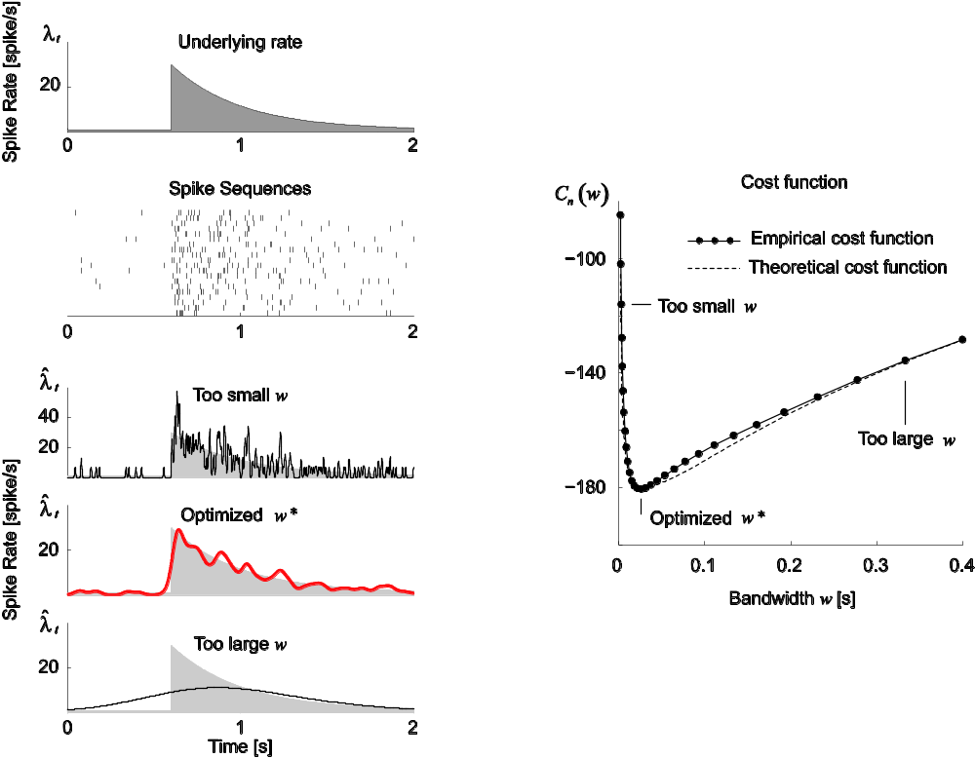
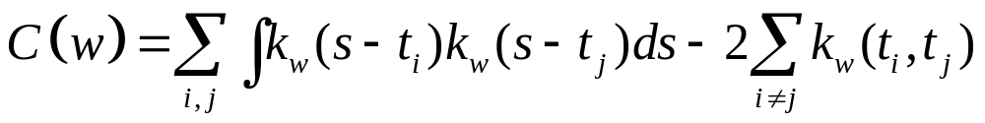
Kernel Optimization
Shimazaki & Shinomoto, J. Comp. Neurosci under review

Slide 8
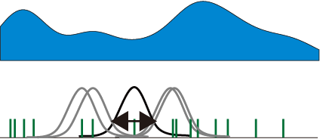
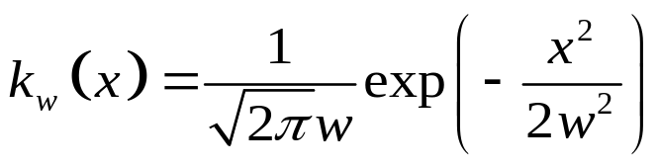
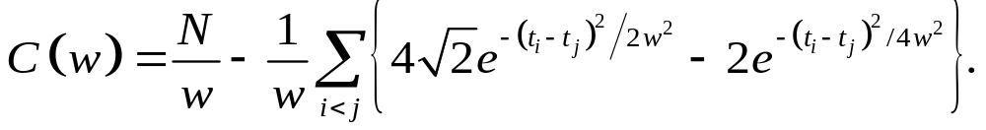
Kernel Optimization Formula
For a Gauss kernel function,
w
find w that minimizes the formula,
Total number of spikes
Bandwidth
Spike Time
Shimazaki & Shinomoto, J. Comp. Neurosci
Notes:
Do not use “error function”

Slide 9
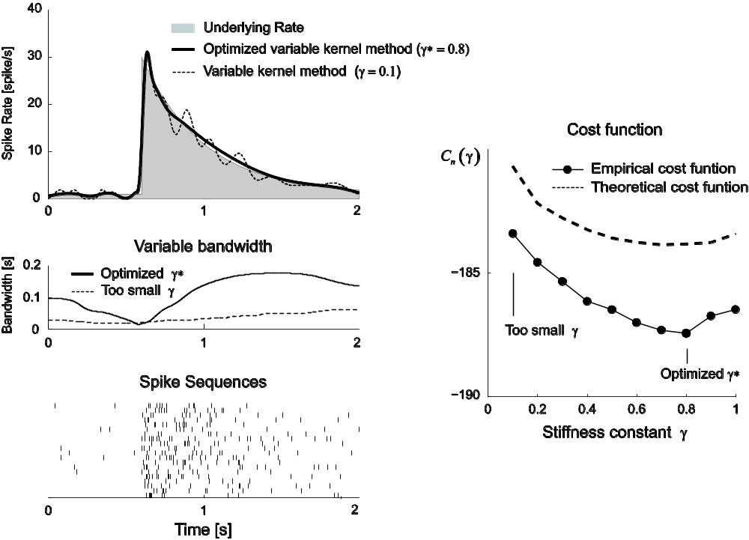
Variable Kernel Method
Our method automatically adjusts the stiffness of bandwidth variability
Shimazaki & Shinomoto, J. Comp. Neurosci.

Slide 10
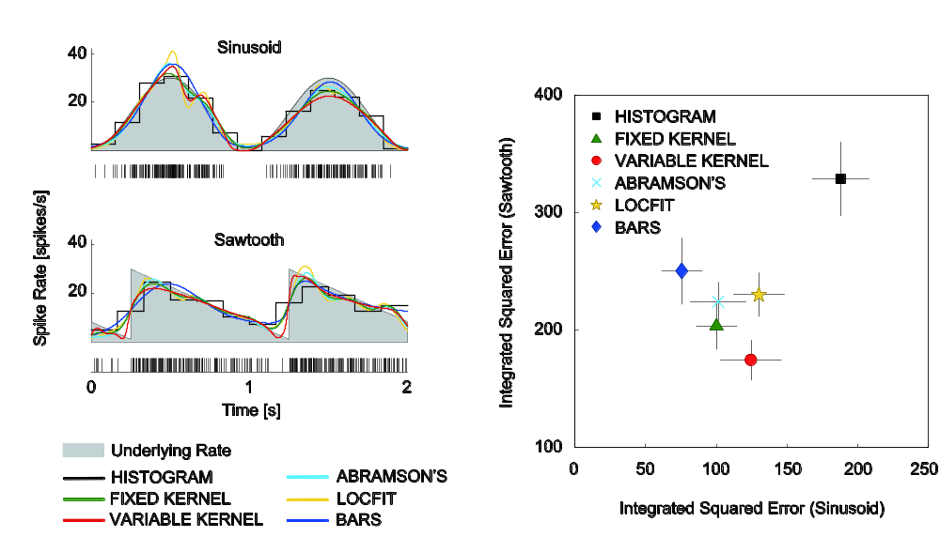


Performance Comparison
Bad
Histogram
Our Methods
Kernel
Good
Adaptive Kernel
Kernel method is comparable to, or even better than modern methods.
Shimazaki & Shinomoto, J. Comp. Neurosci.

Slide 11
Appendix

Slide 12
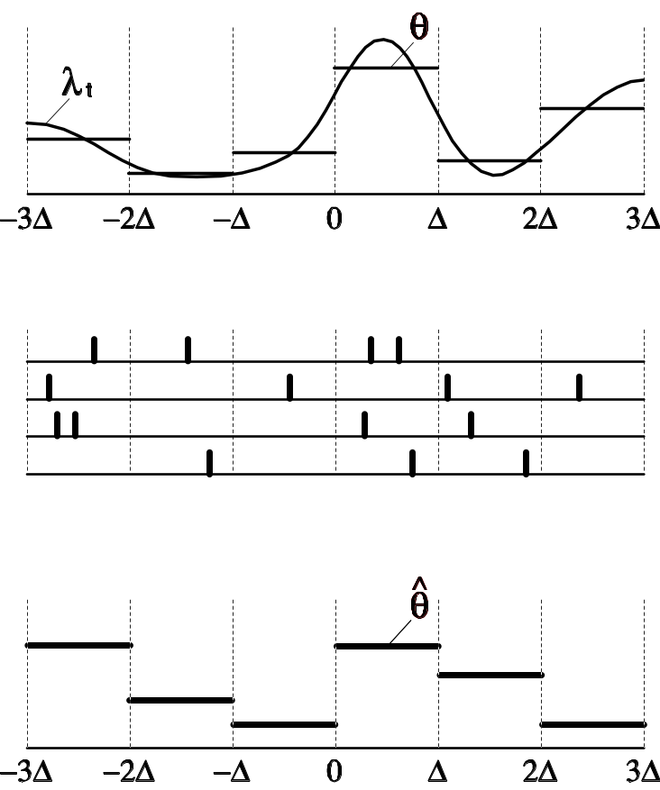
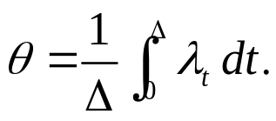
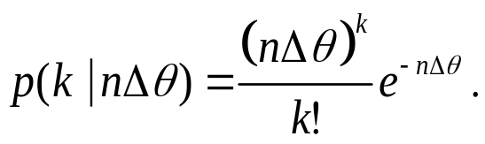
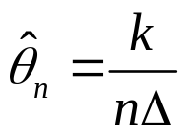
Histogram construction
Time-Varying Rate
The mean underlying rate in an interval [0, Δ]:
Spike Sequences
The spike count in the bin obeys the Poisson distribution*:
Time Histogram
A histogram bar-height is an estimator of θ :
*When the spikes are obtained by repeating an independent trial, the accumulated data obeys the Poisson point process due to a general limit theorem.

Slide 13
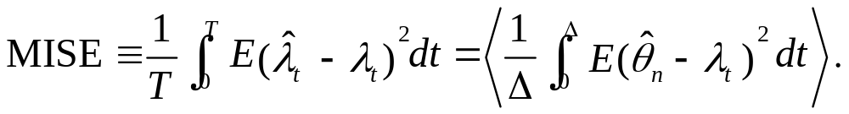
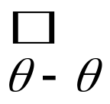
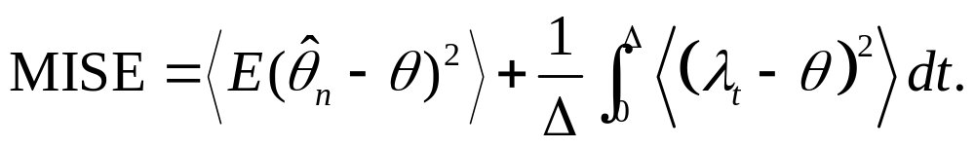
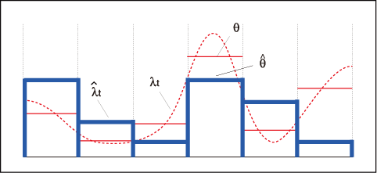

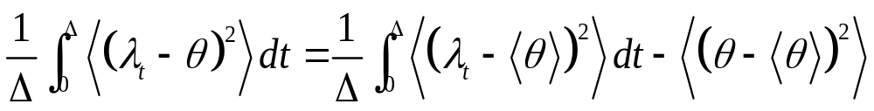
Theory for Histogram Optimization
Expectation by the Poisson statistics, given the rate.
Average over segmented bins.
Sampling Error
Systematic Error
Decomposition of the Systematic Error
Systematic Error
Variance of the rate
Variance of
an ideal histogram
Independent of Δ

Slide 14
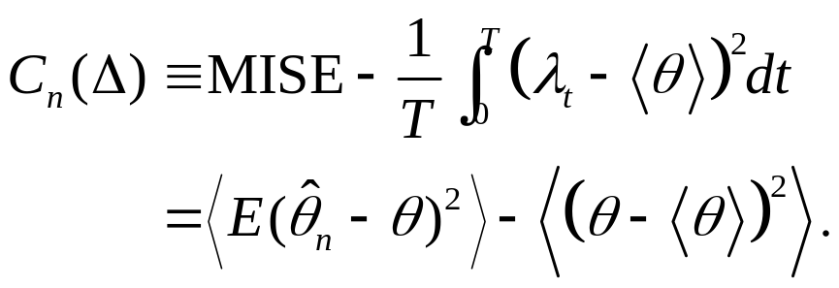
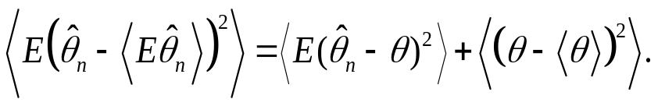
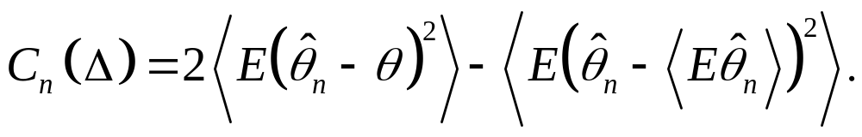
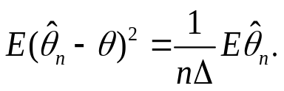
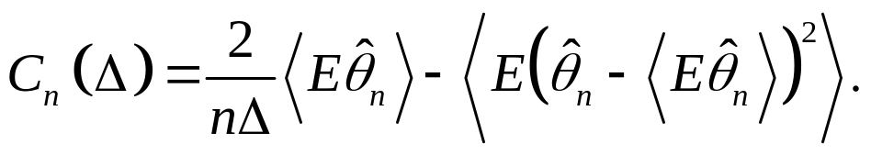
Introduction of the cost function:
Sampling error
Unknown: Variance of an ideal histogram
The variance decomposition:
Variance of a histogram
Sampling error
The Poisson statistics obeys:
Mean of a Histogram
Variance of a Histogram

