Slide 1

A Recipe for Constructing a Peri-stimulus Time Histogram
Hideaki Shimazaki
Dept. of Physics Kyoto University, Japan
March 1, 2007 Johns Hopkins University
March 2, 2007 Columbia University

Slide 2
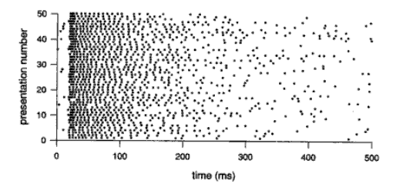

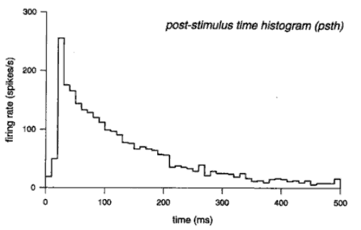
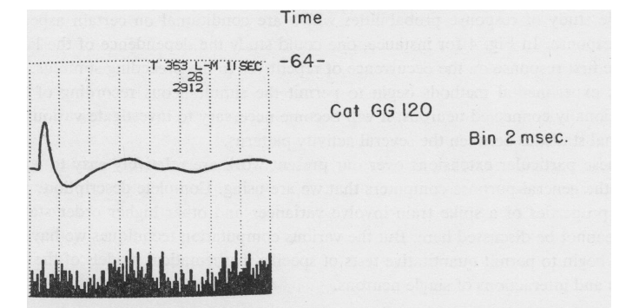
Peri-stimulus Time Histogram
Events (Spikes)
Prof. Gerstein
me
Repeated trials
@Kyoto Univ.
Bin width
a PST Histogram
Adrian, E. (1928). The basis of sensation: The action of the sense organs.
 | George L. Gerstein and Nelson Y.-S. Kiang (1960 ) An Approach to the Quantitative Analysis of Electrophysiological Data from Single Neurons, Biophys J. 1(1): 15–28.
From Spikes: Exploring the Neural Code, Rieke et al. 1997

Slide 3

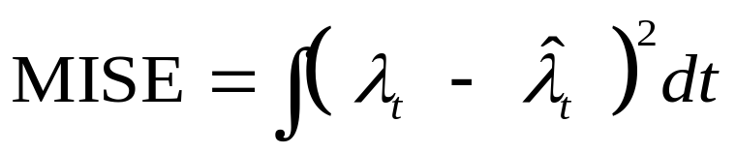

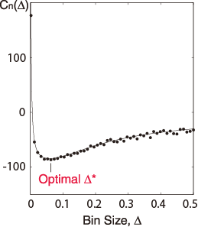

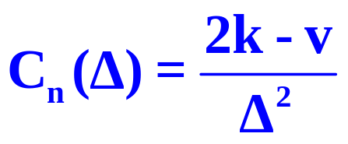


1. Bin Width Selection
Unknown
Underlying Rate
Histogram
Data
Estimate

Slide 4

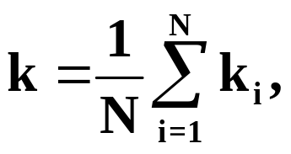
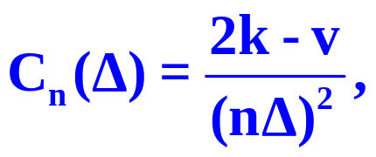
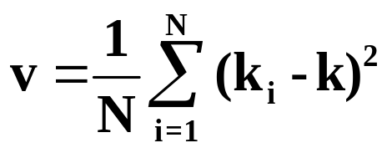

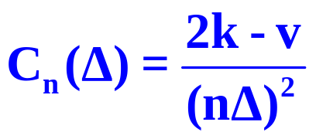

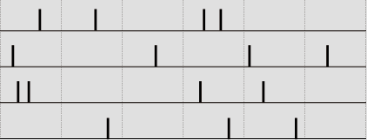


Method for Selecting the Bin Size
Divide the data range into N bins of width Δ.
Count the number of events ki in the i th bin.
Compute the cost function
Mean
Variance
while changing the bin size Δ.
Find Δ* that minimize the cost function.
4
2
1
4
3
1

Slide 5

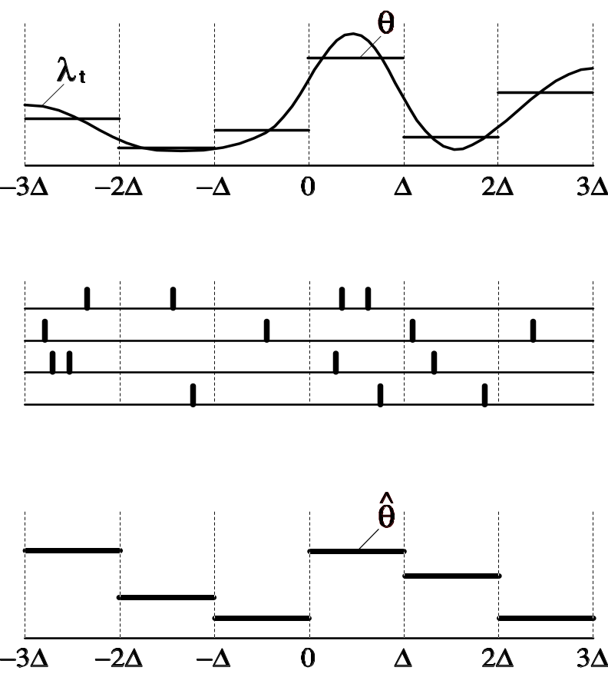
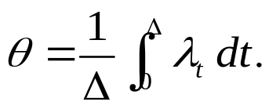
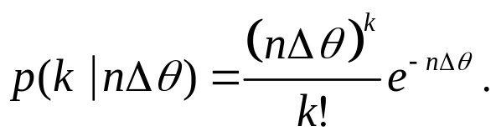
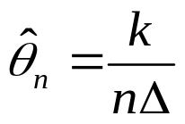
Theory for the Method
Time-Varying Rate
The mean underlying rate in an interval [0, Δ]:
Spike Sequences
The spike count in the bin obeys the Poisson distribution*:
Time Histogram
A histogram bar-height is an estimator of θ :
*When the spikes are obtained by repeating an independent trial, the accumulated data obeys the Poisson point process due to a general limit theorem.

Slide 6
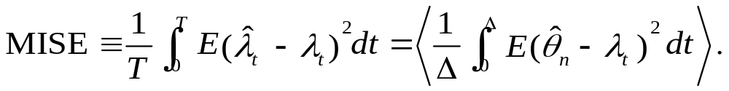
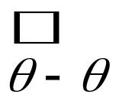
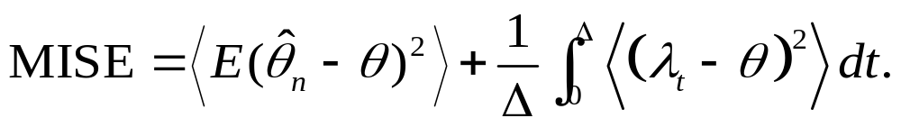
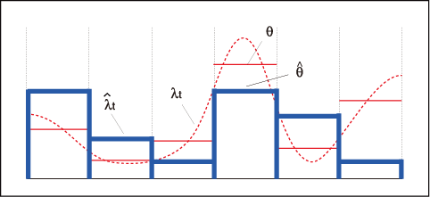

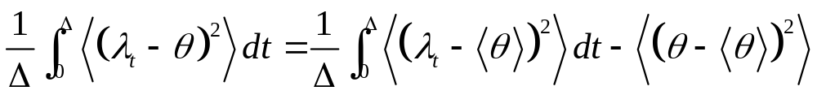
Theory: Selection of the Bin Size
Expectation by the Poisson statistics, given the rate.
Average over segmented bins.
Sampling Error
Systematic Error
Decomposition of the Systematic Error
Systematic Error
Variance of the rate
Variance of
an ideal histogram
Independent of Δ

Slide 7
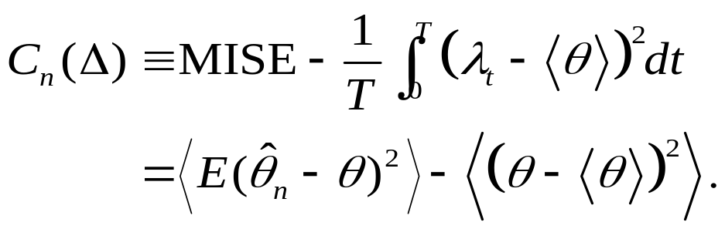
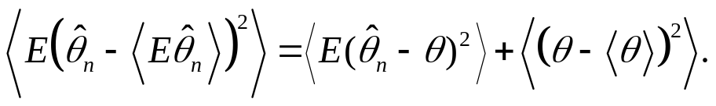
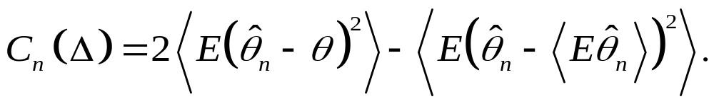
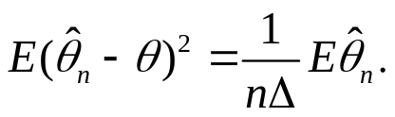
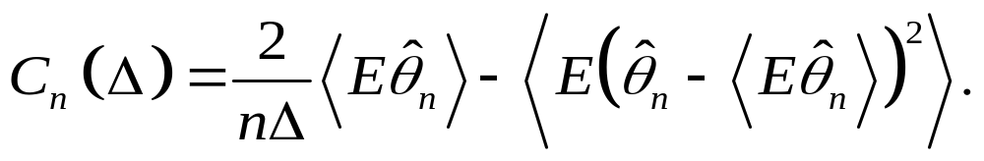
Introduction of the cost function:
Sampling error
Unknown: Variance of an ideal histogram
The variance decomposition:
Variance of a histogram
Sampling error
The Poisson statistics obeys:
Mean of a Histogram
Variance of a Histogram

Slide 8
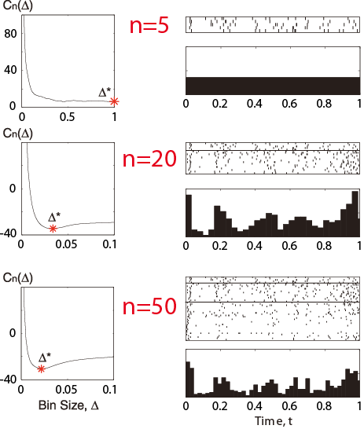
Application to an MT neuron data
2
Too few to make
a Histogram !
Optimized Histogram
1
Optimal bin size decreases
Data : Britten et al. (2004) neural signal archive

Slide 9
Theories on the Optimal Bin Size

Slide 10
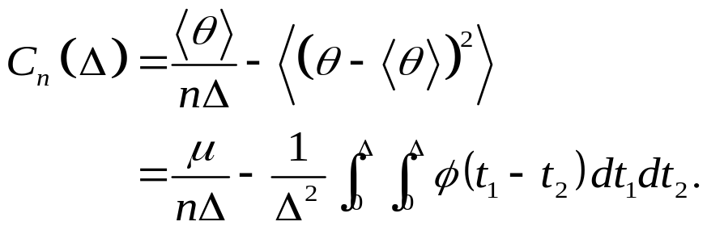
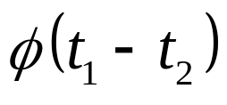

See also Koyama and Shinomoto
J. Phys. A, 37(29):7255–7265. 2004
If you know the underlying rate, you can compute
Theoretical cost function:
Unknown
Theory
Mean
Correlation function
Data
Empirical

Slide 11
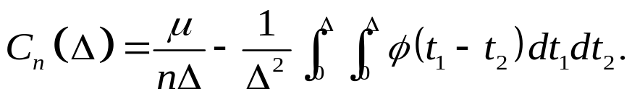
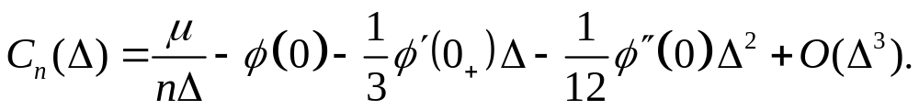
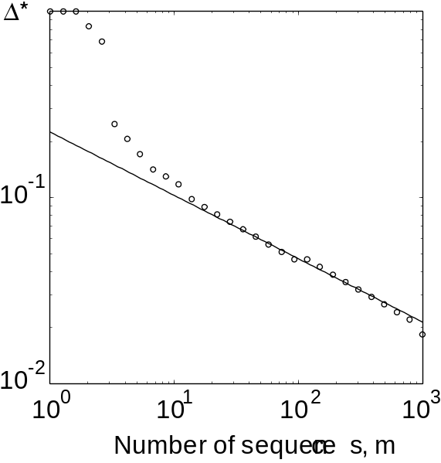
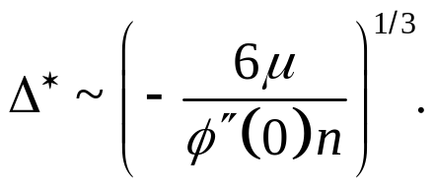
(i) Expansion of the cost function by Δ:
Theoretical cost function:
When the number of sequences is large, the optimal bin size is very small
The expansion of the cost function by Δ:
Scaling of the optimal bin size
-1/3
Scaling of the optimal bin size:
Ref. Scott (1979)

Slide 12
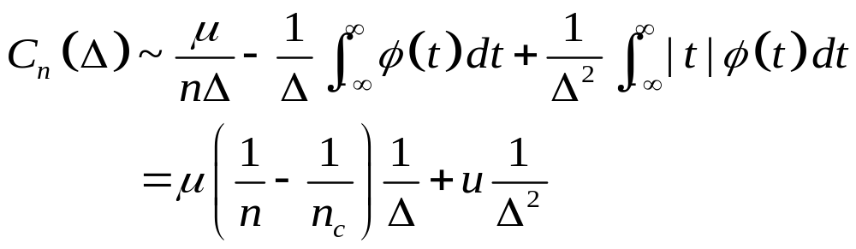
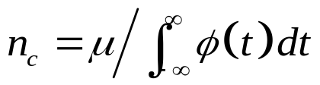


(ii) Divergence of the optimal bin size
When the number of sequences is small, the optimal bin size is very large.
The expansion of the cost function by 1/Δ:
The second order phase transition.
Critical number of trials:
Optimal bin size diverges.
Finite optimal bin size.
Not all the process undergoes the first order phase transition.
Others undergo the second order (discontinuous) phase transition.

Slide 13


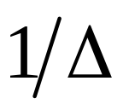


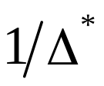



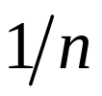
Phase transitions of optimal bin size
n: small
n: small
n: large
n_{c}: critical number of trials
n: large

Slide 14
Back to Practice!

Slide 15
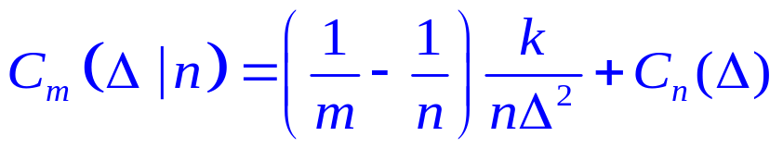
2. The extrapolation method
Too few to make
a Histogram !
Optimized Histogram
Extrapolation
Estimation:
At least 12 trials are required.
Data : Britten et al. (2004) neural signal archive

Slide 16
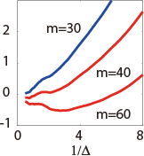

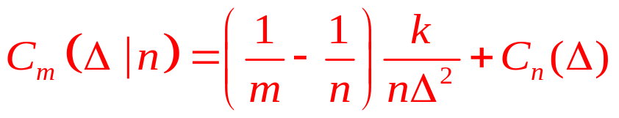
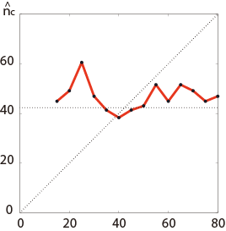
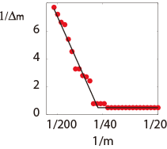
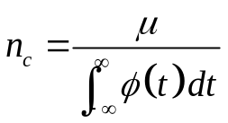

Verification of the extrapolation method
Original:
Optimal bin size diverges
We have n=30 Sequneces
Extrapolated:
Finite optimal bin size
Optimal bin size v.s. m
Required # of trials
Required # of sequences
(Estimation)
Data Size Used
# of sequences used

Slide 17
2. The extrapolation method
Too few to make
a Histogram !
Optimized Histogram
Extrapolation
Estimation:
At least 12 trials are required.
Data : Britten et al. (2004) neural signal archive

Slide 18
Advanced Topics

Slide 19
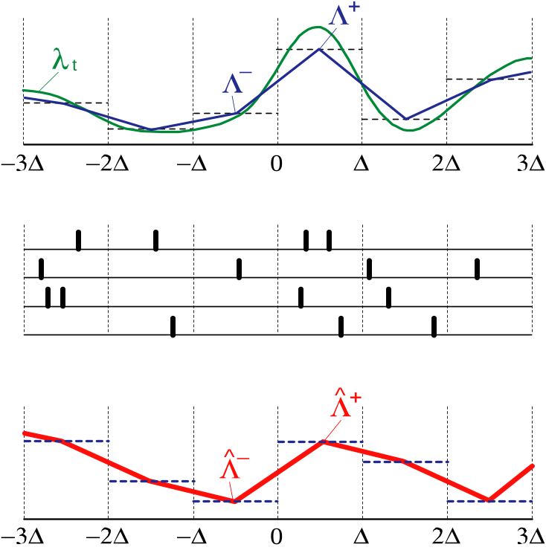





Line-Graph Time Histogram
Line-Graph Model
Rate
A line-graph is constructed by connecting top-centers of adjacent bar-graphs.
Spike Sequences
The spike count obeys the Poisson distribution
Time Histogram
An estimator of a line-graph

Slide 20












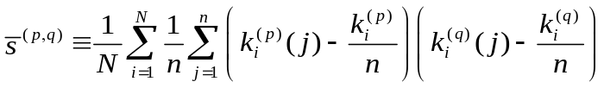



A Recipe for an optimal line-graph TH
(i) Define the four spike counts,
(ii) Summation of the spike count
0
1
1
2
0
1
Covariations w.r.t. bins
Binned-average
Bin-average of the covariation of spike count w.r.t. sequences,
(iii)
The covariances of an ideal line-graph model is
0
2
2
0
0
1
(iv) Cost function:
(v) Repatn i through iv by changing Δ. Find the optimal Δ that minimizes the cost function.

Slide 21
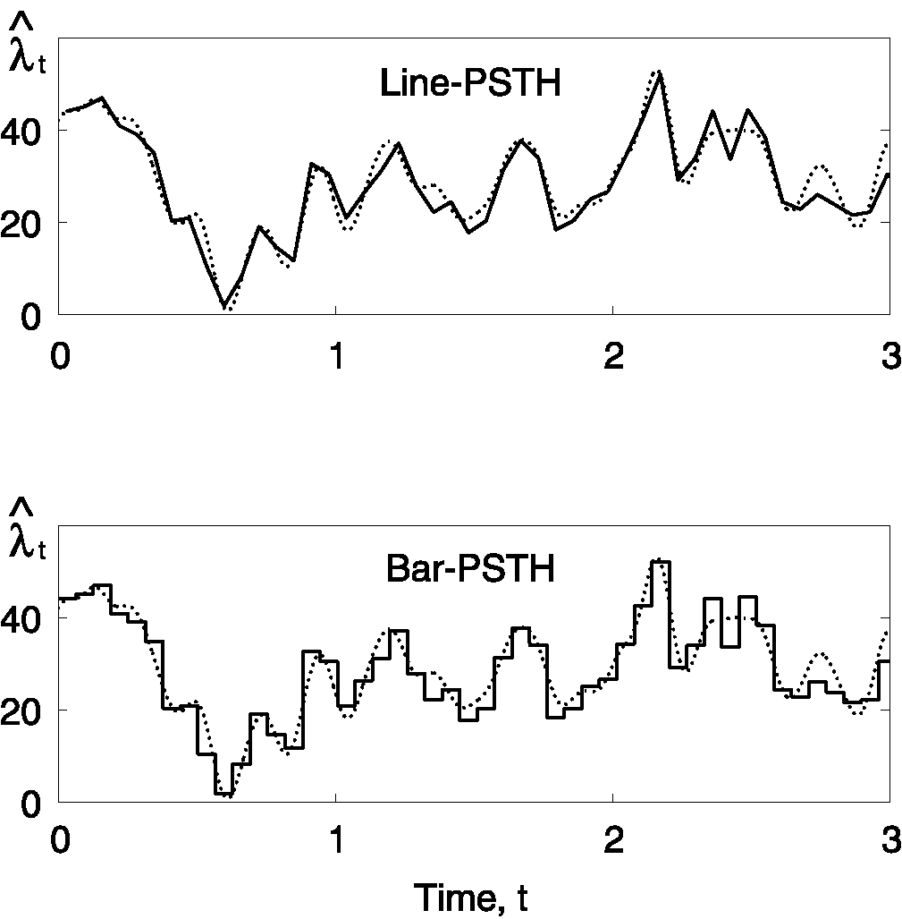
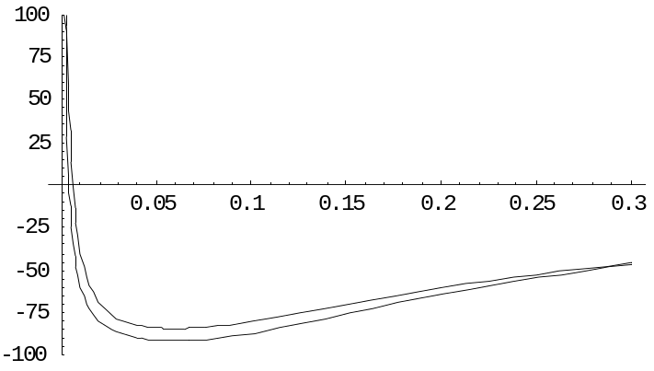
The optimal Line-Graph Histogram
Bar-Graph
Line-Graph
The Line-graph histogram performs better if the rate is smooth.

Slide 22
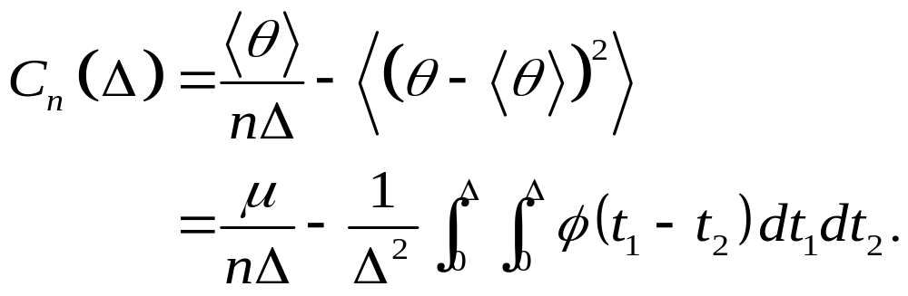
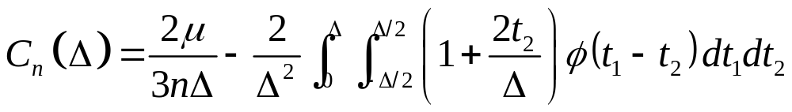
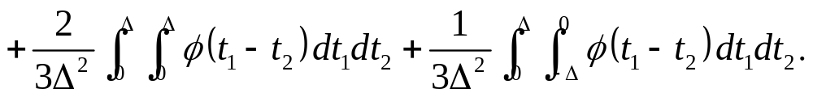
2. Theories on the optimal bin size
Theoretical Cost Function
(Bar-Graph)
(Line-Graph)
Generalization of Koyama and Shinomoto J. Phys. A, 37(29):7255–7265. 2004

Slide 23








(i) Scalings of the optimal bin size
The expansion of the cost function by Δ:
(Bar-Graph)
(Line-Graph)
the second order term vanishes.
A smooth process: A correlation function is smooth at origin.
(Bar-Graph)
(Line-Graph)
A jagged process: A correlation function has a cusp at origin.
(Bar-Graph)
(Line-Graph)

Slide 24





Identification of the scaling exponents
Bar-Graph Histogram
Line-Graph Histogram
smooth
smooth
zig-zag
zig-zag
Data Size Used
Data Size Used
smooth
zig-zag

Slide 25

The second and the first order phase transitions
Second order
(Continuous)
First order
(Discontinuous)
Power spectrum
of a rate process
Cost functions
Optimal Bin Size

Slide 26

Summary of Today’s Talk
1. Bin width selection
The method and theory
Application to an MT neuron
2. Theories on the optimal bin width
Scaling and Phase transitions
3. Advice to experimentalists
Extrapolation method

Slide 27


FAQ
Q. Can I apply the proposed method to a histogram for a probability distribution?
A. Yes.
Q. I want to make a 2-dimensional histogram. Can I use this method?
A. Yes.
Q. I obtained a very small bin width, which is likely to be erroneous. Why?
A. You probably searched smaller bin size than the sampling resolution.
Round Up
Erroneously small optimal bin size
too precise
Q. Can I use unbiased variance for computation of the cost function?
A. No.

Slide 28
Reference
A Method for Selecting the Bin Size
of a Time Histogram
Hideaki Shimazaki and Shigeru Shinomoto
Neural Computation in Press
Short Summary:
Adavances in Neural Information Processing Systems Vol. 19, 2007
Web Application for the Bin Size Selection
Matlab / Mathematica / R sample codes
are available at our homepage
http://www.ton.scphys.kyoto-u.ac.jp/~shino/
/~hideaki/
See also
Koyama, S. and Shinomoto, S. Histogram bin width selection for time-dependent poisson processes. J. Phys. A, 37(29):7255–7265. 2004

Slide 29


Acknowledgements
Prof. Shigeru Shinomoto
Dr. Shinsuke Koyama
JSPS Research Grant

Slide 30


Hideaki Shimazaki
Introducing myself…
2003 MA Prof. Ernst Niebur
Dept. of Neuroscience, Johns Hopkins University Baltimore, Maryland
Ph. D Prof. Shigeru Shinomoto
Dept. of Physics Kyoto University, Kyoto, Japan
2006-2008 JSPS Research Fellow

Slide 31





The Poisson Point Process
Rate
Data
Samples are independently drawn from an identical distribution.

