Slide 1
Air Pollution Forecasting Analysis
Peilan Feng, Mrigangka Medhi, Shimeng (Summer) Wang, Peilin Zhao

Slide 2
Executive Summary
This project provides an extensive analysis and model development for forecasting PM2.5 pollution concentrations in Beijing, China. PM2.5 particles are known for their adverse health impacts, contributing to respiratory diseases, cardiovascular issues, and other serious health conditions (data source).
We evaluated multiple time-series forecasting models(ARIMA, VAR, Prophet, Random Forest, XGBoost, and SVR). XGBoost demonstrated the highest accuracy, effectively handling non-linear dependencies and multivariate interactions.

Slide 3
Project Purpose + Motivation
Our goal
Our motivation
Develop a predictive model for PM2.5 pollution, leveraging historical data to forecast near-future pollution levels.
PM2.5 particles can penetrate lungs, enter the bloodstream, and increase health risks.
Forecasting PM2.5 helps mitigate these risks through advanced machine learning and time-series models.
Effective forecasting can enable proactive measures, informing both public and policy responses.

Slide 4
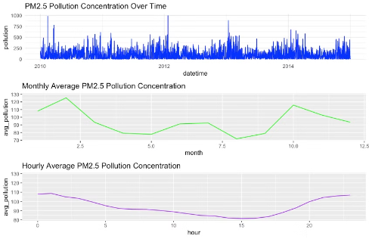
Data Overview
Dataset
Data Cleaning
EDA
Timestamp: date & hour (date)
Remove missing values
PM2.5 concentration over time
Target variable: PM 2.5 concentration (pollution)
Transform date and time into POSIXct format
Monthly and Hourly patterns
Meteorological variables: Dew Point (dew), Temperature (temp), Pressure (press), Wind Direction (wnd_dir), Wind Speed (wnd_spd), Cumulative Hours of Snow (snow), Cumulative Hours of Rain (rain)
Introduce lagged PM2.5 values and rolling averages as additional predictors

Slide 5
Model Selection
1
ARIMA
2
VAR
3
Prophet
Captures trends and seasonality in stationary time series but doesn’t directly incorporate external variables.
Multivariate model that captures dependencies between PM2.5 and weather factors.
Handles seasonal trends flexibly, ideal for daily and monthly PM2.5 patterns.
4
Random Forest
5
XGBoost
6
SVR
Robust for non-linear relationships; models PM2.5 and weather factors but lacks time-series sequencing.
High accuracy, handles non-linear interactions, uses gradient boosting with multiple predictors.
Captures complex non-linear relationships through higher-dimensional transformations.
Data Characteristics
Performance Validation
Priority on models like Prophet, VAR, and XGBoost to handle seasonality, trends, and multivariate interactions
Evaluate RMSE and MAE using a hold-out test set for unbiased accuracy assessment

Slide 6
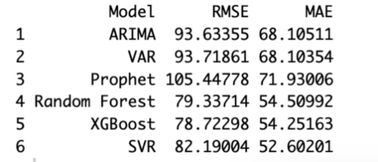
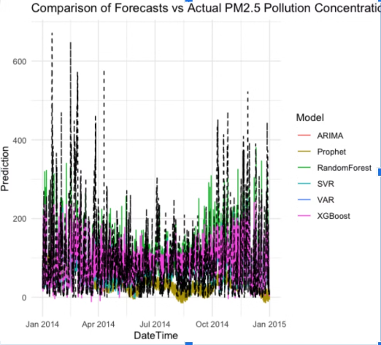
Model Performance evalution
Non-linear Handling: XGBoost’s effectiveness highlights its ability to model non-linear relationships and leverage multivariate features.
Forecast Comparison: XGBoost forecasts closely match actual PM2.5 levels, with other models showing noticeable lag or deviation.
XGBoost Performance: XGBoost achieved the lowest RMSE and second-lowest MAE, indicating strong predictive accuracy and minimal deviation from actual values.
Winter Pollution Fit: XGBoost’s precision in capturing winter pollution spikes, aligning closely with real data.

Slide 7
Conclusions
XGBoost Outperformed
Impact of Meteorological Factors
Seasonal Patterns
Winter months showed elevated pollution levels, underscoring the importance of seasonally-aware forecasting
XGBoost achieved the lowest RMSE and MAE on the test set, proving most effective for PM2.5 pollution forecasting
Incorporating weather data (e.g., wind speed, temperature) improved model accuracy; wind speed showed a strong inverse correlation with PM2.5 levels
Real-World Application
XGBoost’s accuracy and robustness make it suitable for real-time monitoring and public health applications

Slide 8
Conclusions
Recommendations
Future Directions
Deploy XGBoost for Real-Time Monitoring: Integrate XGBoost into air quality systems to provide timely health alerts and support policy decisions
Increase Temporal Resolution: Explore finer time intervals (e.g., 30-minute data) for more precise pollution spike forecasting.
Expand Data Sources: Incorporate additional data (e.g., traffic, industrial emissions) to improve model accuracy
Regional Expansion: Develop the model to predict air quality across multiple cities or regions for broader impact.
Optimize Model Further: Perform hyperparameter tuning and regular updates to maintain and enhance forecasting performance
Enhance Interpretability: Use techniques like SHAP to make the model’s predictions more transparent and interpretable for stakeholders.
Evaluate Alternative Models: Test models like LightGBM or CatBoost for potential accuracy improvements

Slide 9
Thank You!

