Slide 1
Does Financial Instruction Tuning Help LLMs?
Replicating the sentiment-classification slice of Open-FinLLMs (Huang et al., 2024)
Implementation Presentation · 30 min
[Authors] · LLMs in Finance Seminar

Slide 2
What we'll cover
1
Objective and setup
5-7 min
Research question, scope, reproducibility note
2
Method and experimental design
8-10 min
Datasets, models, prompts, matrix, defenses
3
Results and error analysis
10-12 min
Headline numbers, per-class behavior, concrete cases
4
Lessons learned
3-5 min
Reproducibility, prompt sensitivity, what we'd change
LLMs in Finance Seminar · Implementation Presentation

Slide 3
1
Objective and setup
What we set out to test, and why it matters.

Slide 4
The question
Open-FinLLMs (Huang et al., 2024) claims financial instruction tuning improves financial NLP.
Does TheFinAI's financial instruction tuning beat the LLaMA-family base it was built on?
Specifically, on sentiment classification — and how does it compare to classical baselines (FinBERT, VADER) and other 7-8B general-purpose LLMs (Mistral, Qwen2.5)?
Reproduced
Adapted
Simplified
FPB / FiQA-SA sentiment task; 4-bit inference of an 8B financial LLM vs. 7-8B general LLMs vs. classical baselines; F1-macro / accuracy reporting.
Substituted plutus-8B-instruct (TheFinAI's 2025 successor) when FinLLaMA-instruct was unpublished; prompt templates A/B specifically chosen to measure sensitivity.
Inference only (no fine-tuning, no multimodal, no trading sim). 300-sample subsample per dataset for the LLM matrix to fit Modal T4 budget. Two prompts, two shot counts.
LLMs in Finance Seminar · Implementation Presentation

Slide 5
Reproducibility note
What changed since the paper, and what we did about it.
The model in the paper, TheFinAI/FinLLaMA-instruct, has been unpublished by the authors.
We substitute TheFinAI/plutus-8B-instruct (Feb 2025) — the same group's current 8B financial-instruction-tuned model
Same architecture (LLaMA-3 8B), same research direction, same goal: beat the base on financial NLP
This itself is a finding: LLM benchmarks are fragile when the artifact under test can disappear
We document the swap in our slides and report and re-run will be possible if FinLLaMA-instruct returns
LLMs in Finance Seminar · Implementation Presentation

Slide 6
2
Method and experimental design
Pipeline, datasets, models, prompts, defenses against leakage.

Slide 7
Pipeline
Single unified Sample schema; every downstream stage is dataset-agnostic.
data_loader
prompts
model runner
parser
evaluation
FPB + FiQA → unified dicts
Templates A/B + few-shot
Modal T4 (LLMs) or CPU (baselines)
Canonical label or null
F1m / accuracy / coverage
Per-run directory: meta.json + predictions.jsonl + progress.json — checkpoint/resume built in
Run ID schema: {model}__{dataset}__{template}__{shots}shot__seed{seed}
Modal Volume caches HF weights — multi-GB download paid only once across the project
Coverage tracked separately so parse failures aren't force-mapped to 'neutral'
LLMs in Finance Seminar · Implementation Presentation

Slide 8
Datasets
Two financial-sentiment benchmarks with different difficulty profiles.
Dataset | Source | Size | Labels | Note
Financial PhraseBank | Malo et al. 2014 | 690 test (sentences_75agree) | neg / neu / pos (3-class) | Annotator agreement ≥ 75% — clean test signal
FiQA-SA | FiQA 2018 | 1,173 test | score ∈ [-1, 1] → 3-class with ±0.10 band | Headlines + posts; noisier text, harder
LLM matrix uses a 300-sample subsample per dataset (Modal time budget); baselines use full test sets
Few-shot pool: only FPB train (FiQA has no train split) — preserves test purity
Leakage caveat: both datasets predate every LLM here by 7-12 years and were almost certainly seen at pretraining time
LLMs in Finance Seminar · Implementation Presentation

Slide 9
Models
Five models across three families: financial-tuned, general 7-8B LLM, and classical.
Family | Model | Size / Type | Why included
Financial-tuned | TheFinAI/plutus-8B-instruct | 8B · LLaMA-3, 4-bit | Focal model — successor to FinLLaMA-instruct
General-purpose LLM | mistralai/Mistral-7B-Instruct-v0.3 | 7B · 4-bit | Open LLaMA-family-like comparator
General-purpose LLM | Qwen/Qwen2.5-7B-Instruct | 7B · 4-bit | Strong open instruct baseline
Classical specialised | ProsusAI/finbert | 110M · BERT classifier | Domain-specific small model — strong on FPB
Classical lexicon | VADER | Rule-based | Cheap floor — what does no learning give you?
All LLMs run in 4-bit on a single Modal T4 (16GB VRAM). LLaMA-3.1-8B-Instruct skipped — gated, no access yet.
LLMs in Finance Seminar · Implementation Presentation

Slide 10
Two prompt templates (pre-registered)
Two templates is enough to measure prompt sensitivity — we don't pick the best, we report both.
Template A — minimalist
Template B — structured + definitions
Classify the sentiment of the following financial text as positive, negative, or neutral.
Text: {text}
Sentiment:
You are a financial analyst…
- Positive: favorable conditions, growth
- Negative: unfavorable, losses, risks
- Neutral: factual without clear implication
Text: {text}
Answer with one word only:
LLMs in Finance Seminar · Implementation Presentation

Slide 11
Experimental matrix and defenses
24 LLM runs (3 models × 2 datasets × 2 templates × {0, 3}-shot) + 6 baseline runs (FinBERT, FinBERT-tone, VADER × 2 datasets).
Deterministic decode (temperature=0, do_sample=False) — same input ⇒ same output
Seed locked to 42 for every random draw: subsample, few-shot pick, baselines
Few-shot pool drawn only from FPB train — never from test
Two prompt templates pre-registered — both reported, neither selected post-hoc
Coverage as first-class metric — parse failures excluded from F1, not force-mapped to 'neutral'
Greedy parser with synonym map (bullish/bearish/optimistic…) — case-insensitive, first-match wins
Reported metrics: F1-macro (primary), accuracy, F1-weighted, per-class precision/recall, confusion matrix, parsing coverage, runtime.
LLMs in Finance Seminar · Implementation Presentation

Slide 12
3
Results and error analysis
Headline numbers, where models break, and concrete examples.

Slide 13
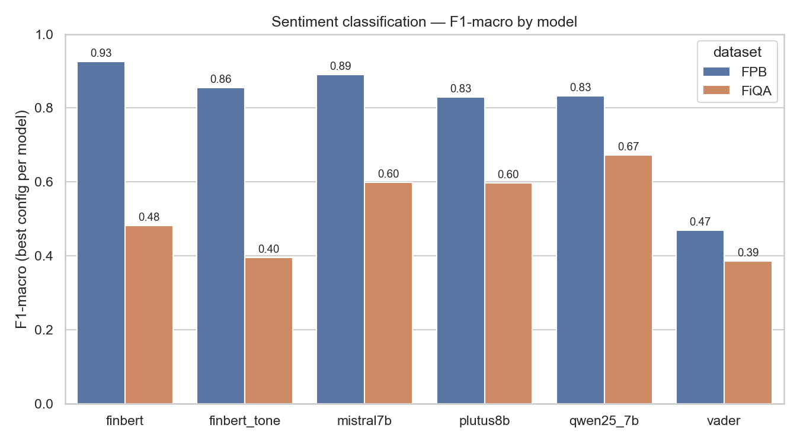
Headline: F1-macro by model
Best configuration per model on each dataset. Bigger = better.
Source: results/summary/final_table.csv · Re-render with scripts/make_figures.py
LLMs in Finance Seminar · Implementation Presentation

Slide 14
Headline numbers — best config per model × dataset
F1-macro is the primary metric (it is robust to the class imbalance in FPB and FiQA).
Model | FPB · F1m | FPB · Acc | FiQA · F1m | FiQA · Acc | Best config
FinBERT (specialised, 110M) | 0.925 | 0.935 | 0.482 | 0.498 | Best on FPB · loses on FiQA
Qwen2.5-7B-Instruct | 0.832 | 0.860 | 0.673 | 0.717 | Best LLM on FiQA: tpl B 0-shot
Mistral-7B-Instruct-v0.3 | 0.890 | 0.903 | 0.599 | 0.620 | Best LLM on FPB: tpl A 3-shot
plutus-8B-instruct (focal) | 0.829 | 0.851 | 0.597 | 0.657 | Mid-pack on both — see findings
VADER (lexicon) | 0.469 | 0.554 | 0.386 | 0.423 | —
Green-highlighted cells: per-dataset best. · Source: results/summary/final_table.csv (dashboard at :8502).
LLMs in Finance Seminar · Implementation Presentation

Slide 15
Three findings the numbers tell us
Read the table once — but interpret it three times.
Financial instruction tuning did NOT pull ahead
plutus-8B (focal financial-tuned model) scored 0.829 F1m on FPB and 0.597 on FiQA. Mistral-7B beat it on FPB (0.890) and Qwen2.5-7B beat it on FiQA (0.673). On the paper's central claim — that financial instruction tuning improves downstream NLP — our subset replication says: not clearly, on these two datasets.
FinBERT dominates FPB; loses on FiQA — strong reverse on out-of-domain text
On FPB the 110M specialised classifier (0.925 F1m) outperforms every 8B LLM. On FiQA it drops to 0.482 — Qwen2.5-7B beats it by 19 points. Domain-trained classifiers crush LLMs in-domain but generalise poorly to noisier text. A useful warning when picking models for production.
Prompt sensitivity is comparable to model choice
Mistral on FPB: Template A 0-shot 0.803 vs Template B 0-shot 0.689 — an 11-point gap from rewording alone. Qwen on FiQA: Template B 0-shot 0.673 vs Template A 0-shot 0.578 — 9 points. Plutus on FiQA: A 0-shot 0.597 vs B 0-shot 0.432 — 16 points. Single-prompt LLM benchmarks should not be trusted.
LLMs in Finance Seminar · Implementation Presentation

Slide 16
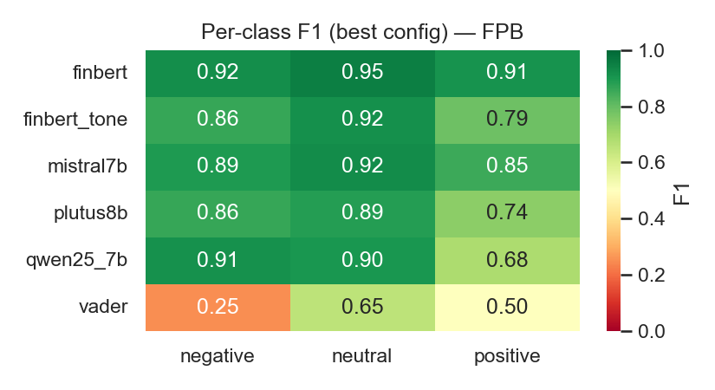
Per-class F1 — Financial PhraseBank
Class-level numbers expose hidden weaknesses an overall F1 can hide.
LLMs in Finance Seminar · Implementation Presentation

Slide 17
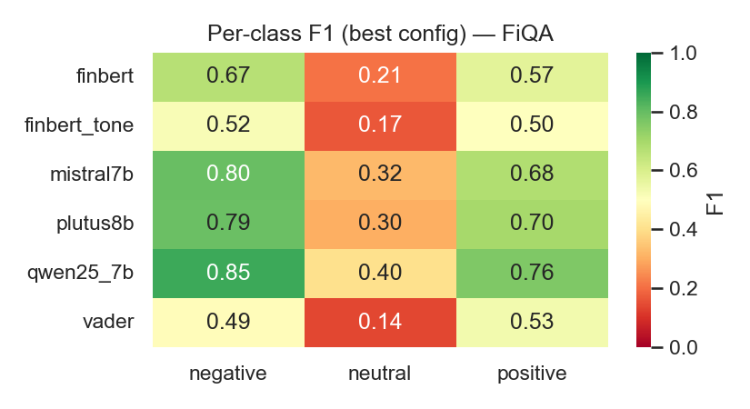
Per-class F1 — FiQA-SA
Note any class-specific gap between the financial model and the general LLMs.
LLMs in Finance Seminar · Implementation Presentation

Slide 18
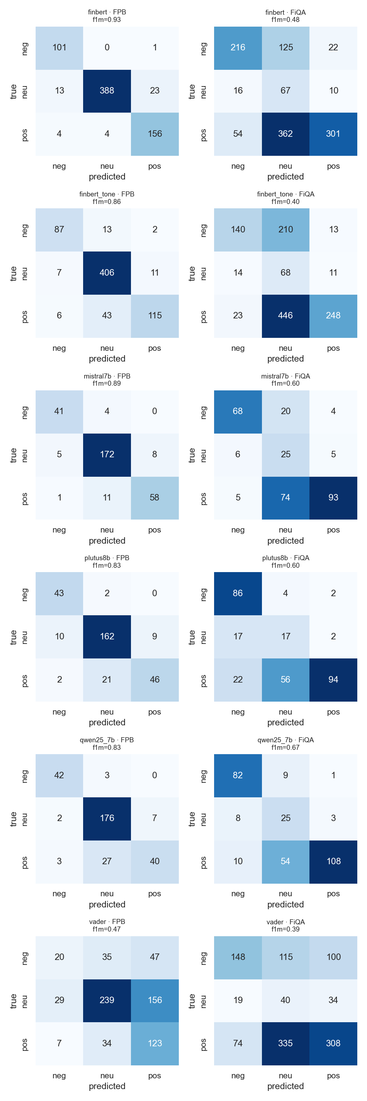
Confusion matrices — best config per model × dataset
Rows: true label · Columns: predicted label · Look for systematic mistakes.
LLMs in Finance Seminar · Implementation Presentation

Slide 19
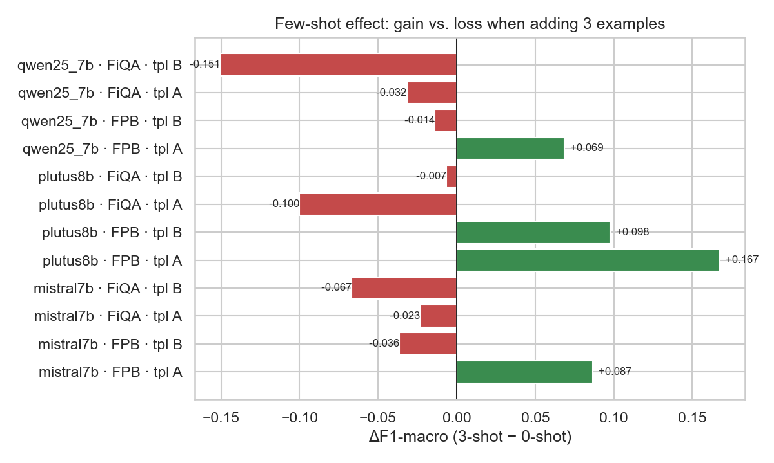
Few-shot effect — does the financial model need fewer examples?
ΔF1-macro when going from 0-shot to 3-shot. If the focal model gains less, its tuning already encodes the task.
LLMs in Finance Seminar · Implementation Presentation

Slide 20
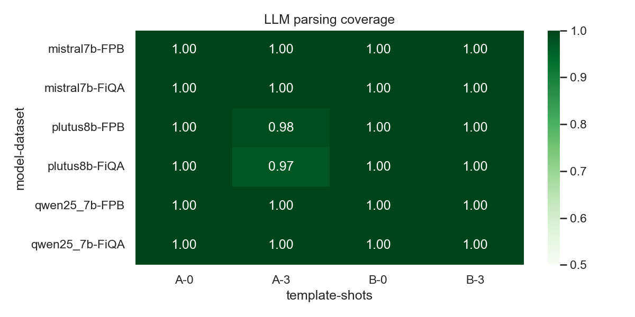
Parsing coverage — does the model follow the format?
Below ~95% is a flag. Coverage is reported separately so we don't paper over format failures.
LLMs in Finance Seminar · Implementation Presentation

Slide 21
Concrete cases — pulled from the dashboard 'Highlights' tab
Each card shows one sample, the gold label, and how each model classified it.
Focal wins, generals miss
Generals win, focal misses
[paste sample text]
Gold: positive · plutus-8B: positive · Mistral: neutral · Qwen2.5: neutral
[paste sample text]
Gold: negative · Mistral: negative · plutus-8B: neutral
Prompt template flips a model
Everyone misses
[paste sample text]
Template A → positive · Template B → negative (same model, same shots)
[paste sample text]
Gold: neutral · All models predicted: positive (likely a calm-news-defaults-positive bias)
LLMs in Finance Seminar · Implementation Presentation

Slide 22
Where the system works
Strengths grounded in our numbers and confusion matrices.
FinBERT on FPB: clean labels + matching domain ⇒ 0.925 F1m and 0.91–0.95 per-class F1 — strongest result anywhere in the matrix.
Mistral-7B on FPB with 3-shot Template A: 0.890 F1m, 0.903 accuracy — closes most of the FinBERT gap and shows that a general-purpose 7B can match a specialist when shown 3 in-context examples.
Qwen2.5-7B on FiQA Template B 0-shot: 0.673 F1m on the noisy/conversational FiQA where FinBERT collapses to 0.482 — generalist beats specialist out-of-domain.
Parsing coverage ≥97% everywhere; only plutus-8B dipped below 100% (2 of 24 runs) — no run was poisoned by 'bullish'/'bearish'-style outputs that would have force-mapped to neutral.
VADER on FPB at 0.469 F1m provides a useful 'no-learning floor' — every other model is at least 17 points above it, validating the comparison.
LLMs in Finance Seminar · Implementation Presentation

Slide 23
Error categories — focal model misses (hand-categorized)
30 hand-tagged plutus-8B errors on FPB (results/summary/focal_error_sample.csv).
Missed positive cue — 15 (50%): mild/forward-looking positives read as neutral (neutral-bias), e.g. 'plans to expand internationally'
Numerical reasoning — 8 (27%): needs comparing figures, e.g. 'loss narrowed 3.7→1.8mn' misread as negative
Factual neutral misclassed — 6 (20%): a neutral fact (appointment, M&A, delisting) read as positive/negative
Ambiguous / out-of-domain — 1 (3%): genuinely unclear sentence
Takeaway: half the misses are a conservative neutral-bias, not random noise — only 1 of 30 errors is genuinely ambiguous label noise.
LLMs in Finance Seminar · Implementation Presentation

Slide 24

Interactive analysis dashboard
Live at localhost:8502 — every chart and table on these slides also updates as new runs finish.
Includes: research-question verdict card, F1 comparison, prompt-sensitivity & few-shot tables, per-class breakdown, confusion matrices.
LLMs in Finance Seminar · Implementation Presentation

Slide 25

Per-example breakdown — every model on the same sentence
Pick any sample, see how each (model, template, shots) classified it; green = correct, red = wrong.
The 'highlights' tab auto-curates cases where models disagree — useful for picking concrete examples for a presentation.
LLMs in Finance Seminar · Implementation Presentation

Slide 26
4
Lessons learned
Reproducibility, prompt sensitivity, and what we'd do differently.

Slide 27
Five lessons
Reproducibility cost is real
Notebook → script split, run-dir schema with checkpoint/resume, parser as a tested module, Modal Volume for cached weights — without these, a 24-run matrix isn't redoable.
Models can vanish
TheFinAI/FinLLaMA-instruct was unpublished between paper and our run. Benchmark results are only as durable as the artifacts they reference.
Prompt sensitivity ≥ model choice (often)
ΔF1 between Template A and B was up to 16 points on the same model and dataset — comparable to gaps between models. Single-prompt LLM benchmarks should not be trusted.
Coverage matters more than people report
Force-mapping plutus-8B's unparsed outputs to 'neutral' would overstate accuracy by up to 1.25 points (FPB, Template A, 3-shot). Most papers don't report it.
Data leakage caveat
FPB (2014) and FiQA (2018) almost certainly leaked into pretraining. Numbers here are an upper bound on real-world generalisation — a 2025 hold-out would be the honest test.
LLMs in Finance Seminar · Implementation Presentation

Slide 28
What we'd do differently
Build a 2025 financial-news held-out set to break leakage from FPB/FiQA pretraining
Run three or four prompt templates instead of two — make sensitivity even more legible
Add an LLM-as-judge sanity pass over a 100-sample slice — catch label noise
Try few-shot examples drawn from the same dataset as the test (when available) — closer to real deployment
Include a smaller financial model (e.g. finma-7b) and a non-financial 8B baseline of the same era for a tighter family comparison
LLMs in Finance Seminar · Implementation Presentation

Slide 29
Bottom line
Financial instruction tuning did NOT clearly help. plutus-8B scored 0.829 / 0.597 F1m on FPB / FiQA — beaten on FPB by Mistral-7B (0.890) and on FiQA by Qwen2.5-7B (0.673). FinBERT (110M, in-domain trained) crushed every 8B model on FPB but lost by 19 points on FiQA.
Two takeaways for the audience to remember:
1. Don't trust LLM benchmarks reported with a single prompt — sensitivity here was 9-16 F1 points.
2. Specialised small models still beat 8B general LLMs in-domain — and the inverse on noisier text.
3. Reproducibility is structural: artefacts disappear, tokenizer formats break, gates close. Build for it.

Slide 30
Thank you
Questions?
Code · github.com/shimi777/finllama-sentiment
Live dashboard · localhost:8502 (run dashboard/run.bat)

