Slide 1
Fraud Screening Agent
An agent that screens card transactions and flags likely fraud for review.
Irish Rosita · SoSe26 · Group A

Slide 2
Environment (Russell & Norvig)
Property | Classification | Reasoning
Observable | Partially observable | Sees only the transaction fields, not who is really holding the card.
Deterministic / Stochastic | Stochastic | Similar-looking transactions can be fraud or legit.
Episodic / Sequential | Episodic | Each transaction is scored on its own.
Static / Dynamic | Dynamic | Fraud tactics and spending patterns keep changing.
Discrete / Continuous | Mostly discrete | Actions are approve or flag. Inputs like amount are continuous.
Single / Multi-agent | Multi-agent | Fraudsters adapt to what the agent catches.

Slide 3
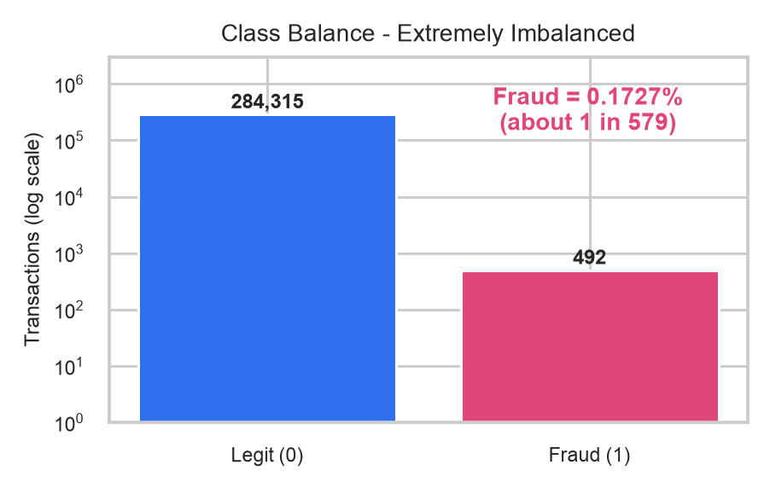
Data
Source: Kaggle, ULB Credit Card Fraud Detection (kaggle.com/datasets/mlg-ulb/creditcardfraud)
Represents: 284,807 real European card transactions over 48 hours, each labeled legit or fraud.
Fields: Time, Amount, V1 to V28 (anonymized), Class (0 = legit, 1 = fraud).
In use: a live stream of new transactions with the same fields.
Problems: only 0.17% fraud (492), 1,081 duplicate rows, anonymized features.
Time | V1 | V2 | V14 | V17 | Amount (EUR) | Class
0 | -1.36 | -0.07 | -0.31 | 0.21 | 149.62 | 0
0 | 1.19 | 0.27 | -0.14 | -0.11 | 2.69 | 0
406 | -2.31 | 1.95 | -4.29 | -2.83 | 0.00 | 1
472 | -3.04 | -3.16 | -1.69 | 0.60 | 529.00 | 1

Slide 4
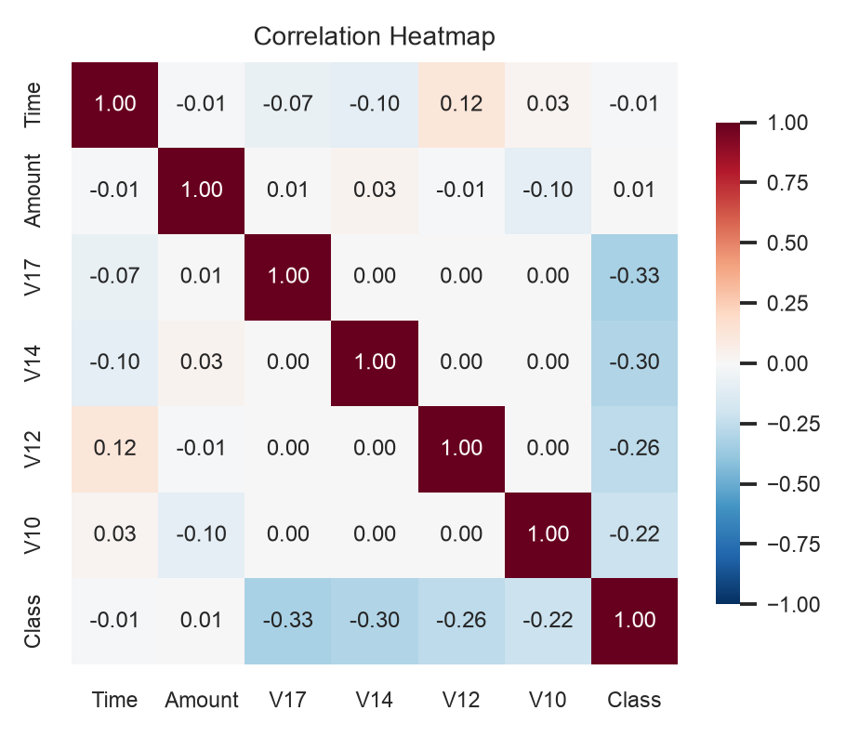
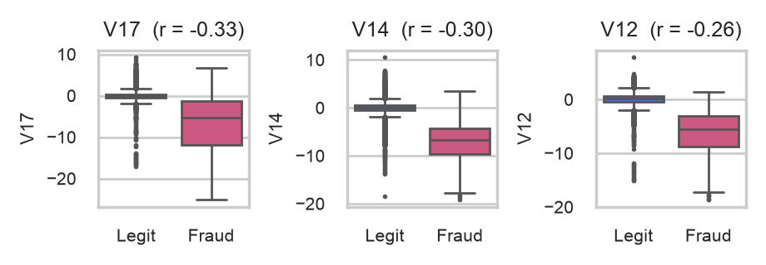
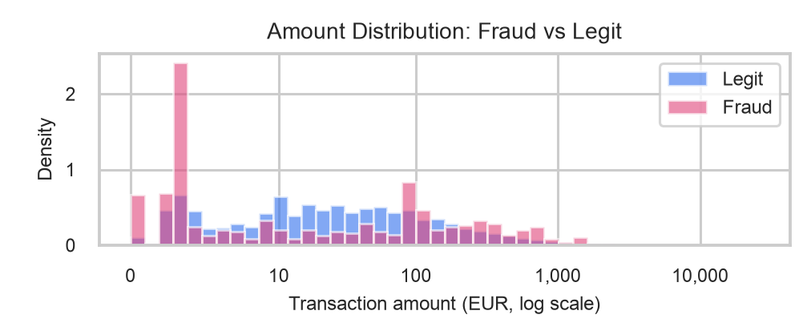
Data Inspection
V17, V14 and V12 separate fraud best (much lower values). 36.8% of frauds are EUR 1 or less, vs 10.7% of legit.

Slide 5
Model: Random Forest
Supervised learning on labeled transactions. An ensemble of decision trees that vote.
Input
30 features
Time, Amount,
V1 to V28
Random Forest (supervised, ensemble)
Output
Fraud probability
0 to 1
Flag if ≥ 0.5
Tree 1
Tree 2
...
Tree 200
Each tree (max depth 12) votes. Votes are averaged into one fraud probability.
Major parameter | Value | What it does
n_estimators | 200 | Number of trees in the forest
max_depth | 12 | How deep each tree can grow
min_samples_leaf | 2 | Smallest group of rows allowed in a leaf (limits overfitting)
class_weight | "balanced" | Missing a fraud costs more, to offset the 0.17% fraud rate
Threshold | 0.5 | Probability needed to flag a transaction
Train / test split | 75 / 25 | 213,605 train rows, 71,202 test rows (stratified)

Slide 6
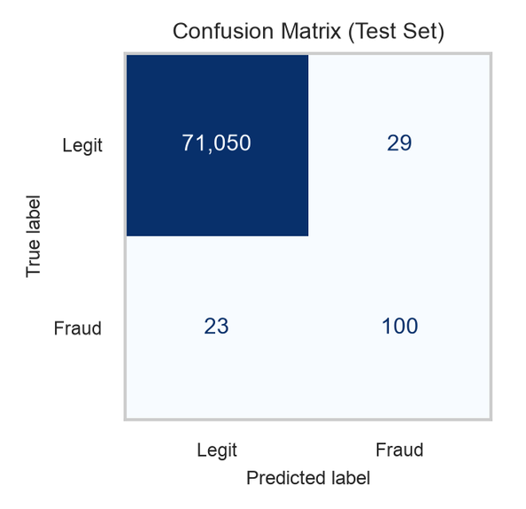
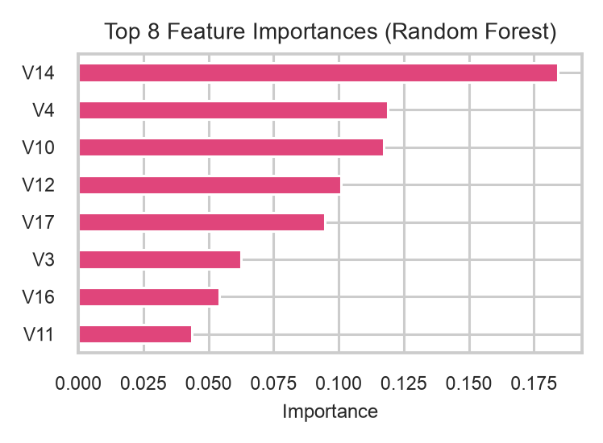
Results
81.3%
Recall (fraud caught)
77.5%
Precision (alerts that were fraud)
0.794
F1 score
0.976
ROC-AUC
Accuracy is misleading. 99.93% sounds great, but always saying "legit" scores 99.83%.
Missed 23 frauds, wrongly flagged 29 real transactions.
To improve: a 0.3 threshold lifts recall to 87.0% but adds false alarms (86). Tune settings and add more fraud examples.

Slide 7
How the Model Serves the Agent
Perceive
reads the transaction
Predict
model gives fraud probability
Decide
probability ≥ 0.5?
Act
flag for review or approve
Understands
Which patterns look like fraud, learned from 284,807 past transactions. Most important features: V14, V4, V10.
Decides
Flag or approve each transaction. The threshold trades missed fraud against false alarms.
Limits
Cannot say why (features are anonymized), cannot see intent, and does not learn after training.
Agent type: a learning agent while training, a simple reflex agent when running (if score ≥ 0.5, flag).

