Slide 1

Predicting Ventricular Tachycardia in ICU Patients Using a Timeseries Foundation Model and Multimodal Waveforms
Konstantinos Kalpakis^{1,*},Shiming Yang^{2,4},William Teeter^{2,5}, Xiangxiang Kong^{1,2}, Meagan Watkins², Bradford Burdette², Kathalyn Urquizo², Timm Dickfeld², Bradley A. Maron^{3,4}, Peter Hu^{2,4}
1.Computer Science, University of Maryland Baltimore County, Baltimore County, MD, USA
2.University of Maryland School of Medicine, Baltimore, MD, USA
3.Department of Medicine and Division of Cardiovascular Medicine, University of Maryland School of Medicine, Baltimore, MD, USA
4.The University of Maryland-Institute of Health Computing, North Bethesda, MD, USA
5.Charles McC Matthias National Study Center for Trauma and EMS
*kalpakis@umbc.edu

Slide 2
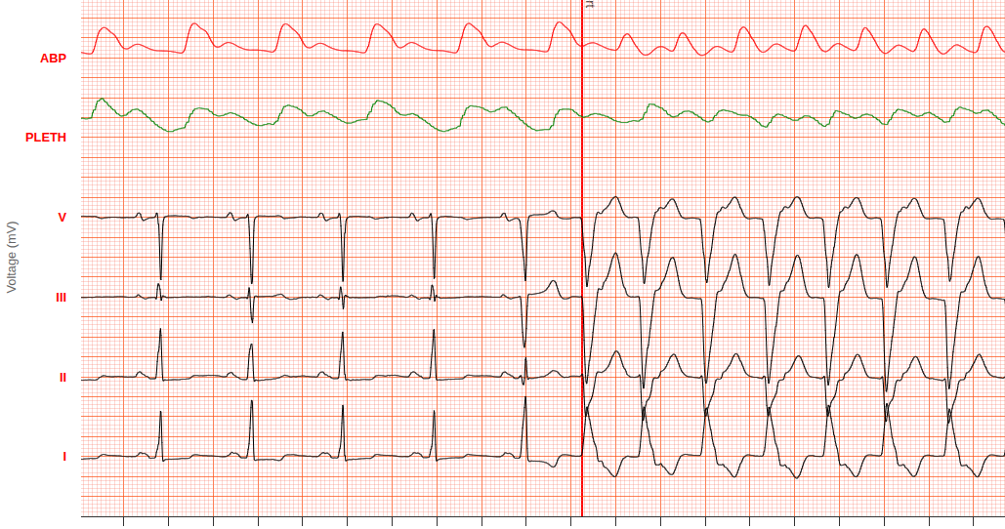
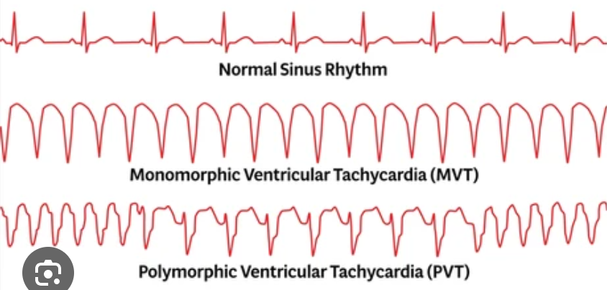
Ventricular Tachychardia (VT)
A life-threatening, rapid heart arrhythmia originating in the ventricles
Leading to cardiac arrest if not promptly addressed

Slide 3
Challenge in ICUs
Current VT detection systems in hospitals are reactive.
They alarm after VT starts, and they suffer from high false alarm rates.
This leads to "alarm fatigue"

Slide 4
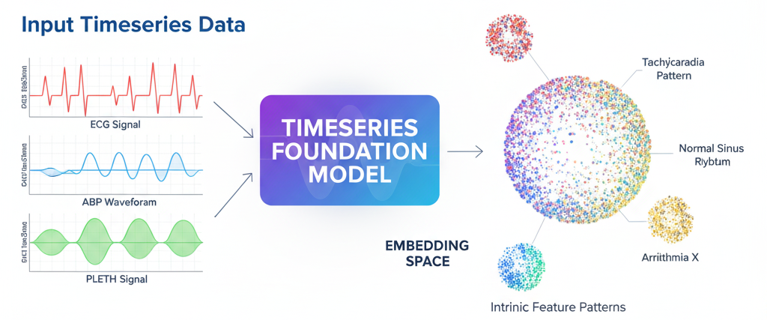
Our Approach: The Foundation Model
Pre-Training
Use a model already trained on millions of unlabeled time-series data
It has learned a universal “language” of timeseries data
MOMENT: A family of open time-series foundation models [1]
Transfer Learning
Apply this pre-trained, knowledgeable model to specific task: detecting VT
[1]. Goswami, Mononito, et al. "Moment: A family of open time-series foundation models." arXiv preprint arXiv:2402.03885 (2024).

Slide 5
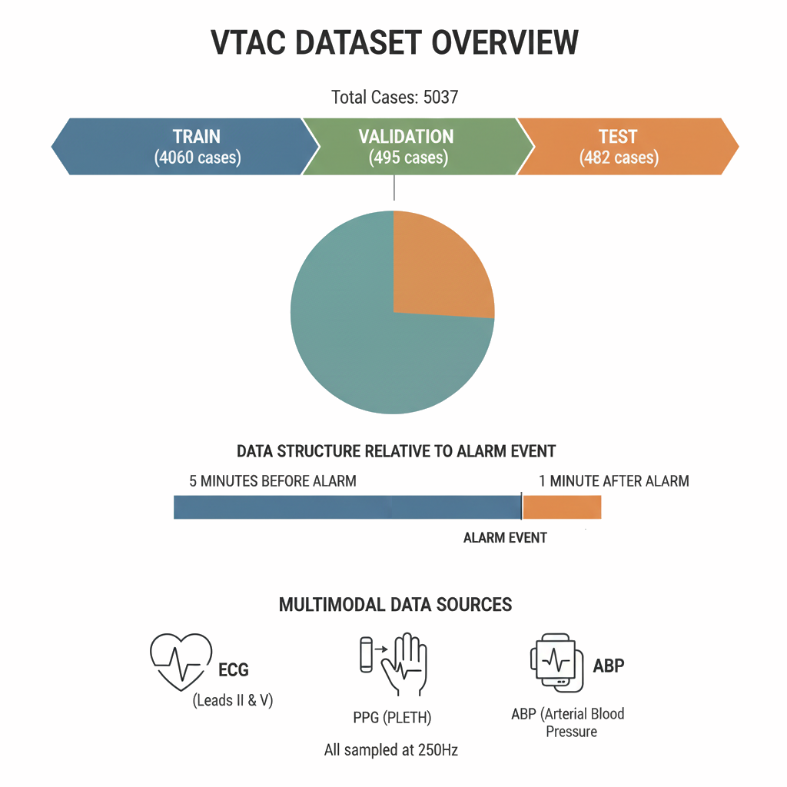
Physionet VTaC dataset
VTaC: 5000+ expertly-annotated VT alarms with multimodal waveforms from diverse ICU settings [2]
Includes 6-minute waveform segments for algorithm development
1441
True alarm
28.6%
3596
false alarm
71.4%
[2]. Lehman, Li-wei, et al. "VTaC: A benchmark dataset of ventricular tachycardia alarms from ICU monitors." Advances in Neural Information Processing Systems 36 (2023): 38827-38843.
Notes:
VTaC is a large and diverse public dataset of 5,037 ventricular tachycardia (VT) alarm events, sourced from three different hospitals and monitor vendors. Each event contains multimodal waveforms (ECG, PPG, ABP) and is expertly annotated as a "true" or "false" alarm to facilitate the development of improved alarm reduction algorithms.
The dataset is structured for machine learning with predefined training, validation, and test splits. Each case provides a 6-minute waveform segment, capturing 5 minutes of data before the alarm and 1 minute after, with all signals uniformly sampled at 250 Hz.

Slide 6
Two methods: Zero-shot vs Fine tuning
Method 1: Use the pretrained MOMENT model “as is” to generate embeddings (the “fingerprints”)
Method 2: Lightly retrain parts of the MOMENT model using VTaC training set
We use 10 secs waveforms for ECG leads II and V, PLETH, and ABP before alarm onset
Use an XGBoostClassifier (Extreme Gradient Boost classifier) with default parameters

Slide 7
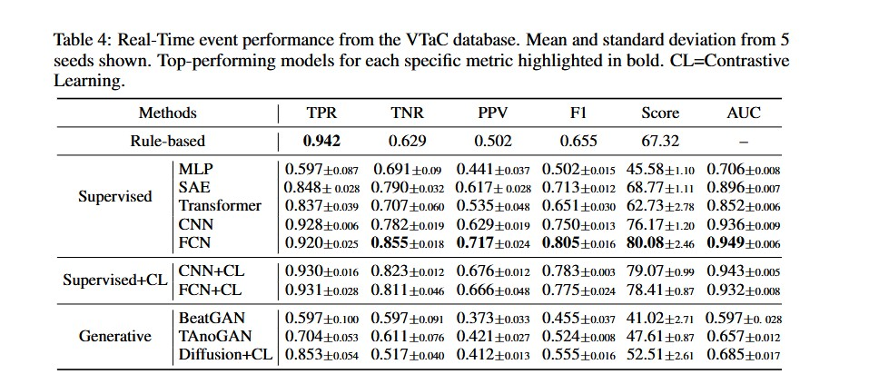
Zero-shot vs Fine-tuning
 | AUC | PPV | TPR | TNR | f-beta | PHYS15
Zero-shot Small (36M params) | 0.923 | 0.741 | 0.730 | 0.899 | 0.735 | 65.079
Base (110M params) | 0.927 | 0.805 | 0.723 | 0.930 | 0.762 | 66.246
Large (342M params) | 0.957 | 0.830 | 0.818 | 0.933 | 0.824 | 74.570
Fine-tune Large model | 0.963 | 0.784 | 0.927 | 0.899 | 0.850 | 83.717
zero-shot
[2]
[2]. Lehman, Li-wei, et al. "VTaC: A benchmark dataset of ventricular tachycardia alarms from ICU monitors." Advances in Neural Information Processing Systems 36 (2023): 38827-38843.

Slide 8
Conclusion
Our method achieves SOTA, comparable to the VTaC benchmark’s top models
This method is efficient in detecting VT events
using zero-shot embeddings
with computationally efficient and inexpensive fine-tuning of select layers
Reduce false alarms and mitigate alarm fatigue
Timely life-saving interventions

