Slide 1
Cortical thickness & Surface area analysis
20210803

Slide 2
Outline
Method
Workflow of Cortical thickness analysis
Desikan Killiany Atlas
Result
Teenagers’ mothers (corresponding to table 3)
Teenagers (corresponding to table 4)

Slide 3
Method

Slide 4
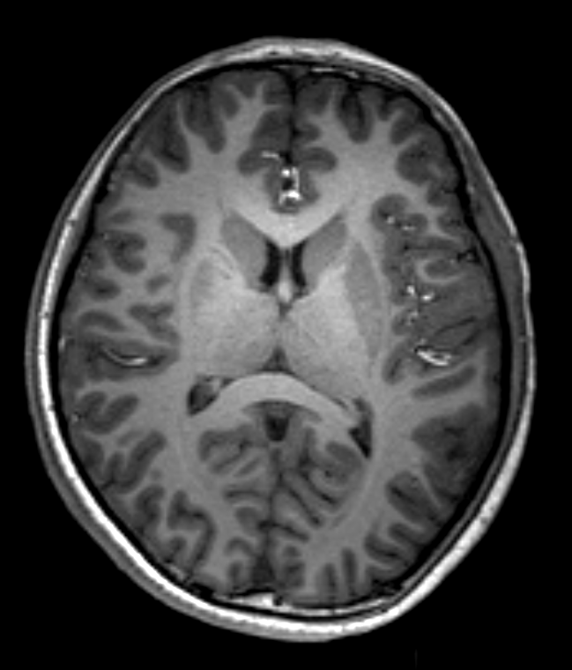
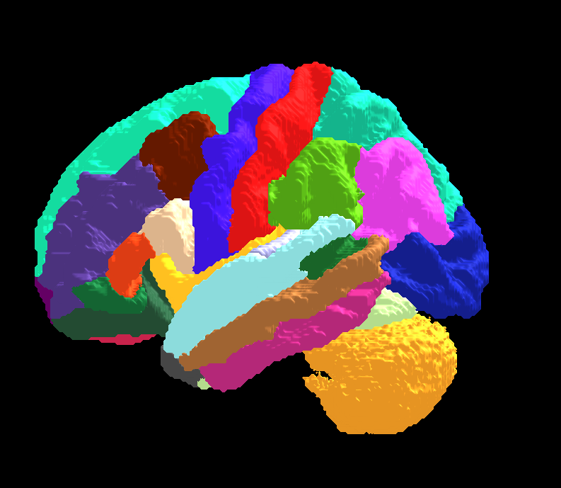
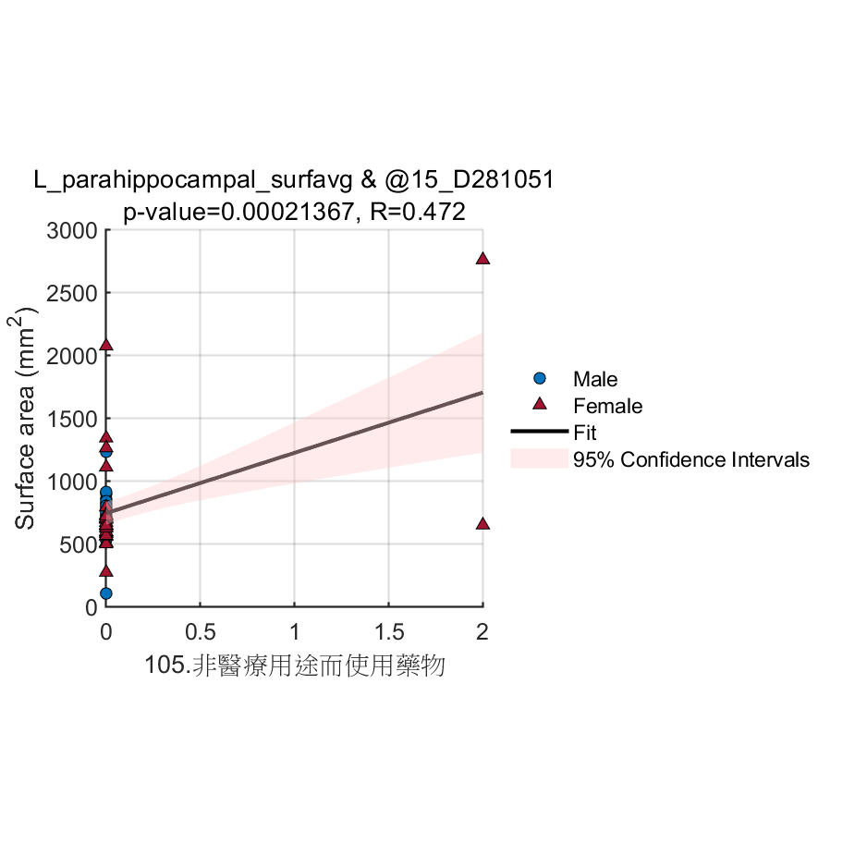
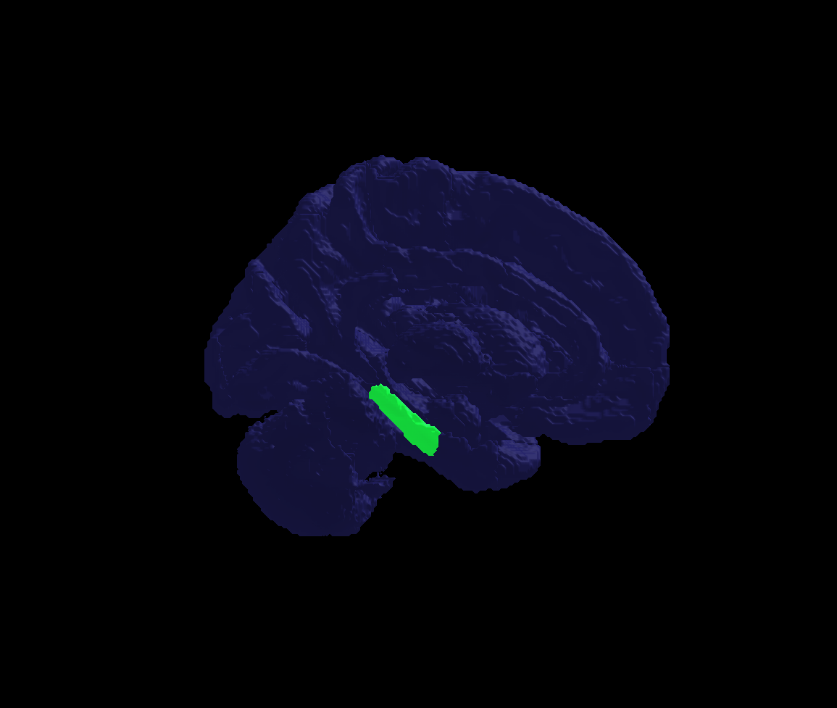
Workflow
Schwarz, Christopher G., et al. "A large-scale comparison of cortical thickness and volume methods for measuring Alzheimer's disease severity." NeuroImage: Clinical 11 (2016): 802-812.
Image processing
Statistical analysis
Cortical Parcellation (Desikan-Killiany Atlas)
68 VOIs
Cortical Parcellation Statistics
Average cortical thickness
Average surface area
T1-w image (N=59)
Image processing
(recon-all)
(by Freesurfer)
Pearson correlation with Cortical Parcellation Statistics
(Bonferroni corrected p-value< 0.000735, 0.05/68) (by SPSS)
Assessments from teenagers (25)
Assessments from their mothers (46)
Desikan Killiany Atlas
Volume (N=59)
Scatter plot
3D Volume rendering

Slide 5
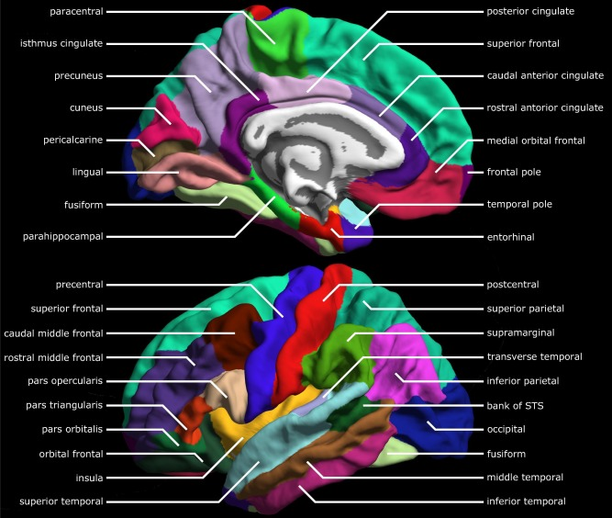
Desikan Killiany Atlas
Nagtegaal, Steven HJ, et al. "Changes in cortical thickness and volume after cranial radiation treatment: A systematic review." Radiotherapy and Oncology 135 (2019): 33-42.

Slide 6
Results –Mothers (see new added variables in table 3)

Slide 7
EDCs | Region | p-value | R
All teenagers’ mothers
Inorganic_arsenic_adjust_UC | L_caudalanteriorcingulate_thickavg | 0.0004847 | -0.5264
Inorganic_arsenic | L_caudalanteriorcingulate_thickavg | 0.0004694 | -0.5275
HEOHP_adjust_UC | R_superiorfrontal_surfavg | 7.71E-05 | 0.54927
MEHHP_A_adjust_UC | R_superiorfrontal_surfavg | 0.00044031 | 0.49713
log10_@66Zn_m | L_bankssts_thickavg | 0.00013304 | 0.53908
 | R_superiorparietal_thickavg | 0.00068218 | 0.48751
log10_@111Cd_m | L_frontalpole_thickavg | 0.00065867 | 0.48871
Mothers with male teenagers
@66Zn_m_adjust_UC | R_parsorbitalis_surfavg | 0.0006517 | 0.66968
@71Ga_m_adjust_UC | L_precentral_thickavg | 0.00058079 | -0.67415
log10_PFDoA_conc | R_parahippocampal_thickavg | 0.00069136 | 0.66736
log10_@60Ni_m_adjust_UC | L_precentral_thickavg | 0.0001617 | 0.71926
log10_@66Zn_m_adjust_UC | R_parsorbitalis_surfavg | 0.0006302 | 0.67099
Mothers with female teenagers
@63Cu_m_adjust_UC | R_precentral_thickavg | 0.00012183 | -0.72822
log10_@51V_m | R_precuneus_surfavg | 0.00037021 | 0.67873
 | R_parahippocampal_thickavg | 0.00050897 | -0.66697
log10_@66Zn_m | L_bankssts_thickavg | 0.00028731 | 0.68773
 | L_supramarginal_thickavg | 0.00071296 | 0.65394
log10_B_Pb_m | R_entorhinal_surfavg | 0.00037286 | -0.6907
log10_udma_maternal_adjust_UC | L_rostralanteriorcingulate_thickavg | 0.00068069 | 0.72401

Slide 8
Results Significant correlation between cortical thickness of specific brain regions and EDC measurements for all teenagers’ mothers(see Table 3)

Slide 9
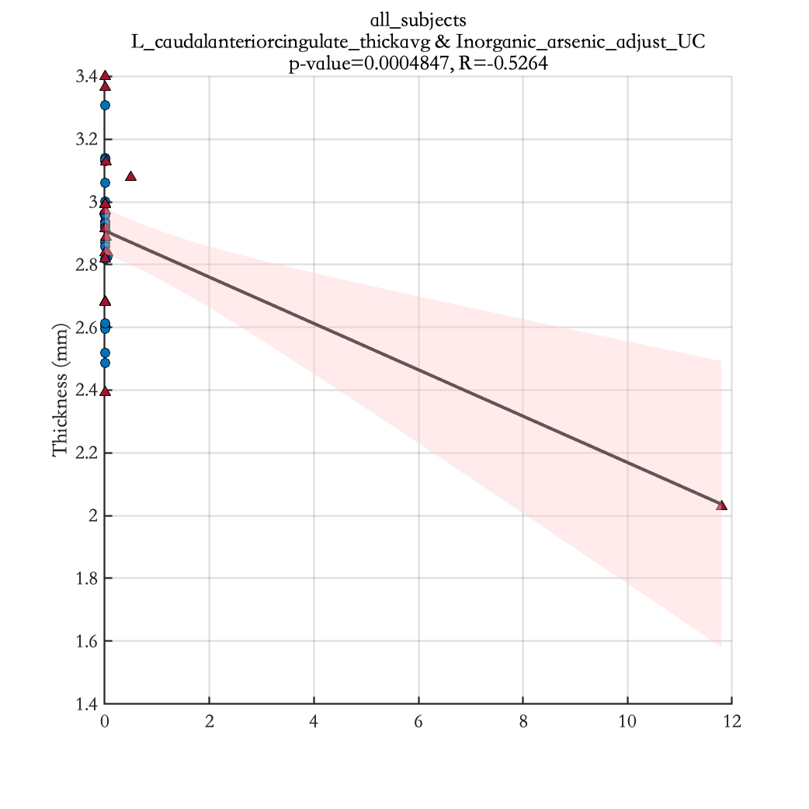
Inorganic_arsenic_adjust_UC

Slide 10
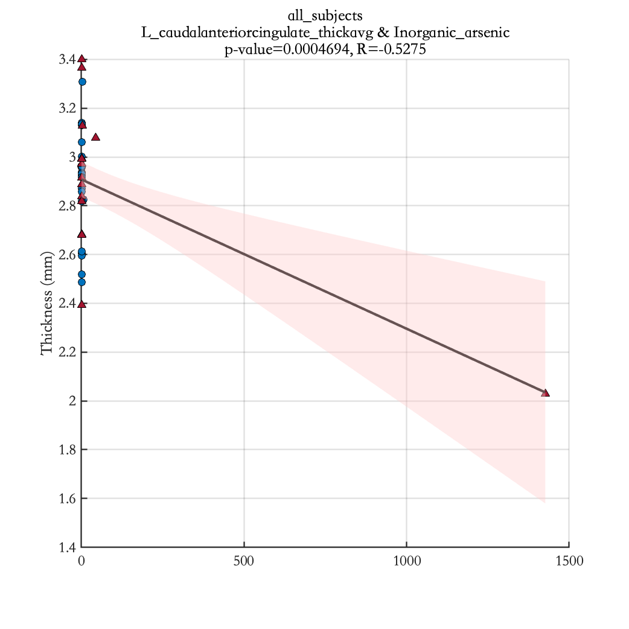
Inorganic_arsenic

Slide 11
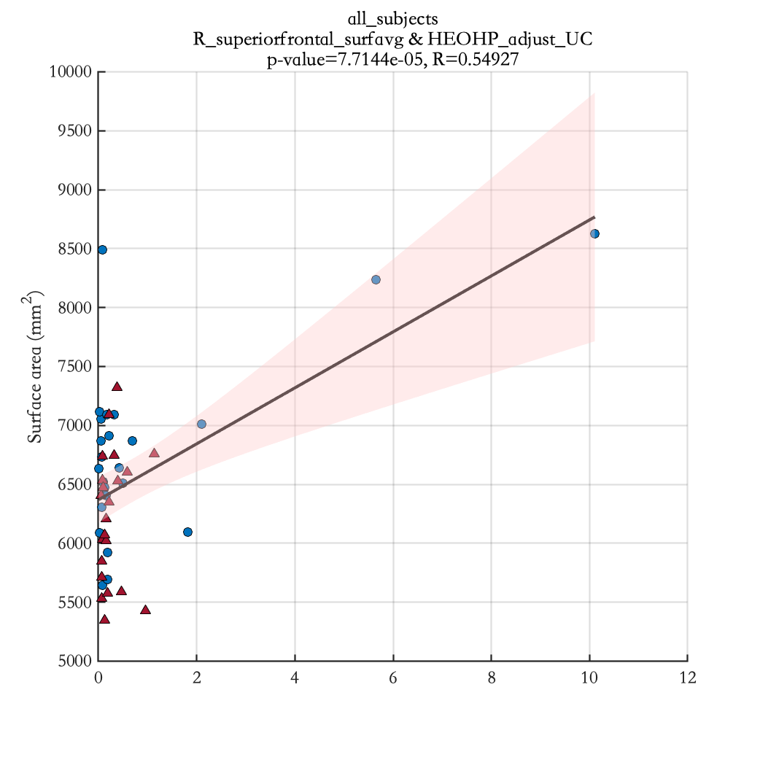
HEOHP_adjust_UC

Slide 12
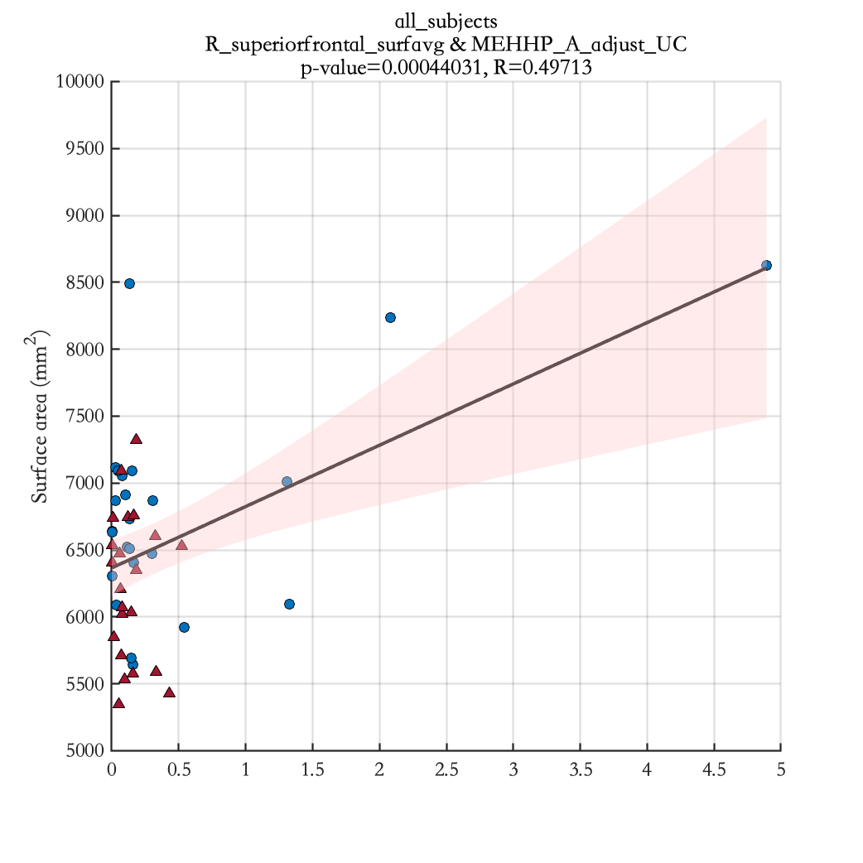
MEHHP_A_adjust_UC

Slide 13
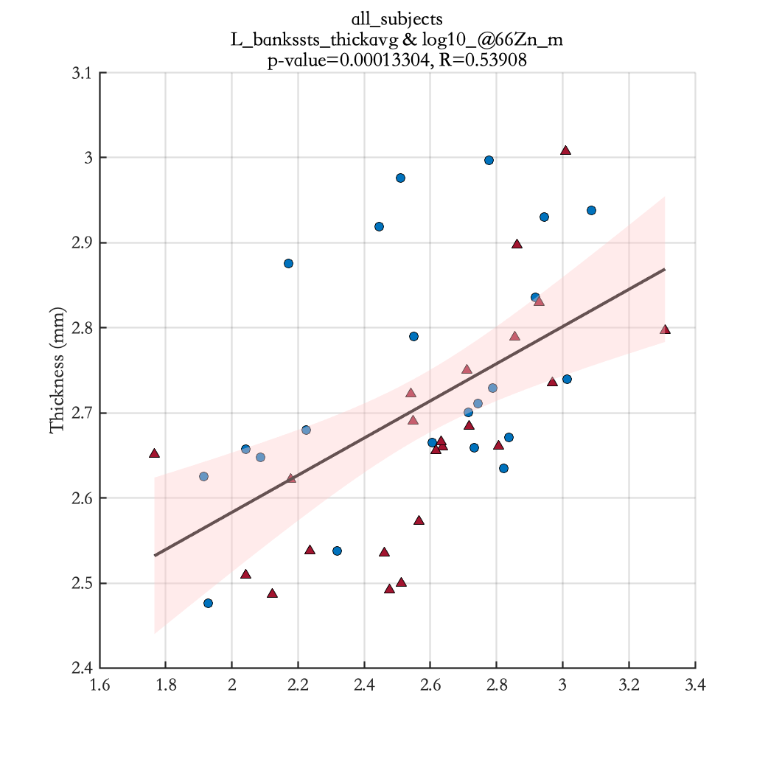
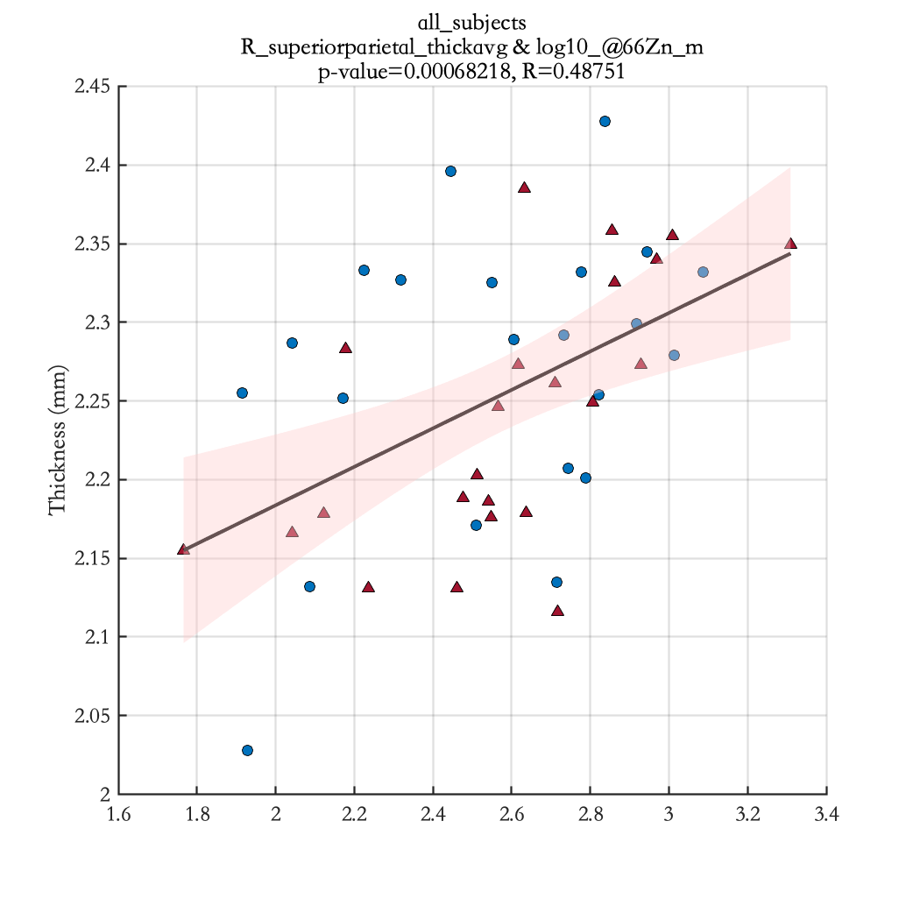
log10_@66Zn_m

Slide 14
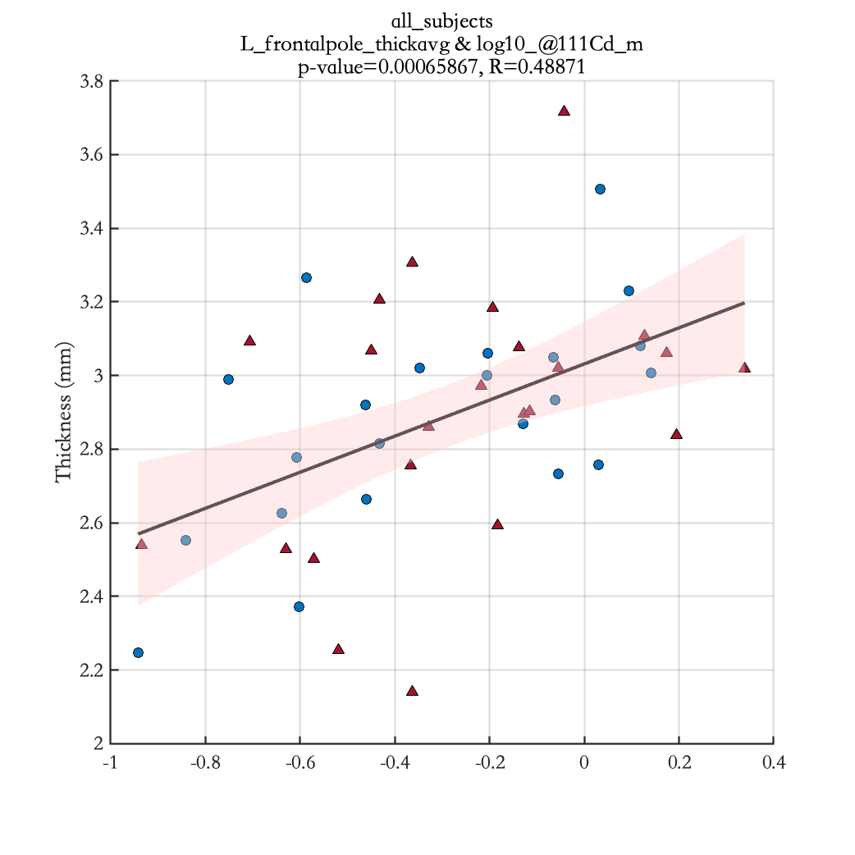
log10_@111Cd_m

Slide 15
Results Significant correlation between cortical thickness of specific brain regions and EDC measurements for mothers with male teenagers(see Table 3)

Slide 16
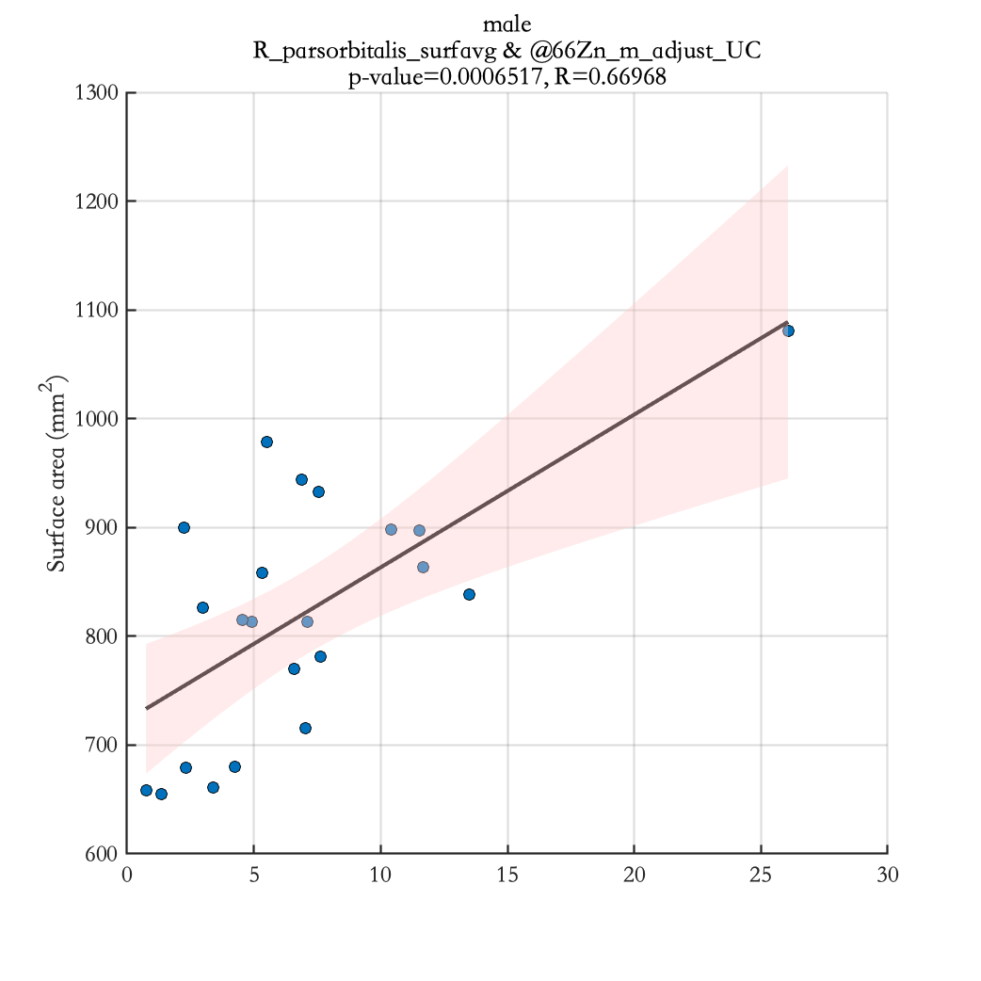
@66Zn_m_adjust_UC

Slide 17
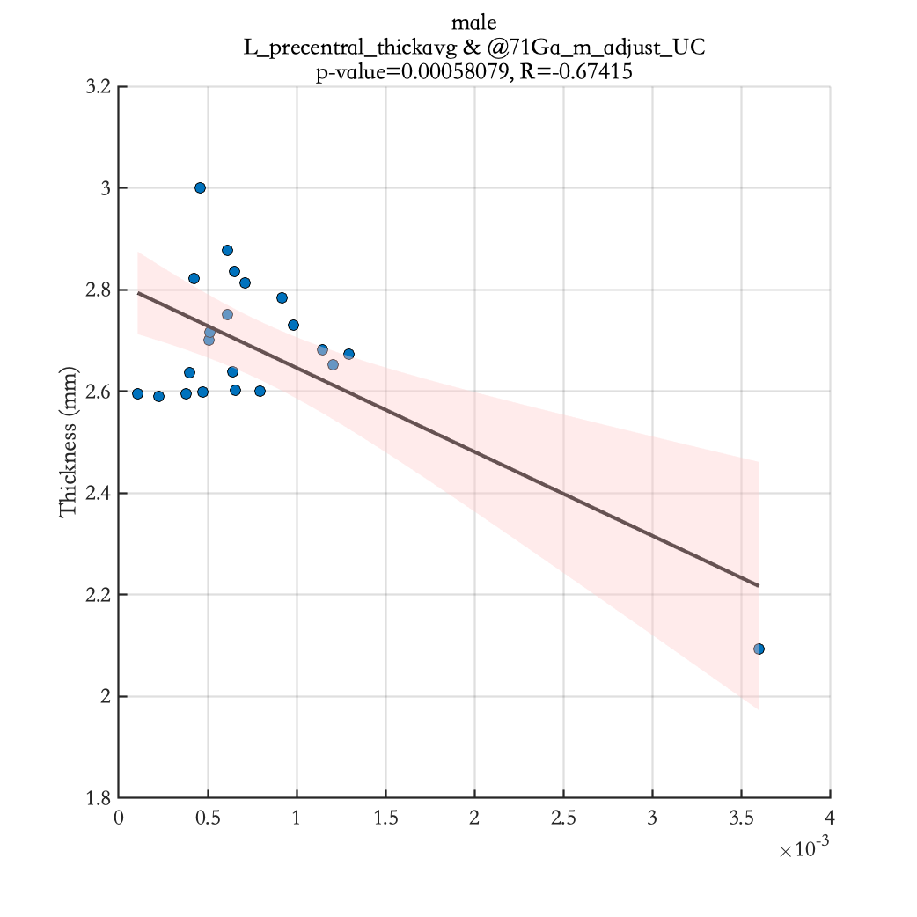
@71Ga_m_adjust_UC

Slide 18
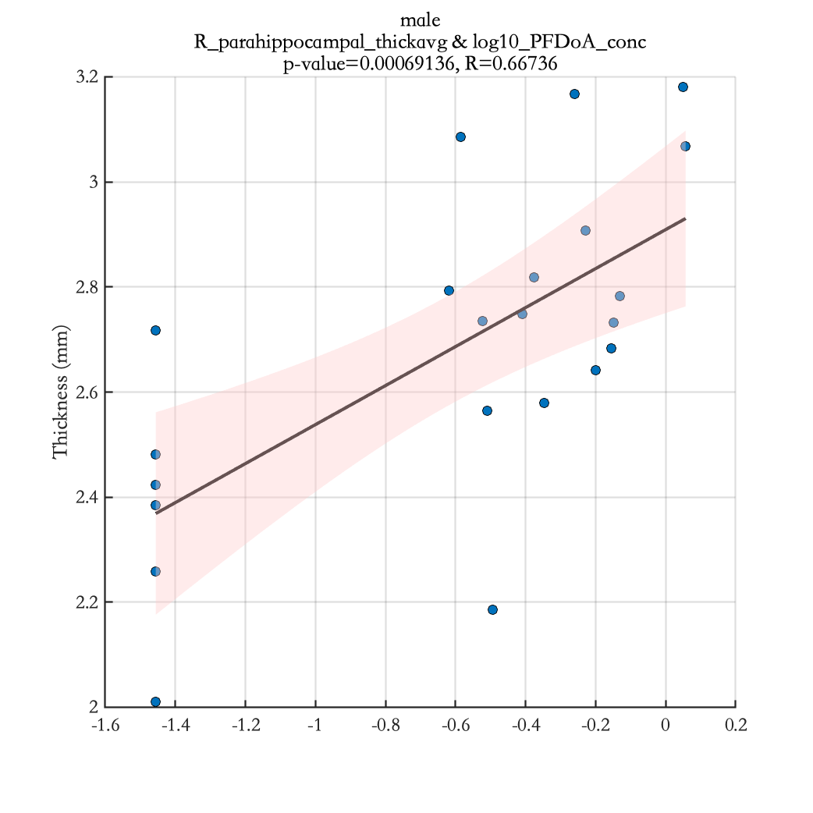
log10_PFDoA_conc

Slide 19
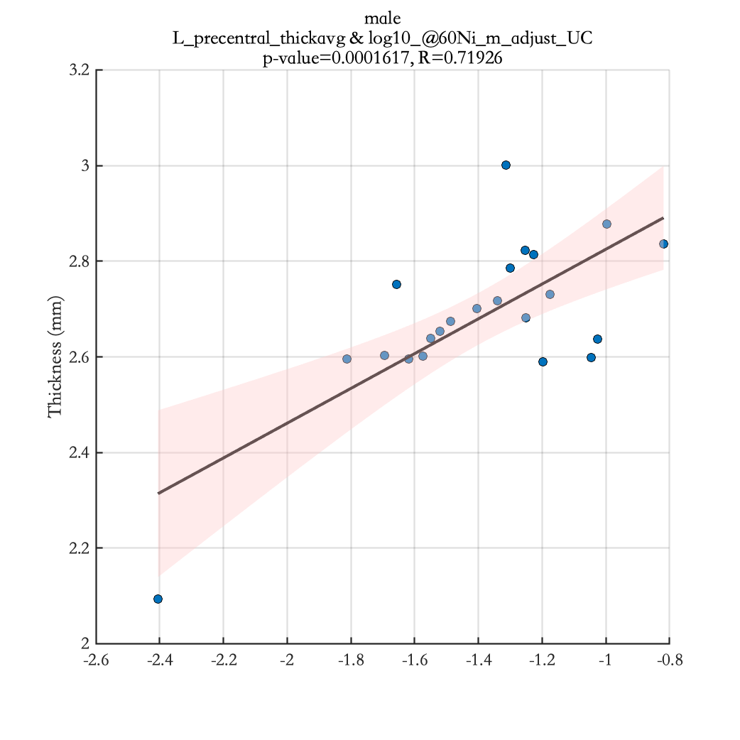
log10_@60Ni_m_adjust_UC

Slide 20
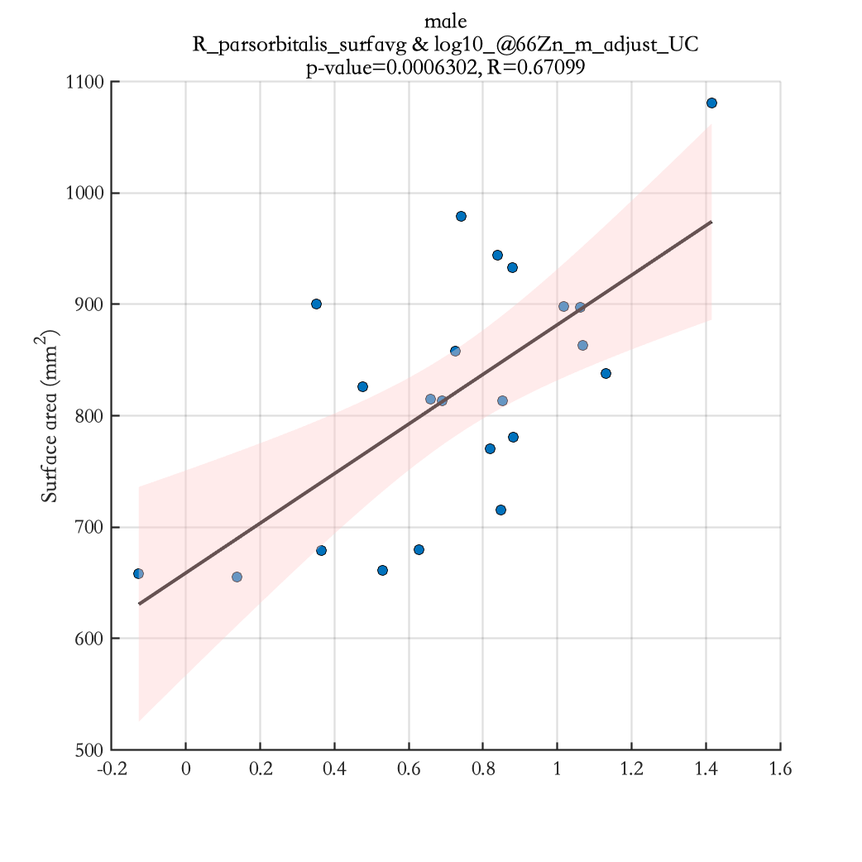
log10_@66Zn_m_adjust_UC

Slide 21
Results Significant correlation between cortical thickness of specific brain regions and EDC measurements for mothers with female teenagers (see Table 3)

Slide 22
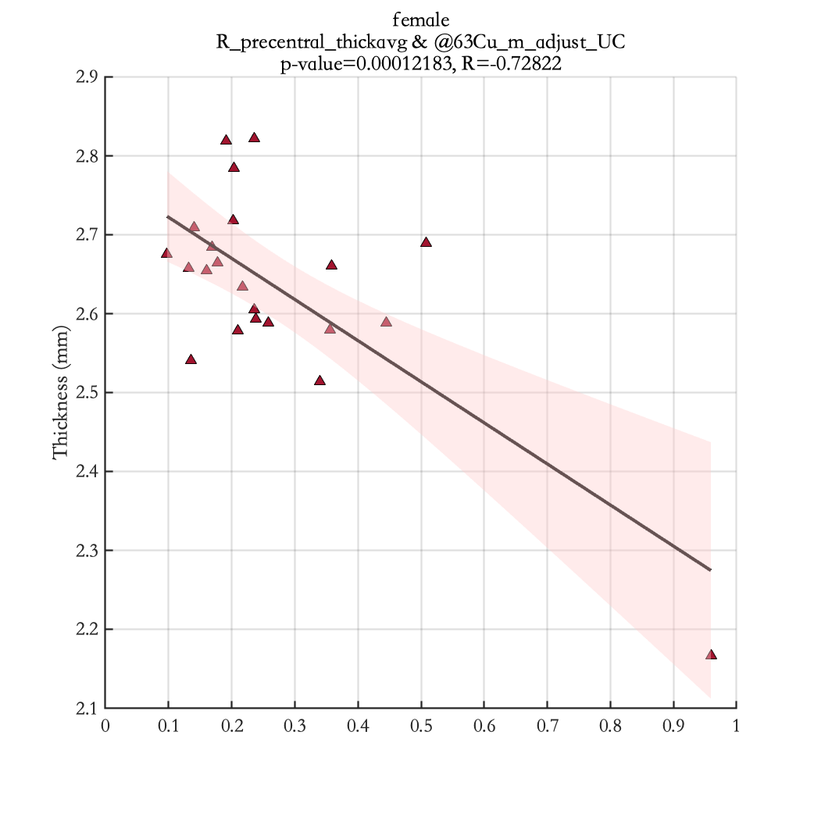
@63Cu_m_adjust_UC

Slide 23
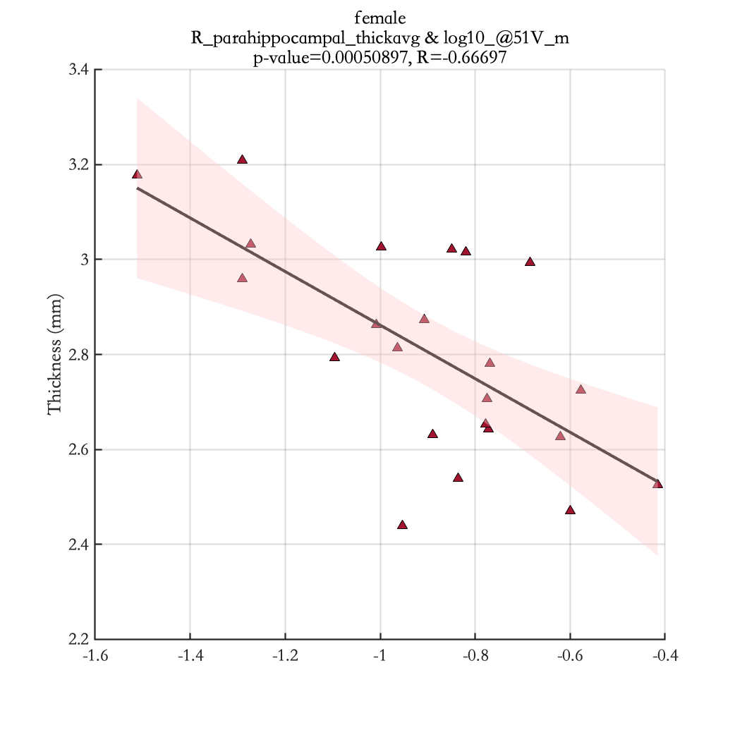
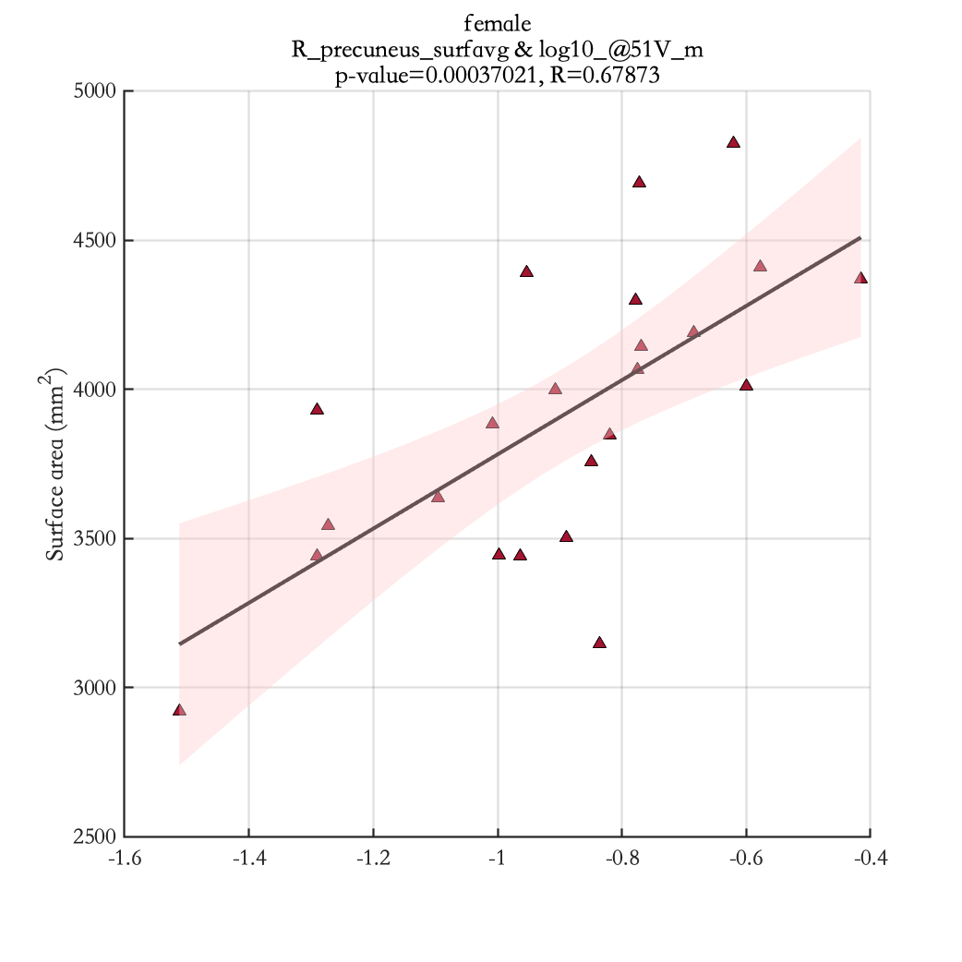
log10_@51V_m

Slide 24
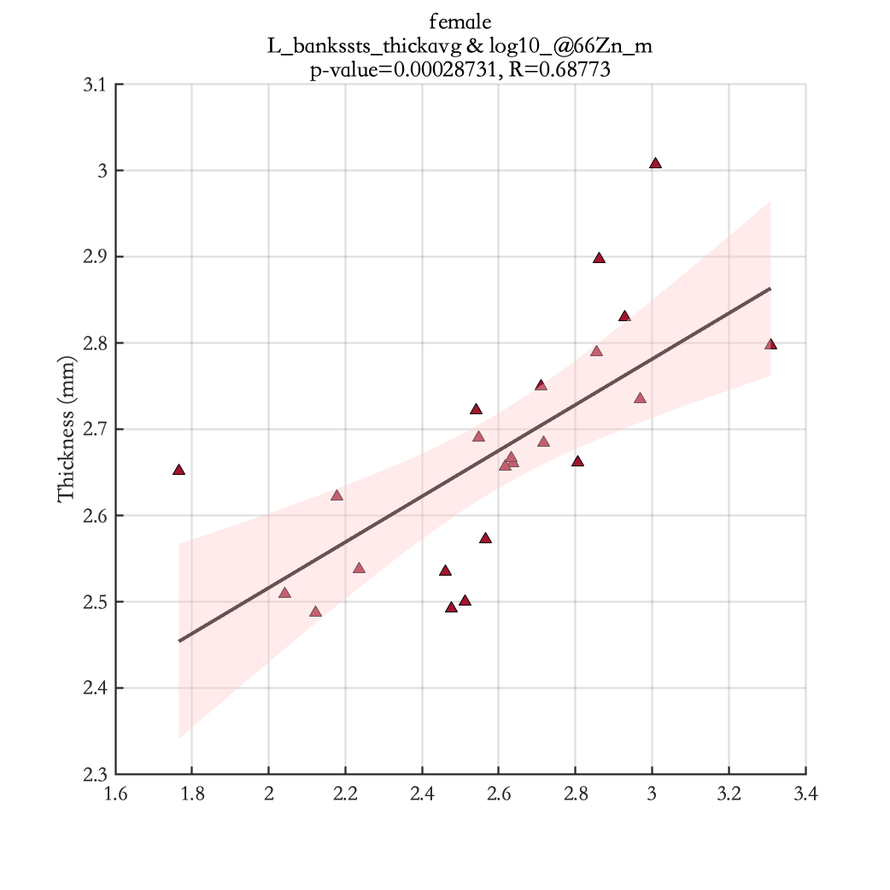
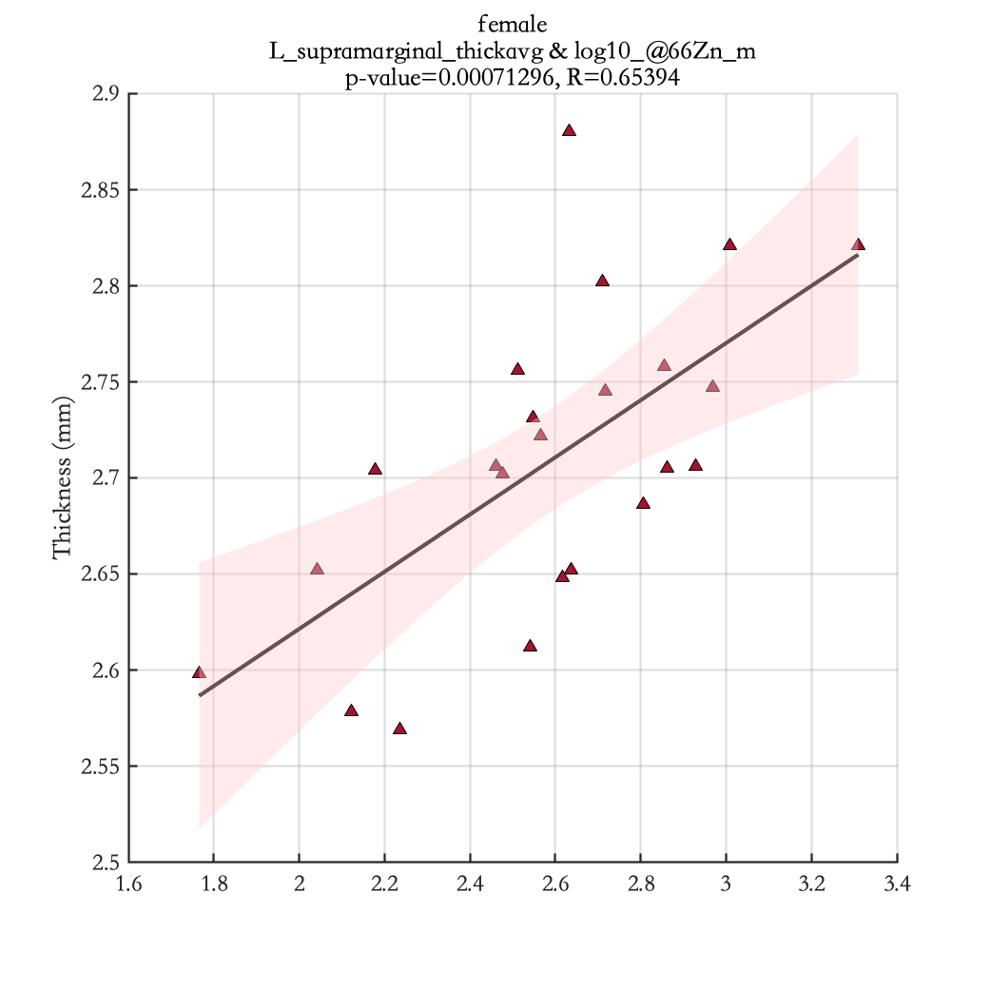
log10_@66Zn_m

Slide 25
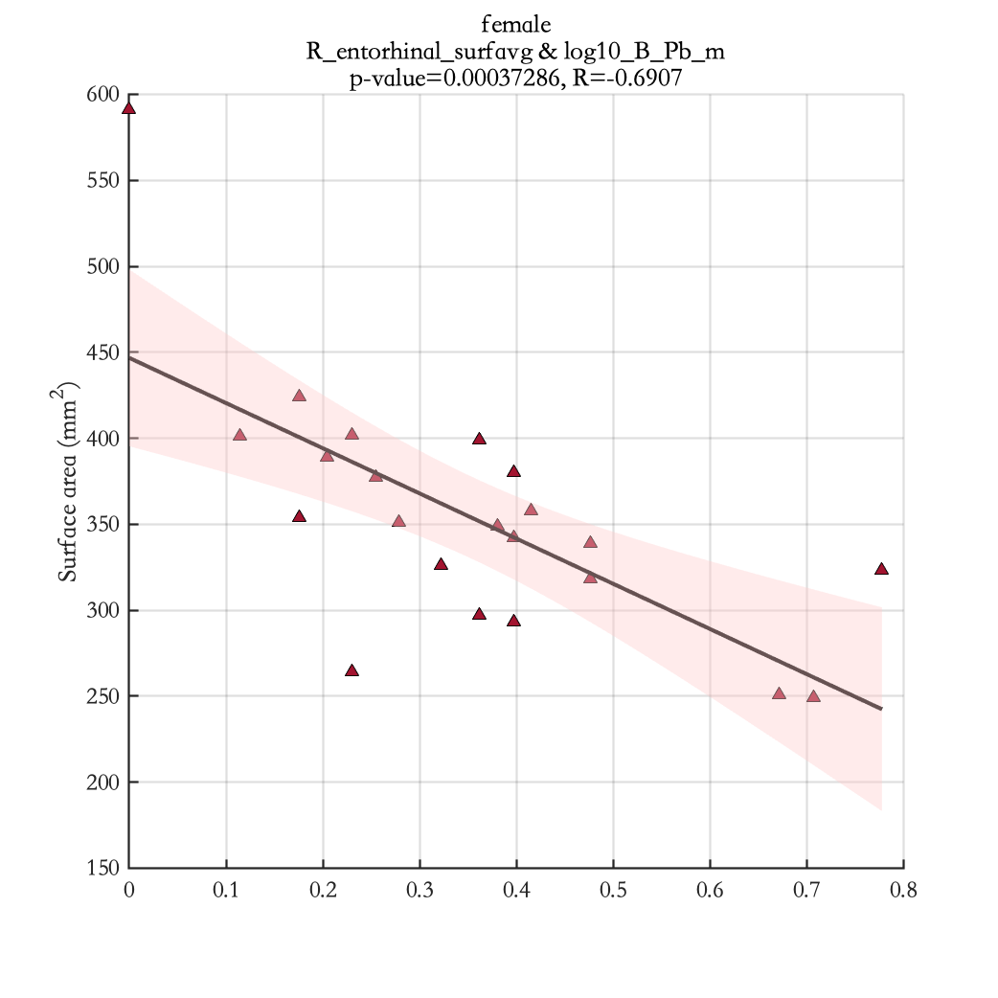
log10_B_Pb_m

Slide 26
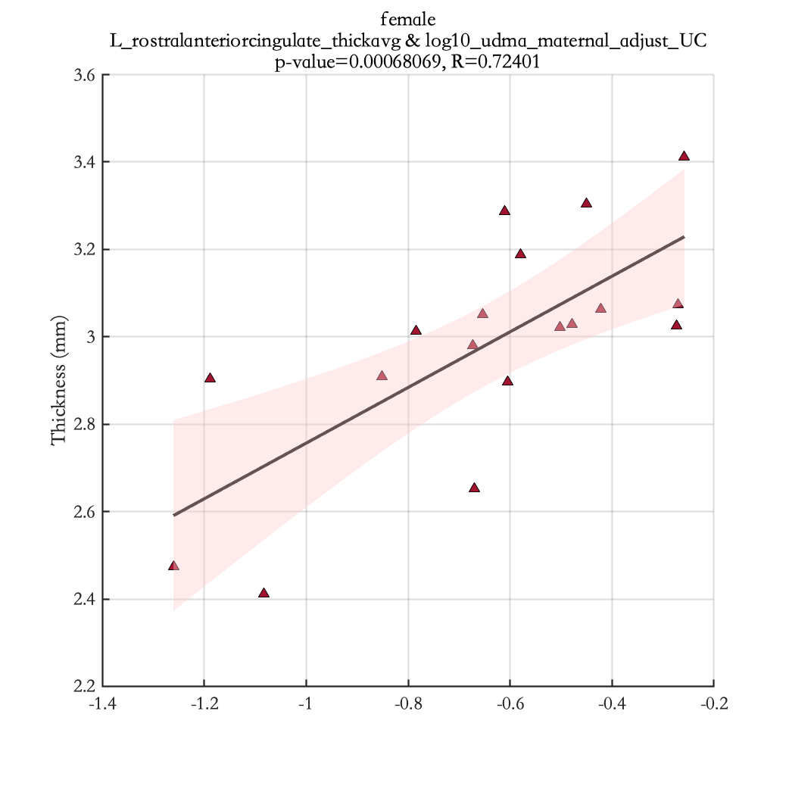
log10_udma_maternal_adjust_UC

Slide 27
Results –Teenagers (see new added variables in table 4)

Slide 28
EDCs | Region | p-value | R
All teenagers
MBzP_adjust_UC | R_precentral_thickavg | 0.00040967 | -0.44527
MiNP_adjust_UC | R_lateraloccipital_surfavg | 0.00038749 | -0.44692
log10_MnBP | R_inferiortemporal_surfavg | 0.00038757 | 0.44691
 | R_lateraloccipital_surfavg | 3.02E-05 | 0.51481
log10_MEHP | L_lateraloccipital_surfavg | 0.00039529 | 0.44633
 | R_cuneus_surfavg | 0.00042569 | 0.44412
 | R_lateraloccipital_surfavg | 3.07E-05 | 0.51446
log10_MEHHP | L_lateraloccipital_surfavg | 0.00027907 | 0.4565
 | R_cuneus_surfavg | 0.00049627 | 0.43951
 | R_lateraloccipital_surfavg | 4.61E-06 | 0.55702
log10_MEOHP | L_lateraloccipital_surfavg | 0.00042543 | 0.44414
 | R_lateraloccipital_surfavg | 1.52E-05 | 0.53085
log10_MECPP | R_cuneus_surfavg | 0.00060171 | 0.43362
 | R_lateraloccipital_surfavg | 7.42E-06 | 0.54687
log10_UrinaryCreatinine | R_lateraloccipital_surfavg | 0.00013586 | 0.47656
log10_T3 | R_precuneus_thickavg | 0.00049578 | 0.44307
log10_Testosterone | R_lateraloccipital_surfavg | 0.00013537 | 0.4804
log10_FreeTT | R_fusiform_surfavg | 0.00051095 | 0.44215
 | R_lateraloccipital_surfavg | 5.92E-05 | 0.5021
log10_MiNP_adjust_UC | R_lateraloccipital_surfavg | 0.00013586 | -0.47656
Male teenagers
MMP_adjust_UC | R_insula_surfavg | 0.0002397 | 0.62246
 | L_superiorfrontal_thickavg | 0.0004438 | -0.60106
 | R_superiorfrontal_thickavg | 0.00036808 | -0.60773
MiBP_adjust_UC | R_precuneus_thickavg | 0.00048072 | -0.59817
log10_FreeT4 | R_bankssts_thickavg | 0.00056859 | -0.592
Female teenagers
MBzP_adjust_UC | R_precentral_thickavg | 0.00013886 | -0.64921

Slide 29
Results Significant correlation between cortical thickness of specific brain regions and EDC measurements for all teenagers (see Table 4)

Slide 30
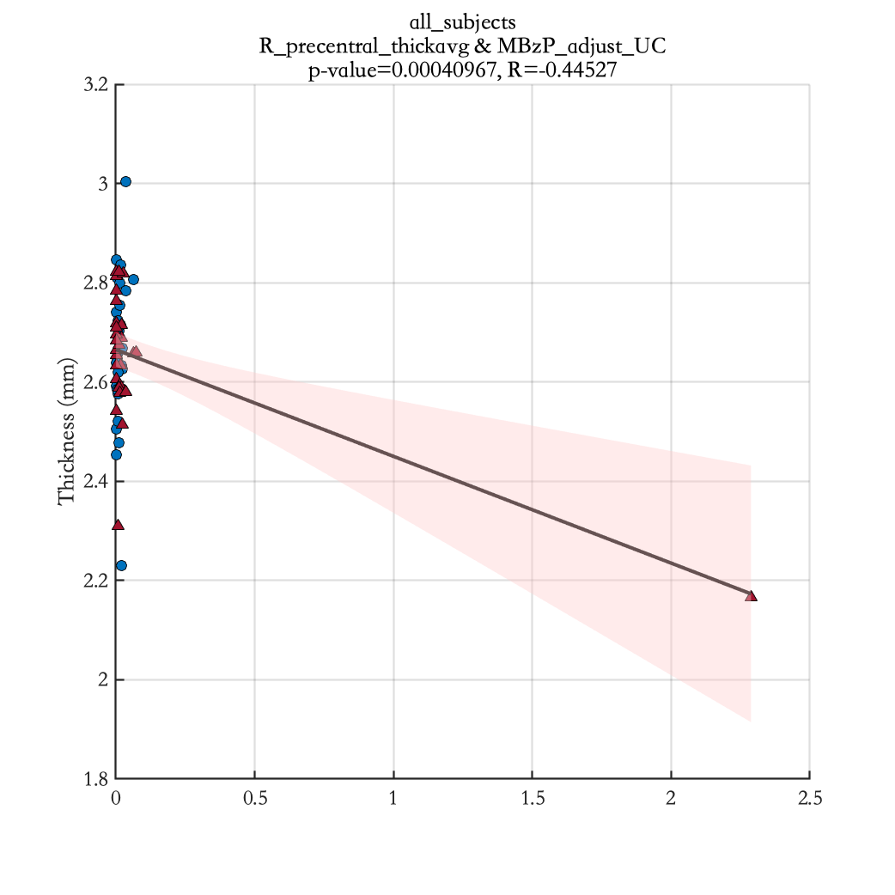
MBzP_adjust_UC

Slide 31
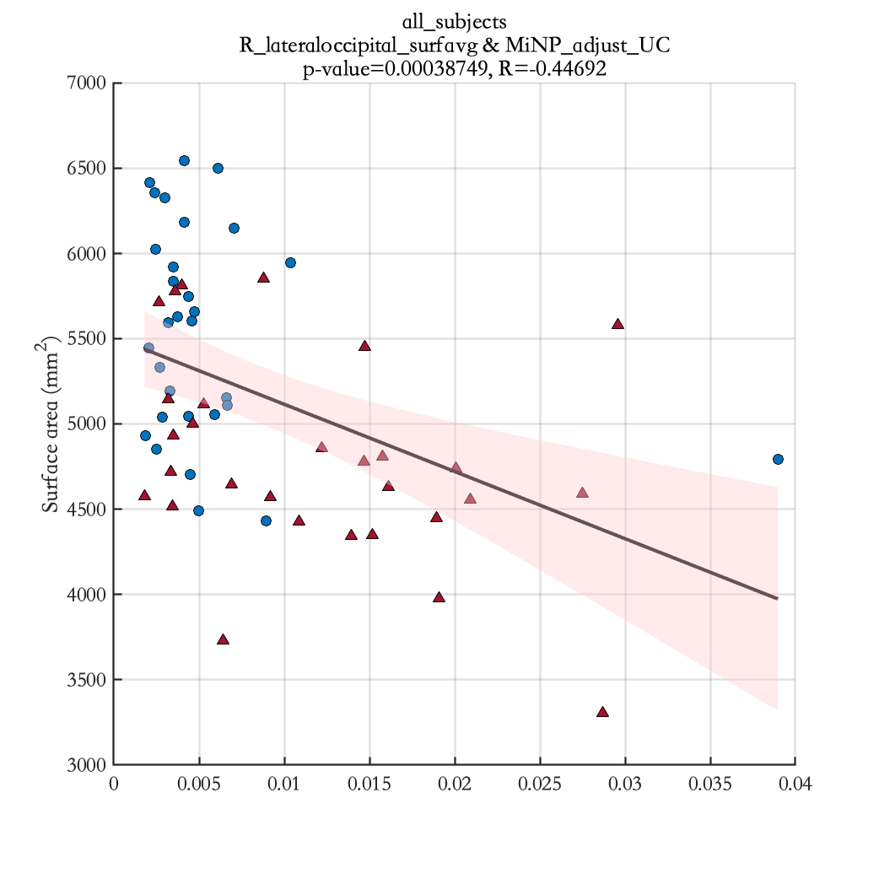
MiNP_adjust_UC

Slide 32
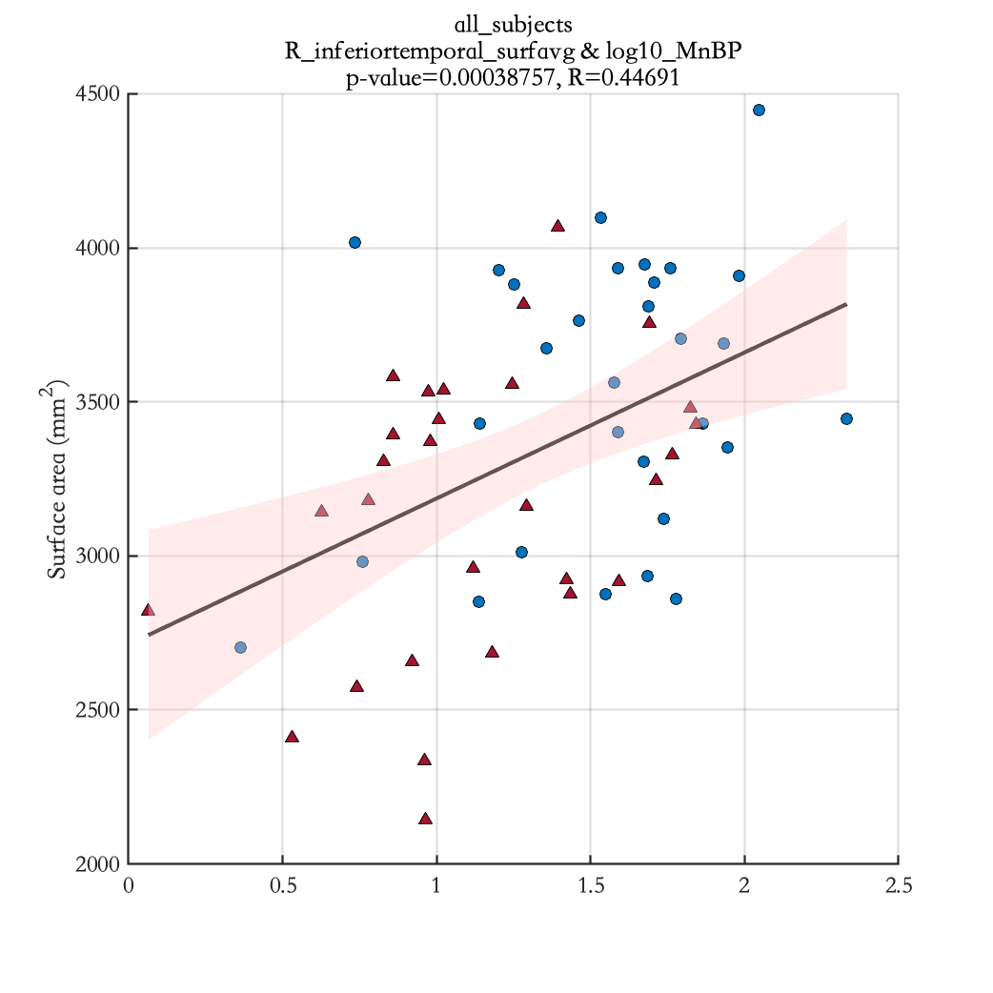
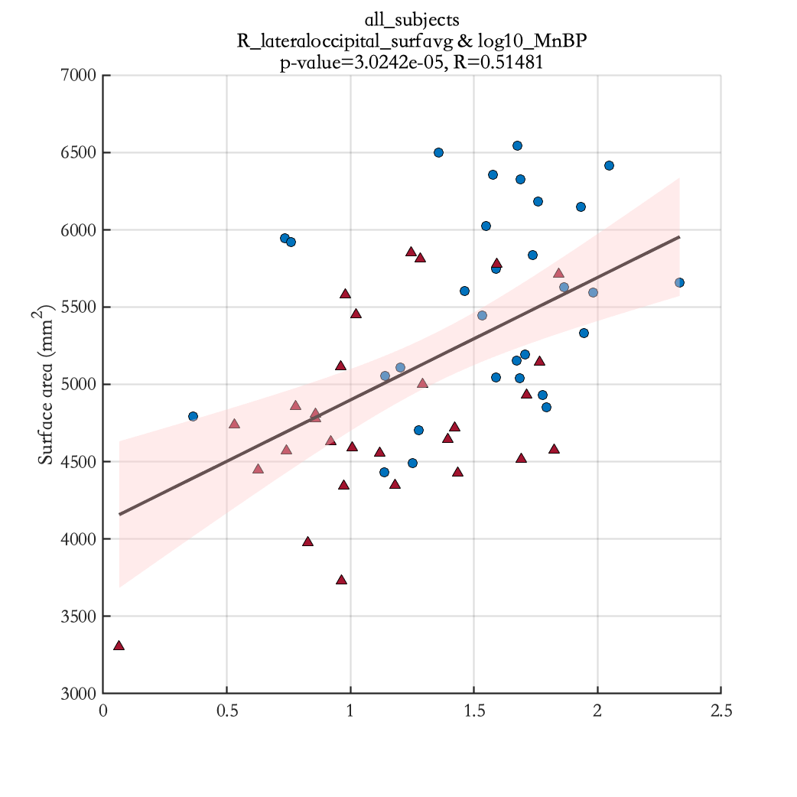
log10_MnBP

Slide 33
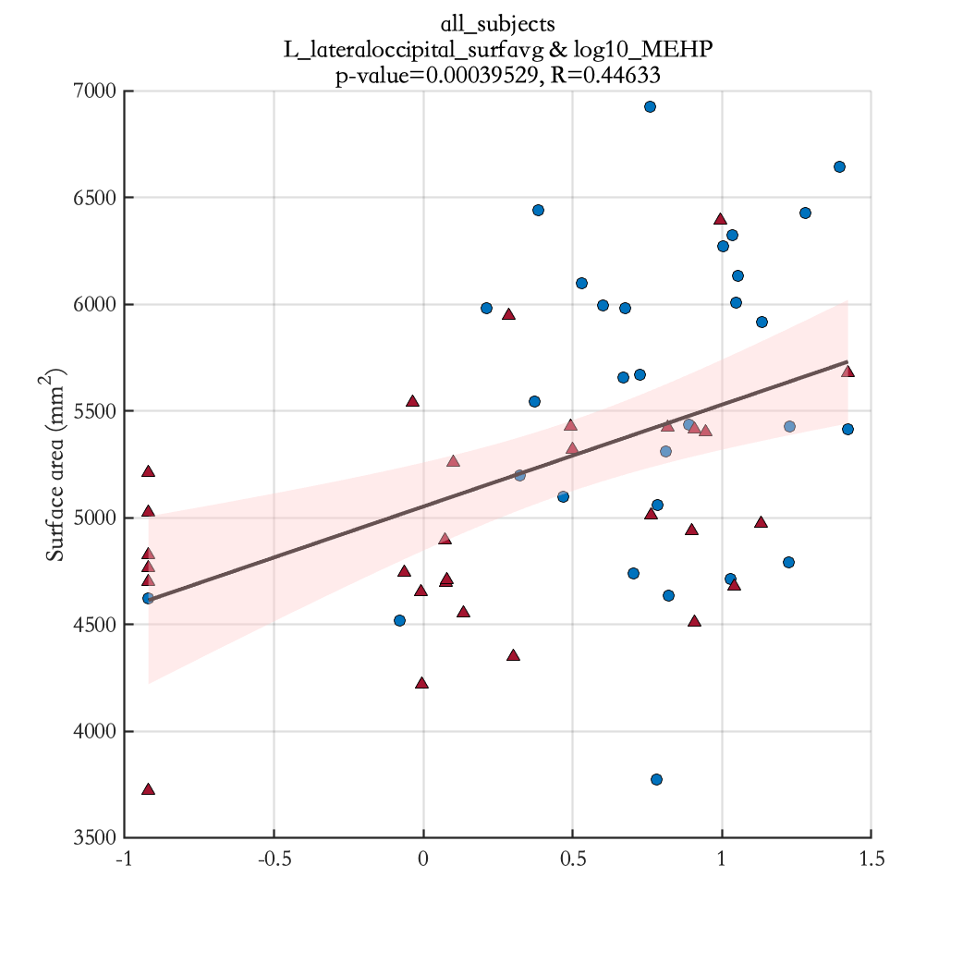
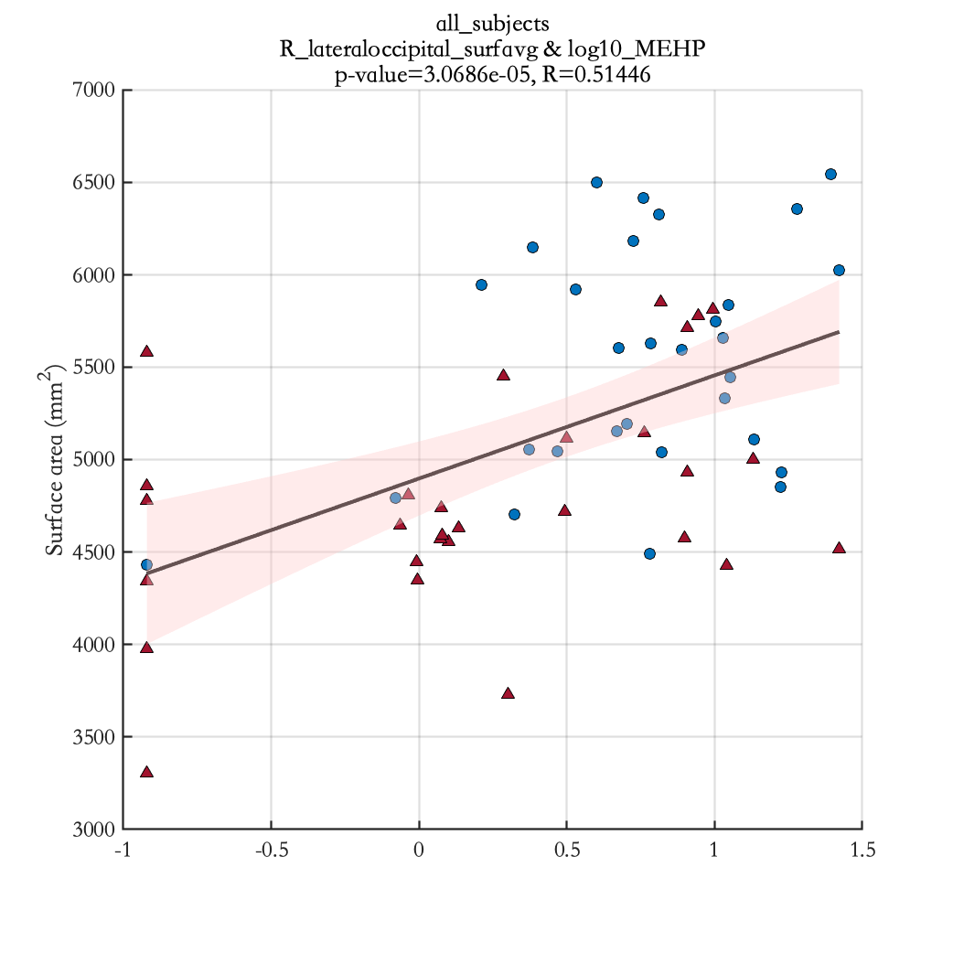
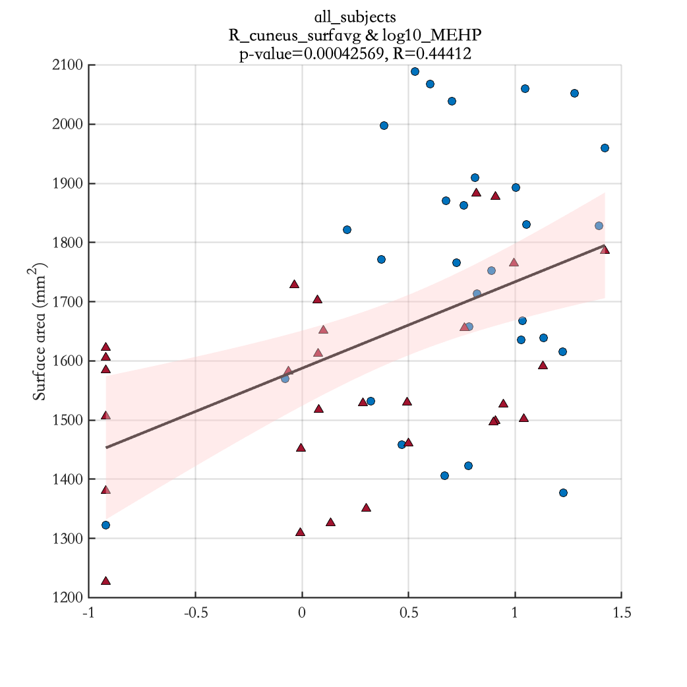
log10_MEHP

Slide 34
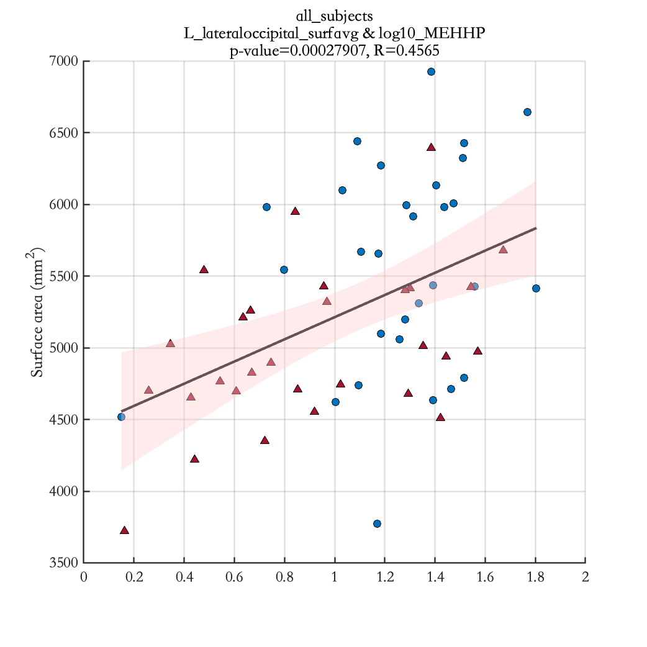
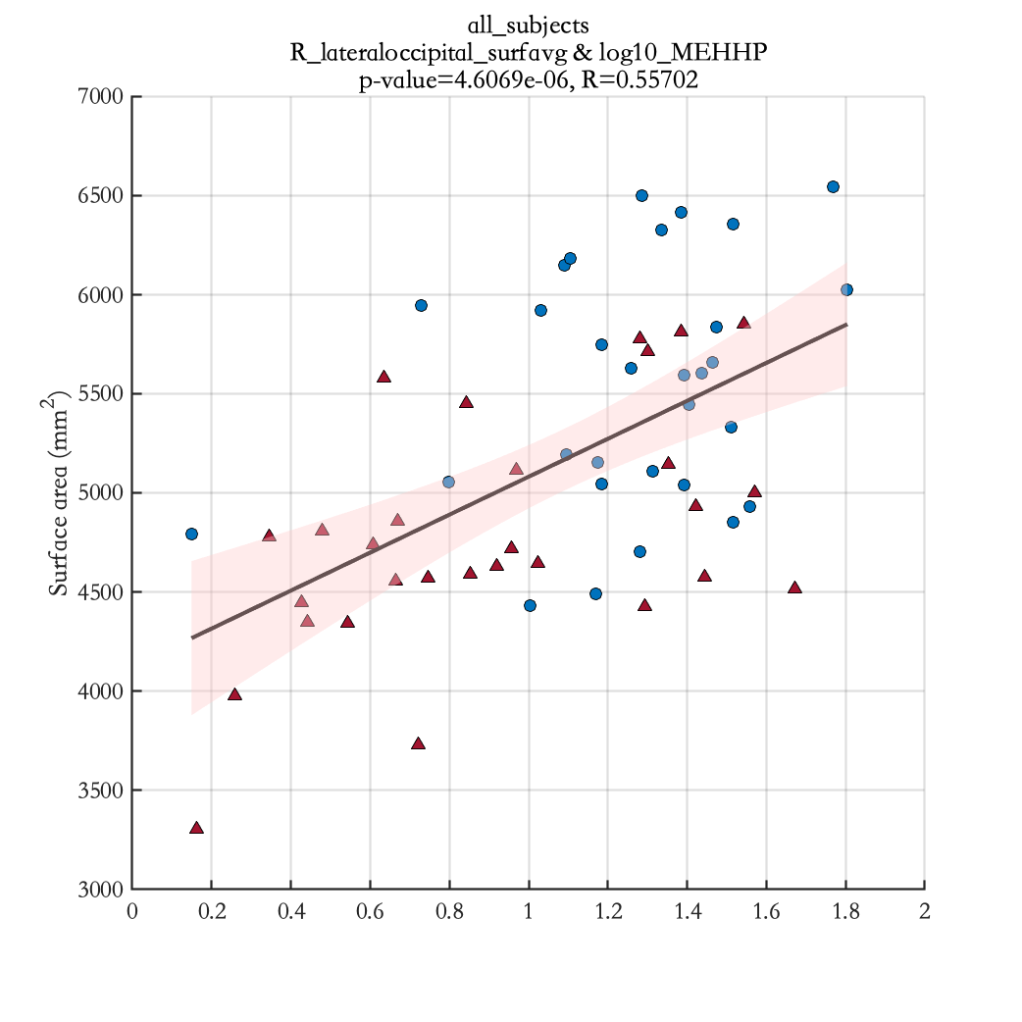
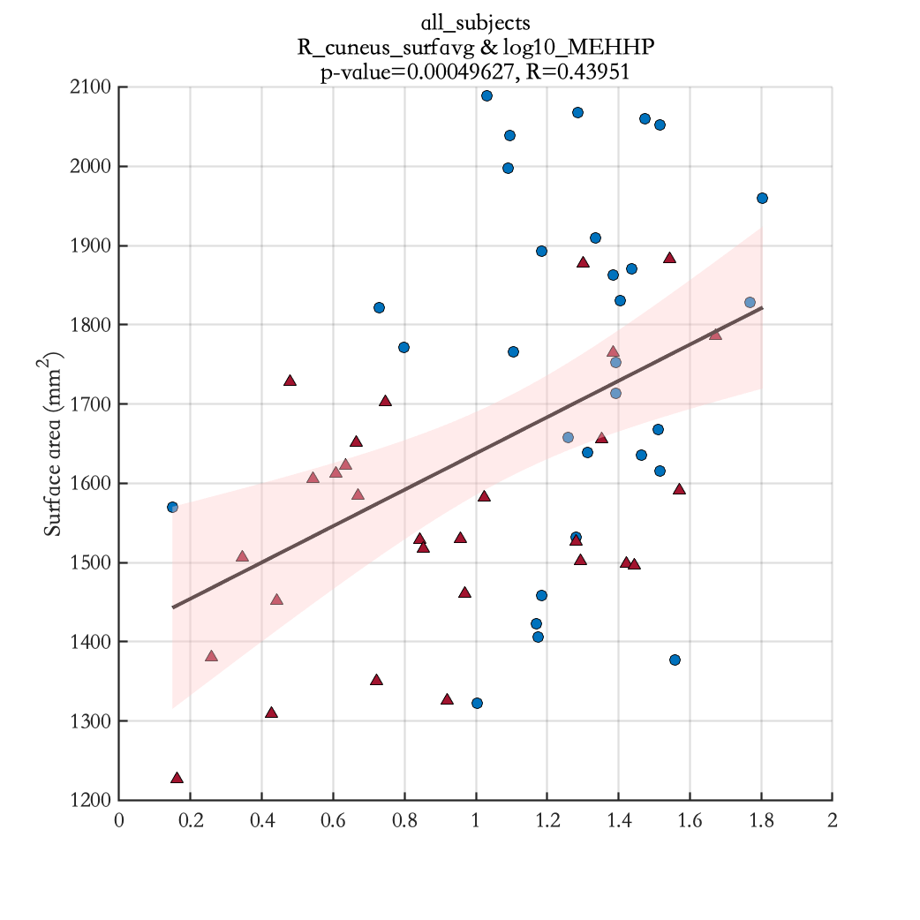
log10_MEHHP

Slide 35
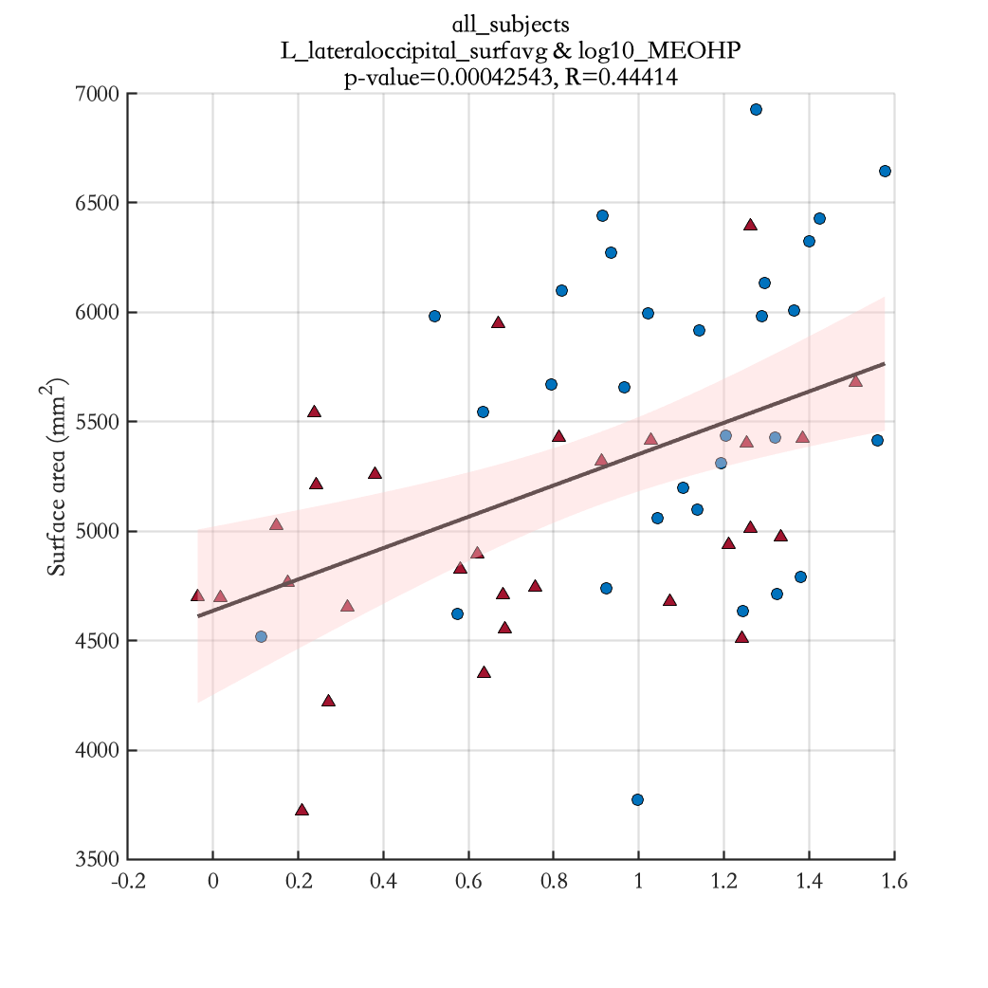
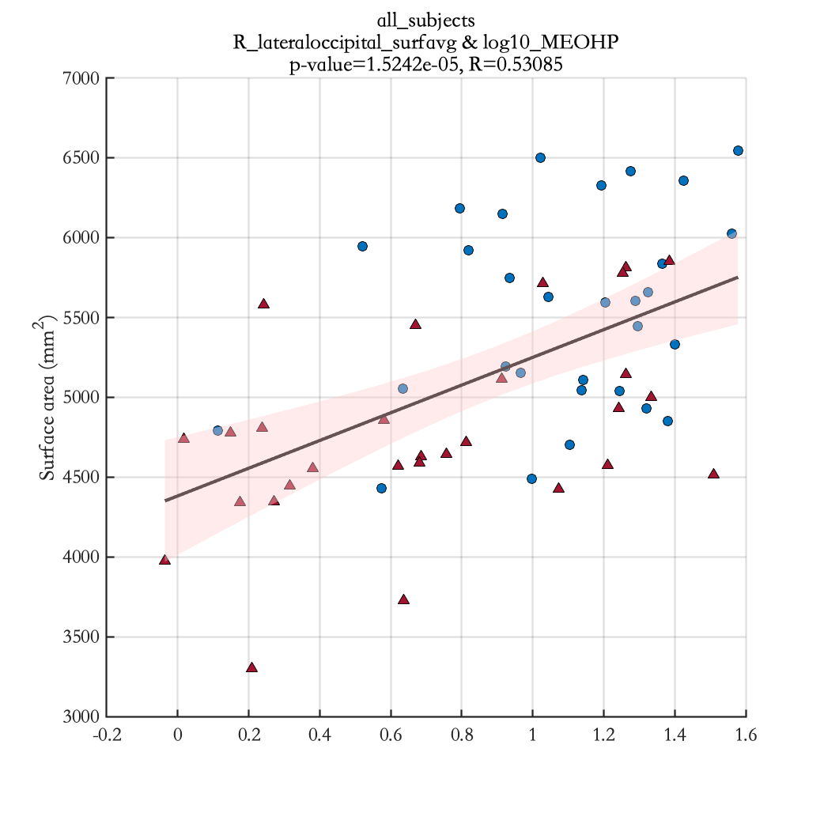
log10_MEOHP

Slide 36
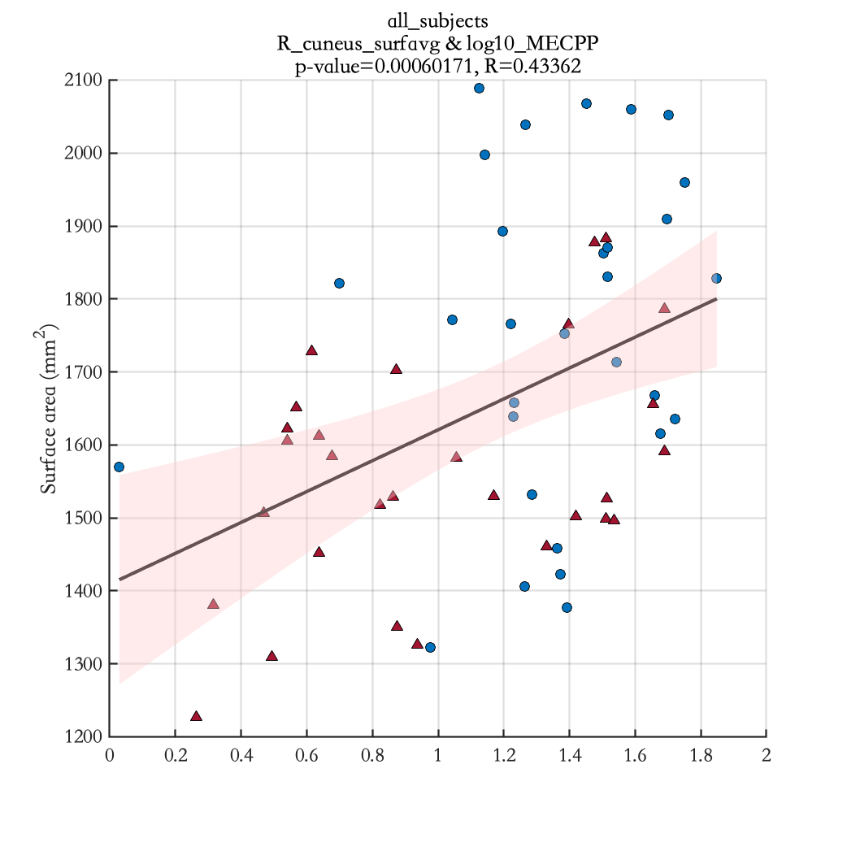
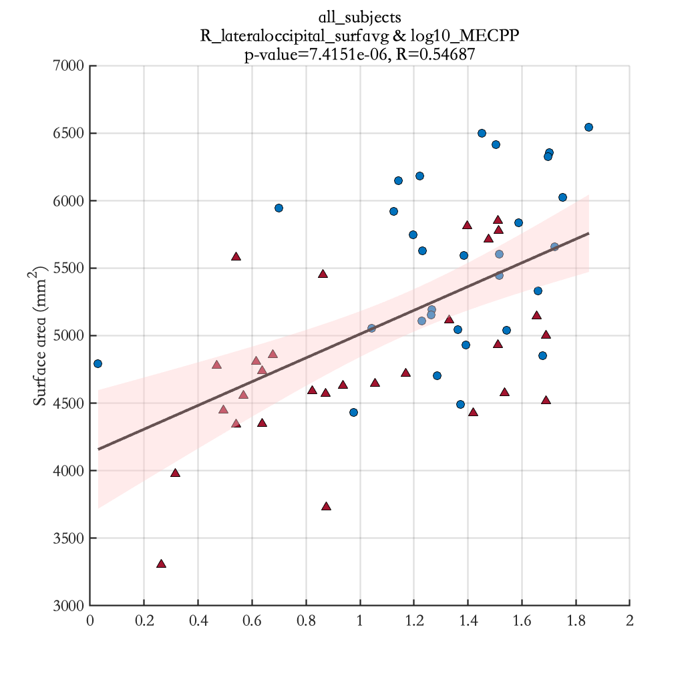
log10_MECPP

Slide 37
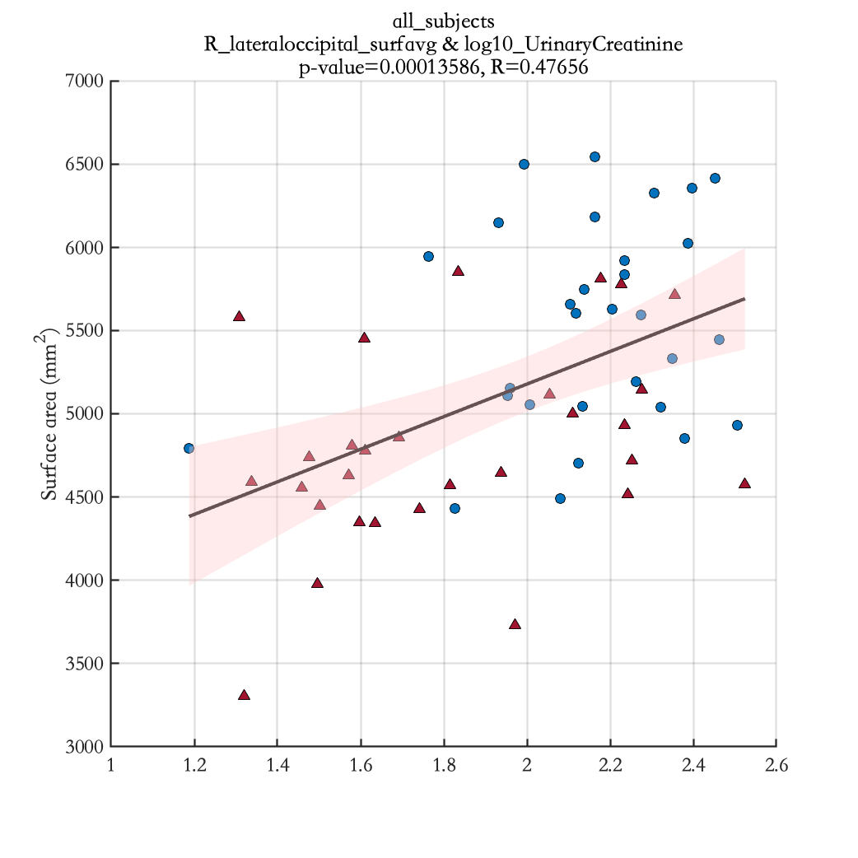
log10_UrinaryCreatinine

Slide 38
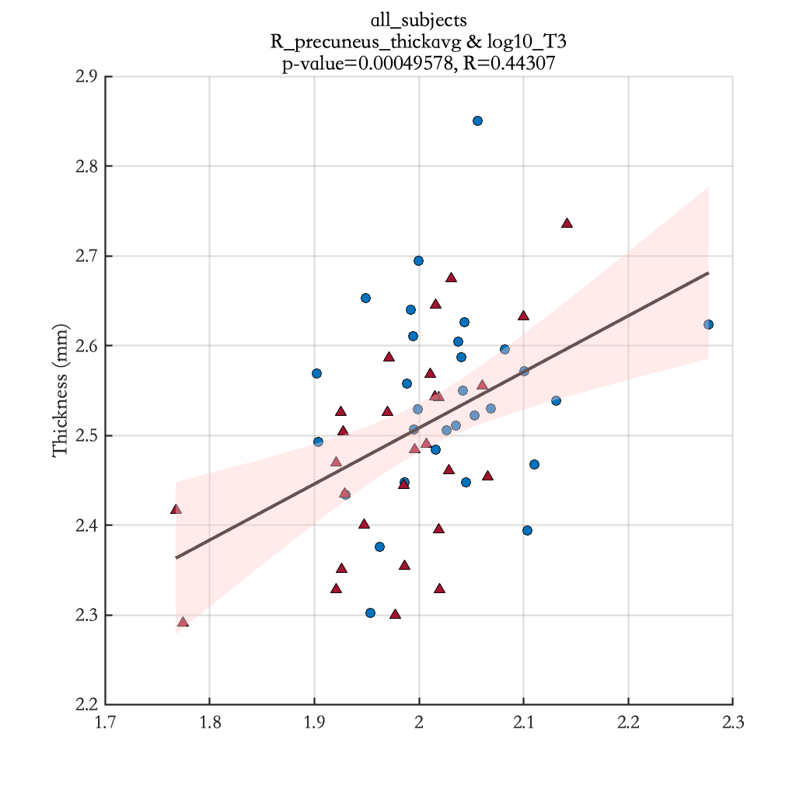
log10_T3

Slide 39
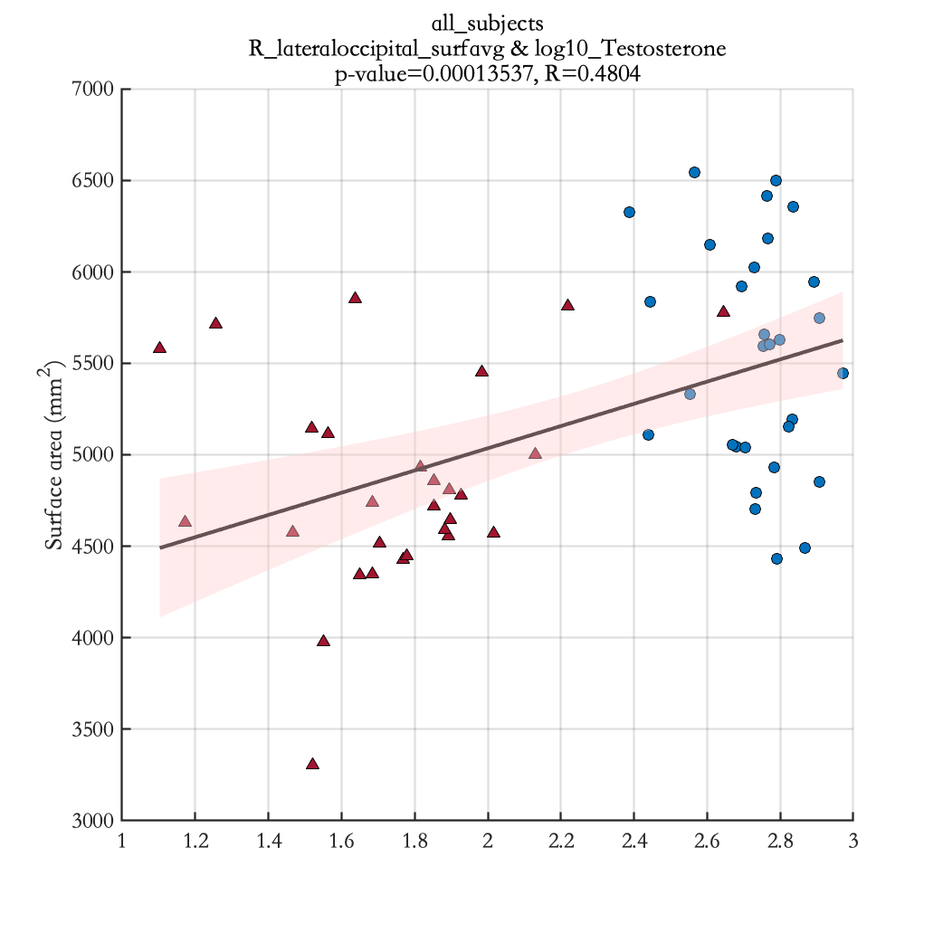
log10_Testosterone

Slide 40
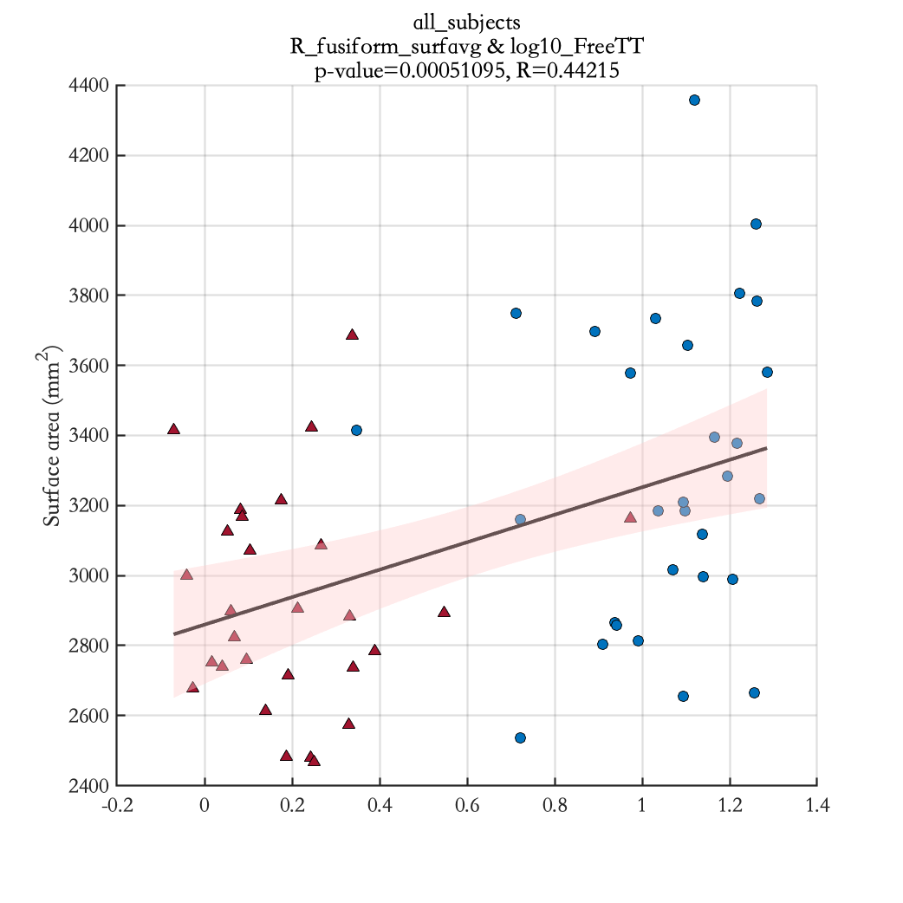
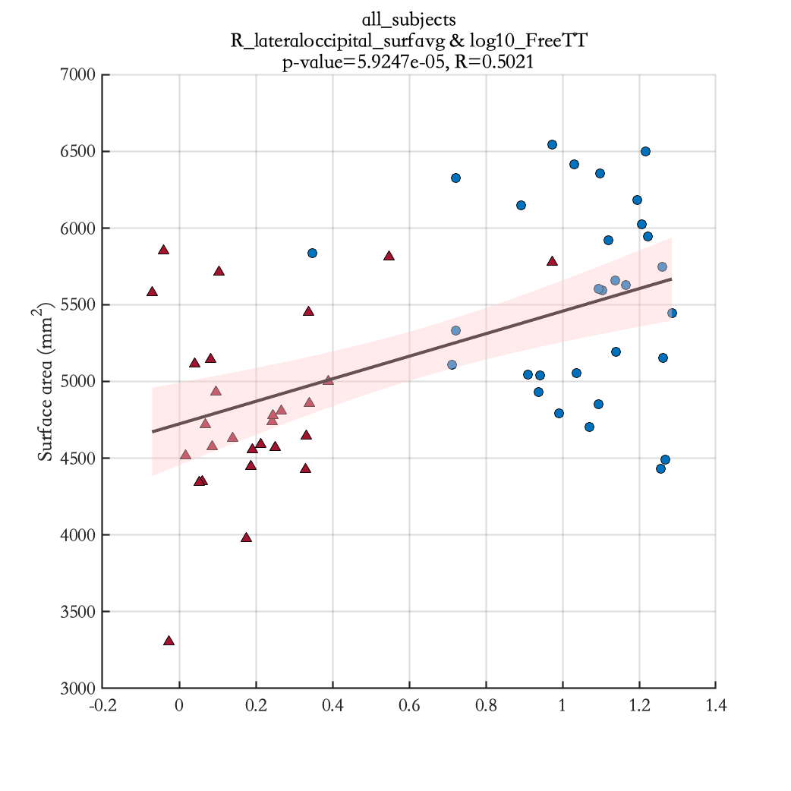
log10_FreeTT

Slide 41
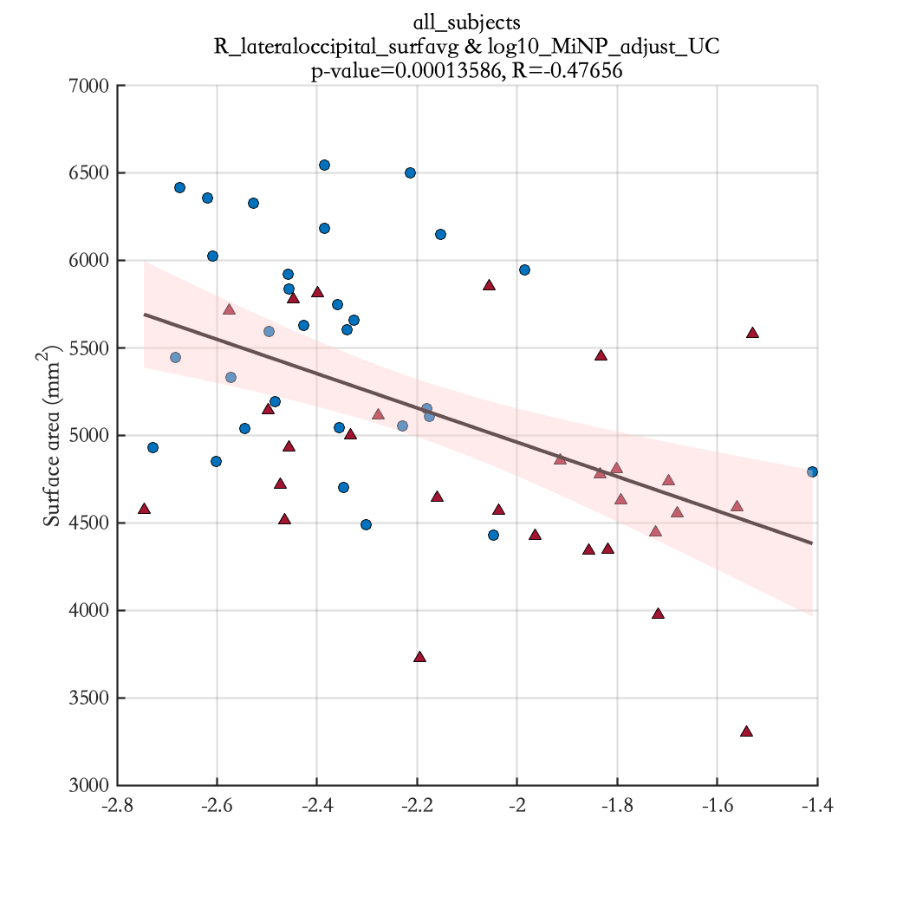
log10_MiNP_adjust_UC

Slide 42
Results Significant correlation between cortical thickness of specific brain regions and EDC measurements for male teenagers (see Table 4)

Slide 43
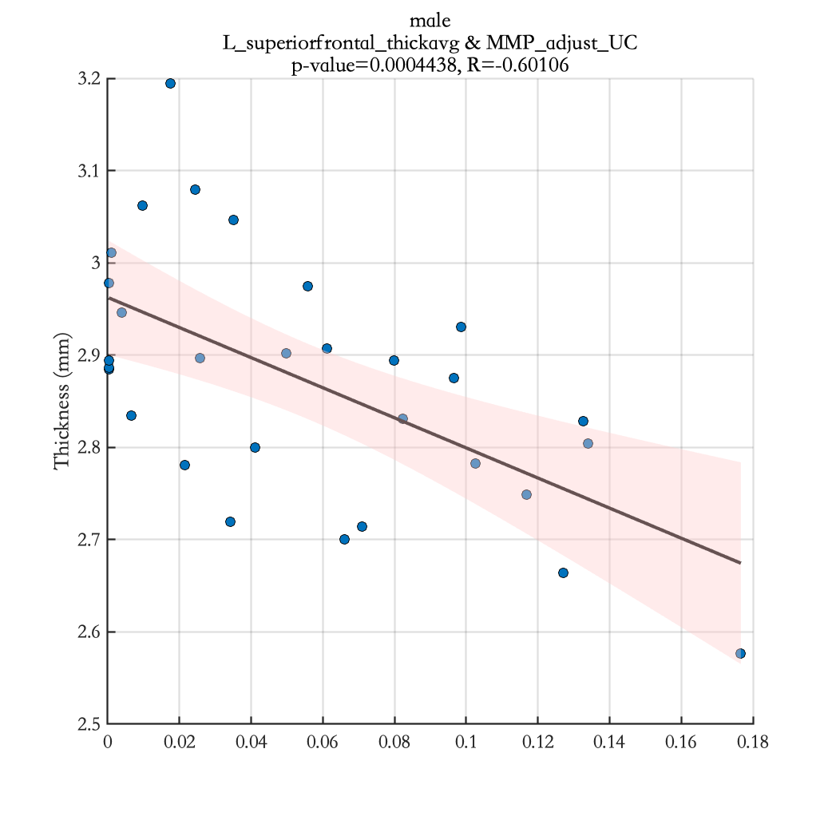
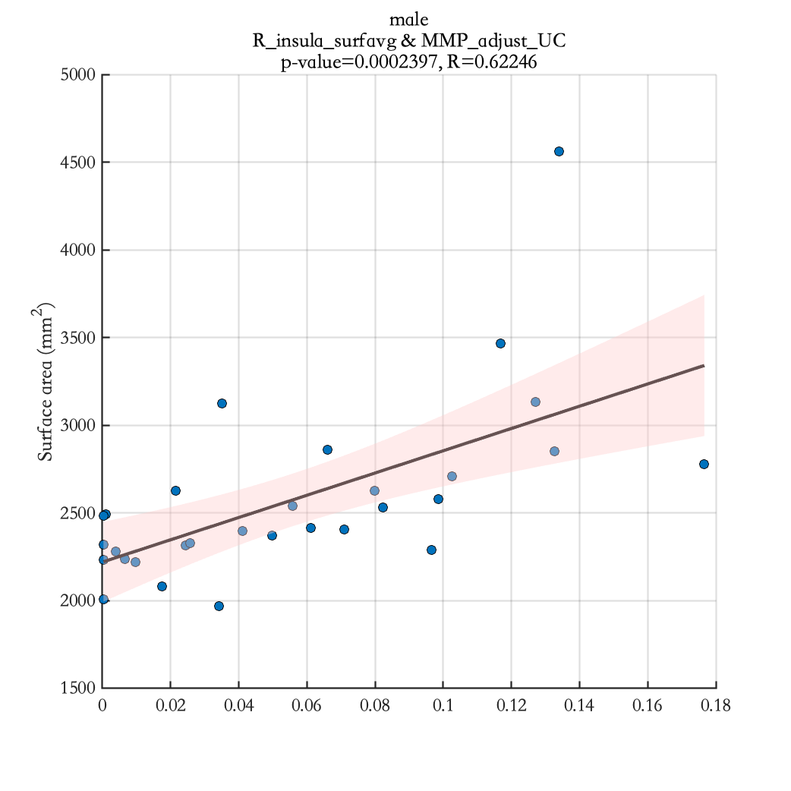
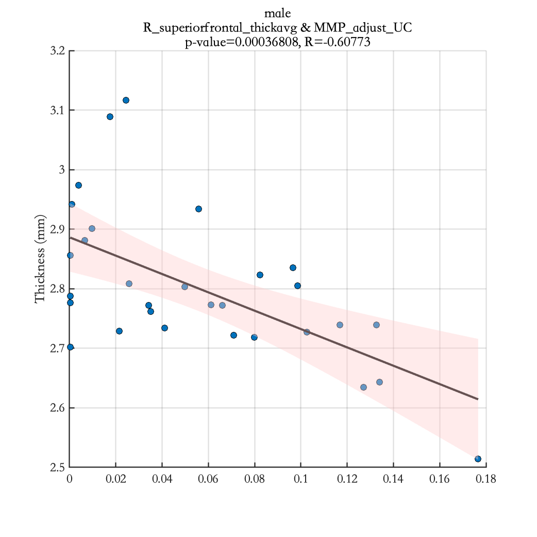
MMP_adjust_UC

Slide 44
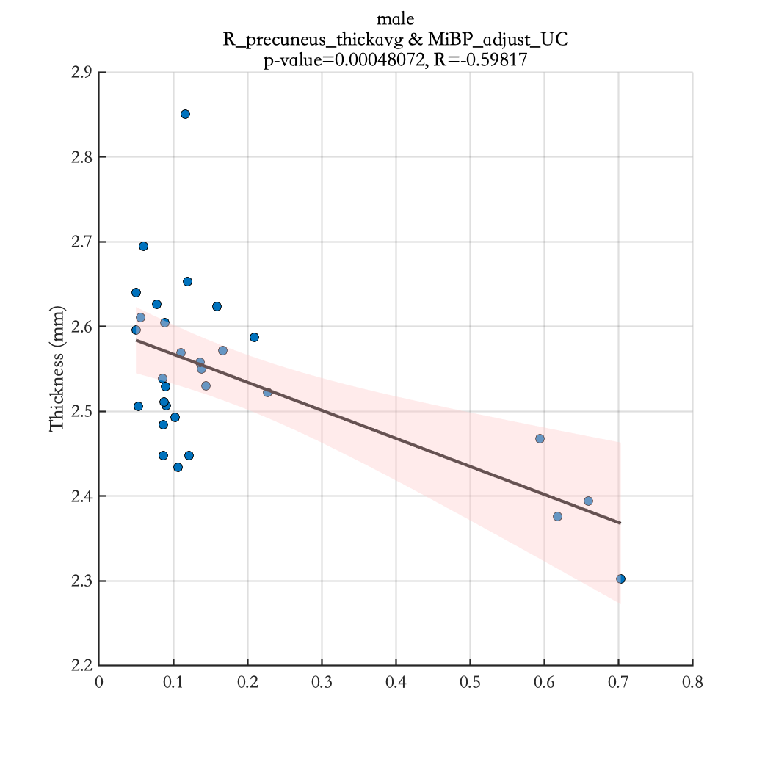
MiBP_adjust_UC

Slide 45
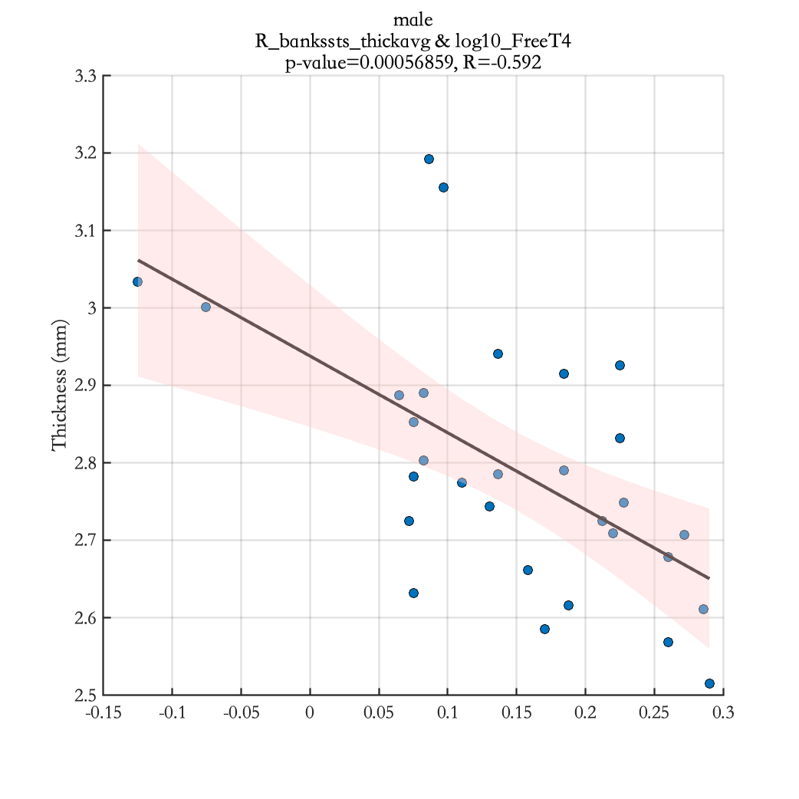
log10_FreeT4

Slide 46
Results Significant correlation between cortical thickness of specific brain regions and EDC measurements for female teenagers (see Table 4)

Slide 47
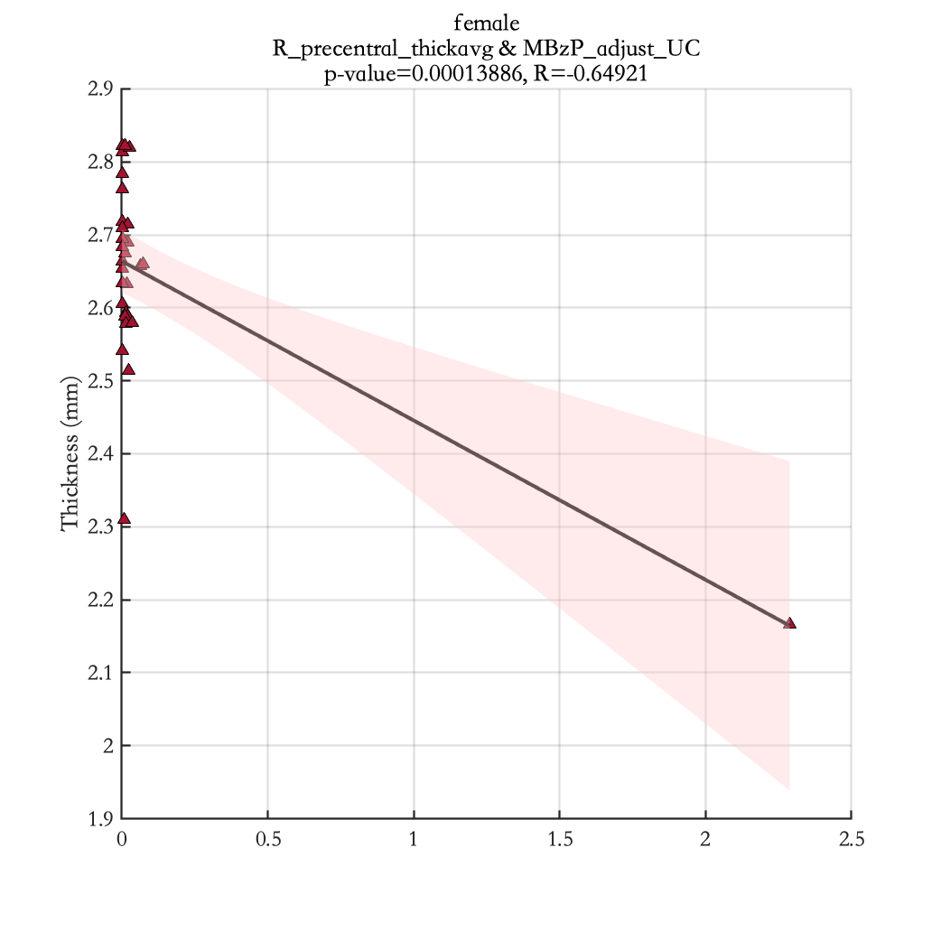
MBzP_adjust_UC

