Slide 1
White Matter DKI analysis

Slide 2
Outline
Introduction
White matter analysis using Diffusion Kurtosis Imaging
Method
Workflow of White Matter analysis
JHU DTI-based white-matter atlases
Result
Teenagers’ mothers (corresponding to table 5)
Teenagers (corresponding to table 6)

Slide 3
Introduction

Slide 4
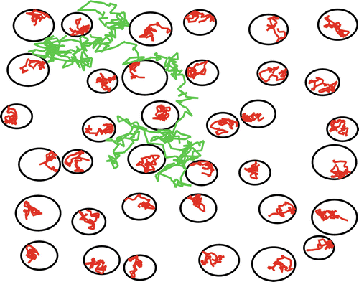
Diffusion kurtosis imaging
Diffusional kurtosis imaging (DKI) is an extension of DTI, which is based on non-Gaussian characteristics and can be used to assess the complex changes within the microenvironment.
Mean kurtosis (MK)
Axial kurtosis (AK)
Radial kurtosis (RK)
Veraart J., Sijbers J. (2016) Diffusion Kurtosis Imaging. In: Van Hecke W., Emsell L., Sunaert S. (eds) Diffusion Tensor Imaging. Springer, New York, NY. https://doi.org/10.1007/978-1-4939-3118-7_21
Notes:
在前面幾種模型中，我們考慮的都是人體內的彌散運動是呈現一種高斯分佈的，所謂的高斯分佈也就是正態分佈。而人體中，由於組織結構複雜，情況多變，細胞器，細胞膜對水分子的限制等因素，水分子的彌散並不是滿足一個高斯分佈的。
所以，考慮了非高斯分佈情況，那麼我們就引入了DKI模型。軸向峰度( axial kurtosis，Ka),徑向峰度（radial kurtosis，Kr) , 平均峰度（Mean Kurtosis）
MK越大，反映組織結構越複雜，非高斯分佈的水分子彌散受限越顯著。mean代表平均，rad代表兩個比較小的方向的平均值，ax代表最大的方向的值

Slide 5
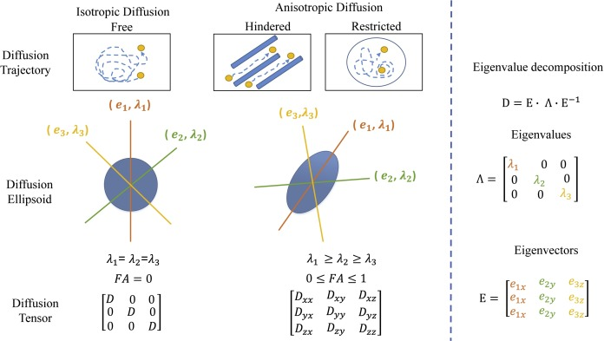
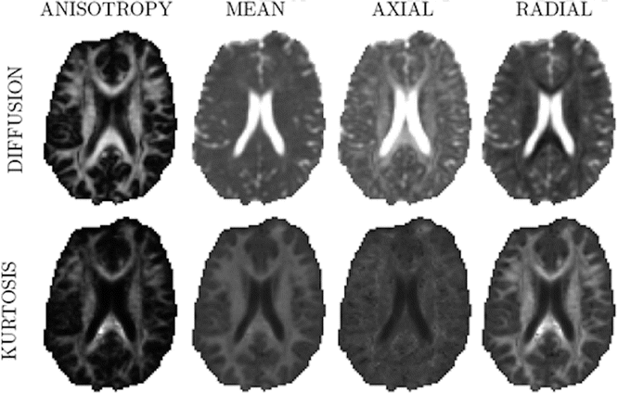
Diffusion kurtosis imaging
Mean kurtosis (MK)
Axial kurtosis (AK)
Radial kurtosis (RK)
Gholizadeh, Neda, et al. "Characterization of prostate cancer using diffusion tensor imaging: A new perspective." European journal of radiology 110 (2019): 112-120.
Veraart J., Sijbers J. (2016) Diffusion Kurtosis Imaging. In: Van Hecke W., Emsell L., Sunaert S. (eds) Diffusion Tensor Imaging. Springer, New York, NY. https://doi.org/10.1007/978-1-4939-3118-7_21
Notes:
因為白質的部分在軸向的擴散是比較不受限制的，而逕向則被限制
所以在RK影像的時候，他代表逕向的擴散被嚴重的限制

Slide 6
Diffusion kurtosis imaging
Frontal white matter (FWM)
Parietal white matter (PWM)
Central white matter (CWM)
Central white matter (CWM)
Shi, Jingjing, et al. "Detecting normal pediatric brain development with diffusional kurtosis imaging." European journal of radiology 120 (2019): 108690.
Notes:
DKI 對於大腦白質發育 更加顯著
對比FA

Slide 7
Method

Slide 8
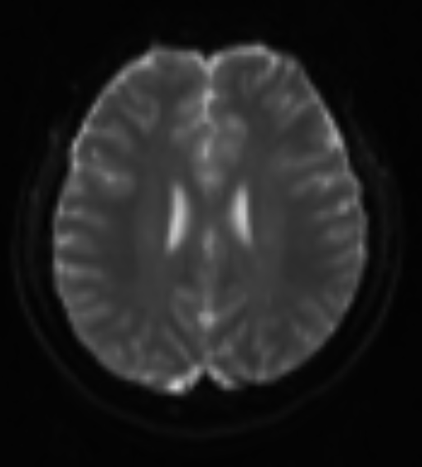
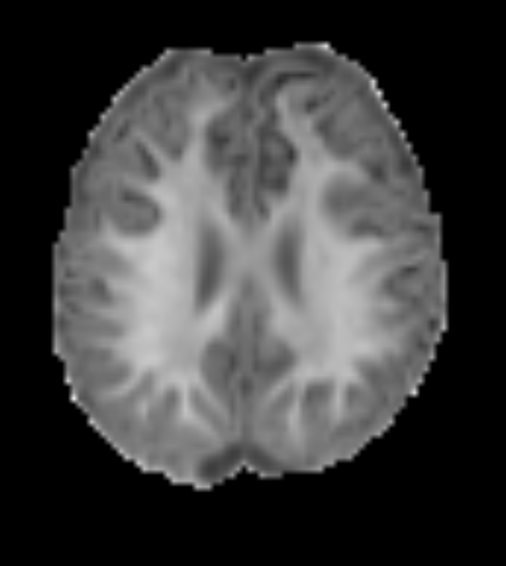
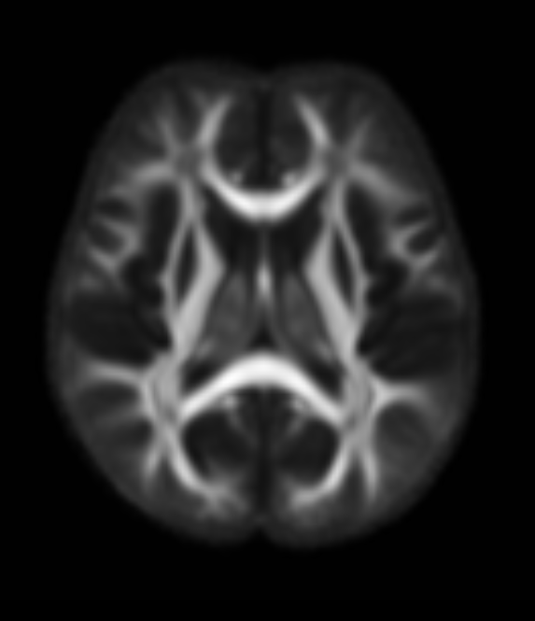
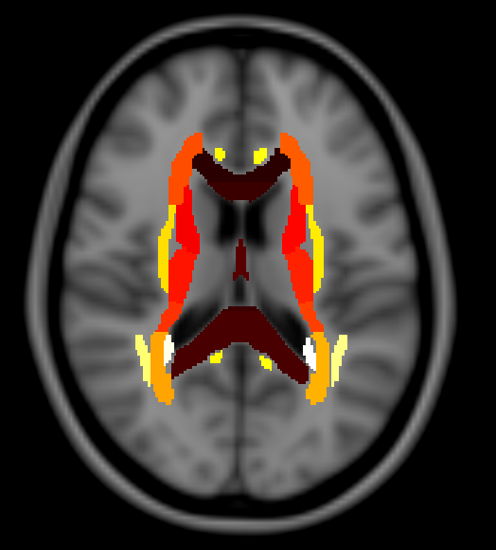
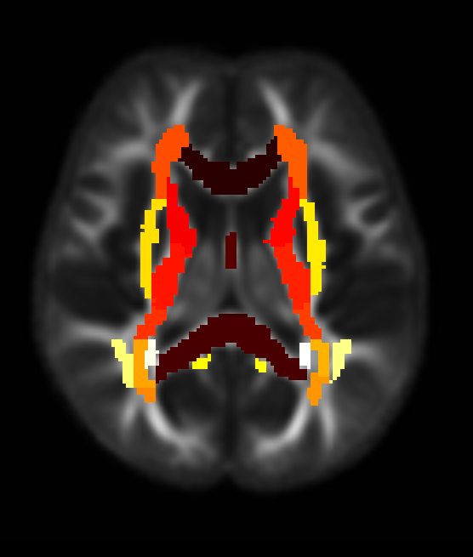
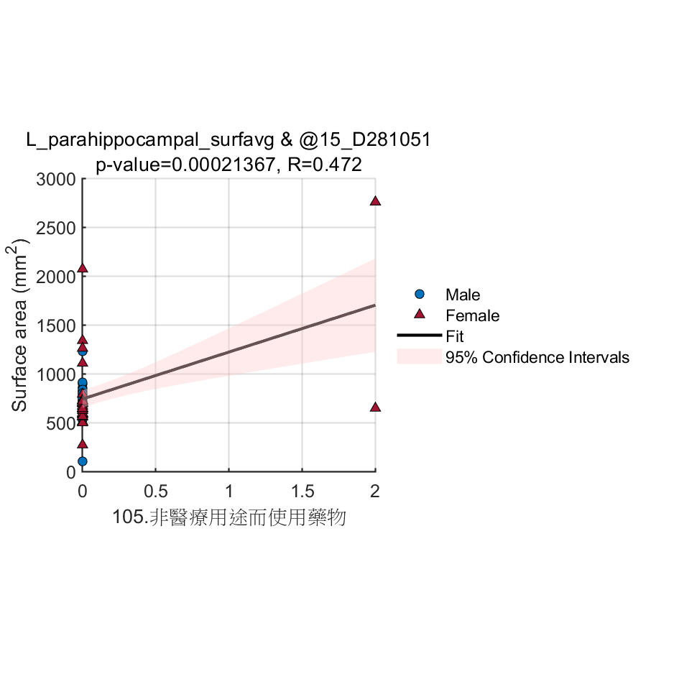
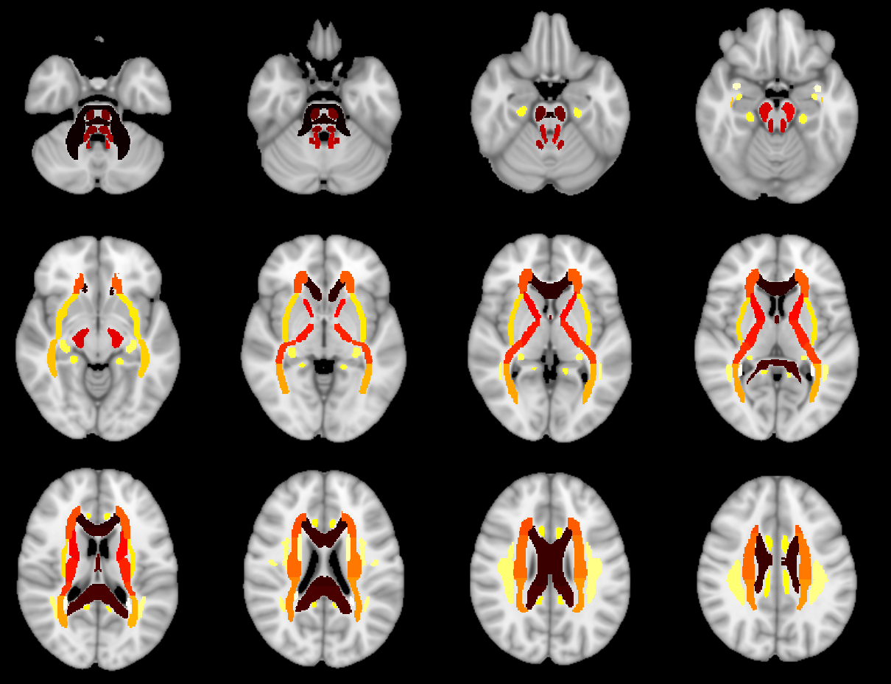
Workflow
Image processing
Statistical analysis
(Native space)
White matter Parcellation (JHU white matter Atlas)
48 VOIs
DKI fitting
White matter Parcellation Statistics
Average MK value in each white tract
Average AK value in each white tract
Average RK value in each white tract
Preprocessed DWI (N=59)
DKI map (MK, AK, RK)
(by dipy toolbox)
Apply transformation matrix
(transformation matrix A)
Image registration
(Transformation matrix A)
Pearson correlation with White matter Parcellation Statistics
(Bonferroni corrected p-value< 0.00104, 0.05/48) (by SPSS)
Assessments from teenagers’ mothers (95)
Create template
FOD map
(by MRtrix)
Group specific template
Image registration
(Transformation matrix A)
Apply transformation matrix
(Transformation matrix A)
MNI JHU white matter template
JHU template parcellation
(MNI space)
Scatter plot
Significant Region

Slide 9
Results –Mothers

Slide 10
table3

Slide 11
Results Significant correlation between cortical thickness of specific brain regions and EDC measurements for all teenagers’ mothers(see Table 5)

Slide 12
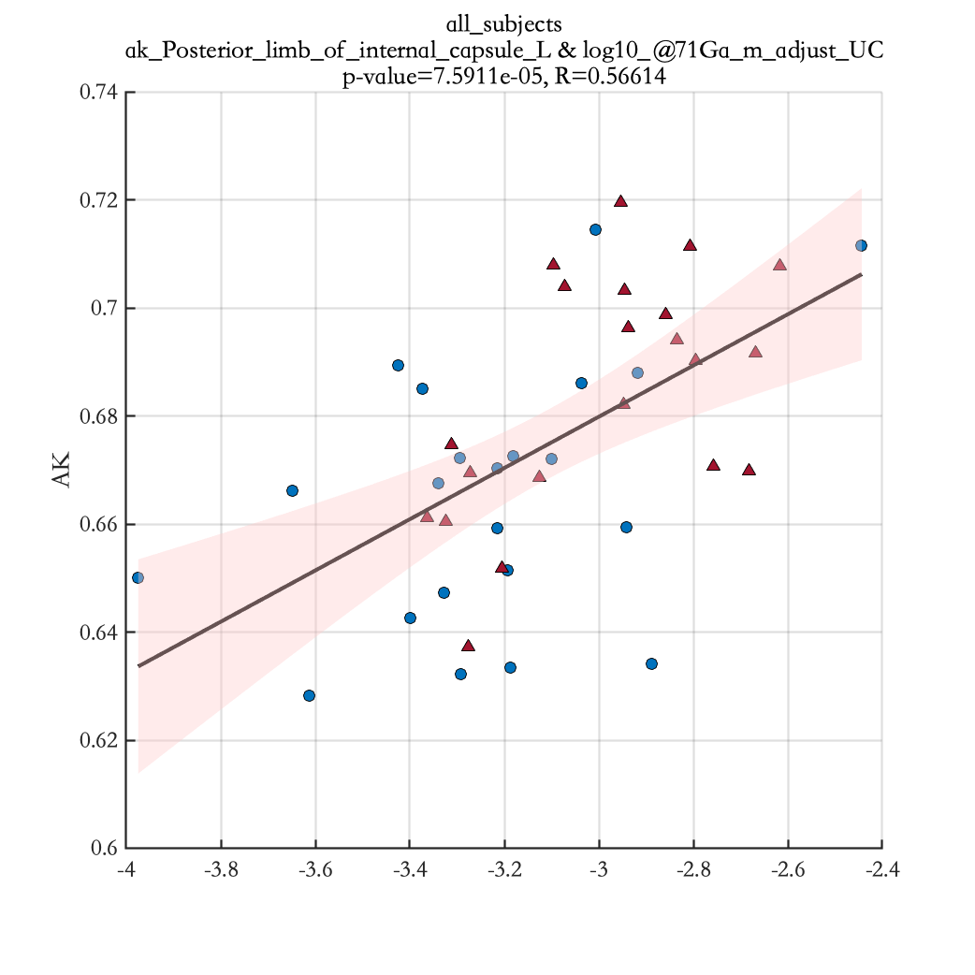
log10_@71Ga_m_adjust_UC

Slide 13
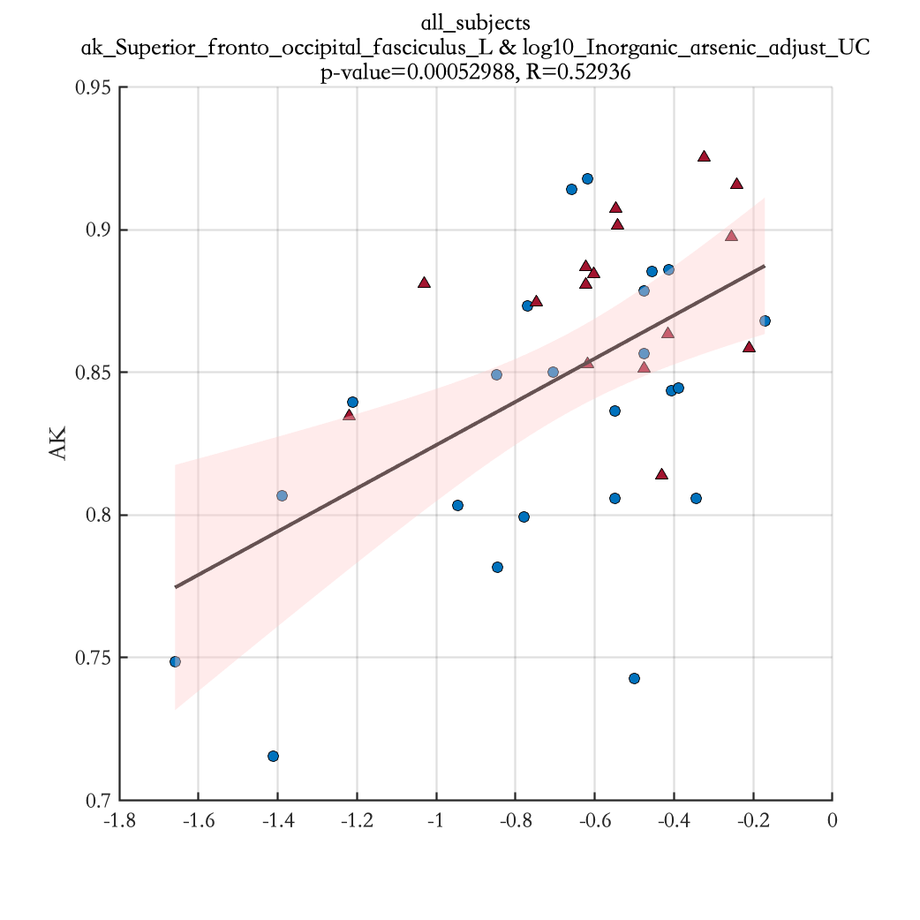
log10_Inorganic_arsenic_adjust_UC

Slide 14
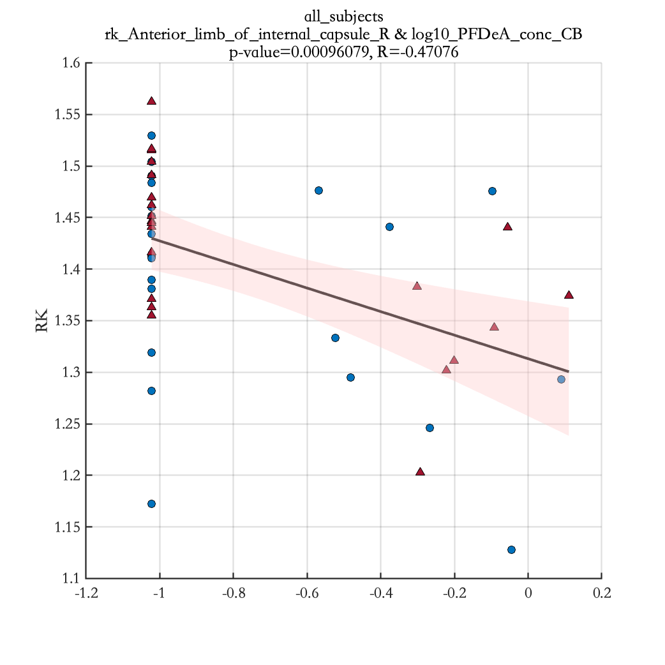
log10_PFDeA_conc_CB

Slide 15
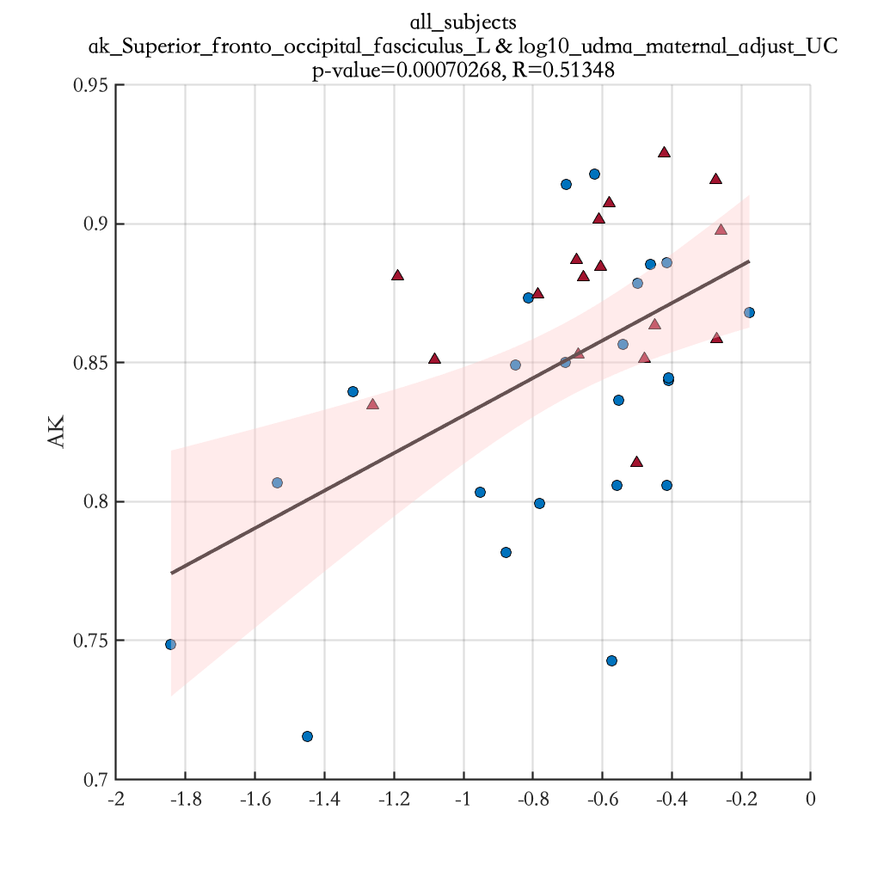
log10_udma_maternal_adjust_UC

Slide 16
Results Significant correlation between cortical thickness of specific brain regions and EDC measurements for mothers with male teenagers(see Table 5)

Slide 17
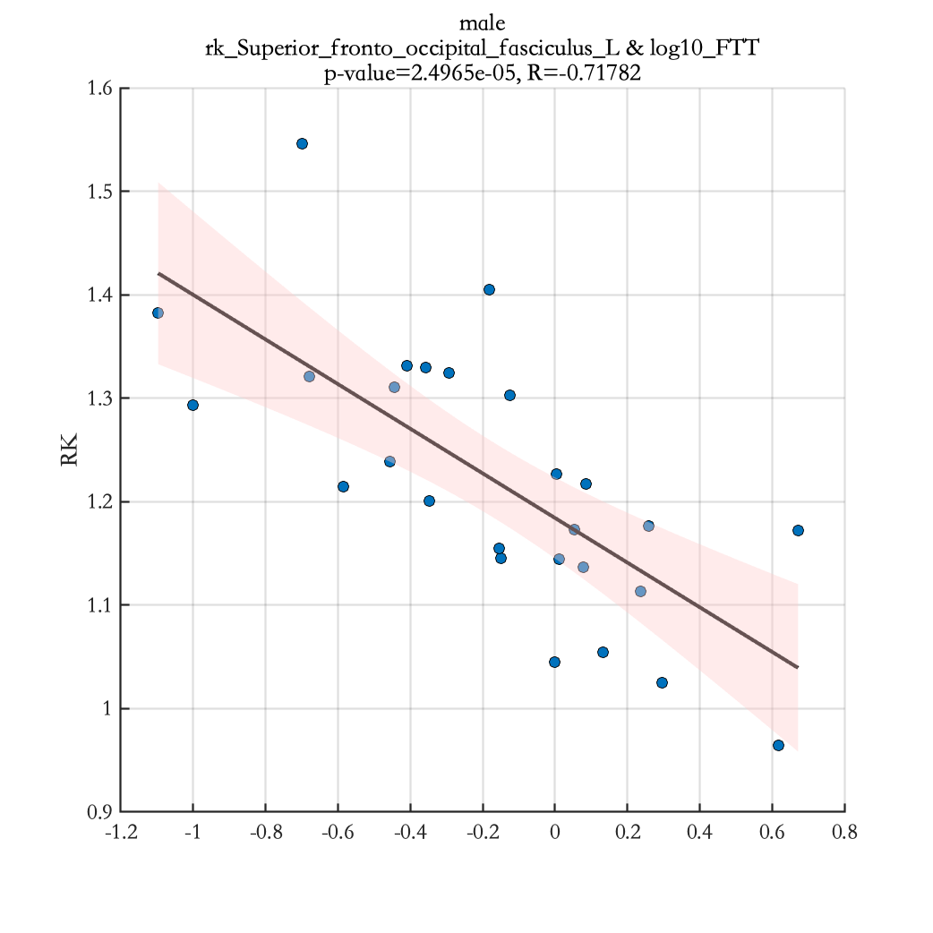
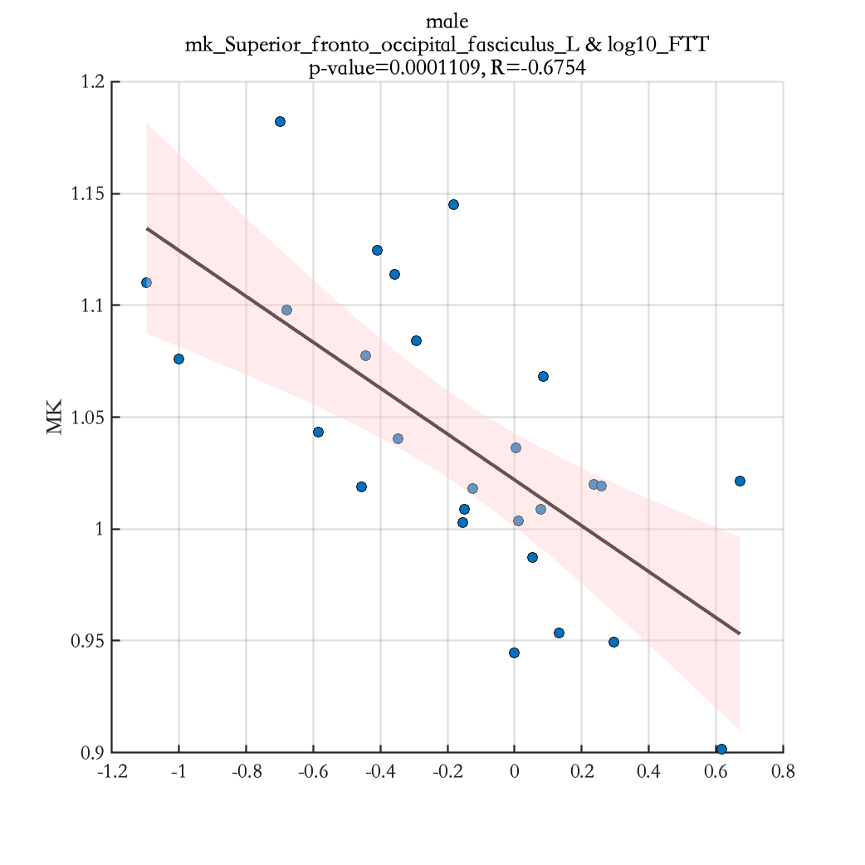
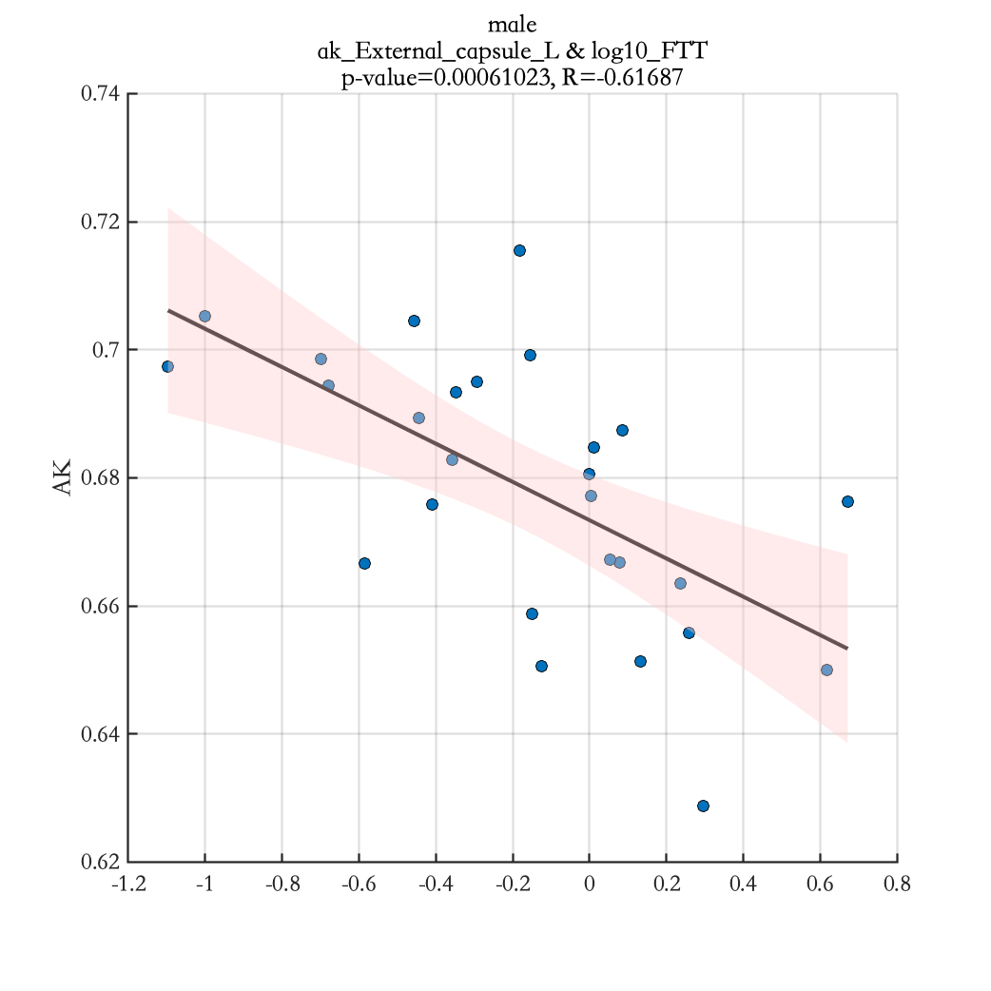
log10_FTT

Slide 18
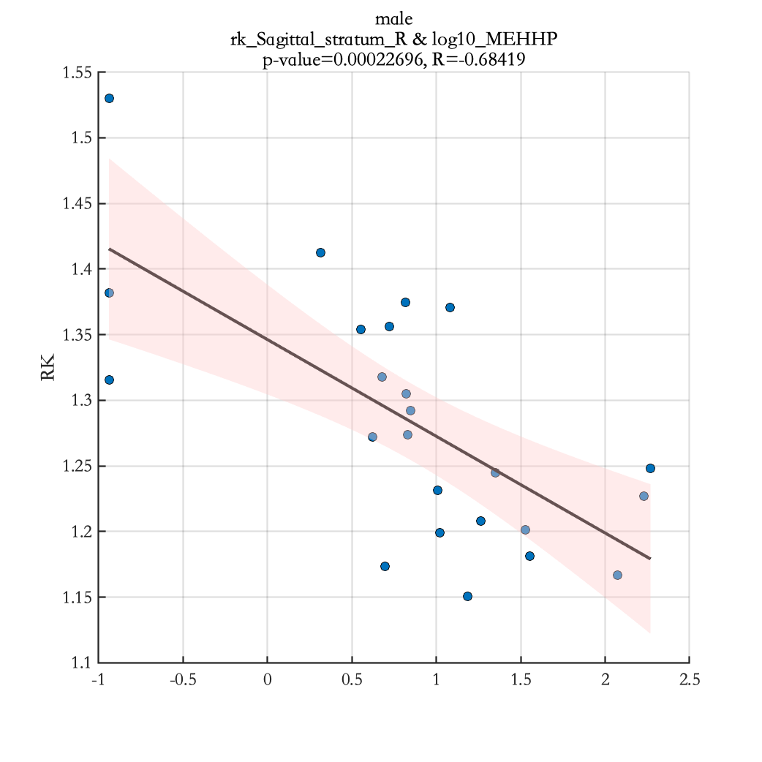
log10_MEHHP

Slide 19
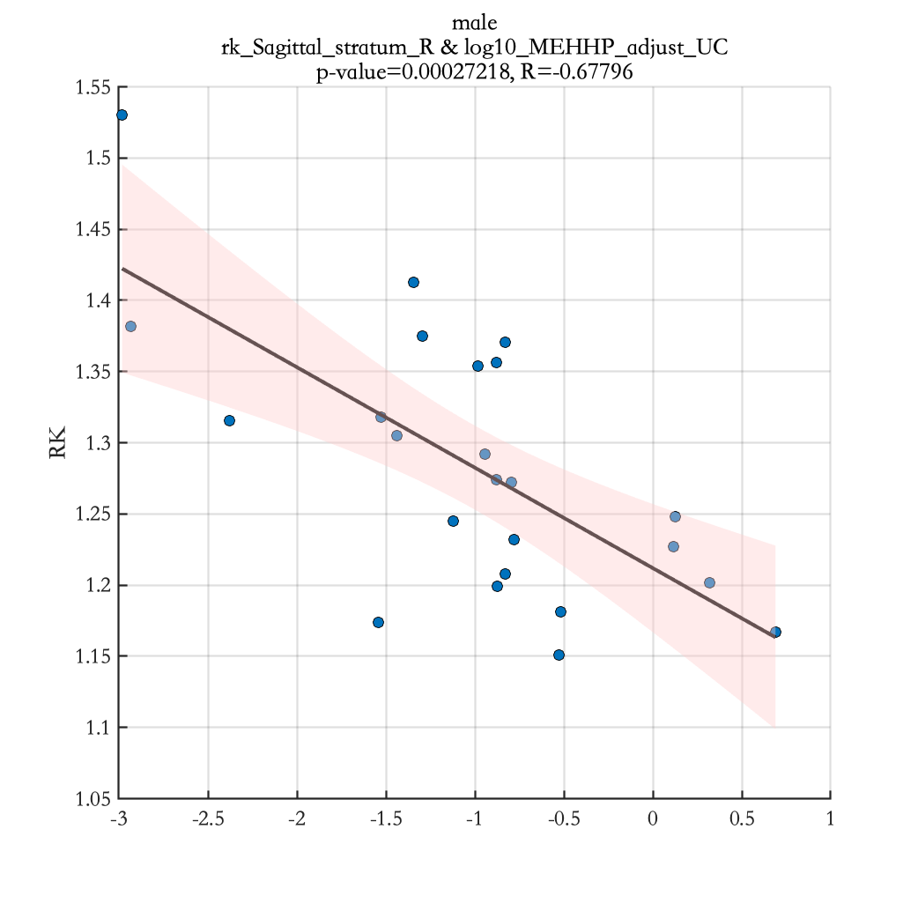
log10_MEHHP_adjust_UC

Slide 20
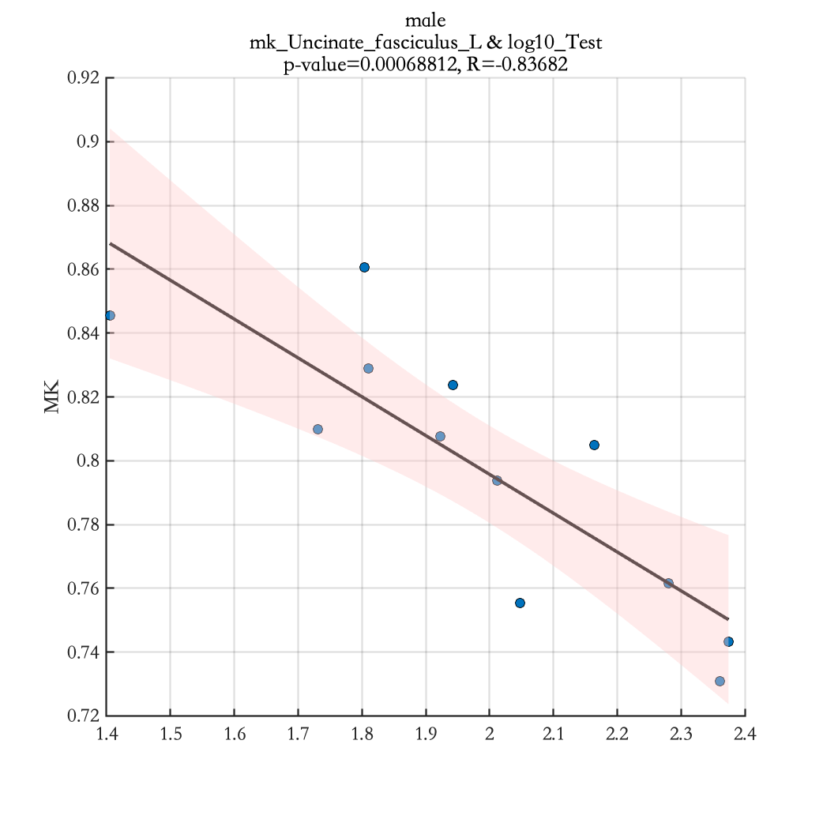
log10_Test

Slide 21
Results Significant correlation between cortical thickness of specific brain regions and EDC measurements for mothers with female teenagers(see Table 5)

Slide 22
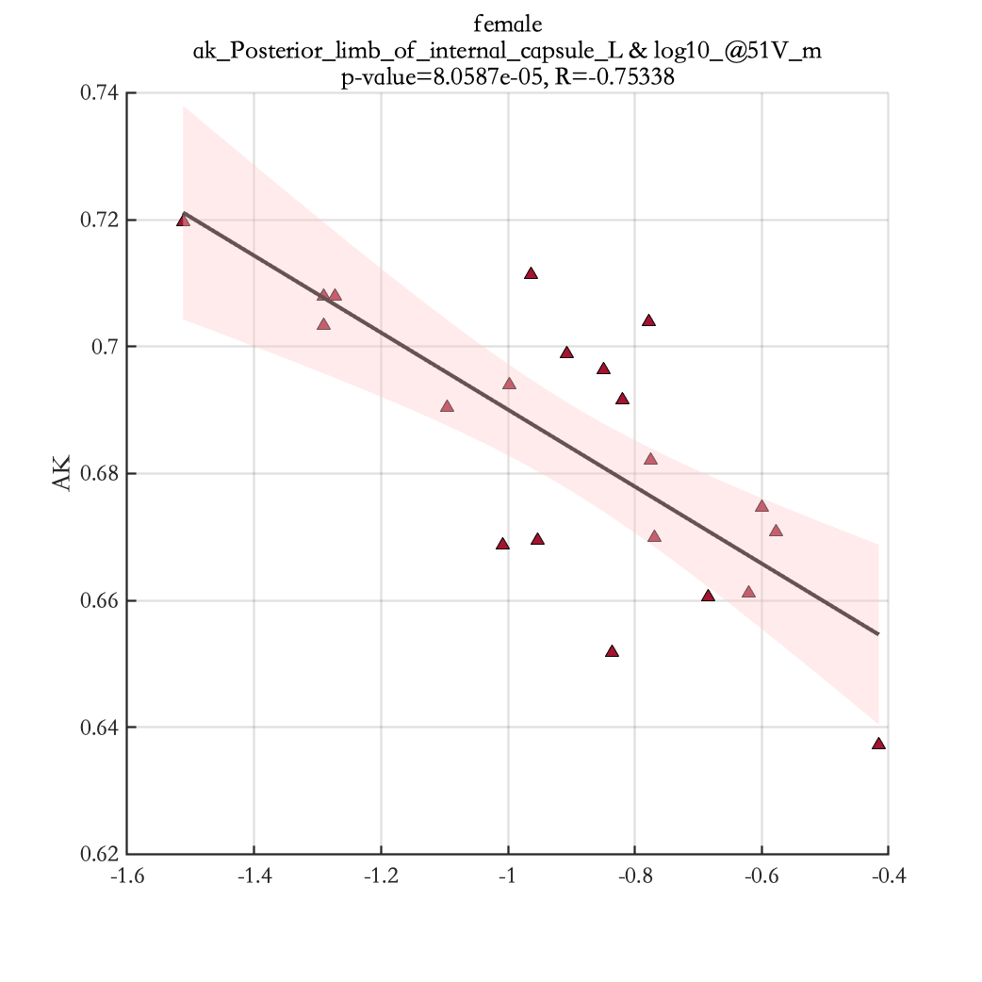
log10_@51V_m

Slide 23
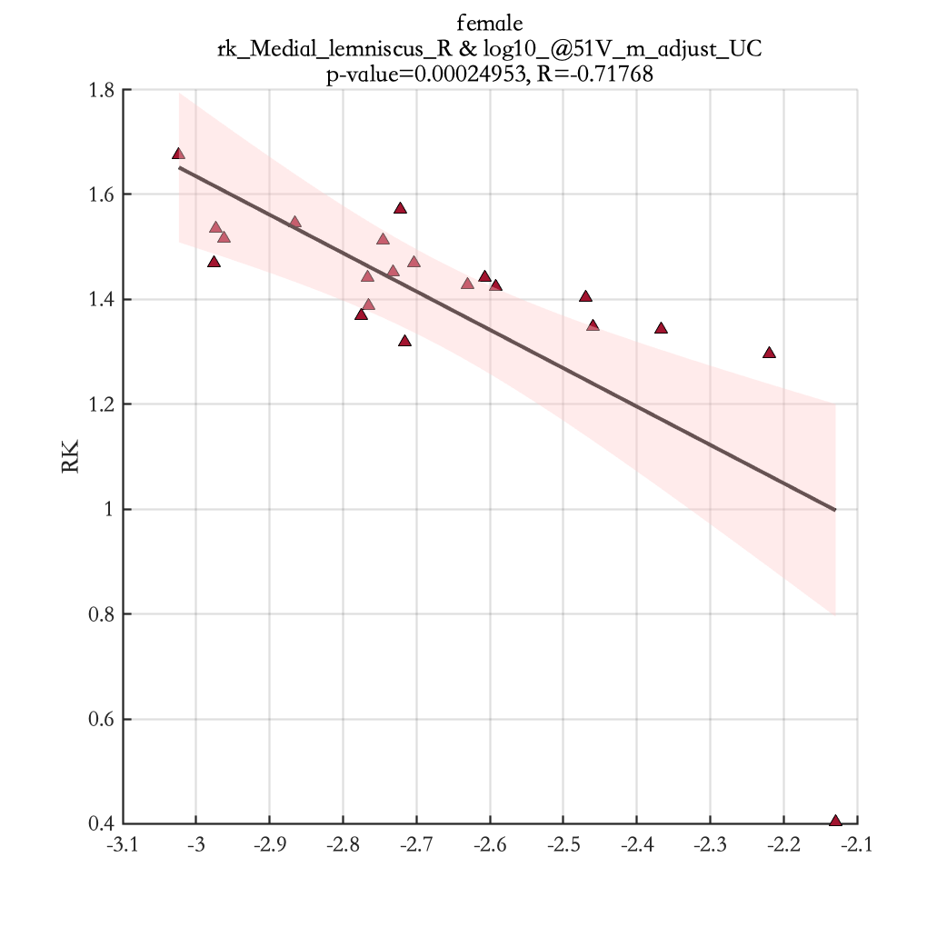
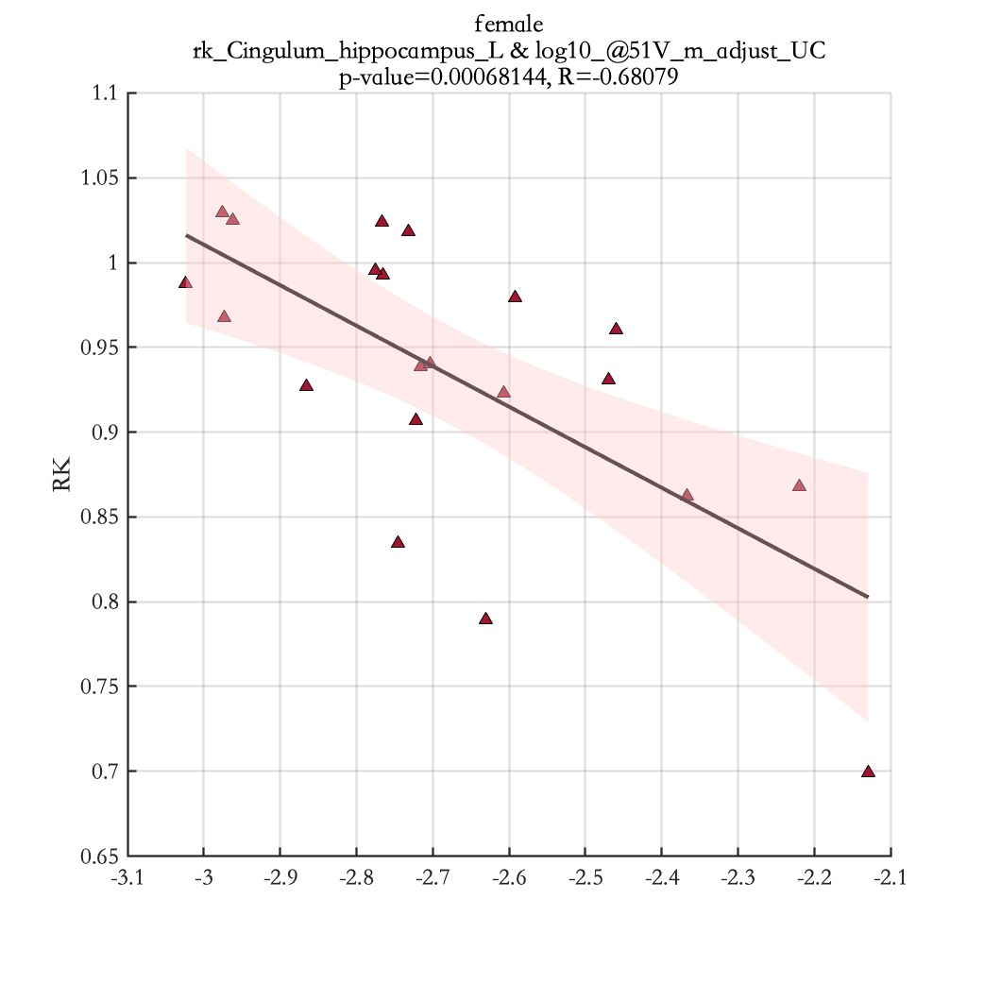
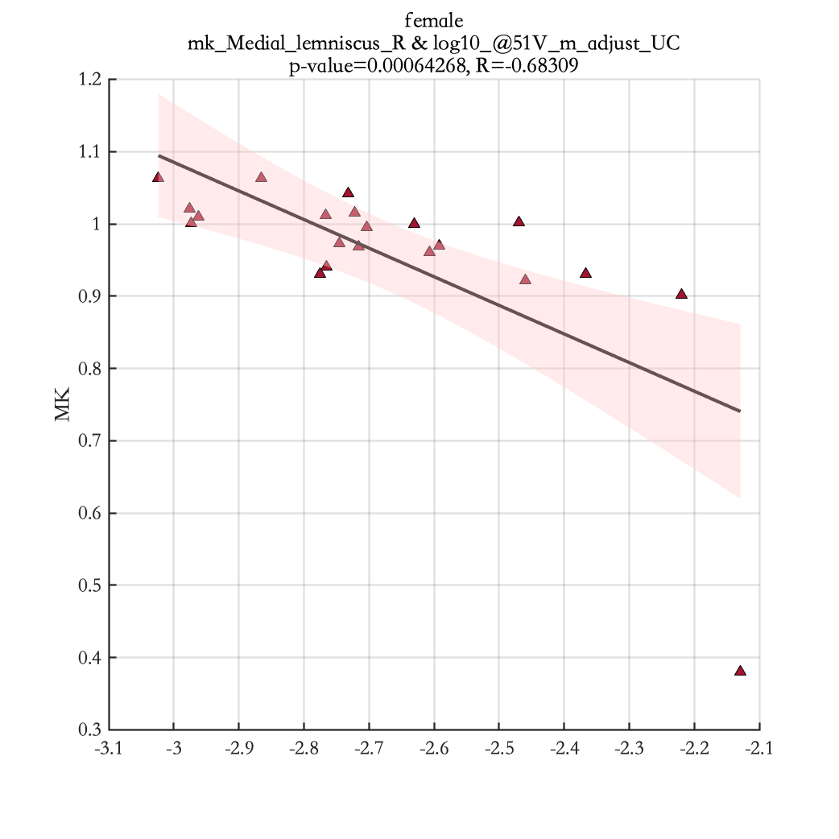
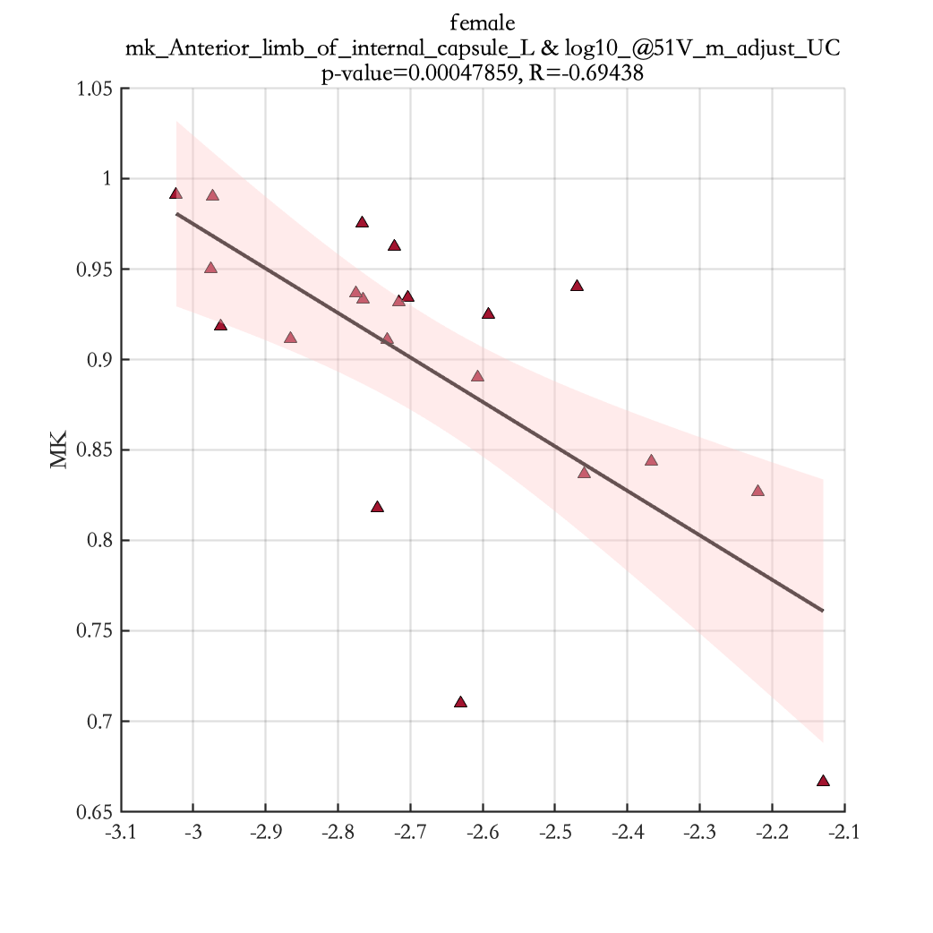
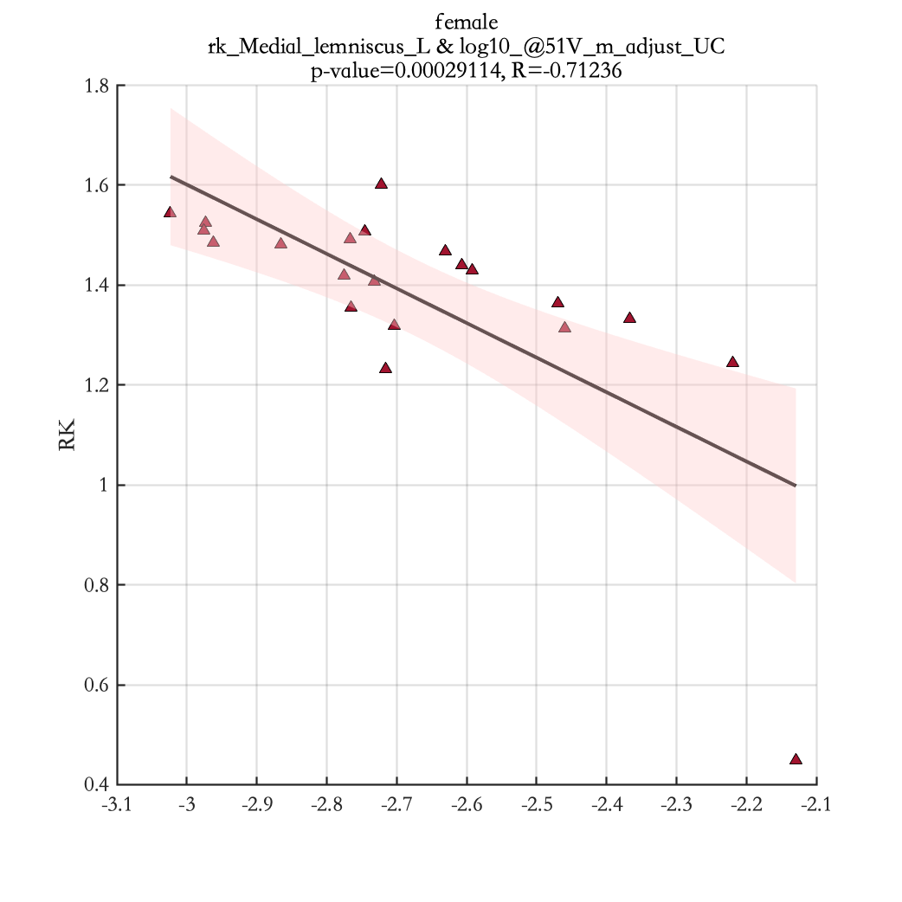
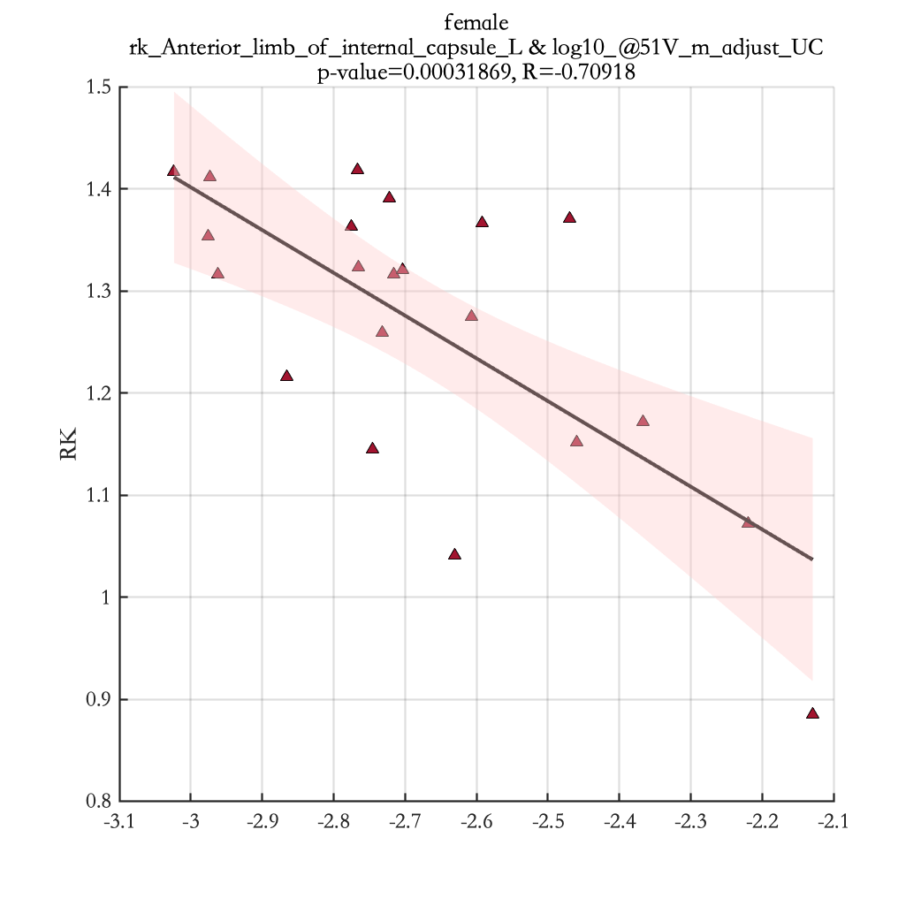
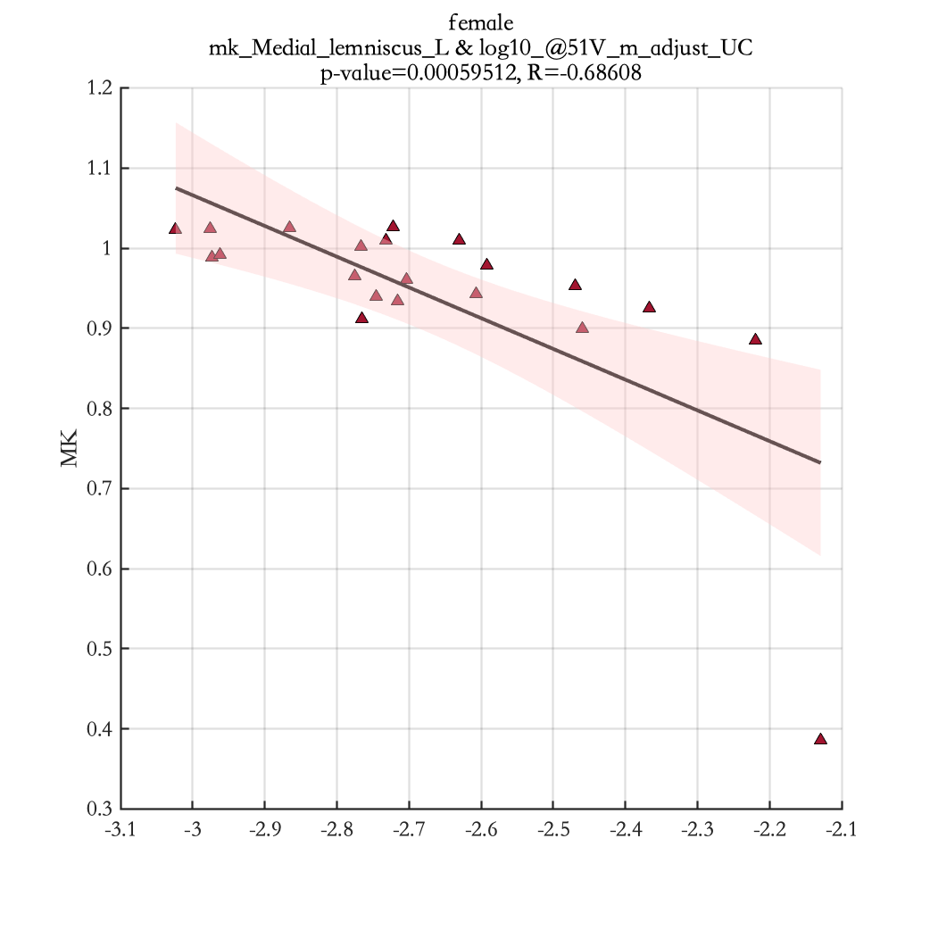
log10_@51V_m_adjust_UC

Slide 24
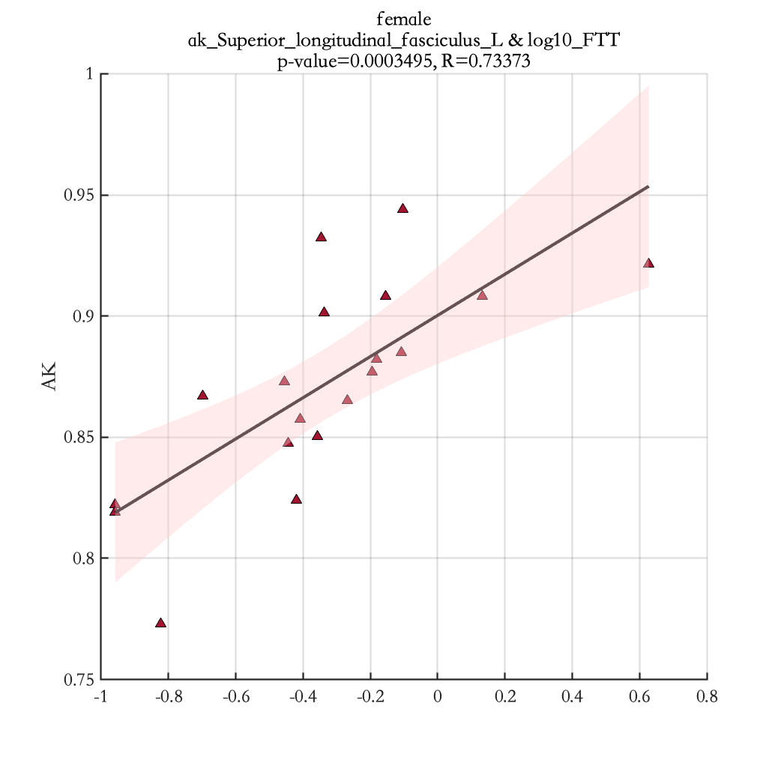
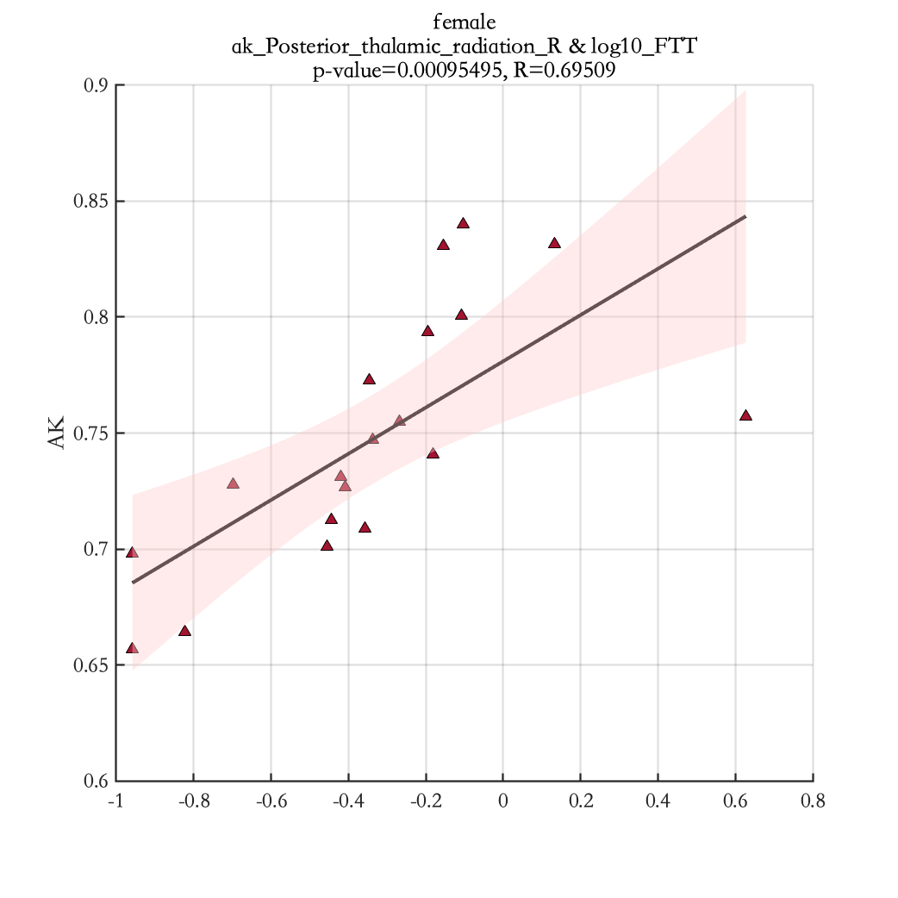
log10_FTT

Slide 25
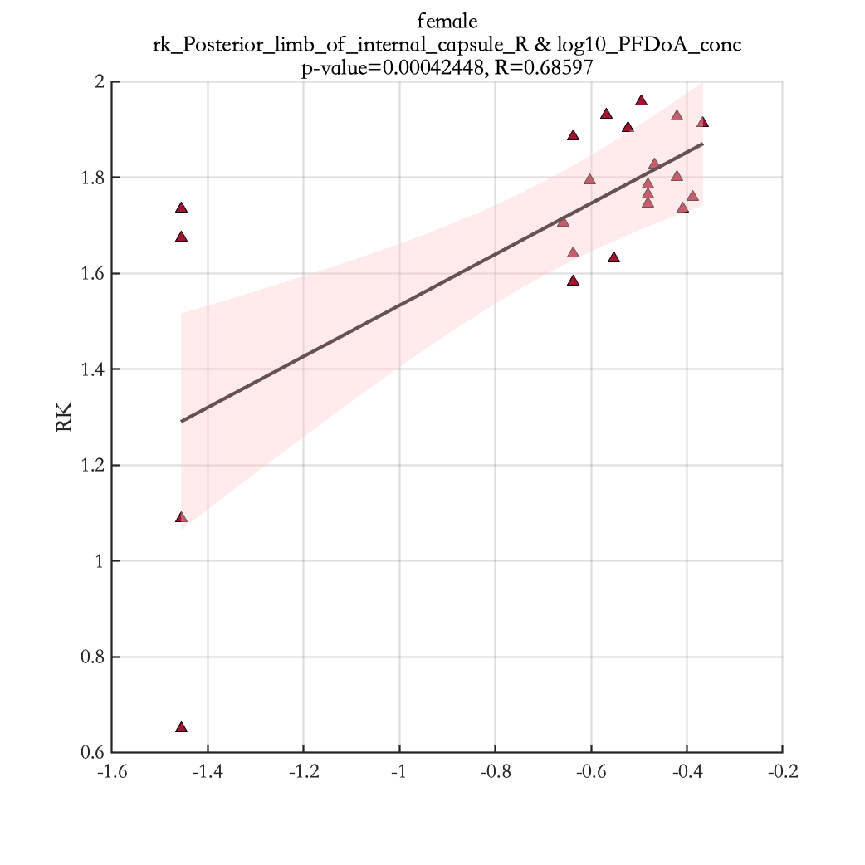
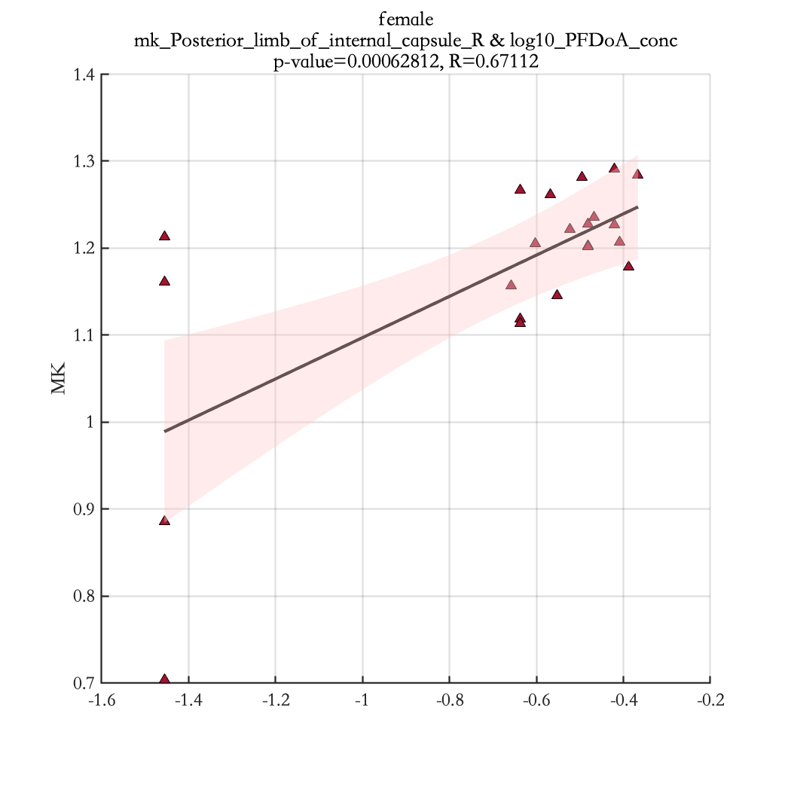
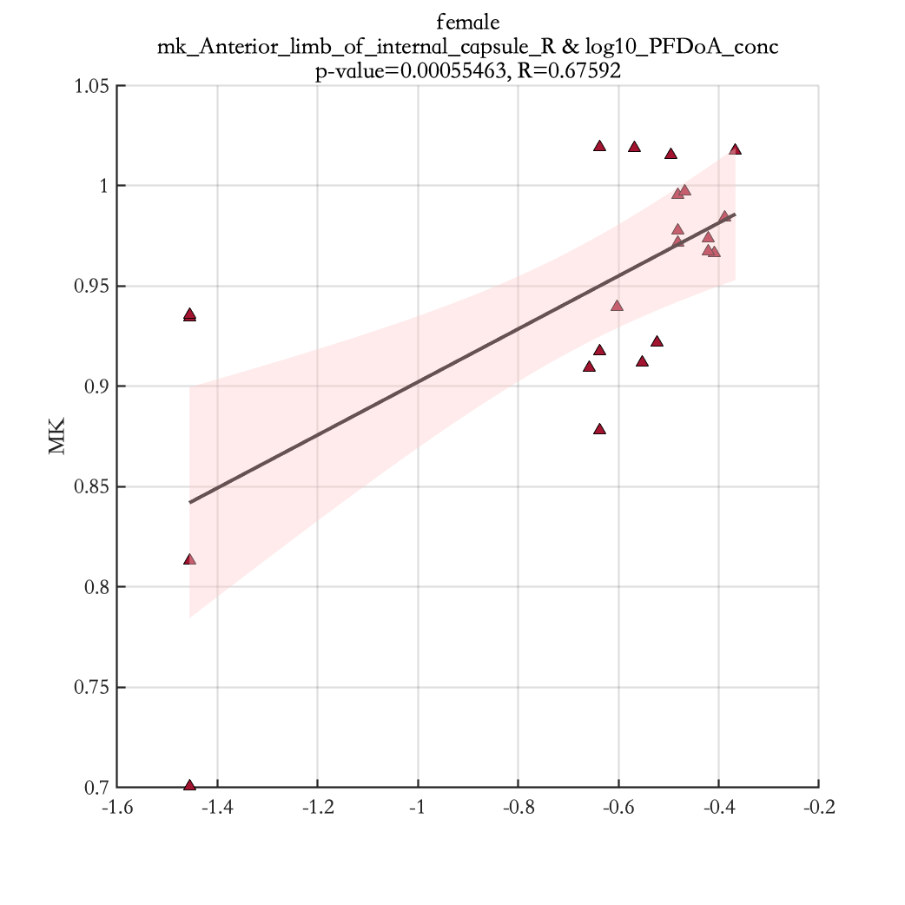
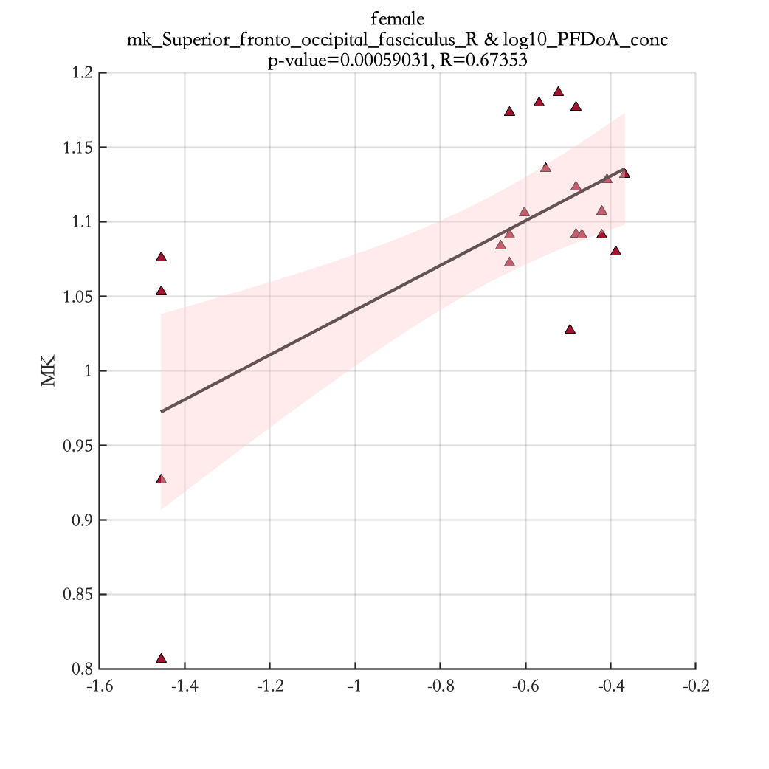
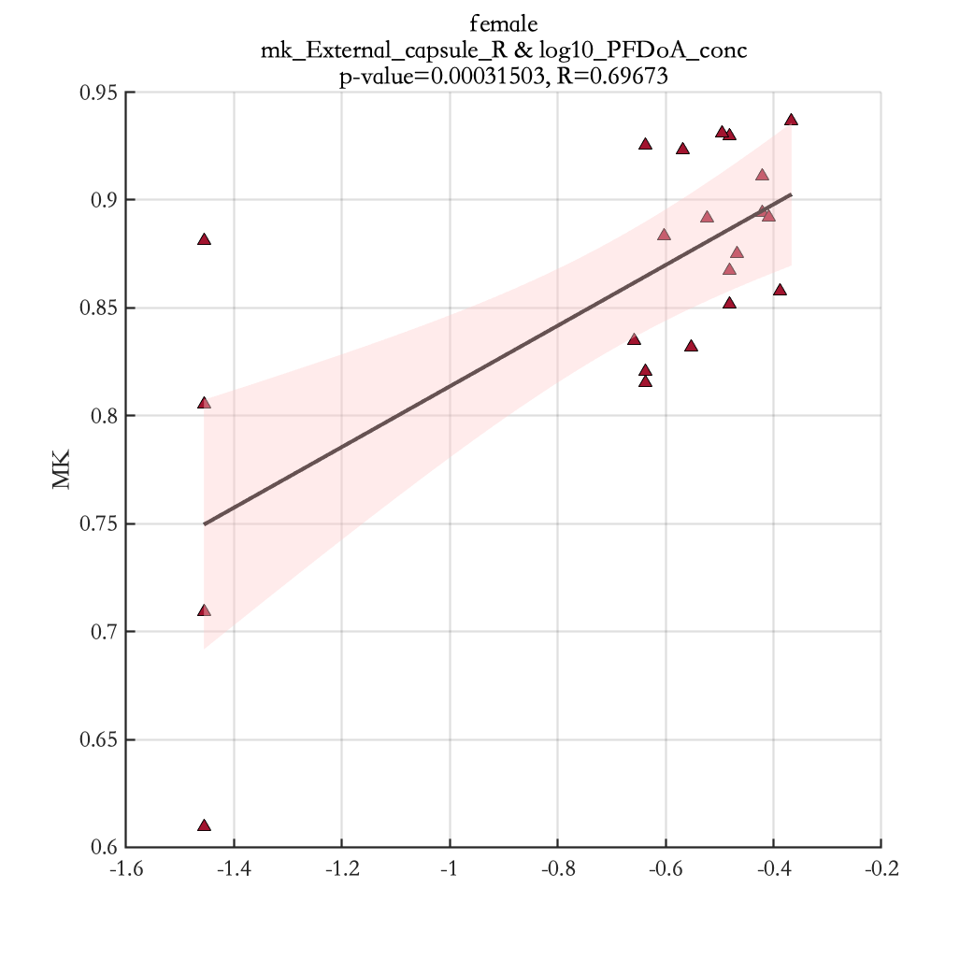
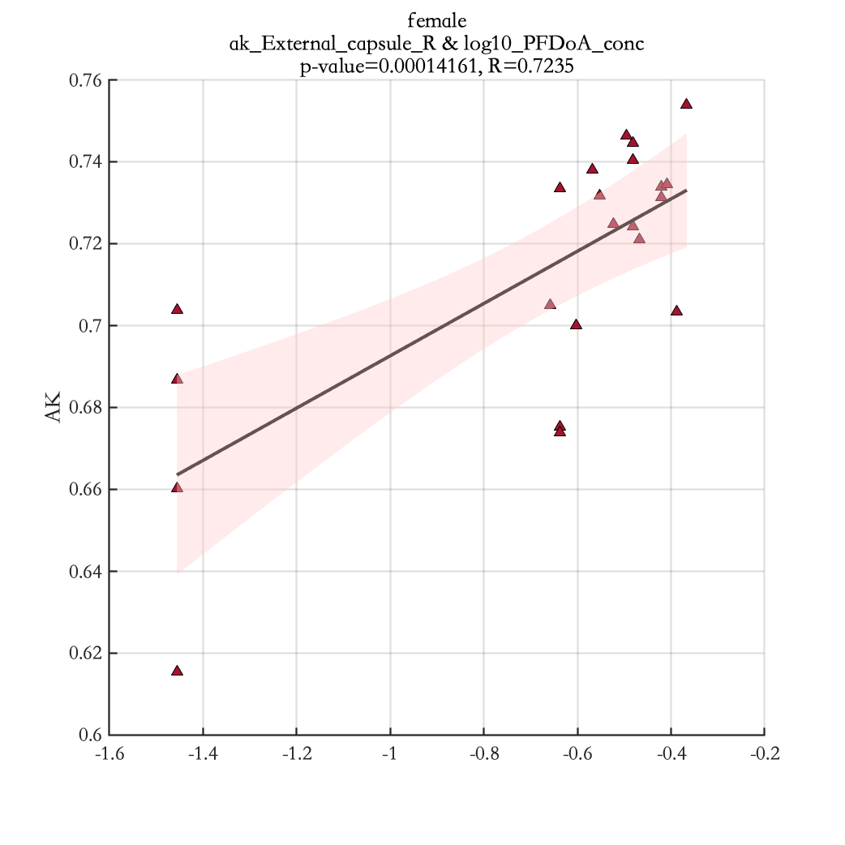
log10_PFDoA_conc

