Slide 1
Cortical thickness & Surface area analysis

Slide 2
Outline
Method
Workflow of Cortical thickness analysis
Desikan Killiany Atlas
Result
Teenagers’ mothers (corresponding to table 2)

Slide 3
Method

Slide 4
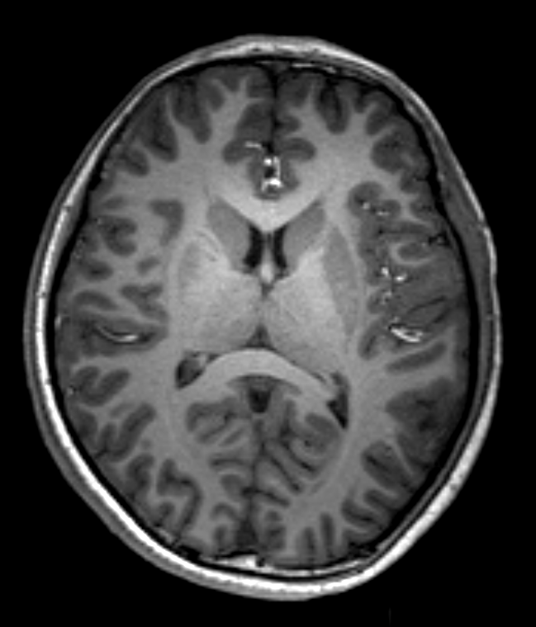
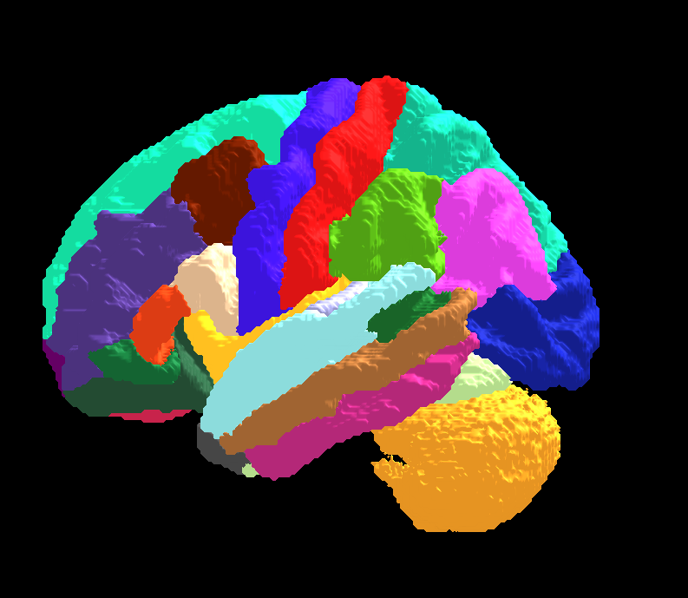
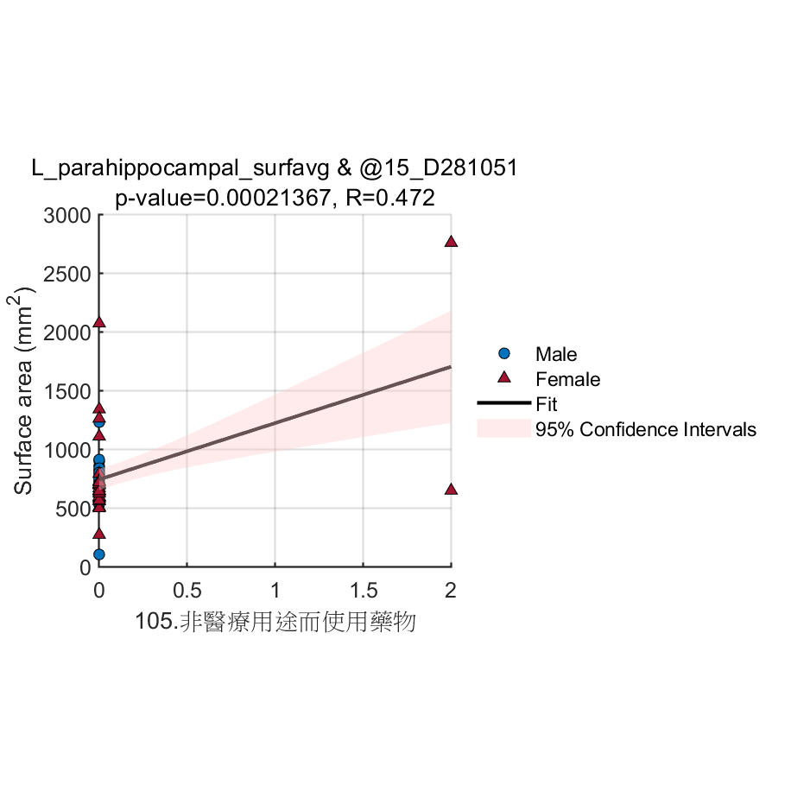
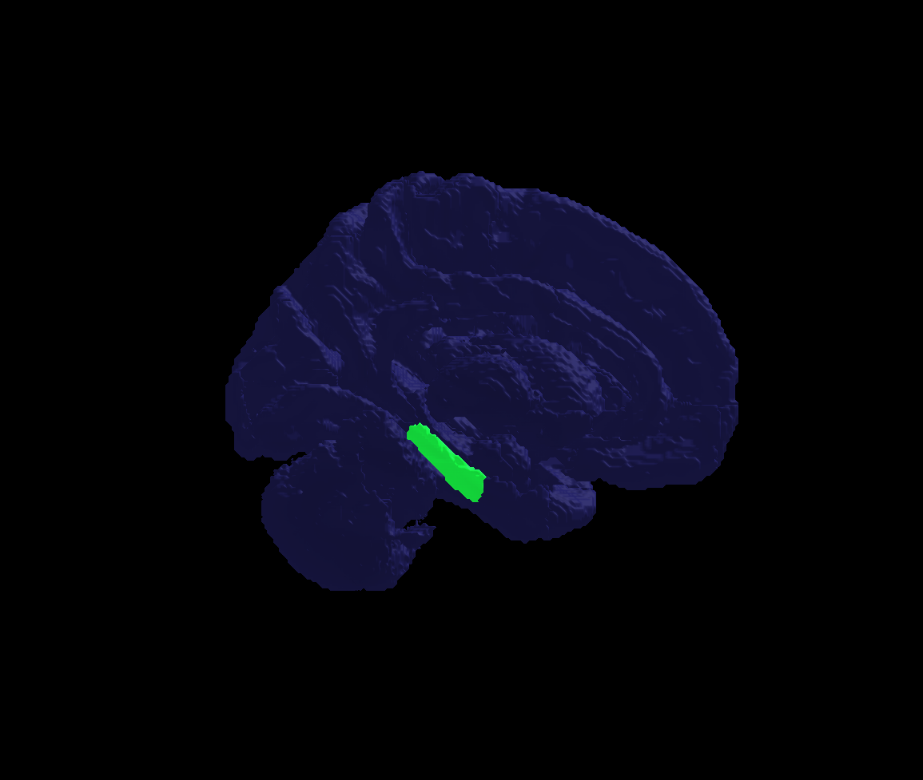
Workflow
Schwarz, Christopher G., et al. "A large-scale comparison of cortical thickness and volume methods for measuring Alzheimer's disease severity." NeuroImage: Clinical 11 (2016): 802-812.
Image processing
Statistical analysis
Cortical Parcellation (Desikan-Killiany Atlas)
68 VOIs
Cortical Parcellation Statistics
Average cortical thickness
Average surface area
T1-w image (N=59)
Image processing
(recon-all)
(by Freesurfer)
Pearson correlation with Cortical Parcellation Statistics
(Bonferroni corrected p-value< 0.000735, 0.05/68) (by SPSS)
Assessments from their mothers (95)
Desikan Killiany Atlas
Volume (N=59)
Scatter plot
3D Volume rendering

Slide 5
Results –Mothers

Slide 6
table 2

Slide 7
Results Significant correlation between cortical measurements of specific brain regions and EDC measurements for all teenagers’ mothers (see Table 2)

Slide 8
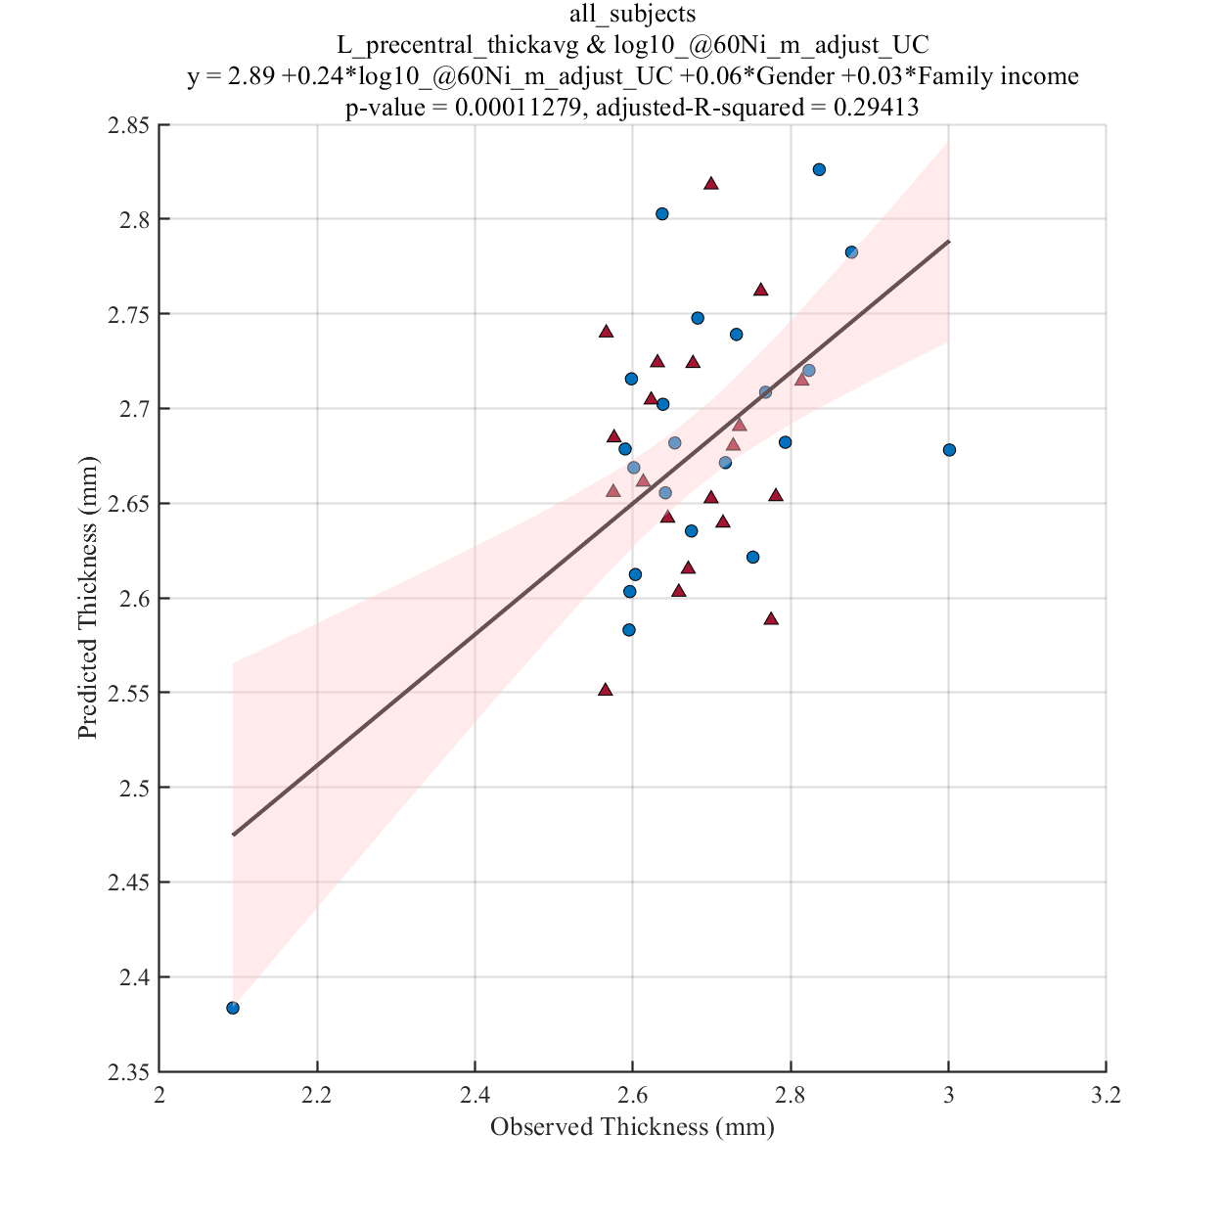
log10_@60Ni_m_adjust_UC

Slide 9
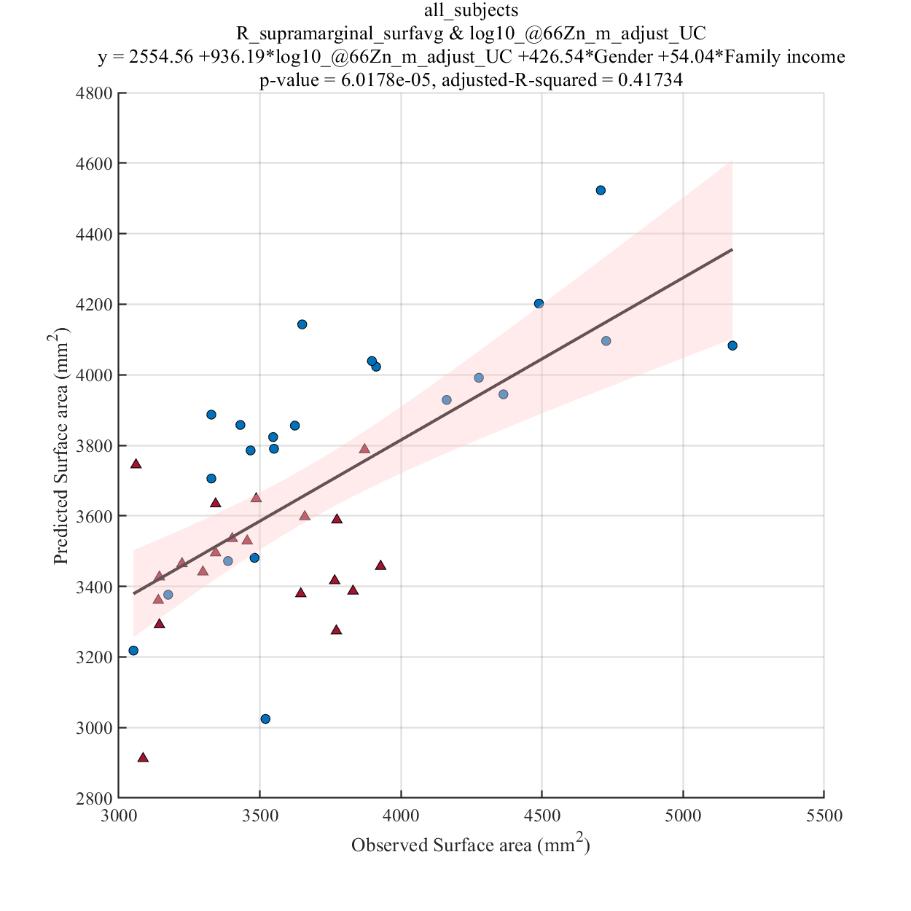
log10_@66Zn_m_adjust_UC

Slide 10
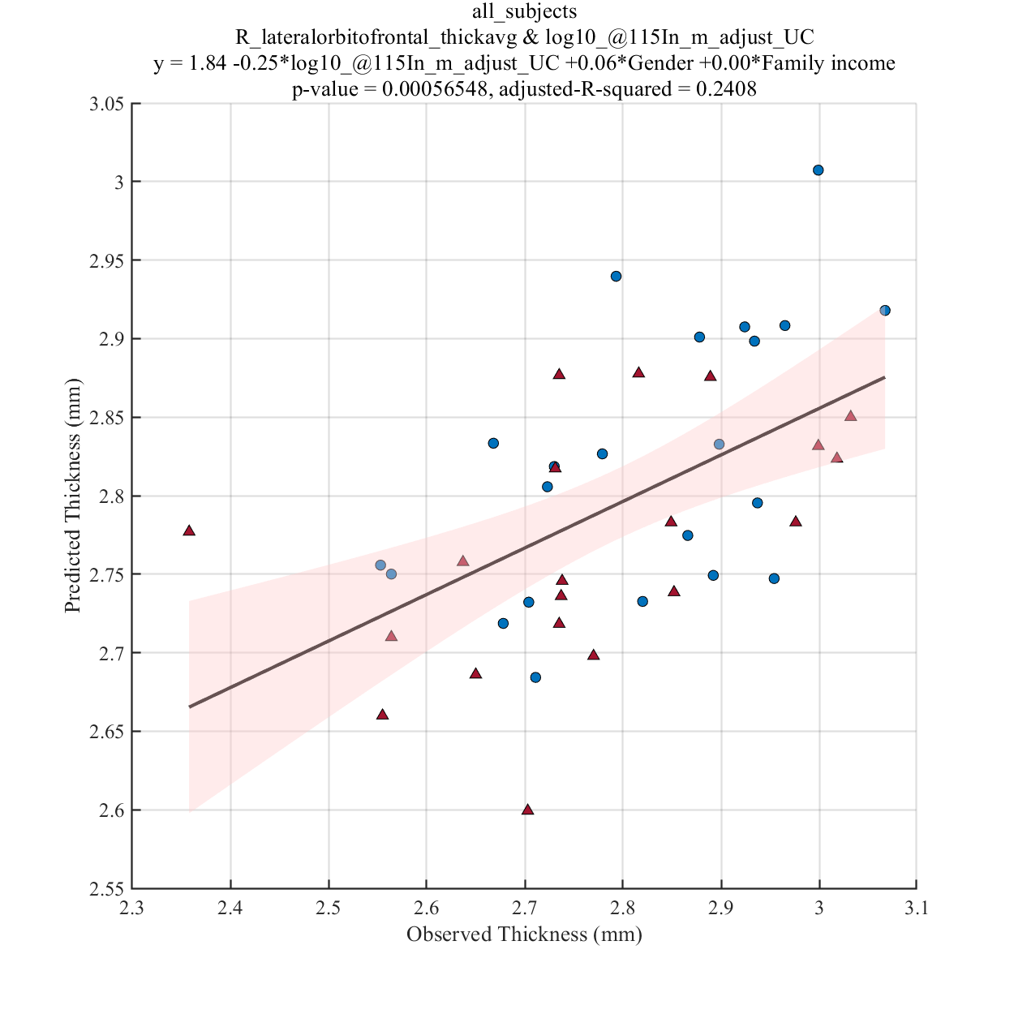
log10_@115In_m_adjust_UC

Slide 11
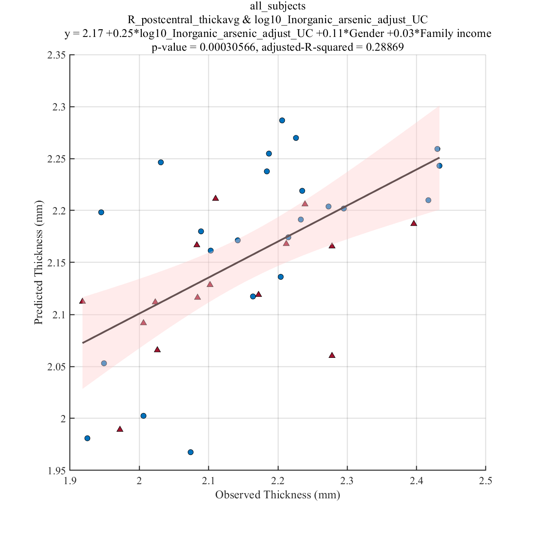
log10_Inorganic_arsenic_adjust_UC

Slide 12
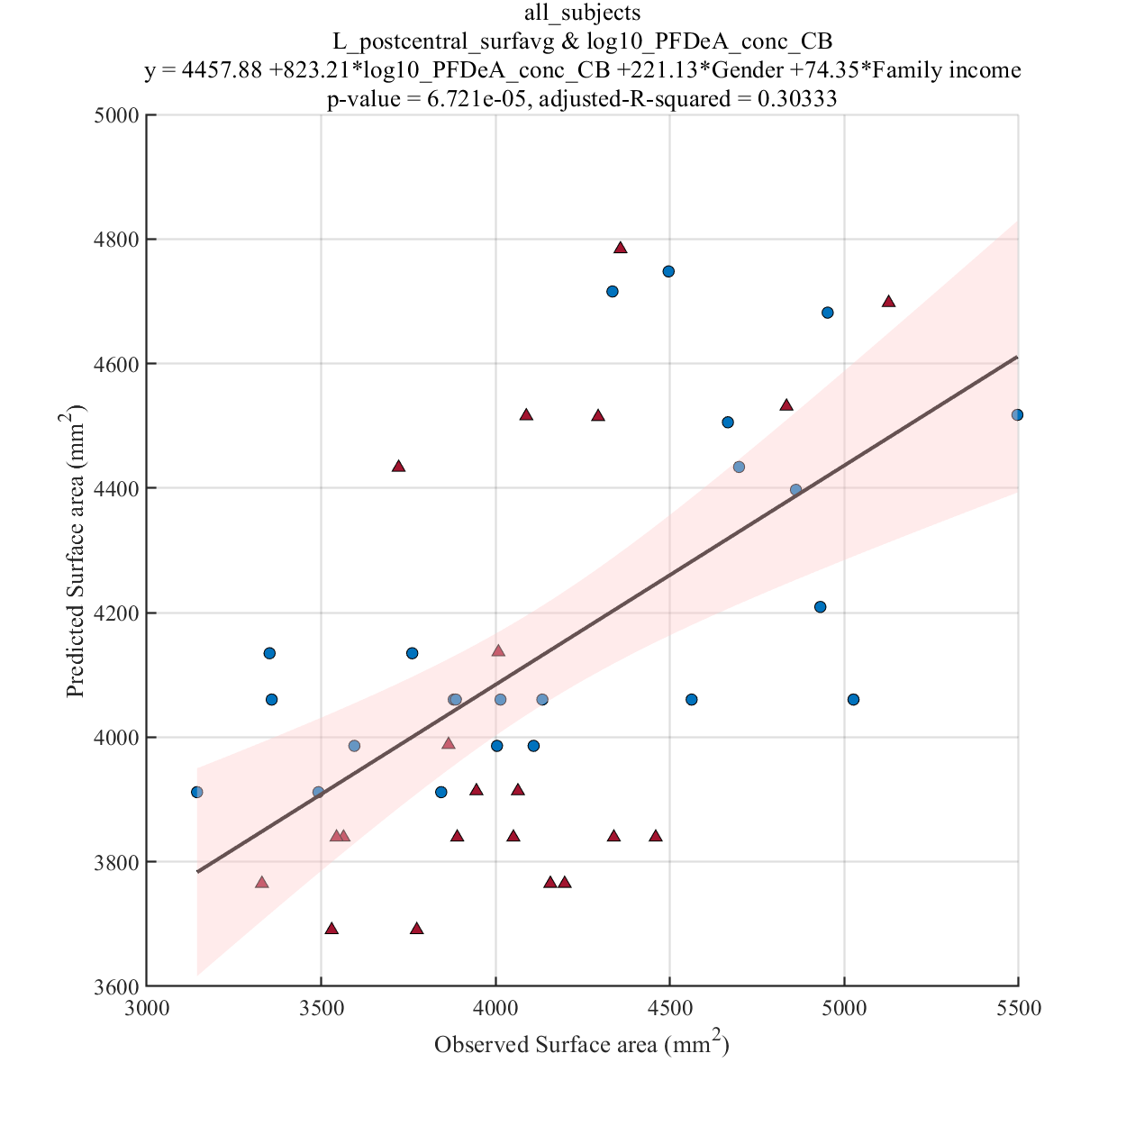
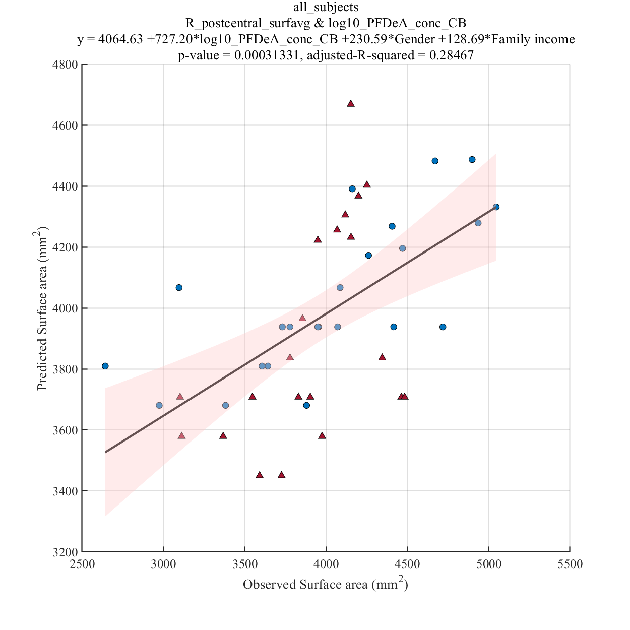
log10_PFDeA_conc_CB

Slide 13
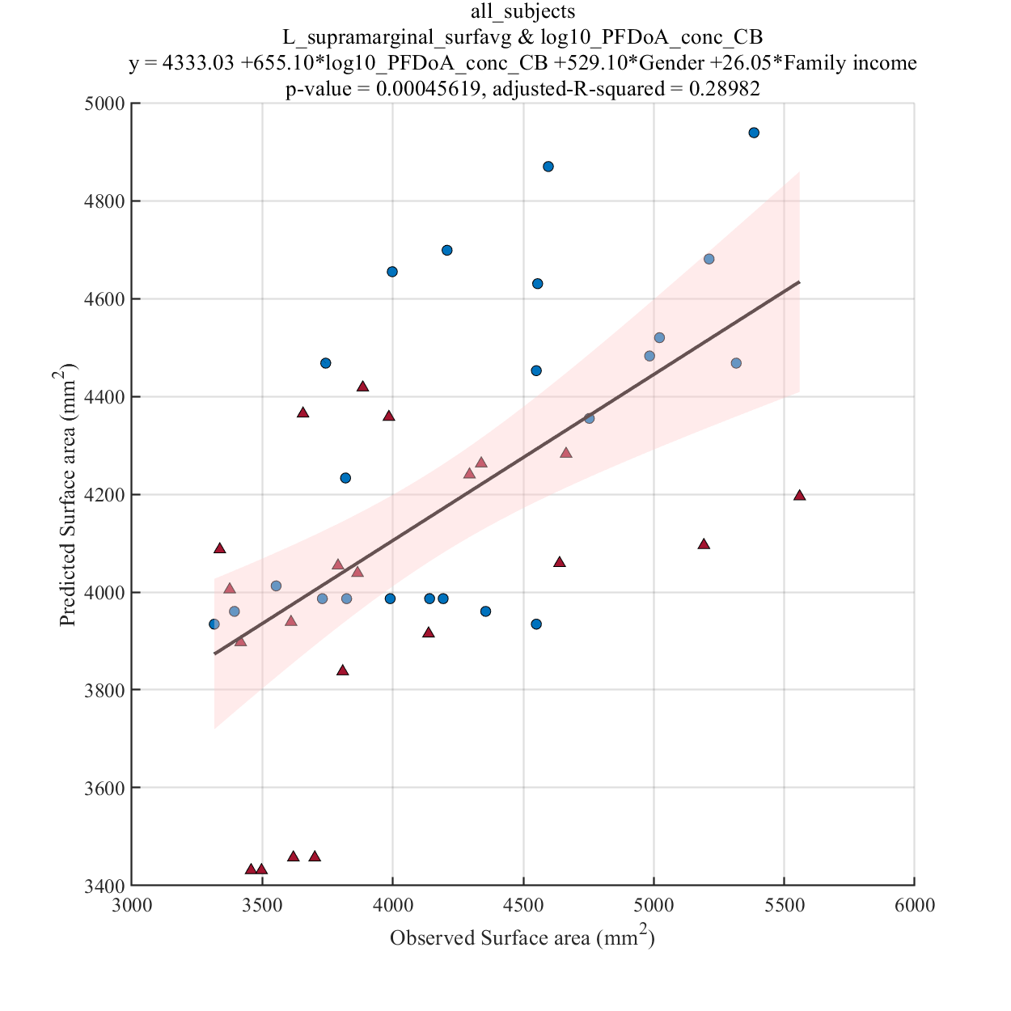
log10_PFDoA_conc_CB

Slide 14
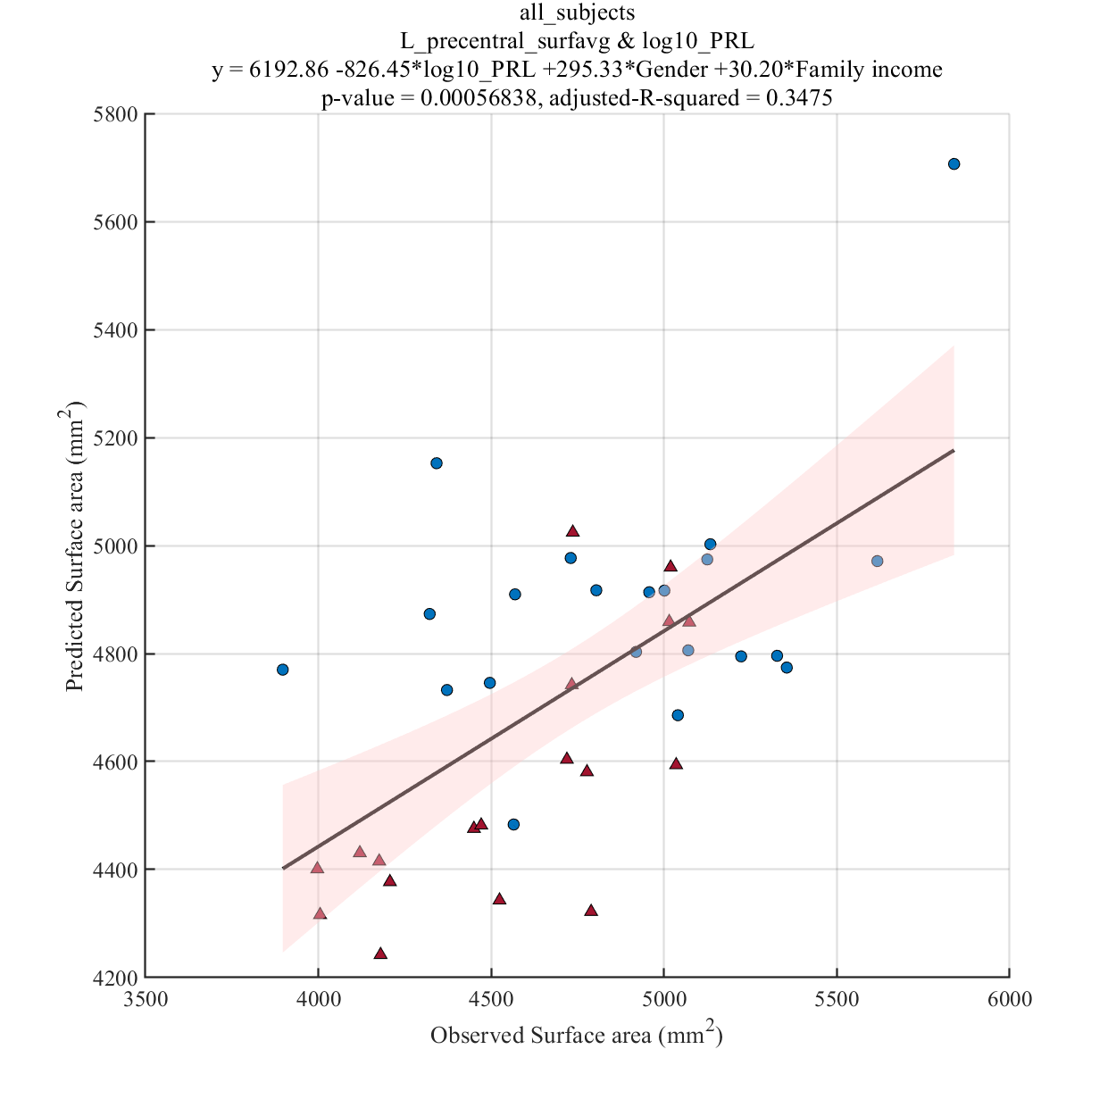
log10_PRL

Slide 15
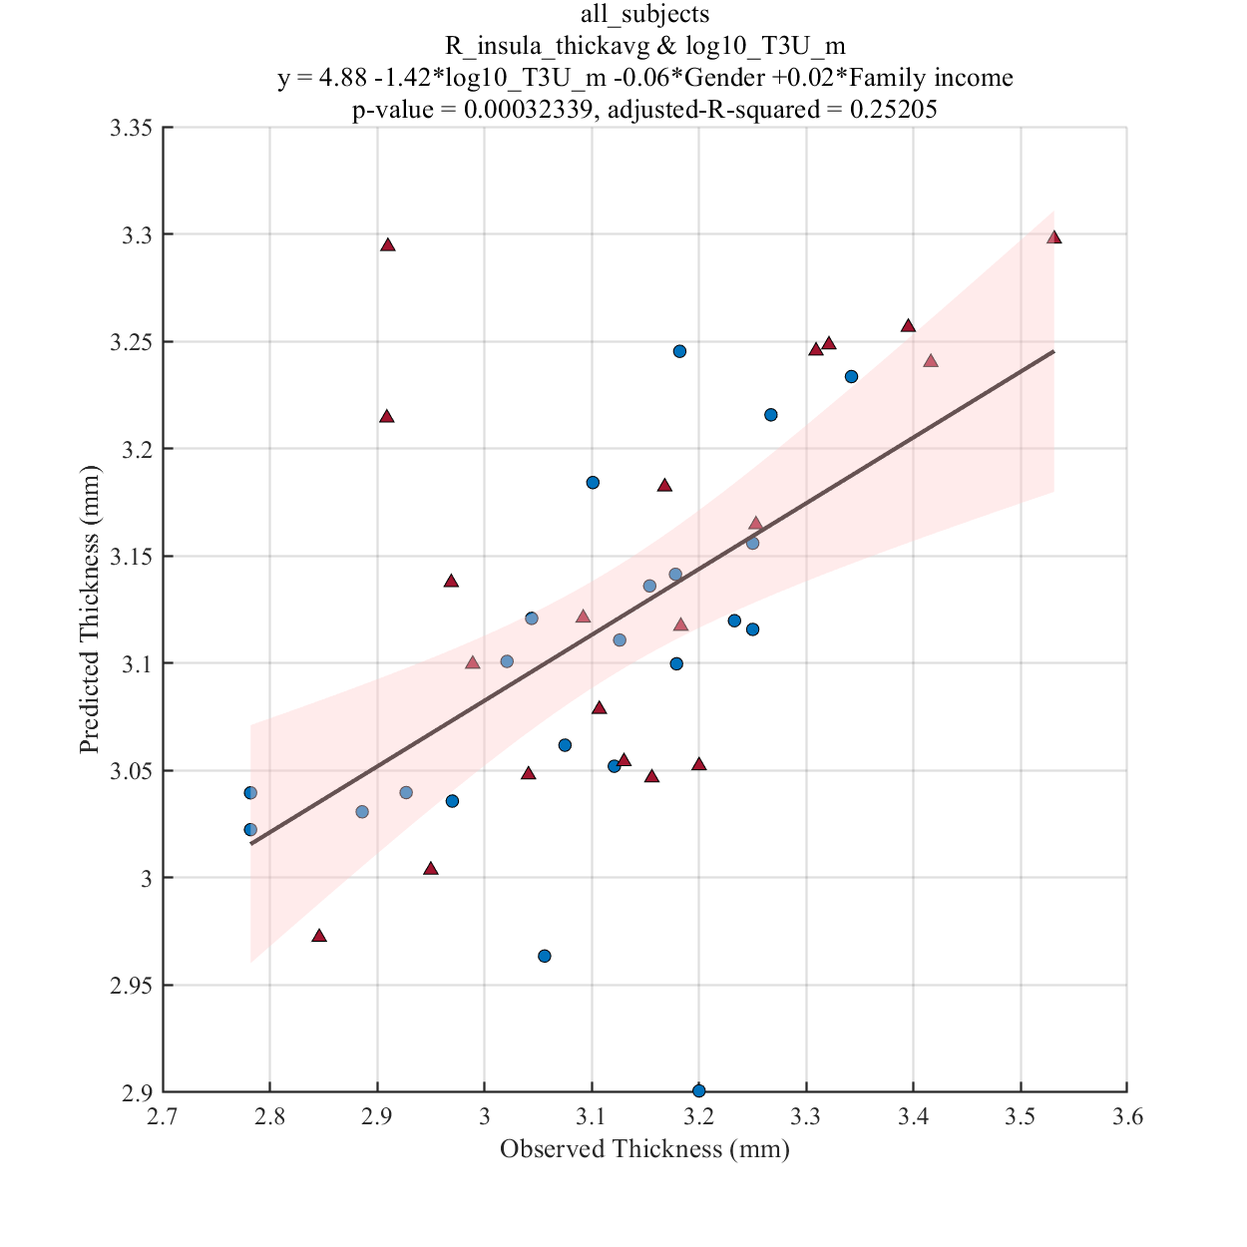
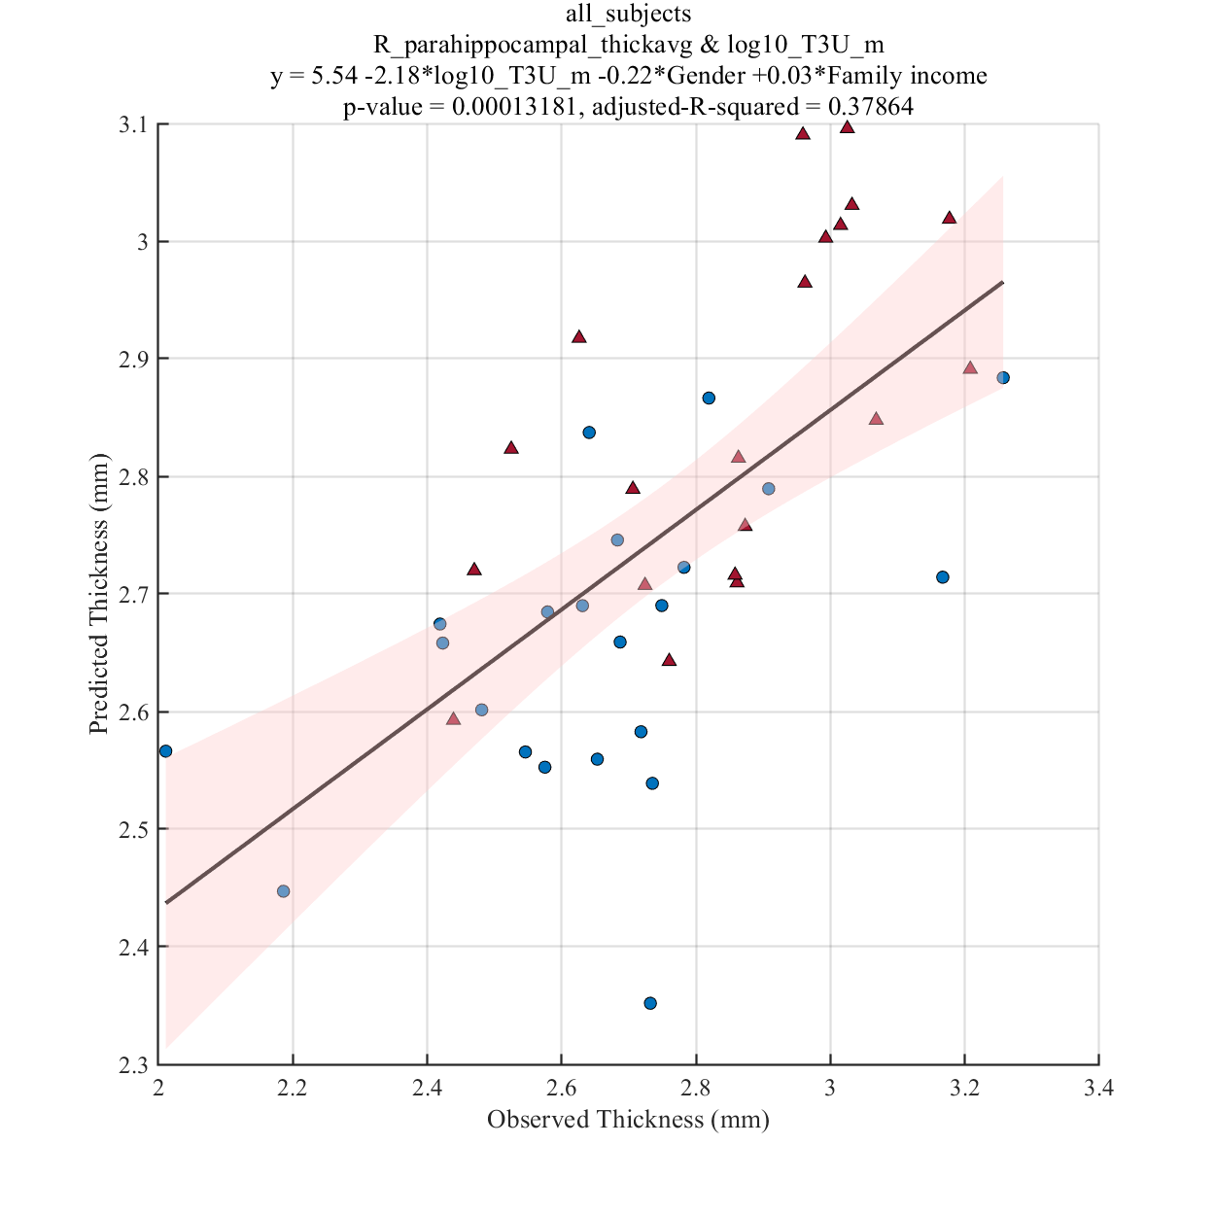
log10_T3U_m

Slide 16
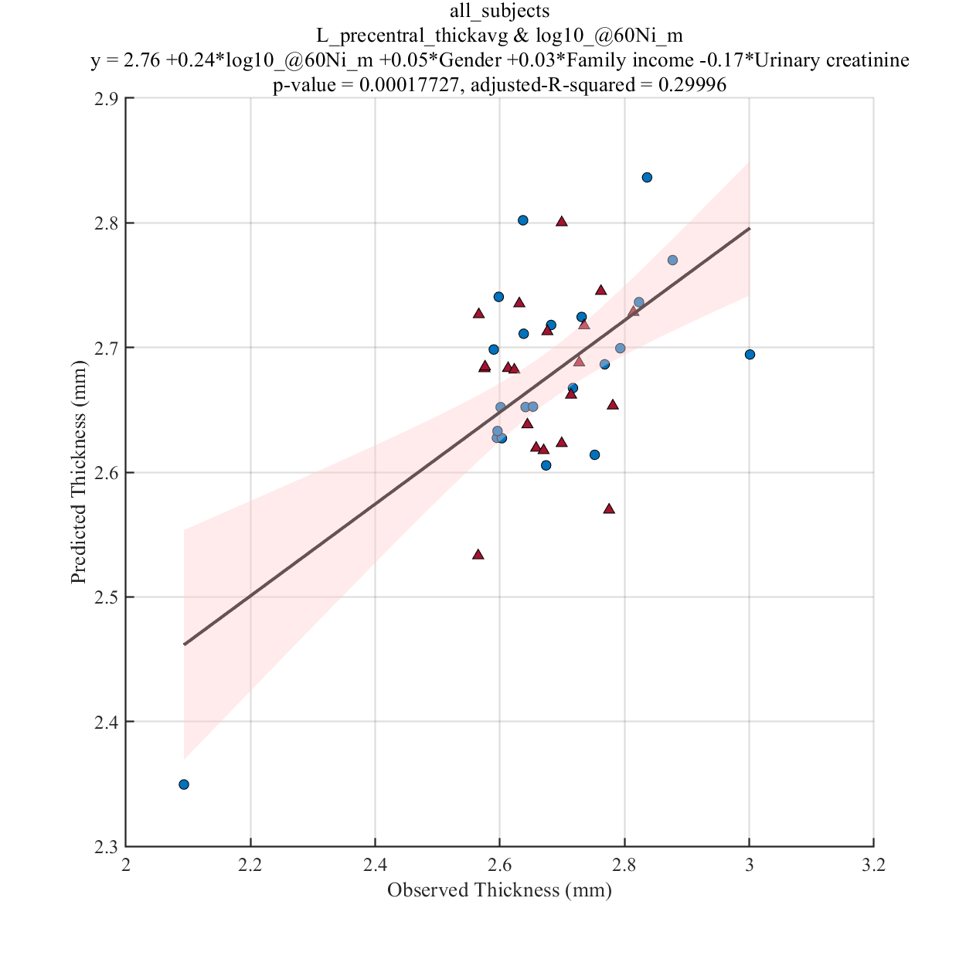
log10_@60Ni_m

Slide 17
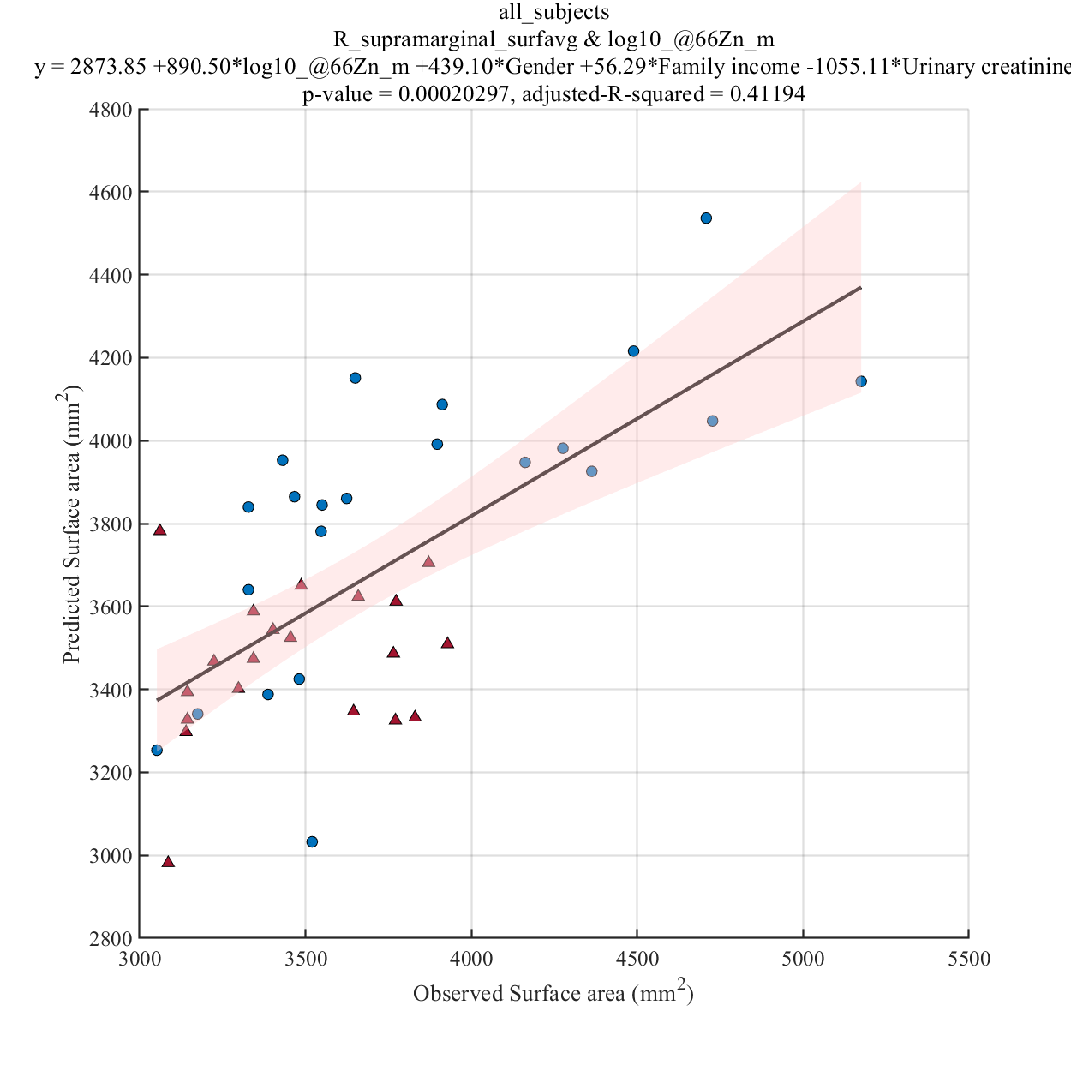
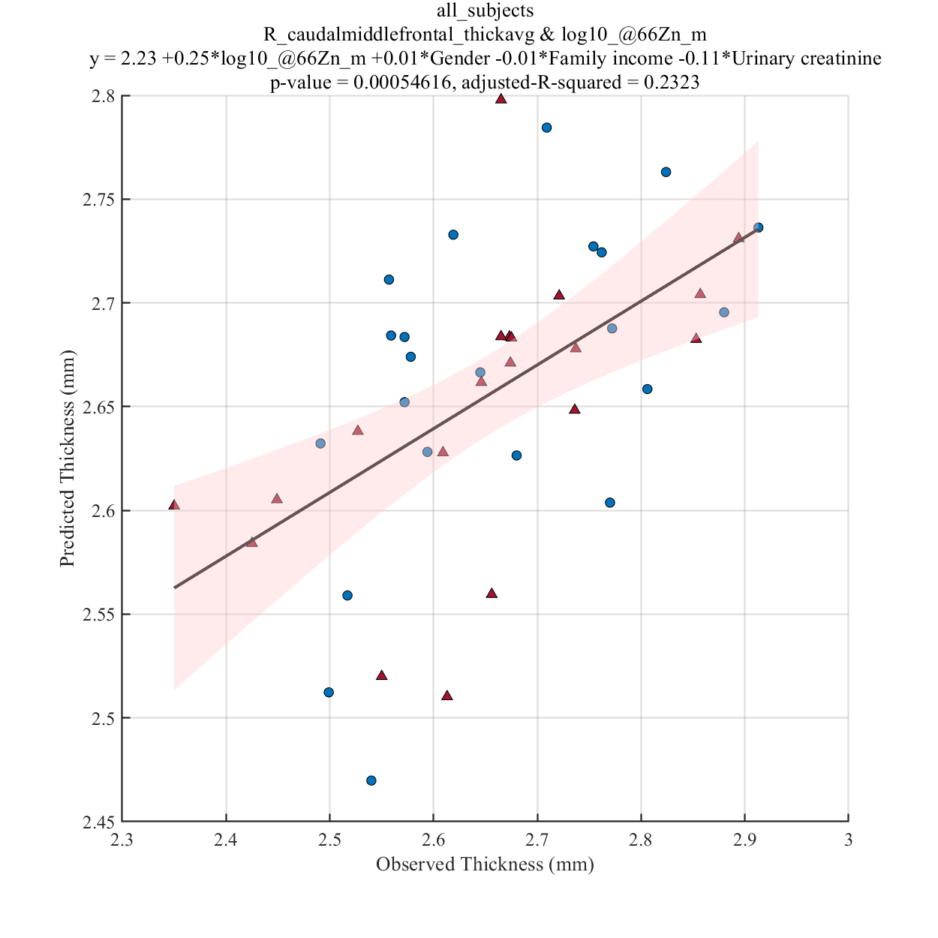
log10_@66Zn_m

Slide 18
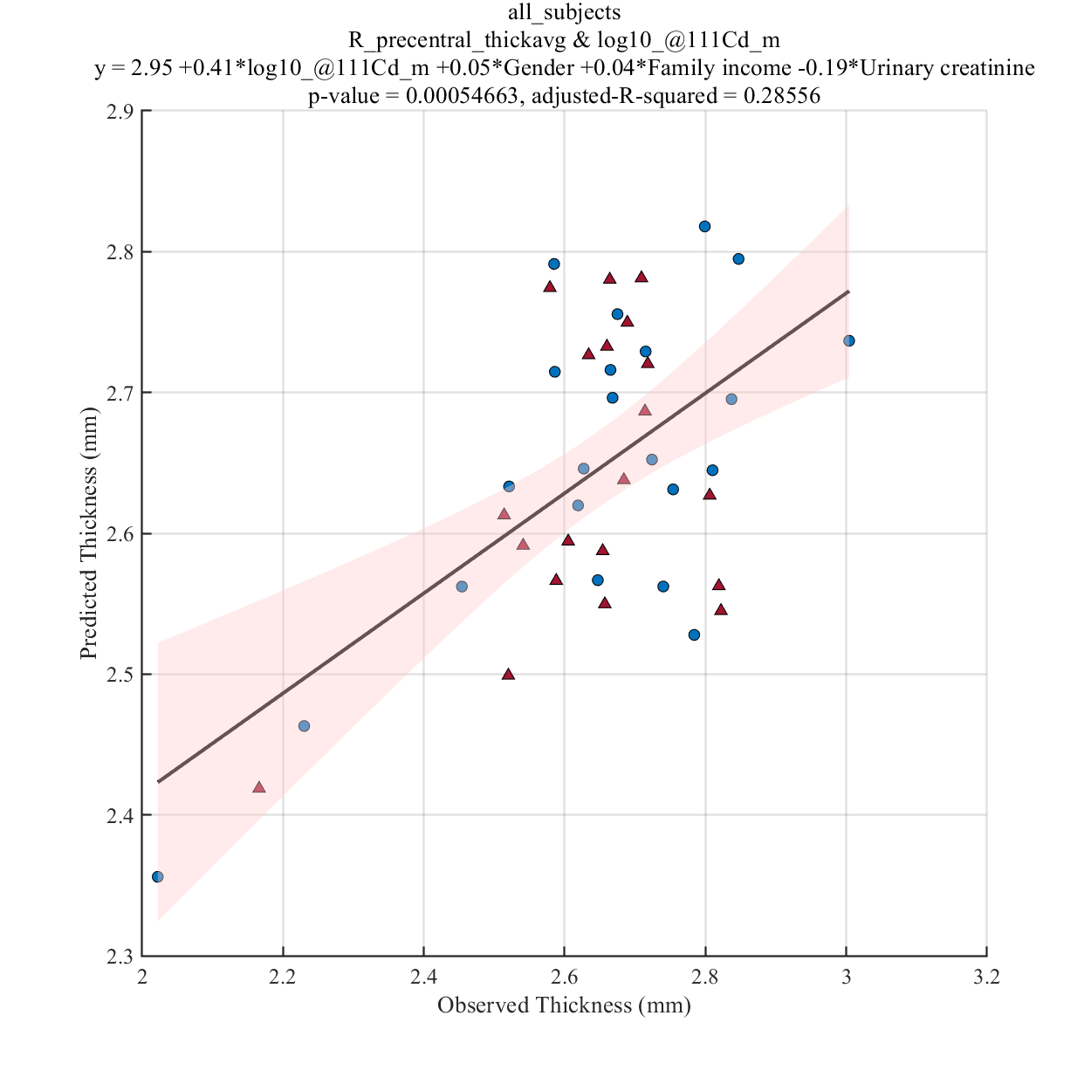
log10_@111Cd_m

Slide 19
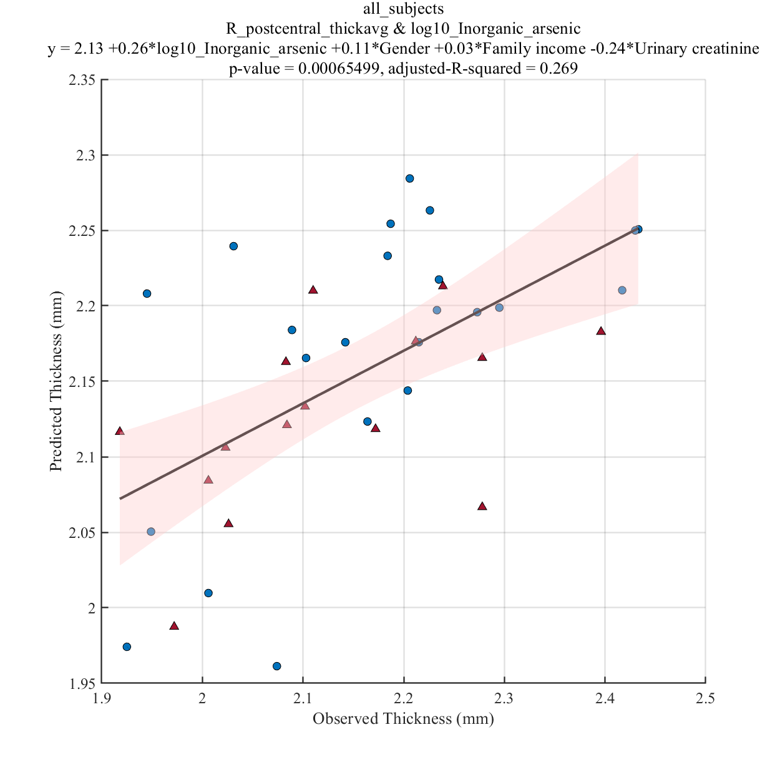
log10_Inorganic_arsenic

Slide 20
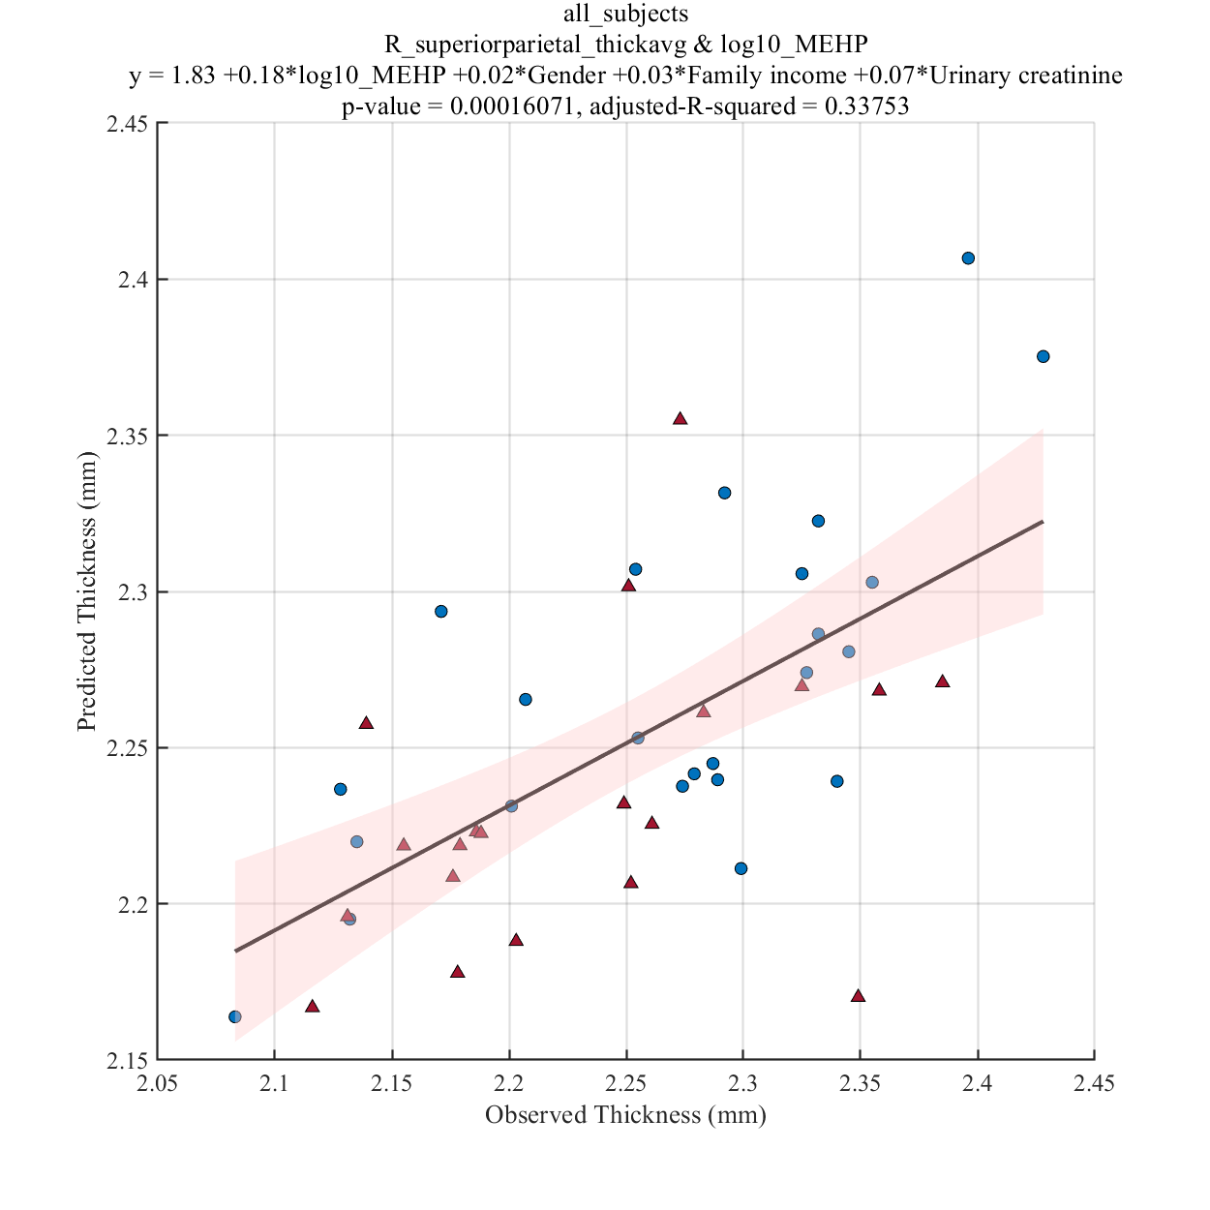
log10_MEHP

Slide 21
Results Significant correlation between cortical measurements of specific brain regions and EDC measurements for mothers with male teenagers(see Table 2)

Slide 22

log10_@60Ni_m_adjust_UC

Slide 23
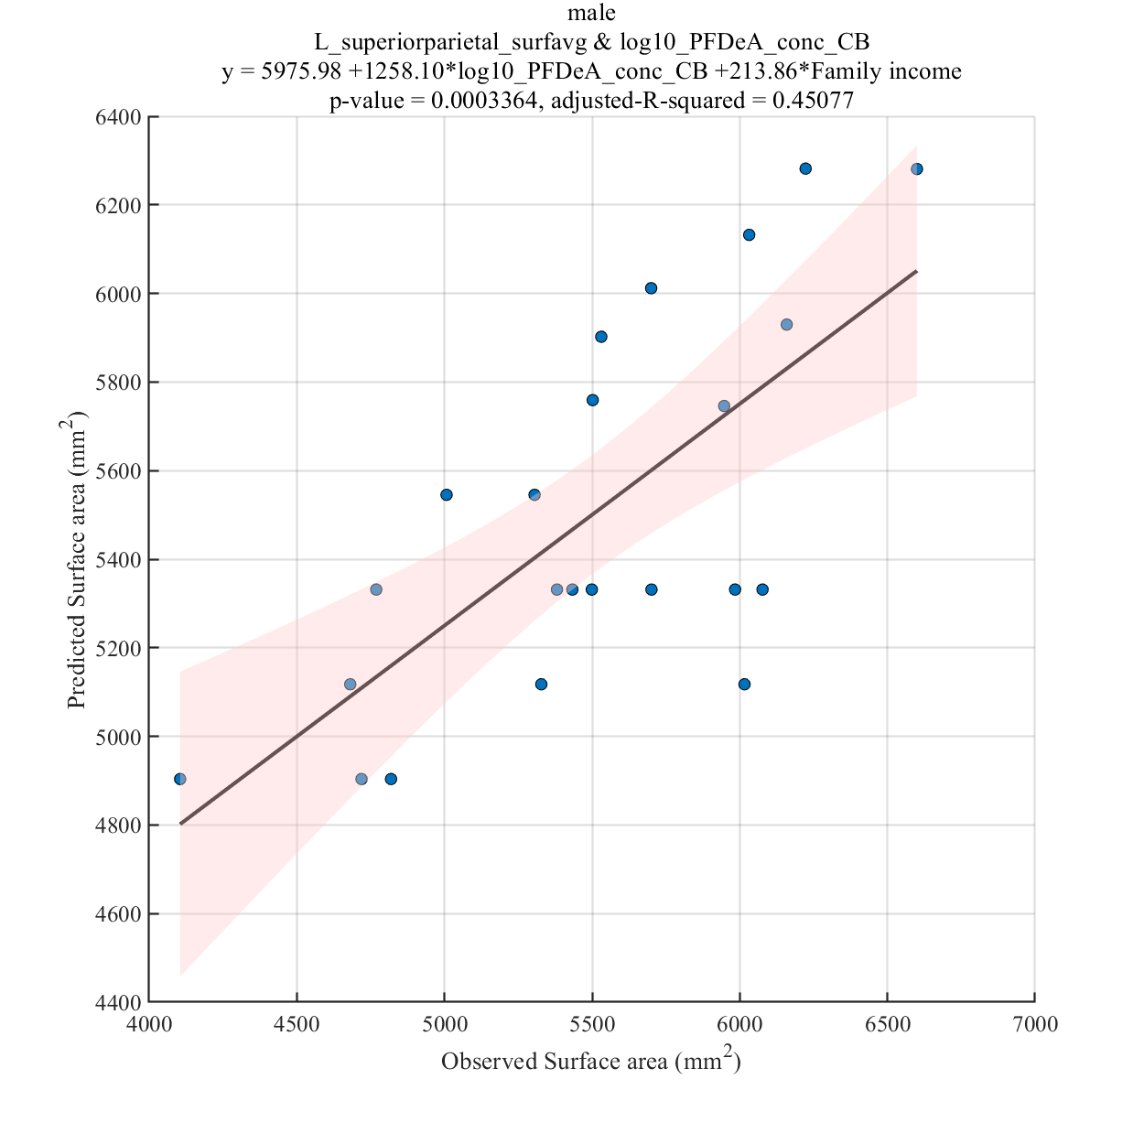
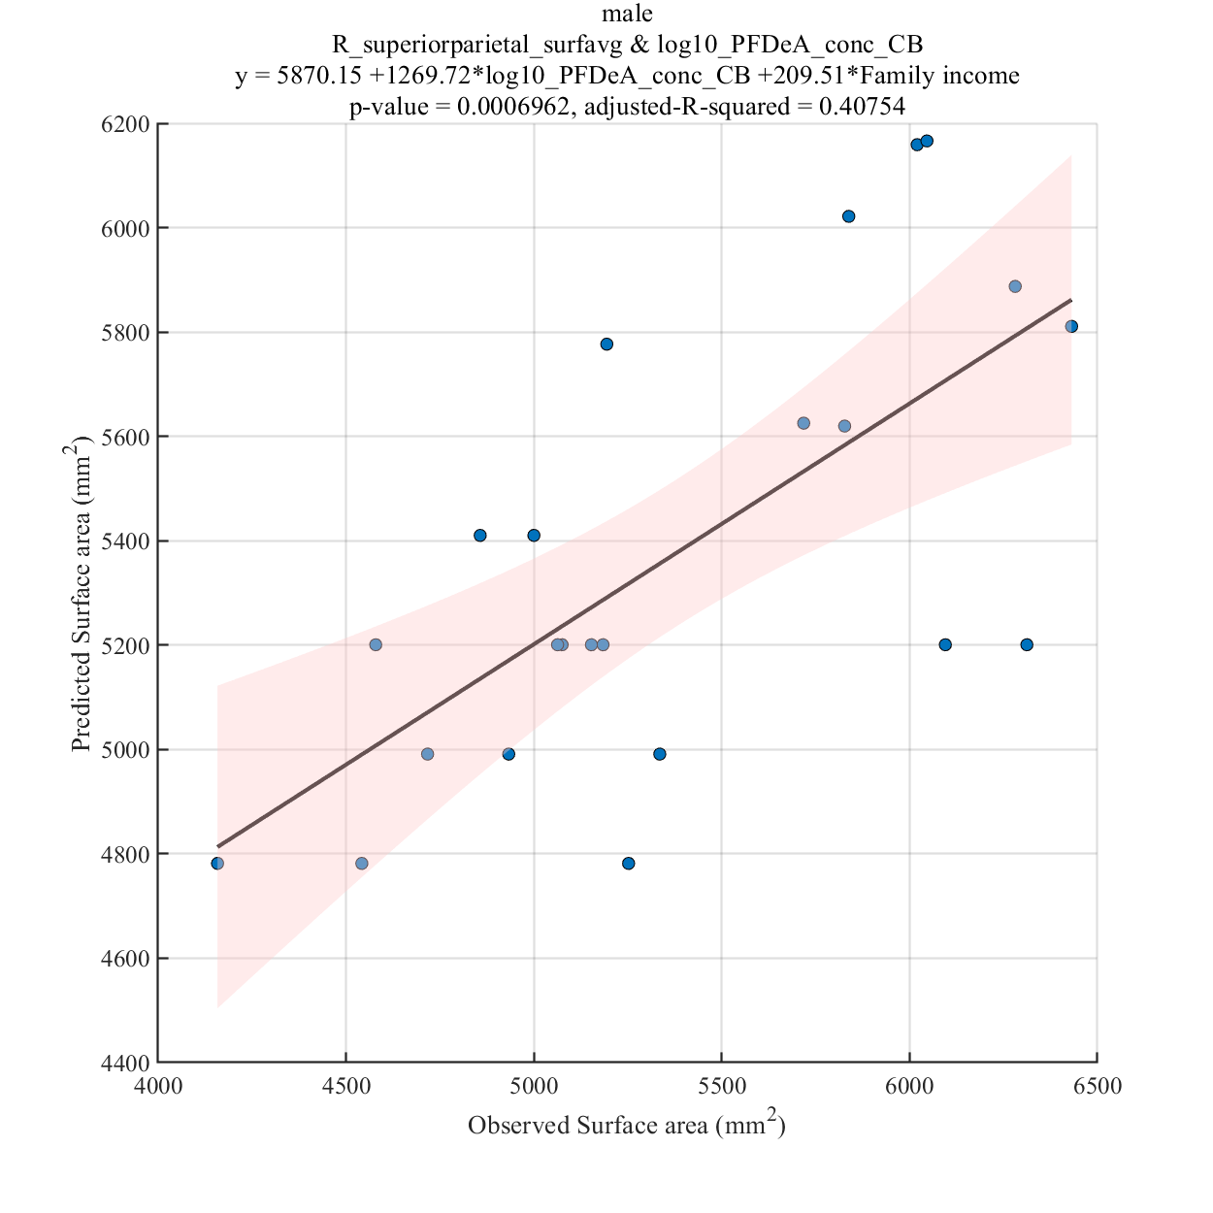
log10_PFDeA_conc_CB

Slide 24
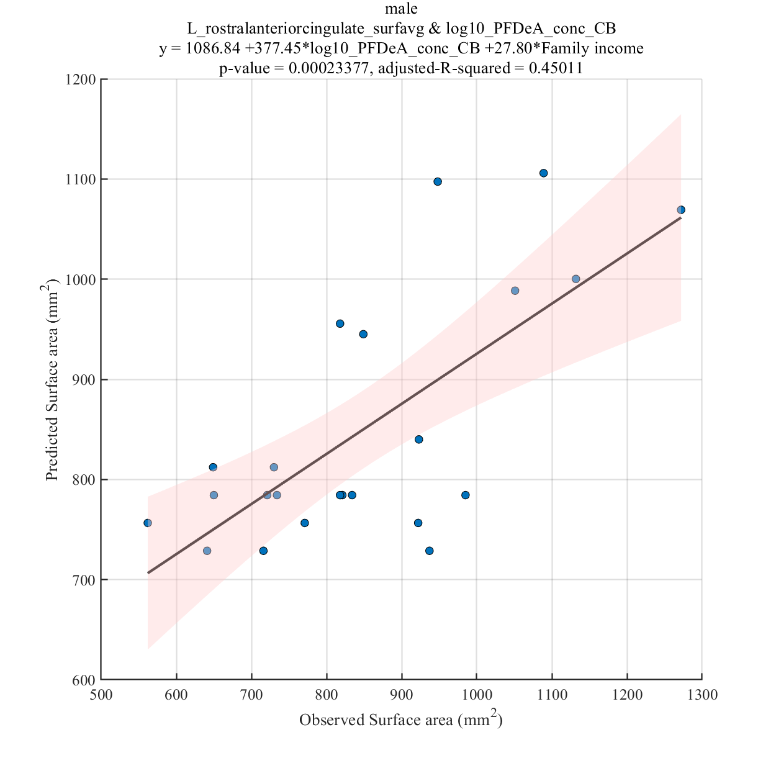
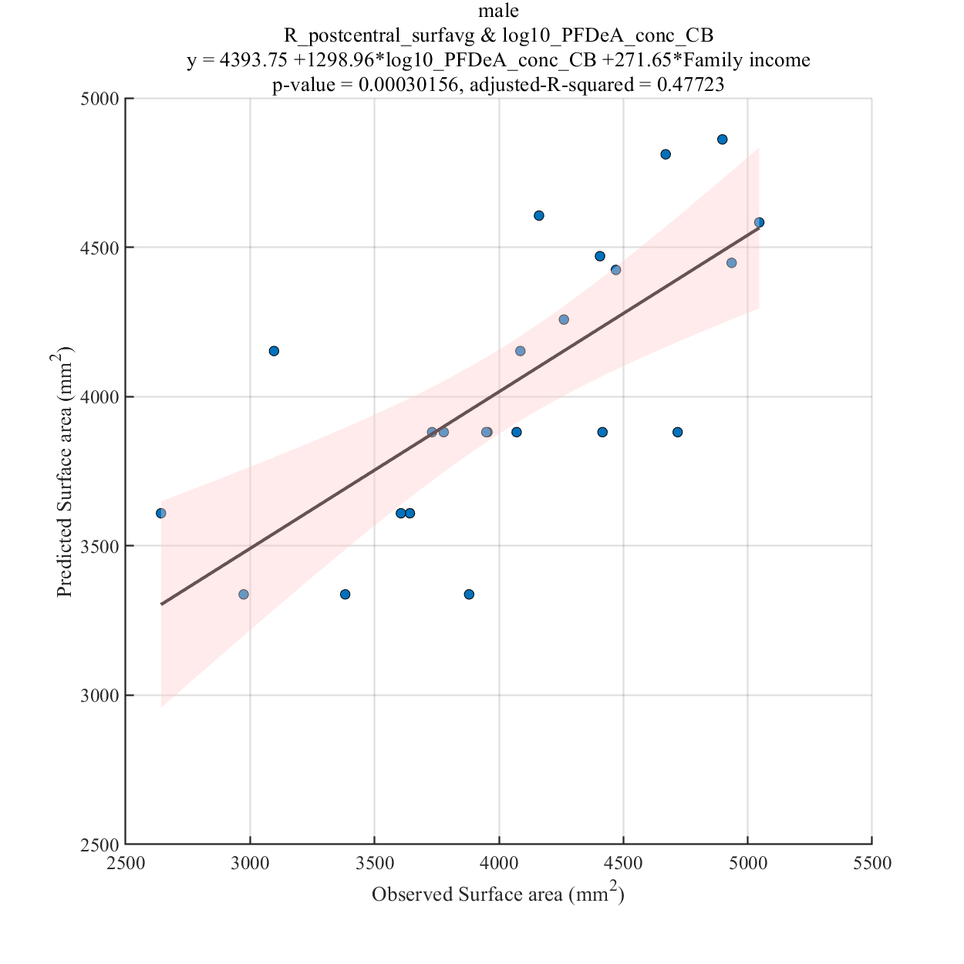
log10_PFDeA_conc_CB

Slide 25
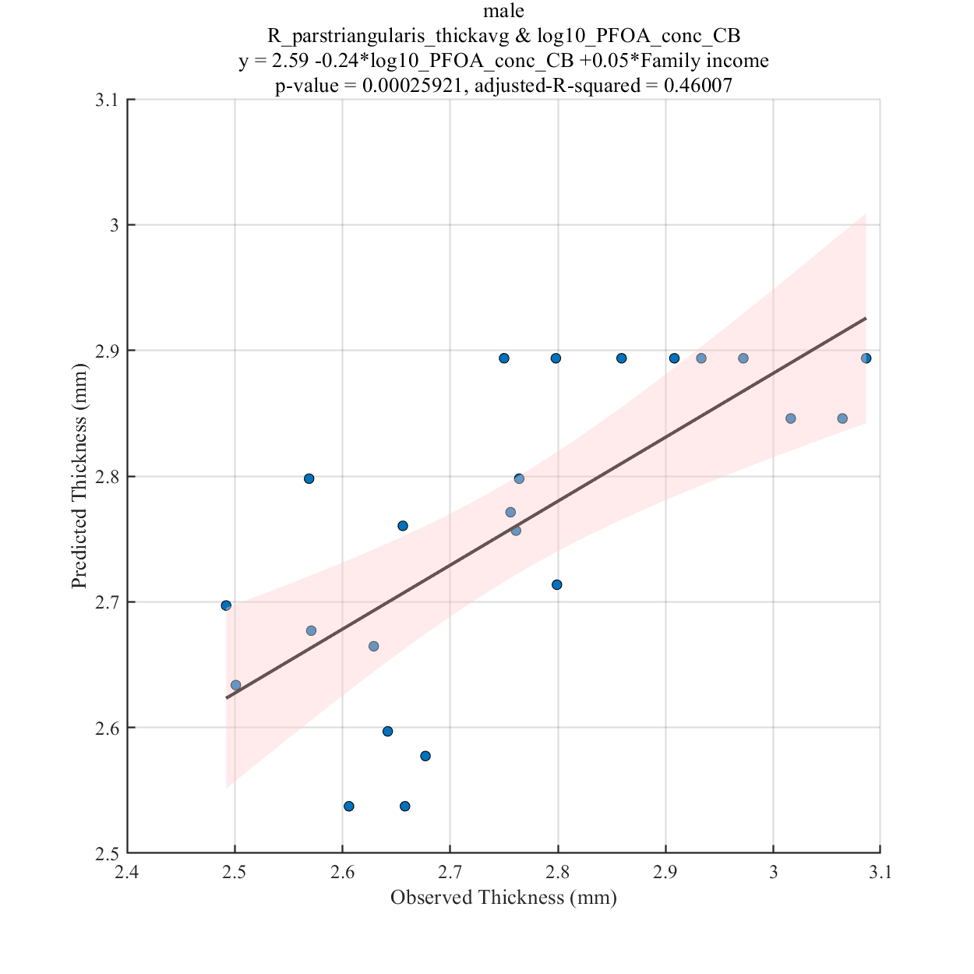
log10_PFOA_conc_CB

Slide 26
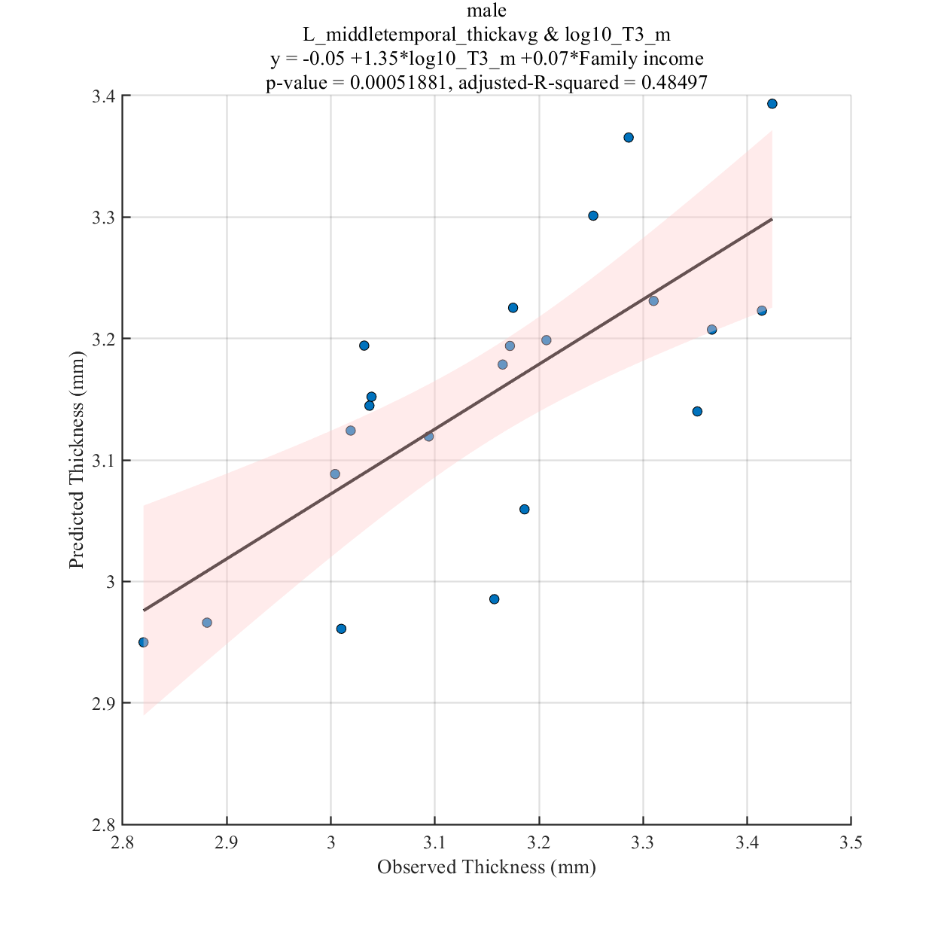
log10_T3_m

Slide 27
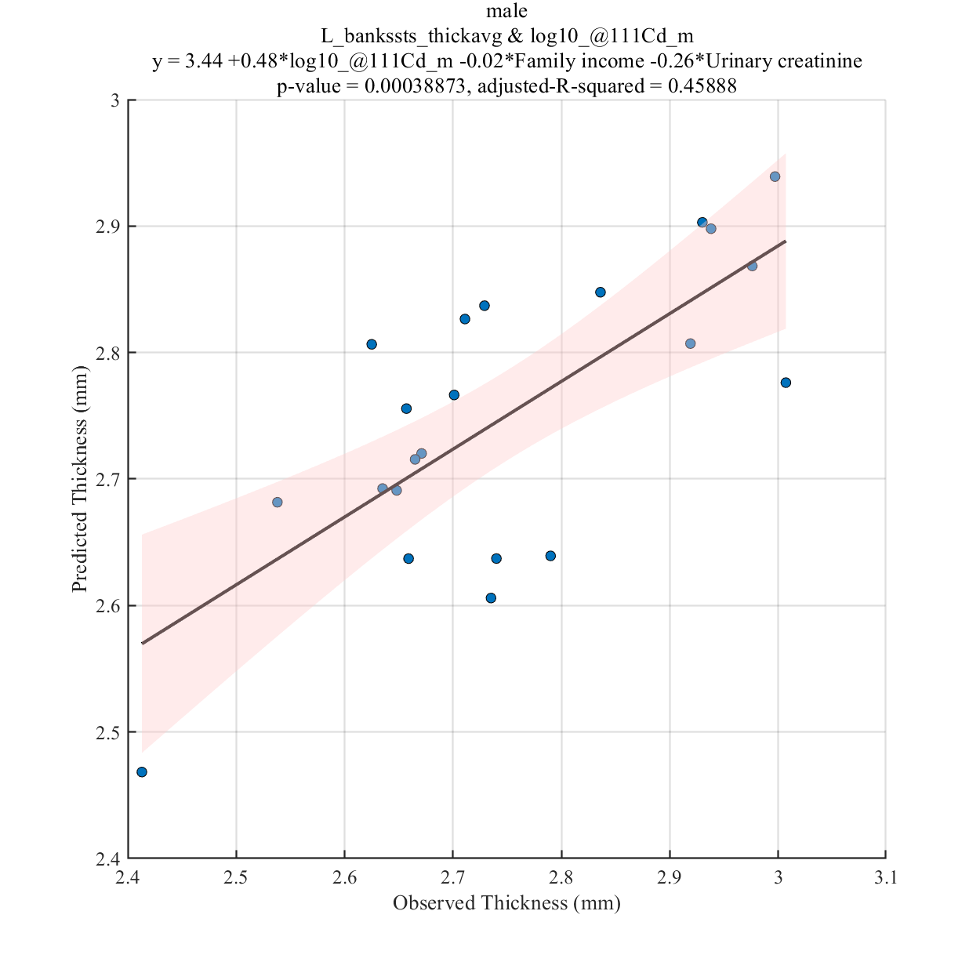
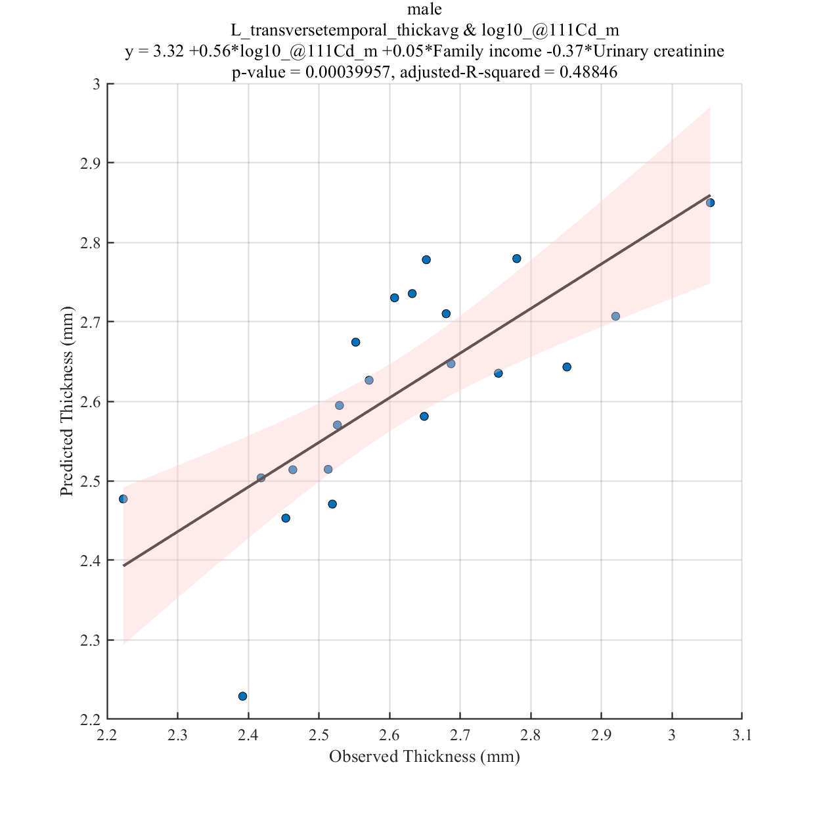
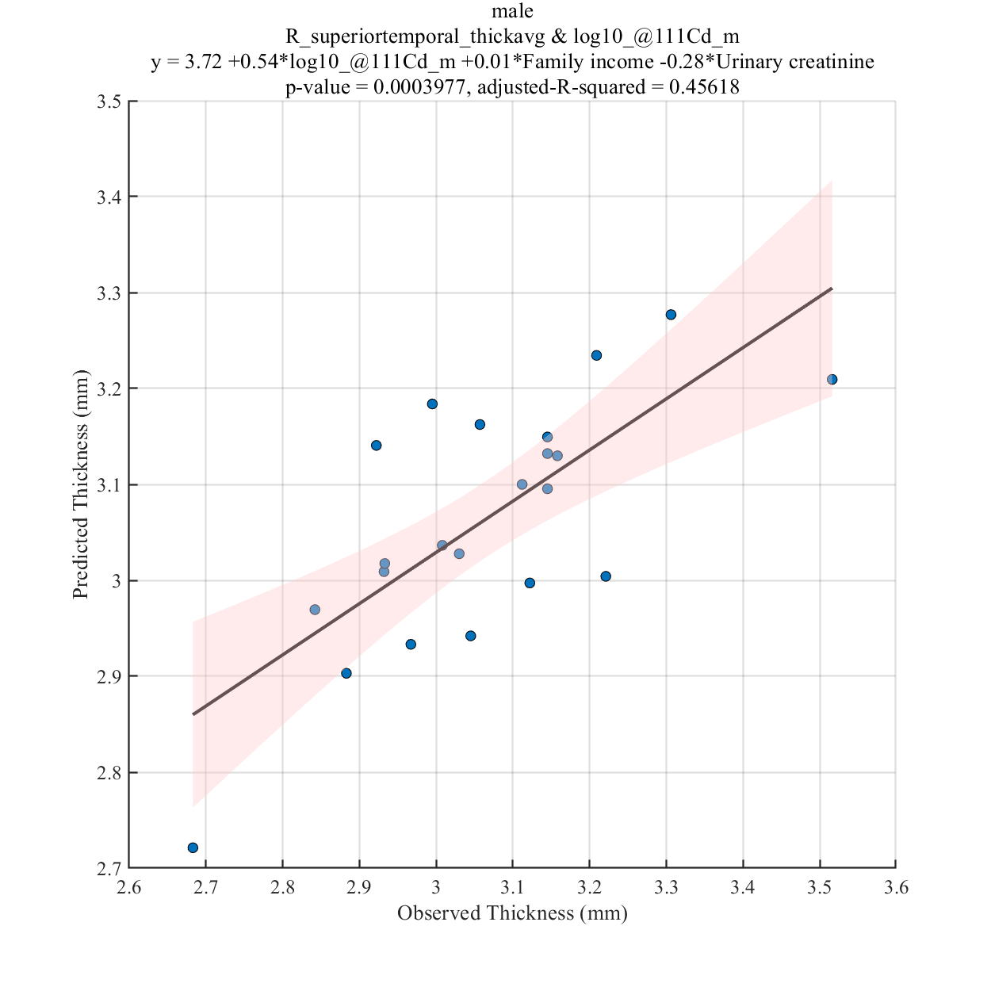
log10_@111Cd_m

Slide 28
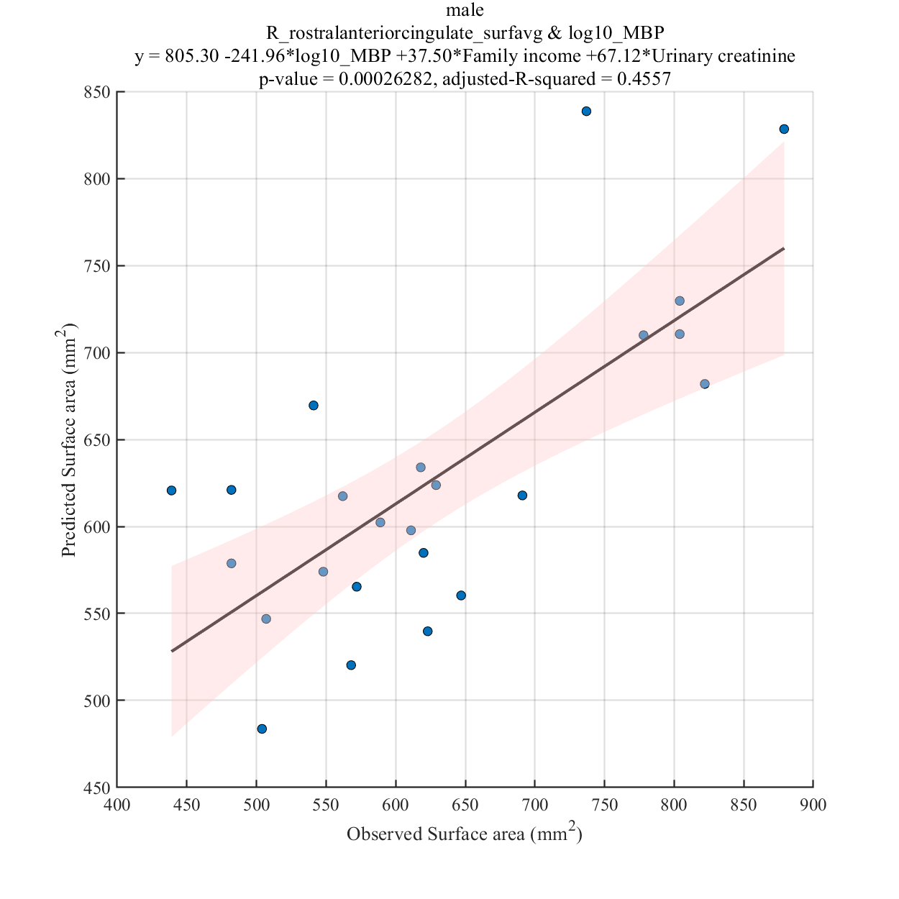
log10_MBP

Slide 29
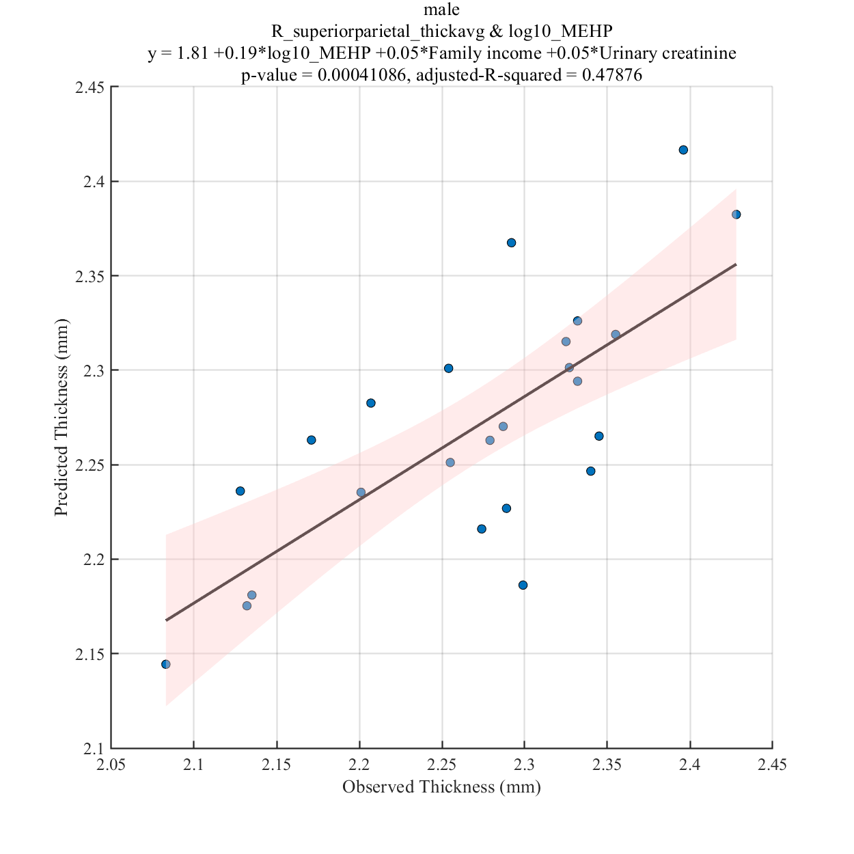
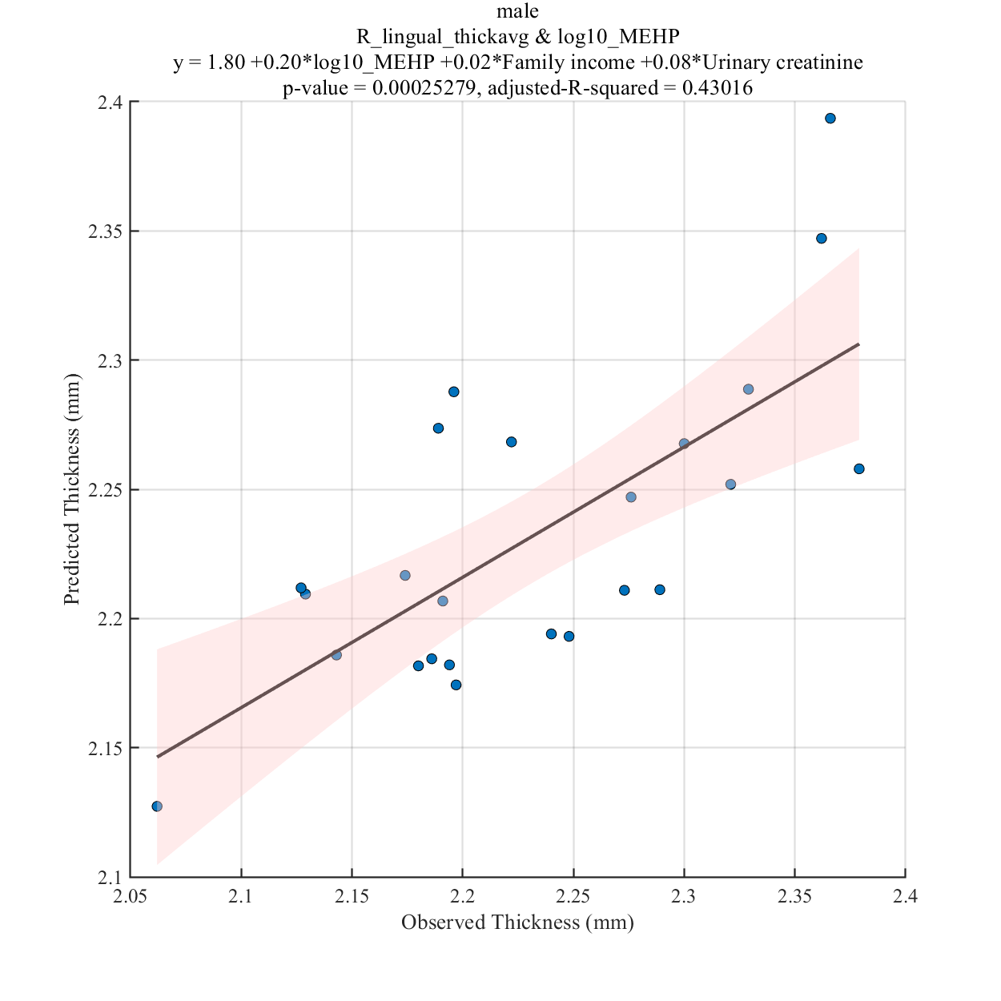
log10_MEHP

Slide 30
Results Significant correlation between cortical measurements of specific brain regions and EDC measurements for mothers with female teenagers (see Table 2)

Slide 31
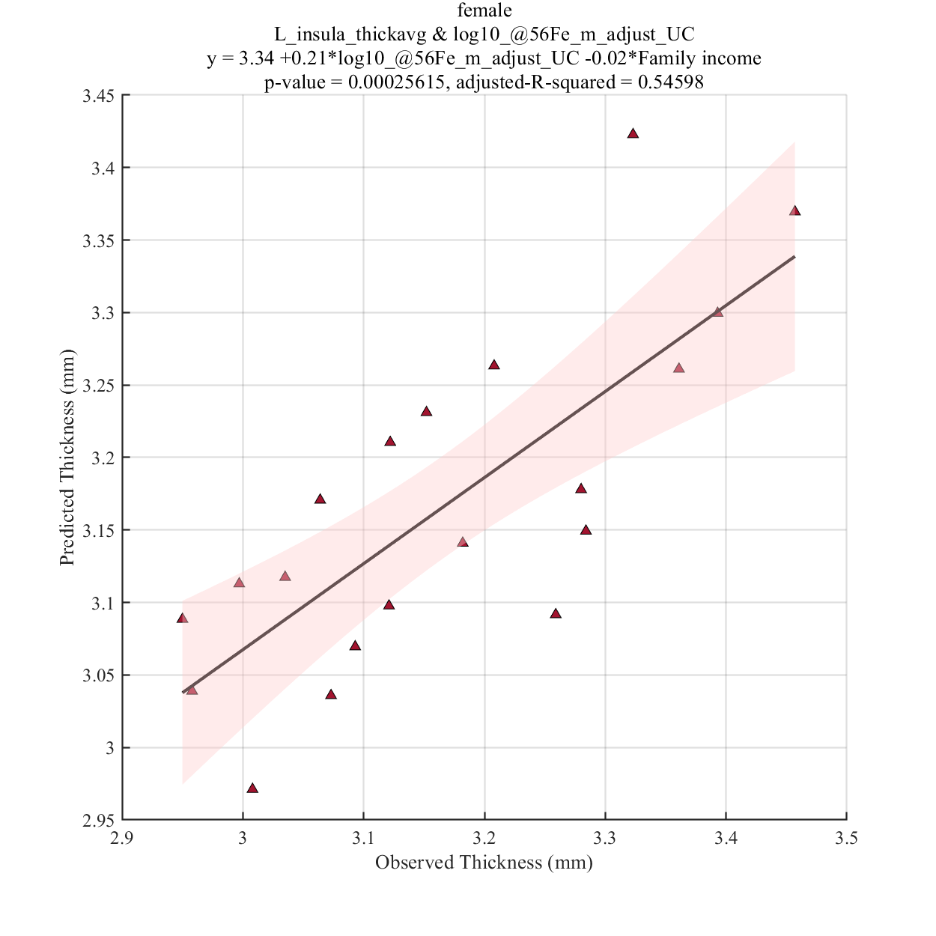
log10_@56Fe_m_adjust_UC

Slide 32
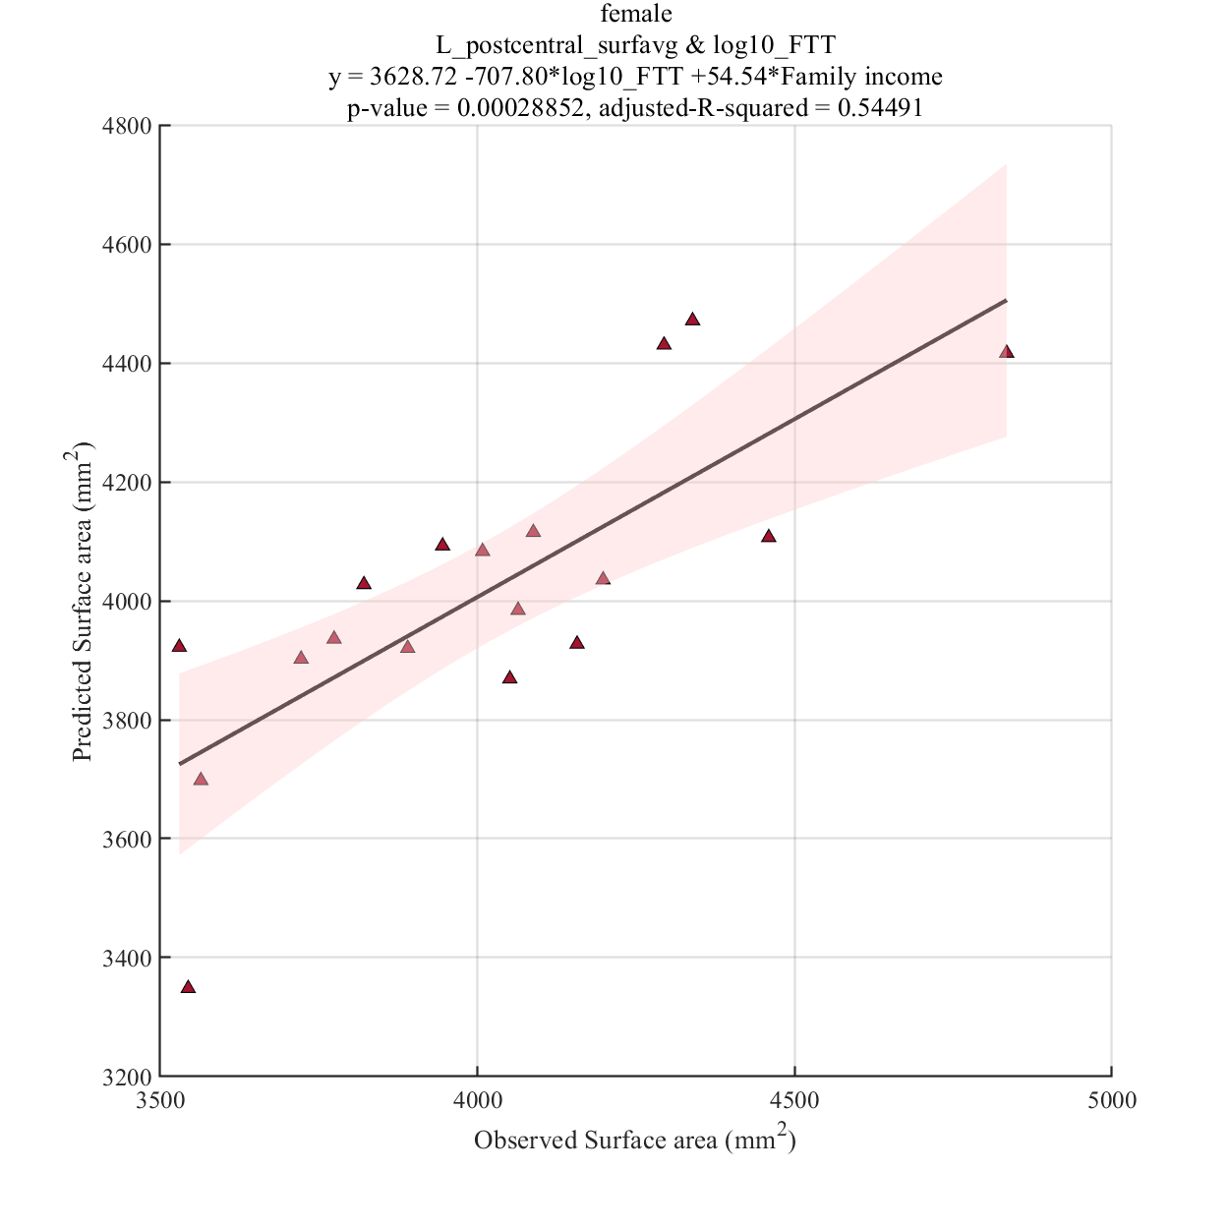
log10_FTT

Slide 33
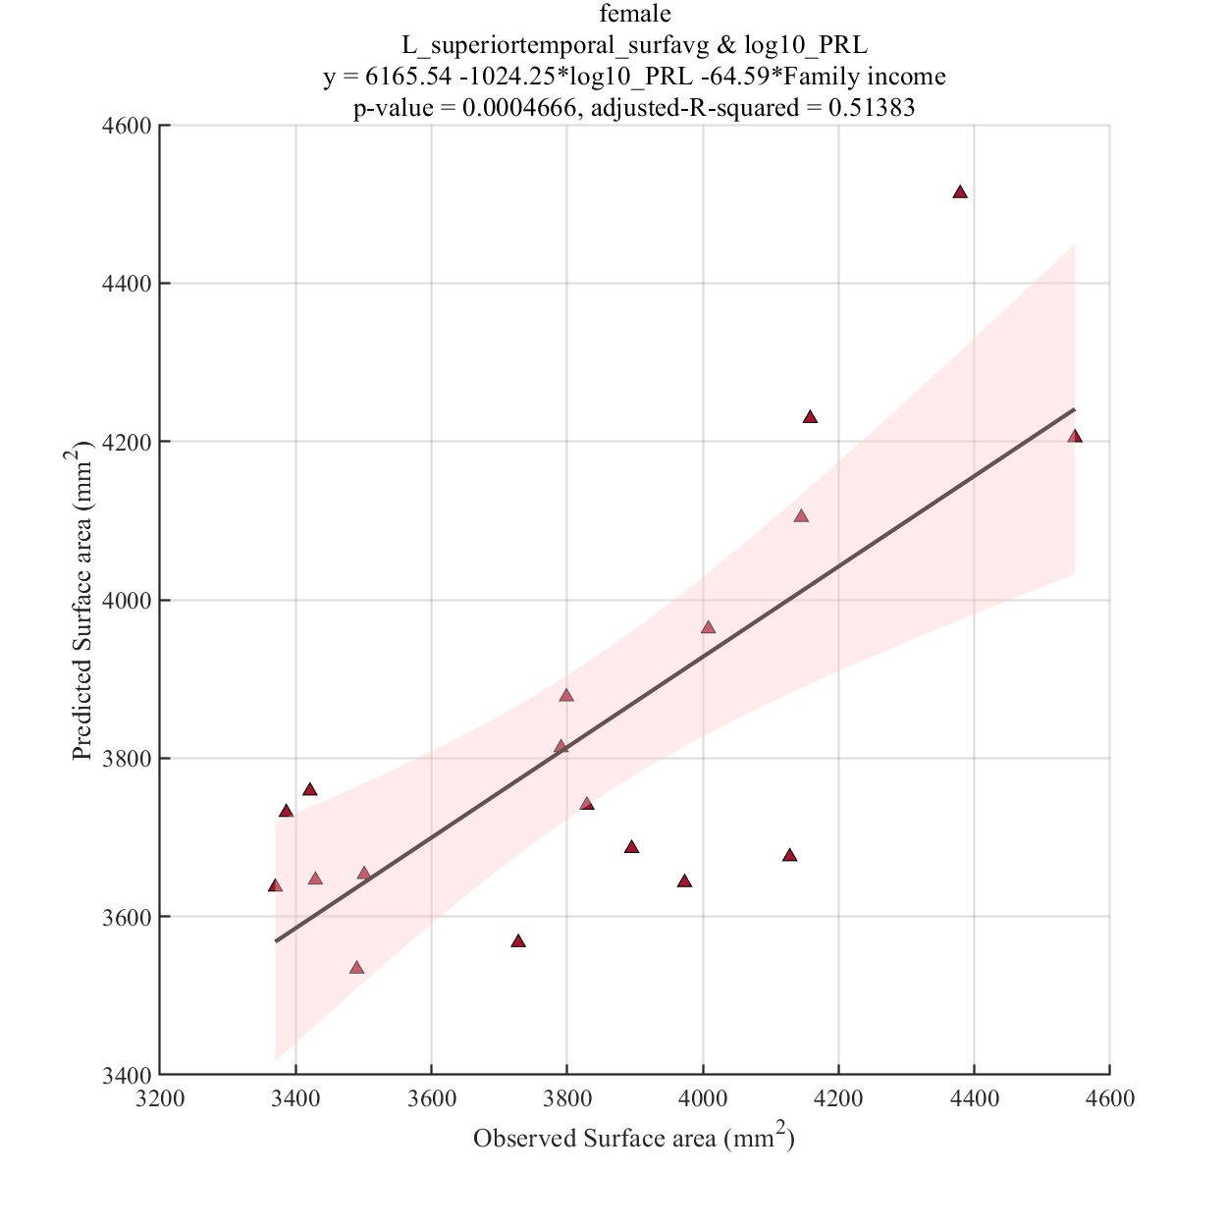
log10_PRL

Slide 34
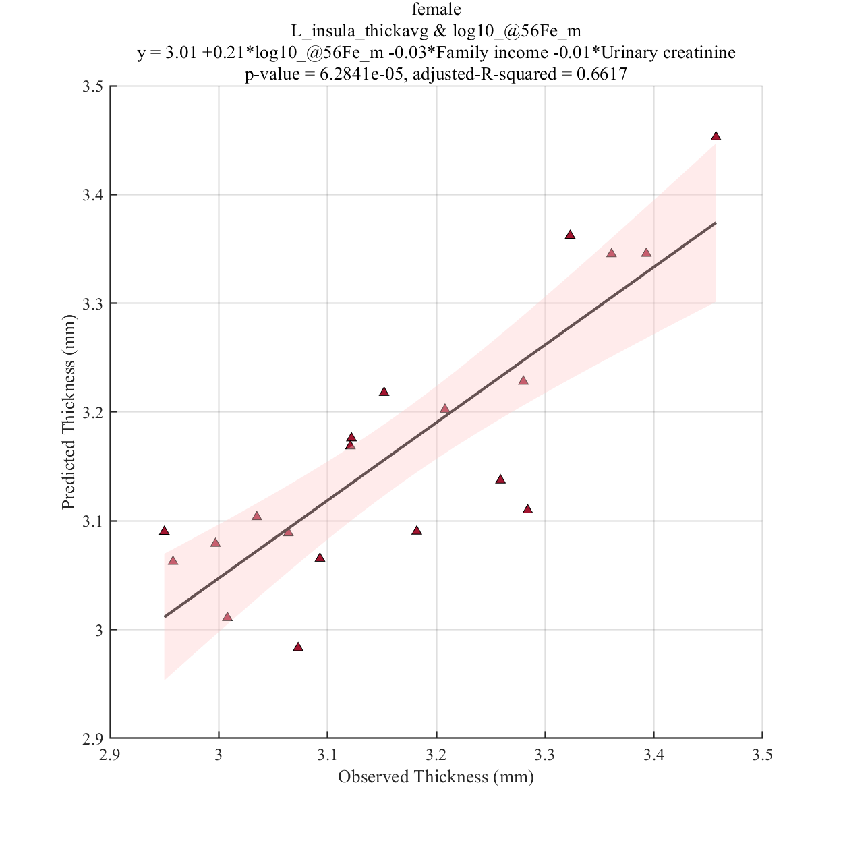
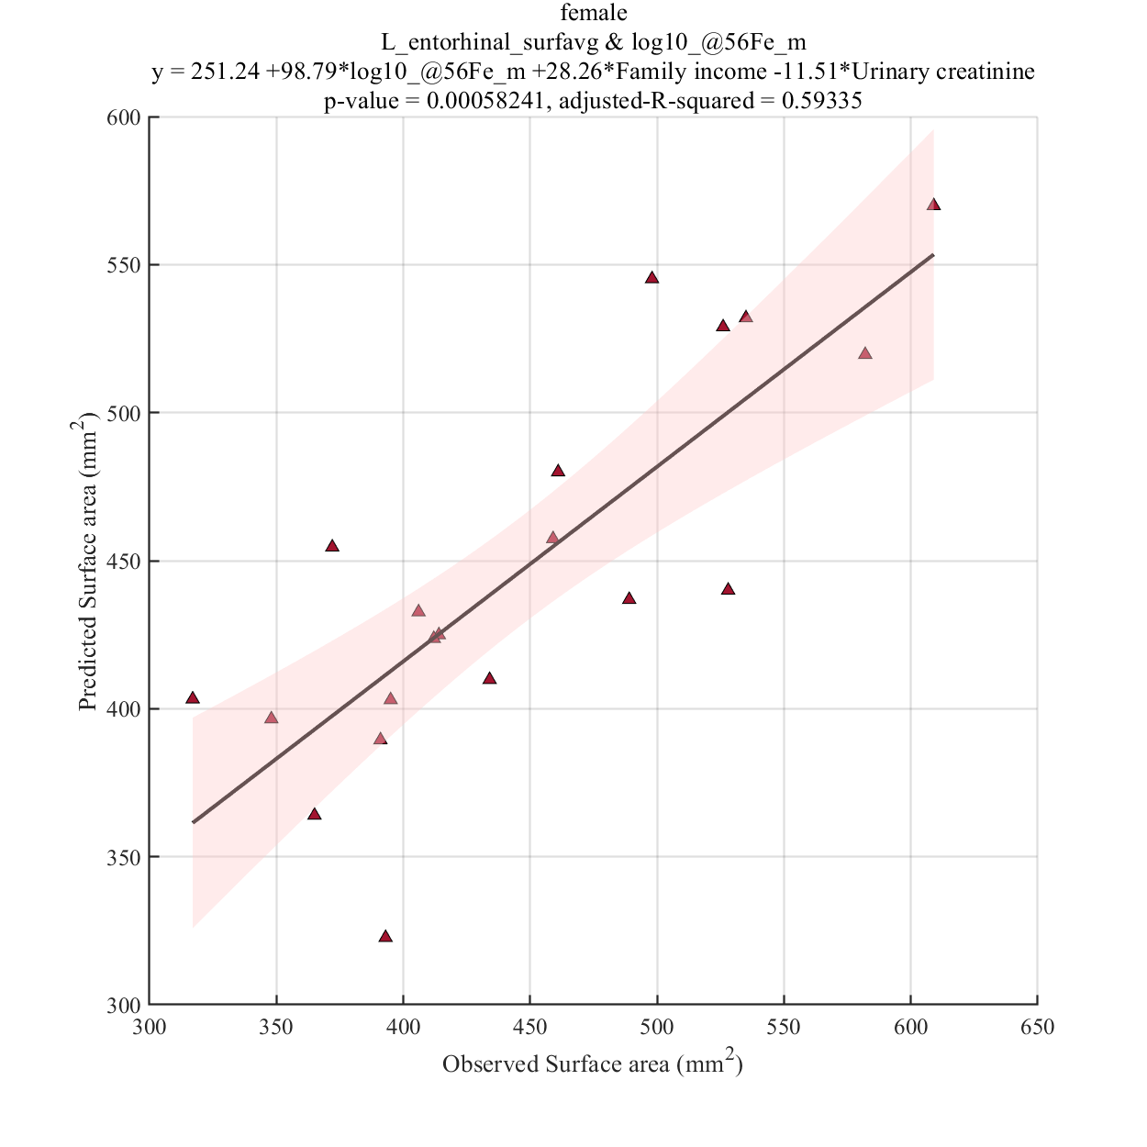
log10_@56Fe

