Slide 1
Algorithms for Minimizing the Movements of Spreading Points in Linear Domains
Shimin Li, Haitao Wang
Utah State University

Slide 2





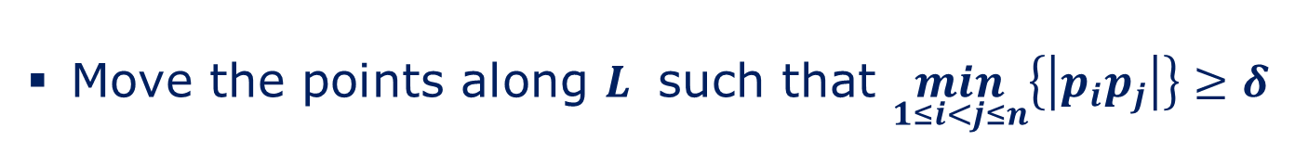
Definition
Line version
Given $n$ points on a line $L$ and a distance $δ$
Move the points along $L$ such that $\min_{1≤i<j≤n}\left\{\left|p_{i}p_{j}\right|\right\}≥δ$
Minimize the maximum moving distance of points
$$>δ$$
$$δ$$
$$δ$$
$$δ$$
$$δ$$

Slide 3
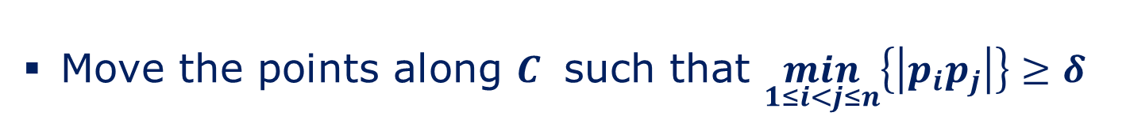
Definition
Cycle version
Given $n$ points on a cycle $C$ and a distance $δ$
Move the points along $C$ such that $\min_{1≤i<j≤n}\left\{\left|p_{i}p_{j}\right|\right\}≥δ$
Minimize the maximum moving distance of points

Slide 4
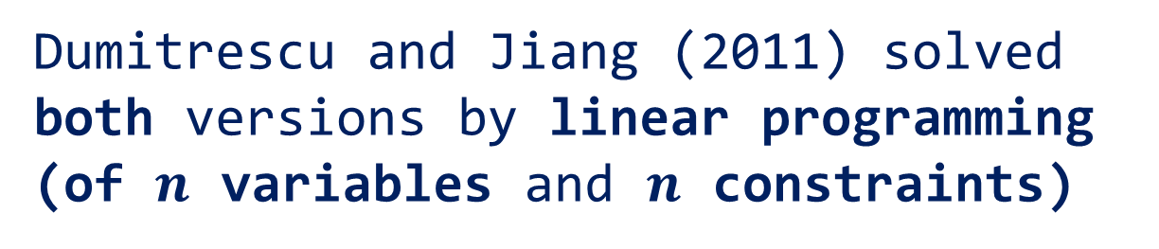
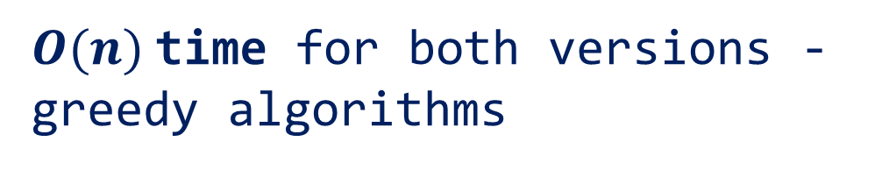
Previous Work And Our Results
Previous work:
Dumitrescu and Jiang (2011) solved both versions by linear programming (of $n$ variables and $n$ constraints)
weakly-polynomial
Our results:
$O(n)$time for both versions - greedy algorithms

Slide 5
Observation
At least two points moved to opposite directions
left
right

Slide 6


Observation (Cont.)
The maximum movement distances to the opposite directions must be the same in any optimal solution
Example: In any $OPT$, we must have $D_{left}=D_{right}$.
$$D_{left}$$
$$D_{right}$$

Slide 7



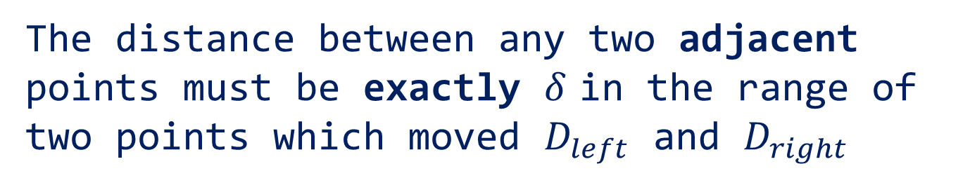



Observation (Cont.)
The distance between any two adjacent points must be exactly $δ$ in the range of two points which moved $D_{left}$ and $D_{right}$
$$D_{left}$$
$$D_{right}$$
$$δ$$
$$δ$$
$$δ$$
$$δ$$

Slide 8



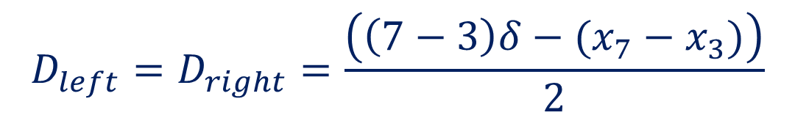





Observation (Cont.)
$$D_{left}=D_{right}=\frac{\left(\left(7−3\right)δ−(x_{7}−x_{3})\right)}{2}$$
$$D_{left}$$
$$x_{7}−x_{3}$$
$$D_{right}$$
$$δ$$
$$δ$$
$$δ$$
$$δ$$
$$4δ$$

Slide 9
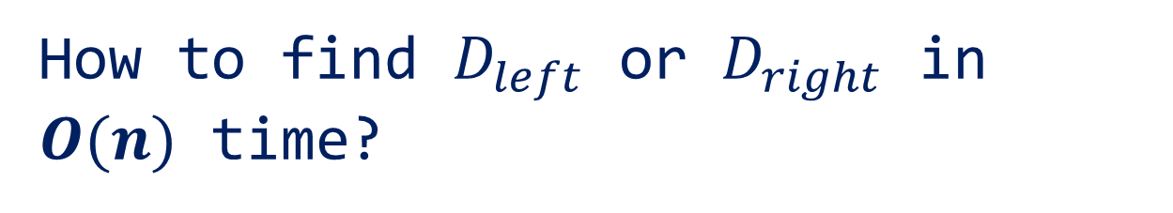
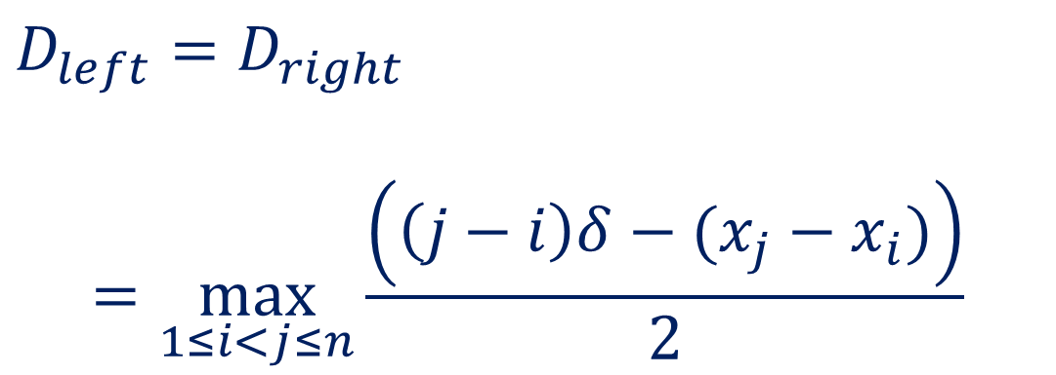
Formula
$$D_{left}=D_{right}$$
$$=\max_{1≤i<j≤n}{\frac{\left(\left(j−i\right)δ−(x_{j}−x_{i})\right)}{2}}$$
Question:
How to find $D_{left}$ or $D_{right}$ in $O(n)$ time?

Slide 10






Observation
$$D_{left}+D_{right}=Constant$$
$$x_{7}−x_{3}$$
$$δ$$
$$δ$$
$$δ$$
$$δ$$
$$4δ$$

Slide 11
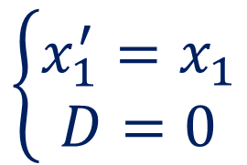
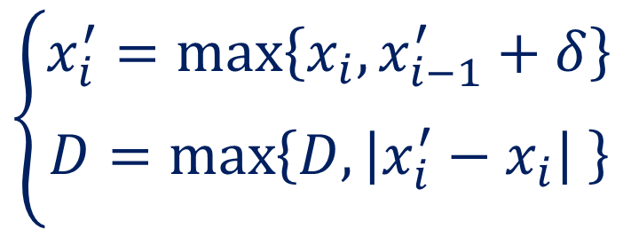
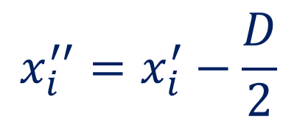

Algorithm Description
$$\left\{\begin{aligned}x_{1}^{′}=x_{1} \\ D=0\end{aligned}\right.$$
Initial Case:
$$\left\{\begin{aligned}x_{i}^{′}=\max_{}\left\{x_{i},x_{i−1}^{′}+δ\right\} \\ D=\max_{}\left\{D,\left|x_{i}^{′}−x_{i}\right| \right\}\end{aligned}\right.$$
Then:
for
$$2≤i≤n$$
$$x_{i}^{′′}=x_{i}^{′}−\frac{D}{2}$$
At last:

Slide 12






Algorithm Description (Cont.)
$$>δ$$
$$δ$$
$$δ$$
$$δ$$
$$δ$$
$$δ$$

Slide 13
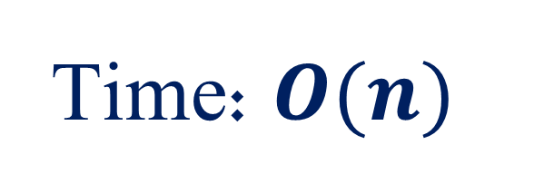
Algorithm Description (Cont.)
Time: $O(n)$

Slide 14
Cycle Version
The difficulty:
How to find a cut/start point on the cycle

Slide 15

Observation
start point
$$<δ$$
didn’t move
the last point not moved

Slide 16
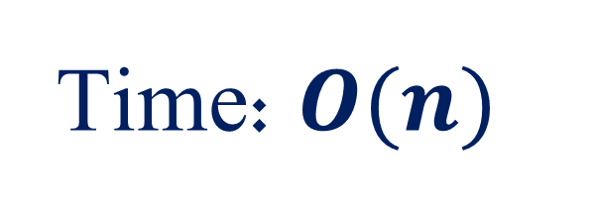

If we start from the last point which did not move, our algorithm can solve the cycle version successfully
$$≥δ$$
Time: $O(n)$

Slide 17
The Facility-location Movement Problem
Given $k$ servers and $n$ clients on a line $L$
Move these servers and clients to make each client co-locate with a server
Minimize the maximum moving distance of servers and clients

Slide 18
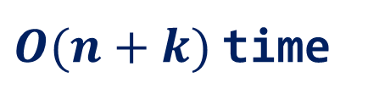
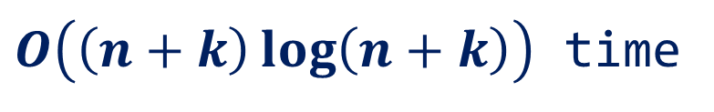
Previous Work And Our Results
Previous work:
Dumitrescu and Jiang (2011) solved the problem by dynamic programming
$O\left(\left(n+k\right)\log\left(n+k\right)\right)$ time
Our results:
$O(n+k)$time

Slide 19

Reducing The Problem To An Interval Coverage Problem
Find $k$ intervals
s.t.:
Each interval covers one server
Each client is covered by at least one interval
Object:
Minimize the length of the longest interval

Slide 20


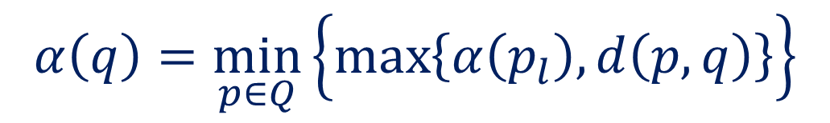
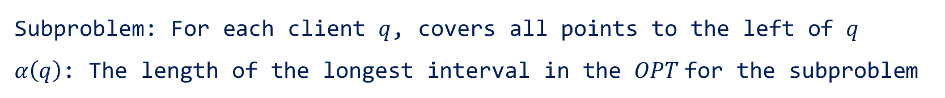





A Dynamic Programming Approach
$$α\left(p_{l}\right)$$
$$Q$$
$$α\left(q\right)$$
$${\text{p}}_{l}$$
$$\text{p}$$
$$d\left(\text{p}, q\right)$$
$$q$$
Subproblem: For each client $q$, covers all points to the left of $q$
$α\left(q\right)$: The length of the longest interval in the $OPT$for the subproblem
$$α\left(q\right)=\min_{p∈Q}\left\{\max_{}\left\{α\left(p_{l}\right),d\left(p,q\right)\right\}\right\}$$

Slide 21








Our Improvement
$$d\left(\text{p}, q\right)$$
$$α\left(p_{l}\right)$$
$$\text{p}$$
$$Q$$
$$p_{l}$$
$$\text{p}$$
$$d\left(\text{p}, q\right)$$
$$q$$

Slide 22
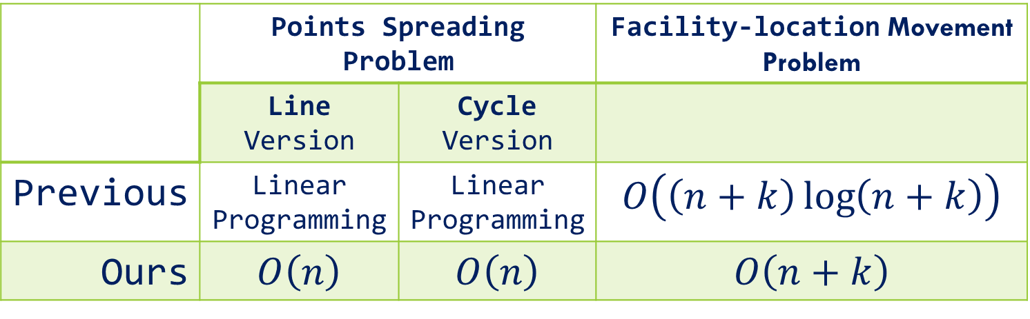
SUMMARY
 | Points Spreading Problem |  | Facility-location Movement Problem
 | Line Version | Cycle Version
Previous | Linear Programming | Linear Programming | $$O\left(\left(n+k\right)\log\left(n+k\right)\right)$$
Ours | $$O\left(n\right)$$ | $$O\left(n\right)$$ | $$O\left(n+k\right)$$

Slide 23
observation
The order of points does NOT change
1
2
3
4
5
6
1
2
3
4
5
6

Slide 24
observation
Only need to extend the distances between these points

Slide 25
Algorithm description

Slide 26

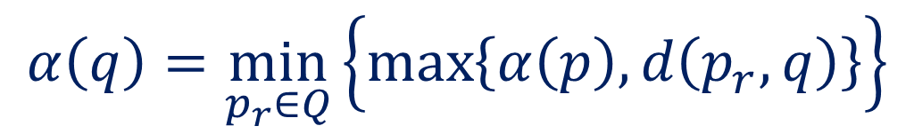
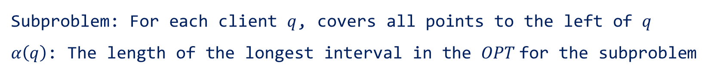



a Dynamic programming approach
$$α\left(p\right)$$
$$Q$$
$$α\left(q\right)$$
$$\text{p}$$
$$p_{r}$$
$$d\left(p_{r}, q\right)$$
$$q$$
Subproblem: For each client $q$, covers all points to the left of $q$
$α\left(q\right)$: The length of the longest interval in the $OPT$for the subproblem
$$α\left(q\right)=\min_{p_{r}∈Q}\left\{\max_{}\left\{α\left(p\right),d\left(p_{r},q\right)\right\}\right\}$$

