Slide 1

Algorithms for Connectivity Maintenance and Barrier Coverage on a Closed Cycle
Shimin Li
Department of Computer Science
Winona State University

Slide 2
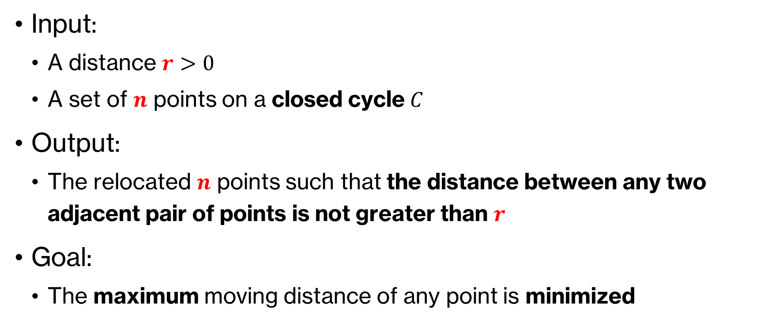
Problem Definition
Input:
  A distance $r>0$
  A set of $n$ points on a closed cycle $C$
Output:
  The relocated $n$ points such that the distance between any two adjacent pair of points is not greater than $r$
Goal:
  The maximum moving distance of any point is minimized

Slide 3
Previous Work and Our Results
The min-max movement problems of barrier coverage on a line or a cycle can be solved in O(n), but the result is not lexicographically optimal. [Chen et al. 2013]
The min-max problems in the plane was solved in linear time. [Das et al. 2017]
  where the sensors are initially located along a path, not a closed cycle
  the sensors are allowed to move in any direction, not just along the path
The connectivity maintenance problems on a line was solved in O(n). [Li et al. 2019]
Our algorithm finds a lexicographically optimal solution to the problems of connectivity maintenance (or barrier coverage) on a closed cycle in linear time based on a greedy technique.

Slide 4


Barrier Coverage
$$r$$
$$r$$

Slide 5

Connectivity Maintenance
$$r$$

Slide 6
Order Preserving Property
The order of points does not need to change in the process of the algorithm

Slide 7

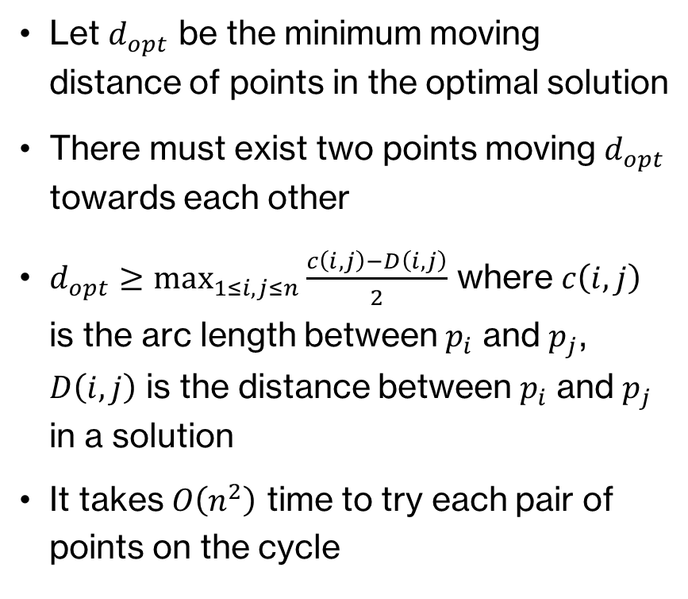

The Non-lexicographical Version
Let $d_{opt}$ be the minimum moving distance of points in the optimal solution
There must exist two points moving $d_{opt}$ towards each other
$d_{opt}≥\max_{1≤i,j≤n}{\frac{c\left(i,j\right)−D\left(i,j\right)}{2}}$ where $c\left(i,j\right)$ is the arc length between $p_{i}$ and $p_{j}$, $D\left(i,j\right)$ is the distance between $p_{i}$ and $p_{j}$ in a solution
It takes $O\left(n^{2}\right)$ time to try each pair of points on the cycle
$$d_{opt}$$
$$d_{opt}$$

Slide 8


The Non-lexicographical Version (Cont.)
$$p_{1}$$
$${2d}_{opt}$$

Slide 9
The Non-lexicographical Version (Cont.)
$$p_{1}$$
$${2d}_{opt}$$

Slide 10

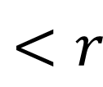
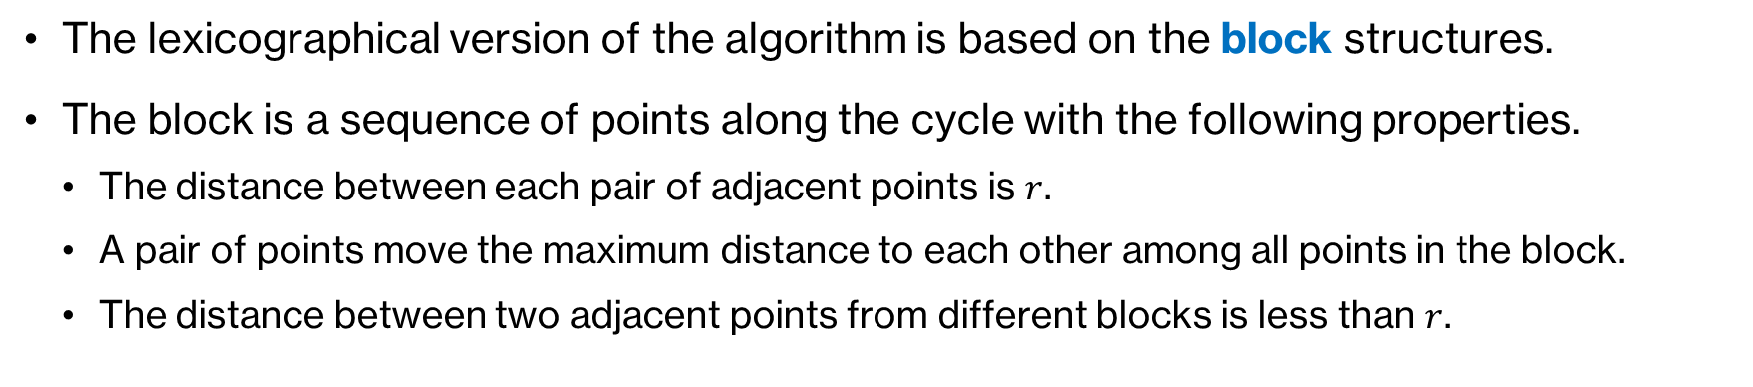
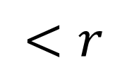


The Lexicographical Version
The lexicographical version of the algorithm is based on the block structures.
The block is a sequence of points along the cycle with the following properties.
  The distance between each pair of adjacent points is $r$.
  A pair of points move the maximum distance to each other among all points in the block.
  The distance between two adjacent points from different blocks is less than $r$.
$$<r$$
$$<r$$
$$r$$
$$r$$
$$r$$

Slide 11
Property 2 of each block

Slide 12

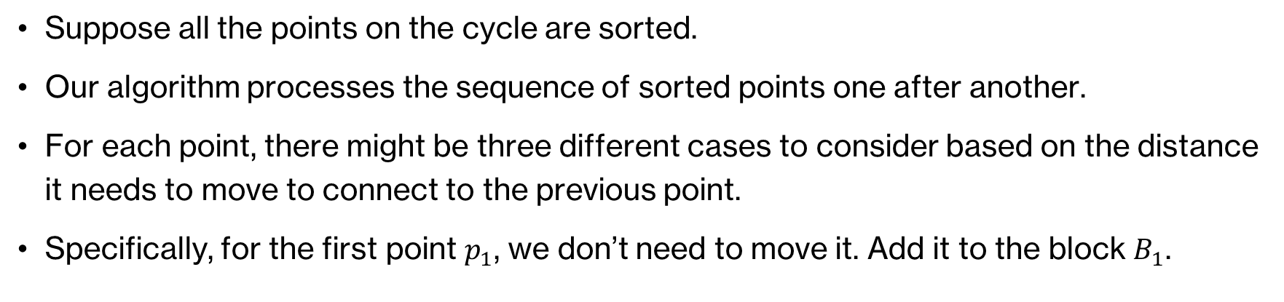
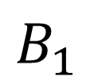
Process of Our Algorithm
Suppose all the points on the cycle are sorted.
Our algorithm processes the sequence of sorted points one after another.
For each point, there might be three different cases to consider based on the distance it needs to move to connect to the previous point.
Specifically, for the first point $p_{1}$, we don’t need to move it. Add it to the block $B_{1}$.
$$B_{1}$$
$$p_{1}$$

Slide 13
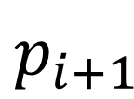
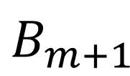

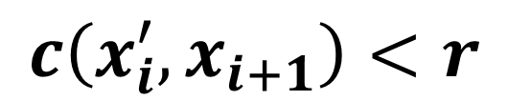

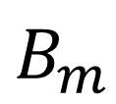
The Case $c\left(x_{i}^{′},x_{i+1}\right)<r$:
$$B_{m}$$
$$B_{m+1}$$
$$p_{i}$$
$$p_{i+1}$$
$$c\left(x_{i}^{′},x_{i+1}\right)<r$$

Slide 14
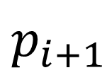



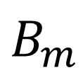
The Case $r≤c\left(x_{i}^{′},x_{i+1}\right)≤r+D_{m}$:
$D_{m}$: the maximum moving distance of points in block $B_{m}$
$$B_{m}$$
$$p_{i}$$
$$p_{i+1}$$
$$r$$

Slide 15
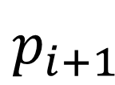



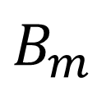
The Case $c\left(x_{i}^{′},x_{i+1}\right)>r+D_{m}$:
$$B_{m}$$
$$p_{i}$$
$$p_{i+1}$$
$$r$$

Slide 16
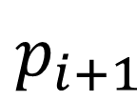

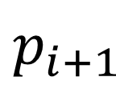
Property 2 of each block is violated in $B_{m}$
$$p_{i+1}$$
Move all the points in the new block $B_{m}$ rightwards such that property 2 holds.
$$p_{i+1}$$

Slide 17


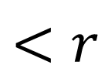

The distance between $B_{m−1}$ and $B_{m}$ might not be less than $r$
$$B_{m−1}$$
$$B_{m}$$
$$<r$$

Slide 18



The distance between $B_{m−1}$ and $B_{m}$ is $r$
Merge $B_{m}$ into $B_{m−1}$ if the distance is exactly $r$
$$B_{m−1}$$
$$B_{m}$$
$$r$$

Slide 19

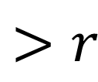
The distance between $B_{m−1}$ and $B_{m}$ is greater than $r$
$$B_{m−1}$$
$$B_{m}$$
$$>r$$

Slide 20
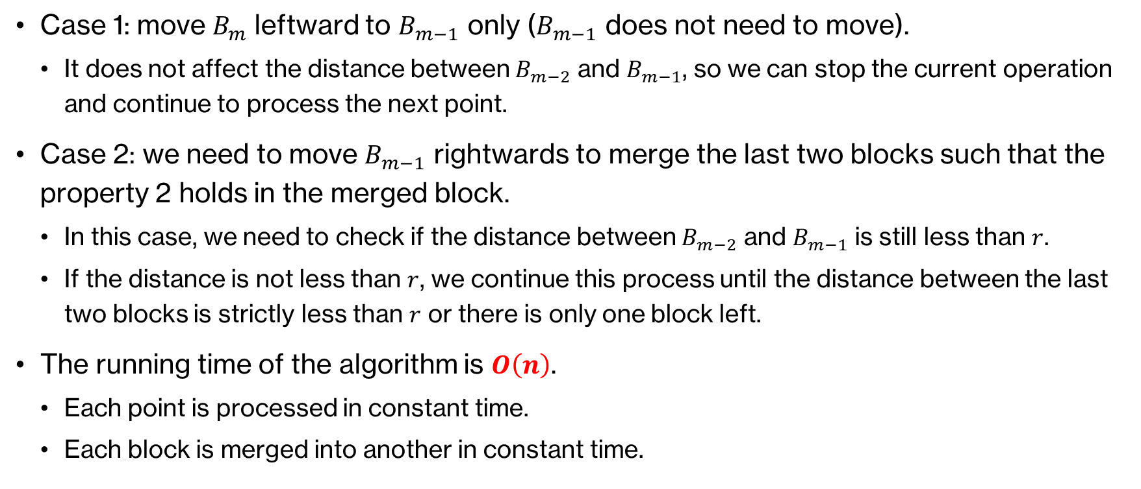
Two cases to consider to merge the last two blocks
Case 1: move $B_{m}$ leftward to $B_{m−1}$ only ($B_{m−1}$ does not need to move).
  It does not affect the distance between $B_{m−2}$ and $B_{m−1}$, so we can stop the current operation and continue to process the next point.
Case 2: we need to move $B_{m−1}$ rightwards to merge the last two blocks such that the property 2 holds in the merged block.
  In this case, we need to check if the distance between $B_{m−2}$ and $B_{m−1}$ is still less than $r$.
  If the distance is not less than $r$, we continue this process until the distance between the last two blocks is strictly less than $r$ or there is only one block left.
The running time of the algorithm is $O\left(n\right)$.
  Each point is processed in constant time.
  Each block is merged into another in constant time.

Slide 21
Thanks!

