Slide 1
Gas Network modelling for a multi-gas system
Version July 12th, 2023

Slide 2
Gas Network Model
Overview on Fluid-Dynamic Solver

Slide 3


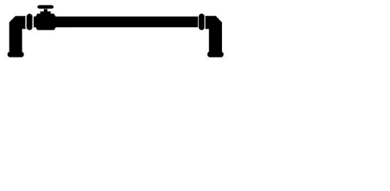

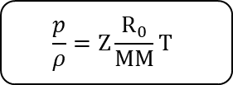

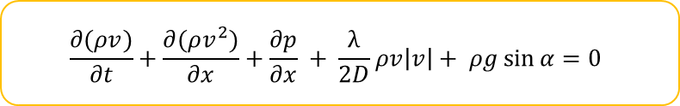
Gas Network Model
Overview:
Equations:
Coninutiy equation
1D gas flow –
Transient –
Isothermal –
Multi-component –
$$\frac{∂ρ}{dt} + \frac{∂(ρv)}{∂x}=0$$
Flow equation
$$\frac{∂(ρv)}{∂t}+\frac{∂(ρv^{2})}{∂x}+\frac{∂p}{∂x} + \frac{λ}{2D}ρv\left|v\right|+ ρg\sin{α}=0$$
Parameters
– Network Topology
Coupled equations to be linearized and solved iteratively
– Pipelines Features
Outputs
Physical Model
– Gas Profiles
Gas Flow – for each branch
– P, Composition at injection node
Closure equation:
P, Composition – at each node
Equation of State
Inputs
$$\frac{p}{ρ}=Z\frac{R_{0}}{MM}T$$
$Z$ determined through GERG-08
wide range equation of state
At each timestep
Notes:
For these reasons, the model is based on one dimensional and transient flow equations, namely the conservation of mass and of momentum. The gas flow is assumed to be iso-thermal, which is a rather common and accepted simplification for gas network modeling througout the literature, thus the equation of concentration of energy is not necessary. In the end the multi-component feature is crucial for the purpose of multi-gas framework modeling.
The physical model needs to be provided with parameter of the gas network and operational data: concerning the parameter: the topology (the network structure, the connection between pipes) and the technical features of the pipes are needed; as of the operational data, the inputs, gas profiles at outlet nodes and pressure and composition values at the injection nodes are needed.

Slide 4
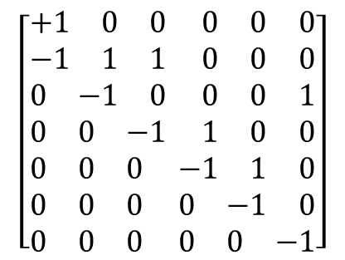
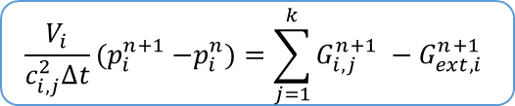

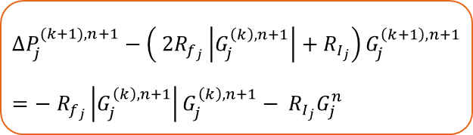


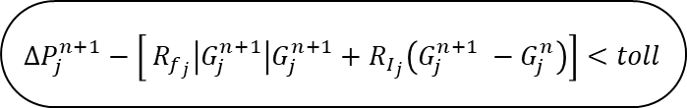



Gas Network Model
Solving Strategy:
$p_{inlet}^{0}$ ; $G_{ext}^{0}$
Networkwide:
initial [t=0]
steady state solution
SIMPLE algorithm
adaptation
3
7
2
Equation of State
$$G_{in}$$
1
updates the fluid properties
1
2
5
3
4
5
6
Coninutiy equation
Network Topology:
4
$$G_{out}′′$$
branches
$$\frac{V_{i}}{c_{i,j}^{2}∆t}{(p}_{i}^{n+1} −p_{i}^{n})=\sum_{j=1}^{k}{G_{i,j}^{n+1} }−G_{ext,i}^{n+1}$$
$$\begin{matrix}1 & 2 & 3\end{matrix} \begin{matrix}4 & 5 & 6\end{matrix}$$
$$1 \\ 2 \\ 3 \\ 4 \\ 5 \\ 6 \\ 7$$
$$\left[\begin{aligned}\begin{matrix}+1 & 0 & 0\end{matrix} \begin{matrix}0 & 0 & 0\end{matrix} \\ \begin{matrix}−1 & 1 & 1\end{matrix} \begin{matrix}0 & 0 & 0\end{matrix} \\ \begin{matrix}0 & −1 & 0\end{matrix} \begin{matrix}0 & 0 & 1\end{matrix} \\ \begin{matrix}0 & 0 & −1\end{matrix} \begin{matrix}1 & 0 & 0\end{matrix} \\ \begin{matrix}0 & 0 & 0\end{matrix} \begin{matrix}−1 & 1 & 0\end{matrix} \\ \begin{matrix}0 & 0 & 0\end{matrix} \begin{matrix}0 & −1 & 0\end{matrix} \\ \begin{matrix}0 & 0 & 0\end{matrix} \begin{matrix}0 & 0 & −1\end{matrix}\end{aligned}\right]$$
Flow equation
LINEARIZED EQUATION
Incidence Matrix
representation of the network
+1 inlet node
-1 outled node
Reading column-by-column
Coupled fluid-dynamic problem
$$X =$$
$$∆P_{j}^{(k+1), n+1}−\left( 2R_{f_{j}}\left|G_{j}^{\left(k\right), n+1}\right|+R_{I_{j}}\right)G_{j}^{\left(k+1\right), n+1}={{− R}_{f_{j}}\left|G_{j}^{\left(k\right),n+1}\right|G_{j}^{\left(k\right),n+1}− R}_{I_{j}}G_{j}^{n}$$
nodes
$∆P_{j}^{n+1}−\left[ R_{f_{j}}\left|G_{j}^{n+1}\right|G_{j}^{n+1}+R_{I_{j}}\left(G_{j}^{n+1} −G_{j}^{n}\right)\right]<toll$
Repeated for
no
each Timestep

Slide 5
Input data structure

Slide 6
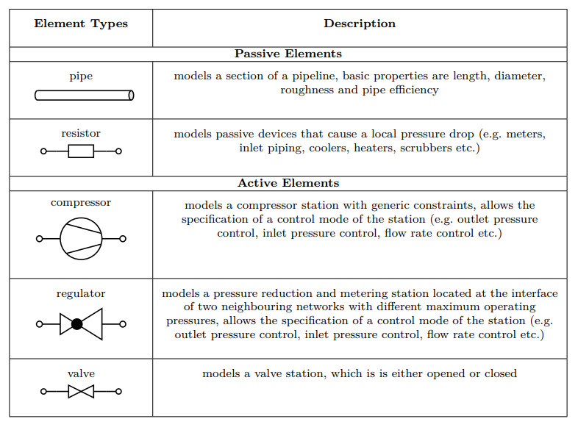
Input Data Structure – EDGE TABLE
Non pipeline elements
Non pipeline elements
nodes
branch | IN | OUT | L (km) | D (m) | epsi[mm] | COMP | REG | VAL | RES | n°Grid points
1 | 1 | 2 | 530.0 | 0.7937 | 0.014 |  |  |  |  | 53
2 | 2 | 3 | 1.0 | 0.7937 | 0.014 | 1 |  |  |  | 1
3 | 3 | 4 | 540.0 | 0.7937 | 0.014 |  |  |  |  | 54
Either 0 or 1 to indicate that a specific branch is a Non-pipeline element thus the equations applied are different
Topological info:
Branch (edges) list and indication of inlet and oulet node
Some additional column may be added as additional information about each pipe:
For example, to take into account the gravitational effect, if the altitude at each node is not available, then the DeltaH or the inclination angle should be indicated for each pipe
Used to create a mesh within each pipe (used both for the fluiddynamic problem and more importantly, for the quality tracking)
Non-pipeline (NP) elements have not been «structurally» embedded. The structure of the models allows for their integration but a more robust and general organization of the code and the integration of the NP elements should be done

Slide 7
Input Data Structure – NODE TABLE
Others units my be accepted such as kg/s or Sm3/h
Vector of the molar composition of natural gas
Node name | Node | Height [m] | Gas Flow [kW] | Pressure [bar-g] | CH4 | N2 | CO2 | C2H6 | C3H8 | H2 | … | H2S
Wafa | 1 | 0 | -5,203,292 | 100 | 85.306 | 3.882 | 1.268 | 6.486 | 2.058 | 0 | … | 0
Mellitah | 2 | 100 | 0 | 65 |  |  |  |  |  |  | …
Mellitah_out | 3 | 200 | 0 | 120 |  |  |  |  |  |  | …
Gela | 4 | 150 | 5,203,292 | 70 | 85.306 | 3.882 | 1.268 | 6.486 | 2.058 | 0.000 | … | 0.000
Some additional column may be added here as well depending on the number of components of the natural gas we want to consider:
For quality tracking goals I would say that the minimum is 2
This should go together with the choice of the equation of state.
Usually the initial pressure is a given value as a boundary condition
Some additional column may be added
For example, for graphical representation purposes, colums for x-y coordinates should be integrated
Usually the outlet gas flow (here given in terms of thermal energy release) is a given value as a boundary condition
Sign convention:
+ if it is exiting form the network;
− If it is entering in the network

Slide 8
Matlab Functions Management

Slide 9
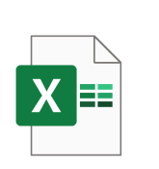

Matlab Functions Management
It creates a .mat set of data about the infrastructure to avoid to always reading the data structures on Excel when working on the same infrastructure.
Given a topology, It is structured so that it is possible to set a number of points for each pipeline so to create a more refined topology of the network.
It is useful not only to obtain much precise fluid-dynamic results but also for the preparation of the batch method for quality tracking
Input PIPE
Input NODES
A_GRID CREATOR
DATA_INPUT_Trial2023_3.mat
This is the model for the fluid-dynamic and quality tracking simulation of the network.
It reads from an excel file the time profiles of the set quantities at the boundary condition (pressure, mass flow, composition)
Input Profiles
These are all functions that are called from the main script already in the preparation phase to calculate some useful quantities such as the molar mass, the mass based heating value and to convert molar concetration to mass and vice versa
MOL2MASS_CONV
MolarMassGERG
MASS_HV
MASS2MOL_CONV
…
A_MODEL

Slide 10
Matlab Functions Management
EQUATION OF STATE
(GERG-2008)
This function is called to calculate the initial condition of all the network simulation that is assumed to be in steady state.
This function uses the same solving algorithm for the fluid dynamic but the time dependent feature is set to 0
Steady State
ReducingParametersGERG;
PseudoCriticalPointGERG;
PropertiesGERG
Other minor functions
For any pressure of the gas in the network (the temperature is assumed to be always constant), all the other properties of the gas needs to be calculated.
There are many possible Equation of State that ones can call
GERG-2008 is the most advanced one but also the most computationally heavy.
The set of functions and subfunction were translated from a VBA tool available online by Marco Cavana, generating a quite complex system of functions and subfunctions, probably not the most efficient one.
One could think of structure the program to give a couple of choices to the final user on what is the desired Eq. Of State that is to be used
A_MODEL
Notes:
To try and answer these questions, a gas network model was developed in order to simulate the transient behoviour of the gas network both in fluid-dynamic terms and from the point of view of the quality perturbation

Slide 11
Matlab Functions Management
EQUATION OF STATE
(GERG-2008)
This function is called to calculate the initial condition of all the network simulation that is assumed to be in steady state.
This function uses the same solving algorithm for the fluid dynamic but the time dependent feature is set to 0
Steady State
ReducingParametersGERG;
PseudoCriticalPointGERG;
PropertiesGERG
Other minor functions
A_MODEL
In previous versions, the author used a different algorithm for the calculation of the steady state condition:
The SIMPLE algorithm adapted for the compressible fluid networks.
In general the SIMPLE algorithm is said to be very robust
We can think of implement it in the open access tool.
OTHERS POSSIBLE ALGORITHM CAN BE IMPLEMENTED

Slide 12

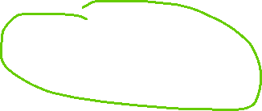
Matlab Functions Management
EQUATION OF STATE
(GERG-2008)
This function is called to calculate the initial condition of all the network simulation that is assumed to be in steady state.
This function uses the same solving algorithm for the fluid dynamic but the time dependent feature is set to 0
Steady State
ReducingParametersGERG;
PseudoCriticalPointGERG;
PropertiesGERG
Other minor functions
save('Trial2023_3_P0','p_0');
save('Trial2023_3_G0','G_0');
A_MODEL
The calculation of the steady state gives
G0 = the mass flow rates at any pipeline (or pipeline section) of the network in the hypothesis that at t=1 the fluid-dynamic of the network is at steady state.
P_0 = the nodal pressure at any node of the network
These quantities are generally saved to save time when doing trials on the same network and starting from the same conditions

Slide 13
Matlab Functions Management
Getting into the fluid-dynamic simulation phase:
EQUATION OF STATE
(GERG-2008)
ReducingParametersGERG;
PseudoCriticalPointGERG;
PropertiesGERG
Other minor functions
The calculation of the friction factor for each pipeline section is done calling an outside function. As it is funciton of the Reynolds Number that, in turn, in funciton of the viscosity calculator, also the viscosity is calculated through an external function as it is variable with the composition and the temperature.
The correlations for the friction factor are many and as for the equation of state, we could decide if setting up different choice.
In any case this friction factor calculator is quite light computationally speaking
A_MODEL
Frictionfactoraverage
Viscosity Calculator

Slide 14
Matlab Functions Management
Getting into the fluid-dynamic simulation phase:
This is the part of the program that is nested in 2/3 cycle:
TIME: if the simulation is time-dependent, any consequent instant of time is solved starting from the solution of the previous timestep (it is the «ii» cycle with reference to the matlab script)
COMPOSITION it is cycled util the gas quality problem reaches a convergence: this to take into account the impact of the change of the gas composition on the fluid dynamic TO BE CHECKED + TO BE CHECKED IF THIS CYCLE IS MEANINGFUL AT THE MOMENT IS NOT INCLUDED.
Convergence of the linearization of the fluid-dynamic problem this is the «k» cycle (with reference to the matlab script) where all what has been discussed and will be described is cycled.
EQUATION OF STATE
(GERG-2008)
ReducingParametersGERG;
PseudoCriticalPointGERG;
PropertiesGERG
Other minor functions
A_MODEL
Frictionfactoraverage
Viscosity Calculator

Slide 15
Deep dive into the fluid-dynamic equations

Slide 16
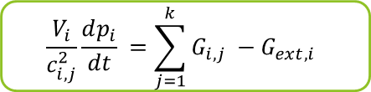


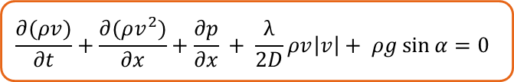

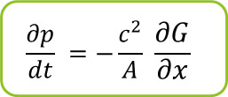


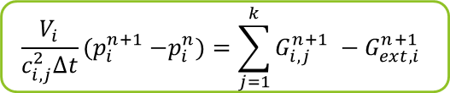
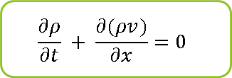

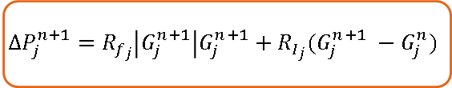







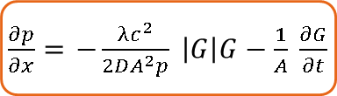




Transient Gas Network Model
A closer look:
$$p_{k}$$
Control Volume integration
$$G_{i,k}$$
$$G_{ext, i}$$
Coninutiy equation
$$G_{i,1}$$
$$\frac{∂ρ}{∂t} + \frac{∂(ρv)}{∂x}=0$$
$$\frac{∂p}{dt} =−\frac{c^{2}}{A} \frac{∂G}{∂x}$$
$$\frac{V_{i}}{c_{i,j}^{2}}\frac{dp_{i}}{dt} =\sum_{j=1}^{k}{G_{i,j} }−G_{ext,i}$$
$$p_{1}$$
$$p_{i}$$
$$G_{i,3}$$
$$p_{3}$$
$$\frac{V_{i}}{c_{i,j}^{2}∆t}{(p}_{i}^{n+1} −p_{i}^{n})=\sum_{j=1}^{k}{G_{i,j}^{n+1} }−G_{ext,i}^{n+1}$$
$$G_{i,4}$$
cv
$$G=ρvA$$
time discretization
$ρ=\frac{p}{ZRT}$
$$p_{2}$$
$$c^{2}=ZRT$$
$$P=p^{2}$$
Flow equation
LINEARIZATION NEEDED!
$$\frac{∂(ρv)}{∂t}+\frac{∂(ρv^{2})}{∂x}+\frac{∂p}{∂x} + \frac{λ}{2D}ρv\left|v\right|+ ρg\sin{α}=0$$
$\frac{∂p}{∂x}=$ $−\frac{{λc}^{2}}{2DA^{2}p} \left|G\right|G−\frac{1}{A} \frac{∂G}{∂t}$
$$∆P_{j}^{n+1}=R_{f_{j}}\left|G_{j}^{n+1}\right|G_{j}^{n+1}+R_{I_{j}}(G_{j}^{n+1} −G_{j}^{n})$$
creeping motion
horizontal pipelines
with:
Fluid-dynamic
Resistance
$$R_{f}=\frac{16 {λc}^{2}}{π^{2}D^{5}p}∆x$$
Finite Difference over a pipeline
Friction factor $λ$ → Colebrook-White correlation
Compressibility Factor $Z$ → GERG-2008 wide range equation of state
Inertia
Resistance
$$R_{I}=\frac{2 p_{m}}{A}\frac{∆x}{∆t}$$
time discretization
Averaged over the pipeline length

Slide 17


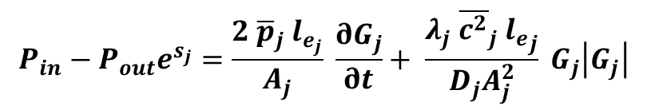
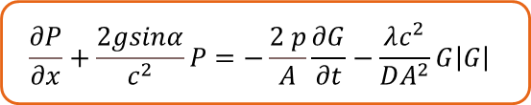










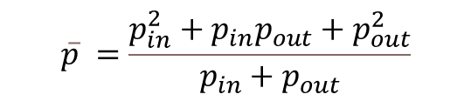

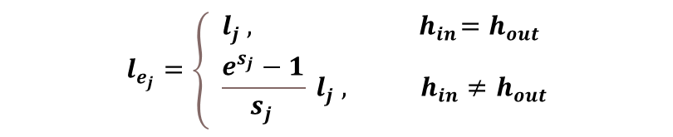
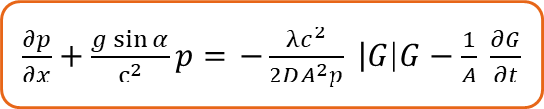


Detail of momentum eq. with gravitational term
$$G=ρvA$$
$ρ=\frac{p}{ZRT}$
$$c^{2}=ZRT$$
Flow equation
$$L_{j}$$
$$\frac{∂(ρv)}{∂t}+\frac{∂(ρv^{2})}{∂x}+\frac{∂p}{∂x} + \frac{λ}{2D}ρv\left|v\right|+ ρg\sin{α}=0$$
$\frac{∂p}{∂x}+\frac{g\sin{α}}{c^{2}}p=$ $−\frac{{λc}^{2}}{2DA^{2}p} \left|G\right|G−\frac{1}{A} \frac{∂G}{∂t}$
$$p_{2}$$
$$G_{j}$$
creeping motion
$$P=p^{2}$$
$$\frac{∂P}{∂x}+\frac{2gsinα}{c^{2}}P=−\frac{2 p}{A}\frac{∂G}{∂t}−\frac{λc^{2}}{DA^{2}}G\left|G\right|$$
$$p_{1}$$
$$α_{j}$$
$$h_{2}$$
integration of the spatial derivative:
linear and non-homogeneous differential equation
$$h_{1}$$
$$P_{in}−P_{out}e^{s_{j}}=\frac{2 {\overline{p}}_{j} l_{e_{j}}}{A_{j}} \frac{∂G_{j}}{∂t}+ \frac{λ_{j} {\overline{c^{2}}}_{j} {l_{e}}_{j}}{D_{j}A_{j}^{2}} G_{j}\left|G_{j}\right|$$
Averaged quantities which makes possible the analytical solution
Effective length $l_{e_{j}}$
$$\overline{p} =\frac{p_{in}^{2}+p_{in}p_{out}+p_{out}^{2}}{p_{in}+p_{out}}$$
$$s_{j}=\frac{2g\left(h_{out}−h_{in}\right)}{{\overline{c^{2}}}_{j}}$$
average pressure
$$l_{e_{j}}=\left\{ \begin{aligned}&l_{j} , { h}_{in}=h_{out} \\ &\frac{e^{s_{j}}−1}{s_{j }} l_{j} , h_{in}≠h_{out}\end{aligned}\right.$$
average speed of
Sound
$$\overline{c^{2}}=Z\left(\overline{p} , T , \left[y\right]\right)RT$$
Gas composition

Slide 18
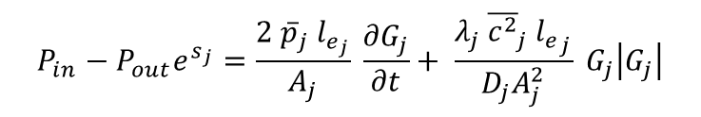


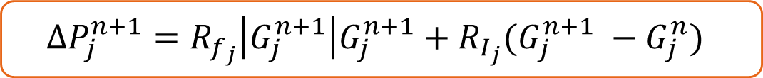
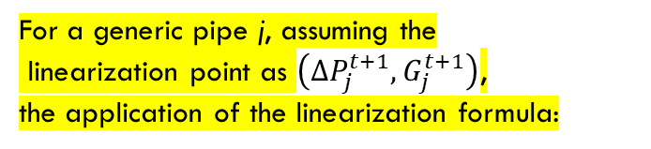

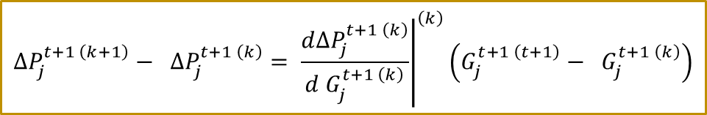
Detail of momentum eq. with gravitational term
$$P_{in}−P_{out}e^{s_{j}}=\frac{2 {\overline{p}}_{j} l_{e_{j}}}{A_{j}} \frac{∂G_{j}}{∂t}+ \frac{λ_{j} {\overline{c^{2}}}_{j} {l_{e}}_{j}}{D_{j}A_{j}^{2}} G_{j}\left|G_{j}\right|$$
Ordinary differential equation in which time derivative (inertia term) can be trated by means of implicit finite different scheme (over each pipe)
$$L_{j}$$
$$p_{2}$$
$$P_{in}^{t+1}−P_{out}^{t+1}e^{s}=\frac{2 \overline{p^{t+1}} l_{e}}{A ∆t}\left(G^{t+1}−G^{t}\right)+\frac{λ \overline{c^{2}} l_{e}}{DA^{2}}G^{t+1}\left|G^{t+1}\right|$$
$$G_{j}$$
$$p_{1}$$
$$α_{j}$$
$$h_{2}$$
$$h_{1}$$
$$∆P_{j}^{n+1}=R_{f_{j}}\left|G_{j}^{n+1}\right|G_{j}^{n+1}+R_{I_{j}}(G_{j}^{n+1} −G_{j}^{n})$$
LINEARIZATION NEEDED!
with:
Fluid-dynamic
Resistance
$$R_{f}=\frac{16 {λc}^{2}}{π^{2}D^{5}p}∆x$$
For a generic pipe j, assuming the
linearization point as $\left(∆P_{j}^{t+1}, G_{j}^{t+1}\right)$,
the application of the linearization formula:
$$∆P_{j}^{t+1 \left(k+1\right)}− ∆P_{j}^{t+1 \left(k\right)}= {\left.\frac{d∆P_{j}^{t+1 \left(k\right)}}{d G_{j}^{t+1 \left(k\right)}}\right|}^{\left(k\right)}\left(G_{j}^{t+1 \left(t+1\right)}− G_{j}^{t+1 \left(k\right)}\right)$$
Inertia
Resistance
$$R_{I}=\frac{2 p_{m}}{A}\frac{∆x}{∆t}$$
Averaged over the pipeline length
LINEARIZATION FORMULA
leads to the following expression:
$$R$$
$$∆P_{j}^{t+1 \left(k+1\right)}−\left(2R_{F}·\left|{G_{j}}^{t+1 \left(k\right)}\right|+R_{I}\right){ G_{j}}^{t+1 \left(k+1\right)}={− R}_{F}·\left|{G_{j}}^{t+1 \left(k\right)}\right|{G_{j}}^{t+1 \left(k\right)}−R_{I}{G_{j}}^{t \left(k\right)}$$

Slide 19




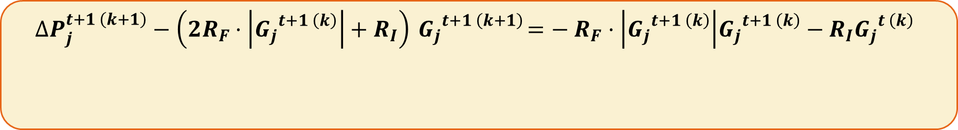

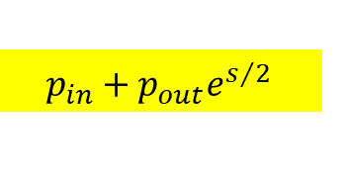




Detail of momentum eq. with gravitational term
$$∆P_{j}^{t+1 \left(k+1\right)}−\left(2R_{F}·\left|{G_{j}}^{t+1 \left(k\right)}\right|+R_{I}\right){ G_{j}}^{t+1 \left(k+1\right)}={− R}_{F}·\left|{G_{j}}^{t+1 \left(k\right)}\right|{G_{j}}^{t+1 \left(k\right)}−R_{I}{G_{j}}^{t \left(k\right)}$$
$$R$$
$$∆P_{j}^{n+1}=P_{in}^{t+1}−P_{out}^{t+1}e^{s}={p_{in}^{2}}^{t+1}−{p_{out}^{2}}^{t+1}e^{s}$$
Dividing by:
$$p_{in}+p_{out}e^{s/2 }$$
$∆p_{j}^{n+1}=$ $p_{in}^{t+1}−p_{out}^{t+1}e^{s/2}$
$$R′$$
$$∆P_{j}^{t+1 \left(k+1\right)}−\left(2R_{F}·\left|{G_{j}}^{t+1 \left(k\right)}\right|+R_{I}\right){ G_{j}}^{t+1 \left(k+1\right)}={− R}_{F}·\left|{G_{j}}^{t+1 \left(k\right)}\right|{G_{j}}^{t+1 \left(k\right)}−R_{I}{G_{j}}^{t \left(k\right)}$$
$$p_{in}^{t+1}+p_{out}^{t+1}e^{s/2}$$
$$p_{in}^{t+1}+p_{out}^{t+1}e^{s/2}$$
$$p_{in}^{t+1}+p_{out}^{t+1}e^{s/2}$$
$$p_{in}^{t+1}+p_{out}^{t+1}e^{s/2}$$
$$R_{F}′$$
$$R_{I}′$$

Slide 20
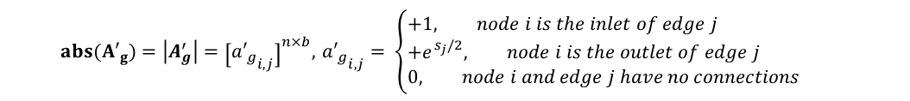
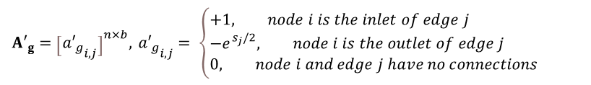

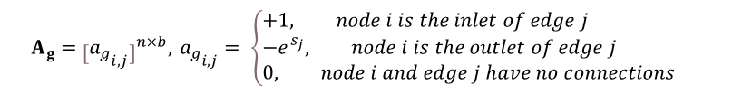
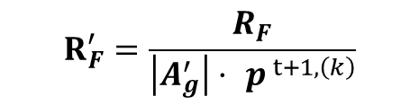

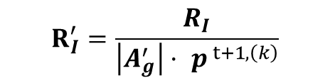
Matrix construction (momentum eq)
Modified incidence matrix
to take into account the gravitational terms (referred to the squared pressures)
Pipeline linearized equation
$$A_{g}^{t} p^{t+1 \left(k+1\right)}−R{ G}^{t+1 \left(k+1\right)}={− R}_{F}\left(\left|{ G}^{t+1 \left(k\right)}\right|{ ∘G}^{t+1 \left(k\right)}\right)−R_{I}{ G}^{t \left(k\right)}$$
$$A_{g}={\left[{a_{g}}_{i,j}\right]}^{n×b},{{ a}_{g}}_{i,j}= \left\{\begin{aligned}&+1, node i is the inlet of edge j \\ &−e^{s_{j}}, node i is the outlet of edge j \\ &0, node i and edge j have no connections\end{aligned}\right.$$
$∘$ ← element by element product
Aminus_s=Aminus.*repmat(exp(s),1,dimn)'
ADP=(-Aminus_s+Aplus)'
Modified incidence matrix
to take into account the gravitational terms (referred to the pressures)
Pipeline linearized equation
$${A′}_{g}={\left[{{a′}_{g}}_{i,j}\right]}^{n×b},{{ a′}_{g}}_{i,j}= \left\{\begin{aligned}&+1, node i is the inlet of edge j \\ &−e^{s_{j}/2}, node i is the outlet of edge j \\ &0, node i and edge j have no connections\end{aligned}\right.$$
$$p_{in}^{t+1}+p_{out}^{t+1}e^{s/2}$$
$${A′}_{g}^{t} p^{t+1 \left(k+1\right)}−R′{ G}^{t+1 \left(k+1\right)}={− R′}_{F}\left(\left|{ G}^{t+1 \left(k\right)}\right|{ ∘G}^{t+1 \left(k\right)}\right)−{R′}_{I}{ G}^{t \left(k\right)}$$
unknowns
$$R_{F}^{′}=\frac{R_{F}}{\left|A_{g}^{′}\right|· p^{ t+1,\left(k\right)}}$$
$$R_{I}^{′}=\frac{R_{I}}{\left|A_{g}^{′}\right|· p^{ t+1,\left(k\right)}}$$
Aminus_s1=Aminus.*repmat(exp(s/2),1,dimn)'
ADP1=(-Aminus_s1+Aplus)'
Element by element division
$$R^{′}=2{R′}_{F}∘\left|G^{t+1 \left(k\right)}\right|+{R′}_{I}$$
$${abs(A′}_{g})=\left|A_{g}^{′}\right|={\left[{{a′}_{g}}_{i,j}\right]}^{n×b},{{ a′}_{g}}_{i,j}= \left\{\begin{aligned}&+1, node i is the inlet of edge j \\ &+e^{s_{j}/2}, node i is the outlet of edge j \\ &0, node i and edge j have no connections\end{aligned}\right.$$

Slide 21




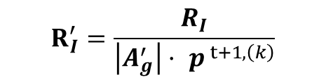
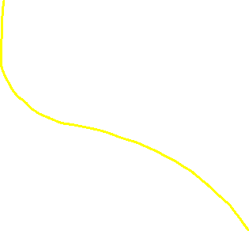
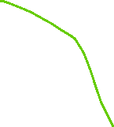
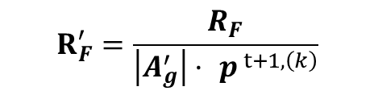

Matrix construction (momentum eq)
unknowns
$$R_{F} , R_{I} diagonal matrices$$
Pipeline linearized equation
$${A′}_{g}^{t} p^{t+1 \left(k+1\right)}−R′{ G}^{t+1 \left(k+1\right)}={− R′}_{F}\left(\left|{ G}^{t+1 \left(k\right)}\right|{ ∘G}^{t+1 \left(k\right)}\right)−{R′}_{I}{ G}^{t \left(k\right)}$$
b x n
n x 1
b x b
b x 1
b x b
b x 1
b x b
b x 1
$$R_{F}^{′}=\frac{R_{F}}{\left|A_{g}^{′}\right|· p^{ t+1,\left(k\right)}}$$
$$R_{I}^{′}=\frac{R_{I}}{\left|A_{g}^{′}\right|· p^{ t+1,\left(k\right)}}$$
Element by element division
$$R^{′}=2{R′}_{F}∘\left|G^{t+1 \left(k\right)}\right|+{R′}_{I}$$
1
p
n
n
b
1
momentum equation
ADP
-R_k
G
=
TN_M_k
b
b
b

Slide 22



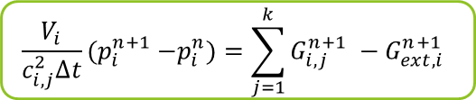




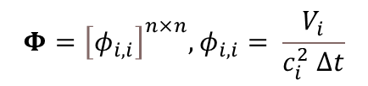



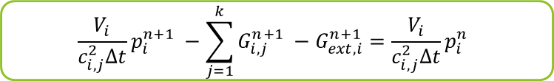
Matrix construction (continuity eq)
$$\frac{V_{i}}{c_{i,j}^{2}∆t}{(p}_{i}^{n+1} −p_{i}^{n})=\sum_{j=1}^{k}{G_{i,j}^{n+1} }−G_{ext,i}^{n+1}$$
$$\frac{V_{i}}{c_{i,j}^{2}∆t}p_{i}^{n+1} −\sum_{j=1}^{k}{G_{i,j}^{n+1} }−G_{ext,i}^{n+1}=\frac{V_{i}}{c_{i,j}^{2}∆t}p_{i}^{n}$$
$$p_{k}$$
$$G_{i,k}$$
$$G_{ext, i}$$
$$G_{i,1}$$
unknowns
n x 1
n x 1
$$diagonal matrix$$
$$Φp^{t+1}+ A G^{t+1}+ I {G_{ext}}^{t+1} =Φp^{t}$$
$$p_{1}$$
$$p_{i}$$
$$G_{i,3}$$
$$p_{3}$$
$$Φ={\left[φ_{i,i}\right]}^{n×n},φ_{i,i}= \frac{V_{i}}{c_{i}^{2} ∆t}$$
$$G_{i,4}$$
cv
n x 1
b x 1
$$p_{2}$$
In this paper here: https://doi.org/10.1016/j.jngse.2015.11.036
They use this methodology for the boundary conditions:
$Φp^{t+1}+ A G^{t+1}=Φp^{t}$ $−0.5 ({{{G_{ext}}^{t}+G}_{ext}}^{t+1})$
When I tried to implement this I was obtaining oscillating behaviours.

Slide 23


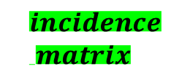

Matrix construction (continuity eq)
$$\frac{V_{i}}{c_{i,j}^{2}∆t}{(p}_{i}^{n+1} −p_{i}^{n})=\sum_{j=1}^{k}{G_{i,j}^{n+1} }−G_{ext,i}^{n+1}$$
$$\frac{V_{i}}{c_{i,j}^{2}∆t}p_{i}^{n+1} −\sum_{j=1}^{k}{G_{i,j}^{n+1} }−G_{ext,i}^{n+1}=\frac{V_{i}}{c_{i,j}^{2}∆t}p_{i}^{n}$$
$$p_{k}$$
$$G_{i,k}$$
$$G_{ext, i}$$
$$G_{i,1}$$
unknowns
n x b
n x 1
n x 1
$$diagonal matrix$$
$$Φp^{t+1}+ A G^{t+1}+ I {G_{ext}}^{t+1} =Φp^{t}$$
$$p_{1}$$
$$p_{i}$$
$$G_{i,3}$$
$$p_{3}$$
$$Φ={\left[φ_{i,i}\right]}^{n×n},φ_{i,i}= \frac{V_{i}}{c_{i}^{2} ∆t}$$
n x n
n x n
n x n
$$G_{i,4}$$
cv
n x 1
b x 1
n
b
n
1
1
$$p_{2}$$
Continuity equation
PHI
Ap
II
p
TN_p
n
n
=
n
$$incidence \\ matrix$$
G
b
G_ext/
p_fixed
n

Slide 24
Matrix construction
Diagonal matrix
n
b
n
1
1
From matlab code
Continuity equation
PHI
Ap
II
p
TN_p
n
n
n
TN_P=PHI*p_n;
%TN_P=PHI*p_n-II./2*L_0(:,ii-1);
momentum equation
ADP
-R_k
0
G
=
TN_M_k
b
b
b
TN_M_k=(-Rf.*abs(G_k(:,k)).*G_k(:,k) -Ri.*G_n);
0
G_ext
TN_L
boundary conditions
n
n
n
TN_L=G_ext_t(:,ii); TN_L(1)=p_in_t(ii)
1 or 0 on the diagonals to fix
PRESSURE OR MASS FLOW
at the designated nodes
Assigned pressure or mass flow (either inlet or outlet) accrodingly

Slide 25
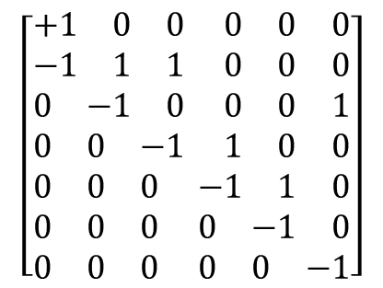
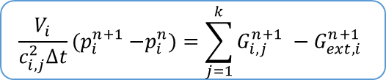








Gas Network Model – overview of the fluid-dynamic solver
Solving Strategy:
$p_{inlet}^{0}$ ; $G_{ext}^{0}$
Networkwide:
initial [t=0]
steady state solution
3
7
2
Equation of State
$$G_{in}$$
1
updates the fluid properties
1
2
5
3
4
5
6
Coninutiy equation
Network Topology:
4
$$G_{out}′′$$
branches
$$\frac{V_{i}}{c_{i,j}^{2}∆t}{(p}_{i}^{n+1} −p_{i}^{n})=\sum_{j=1}^{k}{G_{i,j}^{n+1} }−G_{ext,i}^{n+1}$$
$$\begin{matrix}1 & 2 & 3\end{matrix} \begin{matrix}4 & 5 & 6\end{matrix}$$
$$1 \\ 2 \\ 3 \\ 4 \\ 5 \\ 6 \\ 7$$
$$\left[\begin{aligned}\begin{matrix}+1 & 0 & 0\end{matrix} \begin{matrix}0 & 0 & 0\end{matrix} \\ \begin{matrix}−1 & 1 & 1\end{matrix} \begin{matrix}0 & 0 & 0\end{matrix} \\ \begin{matrix}0 & −1 & 0\end{matrix} \begin{matrix}0 & 0 & 1\end{matrix} \\ \begin{matrix}0 & 0 & −1\end{matrix} \begin{matrix}1 & 0 & 0\end{matrix} \\ \begin{matrix}0 & 0 & 0\end{matrix} \begin{matrix}−1 & 1 & 0\end{matrix} \\ \begin{matrix}0 & 0 & 0\end{matrix} \begin{matrix}0 & −1 & 0\end{matrix} \\ \begin{matrix}0 & 0 & 0\end{matrix} \begin{matrix}0 & 0 & −1\end{matrix}\end{aligned}\right]$$
Flow equation
LINEARIZED EQUATION
Incidence Matrix
representation of the network
+1 inlet node
-1 outled node
Reading column-by-column
Coupled fluid-dynamic problem
$$X =$$
$$∆P_{j}^{(k+1), n+1}−\left( 2R_{f_{j}}\left|G_{j}^{\left(k\right), n+1}\right|+R_{I_{j}}\right)G_{j}^{\left(k+1\right), n+1}={{− R}_{f_{j}}\left|G_{j}^{\left(k\right),n+1}\right|G_{j}^{\left(k\right),n+1}− R}_{I_{j}}G_{j}^{n}$$
nodes
$∆P_{j}^{n+1}−\left[ R_{f_{j}}\left|G_{j}^{n+1}\right|G_{j}^{n+1}+R_{I_{j}}\left(G_{j}^{n+1} −G_{j}^{n}\right)\right]<toll$
Repeated for
no
each Timestep

Slide 26
Quality Tracking section
For the moment I am stopping here: in the following slide I gave to you just the overview of the method used. I need to revise more carefully the different version I created.
In any case I always found it hard to model this “batch method” and I would appreciate if we could work together, even starting from almost scratch, in order to create a tool that is much more efficient than the one I used to have.
After all, I think that the application of the batch method is, at least for the case of each pipeline, a problem that can be formalized as a “queue problem”. It needs to be coupled with conservation of mass at the intersections.

Slide 27


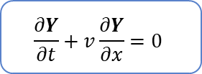


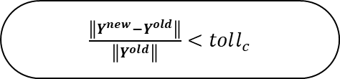



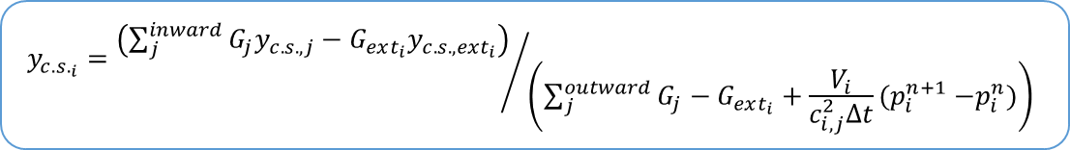

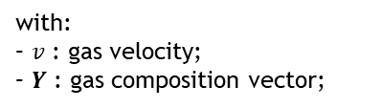

Validation
Quality Tracking section:
Solving strategy:
→ Transport of the concentration vector along the pipelines
Convergence of fluid-dynamic problem
Advective transport equation
$$\frac{∂Y}{∂t}+v\frac{∂Y}{∂x}=0$$
with:
– $v$ : gas velocity;
– $Y$ : gas composition vector;
Coninutiy equation
$$applied at mixing nodes$$
Lagrangian coordinates-based BATCH TRACKING METHOD
$$b_{i}^{n}$$
$$b_{i}^{n+1}$$
Back to coupled fluid-dynamic problem
Advective transport equation
$$b_{i}^{n+1}=b_{i}^{n}+v_{j}^{n}Δt$$
$$v_{j}^{n}$$
$$b_{i}^{n+1}=b_{i}^{n}+v_{j}^{n}Δt$$
for each branch connecting two mixing nodes
$$x_{i−1}$$
$$x_{i}$$
$$x_{i+1}$$
→ Mixing at network nodes
Coninutiy equation
for each chemical species
$\frac{\left\|Y^{new}−Y^{old}\right\|}{\left\|Y^{old}\right\|}<toll_{c}$
no
$$y_{c.s._{i}}={\left(\sum_{j}^{inward}{G_{j}y_{c.s. , j}}−G_{ext_{i}}y_{c.s. , ext_{i}}\right)}/{ \left(\sum_{j}^{outward}{G_{j}}−G_{ext_{i}}+\frac{V_{i}}{c_{i,j}^{2}∆t}{(p}_{i}^{n+1} −p_{i}^{n})\right)}$$
Repeated for
each Timestep

Slide 28
To be continued…

