Slide 1
1st Test Case for Internal Validation
SHIMMER WP4 Update

Slide 2
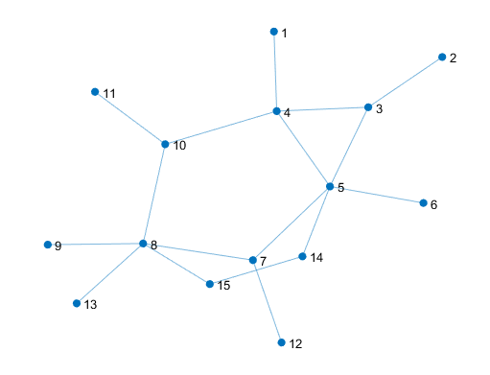
Case Study Presentation Topology
 | Entry Node | Nodes: 1, 12
 | Junction Node | Nodes: 4, 5, 8
 | Exit Node | Nodes: 2, 3, 6, 7, 9, 10, 11, 13, 14, 15
 | Compressor | Pipe: 16 Nodes: 14 - 15

Slide 3
Case Study Presentation Profiles

Slide 4
Remarks General
Pressure set points and pressure guess are given in [bar]
Matlab code converts [bar] in [Pa]
No compressor control mode switch
Compressor control mode is given as input and never changed
For example, if the compressor is regulated as Outlet Pressure, it cannot be changed to Power Driver

Slide 5
Remarks Nodal Boundary Condition Check
Once the node is “Closed” it cannot be “Opened” again in the Matlab Version
No Boundary Condition Check
Node 1 becomes an Entry
With Boundary Condition Check
Node 1 is “Closed”

Slide 6
Results Power Driver = 2 MW

Slide 7
Results Compressor Outlet Pressure = 80 bar

Slide 8
Results Compressor Inlet Pressure = 50 bar

Slide 9
Results Beta = 1.8

Slide 10
Results Compressor Flow Rate = 5 kg/s

