Slide 1
Algorithm Analysis

Slide 2
Introduction
Data structures
  Methods of organizing data in order to facilitate access and modification.
What is Algorithm?
  a clearly specified set of simple instructions on the data to be followed to solve a problem
    Takes a set of values, as input and
    produces a value, or set of values, as output
  May be specified
    In English
    As a computer program
    As a pseudo-code
Program = data structures + algorithms

Slide 3
Introduction
Why need algorithm analysis ?
  writing a working program is not good enough
  The program may be inefficient!
  If the program is run on a large data set, then the running time becomes an issue

Slide 4
Example: Selection Problem
Given a list of N numbers, determine the kth largest, where k ≤ N.
Algorithm 1:
  (1) Read N numbers into an array
  (2) Sort the array in decreasing order by some simple algorithm
  (3) Return the element in position k

Slide 5
Algorithm 2:
  (1) Read the first k elements into an array and sort them in decreasing order
  (2) Each remaining element is read one by one
    If smaller than the kth element, then it is ignored
    Otherwise, it is placed in its correct spot in the array, bumping one element out of the array.
  (3) The element in the kth position is returned as the answer.

Slide 6
Which algorithm is better when
  N =100 and k = 100?
  N =100 and k = 1?
What happens when
  N = 1,000,000 and k = 500,000?
We come back after sorting analysis, and there exist better algorithms

Slide 7
Algorithm Analysis
We only analyze correct algorithms
An algorithm is correct
  If, for every input instance, it halts with the correct output
Incorrect algorithms
  Might not halt at all on some input instances
  Might halt with other than the desired answer
Analyzing an algorithm
  Predicting the resources that the algorithm requires
  Resources include
    Memory
    Computational time (usually most important)

Slide 8
Factors affecting the running time
  computer
  compiler
  algorithm used
  input to the algorithm
    The content of the input affects the running time
    typically, the input size (number of items in the input) is the main consideration
      E.g. sorting problem ⇒ the number of items to be sorted
      E.g. multiply two matrices together ⇒ the total number of elements in the two matrices
Machine model assumed
  Instructions are executed one after another, with no concurrent operations ⇒ Not parallel computers

Slide 9
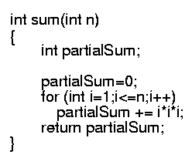
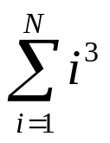
Example
Calculate
Lines 1 and 4 count for one unit each
Line 3: executed N times, each time four units
Line 2: (1 for initialization, N+1 for all the tests, N for all the increments) total 2N + 2
total cost: 6N + 4 ⇒ O(N)
1
2
3
4
1
2N+2
4N
1

Slide 10
Typical Running Time Functions
1 (constant running time):
  Instructions are executed once or a few times
logN (logarithmic)
  A big problem is solved by cutting the original problem in smaller sizes, by a constant fraction at each step
N (linear)
  A small amount of processing is done on each input element
N logN
  A problem is solved by dividing it into smaller problems, solving them independently and combining the solution

Slide 11
Typical Running Time Functions
N² (quadratic)
  Typical for algorithms that process all pairs of data items (double nested loops)
N³ (cubic)
  Processing of triples of data (triple nested loops)
N^{K} (polynomial)
2^{N} (exponential)
  Few exponential algorithms are appropriate for practical use

Slide 12
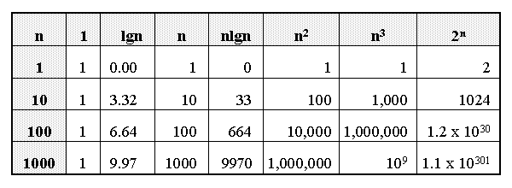
Growth of Functions

Slide 13
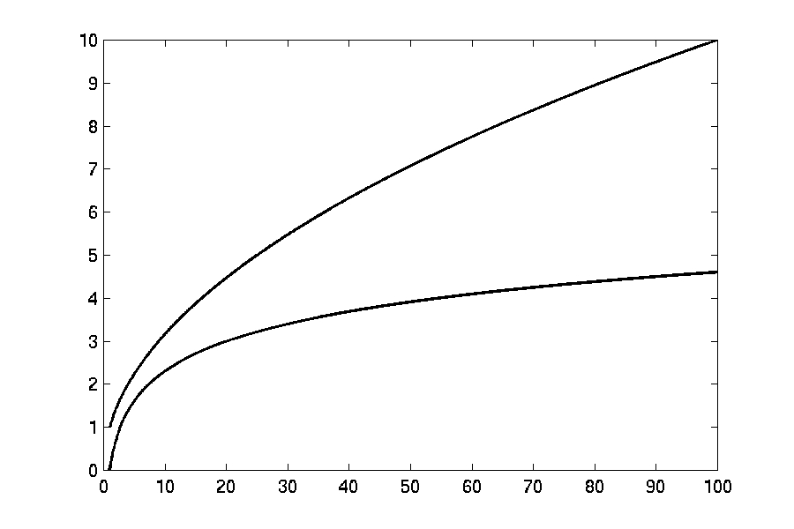

Complexity Graphs
log(n)

Slide 14
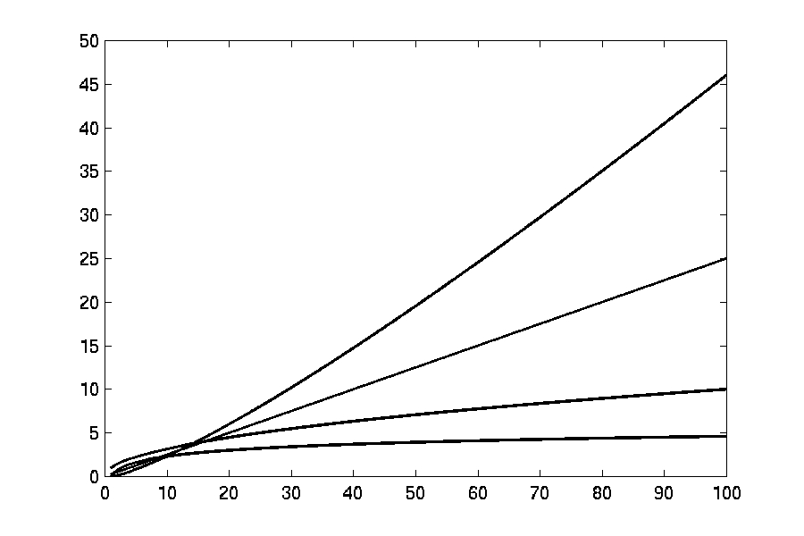
Complexity Graphs
n log(n)
n
log(n)

Slide 15
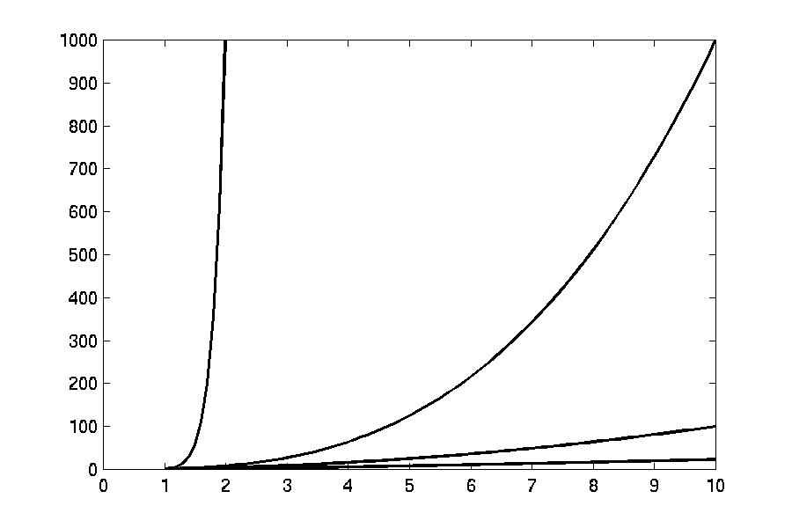
Complexity Graphs
n¹⁰
n³
n²
n log(n)

Slide 16
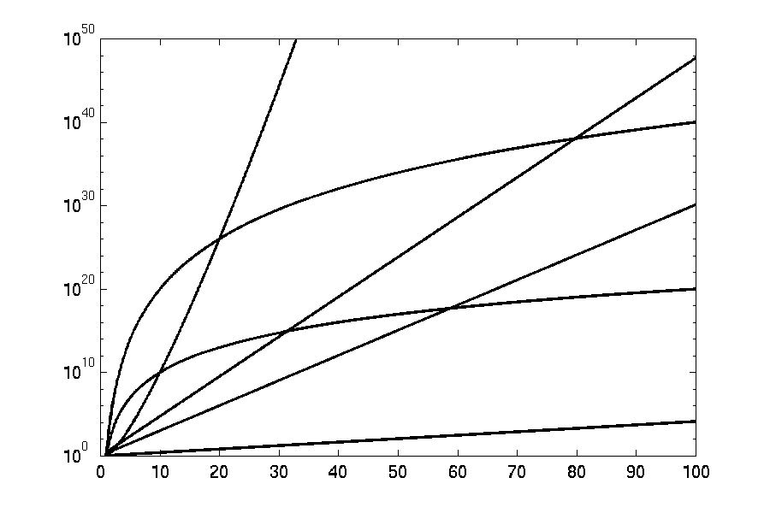
Complexity Graphs (log scale)
3^{n}
n^{n}
n²⁰
2^{n}
n¹⁰
1.1^{n}

Slide 17
Running-time of algorithms
Bounds are for the algorithms, rather than programs
  programs are just implementations of an algorithm, and almost always the details of the program do not affect the bounds
Algorithms are often written in pseudo-codes
  We use ‘almost’ something like C/C++.
Bounds are for algorithms, rather than problems
  A problem can be solved with several algorithms, some are more efficient than others

Slide 18
Introduction
Why are asymptotic notations important?
They give a simple characterization of an algorithm’s efficiency.
They allow the comparison of the performances of various algorithms.
For large values of components/inputs, the multiplicative constants and lower order terms of an exact running time are dominated by the effects of the input size (the number of components).

Slide 19
Algorithm Complexity
Worst Case Complexity:
  the function defined by the maximum number of steps taken on any instance of size n
Best Case Complexity:
  the function defined by the minimum number of steps taken on any instance of size n
Average Case Complexity:
  the function defined by the average number of steps taken on any instance of size n

Slide 20
Worst- / average- / best-case
Worst-case running time of an algorithm
  The longest running time for any input of size n
  An upper bound on the running time for any input
  ⇒ guarantee that the algorithm will never take longer
  Example: Sort a set of numbers in increasing order; and the data is in decreasing order
  The worst case can occur fairly often
    E.g. in searching a database for a particular piece of information
Best-case running time
  sort a set of numbers in increasing order; and the data is already in increasing order
Average-case running time
  May be difficult to define what “average” means

Slide 21
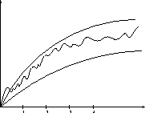
Doing the Analysis
It’s hard to estimate the running time exactly
  Best case depends on the input
  Average case is difficult to compute
  So we usually focus on worst case analysis
    Easier to compute
    Usually close to the actual running time
Strategy: find a function (an equation) that, for large n, is an upper bound to the actual function (actual number of steps, memory usage, etc.)
Upper bound
Actual function
Lower bound

Slide 22
Asymptotic notations
Upper bound O(g(N)
Lower bound Ω(g(N))
Tight bound Θ(g(N))

Slide 23
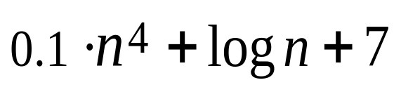
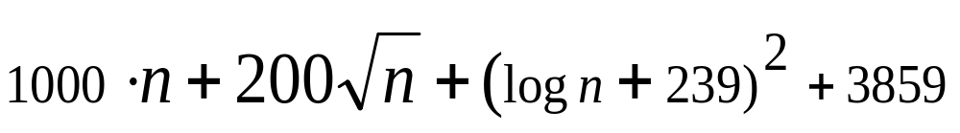
Asymptotic Analysis
Motivation: Suppose you want to evaluate two programs according to their run-time for inputs of size n. The first has run-time of:
and the second has run-time of:
For small inputs, it doesn’t matter, both programs will finish before you notice. What about (really) large inputs?

Slide 24

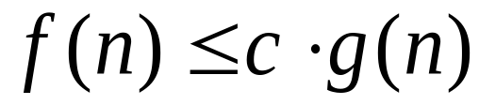
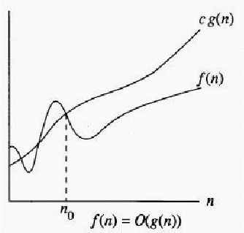
Big - O
Definition:
if there exist constants c>0 and n₀ such that for all n>n₀,

Slide 25
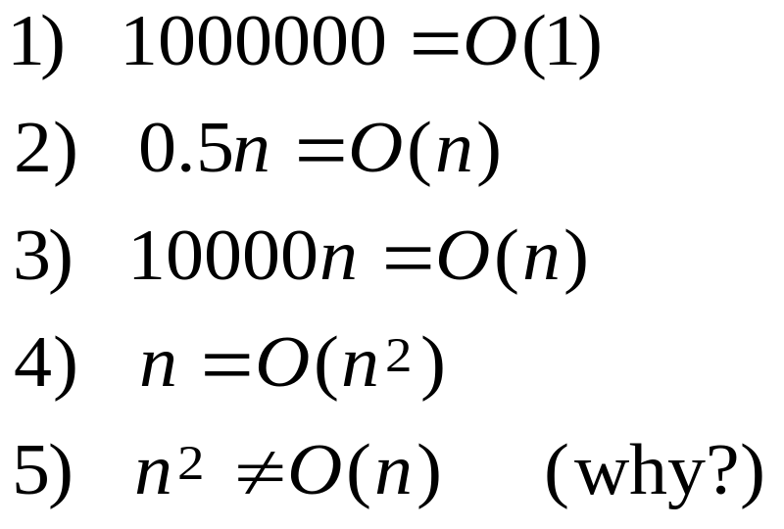
Big - O
In other words, g(n) bounds f(n) from above (for large n’s) up to a constant.
Examples:

Slide 26
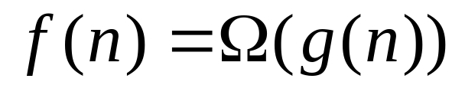
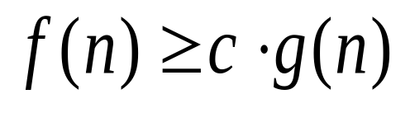
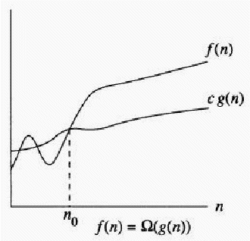
Big - Omega
Definition:
if there exist constants c>0 and n₀ such that for all n>n₀,

Slide 27
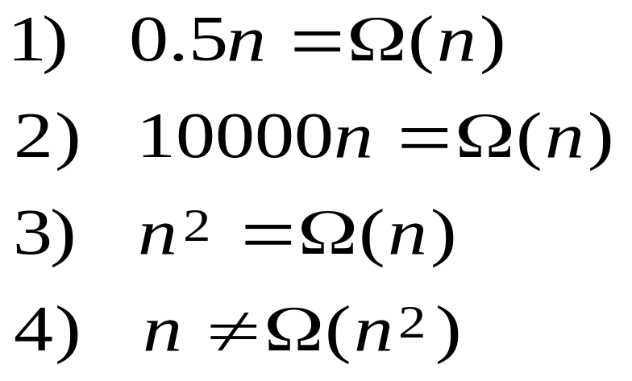
Big - Omega
In other words, g(n) bounds f(n) from below (for large n’s) up to a constant.
Examples:

Slide 28
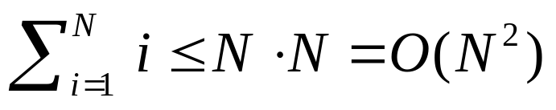
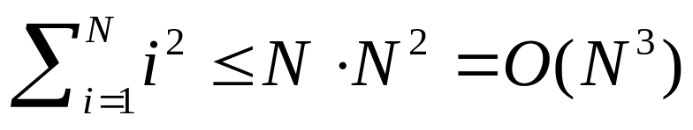
Big Oh: more examples
N² / 2 – 3N = O(N²)
1 + 4N = O(N)
7N² + 10N + 3 = O(N²)
log₁₀ N = log₂ N / log₂ 10 = O(log₂ N) = O(log N)
sin N = O(1); 10 = O(1), 10¹⁰ = O(1)
log N + N = O(N)

Slide 29
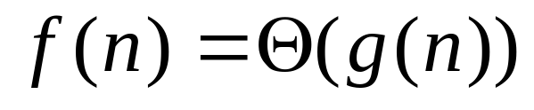
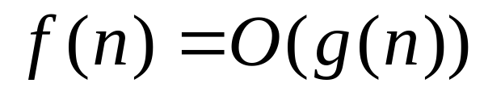
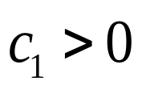
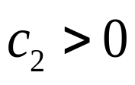

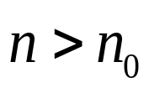
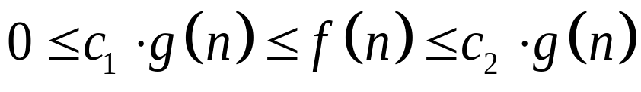
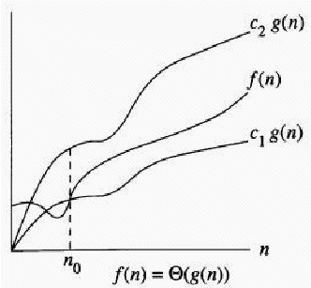
Big - Theta
Definition: if:
and
This means there exist constants ,
such that for all ,

Slide 30
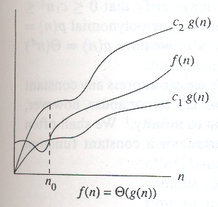
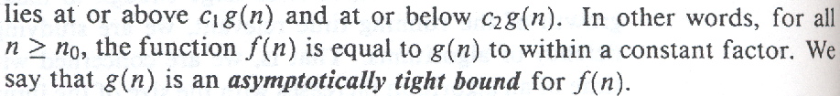

Θ − Asymptotic tight bound
Eg.

Slide 31





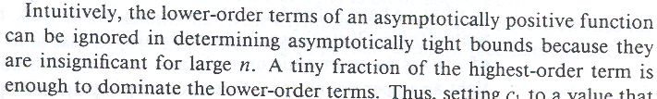
Θ − Asymptotic tight bound
Eg.

Slide 32
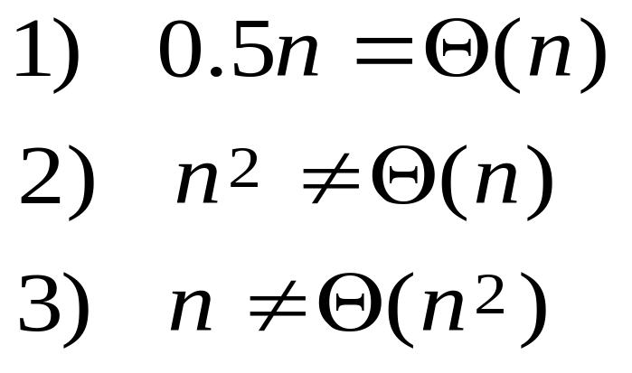
Big - Theta
In other words, g(n) is a tight estimate of f(n) (in asymptotic terms).
Examples:

Slide 33
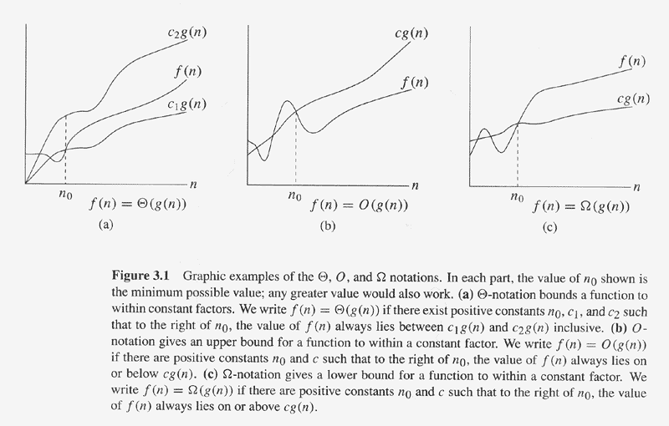
Asymptotic notation

Slide 34

General Rules
Loops
  at most the running time of the statements inside the for-loop (including tests) times the number of iterations.
  O(N)
Nested loops
  the running time of the statement multiplied by the product of the sizes of all the for-loops.
  O(N²)

Slide 35
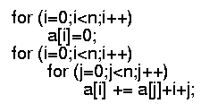
Consecutive statements
  These just add
  O(N) + O(N²) = O(N²)
Conditional: If S1 else S2
  never more than the running time of the test plus the larger of the running times of S1 and S2.
  O(1)

Slide 36
Our first example: search of an ordered array
Linear search and binary search
Upper bound, lower bound and tight bound

Slide 37
Linear search:
// Given an array of ‘size’ in increasing order, find ‘x’
int linearsearch(int* a[], int size,int x) {
int low=0, high=size-1;
for (int i=0; i<size;i++)
if (a[i]==x) return i;
return -1;
}
O(N)

Slide 38
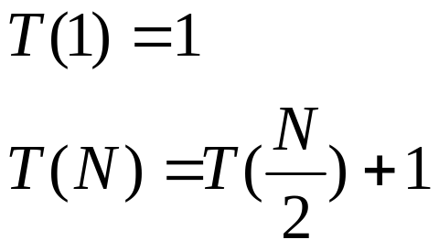
Recursive binary search:
int bsearch(int* a[],int low, int high, int x) {
if (low>high) return -1;
else int mid=(low+high)/2;
if (x=a[mid]) return mid;
else if(a[mid]<x)
bsearch(a,mid+1,high,x);
else bsearch(a,low,mid-1);
}
O(1)
O(1)
T(N/2)

Slide 39
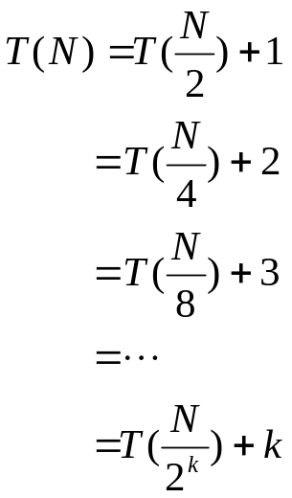

Solving the recurrence:
With 2^{k} = N (or asymptotically), k=log N, we have
Thus, the running time is O(log N)

Slide 40
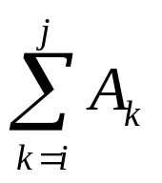
Another Example
Maximum Subsequence Sum Problem
Given (possibly negative) integers A₁, A₂, ...., A_{n}, find the maximum value of
  For convenience, the maximum subsequence sum is 0 if all the integers are negative
E.g. for input –2, 11, -4, 13, -5, -2
  Answer: 20 (A₂ through A₄)

Slide 41
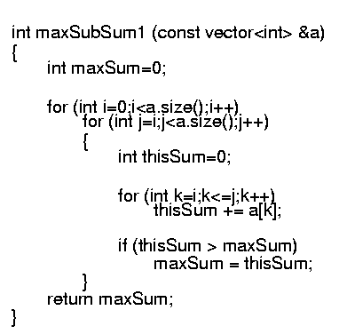
Algorithm 1: Simple
Exhaustively tries all possibilities (brute force)
O(N³)
N
N-i, at most N
j-i+1, at most N

Slide 42
Algorithm 2: improved
// Given an array from left to right
int maxSubSum(const int* a[], const int size) {
int maxSum = 0;
for (int i=0; i< size; i++) {
int thisSum =0;
for (int j = i; j < size; j++) {
thisSum += a[j];
if(thisSum > maxSum)
maxSum = thisSum;
}
}
return maxSum;
}
N
N-i, at most N
O(N^2)

