Slide 1
CSE-304
Design & Analysis of Algorithm
Lecture 21
Asymptotic Notation II
and Recurrence Relation

Slide 2
Asymptotic Complexity
Running time of an algorithm as a function of input size n for large n.
Expressed using only the highest-order term in the expression for the exact running time.
  Instead of exact running time, say Θ(n²).
Describes behavior of function in the limit.
Written using Asymptotic Notation.

Slide 3
Asymptotic Notation
Θ, O, Ω, o, ω
Defined for functions over the natural numbers.
  Ex: f(n) = Θ(n²).
  Describes how f(n) grows in comparison to n².

Slide 4
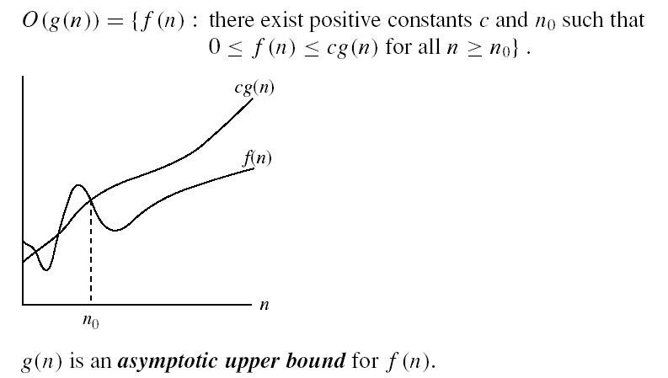
Asymptotic notations
O-notation
Intuitively: O(g(n)) = the set of functions with a smaller or same order of growth as g(n)

Slide 5
o-notation
For a given function g(n), the set little-o:
o(g(n)) = {f(n): ∀ c > 0, ∃ n₀ > 0 such that
∀ n ≥ n₀, we have 0 ≤ f(n) < cg(n)}.
f(n) becomes insignificant relative to g(n) as n approaches infinity:
lim [f(n) / g(n)] = 0
^{n→∞}
g(n) is an upper bound for f(n) that is not asymptotically tight.
Example: 2n = o(n²) but 2n²≠ o(n²)

Slide 6
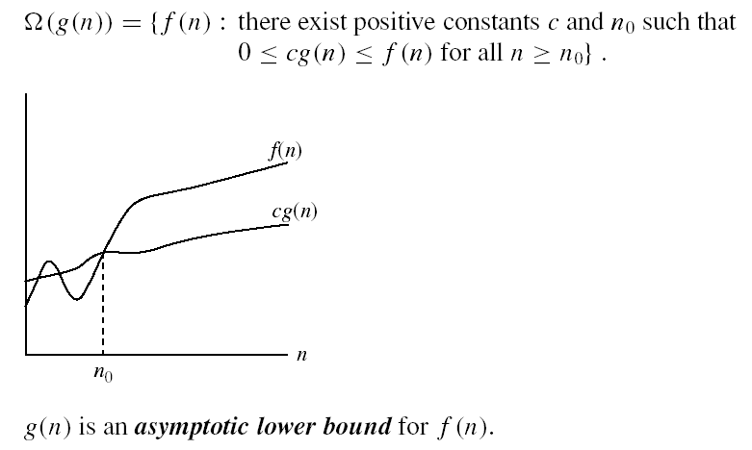
Asymptotic notations (cont.)
Ω - notation
Intuitively: Ω(g(n)) = the set of functions with a larger or same order of growth as g(n)

Slide 7
ω -notation
For a given function g(n), the set little-omega:
ω(g(n)) = {f(n): ∀ c > 0, ∃ n₀ > 0 such that
∀ n ≥ n₀, we have 0 ≤ cg(n) < f(n)}.
f(n) becomes arbitrarily large relative to g(n) as n approaches infinity:
lim [f(n) / g(n)] = ∞.
^{n→∞}
g(n) is a lower bound for f(n) that is not asymptotically tight.

Slide 8


Asymptotic notations (cont.)
Θ-notation
Intuitively Θ(g(n)) = the set of functions with the same order of growth as g(n)

Slide 9
Exercise on O-notation
Show that 3n²+2n+5 = O(n²)
  10 n² = 3n² + 2n² + 5n²
  ≥ 3n² + 2n + 5 for n ≥ 1
  c = 10, n₀ = 1

Slide 10
Exercise on O-notation
O(n²)
O(n log n)
O(n²)
O(n log n)
f1(n) = 10 n + 25 n²
f2(n) = 20 n log n + 5 n
f3(n) = 12 n log n + 0.05 n²
f4(n) = n^{1/2} + 3 n log n
Notes:
For each function, find the simplest and g(n) such that f_i(n) = O(g(n))

Slide 11
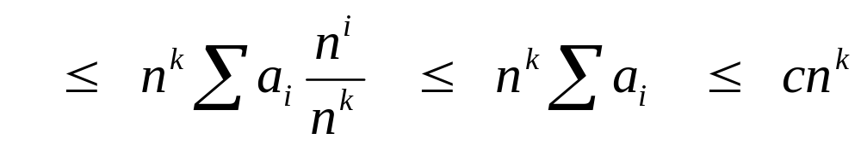
Big O Fact
A polynomial of degree k is O(n^{k})
Proof:
  Suppose f(n) = b_{k}n^{k} + b_{k-1}n^{k-1} + … + b₁n + b₀
    Let a_{i} = | b_{i} |
  f(n) ≤ a_{k}n^{k} + a_{k-1}n^{k-1} + … + a₁n + a₀

Slide 12
Comparisons of Functions
Transitivity:
  f(n) = Θ(g(n)) and g(n) = Θ(h(n)) ⇒ f(n) = Θ(h(n))
  Same for O and Ω
Reflexivity:
  f(n) = Θ(f(n))
  Same for O and Ω
Symmetry:
  f(n) = Θ(g(n)) if and only if g(n) = Θ(f(n))
Transpose symmetry:
  f(n) = O(g(n)) if and only if g(n) = Ω(f(n))

Slide 13
Simplifying Assumptions
1. If f(n) = O(g(n)) and g(n) = O(h(n)), then f(n) = O(h(n))
2. If f(n) = O(kg(n)) for any k > 0, then f(n) = O(g(n))
3. If f₁(n) = O(g₁(n)) and f₂(n) = O(g₂(n)),
then f₁(n) + f₂(n) = O(max (g₁(n), g₂(n)))
4. If f₁(n) = O(g₁(n)) and f₂(n) = O(g₂(n)),
then f₁(n) * f₂(n) = O(g₁(n) * g₂(n))

Slide 14
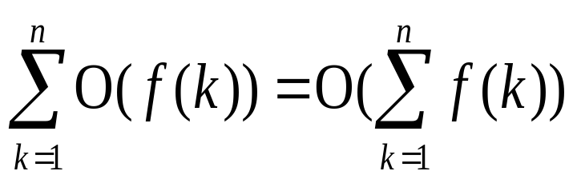
Manipulating Asymptotic Notation
cO(f(n)) = O(f(n))
O(O(f(n))) = O(f(n))
O(f(n))O(g(n)) = O(f(n)g(n))
O(f(n)g(n)) = f(n)O(g(n))
O(f(n)+g(n)) = ( max ( f(n),g(n))

Slide 15
More Examples
(a) 0.5n² - 5n + 2 = Ω( n²).
Let c = 0.25 and n₀ = 25.
0.5 n² - 5n + 2 = 0.25( n²) for all n = 25
(b) 0.5 n² - 5n + 2 = O( n²).
Let c = 0.5 and n₀ = 1.
0.5( n²) = 0.5 n² - 5n + 2 for all n = 1
(c) 0.5 n² - 5n + 2 = Θ( n²)
from (a) and (b) above.
Use n₀ = 25, c₁ = 0.25, c₂ = 0.5 in the definition.

Slide 16
GENERAL RULES FOR ANALYSIS(1/5)
1. Consecutive statements
  Maximum statement is the one counted
    e.g. a fragment with single for-loop followed by double for- loop is O(n²).
Block #1
t₁
t₁+t₂ = max(t₁,t₂)
Block #2
t₂

Slide 17
GENERAL RULES FOR ANALYSIS(2/5)
2. If/Else
if cond then S1
else
S2
Block #1
t₁
Block #2
t₂
Max(t₁,t₂)

Slide 18
GENERAL RULES FOR ANALYSIS(3/5)
3. For Loops
Running time of a for-loop is at most the running time of the statements inside the for-loop times number of iterations
for (i = sum = 0; i < n; i++)
sum += a[i];
for loop iterates n times, executes 2 assignment statements each iteration ==> asymptotic complexity of O(n)

Slide 19
GENERAL RULES FOR ANALYSIS(4/5)
4. Nested For-Loops
Analyze inside-out. Total running time is running time of the statement multiplied by product of the sizes of all the for-loops
e.g. for (i =0; i < n; i++)
for (j = 0, sum = a[0]; j <= i ; j++)
sum += a[j];
  printf("sum for subarray - through %d is %d\n", i, sum);

Slide 20
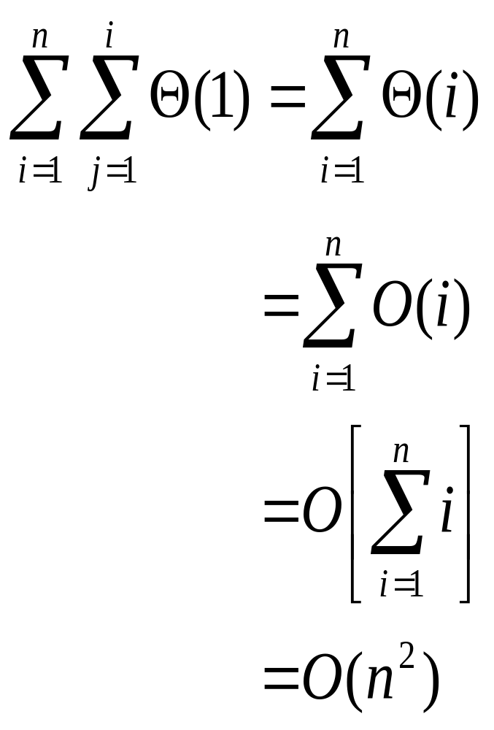
GENERAL RULES FOR ANALYSIS(5/5)

Slide 21
One more example
T(n)=T(n/3)+ T(2n/3)+O(n).
T(n)=O(cnlg_{3/2}^{n}) = O(nlg n).
Prove T(n) ≤ dnlg n.

Slide 22
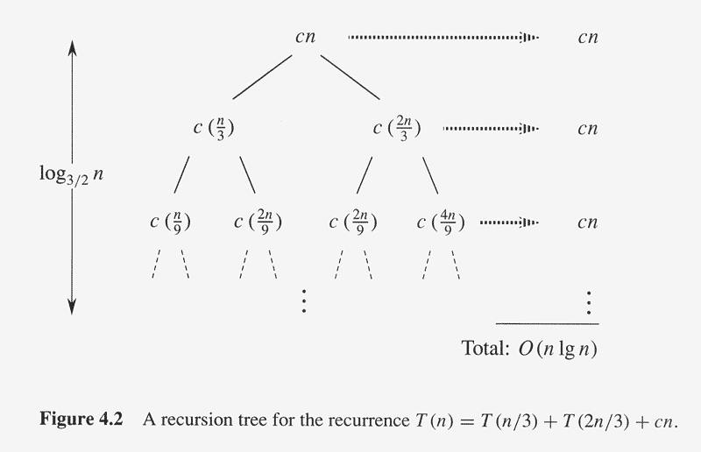
Recursion Tree of T(n)=T(n/3)+ T(2n/3)+O(n)

Slide 23
Master Method/Theorem
Theorem 4.1 (page 73)
  for T(n) = aT(n/b)+f(n), n/b may be ⎡n/b⎤ or ⎣n/b⎦.
  where a ≥ 1, b>1 are positive integers, f(n) be a non-negative function.
  If f(n)=O(n^{log}b^{a-ε}) for some ε>0, then T(n)= Θ(n^{log}bª).
  If f(n)= Θ(n^{log}bª), then T(n)= Θ(n^{log}bª lg n).
  If f(n)=Ω(n^{log}b^{a+ε}) for some ε>0, and if af(n/b) ≤cf(n) for some c<1 and all sufficiently large n, then T(n)= Θ(f(n)).

Slide 24
Implications of Master Theorem
Comparison between f(n) and n^{log}bª (<,=,>)
Must be asymptotically smaller (or larger) by a polynomial, i.e., n^{ε} for some ε>0.
In case 3, the “regularity” must be satisfied, i.e., af(n/b) ≤cf(n) for some c<1 .
There are gaps
  between 1 and 2: f(n) is smaller than n^{log}bª, but not polynomially smaller.
  between 2 and 3: f(n) is larger than n^{log}bª, but not polynomially larger.
  in case 3, if the “regularity” fails to hold.

Slide 25
Application of Master Theorem
T(n) = 9T(n/3)+n;
  a=9,b=3, f(n) =n
  n^{log}bª = n^{log}3⁹ = Θ (n²)
  f(n)=O(n^{log}3^{9-ε}) for ε=1
  By case 1, T(n) =Θ (n²).
T(n) = T(2n/3)+1
  a=1,b=3/2, f(n) =1
  n^{log}bª = n^{log}3/2¹ = Θ (n⁰) = Θ (1)
  By case 2, T(n)= Θ(lg n).

Slide 26
Application of Master Theorem
T(n) = 3T(n/4)+nlg n;
  a=3,b=4, f(n) =nlg n
  n^{log}bª = n^{log}4³ = Θ (n^{0.793})
  f(n)= Ω(n^{log}4^{3+ε}) for ε≈0.2
  Moreover, for large n, the “regularity” holds for c=3/4.
    af(n/b) =3(n/4)lg (n/4) ≤ (3/4)nlg n = cf(n)
  By case 3, T(n) =Θ (f(n))=Θ (nlg n).

Slide 27
Exception to Master Theorem
T(n) = 2T(n/2)+nlg n;
  a=2,b=2, f(n) =nlg n
  n^{log}bª = n^{log}2² = Θ (n)
  f(n) is asymptotically larger than n^{log}bª , but not polynomially larger because
  f(n)/n^{log}bª = lg n, which is asymptotically less than n^{ε} for any ε>0.
  Therefore,this is a gap between 2 and 3.

Slide 28
Where Are the Gaps
f(n), case 3, at least polynomially larger
n^{ε}
Gap between case 3 and 2
c₁
n^{logba}
f(n), case 2: within constant distances
c₂
n^{ε}
Gap between case 1 and 2
f(n), case 1, at least polynomially smaller
Note: 1. for case 3, the regularity also must hold.
2. if f(n) is lg n smaller, then fall in gap in 1 and 2
3. if f(n) is lg n larger, then fall in gap in 3 and 2
4. if f(n)=Θ(n^{logba}lg^{k}n), then T(n)=Θ(n^{logba}lg^{k+1}n). (as exercise)

