Slide 1
Building Distributed Applications with .NET Aspire
Shimon Dahan
Shimond@any-techs.co.il

Slide 2
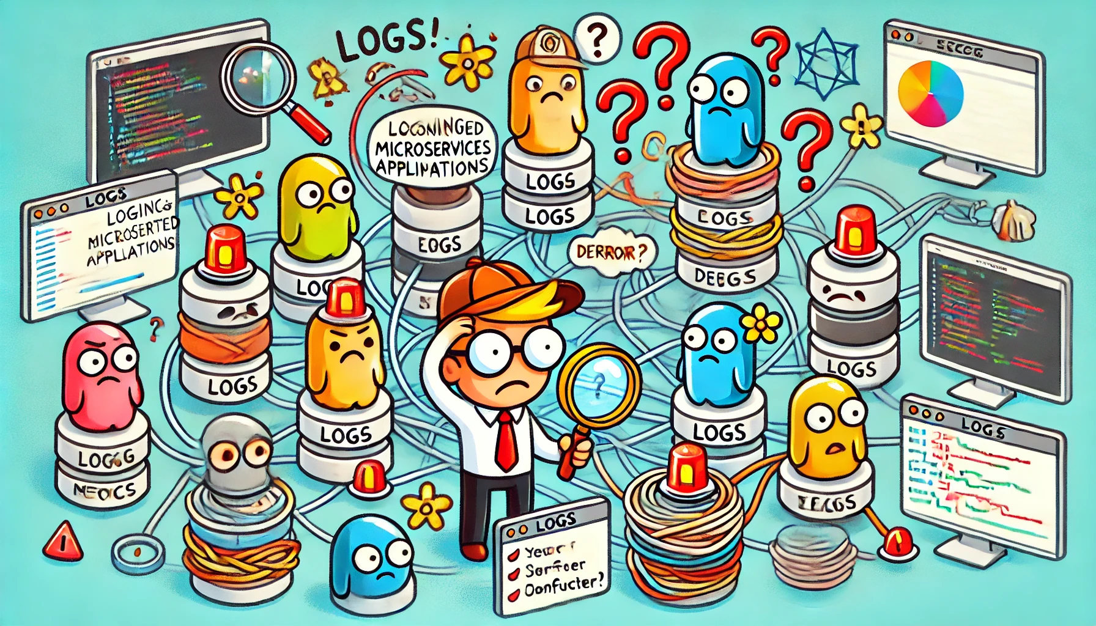
Distributed Applications - the Challenge
Complex Setup: Configuring local development environments to mirror production can be intricate and time-consuming.
Dependency Management: Managing dependencies across multiple services and ensuring compatibility is challenging.
Service Orchestration: Coordinating the startup and interaction of various services during development requires significant effort.
Debugging Nightmares :Scattered logs across services made troubleshooting challenging.

Slide 3
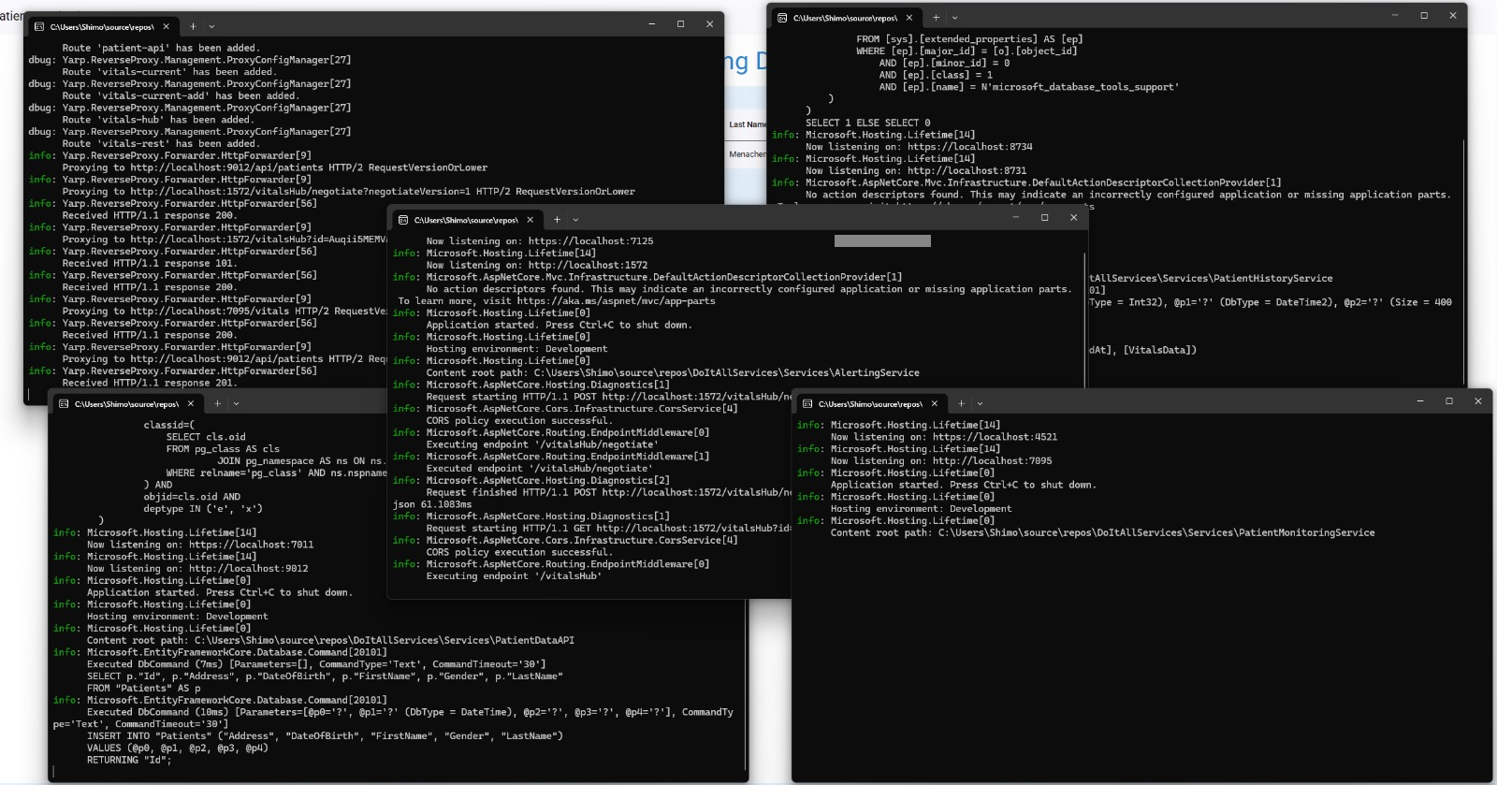
Logging and Monitoring Challenges
Distributed Logging: Collecting logs across multiple services and aggregating them into a central system.
Tracing: Implementing distributed tracing to identify bottlenecks and errors across service calls.
Monitoring: Setting up comprehensive monitoring for metrics, logs, and traces using tools like Prometheus, Grafana, or Application Insights.

Slide 4
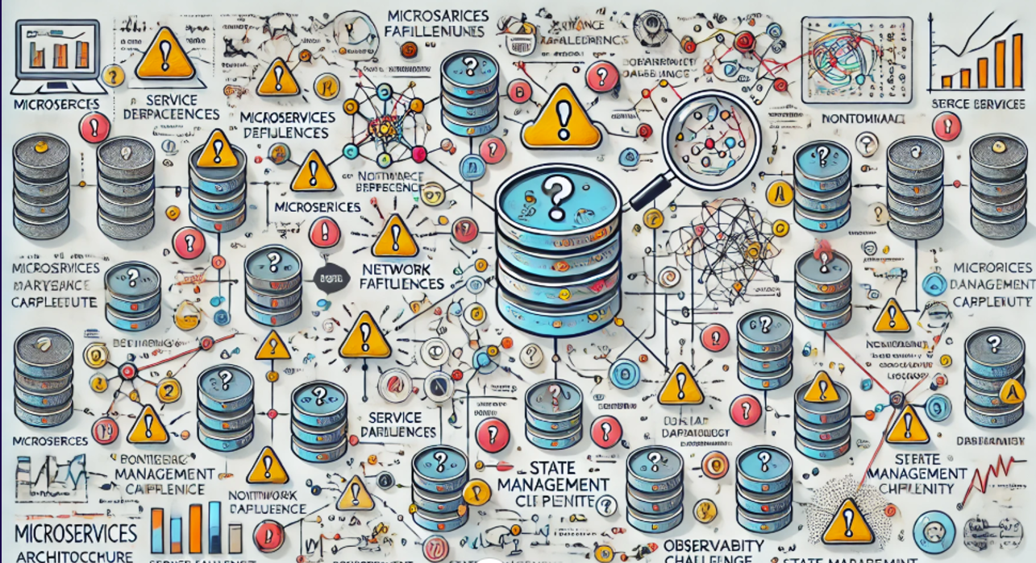
Resilience & Fault Tolerance Challenges

Slide 5
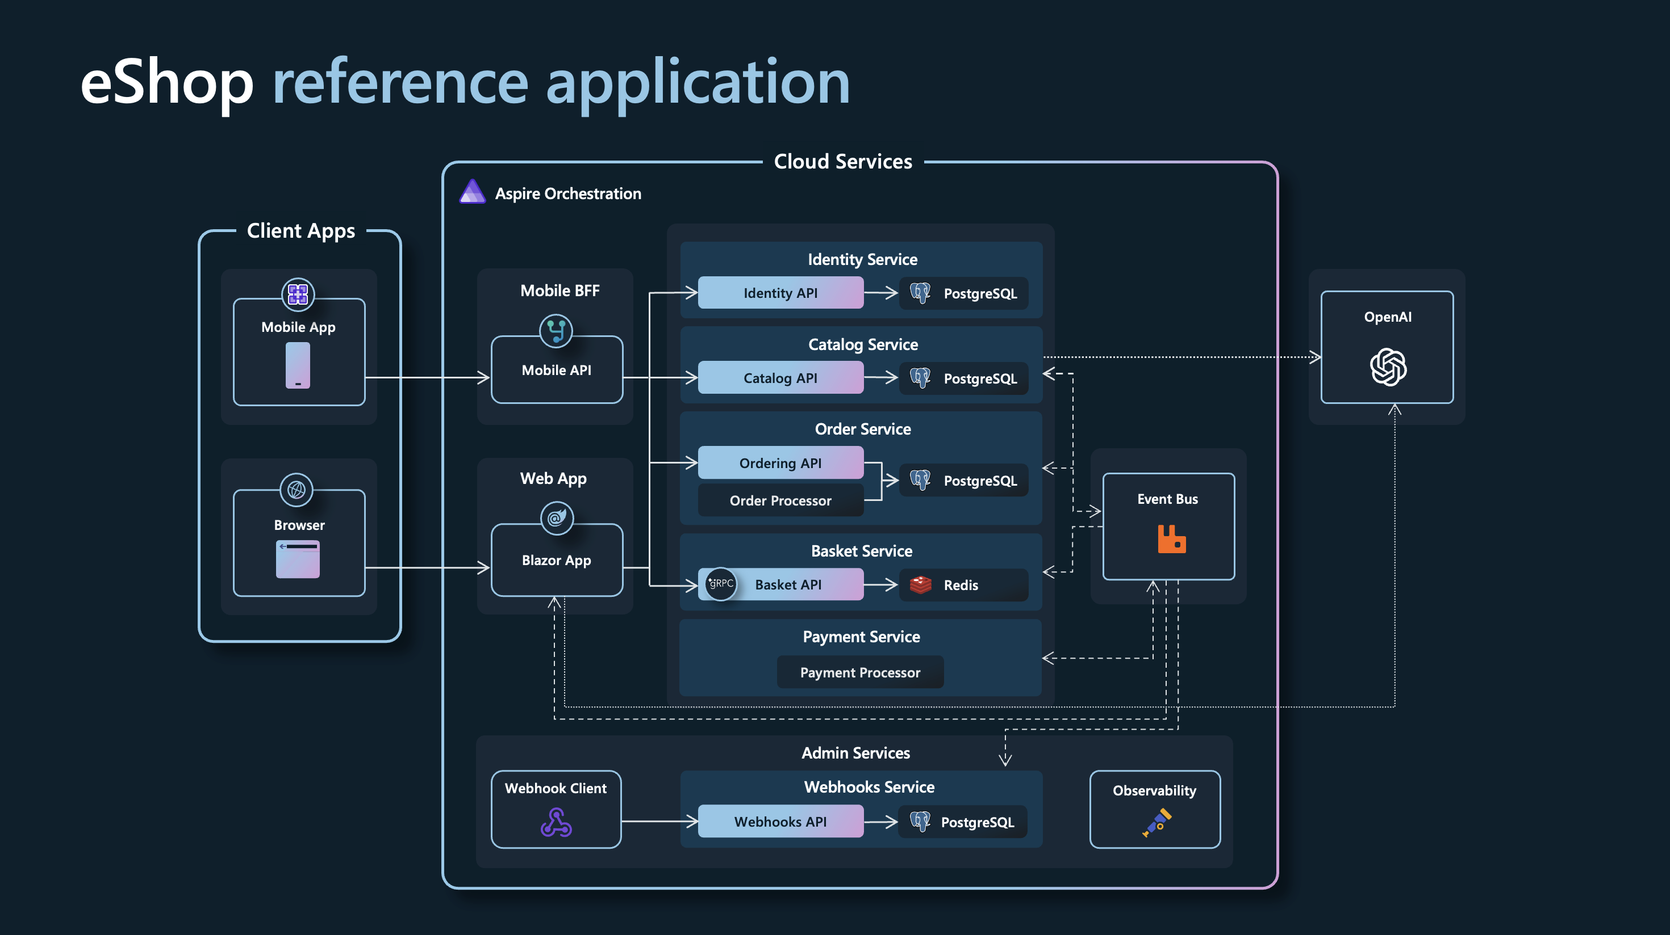

Slide 6
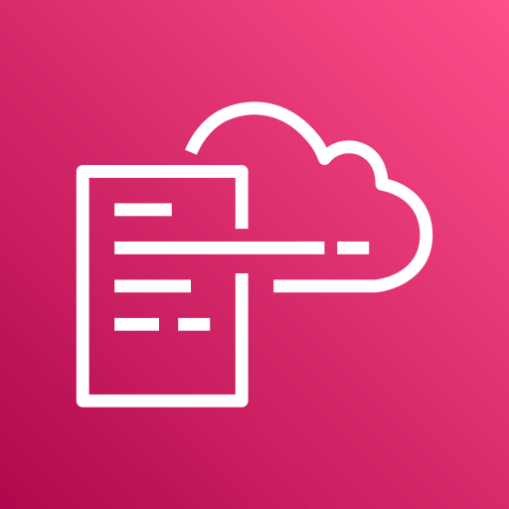
Demo: CarePulse Monitoring system

Slide 7
Docker compose
Multi-Service OrchestrationEasily run multiple containers (e.g., ASP.NET service, database, Redis) in one step. Compose takes care of starting, linking, and managing them.
Consistent Development EnvironmentDefine all services in a single YAML file, ensuring everyone on the team runs the same setup—no more “it works on my machine.
”Simplified ConfigurationUse environment variables and configuration in docker-compose.yml to centralize settings (like connection strings) for your ASP.NET application.

Slide 8
Demo: CarePulse Monitoring system Using docker-compose

Slide 9

Docker compose disadvantages
Complex Networking in Large Setups
While it simplifies networking for small setups, managing complex networks or cross-host communication can become cumbersome without additional tools.
Lacks Advanced Monitoring
Docker Compose doesn’t include built-in tools for monitoring container health or resource usage, which are essential for large-scale applications.

Slide 10
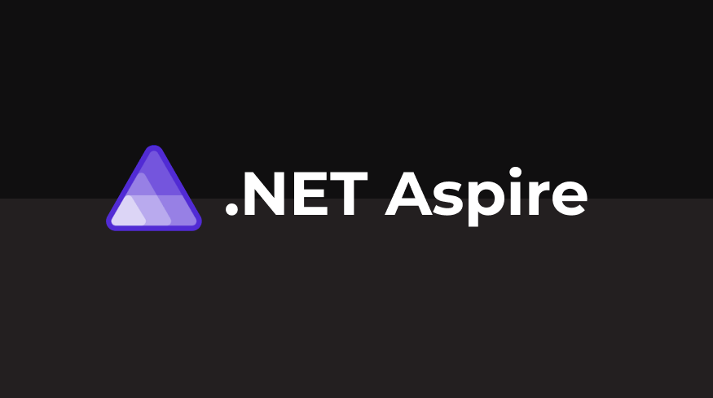
.NET Aspire
.NET Aspire is a modern application development framework designed to simplify the creation, management, and scalability of distributed systems. It integrates seamlessly with the Microsoft ecosystem and cloud-native technologies, offering a unified platform for developers to build robust applications.

Slide 11
.NET Aspire ServiceDefaults project
Resilience
Configures default policies for handling transient faults, enhancing application robustness.
Observability
Health Checks
Integrates OpenTelemetry for metrics, tracing, and logging, facilitating comprehensive monitoring and diagnostics
Adds default health check endpoints to monitor service health and readiness.
Service Discovery
Enables seamless service-to-service communication through automatic discovery mechanisms

Slide 12
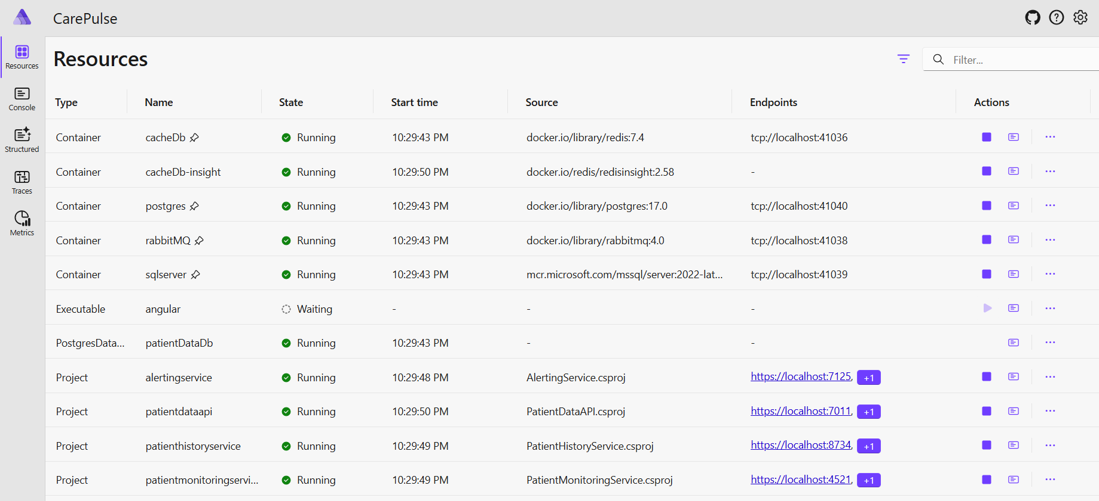
.NET Aspire dashboard

Slide 13
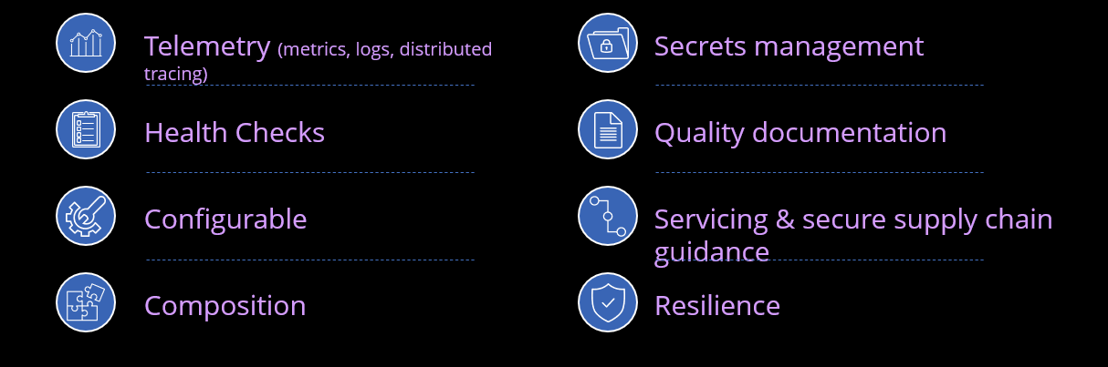
Advantages of Aspire
Productivity
Reliability
Consistency
Faster development with pre-defined patterns
Ensures fault tolerance and resilience
Unified development practices across teams

Slide 14
Demo: CarePulse Monitoring system Using Asp.net aspire 9

Slide 15
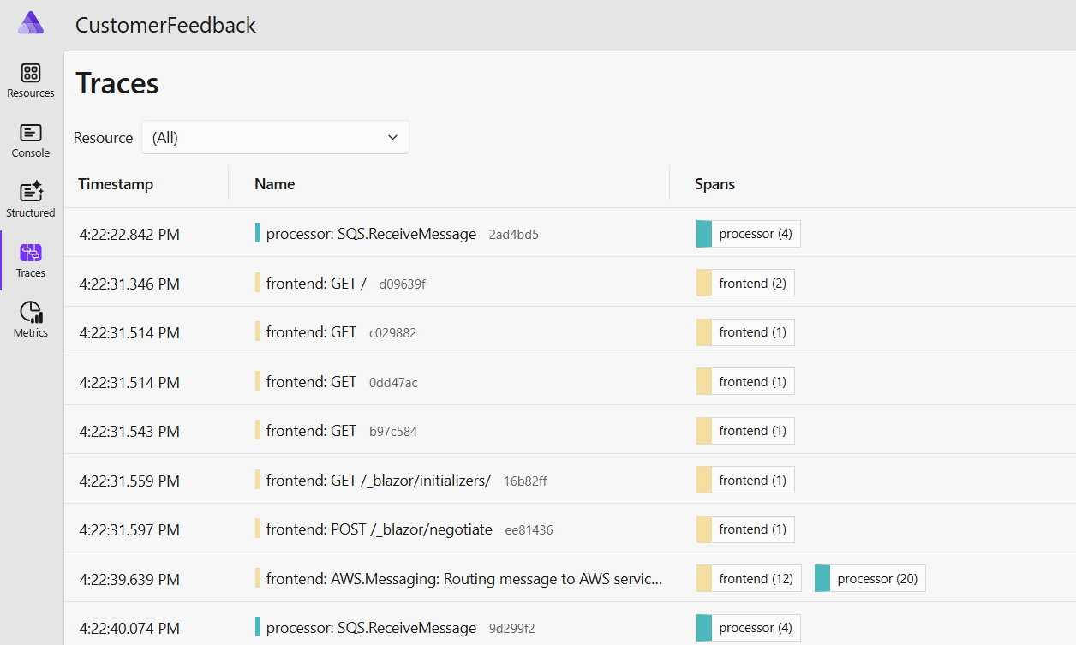
OpenTelemetry and .NET Aspire
OpenTelemetry lets you see what your application is doing under the covers.
Aspire Dashboard shows Traces and Metrics
Instrument AWS SDK with OpenTelemetry.Instrumentation.AWS NuGet package
See what AWS calls your application is making.

Slide 16
Thank You

