Slide 1
.net core & microservices
Shimon Dahan – sdahan@jbh.co.il

Slide 2
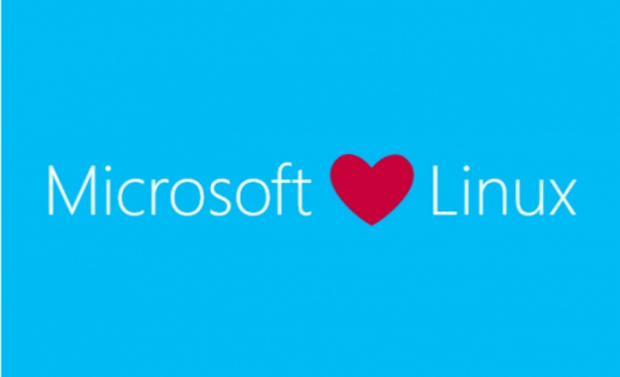
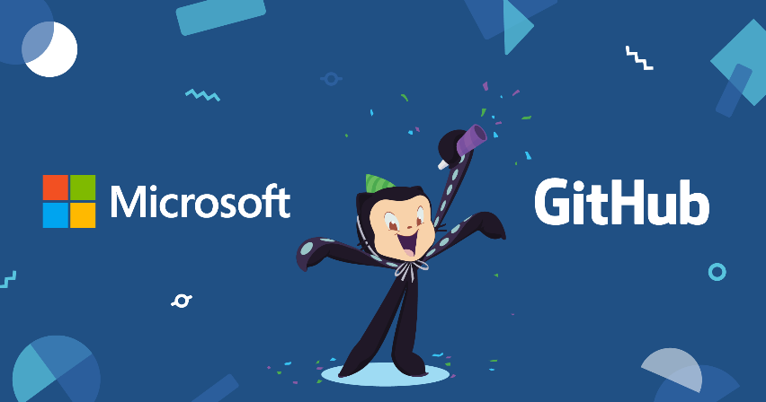
ASP.NET CORE
ASP.NET Core is a cross-platform, high-performance, open-source framework for building modern, cloud-based, Internet-connected applications
A unified story for building web UI and web APIs.
Architected for testability.
Razor Pages makes coding page-focused scenarios easier and more productive.
Ability to develop and run on Windows, macOS, and Linux.
Open-source and community-focused.
Integration of modern, client-side frameworks and development workflows..
A cloud-ready, environment-based configuration system.
Built-in dependency injection.
A lightweight, high-performance, and modular HTTP request pipeline.

Slide 3
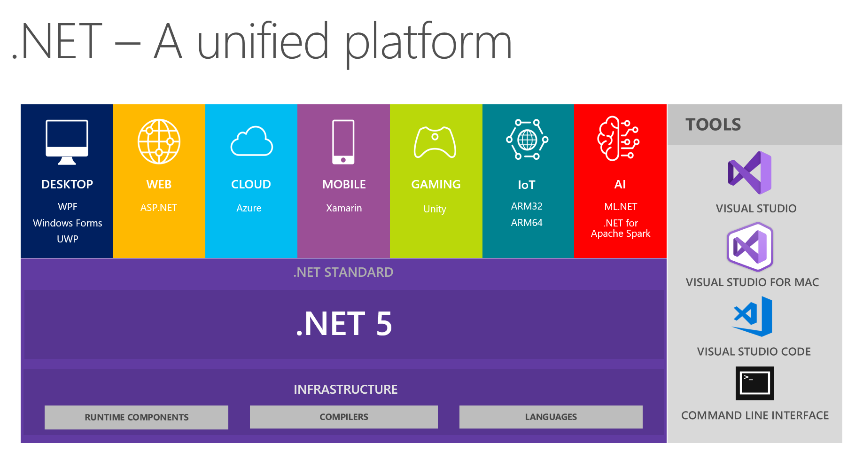
NET Core is the Future of .NET
.NET 5 = .NET Core vNext

Slide 4
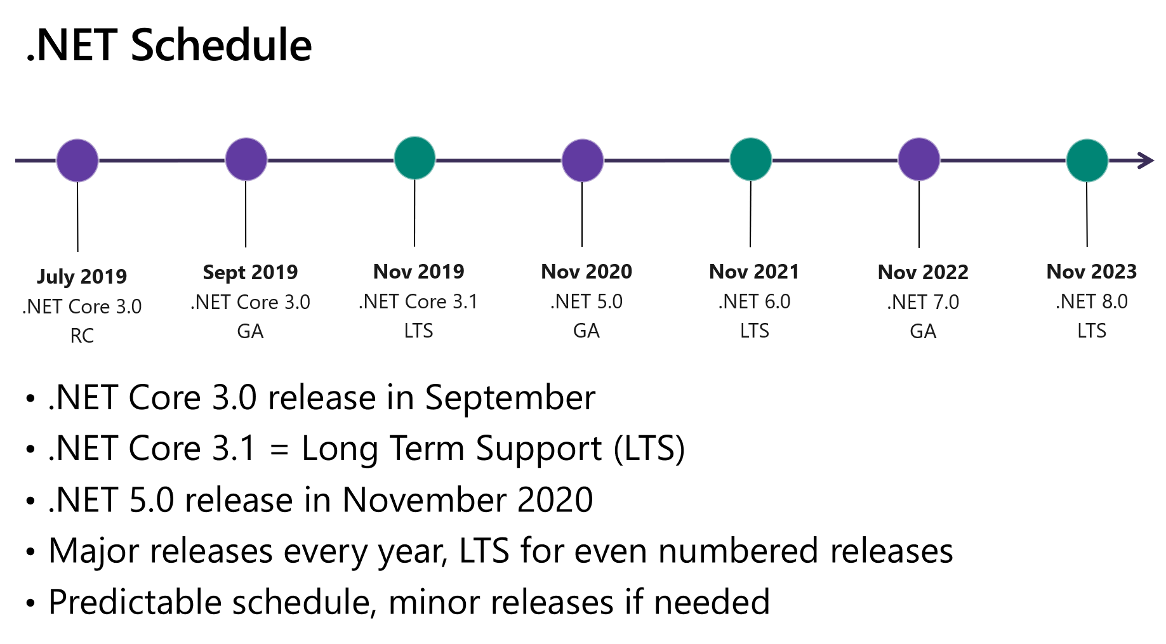

Slide 5
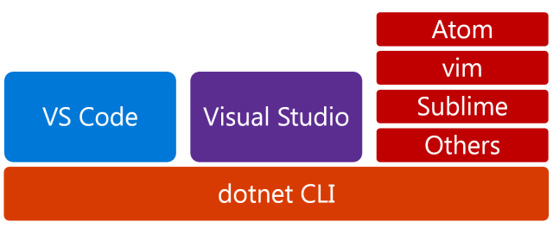
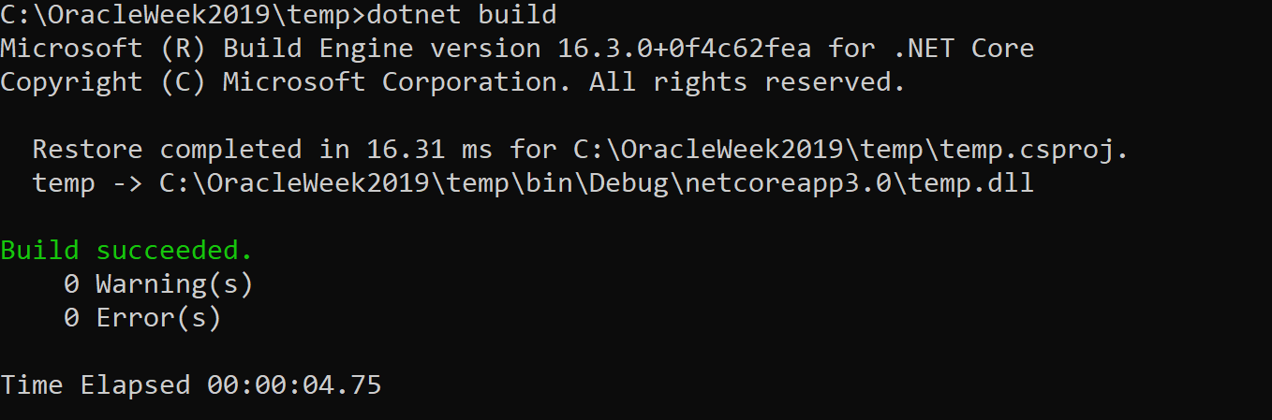
dotnet CLI

Slide 6
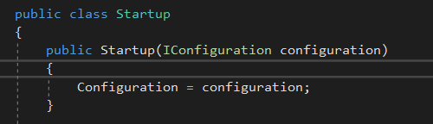
.ner core configuration
App configuration in ASP.NET Core is based on key-value pairs established by configuration providers
Providers:
Azure Key Vault
Azure App Configuration
Command-line arguments
Custom providers (installed or created)
Directory files
Environment variables
In-memory .NET objects
Settings files

Slide 7


Dependency injection
ASP.NET Core supports the dependency injection (DI) software design pattern, which is a technique for achieving Inversion of Control (IoC) between classes and their dependencies.

Slide 8
Dependency injection
Transient
Transient lifetime services are created each time they're requested from the service container. This lifetime works best for lightweight, stateless services.
Scoped
Scoped lifetime services are created once per http context.
Singleton
Singleton lifetime services are created the first time they're requested Every subsequent request uses the same instance. Don't implement the singleton design pattern and provide user code to manage the object's lifetime in the class.

Slide 9
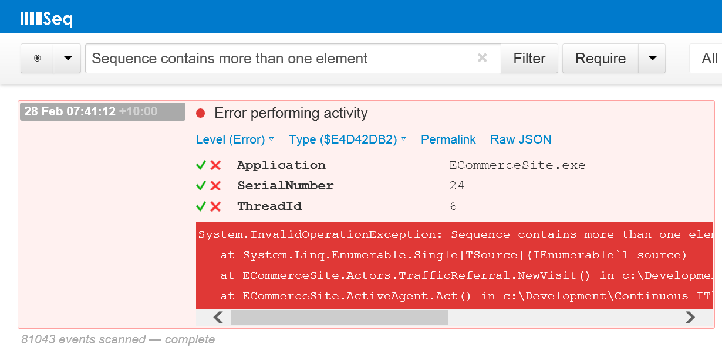
.net core logging
.NET Core supports a logging API that works with a variety of built-in and third-party logging providers
Default ASP.NET Core providers:
Console
Debug
EventSource
EventLog (only when running on Windows)

Slide 10
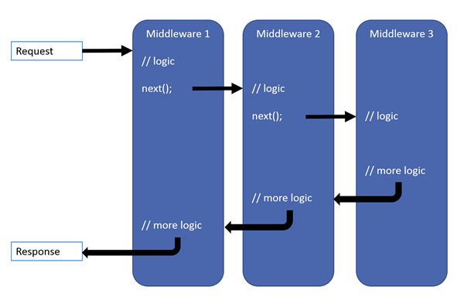
Middleware
Middleware is software that's assembled into an app pipeline to handle requests and responses. Each component:
Chooses whether to pass the request to the next component in the pipeline.
Can perform work before and after the next component in the pipeline.

Slide 11
Middleware
The order that middleware components are added in the Startup.Configure method defines the order in which the middleware components are invoked on requests and the reverse order for the response
Common middleware:
UseStaticFiles
UseRouting
UseAuthentication
UseAuthorization
Health Check
UseDeveloperExceptionPage
UseEndpoints

Slide 12
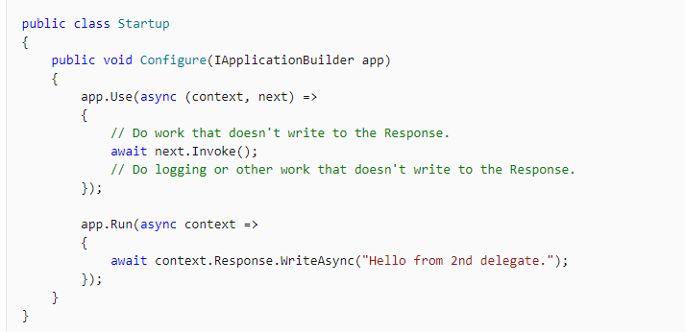
Middleware – custom
Chain multiple request delegates together with ”Use” method
You can short-circuit the pipeline by not calling the next parameter.
You can typically perform actions both before and after the next delegate
The first Run delegate terminates the pipeline

Slide 13
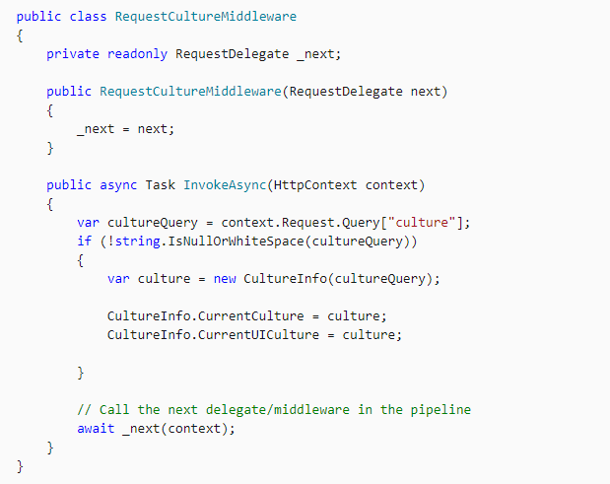
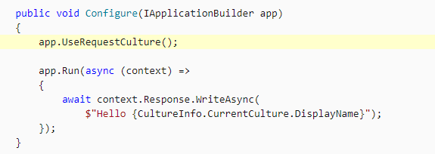
Middleware – custom
Middleware class
Middleware is generally encapsulated in a class and exposed with an extension method

Slide 14
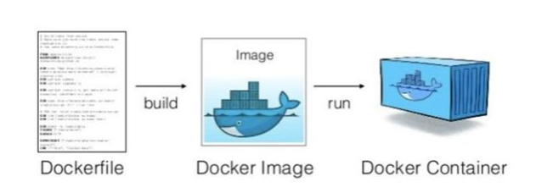
Docker
Docker is a set of platform as a service (PaaS) products that use OS-level virtualization to deliver software in packages called containers
Container is a standard unit of software that packages up code and all its dependencies so the application runs quickly and reliably from one computing environment to another.

Slide 15

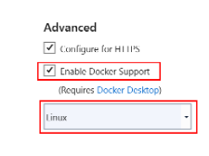

Visual studio Container Tools
The Visual Studio Container Tools Extensions (Preview) are intended to extend the container tooling already in Visual Studio 2019 with the goal of aiding container developers in building and diagnosing their containerized applications
List images on local machine
List containers on local machine
Start, Stop & Remove containers
View, Stream & Search container logs
View file system in running containers
Open files from a running container
Open a terminal window into a running container
Attach to a process in a running container
Inspect port mappings & environment variables

Slide 16
Microservices

Slide 17
Microservices
Definition:
“Microservices is a variant of the service-oriented architecture (SOA) architectural style that structures an application as a collection of loosely coupled services” (wiki)
Break application into small, fine-grained, standalone services
Each services has
  its contract (interface)
  its own deployment settings
  Its own container / server instance(s)

Slide 18
Microservices
Benefits:
Each business component maintained separately
Business flow based on services may use both internal and external business logic transparently
Intensive releases and continuous developments are easier
Service may count on multiple alternative services for failover
Service deployment, availability and maintainability can be automated via DevOps tools

Slide 19
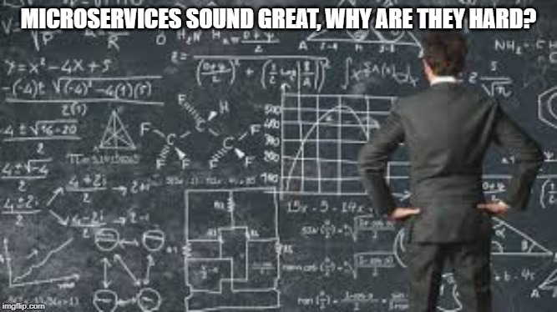

Slide 20
Microservices
Drawbacks:
Intensive HTTP communication (still text based…)
Going stateless? Not always… and then what?
2-phase commit is not supported in any microservice–so can’t be used…
Higher costs –each microservicecomes with its infrastructure….
When microservicesspan over different systems or divisions few challenges emerges:
    Team communication
    Need in good documentation
    Testing is hard when more than single service is involved

Slide 21
Microservices
Best practices:
Create separate data-store per microservice
Provide global data management system
Runs in the backgrounds
Fixes data inconsistencies
Update code by creating a new microservice
Combine with version control
Use separate builds for each service
Run services in containers. Container is NOT a services
Keep server configuration plain when administrating microservices
Any complex configuration should be set internally by the server

Slide 22
Microservices - features
Distributed/versioned configuration
Service registration and discovery
Routing
Service-to-service calls
Load balancing
Circuit Breakers
Distributed messaging

Slide 23
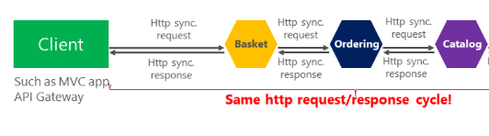
Microservices – Sync messages
HTTP is a synchronous protocol. The client sends a request and waits for a response from the service. That's independent of the client code execution that could be synchronous (thread is blocked) or asynchronous (thread isn't blocked, and the response will reach a callback eventually). The important point here is that the protocol (HTTP/HTTPS) is synchronous and the client code can only continue its task when it receives the HTTP server response.

Slide 24
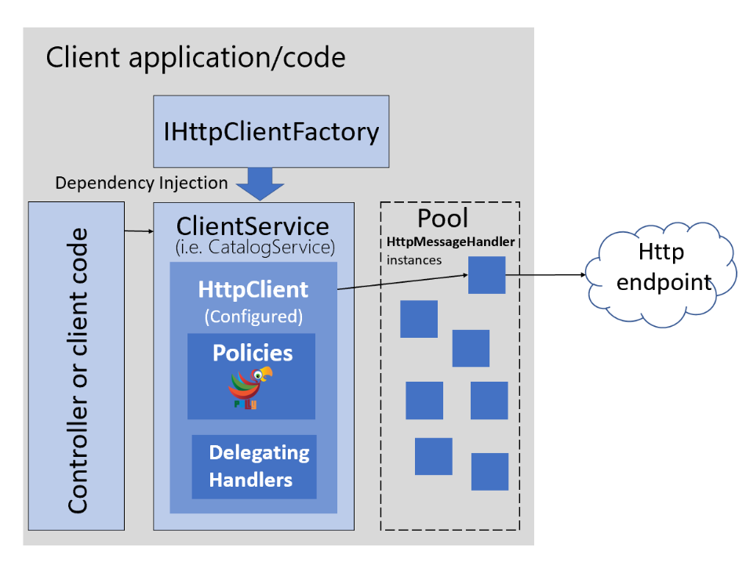
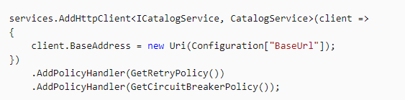
Microservices – Sync messages
Instantiating an HttpClient class for every request will exhaust the number of sockets available under heavy loads. That issue will result in SocketException errors.
Http Client Factory
Provide a central location for naming and configuring logical HttpClient objects. For example, you may configure a client (Service Agent) that's pre-configured to access a specific microservice.
HttpClient already has the concept of delegating handlers that could be linked together for outgoing HTTP requests. You register HTTP clients into the factory and you can use a Polly handler to use Polly policies for Retry, CircuitBreakers, and so on.
Manage the lifetime of HttpClientMessageHandlers to avoid the mentioned problems/issues that can occur when managing HttpClient lifetimes yourself

Slide 25
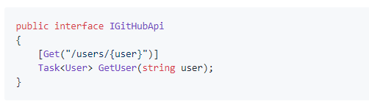
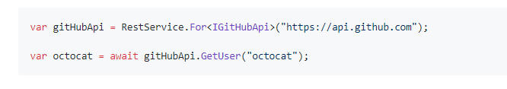
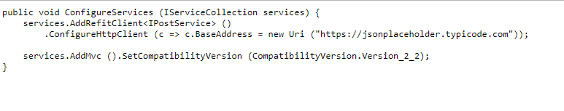
Microservices – Refit
Refit: The automatic type-safe REST library for .NET Core, Xamarin and .NET
The RestService class generates an implementation of IGitHubApi that uses HttpClient to make its calls:

Slide 26
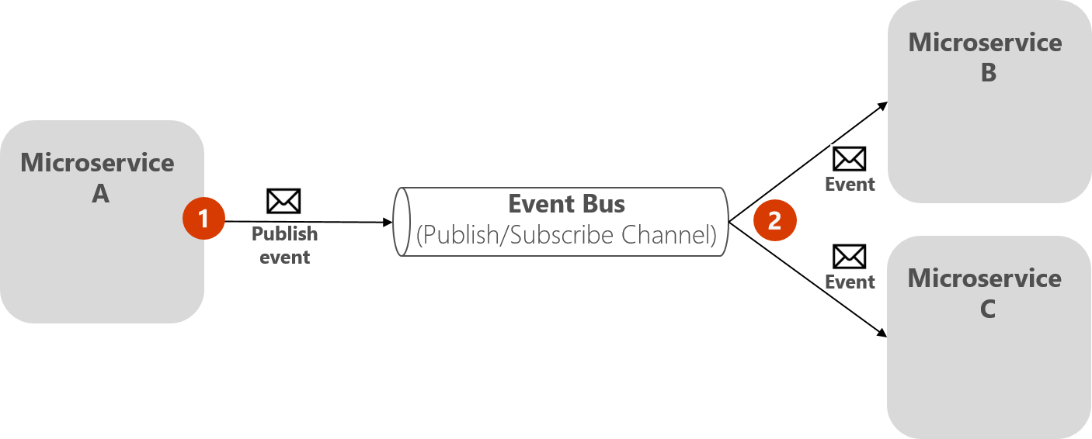
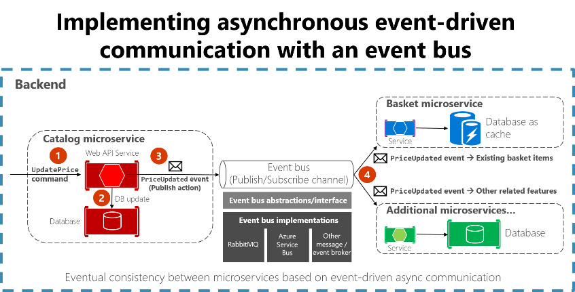
Microservices - messages

Slide 27
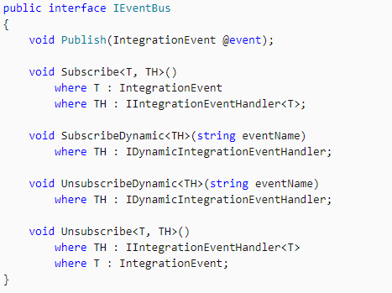
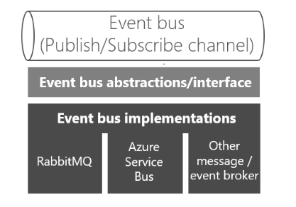
Microservices – Async messages
event bus
How do you achieve anonymity between publisher and subscriber? An easy way is let a middleman take care of all the communication. An event bus is one such middleman.

Slide 28
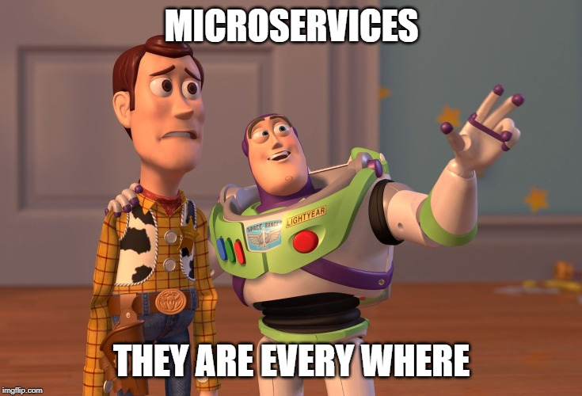
Api Gateway

Slide 29
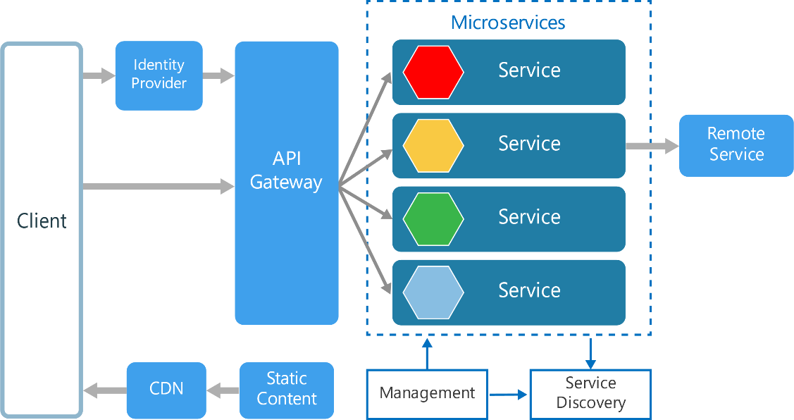
Api Gateway
Benefits:
Insulates the clients from how the application is partitioned into microservices
Insulates the clients from the problem of determining the locations of service instances
Reduces the number of requests/roundtrips. For example, the API gateway enables clients to retrieve data from multiple services with a single round-trip. Fewer requests also means less overhead and improves the user experience. An API gateway is essential for mobile applications

Slide 30

Api Gateway - Ocelot
Ocelot is a .NET API Gateway. This project is aimed at people using .NET running a micro services / service oriented architecture that need a unified point of entry into their system
Routing
Request Aggregation
Service Discovery with Consul & Eureka
Authentication
Authorisation
Caching
Load Balancing
Logging / Tracing / Correlation
Headers / Query String / Claims Transformation
Custom Middleware / Delegating Handlers
Configuration / Administration REST API
Platform / Cloud Agnostic

