Slide 2
.NET 8 & Microservices
Shimon Dahan
Shimond@any-techs.co.il
Sdahan@jbh.co.il

Slide 3









.NET
Cloud
Web
Desktop
Mobile
Gaming
IoT
AI
+
+
Visual Studio
Visual Studio Code
CLI
Linux
NuGet
GitHub
Components, tools, library vendors
Windows
macOS
Tools
Operating system
Ecosystem

Slide 4
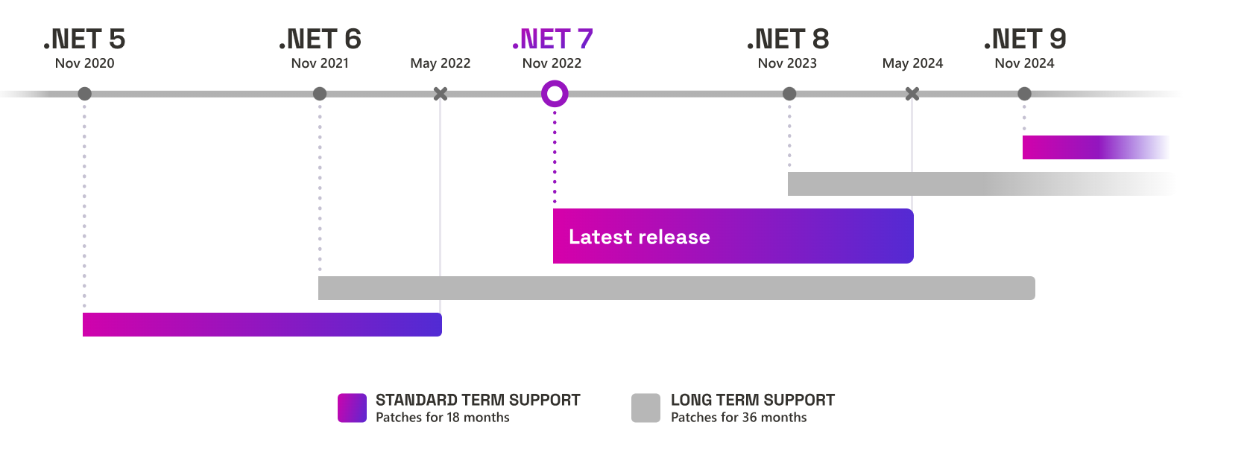

Slide 5

.NET Momentum
6.1+ Million
Monthly active users
53,000+
Community members have contributed to .NET
#1 2023
Most Admired Developer Framework
Top 5
Highest velocity OSS project
Top 5
Top Programming Language on GitHub

Slide 6
Most performant release yet
Performance-related improvements
1250+
250+
550+
1000+
.NET 5
.NET 6
.NET 7
.NET 8

Slide 7
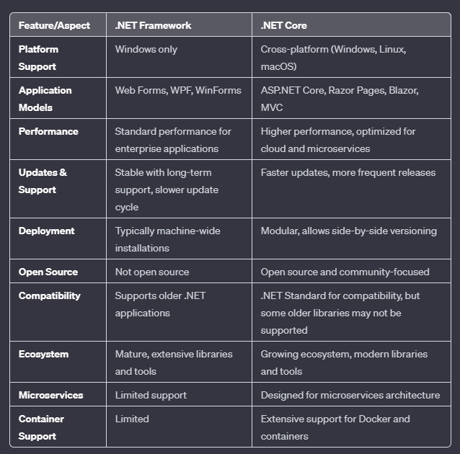
.Net Framework VS
.Net (core)

Slide 8
.NET FRAMEWORK
.NET (core)
Project File (.csproj):
- XML format.
- Includes details about the project, including an exhaustive list of all files and references.
- Can become quite lengthy and complex for larger projects.
References:
- Managed via the `.csproj` file or through Visual Studio's GUI.
- References both NuGet packages and other projects.
- Relies on the Global Assembly Cache (GAC) for system assemblies.
Packages.config or package references in .csproj:
- Older projects use a `packages.config` file to list NuGet dependencies.
- Newer .NET Framework projects may use package references directly in the `.csproj` file.
web.config/app.config:
- Used for configuration settings.
- `web.config` for web applications and `app.config` for other types of projects.
AssemblyInfo.cs:
- Contains assembly metadata like version, author info, etc.
Project File (.csproj):
- Simplified XML structure.
- Does not require listing all files due to default inclusion.
- Package references are included directly in the `.csproj` file.
References:
- Managed within the `.csproj` file.
- Uses a package-based approach. System and framework references are handled as NuGet packages.
- No reliance on the GAC.
No packages.config:
- NuGet dependencies are declared directly in the `.csproj` file.
appsettings.json:
- Replaces `web.config`/`app.config` for configuration settings.
- JSON format, easier to read and supports complex hierarchies.
No AssemblyInfo.cs:
- Assembly information can be included directly in the `.csproj` file or in separate files if needed, but it's more streamlined.
launchSettings.json (for web projects):
- Configures the application’s launch settings, like environment variables and command-line arguments.

Slide 9
C# 9 (Released in November 2020 with .NET 5)
Init Only Setters: Allows properties to be set only during object initialization.
Records: Provides a concise syntax for defining immutable reference types.
Top-level Statements: Reduces boilerplate code for simple programs by eliminating the need for a `Main` method.
Pattern Matching Enhancements: Includes simple type patterns, relational patterns, and logical patterns.
Target-typed New Expressions: Enables you to omit the type when instantiating an object if the type is already known.

Slide 10

C# 10 (Released in November 2021 with .NET 6)
Global Using Directives: Allows using directives to be declared globally for the entire project.
File-scoped Namespace Declaration: Simplifies namespace declaration for files containing a single namespace.
Constant Interpolated Strings: Allows constant strings to use interpolated string syntax.

Slide 11
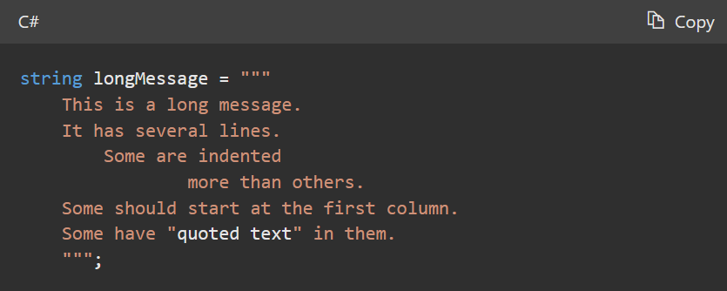
C# 11 (Expected release in November 2022 with .NET 7)
Required Members: Allows you to specify that certain properties or fields must be initialized.
Raw string literals : A raw string literal starts with at least three double-quote (""") characters

Slide 12

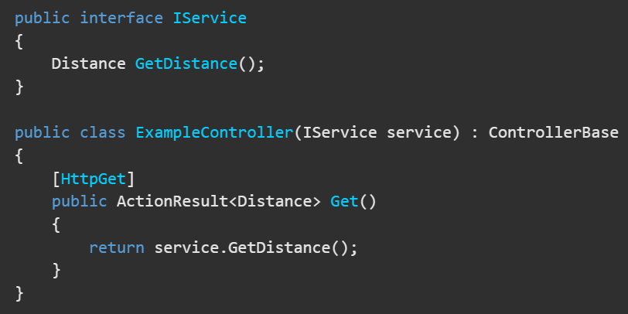
C# 12 (.NET 8)
Primary Constructors: Simplifies the syntax for defining constructors.
Collection expressions:

Slide 13
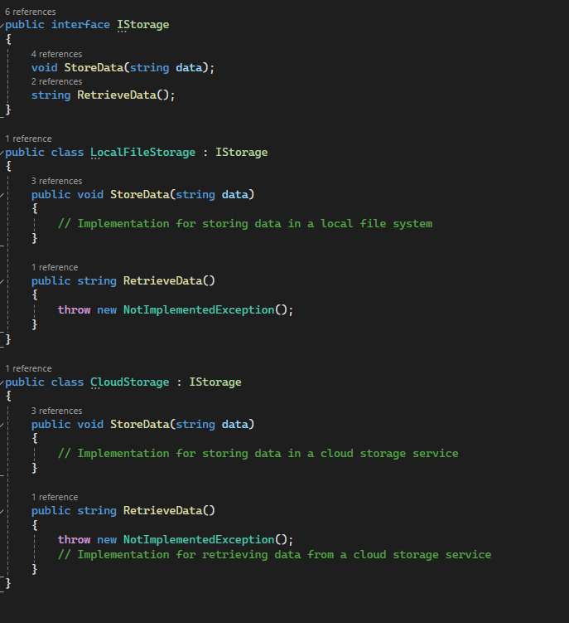
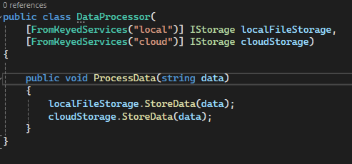
Keyed services support in Dependency Injection
The AddKeyedScoped method is used in dependency injection to register services that have a scoped lifetime. This means that a new instance of the service is created once per request within the scope. It is useful when you want different implementations of an interface to be used in different parts of your application.

Slide 14
Minimal API
Simplicity and Conciseness: Minimal APIs reduce the amount of boilerplate code. You can define endpoints more succinctly, making the code easier to read and maintain.
Improved Performance: By cutting down on unnecessary layers and abstractions, minimal APIs can offer improved performance. This is particularly beneficial for microservices and high-throughput applications.
Ease of Learning: For newcomers, minimal APIs can be less daunting compared to the full MVC framework. They present a simpler way to get started with ASP.NET.
Flexibility: They allow more control over the HTTP pipeline, offering flexibility for developers to handle requests and responses directly.
Better Suitability for Microservices: Due to their lightweight nature, minimal APIs are well-suited for microservice architectures, where each service is small, and simplicity is key.
Integration with OpenAPI/Swagger: Minimal APIs support OpenAPI out of the box, making it easy to document your APIs.

Slide 15
TypedResults
The TypedResults class provides various methods to create different types of HTTP responses. The advantage of using TypedResults is that they provide strong typing, which can be self-describing and beneficial for tooling such as OpenAPI because the response type information is statically available.
Ok: Returns a 200 OK HTTP response with the specified value
BadRequest: Returns a 400 Bad Request HTTP response
NotFound: Returns a 404 Not Found HTTP response
Unauthorized: Returns a 401 Unauthorized HTTP response
Forbid: Returns a 403 Forbidden HTTP response
StatusCode: Returns an HTTP response with the specified status code

Slide 16
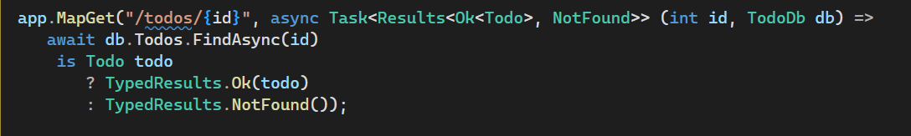
Results<TResult1, TResultN>
Use Results<TResult1, TResultN> as the endpoint handler return type instead of IResult when:
Multiple IResult implementation types are returned from the endpoint handler.
The static TypedResult class is used to create the IResult objects.

Slide 17
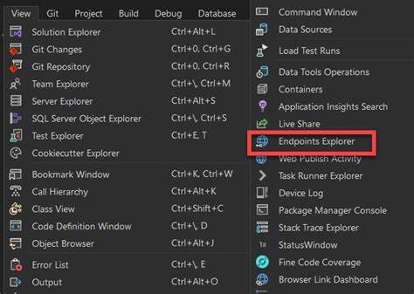
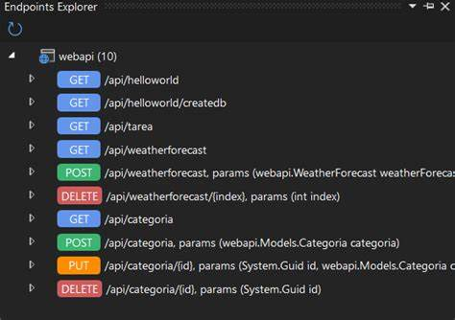
Endpoints Explorer
The Endpoint Explorer in Visual Studio 2022 is a feature that significantly streamlines the process of working with API endpoints within your projects. It allows developers to easily discover, test, and interact with API endpoints directly from the Visual Studio environment, thereby enhancing productivity and simplifying the testing workflow.

Slide 18
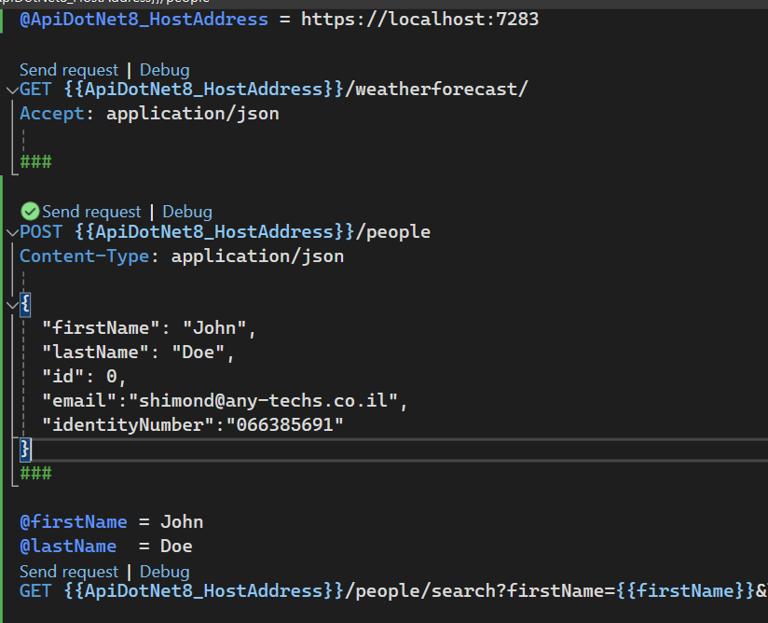
The "HTTP File" feature in Visual Studio
Inline Editing and Responses: View and edit HTTP requests alongside your code. See responses inline for quick debugging and analysis.
Syntax Highlighting and Autocompletion: Enjoy full syntax highlighting and autocompletion features, making it easier to compose and modify HTTP requests.
Integration with Project Environment: HTTP files are integrated with your project environment, allowing for easy management and version control alongside your existing codebase.
Support for Multiple HTTP Methods: Comprehensive support for various HTTP methods including GET, POST, PUT, DELETE, and more.

Slide 19
Use async methods in minimal api and controllers
Improved Scalability: Async methods free up the thread handling the request while awaiting an I/O-bound operation like database calls, file system operations, or network requests. This allows the web server to use the thread to handle other requests. In high-traffic scenarios, this leads to significantly better scalability as the server can handle more concurrent requests with fewer threads.
Efficient Resource Utilization: Synchronous operations block the executing thread, making it idle while waiting for the I/O operation to complete. In contrast, async operations do not block the thread, allowing for better resource utilization. This is particularly important in cloud environments where resources are metered and efficiency is key.
Improved Performance: While asynchronous programming doesn't inherently make individual requests faster, it allows the system to handle more requests simultaneously, which can lead to overall better system throughput.
Responsiveness: In scenarios where the server is handling multiple tasks that might take a considerable amount of time, asynchronous programming helps in maintaining responsiveness. The server can continue to respond to other shorter requests while the longer tasks are being processed.
Avoiding Thread Pool Exhaustion: In high-load scenarios, a synchronous model can lead to thread pool exhaustion. Since each request occupies a thread for its entire duration, you might run out of available threads under heavy load, leading to request queuing and increased response times.

Slide 20
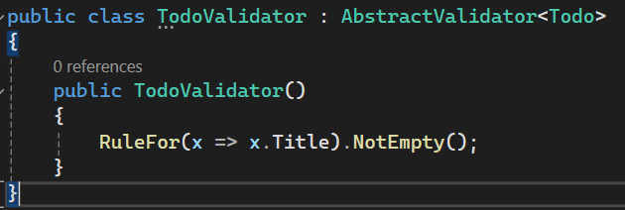

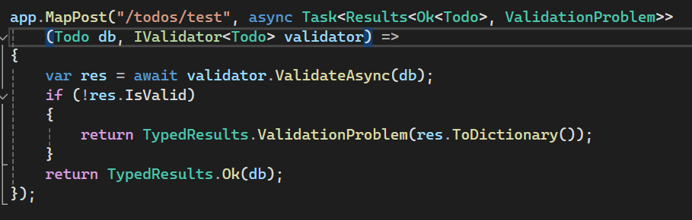
MinimalApi Validation
Data annotation attributes are not supported in minimal APIs
Use Fluent validation package to validates your model
Install Fluent validation for asp.net core Install-Package FluentValidation.AspNetCore
Create a validation service for the specific model and register to the service collection
You must call the validation function by yourself

Slide 21

Copilot

Slide 22
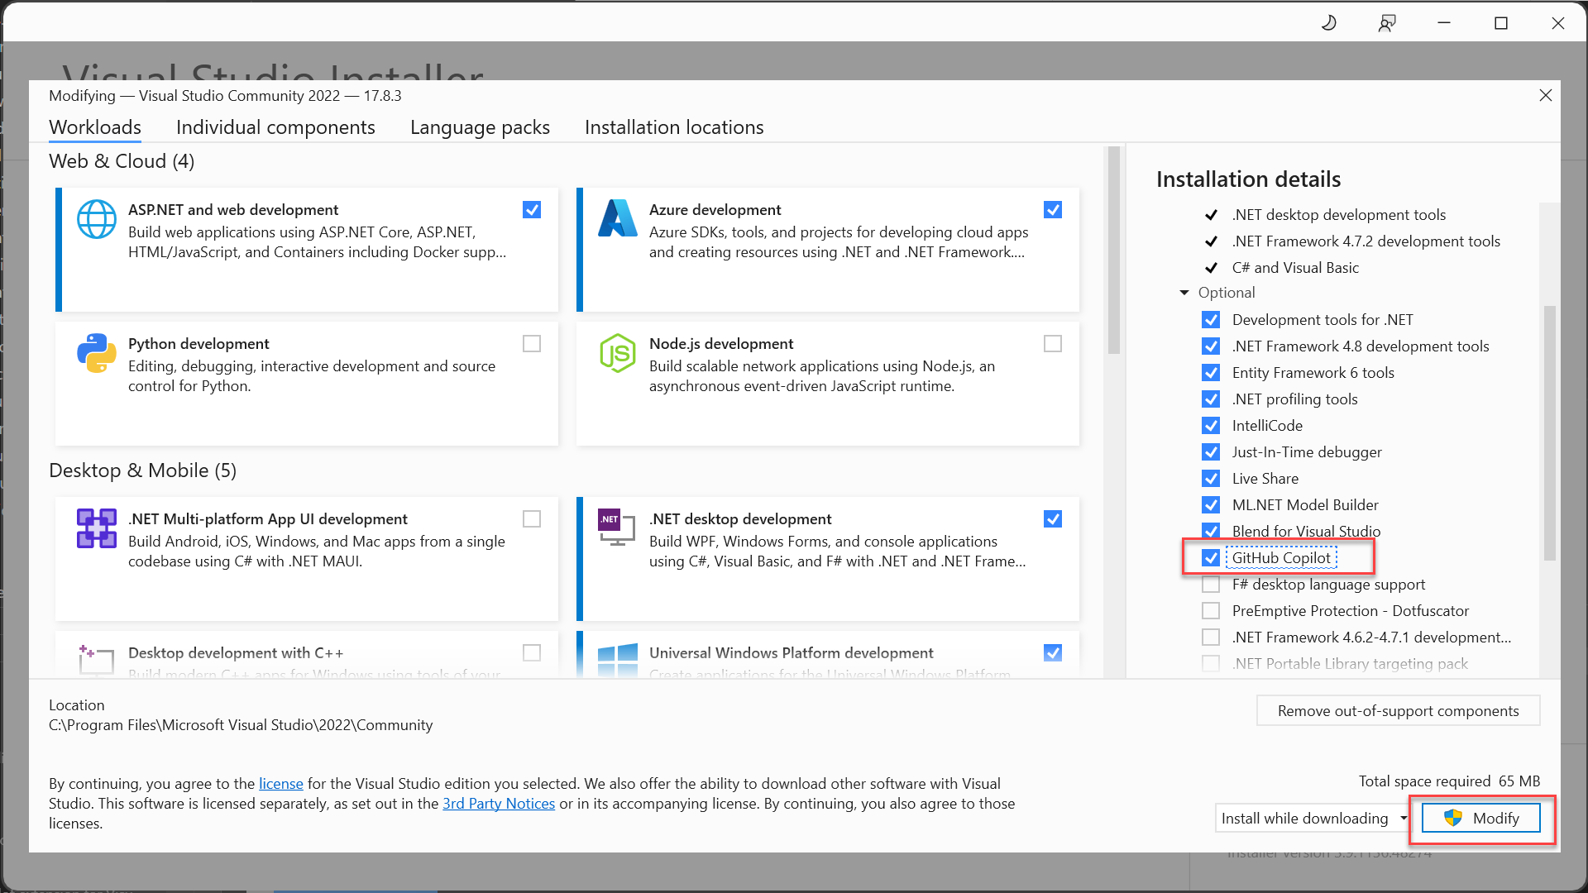

Copilot for visual studio
You can install GitHub Copilot as an extension, but Microsoft recommend you install GitHub Copilot as a component using the Visual Studio Installer

Slide 24
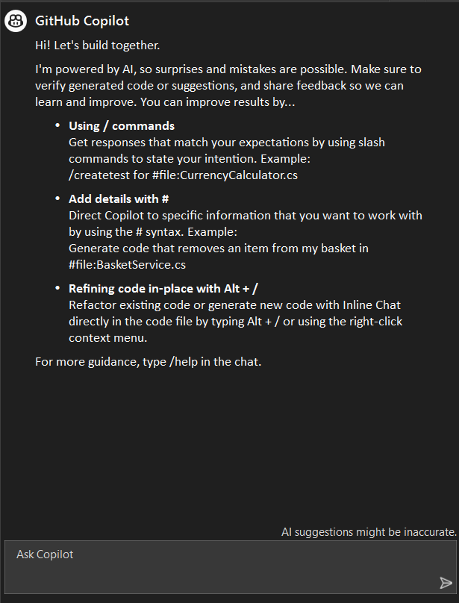

Copilot chat

Slide 25
Microservices

Slide 26
Microservices benefits:
Modularity: Microservices allow for breaking down the application into smaller, manageable pieces. This modularity facilitates easier understanding, development, and maintenance of each service.
Scalability: Each microservice can be scaled independently, allowing for more efficient use of resources. This is particularly advantageous in cloud environments where services can be scaled up or down based on demand.
Flexibility in Technology Stack: Different microservices can use different technologies and programming languages, allowing teams to choose the best tools for each specific task.
Resilience: Since services are independent, the failure of one service doesn't bring down the entire system. This compartmentalization enhances the overall resilience and reliability of the application.
Continuous Deployment and Delivery: Microservices enable more frequent and reliable continuous deployment and continuous integration (CI/CD) practices. Updates to individual services can be deployed without impacting the entire application.
Easier Maintenance and Debugging: Smaller codebases and service isolation make it easier to maintain and debug the application.
Improved Performance: Microservices can improve application performance, especially when they enable more efficient and distributed processing.
Better Alignment with Organizational Structure: Microservices can align well with small, cross-functional teams, where each team is responsible for specific services. This enhances both accountability and productivity.
Reduced Risk in Change Management: Changes made in one service have minimal impact on other services. This reduces the risk associated with changing code.

Slide 27
Microservices challenges:
Complex Service Management: Managing numerous services can become complex, especially as the system scales. This complexity requires robust service orchestration and management tools.
Network Latency and Communication Overhead: Microservices communicate over the network, which can introduce latency and communication overhead. Effective communication protocols and patterns are necessary to mitigate this.
Data Consistency: Ensuring data consistency across different services, each possibly with its own database, can be challenging. Implementing distributed transactions or eventual consistency requires careful design.
Increased Resource Usage: Each microservice might need its own runtime environment and resources, which can lead to higher overall resource consumption compared to monolithic applications.
Difficulty in Testing: Testing a microservices-based application can be more challenging due to the number of independently deployable components and their interactions.
Deployment Complexity: Continuous deployment becomes more complex as you need to manage the deployment of multiple services, potentially with different deployment schedules and environments.
Service Versioning and Compatibility: Maintaining compatibility between different versions of services can be a challenge, especially when services are updated independently.
Security Concerns: The increased number of services and interactions can raise security concerns, requiring more comprehensive and robust security strategies.
DevOps and Cultural Shift: Microservices require a strong DevOps culture and practices, including automation, continuous integration, and continuous delivery. Adopting these practices can be a significant shift for some organizations.
Monitoring and Logging: With many services running simultaneously, monitoring and logging become more complex.

Slide 28
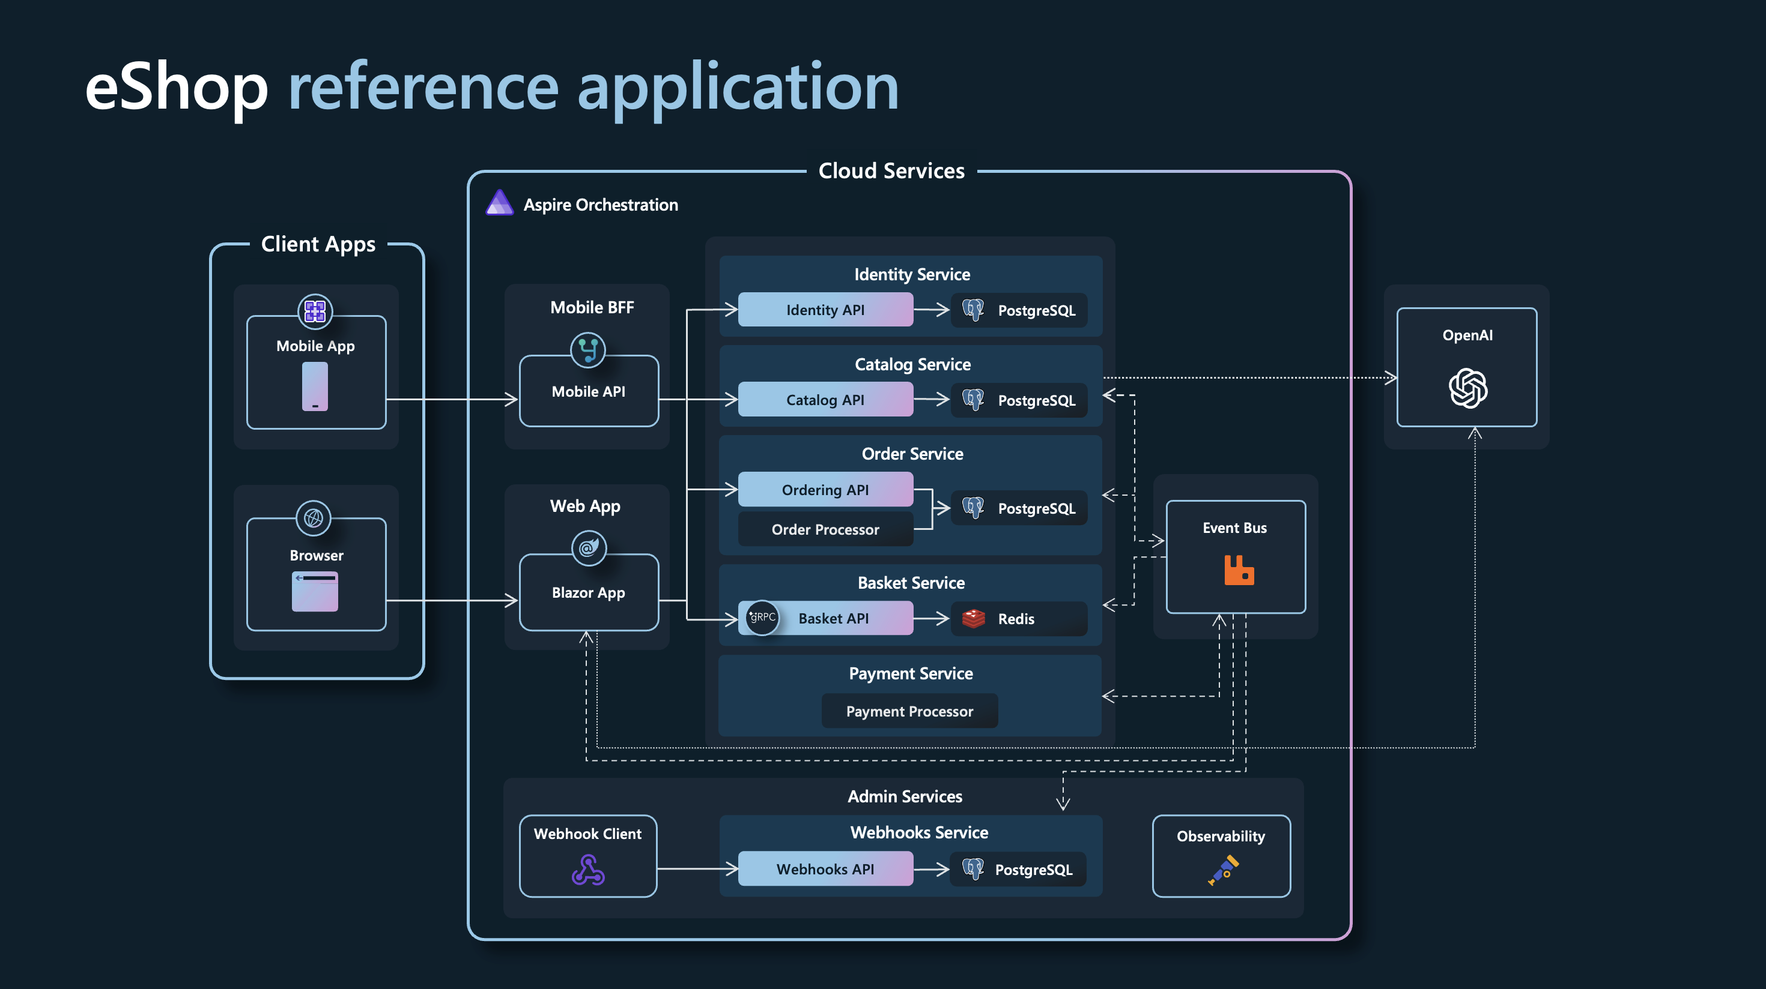

Slide 29
ASP.NET Core improvements in .NET 8
Full stack web UI
Security & APIs
Runtime
Static server rendering
Simplified auth for SPA
HTTP/3
Enhanced navigation & form handling
Identity endpoints
Native AOT
Streaming rendering
Token based support
Request timeouts
Interactivity per component or page
Simplified custom authorization policies
Route short-circuits
Faster app load with Auto render mode
Anti-forgery
Metrics
Route tooling
Named pipes
Endpoints explorer

Slide 30

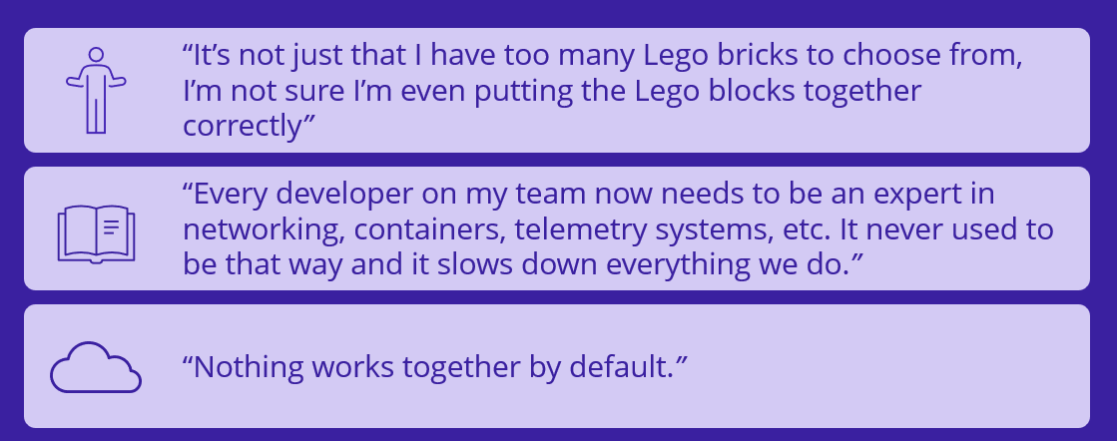

Slide 31



Telemetry (metrics, logs, distributed tracing)
Secrets management
Health Checks
Quality documentation
Configurable
Servicing & secure supply chain guidance
Composition
Resilience

