Slide 1
DSARP
Interim progress review
An evidence-based refactoring agent for Java. It proposes a change, applies it, builds it, and then measures whether the architecture actually improved.
Apache Tika · Logging log4j2 · Apache Struts Detector: Arcan 1.2.1
Nursapa et al., “ROSE,” arXiv:2507.12561, 2025
Notes:
Opening. The claim of the project is the loop: not just detecting smells but proving a change helped.

Slide 2
The idea
What the project is for, and the gap it exists to close.

Slide 3
Every refactoring tool reports an improvement
That is the problem. A tool that always has something encouraging to show you cannot tell you when it has found nothing — and most of the time, there is nothing.
Causal claim allowed: false
No validated source refactoring was applied; smell changes must not be attributed to refactoring.
Our own system, on a complete run against Apache Tika. Every stage green, and it still declined to take credit.
This deck is about building a tool that is allowed to say that — and what it told us once it could.
Notes:
The hook. Hold on the red box for a beat. The point is not that the run failed — it is that the tool was ABLE to report failure. Most of the field cannot. Everything after this is what that honesty bought us.

Slide 4
A detector says where. It never says what to change
What the tools give us
Arcan reports 252 architectural smells in Tika. Each names packages and a severity. None of them names an edit.
What is missing
A concrete source change with real parameters. Proof it compiles and keeps the tests green. A second measurement, so “better” is a fact rather than a hope.
Detect
Propose
Apply
Build & test
Re-measure
Only the last station is entitled to the word “better”.
Notes:
The gap the project exists to close.

Slide 5
Four moving parts, and only one of them is hard
Evidence
Detect smells; mine what maintainers really did.
Transformation
Turn a finding into a parameterised source change.
Validation
Compile it, test it, gate it.
Measurement
Re-run the same detector on the built result.
Each hands its work to the next. The network map of all four is a separate artifact.

Slide 6
The architecture
The architecture of the pipeline itself, at three levels of zoom.

Slide 7
What we built
Four stages, built on other people's detectors and our own glue. The interesting part is the last one: nothing counts until the same detector is run again on a tree that actually compiled.
Evidence
Transformation
Validation
Measurement
1
2
3
4
Arcan 1.2.1 · RefactoringMiner 3.1.4 · jdeps + ArchUnit
OpenRewrite 6.46.1 · Spoon 10.4.2 · DistilBERT model
Compile · test · residual · coverage gates
Arcan re-run, same config · matched before/after diff
Each stage hands its validated output to the next. The container-level map is the C4 model that follows.

Slide 8
Zoom in three times and it still holds
One model, three zoom levels, so the pipeline can be read at whatever altitude your question lives at. The interactive version is a separate artifact.
Level 1 · Context
Level 2 · Container
Level 3 · Component
DSARP as one box. Who asks it for a change, and what it reads: a Java repository at a named commit, plus the detectors that judge it.
The four runnable concerns, each a separate process with its own inputs and outputs. This is the level the previous slide shows.
Inside Transformation: candidate generation from the dependency graph, ranking, recipe emission, and the OpenRewrite or Spoon run that applies it.
Developer · Java repository · Arcan · RefactoringMiner
Evidence · Transformation · Validation · Measurement
generate_recipes · ranking · recipe plan · executor
One model, three zoom levels. Nothing in it is aspirational: every container named here runs today.

Slide 9
Everything in green runs today
Capability | Tool | Status
Smell detection, bytecode | Arcan 1.2.1 | ● running
Smell detection, source | DesigniteJava | ● trial licence, 50k line cap
History mining | RefactoringMiner 3.1.4 | ● running
Dependency graphs | jdeps + ArchUnit, cross-checked | ● running
Source transformation | OpenRewrite 6.46.1, Spoon 10.4.2 | ● running
Suggestion model | DistilBERT, multi-label | ● trained and served
Validation gates | compile · test · residual · coverage | ● running

Slide 10
Four kinds of sentence, and only two you can publish
The pipeline separates four kinds of statement. Only the last two support the sentence “this refactoring helped”.
1
Model suggestion
A ranked, probabilistic label. No parameters, no proof.
2
Concrete candidate
Repository analysis supplied the parameters a recipe needs.
3
Validated refactoring
Compiled, tested, passed the configured checks.
4
Measured result
Before and after, same detector version, same configuration.
Notes:
This ladder is why the negative findings are meaningful rather than embarrassing.

Slide 11
The console
The console that runs an experiment and records what each stage did.

Slide 12
Thirteen stages, and every one shows its work
An experiment is thirteen stages in four groups. Each records what it consumed, what it called and what it produced — so you can audit a run afterwards instead of taking our word for it.
SETUP
LEARNING
REPOSITORY
CHANGE & EVIDENCE
1 · Preflight
3 · Mining
6 · Clone
8 · OpenRewrite
Validate environment
Extract history evidence
Clone exact revision
Resolve, generate, validate
2 · Inputs
4 · Training
7 · Baseline
9 · Focused tests
Prepare model records
Train ranked model
Build and measure
Run targeted tests
5 · Prediction
10 · Format
Rank suggestions
Format and check diff
11 · Final verify
Verify whole project
12 · Smells
Compare architecture
13 · Summary
Present final evidence
Stage 12 is the one that decides whether anything improved: it re-runs Arcan on the built tree and compares it with the baseline from stage 7.

Slide 13
What a smell actually is
What a detector actually hands over, and how a single smell is identified across two runs.

Slide 14
A smell is an identity, not a row
Arcan hands you tables, not problems. To ask whether a particular smell survived, you first have to decide what makes it the same smell twice. Get this wrong and every later number is fiction.
Smell | Identified by | Read from | Count, all three systems
Cyclic Dependency | the set of packages, or classes, in the cycle | packageCyclicDependencyTable.csv, classCyclicDependencyTable.csv | 889
Unstable Dependency | the (package, correlated package) pair | UD.csv | 300
Hub-Like Dependency | the class | HL.csv | 4
The cycle tables are membership matrices: one row per cycle, one column per component, a 1 where that component belongs. A cycle is therefore the set of its members — which is why two runs can hold the same number of cycles and not one of them in common.
UD30.csv is the same unstable dependencies filtered at 30% instability. It is a severity view of UD.csv and is deliberately not counted again — see the correction in Results.

Slide 15
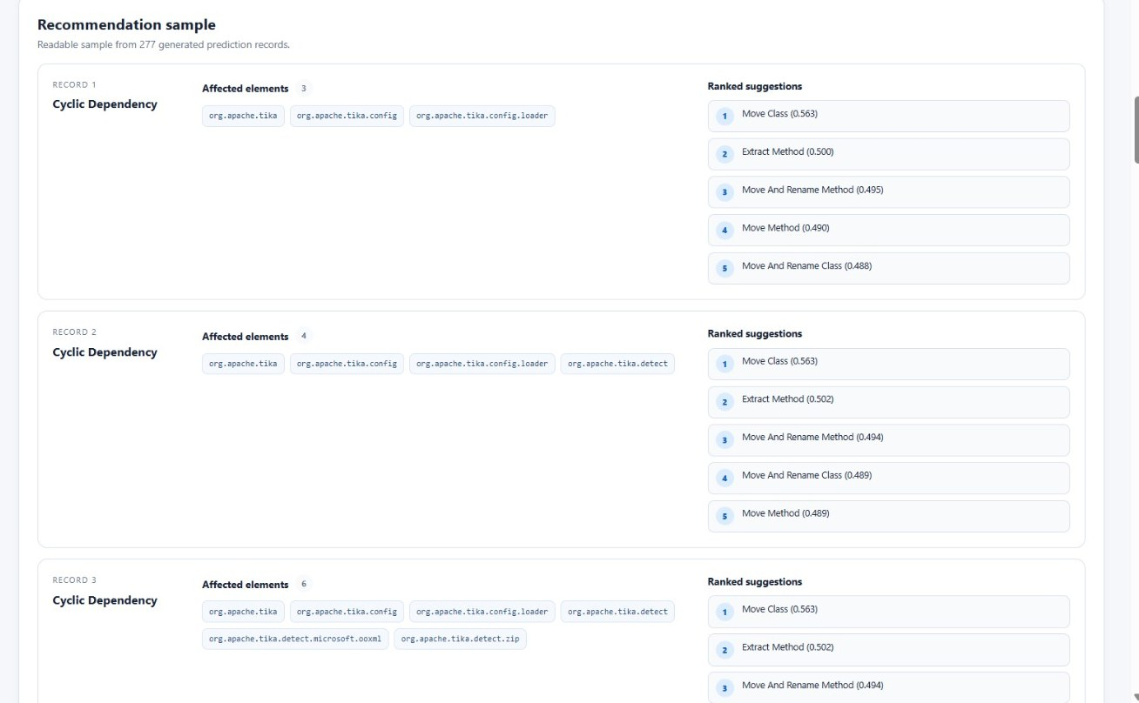
Here is what the model actually says
Smell type, the exact elements affected, five ranked refactoring types with scores. Look closely at the right-hand column — this is the whole of what the model contributes.
Three cyclic dependencies
Each names the packages in the cycle — three, four and six elements.
Move Class, every time
Ranked first at 0.563 on all three, with near-identical runners-up.
No destination
The record never says where to move the class to. The generator infers that separately.
Console: Predictions tab, Tika run, 277 generated prediction records.

Slide 16
The suggestion engine
How a suggestion is produced, what it contains, and how far it gets.

Slide 17
A neural network with exactly one job
Trained here from the supplied dataset, with the repository's own notebook recipe. One job: look at a smell, name the kind of refactoring that fixes it.
In
DistilBERT
Out
One sentence describing a smell, plus its metrics: type, severity, affected elements, edge count.
Multi-label classifier trained on the supplied refactoring-history dataset. 686 rows, 18 labels.
Five refactoring type names with scores. Never a class, never a destination.
The gap between In and Out is the open question: a label is chosen without ever naming the code it applies to.

Slide 18
The metric you quote decides the story
In
One sentence describing a smell and its metrics: “Hub-like Dependency … affected elements org.apache.tika.utils … severity 24.0 … 24 edges …”
Held-out test
Rows / labels | 686 / 18
micro-F1 | 0.353
macro-F1 | 0.039
top-1 hit rate | 0.534
top-5 hit rate | 0.913
macro-F1, across all 18 labels | 0.039
Out
Five refactoring type names with scores. Never a class. Never a destination.
Notes:
Macro-F1 of 0.039 over eighteen labels is the number that matters.

Slide 19
Ask it anything. It says Move Class.
Input given to the model | Move Class score
Hub-like Dependency, 24 edges, severity 24.0 | 0.563
Identical input, smell type changed to Cyclic | 0.564
Unstable Dependency, every metric different | 0.563
Changing the smell type and every numeric feature moves the answer by 0.001.
277 / 277
381 / 686
40 / 40
rows where Move Class ranks first
training rows carrying that same label
rows where our retrain matches the supplied file
It learned the label prior, not a mapping from smell to fix.
Notes:
This is the central negative finding, so land it slowly. The model is not slightly wrong, it is constant. Top-5 hit rate 0.913 looks fine until you notice Move Class is 381 of 686 training rows and macro-F1 is 0.039 — level with always guessing the majority label.

Slide 20
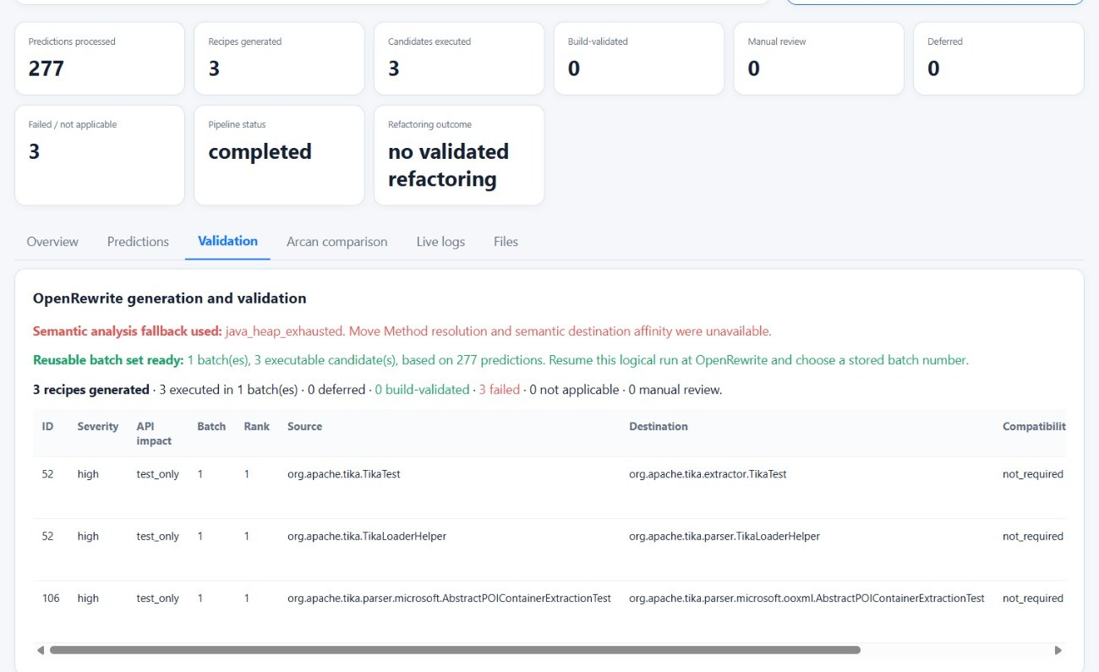
277 suggestions in. Three come out.
The console does not round up. It shows what happened to every candidate, including the ones that died, and it is blunt about the total.
277 in, 3 executable
Only three predictions resolved to a candidate the pipeline could run.
0 build-validated, 3 failed
None of the three survived the build gate, so none can be claimed as an improvement.
All three are test code
API impact test_only: the only resolvable moves were test classes.
The heap fallback note is real: Move Method resolution was unavailable on this machine.

Slide 21
Where the other 274 went
Suggestions
Concrete moves
Viable
Comparable batches
Reduced anything
1,282
473
354
17 of 31
2
Most of the loss has one cause. Of Tika's 249 named elements, 178 are classes rather than packages, and the generator only understands package granularity — so it discards 128 of 277 rows as “not present at this revision” when they are present, just at the wrong level.
Every one of Tika's 86 surviving candidates is flagged high risk to the public API by the generator that produced it.

Slide 22
What a run produces
The prediction CSV and the rest of what a run produces.

Slide 23
A flawless run that improved nothing
Every stage green, no errors, nothing crashed. And this is the point: a run can succeed completely and still have achieved nothing, which is exactly what the tool then tells you.
277
3
3
0
3
predictions processed
recipes generated
candidates executed
build-validated
failed
Refactoring outcome: no validated refactoring
Pipeline status: completed. The run did not fail — it finished and reported that nothing it produced survived validation.
277 predictions in, 3 executable candidates out, 0 of them validated. The funnel on the Results slides measures the same collapse across all three systems.

Slide 24
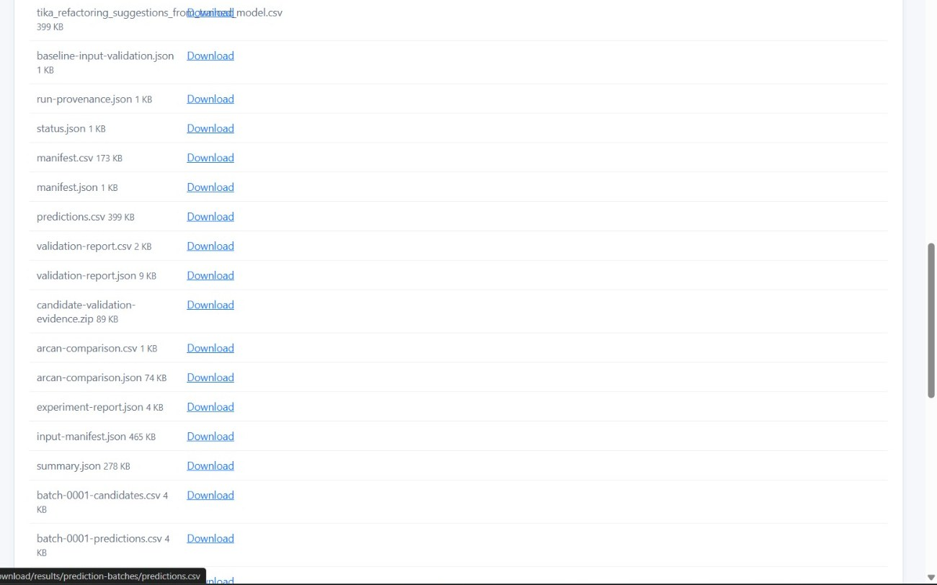
Everything is on disk, so you can check us
Inputs, predictions, validation report and Arcan comparison, all written to disk and downloadable. Every figure in this deck can be recomputed from these files.
predictions.csv
399 KB, 277 rows. Smell, affected elements, and five scored refactoring types.
validation-report.json
Per-candidate outcome, including why each one was rejected.
arcan-comparison.json
The before/after measurement that stage 12 produced.
Console: Files tab. Nothing here is generated for the slide; it is the run's own output.

Slide 25
Results
Three systems, 1,193 distinct smells, 56 batches, every number from a tree that built.

Slide 26
1,193 smells, three systems, nowhere to hide
Three real systems, 1,193 distinct smells, 56 batches. Every number ahead came from a tree that compiled — and the ones that did not are shown too.
252
714
227
Apache Tika, baseline smells
Logging log4j2, baseline smells
Apache Struts, baseline smells
1,193 distinct smells in all. Full baseline detail — commit, modules built, class counts — is on the next slide.

Slide 27
The baselines
System | Commit | Modules built | Classes | Arcan smells
Apache Tika | 697d7c04 | 101 of 102 | 1,804 | 252
Logging log4j2 | 4f474b32 | 41 of 41 | 3,170 | 714
Apache Struts | d59aea5f | 24 of 27 | 1,193 | 227
Tika's 252 reconciles exactly against Arcan's raw output: 68 package cycles + 105 class cycles + 78 unstable + 1 hub-like. The 260 reported earlier added UD30.csv's 8 rows, which UD.csv already contains.
Two modules cannot build on this machine for reasons unrelated to any refactoring: tika-grpc needs a protoc plugin, Struts 2 Tiles Plugin fails likewise. The same exclusion is applied to every later measurement, so before and after stay comparable.

Slide 28
The instrument caught its own author
The best moment in this project. Two independent measurements disagreed, we chased the gap instead of publishing the bigger number — and found that our own adapter had been inflating every total, including our own best result.
System | As first reported | Distinct | Rows counted twice
Apache Tika | 260 | 252 | 8
Logging log4j2 | 767 | 714 | 53
Apache Struts | 274 | 227 | 47
63/63
37/37
3
−6
Arcan runs in which every UD30 pair was already present in UD. The subset holds without exception.
batches where the row count and the independent identity diff now agree exactly. Before the fix they disagreed on every affected batch.
verdicts that changed direction once restated, including one reduction that is really a worsening.
the best result in the project, restated from −16. The duplicate count varies with the tree, so it never cancels in a delta.
The identity diff reported −6 where the row count reported −16. Chasing that gap instead of publishing the larger number is what exposed it.
Notes:
Tell this as a story, not an apology. Two measurements disagreed: row count said -16, identity diff said -6. We chased the gap rather than publishing the bigger number, and found our own adapter was double-counting UD30. Every total in the project shrank, including our best result. A measurement rig that catches its own author is the actual deliverable.

Slide 29
Model versus planner, same rules for both
Both arms move classes. Arm B trusts the model's label; Arm C reads the real cycles from bytecode and prices each move first. Same baselines, same batching, same build, same Arcan jar — so the comparison is fair.
System | Arm | Batches | Comparable | Reduced | Worsened | Best | Removed
Tika | B · model | 14 | 11 | 0 | 9 | 0 | 0.00%
Tika | C · planner | 9 | 8 | 4 | 4 | −12 | 4.76%
log4j2 | B · model | 11 | 5 | 2 | 3 | −6 | 0.84%
log4j2 | C · planner | 6 | 4 | 1 | 1 | −6 | 0.84%
Struts | B · model | 6 | 1 | 0 | 1 | +27 | 0.00%
Struts | C · planner | 10 | 8 | 1 | 6 | −15 | 6.61%
Across 1,193 baseline smells arm B removed 6 at best and arm C removed 33. Arm C wins on two systems and ties log4j2. Neither selection is generally better.

Slide 30
The number went down. Nothing got better.
Here is why counting is not measuring. Match the smells by identity instead of by quantity and the same batches tell a completely different story.
Batch | Moves | Net | Removed | Created | What actually happened
tika-B7 | 1 | 0 | 10 | 10 | Reads as no change. Swapped ten smells for ten others.
struts-C8 | 1 | +26 | 77 | 103 | One move dissolved 77 cycles and created 103.
log4j2-B3 | 25 | +16 | 194 | 210 | Wholesale re-shuffle of the cycle structure.
tika-C3 | 12 | −12 | 42 | 30 | Best Tika batch, and still created 30 new smells.
These operations do not improve an architecture incrementally. They re-partition it, and the count lands wherever the re-partition puts it.

Slide 31
Winning on count, losing on structure
Eight batches did reduce the count. For four of them the replacement cycles were bigger than the ones removed, and two ended with more package cycles than they started with.
Batch | Net smells | Package cycles | Removed, avg size | Created, avg size
tika-C3 | −12 | 68 → 64 | 3.7 | 4.5
tika-C4 | −2 | 68 → 73 | 3.8 | 4.6
tika-C7 | −3 | 68 → 71 | 3.7 | 4.4
log4j2-B1 | −6 | 201 → 199 | 4.6 | 5.4
struts-C2 | −15 | 87 → 75 | 4.6 | 4.5
tika-C8 | −2 | 68 → 67 | 2.0 | none
Fewer smells and a better structure are not the same measurement.

Slide 32
And then, once, it worked
tika-C8
One class moved: org.apache.tika.server.core.MetadataList → server.core.writer
Removed one package cycle (server.core ↔ server.core.writer) and one unstable dependency. Created nothing. Package cycles 68 → 67. Build green.
2
0
1
37
smells removed
smells created
class relocated
comparable batches it was found among
MetadataList.java: package org.apache.tika.server.core; → package org.apache.tika.server.core.writer;
Small, and the only change in 37 batches that improves on every measure taken.
Notes:
The payoff. After 36 batches that churned or regressed, one single move removed two smells, created nothing, shrank the package cycle count and kept the build green. This is the shape to aim for, and it is the existence proof that the loop can produce a clean win.

Slide 33
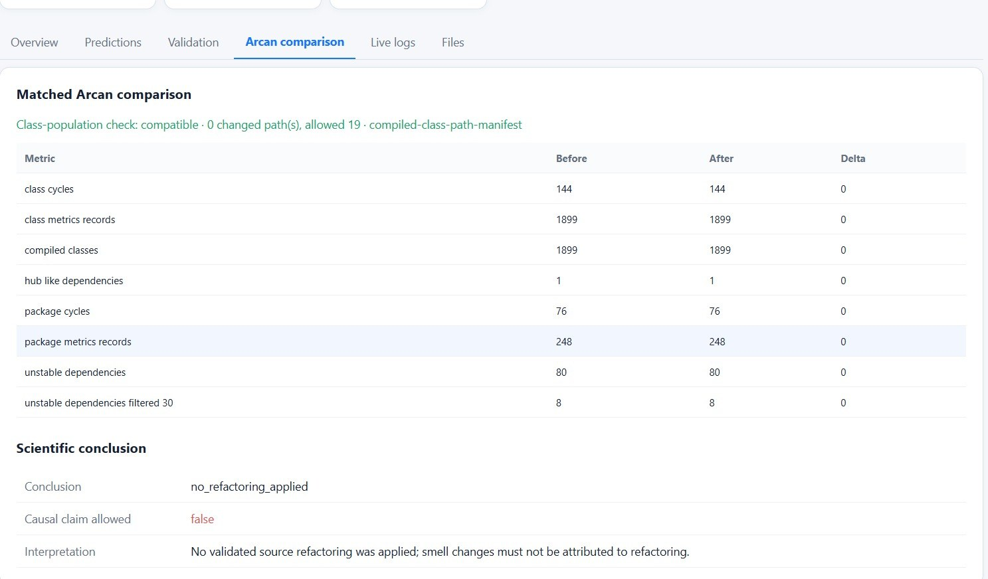
A tool that refuses to take credit
Most tools would find something encouraging to report here. This one fills the delta column with zeros and writes “Causal claim allowed: false”. That refusal is a feature we built on purpose.
Every delta zero
No validated change was applied, so the architecture is unchanged.
It refuses the causal claim
Causal claim allowed: false. The tool will not let a null run read as a result.
UD and UD30 kept apart
80 unstable and 8 filtered-at-30 are listed separately, never summed.
This is the behaviour the project wants: a run that achieves nothing must report nothing.

Slide 34
The nineteen results we threw away
Nineteen of 56 batches built a different module set from their baseline. Their numbers are real Arcan output, they look like results, and every one is meaningless. Here is what we would have claimed.
Batch | Modules built | Smells read | Would have read as
struts-B5, B6 | 4 of 24 | 22 | −92%
log4j2-B6, B9 | 9 of 41 | 197–208 | −73%
log4j2-B4 | 3 of 41 | 627 | −18%
tika-B1 | 84 of 101 | 181 | −30%
A smell count falls reliably when code stops compiling. Without the module-set check this experiment would have reported improvements of up to 92% and been entirely wrong.
The guard is a result, as much as the percentages are.

Slide 35
What already works, and is reproducible
Result | Evidence
Stock static analysis on commons-validator | 201 → 194 production smells, compiles, 1,147 tests green
With a custom magic-number recipe added | 201 → 190, nothing introduced, same tests green
Planned class moves | 18 of 18 applied, built, and removed their target edge
Predicting a move's cost before making it | Added edges exact on 14 of 18, within one on 18 of 18
Package splitting | 0 of 4 accepted; predicted 0 better, 77 worse
Dissolving a dependency cycle | Never achieved — here, or in two expert-refactored trees
Every figure comes from a run in this repository and is reproducible from committed code.

Slide 36
Why we think this is working
The headline deltas are small, and we are not going to pretend otherwise. But the machinery under them is measured, reproducible, and mostly finished — and these are the numbers we would point a sceptic at.
18 of 18
planned class moves applied, compiled, and removed the exact dependency edge they were aimed at. When the pipeline knows what to do, it does it.
14 of 18
move costs predicted exactly before making the change, and 18 of 18 within a single edge. The planner understands the graph it is editing.
201 → 190
smells on commons-validator with 1,147 tests still green. The full loop — propose, apply, build, test, re-measure — closes end to end.
37 of 37
batches where two independent measurements now agree. The instrument is trustworthy enough to have caught our own counting bug.
One component is not working — the suggestion model — and we can name its number, its cause and its fix.
Notes:
The optimism slide, and it is earned rather than spun. Every figure here is measured and in the repository. The argument: the engineering is done and verified, the failure is localised to one component, and that component has a named diagnosis. Expect the question 'so is this a negative result?' — answer: it is a trustworthy one, which is rarer.

Slide 37
What we learned
What the measurements changed in our thinking, and what is still open.

Slide 38
Four things we believed in October and no longer do
A label is not a refactoring.
The gap between “Move Class” and a compiling edit is where almost all of the engineering lives.
The detector's count is not the goal.
Across six repositories and 2,085 findings only about 28% are reachable at all; the rest is published API, test code, or a warning the maintainers deliberately suppressed.
Edge arithmetic does not predict the verdict.
The planner's prediction is exact on edges and correlates only +0.38 with the measured smell delta; 7 of 19 batches predicted to improve actually did.
Improvement must be measured on a tree that builds.
Three separate times a broken build produced a number that looked like success.

Slide 39
Where this stands
Four statements, sorted by how much evidence stands behind each. Three are measured. One is a question for you.
Evidence + transformation
Detectors, miners and both transformation backends (OpenRewrite, Spoon) operate end to end on all three systems.
built, running
Validation + matched measurement
Compile, test, residual and coverage gates plus the module-build guard are in place; 56 batches run across both arms.
built, running
Suggestion model
Macro-F1 0.039 over 18 labels means it is not yet mapping smells to fixes. Rebalancing the training corpus is the next task, not a future nice-to-have.
open problem
Thesis framing
Smell reduction, or a trustworthy verdict on whether a refactoring helped. The two questions at the end of this deck.
open, for this meeting
Three of the four are measured and reproducible. The fourth is the one we would like your steer on.

Slide 40
Two questions for you
1
2
Should the thesis target smell reduction, or a trustworthy verdict on whether a proposed refactoring helps?
Is a negative, well-measured result an acceptable primary contribution here?
The second is what the pipeline measurably does well. The first is what the literature usually promises, and our evidence bounds it at roughly a quarter of what a detector reports.
We can state precisely why the suggestion model carries no information about the specific smell, and precisely where the pipeline loses 191 of 277 suggestions. Both are reproducible.

Slide 41
What happens next
What happens next, in the order we would do it.

Slide 42
The next three months, in order of leverage
Immediate
Then
Teach the recipe generator class granularity, which alone unlocks 128 of the 277 discarded Tika suggestions.
Give the generator a visibility screen, so it stops proposing moves that cannot compile anywhere.
Re-run the 19 void batches with a larger heap so the module sets match.
Rebalance the training corpus so the model stops answering with the majority label.
Score candidates on cycle participation and cycle size, not on the raw smell count.
Extend the measured corpus beyond the repositories the current licence allows.
The clean win, tika-C8, is the shape to aim for: a single move that removes smells and creates none.

Slide 43
Thank you
Every number in this deck comes from a run on one machine, against the commits named, with Arcan 1.2.1, and is reproducible from committed code. Where a measurement was discarded, the deck says so rather than reporting it.
1,193
56
37
2
baseline smells
batches run
comparable
clean wins

