Slide 1
Bug Brain: Robust Insect image classification via Convolutional Neural Network
Geoffrey Shimotsu

Slide 2
Overview
Introduction
Raw Data Set
ResNet18 Convolutional Neural Network (CNN)
Experiments
Discussion

Slide 3
Introduction
Problem: Insect classification from image under poor lighting conditions
What data is available?
Multiclass Classification
Supervised Learning

Slide 4
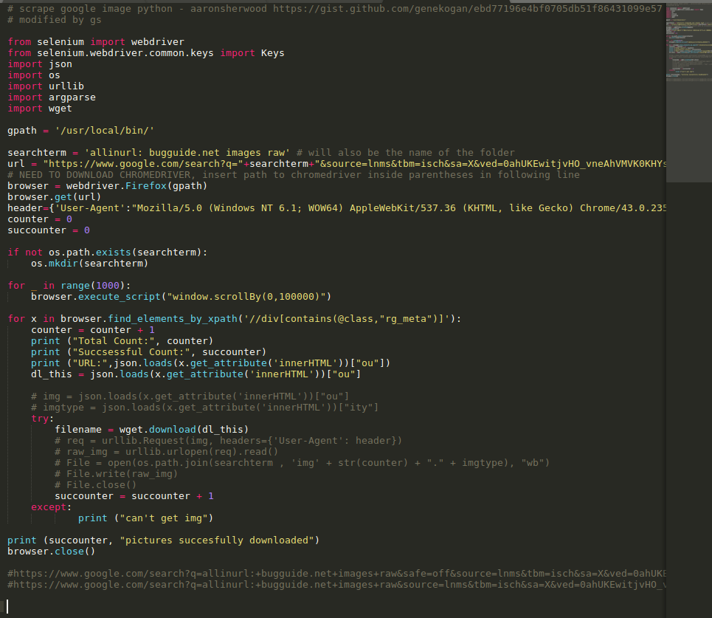
Data Set
7 Classes
Bees (hymenoptera)
Beetles (coleoptera)
Butterflies (lepidoptera)
Millipedes (myrapodia)
Scorpions (chelicerata)
Spiders (chelicerata)

Slide 5
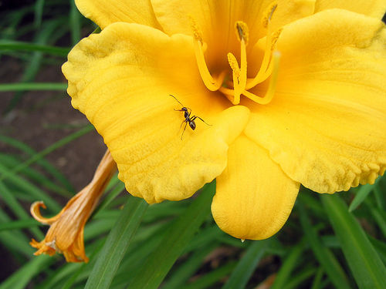
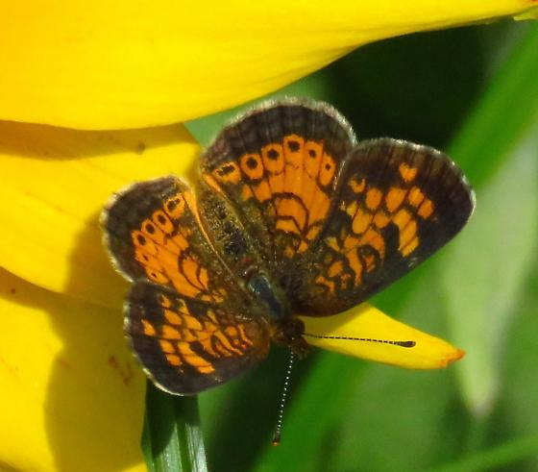
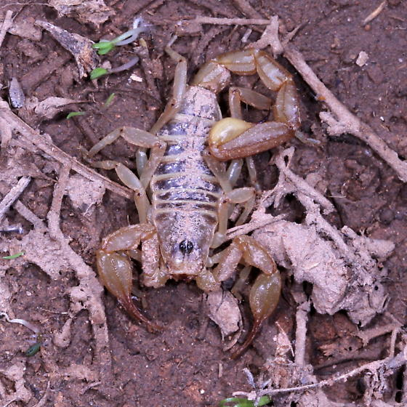
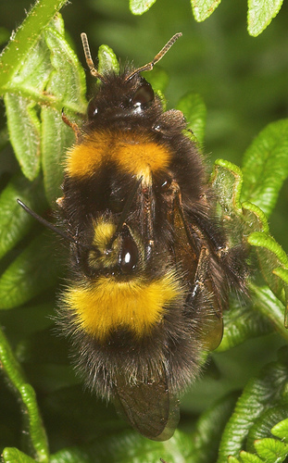
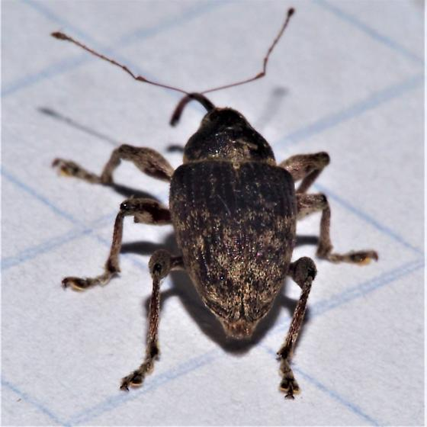
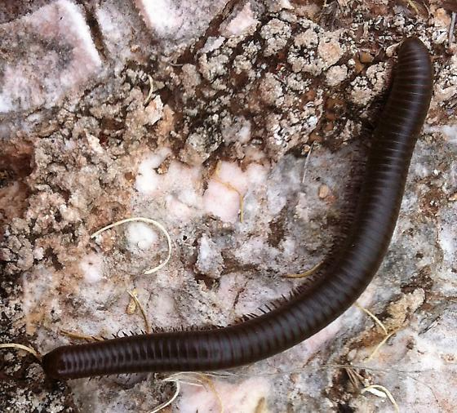
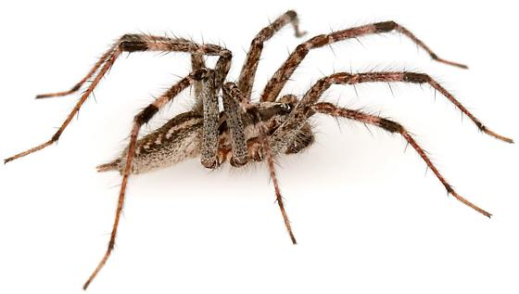
Data Set

Slide 6
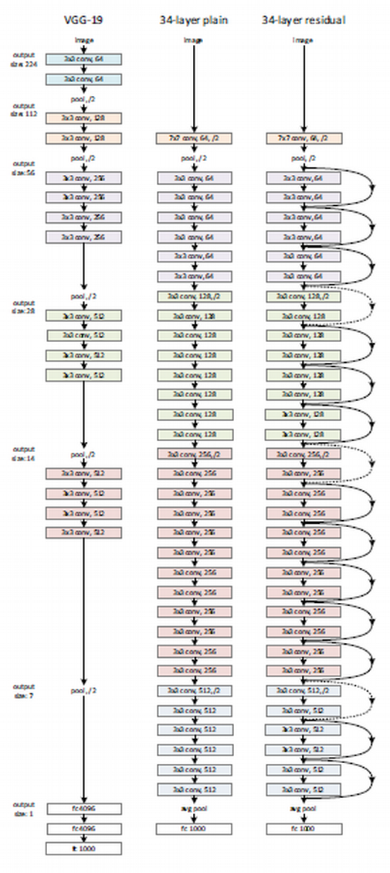
resnet18

Slide 7
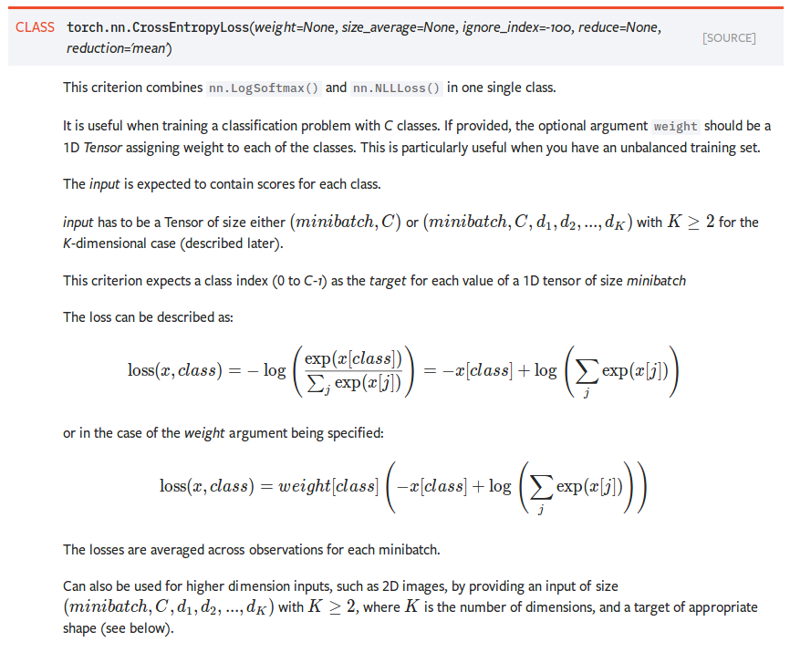
Resnet18

Slide 8
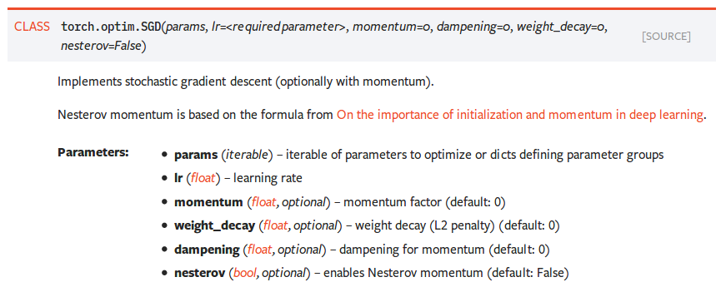
Resnet18

Slide 9
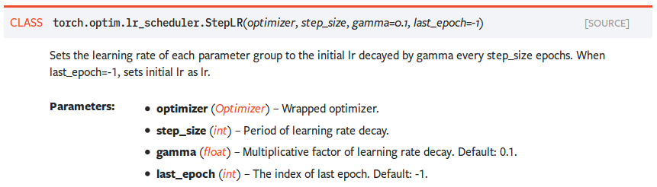
Resnet18

Slide 10
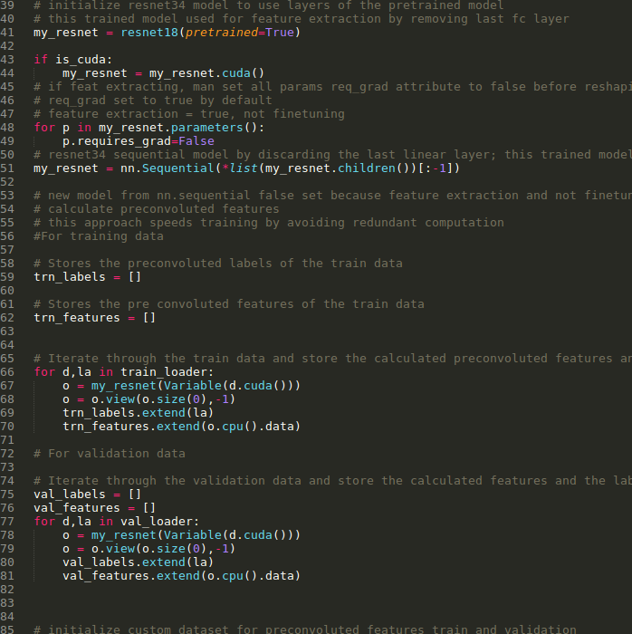
resnet18

Slide 11
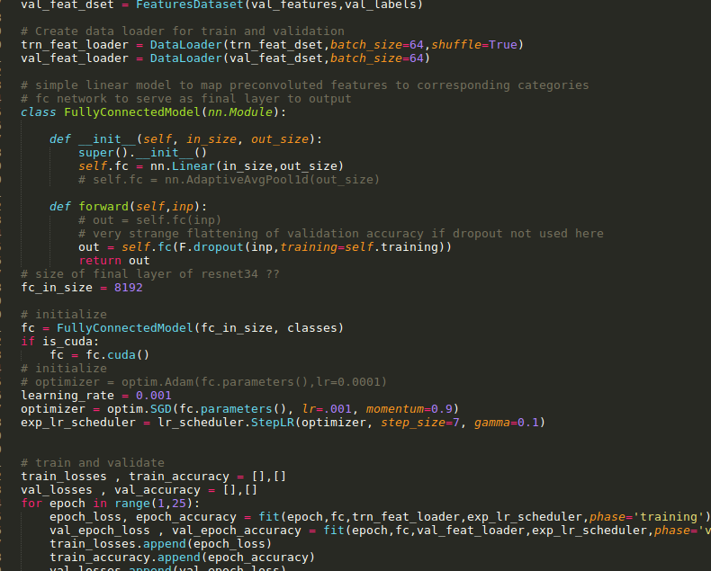
resnet18

Slide 12
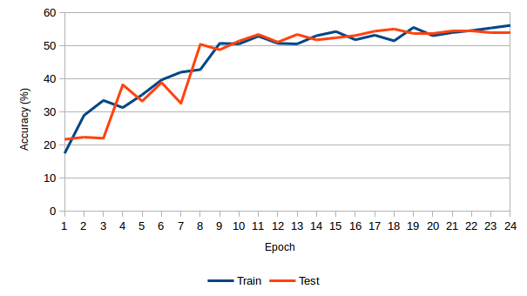
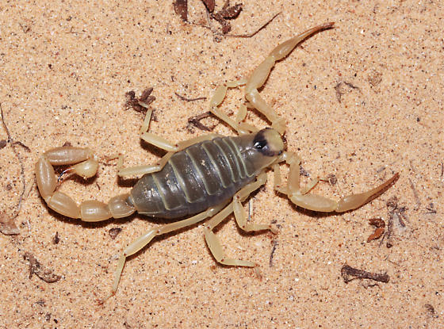
Experiments

Slide 13
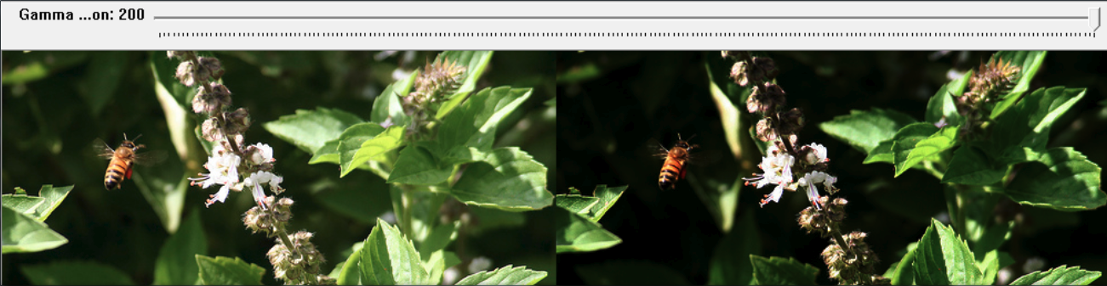
Experiments

Slide 14
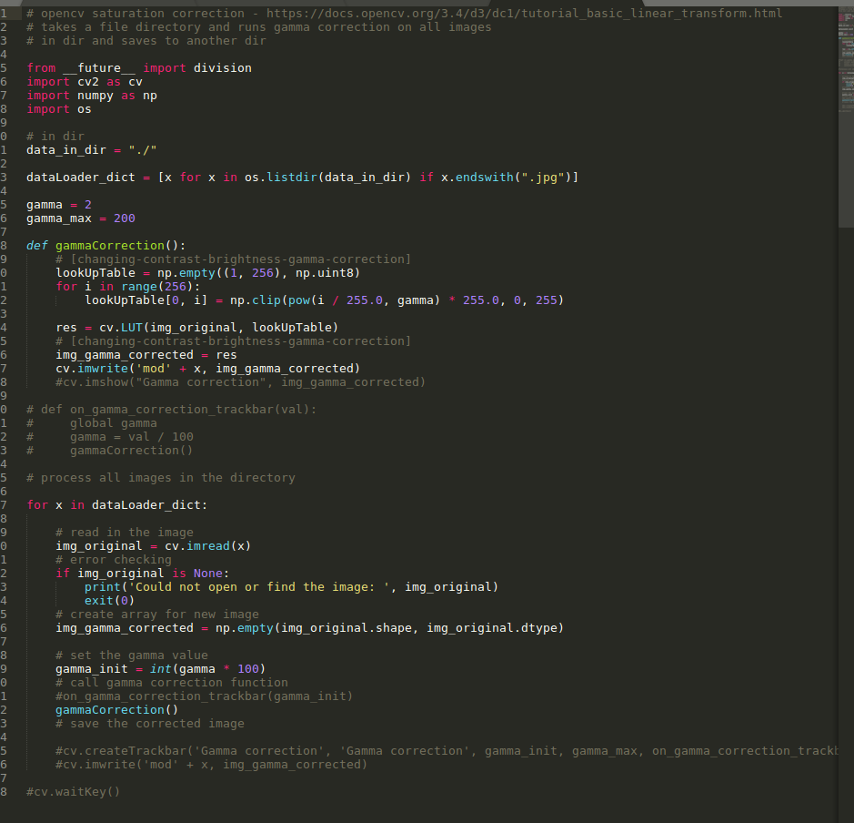
Experiments

Slide 15
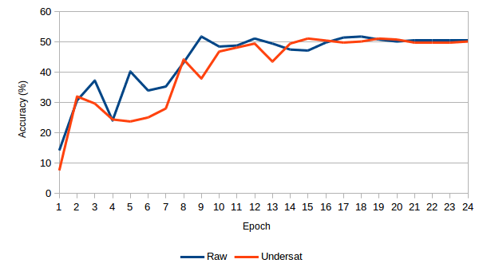
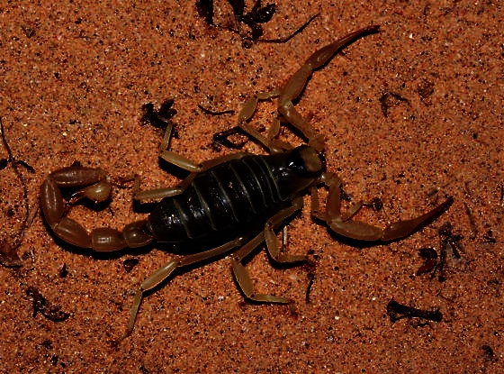
Experiments
Dark Images

Slide 16
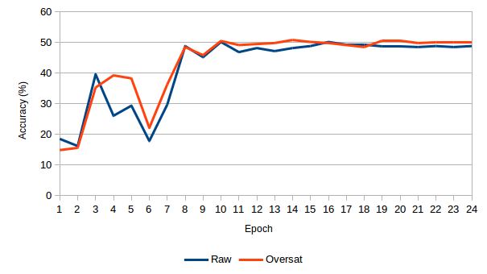
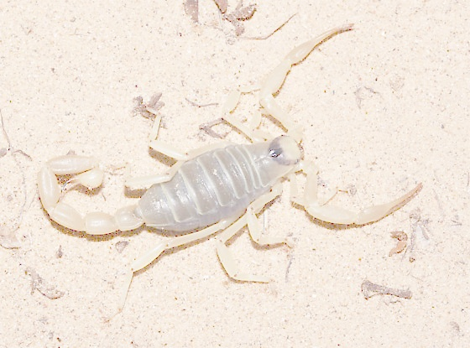
Experiments
Light Images

Slide 17
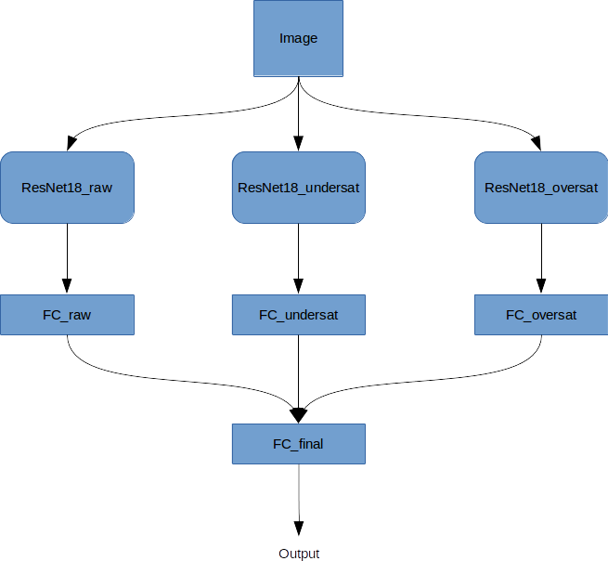
Ensemble

Slide 18
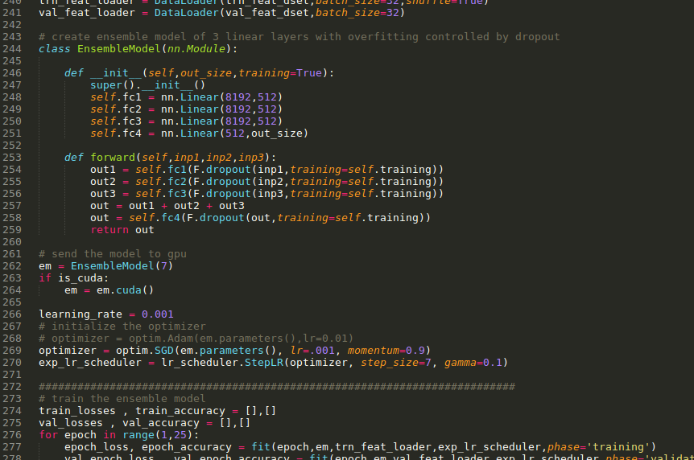
Ensemble

Slide 19
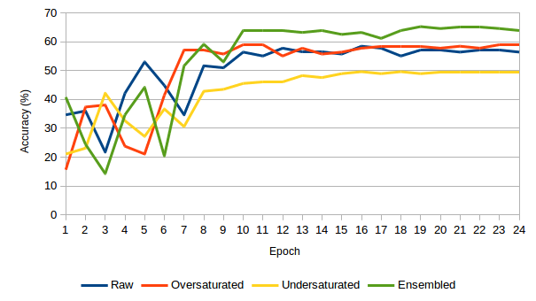
Experiments
Mixed Images

Slide 20
DiScussion
Relatively Low Testing Accuracy
Model Architecture
Hyperparameters
Boosting
Increase Dataset

Slide 21
Questions

