Slide 1
Trick Real-Time

Slide 2
Real-time
Trick's definition of a real-time simulation:
A simulation that can consistently and repetitively execute its scheduled math models to completion within some predetermined interval time frame for an indefinite period of time. This predetermined interval time frame is referred to as the real-time frame.
To enable real-time synchronization, call real_time_enable() in the input file
trick.real_time_enable()
The default real-time clock provided by Trick is the system clock accessed by the clock_gettime(CLOCK_REALTIME,…) call in Linux and gettimeofday() call in Mac OSX.

Slide 3
Real-Time
The real-time frame is tied to executive software frame. The real-time frame determines how often Trick will synchronize simulation time to the real time clock. Simulation time will run as fast as it can in the intervals between real-time synchronizations.
To set the software frame:
trick.exec_set_software_frame(double time)
If the executive finishes running all of the jobs scheduled to run between synchronizations to the real time clock, this is an underrun.
The executive will spin waiting for the next real-time frame to start
If the executive does not finish running all of the jobs scheduled to run, this is an overrun.
The executive will immediately start the next frame in an attempt to catch up.

Slide 4
Realtime Underrun
software frame boundary
executive spin
rt_frame n-1
rt_frame n
rt_frame n+1
Scheduled Jobs

Slide 5
Realtime Overrun
software frame boundary
rt_frame n-1
rt_frame n
rt_frame n+1
Scheduled Jobs
overrun

Slide 6
Sleeping during Underruns
During real-time underruns it may be desirable to release the processor for other tasks to use instead of spinning waiting for the clock.
Trick provides a real-time sleep timer based on itimers.
To enable itimers call itimer_enable() from the input file
trick.itimer_enable()
The itimer interval is set to start at each real-time frame.
The itimer is set to wake up 2ms before the real-time frame is to expire. The executive will spin for the final 2ms.
The 2ms spin is there because an itimer interval is not guaranteed to be perfectly precise.

Slide 7
Realtime with Itimer
executive spin
itimer set here
itimer expires
rt_frame n-1
rt_frame n
rt_frame n+1
Scheduled Jobs
Pause()
2 ms
rt_itimer_frame- 2 ms

Slide 8
Optimizing Real-time Performance
Real-time simulations may experience temporary “spikes” where the simulation is not able to complete it’s scheduled jobs.
OS may schedule other higher priority tasks to run instead of the simulation
To remove these spikes we need to remove the OS’es ability to swap out our process.
There are several Trick parameters and OS level settings that may be set to optimize real-time performance.

Slide 9
Real-Time
Several of the realtime features discussed in the next pages require the simulation to run as root
Ways to give root privilege to sim
Run as root
Change owner of executable to root and set user id bit
su to root or use sudo command (see man page) to give root privileges using chown and chmod commands
chown root S_main_${TRICK_HOST_CPU}.exe
chmod 4775 S_main_${TRICK_HOST_CPU}.exe

Slide 10
Executive Real-time Parameters
Simulations run best when each thread of execution is assigned to it’s own processor.
trick.exec_set_thread_cpu_affinity(thread_id, cpu_num)
The main thread is thread_id=0. Child threads start from 1.
Setting a thread to run on a specific CPU does not exclude other processes to continue to run on the same CPU.
To keep the simulation threads running on the processor we want to set a real-time priority on each thread.
trick.exec_set_thread_priority(thread_id, priority)
For the exec_set_thread_priority() call, 1 is the highest priority. This number is converted internally to the highest priority of the system automatically.
Note: Setting a simulation to run as priority 1 may lock out keyboard and mouse processing.

Slide 11
Executive Real-time Parameters
We want to keep all simulation related data in memory. We do not want the OS to copy part of the simulation memory into virtual memory (disk).
trick.exec_lock_memory( yes_no )

Slide 12
OS level Real-time Optimizations
Running as root is a must for best real-time performance.
Recommend turning off services to turn off to protect against system interrupts and process context switching
Turn off as many services as possible, especially irqbalance:
If left on, the irqbalance service can change processor interrupt assignments during simulation execution
Cat /proc/interrupts to see interrupt to processor mapping
This may help in your Trick process to processor real-time assignments for muti-processor platforms
Assign Trick real-time process to processors that do not have interrupts assigned to them

Slide 13
Interrupts cont.
Interrupts can be mapped to specific processors to optimize processor and hardware I/O performance
/proc/interrupts
Dynamically updated file showing current interrupts and CPU mapping
/proc/irq/*
Directories where * is the interrupt number that is shown in /proc/interrupts
Each irq directory contains a “special file” named smp_affinity which contains the bit wise number for the processor designation
smp_affinity files get reset every time you reboot so you need an initialization script to configure them
Interrupt balancing service (irqbalance) may need to be turned off
In general, interrupts not relevant to your real-time process should be redirected away from your real-time processor

Slide 14
Isolate Processors
Under Linux, we can isolate a CPU from the OS. Isolated processors will not have any processes assigned to them by the OS. The only way to assign a thread to the isolated processor is with the system set_affinity calls.
trick.exec_set_thread_cpu_affinity()
To isolate CPUs the kernel must be booted with the isolcpus option.
Usage: isolcpus=cpu_number[,cpu_number,…]
Example in RHEL/CentOS/Scientifc Linux /boot/grub/menu.lst file
kernel /boot/vmlinuz… isolcpus=1,2

Slide 15
Graphing Real-time Performance
Trick can gather simulation performance data to plot and analyze.
trick.frame_log_on()
turing on frame logging will add some overhead to a simulation as each job is timed and recorded
Frame logging records data for the overall underrun/overrun state of the simulation as well as the job execution time for each individual job.

Slide 16
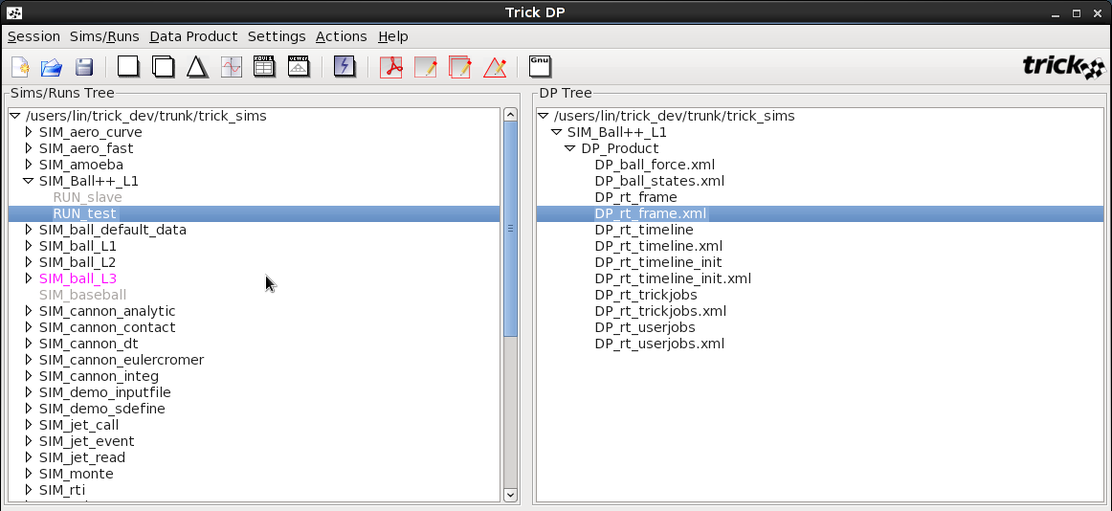
Analyzing Frame Log Data
Frame logging data is available to view in trick_dp with several auto-generated DP files.
DP_rt_frame.xml shows overall real time performance

Slide 17
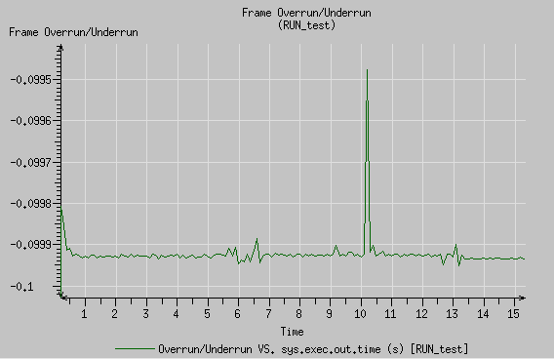
Graphing Overall Frame Overrun/Underrun
The Frame Overrun/Underrun graph shows how much of the real time frame was left during execution.
The minimum value for the Y axis is (-software_frame)
Negative values are underruns, positive are overruns

Slide 18
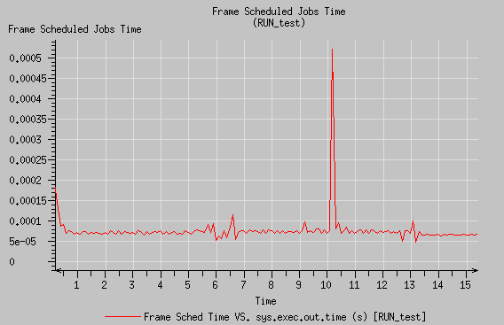
Graphing Frame Scheduled Jobs Time
The Frame Scheduled Jobs Time shows the time used to execute all jobs for that frame.

Slide 19
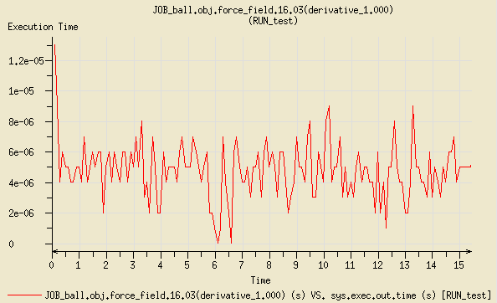
Graphing Individual Job Execution Time
The DP_rt_userjobs.xml DP group graphs the execution time for each job for each software frame.

Slide 20
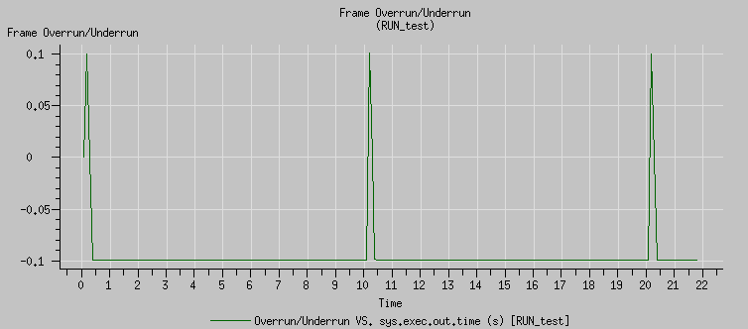
Graphs Showing an Overrun
This Frame Over/Under graph shows overruns.

Slide 21
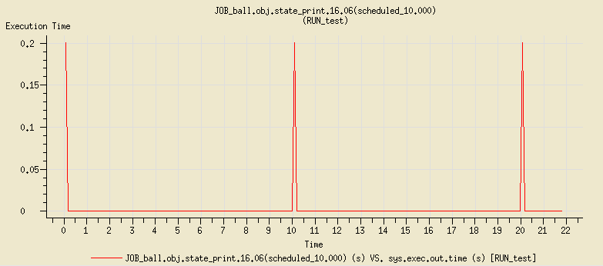
Graphs Showing an Overrun
This Job Execution Times graph shows the culprit.

Slide 22
Using Custom Clocks and Timers

