Slide 1
Binary Checkpointing with Trick
Meena Arnold
Danny Strauss
Alex Lin
John Penn

Slide 2
Contents
Introduction
Binary Checkpoint
DMTCP
Dumping DMTCP Checkpoints
Method 1: Sim Control Panel
Method 2: Input File
Loading DMTCP Checkpoints
Trick ASCII vs. DMTCP

Slide 3
Introduction
Binary Checkpoint
A dump of a Trick simulation’s memory state to an executable script
The script is used to later restart the Trick simulation from the saved state
DMTCP (Distributed MultiThreaded Checkpointing)
Trick interfaces with an open source application named “DMTCP” to perform binary checkpointing
The terms “DMTCP checkpoint” and “binary checkpoint” are used interchangeably in the context of Trick checkpointing
Official Site: http://dmtcp.sourceforge.net

Slide 4
Setting up Trick with DMTCP
Configure Trick with DMTCP
> cd $TRICK_HOME
> ./configure --dmtcp=<path_to_dmtcp>
Example:
./configure --dmtcp= /users/trick/dmtcp/trick_dmtcp-1.2.6/dmtcp-1.2.6-linux-x86_64
DMTCP releases are kept in /users/trick/dmtcp/
It is recommended to use the latest version
Although most our systems are 64-bit, both 32-bit and 64-bit versions are available
64-bit versions are labeled with “-linux-x86_64”

Slide 5
Running Trick with DMTCP
Start the simulation with ‘s_main_dmtcp.py’
$TRICK_HOME/bin/s_main_dmtcp.py is a Python script that executes DMTCP with S_main_*.exe as its argument. At this point, DMTCP is a parent process to Trick
> s_main_dmtcp.py RUN_test/input.py
DMTCP checkpoints are dumped to and loaded from the DMTCP Checkpoint Directory Environment Variable
defined in $TRICK_HOME/bin/s_main_dmtcp.py:
“--ckptdir ${PWD}/dmtcp_checkpoints”

Slide 6
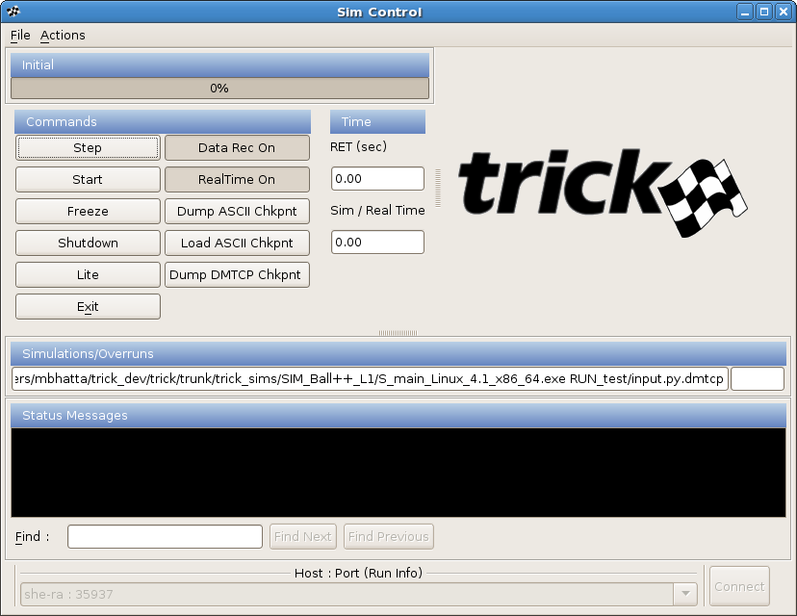
Dumping a Checkpoint Method 1: Sim Control Panel
Click “Dump DMTCP Chkpnt” button during Freeze or Initialization

Slide 7
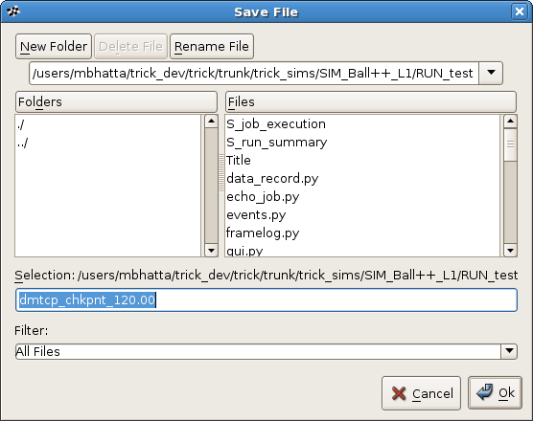
Dumping a Checkpoint Method 1: Sim Control Panel, continued
“dmtcp_chkpnt_120.00” will be saved to the DMTCP Checkpoint Directory (i.e. ‘dmtcp_checkpoints’)

Slide 8
Dumping a Checkpoint Method 2: Input File
Checkpoint now:
trick.dmtcp_checkpoint(“filename”)
trick.dmtcp_checkpoint()
Binary checkpoints dumped during Initialization will be named “dmtcp_chkpnt_init” unless a new filename is specified.
Checkpoint at <n> seconds:
trick.dmtcp_checkpoint(<n>)
Periodic checkpoints every <n> seconds:
trick.dmtcp_checkpoint_safestore(<n>)
trick.dmtcp_checkpoint_safestore_set_enabled(True|False)
Notes:
If you just call trick.checkpoint() with no filename, Trick will create the filename as “chkpnt_<time>”

Slide 9
Dumping a Checkpoint Method 2: Input File, continued
Checkpoint at <n> seconds:
trick.add_read(<n>, "trick.dmtcp_checkpoint()")
Important Notes:
When dumping binary checkpoints via the “add_read()” command, the Sim Control Panel must be disabled.
DMTCP is unavailable with the “add_event() “ command
Notes:
If you just call trick.checkpoint() with no filename, Trick will create the filename as “chkpnt_<time>”

Slide 10
Loading a DMTCP Checkpoint
For binary checkpoints, Trick will dump an executable restart script. To load (i.e. restart) a DMTCP checkpoint, simply execute the script:
> cd dmtcp_checkpoints
> dmtcp_chkpnt_120.00
The simulation will start in the same state it was in at the time it was checkpointed.
Open files will be restored
Socket connections between simulations must be restored manually

Slide 11
Loading a DMTCP Checkpoint
Important Notes:
Binary checkpoints can only be restarted from the command line. The Sim Control Panel is part of the binary executable and will appear when the binary checkpoint restart script is executed.
DMTCP checkpoints must be loaded from the “DMTCP Checkpoint Directory” (see slide “Running Trick with DMTCP”)

Slide 12
Trick ASCII vs. DMTCP Checkpointing
Capability | Trick ASCII | DMTCP
Primitive types | Y | Y
C structures | Y | Y
C++ class public primitive types | Y | Y
C++ class protected/private primitive types | Y with friend | Y
C++ user defined templates | Some | Y
C++ STLs | Some with macro | Y
C++ references | N | Y
C++ static const variables | N | Y
C++ exotic constructs (class inherits from template) | N | Y

Slide 13
Trick ASCII vs. DMTCP Checkpointing continued
Capability | Trick ASCII | DMTCP
File pointers and streams | N | Y
Open file contents (partially written files restored) | N | Y
Function pointers | N | Y
System types: sockets, semaphores, mutexes, etc. | N | Y
Global variables | Y if MM knows | Y
Local static variables | N | Y
Python Input Processor State | N | Y
Other languages (e.g. Ada) | Y mapped to C | Y
3rd party libraries (e.g. Matlab model) | N | Y

Slide 14
Trick ASCII vs. DMTCP Checkpointing continued
Capability | Trick ASCII | DMTCP
Saves original simulation executable | N | Y
Restart using rebuilt (CP) simulation executable | Sometimes | N
Reconnect socket connections | Y with restart jobs | Auto and restart jobs
Creates checkpoint in forked process | Y | Y
Takes simultaneous checkpoints across sims. | Y | Y
Checkpoint non-Trick applications | N | Y
ASCII output (human readable checkpoints) | Y | N
Runs on Linux and Mac OSX | Y | N Linux only
Reloads checkpoint without restarting | Y | N

