Slide 1
Trick Simulation Environment: Advanced Topics
John Penn (L-3Com/ER7)
Danny Strauss (L-3Com/ER7)
Alex Lin (NASA/ER7)
also authored by
Scott Killingsworth (NASA/ER7)
Eddie Paddock (NASA/ER7)
Les Quiocho (NASA/ER7)
Keith Vetter (Spoonbill Services/ER7)

Slide 2
Agenda/Schedule
Realtime and Distributed Topics
Trickcomm and the Variable Server
Multiprocessing and Realtime
Master/Slave Import/Export
Real World Realtime/Multiprocessing/Master/Slave example
Monte Carlo
Generic Malfunction Insertion
Units Upgrade
Wide Character Support
Additional Material
External Clocks and Timers
External Libraries and Trick Math Library

Slide 3
Trickcomm and the Variable Server

Slide 4
Trickcomm and the Variable Server
Objective
Describe the Trickcomm package
Describe the Variable server
Prerequisites
Knowledge of sockets

Slide 5
Trickcomm
Trickcomm is a C library built on top of the system TCP/IP socket library.
Originally, Trickcomm was provided as a consistent “stream” interface over sockets, reflective memory, and shared memory.
Sockets have proved fast enough so Trickcomm only supports sockets.
Trickcomm can be used as a standalone package.
Usable as a library to non-Trick sims
Usable under Windows

Slide 6
Trickcomm
Provided functions – Connecting (Server)
tc_init(TCDevice * listen_device) ;
Initializes a listen socket and begins listening for a client connection.
listen_device.port must be specified. Uses unix listen().
tc_listen(TCDevice * listen_device) ;
Returns true if a client is trying to connect on the listen socket.
Uses unix poll().
tc_accept(TCDevice *listen_device, TCDevice *device) ;
Accepts the client connection request from listen_device onto device.
Will block until client connects. Endianness of client is recorded.
Uses unix accept().
Provided function – Connecting (Client)
tc_connect(TCDevice *device);
Connects to a listening socket. Endianness of server is recorded.
listen_device.port & hostname must be specified. Uses unix connect().

Slide 7
Trickcomm
Provided functions – Connecting (Server and Client)
tc_multiconnect(TCdevice *device, char *connection_tag, char *my_tag, TrickErroHndlr *error_handler) ;
Both the server and client call tc_multiconnect
Each side provides connection_tag which must be equal
Each side provides my_tag which must be different
tc_multiconnect will use multicasting sockets to find other connections that have the same connection_tag and different my_tag
tc_multiconnect will determine who is the server and client and call tc_accept and tc_connect with appropriate port numbers to establish a connection (user does not specify port)
tc_multiconnect returns when the connection is made
process 1:
tc_multiconnect(dev , “important_comm!” , “side a” , err_hndlr) ;
process 2:
tc_multiconnect(dev , “important_comm!” , “side b” , err_hndlr) ;

Slide 8
Trickcomm
Provided functions – Read/Write
tc_read(TCDevice * device, char *buffer, int size) ;
Reads size number of bytes
tc_write(TCDevice * device, char *buffer, int size) ;
Writes size number of bytes
tc_read_byteswap(TCDevice * device, char *buffer, int size, ATTRIBUTES *attr) ;
Calls tc_read. If other side of connection is opposite endianness, takes structure information of buffer from attr and byteswaps buffer .
attr is generated for each structure by ICG (in S_source.c)
tc_write_byteswap(TCDevice * device, char *buffer, int size, ATTRIBUTES *attr) ;
If other side of connection is opposite endianness, takes structure information of buffer from attr and byteswaps buffer . Calls tc_write.
attr is generated for each structure by ICG (in S_source.c)

Slide 9
Trickcomm - Blocking
Provided Functions - Blocking
tc_blockio(TCDevice * device, TCCommBlocking blockflag);
Sets the socket blocking type
Blocking
A connection that "blocks" on a read/write will wait until it has read/written all the data over its connection before proceeding. Blocking will force a system call and put itself to sleep and wait on the OS to wake it up.
No blocking
"Non-blocking" is asynchronous in nature and will read/write whatever it can offering no guarantee that it has finished.
Timed blocking
The timed block will block for a specified period of time, and give up if time expires. The "timed block" will consume CPU time as the read waits for data.
“All or nothing" blocking
The "all or nothing" block will not block until there is something to read. Once something is on the pipe, it will block indefinitely until it receives all data it expects. The "all or nothing" approach will consume CPU time as it waits.
tc_set_blockio_timeout_limit(TCDevice *device, double limit) ;
Sets the time a Timed blocking socket will wait for data

Slide 10
Trickcomm
Provided Functions
tc_pending(TCDevice * device) ;
Checks to see if any data is available for reading
tc_isValid(TCDevice * device) ;
Checks to see if the socket is still connected
tc_error(TCDevice *device, int on_off) ;
Turns on/off error messages from trickcomm activity
tc_disconnect(TCDevice * device) ;
Disconnects a socket

Slide 11
Trick Communications
Server/Client Communication Sequence
Server
Client
Initialize Listen Device
tc_init(TCDevice * listen_device) ; Server sets up a socket called a "listen device" to listen for client connections. This listen is done on a predetermined port agreed upon by server and client. Returns when a connection is ready to made on the listen device
Connect To Server
tc_connect(TCDevice *)
Client connects to server over socket. Connection is done over predetermined port.
Accept Client
tc_accept(TCDevice *listen_dev , TCDevice *dev)
Accept client on listen device socket. Returns dev
Setup Blocking
tc_blockio(TCDevice *dev, TCCommBlocking block);
Set the socket to blocking/timed/non blocking/all or nothing
Setup Blocking
tc_blockio(TCDevice *dev, TCCommBlocking block);
Set the socket to blocking/timed/non blocking/all or nothing
Read and Write
tc_read(TCDevice *dev, char *buffer, int size);
tc_write(TCDevice *dev, char *buffer, int size) ;
Send and receive data
Read and Write
tc_read(TCDevice *dev, char *buffer, int size);
tc_write(TCDevice *dev, char *buffer, int size) ;
Send and receive data
Close Conection
tc_disconnect(TCDevice *dev);
Shutdown the socket
Close Conection
tc_disconnect(TCDevice *dev);
Shutdown the socket

Slide 12
Trick Communications
Communication Sequence with tc_multiconnect
Server
Client
Connect to other side
tc_multiconnect(TCDevice *, char *t1, char *t2…) ; Finds other machine/port number. Determines who is server/client. Connects and returns device
Connect to other side
tc_multiconnect(TCDevice *, char *t1, char *t2…) ; Finds other machine/port number. Determines who is server/client. Connects and returns device
Setup Blocking
tc_blockio(TCDevice *dev, TCCommBlocking block);
Set the socket to blocking/timed/non blocking/all or nothing
Setup Blocking
tc_blockio(TCDevice *dev, TCCommBlocking block);
Set the socket to blocking/timed/non blocking/all or nothing
Read and Write
tc_read(TCDevice *dev, char *buffer, int size);
tc_write(TCDevice *dev, char *buffer, int size) ;
Send and receive data
Read and Write
tc_read(TCDevice *dev, char *buffer, int size);
tc_write(TCDevice *dev, char *buffer, int size) ;
Send and receive data
Close Conection
tc_disconnect(TCDevice *dev);
Shutdown the socket
Close Conection
tc_disconnect(TCDevice *dev);
Shutdown the socket

Slide 13
Variable Server
What is the variable server?
The variable server is a TCP/IP server (using Trickcomm) which runs in an asynchronous simulation thread. Clients may connect to the server and set/get simulation parameters.
Why use it?
Nice for interactive GUIs
Simple asynchronous way to drive the simulation
Simple interface for probing states for graphics displays or strip charts
Useful for crew training when an instructor needs to introduce a specific scenario on-the-fly
Useful for debugging

Slide 14
Variable Server
Where to connect?
Client needs to know the hostname and port
As of 10.5, the port number is determined by the operating system
External applications must listen to the variable server broadcast channel (224.3.14.15 port 9265).

Slide 15
Variable Server
Variable server sends all commands through Python
All valid python commands available
Setting variables with assignment statements (e.g. mystruct.x = 5.0),
command simulation to run/freeze/dump checkpoint,
call jobs,
etc…

Slide 16
Variable Server
User accessible routines
These commands may be used in model code to get the status of the variable server.
const char* var_server_get_hostname()
int var_server_get_port()
int var_server_get_enabled()
int var_server_set_enabled(int on_off)
Note: Disabling the variable server will disable the Trick runtime GUIs.

Slide 17
Variable Server
In addition to handling all valid python commands, the variable server has specific commands to handle sending back data to the client at a semi-regular frequency
trick.var_add(string var_name)
Add a variable name to the list to send back to the client.
trick.var_add(string var_name, string units)
Add a variable name to the list to send back to the client with the desired return units.
trick.var_remove(string var_name)
Remove a variable name from the list.
trick.var_send()
Forces the variable server to return the list of values immediately.
trick.var_clear()
Clears the list of variables
trick.var_cycle(double cycle_rate)
Sets the frequency of data being sent
trick.var_pause()
Pauses variable server from returning data, but it still accepts new commands
trick.var_unpause()
Resumes sending the data
trick.var_exit()
Disconnects the current client form the variable server

Slide 18
Variable Server
Other variable server commands
trick.var_units(string var_name, string units)
Use the specified units with var_name. If the units are changed, then the units are included in the returned string.
trick.var_debug(int level)
The level may range from 0-3.
Print out increasing amounts of debugging information
trick.var_ascii()
Sets the message format to ascii (default)
trick.var_binary()
Sets the message format to binary
trick.var_sync(bool on_off)
When true, all values are time homogenous (which may slow simulation if large amounts of data are being sent).
When false, the values are not guaranteed to be time homogenous (timing of simulation is not affected)
trick.var_exists(string var_name)
To test if a var_name exists.

Slide 19
Variable Server
Returned Values
By default, the values are sent asynchronously to the client.
Values will be returned to the client in the same order that they were issued in the var_add command(s).
Ascii Format
The default format which causes the variable server to return a buffer containing a tab delimited character string in the following format:
0\t<variable1 value>\t<variable2 value>{<variable2 units>}\t<variableN value>\n
The 1st value returned in the list will always be a message indicator. Below are the possible values:
0 returned variable value(s) from var_add or var_send
1 returned value from var_exists
1<1 byte binary 0 or 1>
2 returned value from send_sie_resource
-1 input parse error occurred while processing command (NOT IMPLEMENTED)

Slide 20
Variable Server
Binary Format
The variable server will return values in a binary message in the following format:
<message indicator><message size><N>
<var1 name length><var1 name><var1 type><var1 size><var1 value>
<var2 name length><var2 name><var2 type><var2 size><var2 value>
.
.
<varN name length><varN name><varN type><varN size><varN value>
message indicator: same possible values as the Ascii message : 4 byte integer
message size: total size of the message in bytes (NOT including message indicator) : 4 byte integer
N : the number of variables registered via the var_add command : 4 byte integer
Var name length: the string length of the variable’s name : 4 byte integer
Var name: the Ascii variable string name : var name length bytes of string
Var type: Trick data type of the variable : 4 byte integer
Var size: the number of bytes the variable occupies in memory : 4 byte integer
Var value: the variable’s current value : var size bytes of var type

Slide 21
Variable Server
All of Trick’s runtime GUIs use the variable server
Sim control panel
Trick View (TV)
Malfunction Trick View (MTV)
Stripcharts

Slide 22
Trick Real-Time

Slide 23
Real-Time Clocks
Trick's definition of a real-time simulation:
A simulation that can consistently and repetitively execute its scheduled math models to completion within some predetermined interval time frame for an indefinite period of time. This predetermined interval time frame is referred to as the real-time frame, and it is typically determined by real-world SW/HW or some output data requirement such as 30 Hz graphics or a hardware control frequency.
By default, Trick uses the Linux system call clock_gettime() for its real-time clock reference - (legacy call was to gettimeofday())
By default, during an under run the Trick executive spins on calls to clock_gettime() at the end of each real-time frame (rt_software_frame) to wait for real-time to catch up to sim

Slide 24
Real-Time
Let's look at Trick real-time control parameters
sys.exec.in.rt_software_frame = <double> ;
defines real-time frame
sys.exec.in.rt_clock = (Gettimeofday|EXTERNAL);
Exec_Clock enumerated type
Gettimeofday – default system clock (uses clock_gettime())
EXTERNAL for external clock function
We will talk about this later

Slide 25
Real-Time
Let's look at Trick real-time control parameters -- itimers
sys.exec.in.rt_itimer = (Yes|No) ;
Flag to enable itimers
sys.exec.in.rt_itimer_frame = <double> ;
defines interval for signal
sys.exec.in.rt_itimer_pause = (Yes|No) ;
enables pause() to release process control at end of RT scheduling frame before itimer signal (if not set, the executive spins on clock)
sys.exec.in.rt_nap = (Yes|No) ;
releases process control from executive while executive is waiting for resource after itimer signal

Slide 26
Realtime
rt_nap
Itimer set here
Itimer expires
rt_frame n-1
rt_frame n
rt_frame n+1
Scheduled Jobs
Pause()
2 ms
rt_itimer_frame- 2 ms

Slide 27
Real-Time
Variable for simulation RT performance analysis
sys.exec.in.frame_log = (Yes|No) ;
Performance intrusive (increases executive overhead) flag that will log real-time analysis data for simulation
Note that job performance data will be very accurate

Slide 28
Real-Time
Real-time process, processor and memory control variables
sys.exec.in.rt_cpu_number[#] = <int> ;
assign CPU number to process/thread ID #, CPU numbers begin at 0
# refers to the simulation process or thread ID; 0 is reserved for clock (SGI platform allows control of clock process), 1 is the main thread, 2 is the first child thread, n ... child threads
sys.exec.in.rt_lock_to_cpu[#] = (Yes|No) ;
Yes to lock thread ID # to the CPU no. defined in rt_cpu_number above
sys.exec.in.rt_lock_memory[#] = (Yes|No) ;
Yes to lock thread ID # into memory
sys.exec.in.rt_semaphores[#] = (Yes|No) ;
Yes to use pthread mutexes for thread ID # synchronization (semaphore legacy syntax)
No will use default of spinlocks (CPU hog)

Slide 29
Real-Time
More real-time process/processor control variables
sys.exec.in.rt_nond_pri[#] = (Yes|No) ;
Yes to set the non-degrading real-time priority (defined in rt_priority below) for thread ID #
sys.exec.in.rt_priority[#] = <int> ;
Real-time priority integer for thread ID # ( 1 is the highest, 2 is the second highest, ..., n)
Note that priority setting requires root privilege

Slide 30
Real-Time
Several of the realtime features require the simulation to run as root
Ways to give root privilege to sim
Run as root, or
Change owner of executable to root and set user id bit
su to root or use sudo command (see man page) to give root privileges using chown and chmod commands
> chown root S_main_Linux_3.4_234.exe
> chmod 4775 S_main_Linux_3.4_234.exe

Slide 31
Interrupt Topics
Recommended services to turn off to protect against system interrupts and process context switching
Turn off everything but:
acpid, anacron, atd, autofs, crond, cups, gpm, kudzu, lm_sensors, messagebus, netfs, nfslock, portmap, rawdevices, sshd, syslog, xinet.d
IMPORTANT service to turn off!
If left on, the irqbalance service can change processor interrupt assignments during simulation execution
Cat /proc/interrupts to see interrupt to processor mapping
This may help in your Trick process to processor real-time assignments for muti-processor platforms
Assign Trick real-time process to processors that do not have interrupts assigned to them

Slide 32
Isolate Processors
Set “isolcpus” option in “/boot/grub/menu.lst” to isolate CPU from UNIX scheduler
title Fedora Core ISOLATE_CPU_1 root (hd0,2) kernel /vmlinuz-2.6.12-1.1376_FC3 ro
root=/dev/VolGroup00/LogVol00 rhgb quiet isolcpus=1 initrd /initrd-2.6.12-1.1376_FC3.img

Slide 33
Interrupts cont.
Interrupts can be mapped to specific processors to optimize processor and hardware I/O performance
/proc/interrupts
Dynamically updated file showing current interrupts and CPU mapping
/proc/irq/*
Directories where * is the interrupt number that is shown in /proc/interrupts
Each irq directory contains a “special file” named smp_affinity which contains the bit wise number for the processor designation
smp_affinity files get reset every time you reboot so you need an initialization script to configure them
Interrupt balancing service (irqbalance) may need to be turned off
In general, interrupts not relevant to your real-time process should be redirected away from your real-time processor

Slide 34
MultiProcess (threaded) Simulations

Slide 35
Multi-Processing
Bring up trick_ui panel and select SIM_cannon_multi
CP SIM_cannon_multi

Slide 36
Multi-Processing
Real-time features typically controlled from Modified_data/realtime.d
Add to RUN_grav/input file just for this lesson
10 millisecond frame (rt_software_frame) with itimers enabled
Itimers and itimer pause keep sim from spinning on clock during underrun; prevents thrashing on single CPU machines
frame_log parameter turns on real-time analysis logging
Select RUN_grav and “Run” sim
sys.exec.in.frame_log = Yes ;
sys.exec.in.rt_software_frame {s} = 0.01 ;
sys.exec.in.rt_itimer = Yes ;
sys.exec.in.rt_itimer_pause = Yes ;
sys.exec.in.rt_itimer_frame {s} = 0.01 ;

Slide 37
Multi-Processing
Bring up Data Products from trick_ui (DP button)
Expand SIM_cannon_multi and select RUN_grav from sim pane and select DP_rt_frame from Data Product pane
Launch single plot (square) from upper left menu bar
Real-Time Scheduling Frame
Gives overrun/underrun in terms of overrun
Overrun value is negative mirror of underrun
Add plotted overrun value to RT frame to get used processing time
e.g.: if overrun value is -0.00995 for a 0.01 second frame, then only 0.00005 or 50 microseconds of the 10 ms frame was used
Try zooming plot with middle mouse drag
Changing axis scale with left mouse drag
Right mouse resets plot

Slide 38
Multi-Processing
Other Real-Time Scheduling Frame Plots
Frame Scheduling Time
Executive overhead plot
Asynchronous Must Finish (AMF), Child Start and Complete, Depends On, and Master/Slave Sync Wait Time Plots
Measures wait times
Data Recording
Measures time spent in data recording
Exit Real-Time Scheduling plot set from “Exit Plots” pop up dialog

Slide 39
Multi-Processing
Deselect (dbl click) DP_rt_frame from Data Product pane
Select (dbl click) DP_rt_itimer, DP_rt_jobs & DP_rt_timeline from Data Product pane
Launch single plot (square) from upper left menu bar
Job Execution Times
Each job plot point contains an accumulative sum of time the job has executed in each RT frame
Also gives executive overhead plot
Execution Timelines
Shows Job ID with respect to Real-Time (bar chart)
set sys.exec.in.frame_log_max_samples to increase logging time
Exit plots

Slide 40
Multi-Processing
Since the sim still runs real-time, let's add a sleep(1) system call to the cannon_print_position2() function to induce an overrun
Use the trick_ui to edit cannon_print_position2.c
Turn off itimers in RUN_grav/input to prevent interval timer signal from interrupting sleep
Make SIM_cannon_multi (No need to re-CP since S_define did not change)
Select and execute SIM_cannon_multi with RUN_grav again
Notice constant overrun state
Freeze and shut down the simulation
sys.exec.in.rt_itimer = No ;

Slide 41
Multi-Processing
Bring up real-time frame plot (DP_rt_frame) again to show plot of continuous overrun (first deselect other plots)
Now bring up DP_rt_jobs plot to show each job’s execution performance for each RT frame
Notice 1 second overruns in cannon_print_position2() job plot
Exit plots

Slide 42
Multi-Processing
Let's use Trick pthreads multi-processing capability to solve overrun problem
Trick Multi-threaded simulations are called process groups
With trick_ui, edit S_define and add a C1 (Child thread 1) to the front of the cannon_print_position2() job call
This will cause this job to run in parallel for the 0.1 second job frame
Re-CP SIM_cannon_multi
Turn itimers back on (threaded child processes do not receive itimer signals)
Edit RUN_grav/input
Rerun RUN_grav
Note that the overruns did not go away
What can we change about the parallel job to make the overruns go away?

Slide 43
Multi-Processing
Why didn’t the overruns go away?
The Trick simulation executive still waits for each “synchronous” job at the end of each job frame before moving to the next job frame
Edit the S_define file and change the cannon_print_position2 job class to asynchronous
This will cause the executive scheduler to not wait for job to complete and only reschedule after completion
asynchonous_must_finish job class will cause the executive to wait for the job to finish if it is time to reschedule it
After saving the S_define file, Re-CP, and rerun to see that overruns go away
Look at DP_rt_frame plots again

Slide 44
Multi-Processing
Real-time parameters for cannon multi-process simulation
Uncomment these real-time control parameters in RUN_grav/input
#define CLOCK 0
#define PARENT 1
#define CHILD_THR 2
sys.exec.in.rt_nap = Yes;
sys.exec.in.rt_semaphores[CHILD_THR] = Yes;
sys.exec.in.rt_cpu_number[PARENT] = 0;
sys.exec.in.rt_cpu_number[CHILD_THR] = 0;
sys.exec.in.rt_lock_to_cpu[PARENT] = Yes;
sys.exec.in.rt_lock_to_cpu[CHILD_THR] = Yes;
sys.exec.in.rt_nond_pri[PARENT] = Yes;
sys.exec.in.rt_priority[PARENT] = 1;

Slide 45
Multi-Processing
Change owner of executable to root and set user id bit
su to root or use sudo command (see man page) to give root privileges using chown and chmod commands
Configure simulation with root access
Rerun simulation
Look at RT plots and notice tight repeatable performance (should be no abnormal spikes)
> cd ~/trick_sims/SIM_cannon_multi
> sudo su
> chown root S_main_${TRICK_HOST_CPU}.exe
> chmod 4775 S_main_${TRICK_HOST_CPU}.exe

Slide 46
Master/Slave Import/Export

Slide 47
Distributed Processing
Trick uses a master/slave start up and sync design
Multiple S_defines, one master process and up to 16 slave processes
Master launches slaves with remote (rsh) or secure (ssh) shell
Slave process clocks are synced to the master over sockets
Frequency of sync defined with sys.exec.in.rt_sync_frame
rt_sync_frame may be equal to or larger than rt_software_frame, but it must be a multiple of it
Itimer pause capability on slaved processes is deactivated because of master sync
External timers with pause capability can be used on slaves
By default, the master/slave processes will go to sleep (socket select call) waiting for handshake synchronization
Each master or slave process can also use Trick pthread or child multi-process capability (called a process group)
There is S_define syntax for importing and exporting data between master/slave process groups
Trickcomm code is auto generated (uses tc_multiconnect)

Slide 48
Distributed Processing
Let's look at a master/slave distributed sim across two S_defines, and import/export data between them
SIM_master_imp_exp and SIM_slave_imp_exp
Bring up the trick_ui and let's look at the two simulations
First, look at the S_define for both sims
Simple single sim_object with initialization and scheduled jobs
Notice P# syntax for phased initialization job sequencing
Notice import/export syntax - exported messages are attached to the job before its syntax and imported messages are attached to the job that immediately follows its syntax
Use trick_ui to view simple src and include files for simulations
Finally, let's look at the input file setup for both simulations
Notice the setup for master/slave configuration

Slide 49
Distributed Processing
CP both SIM_master_imp_exp and SIM_slave_imp_exp sims with the trick_ui
Check for and resolve any errors
Configure sim & shell to use secure shell for slave startup
Under SIM_master_imp_exp, edit RUN_Master/input
Add the line
You may also need to add “./” to S_main_name to resolve the executable path if “.” is not in your environment shell path
sys.exec.in.remote_shell = TRICK_SSH ;

Slide 50
Distributed Processing
Continue secure shell configuration
From terminal and home directory:
Run ssh command twice to create known_hosts and test that ssh command works with no password prompt:
% ssh-keygen -t dsa
(3 questions will be asked, hit return for all 3)
% cd ~/.ssh
% cp id_dsa identity
% cp id_dsa.pub authorized_keys
% ssh localhost ls
<asks a question> Answer “yes”
<listing>
% ssh localhost ls
<listing given without questions>

Slide 51
Distributed Processing
Add “sys.exec.in.echo_job = Yes;” to the input file for both Sim_master_imp_exp/RUN_Master and Sim_slave_imp_exp/RUN_Slave
This will show verbose print outs of job execution time
Also, comment out the stop time in RUN_Master/input
We can use the sim control panel to freeze and shutdown
Run Sim_master_imp_exp with RUN_Master from the trick_ui
Notice that since sys.exec.in.enable_init_stepping is turned on in the master's input file, the control panel is waiting to step through the phased initialization class jobs
Step through phased init jobs to get to freeze, then run
Freeze and shutdown the sim after about 20 seconds

Slide 52
Distributed Processing
View Status Messages pane in sim control panel for execution history of Master/Slave run
Exit sim control and bring up DP from the trick_ui
Select SIM_master_imp_exp/RUN_master from the Sims/Runs pane and DP_test from the Data Product pane
Then click on the single plot icon in the upper left to bring up plot of import/export test data
Do these values make sense?
Also look at the DP_rt plots
A few words about dynamic connections between sims
Users can build their own connection managers with Trick by using child threads and asynchronous class jobs

Slide 53
Phasing & Job Times
Job Phasing (of regularly scheduled jobs)
S_define Syntax (P#) is identical to initialization job phasing
Initialization class job phases are synchronized across distributed simulations, but regularly scheduled phased jobs only perform a reorder sync within a single S_define
When regularly scheduled jobs use phasing (P#), the sort order becomes class, phase, and top down order in S_define
Phasing gives users another mechanism for scheduling order of like class jobs that is independent of top down order in S_define
Start (or offset) and stop times can also be defined for each job entry in the S_define file
See Trick user's guide for more info on job syntax in the S_define

Slide 54
Trick Simulation Environment: Real World Real Time HIL Application
Alex Lin (NASA/ER7)
February 14th-16th, 2006

Slide 55
MRMDF Introduction
The Multi-use Remote Manipulator Development Facility (MRMDF) is an International Space Station ground facility supporting
Astronaut training
Procedures development
Engineering evaluations associated with the operations of the Space Station Remote Manipulator System (SSRMS)
Full scale functional replica of the SSRMS designed to operate in the 1-g environment
Hydraulically actuated arm
Arm control and safety electronics
Functional End Effector
Test Director Console
SSRMS simulation

Slide 56
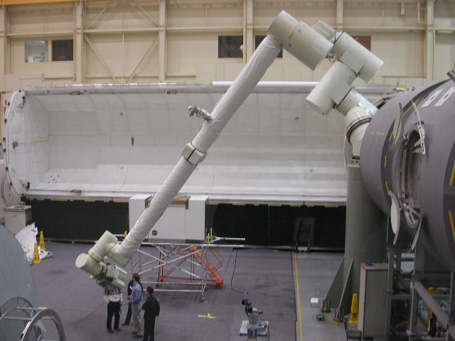
MRMDF Introduction

Slide 57
MRMDF Introduction
Part 1
Machine hardware and software configuration
MRMDF real-time parameter settings
Part 2
Real time performance analysis using Data Products

Slide 58
MRMDF Introduction
MRMDF is a distributed system using 5 computers
Test Directors Console (TDC)
Desktop Dell 2GHz Xeon workstation
Test Director interface
Facility Control System Electronics (FCSE)
VMIC 7750 VME Single Board computer 1.26Ghz Pentium III
2 Manipulator Control System Electronics (MCSEA) and (MCSEB)
VMIC 7750 VME Single Board computer 1.26Ghz Pentium III
SSRMS simulation or Basic Operational Robotics Instructional System (BORIS) simulation
Desktop Dell Dual 2GHz Xeon workstation
Astronaut/Trainer interface
Facility is on an isolated 1Gbs network
All network cards are 100Mbs

Slide 59
MRMDF Machine Configuration
All computers running RedHat Enterprise Linux 4 (RHEL4)
Non-updated straight from the RHEL4 CD installation
Embedded computers set to boot to run level 3 (multi-user text only)
TDC and BORIS computers set to run level 5
Some services turned off because they are non-essential or may hurt real-time performance
irqbalance
cpuspeed
sendmail

Slide 60
MRMDF Machine Configuration
Output of services still running on embedded computers
> chkconfig --list | grep "3:on" | sort
acpid 0:off 1:off 2:off 3:on 4:on 5:on 6:off
anacron 0:off 1:off 2:on 3:on 4:on 5:on 6:off
atd 0:off 1:off 2:off 3:on 4:on 5:on 6:off
autofs 0:off 1:off 2:off 3:on 4:on 5:on 6:off
crond 0:off 1:off 2:on 3:on 4:on 5:on 6:off
cups 0:off 1:off 2:on 3:on 4:on 5:on 6:off
gpm 0:off 1:off 2:on 3:on 4:on 5:on 6:off
kudzu 0:off 1:off 2:off 3:on 4:on 5:on 6:off
lm_sensors 0:off 1:off 2:on 3:on 4:on 5:on 6:off
messagebus 0:off 1:off 2:off 3:on 4:on 5:on 6:off
netfs 0:off 1:off 2:off 3:on 4:on 5:on 6:off
network 0:off 1:off 2:on 3:on 4:on 5:on 6:off
nfslock 0:off 1:off 2:off 3:on 4:on 5:on 6:off
portmap 0:off 1:off 2:off 3:on 4:on 5:on 6:off
rawdevices 0:off 1:off 2:off 3:on 4:on 5:on 6:off
sshd 0:off 1:off 2:on 3:on 4:on 5:on 6:off
syslog 0:off 1:off 2:on 3:on 4:on 5:on 6:off
xfs 0:off 1:off 2:on 3:on 4:on 5:on 6:off
xinetd 0:off 1:off 2:off 3:on 4:on 5:on 6:off

Slide 61
MRMDF Machine Configuration
Output of “lsmod” command
> lsmod
Module Size Used by
nfs 218309 0
lockd 63977 1 nfs
sunrpc 157093 3 nfs,lockd
vme_vmitmrf 11752 0
vme_universe 108708 0
md5 4033 1
ipv6 232705 12
parport_pc 24705 0
lp 12077 0
parport 37129 2 parport_pc,lp
autofs4 23237 1
i2c_dev 11329 0
i2c_core 22081 1 i2c_dev
dm_mod 54741 0
uhci_hcd 31065 0
hw_random 5845 0
e100 39493 0
mii 4673 1 e100
floppy 58481 0
ext3 116809 1
jbd 71257 1 ext3

Slide 62
MRMDF Machine Configuration
irqbalance service turned off the BORIS computer
irqbalance is a service that tries to spread interrupt handling to all available processors
Reassigns interrupts to specific processors
If a simulation is “burning” all CPU cycles, any interrupt assigned to that CPU will not be serviced. The machine will appear “locked up”

Slide 63
MRMDF Machine Configuration
Output of “cat /proc/interrupts” with irqbalance on
> cat /proc/interrupts
CPU0 CPU1
0: 686551361 690211955 IO-APIC-edge timer
1: 65200 64966 IO-APIC-edge i8042
8: 1 0 IO-APIC-edge rtc
9: 0 0 IO-APIC-level acpi
12: 0 0 IO-APIC-edge i8042
14: 273884 283455 IO-APIC-edge ide0
15: 10380479 10961469 IO-APIC-edge ide1
169: 8677476 8633408 IO-APIC-level uhci_hcd
177: 7127 7074 IO-APIC-level Intel 82801BA-ICH2
185: 32970665 0 IO-APIC-level uhci_hcd, eth0
193: 55050079 55390831 IO-APIC-level ohci1394, nvidia
201: 30 0 IO-APIC-level aic7xxx
209: 1678484 1679598 IO-APIC-level aic7xxx
NMI: 0 0
LOC: 1376788791 1376785050
ERR: 10
MIS: 0

Slide 64
MRMDF Machine Configuration
Output of “cat /proc/interrupts” with irqbalance off on the BORIS computer
> cat /proc/interrupts
CPU0 CPU1
0: 451274705 0 IO-APIC-edge timer
1: 552 0 IO-APIC-edge i8042
8: 1 0 IO-APIC-edge rtc
9: 0 0 IO-APIC-level acpi
12: 506838 0 IO-APIC-edge i8042
14: 79358 0 IO-APIC-edge ide0
15: 4058658 0 IO-APIC-edge ide1
169: 0 0 IO-APIC-level uhci_hcd
177: 1278 0 IO-APIC-level Intel 82801BA-ICH2
185: 9368789 0 IO-APIC-level eth0, uhci_hcd
193: 27195681 0 IO-APIC-level nvidia
NMI: 0 0
LOC: 451282615 451282536
ERR: 2
MIS: 0

Slide 65
MRMDF Trick Real-time Features
All machines in the MRMDF use a modified Trick 05.6.1
All MRMDF specific changes merged back into Trick 05.7.0
MRMDF uses many of the real-time features in Trick
Scheduling
30Hz sync frame (0.033330 sec)
300Hz real time loop (0.003333 sec)
Distributed application across 5 computers
Master/Slave synchronization
Clock/timers - External timers
Real-time controls and parameters
Multi-threaded applications

Slide 66
MRMDF Real-time Scheduling
Scheduling
30Hz sync frame and 300Hz real time loop
Paritial S_define listing from an MCSE
#define HZ30 0.033330 /*--- MRM SW FREQUENCY CYCLE TIME ---*/
sim_object {
<data structures and init jobs>
(HZ30) mcse/device: mcse_rs422_write(…) ;
(HZ30,0.003333) mcse/comm: mcse_tdc_read(…) ;
(HZ30,0.006666) mcse/device: mcse_rs422_read(…);
(HZ30,0.006666) mcse/device: mcse_device_read(…) ;
(HZ30,0.006666) mcse/mrm: mcse_exec(…) ;
(HZ30,0.013332) mcse/mee: mee_exec(…);
(HZ30,0.013332) mcse/poa: poa_exec(…);
(HZ30,0.016665) mcse/comm: mcse_fcse_read(…) ;
(HZ30,0.016665) mcse/comm: mcse_simhost_read(…) ;
(HZ30,0.016665) mcse/manipulator: manipulator_exec(…);
(HZ30,0.016665) mcse/jbce_sim: jbce_sim(…);
(HZ30,0.016665) mcse/comm: mcse_simhost_write(…) ;
(HZ30,0.016665) mcse/comm: mcse_fcse_export(…) ;
} mcse ;

Slide 67
MRMDF Real-time Scheduling
To set the frequencies in the S_define file is not enough to run real-time. Real time performance is greatly shaped by one parameter in the input file.
Setting rt_software_frame to 3.333ms tells Trick to schedule jobs for the next 3.333ms to run and wait (if underrunning) for the next frame
sys.exec.in.rt_software_frame {s} = 0.0033330 ;
mcse_fcse_read
mcse_simhost_read
manipulator_exec
jbce_sim
mcse_simhost_write
mcse_fcse_export
mcse_rs422_read
mcse_device_read
mcse_exec
mcse_rs422_write
mcse_tdc_read
mee_exec
poa_exec
0
3.333
6.666
9.999
13.332
16.665
19.998
23.331
26.664
29.997
33.330
Time(ms)

Slide 68
MRMDF Real-time Scheduling
If we had set rt_software_frame to 33.33ms, all jobs within each 33.33ms would be scheduled to run in succession.
mcse_rs422_write
mcse_tdc_read
mcse_rs422_read
mcse_device_read
mcse_exec
mee_exec
poa_exec
mcse_fcse_read
mcse_simhost_read
manipulator_exec
jbce_sim
mcse_simhost_write
mcse_fcse_export
0
3.333
6.666
9.999
13.332
16.665
19.998
23.331
26.664
29.997
33.330

Slide 69
MRMDF Master/Slave Configuration
Master/Slave synchronization
MRMDF requires 4 computers to communicate synchronously
To ensure that all simulations are working with to the same clock we use Trick’s Master/Slave synchronization capabilities
4 of the 5 computers participate in the Master/Slave setup
FCSE Master
MCSEA Slave
MCSEB Slave
SSRMS/BORIS Slave
The 5th computer, the TDC is asynchronously connected to all systems
Controls simulation mode of the system

Slide 70
MRMDF Master/Slave configuration
Master/Slave
TDC
FCSE (Master)
MCSEA (slave)
Master/Slave
Moding
MCSEB (slave)
BORIS (slave)

Slide 71
Master/Slave Configuration
Partial input file detailing Master/Slave activation and synchronization (FCSE)
/* Activation */
sys.exec.in.ms_sync = Master_sync ;
sys.exec.in.remote_shell = TRICK_SSH ;
int num_slaves = 0 ;
sys.exec.in.activate_slave[num_slaves] = Yes ;
sys.exec.in.slaves[num_slaves].machine_name = "${MCSEA_HOST}" ;
sys.exec.in.slaves[num_slaves].sim_path = "${MCSEA_SIM_DIR}" ;
sys.exec.in.slaves[num_slaves].S_main_args[0] = "${MCSEA_RUN_DIR}/input" ;
num_slaves++ ;
<similar code for mcse_b and boris>
sys.exec.in.slave_cnt = num_slaves ;
/* Synchronization */
sys.exec.work.slave_sync_at_init = Yes ;
sys.exec.in.sync_error_terminate = No ;

Slide 72
Master/Slave Configuration
Partial input file detailing Master/Slave activation and synchronization (FCSE)
/* Activation */
sys.exec.in.ms_sync = Master_sync ;
sys.exec.in.remote_shell = TRICK_SSH ;
int num_slaves = 0 ;
sys.exec.in.activate_slave[num_slaves] = Yes ;
sys.exec.in.slaves[num_slaves].machine_name = "${MCSEA_HOST}" ;
sys.exec.in.slaves[num_slaves].sim_path = "${MCSEA_SIM_DIR}" ;
sys.exec.in.slaves[num_slaves].S_main_args[0] = "${MCSEA_RUN_DIR}/input" ;
num_slaves++ ;
<similar code for mcse_b and boris>
sys.exec.in.slave_cnt = num_slaves ;
/* Synchronization */
sys.exec.work.slave_sync_at_init = Yes ;
sys.exec.in.sync_error_terminate = No ;
Turns on Master/Slave sync. Choices are
Master_sync
Slave_Sync
No_sync

Slide 73
Master/Slave Configuration
Partial input file detailing Master/Slave activation and synchronization (FCSE)
/* Activation */
sys.exec.in.ms_sync = Master_sync ;
sys.exec.in.remote_shell = TRICK_SSH ;
int num_slaves = 0 ;
sys.exec.in.activate_slave[num_slaves] = Yes ;
sys.exec.in.slaves[num_slaves].machine_name = "${MCSEA_HOST}" ;
sys.exec.in.slaves[num_slaves].sim_path = "${MCSEA_SIM_DIR}" ;
sys.exec.in.slaves[num_slaves].S_main_args[0] = "${MCSEA_RUN_DIR}/input" ;
num_slaves++ ;
<similar code for mcse_b and boris>
sys.exec.in.slave_cnt = num_slaves ;
/* Synchronization */
sys.exec.work.slave_sync_at_init = Yes ;
sys.exec.in.sync_error_terminate = No ;
Which remote shell to use to start slave simulations. Choices are
TRICK_SSH
TRICK_RSH

Slide 74
Master/Slave Configuration
Partial input file detailing Master/Slave activation and synchronization (FCSE)
/* Activation */
sys.exec.in.ms_sync = Master_sync ;
sys.exec.in.remote_shell = TRICK_SSH ;
int num_slaves = 0 ;
sys.exec.in.activate_slave[num_slaves] = Yes ;
sys.exec.in.slaves[num_slaves].machine_name = "${MCSEA_HOST}" ;
sys.exec.in.slaves[num_slaves].sim_path = "${MCSEA_SIM_DIR}" ;
sys.exec.in.slaves[num_slaves].S_main_args[0] = "${MCSEA_RUN_DIR}/input" ;
num_slaves++ ;
<similar code for mcse_b and boris>
sys.exec.in.slave_cnt = num_slaves ;
/* Synchronization */
sys.exec.work.slave_sync_at_init = Yes ;
sys.exec.in.sync_error_terminate = No ;
Activate this slave at initialization?
Yes = Master will use a remote shell to automatically start slave simulation
No = Master will not start the slave, but will synchronize with the slave when connected

Slide 75
Master/Slave Configuration
Partial input file detailing Master/Slave activation and synchronization (FCSE)
/* Activation */
sys.exec.in.ms_sync = Master_sync ;
sys.exec.in.remote_shell = TRICK_SSH ;
int num_slaves = 0 ;
sys.exec.in.activate_slave[num_slaves] = Yes ;
sys.exec.in.slaves[num_slaves].machine_name = "${MCSEA_HOST}" ;
sys.exec.in.slaves[num_slaves].sim_path = "${MCSEA_SIM_DIR}" ;
sys.exec.in.slaves[num_slaves].S_main_args[0] = "${MCSEA_RUN_DIR}/input" ;
num_slaves++ ;
<similar code for mcse_b and boris>
sys.exec.in.slave_cnt = num_slaves ;
/* Synchronization */
sys.exec.work.slave_sync_at_init = Yes ;
sys.exec.in.sync_error_terminate = No ;
Machine name to start the slave on.
In this case ${MCSEA_HOST} is an environment variable

Slide 76
Master/Slave Configuration
Partial input file detailing Master/Slave activation and synchronization (FCSE)
/* Activation */
sys.exec.in.ms_sync = Master_sync ;
sys.exec.in.remote_shell = TRICK_SSH ;
int num_slaves = 0 ;
sys.exec.in.activate_slave[num_slaves] = Yes ;
sys.exec.in.slaves[num_slaves].machine_name = "${MCSEA_HOST}" ;
sys.exec.in.slaves[num_slaves].sim_path = "${MCSEA_SIM_DIR}" ;
sys.exec.in.slaves[num_slaves].S_main_args[0] = "${MCSEA_RUN_DIR}/input" ;
num_slaves++ ;
<similar code for mcse_b and boris>
sys.exec.in.slave_cnt = num_slaves ;
/* Synchronization */
sys.exec.work.slave_sync_at_init = Yes ;
sys.exec.in.sync_error_terminate = No ;
Full path to slave simulation directory on remote machine
In this case ${MCSEA_SIM_DIR} is an environment variable

Slide 77
Master/Slave Configuration
Partial input file detailing Master/Slave activation and synchronization (FCSE)
/* Activation */
sys.exec.in.ms_sync = Master_sync ;
sys.exec.in.remote_shell = TRICK_SSH ;
int num_slaves = 0 ;
sys.exec.in.activate_slave[num_slaves] = Yes ;
sys.exec.in.slaves[num_slaves].machine_name = "${MCSEA_HOST}" ;
sys.exec.in.slaves[num_slaves].sim_path = "${MCSEA_SIM_DIR}" ;
sys.exec.in.slaves[num_slaves].S_main_args[0] = "${MCSEA_RUN_DIR}/input" ;
num_slaves++ ;
<similar code for mcse_b and boris>
sys.exec.in.slave_cnt = num_slaves ;
/* Synchronization */
sys.exec.work.slave_sync_at_init = Yes ;
sys.exec.in.sync_error_terminate = No ;
Relative path from slave simulation directory to run directory
In this case ${MCSEA_RUN_DIR} is an environment variable

Slide 78
Master/Slave Configuration
Partial input file detailing Master/Slave activation and synchronization (FCSE)
/* Activation */
sys.exec.in.ms_sync = Master_sync ;
sys.exec.in.remote_shell = TRICK_SSH ;
int num_slaves = 0 ;
sys.exec.in.activate_slave[num_slaves] = Yes ;
sys.exec.in.slaves[num_slaves].machine_name = "${MCSEA_HOST}" ;
sys.exec.in.slaves[num_slaves].sim_path = "${MCSEA_SIM_DIR}" ;
sys.exec.in.slaves[num_slaves].S_main_args[0] = "${MCSEA_RUN_DIR}/input" ;
num_slaves++ ;
<similar code for mcse_b and boris>
sys.exec.in.slave_cnt = num_slaves ;
/* Synchronization */
sys.exec.work.slave_sync_at_init = Yes ;
sys.exec.in.sync_error_terminate = No ;
Number of slaves the master will synchronize
In MRMDF num_slaves = 3

Slide 79
Master/Slave Configuration
Partial input file detailing Master/Slave activation and synchronization (FCSE)
/* Activation */
sys.exec.in.ms_sync = Master_sync ;
sys.exec.in.remote_shell = TRICK_SSH ;
int num_slaves = 0 ;
sys.exec.in.activate_slave[num_slaves] = Yes ;
sys.exec.in.slaves[num_slaves].machine_name = "${MCSEA_HOST}" ;
sys.exec.in.slaves[num_slaves].sim_path = "${MCSEA_SIM_DIR}" ;
sys.exec.in.slaves[num_slaves].S_main_args[0] = "${MCSEA_RUN_DIR}/input" ;
num_slaves++ ;
<similar code for mcse_b and boris>
sys.exec.in.slave_cnt = num_slaves ;
/* Synchronization */
sys.exec.work.slave_sync_at_init = Yes ;
sys.exec.in.sync_error_terminate = No ;
Will the Master wait at time=0 for all slaves to start before proceeding

Slide 80
Master/Slave Configuration
Partial input file detailing Master/Slave activation and synchronization (FCSE)
/* Activation */
sys.exec.in.ms_sync = Master_sync ;
sys.exec.in.remote_shell = TRICK_SSH ;
int num_slaves = 0 ;
sys.exec.in.activate_slave[num_slaves] = Yes ;
sys.exec.in.slaves[num_slaves].machine_name = "${MCSEA_HOST}" ;
sys.exec.in.slaves[num_slaves].sim_path = "${MCSEA_SIM_DIR}" ;
sys.exec.in.slaves[num_slaves].S_main_args[0] = "${MCSEA_RUN_DIR}/input" ;
num_slaves++ ;
<similar code for mcse_b and boris>
sys.exec.in.slave_cnt = num_slaves ;
/* Synchronization */
sys.exec.work.slave_sync_at_init = Yes ;
sys.exec.in.sync_error_terminate = No ;
Will the simulation terminate if loss of sync connection detected
No = continue to run, but as a standalone sim.
In MRMDF, Loss of sync will send the facility to “safe” mode through a user model

Slide 81
Real-time Input Parameters
MRMDF runs with 33.33ms major frame with 3.333ms minor frame
When running we want executables to run at maximum non-degrading real-time priority

Slide 82
Real-time Input Parameters
Partial input file for real-time input parameters (FCSE)
#define SW_FRAME 0.0333300
#define RT_FRAME 0.0033330
/* SIM-TO-WALL-CLOCK SYNCHRONIZATION */
sys.exec.in.rt_nap = No ;
sys.exec.in.rt_itimer = No ;
sys.exec.in.rt_itimer_pause = No ;
sys.exec.in.rt_software_frame {s} = RT_FRAME ;
sys.exec.in.rt_sync_frame {s} = SW_FRAME ;
sys.exec.in.sync_wait_limit {s} = 0.050 ;
/* MAXIMUM NON-DEGRADING PRIORITY */
sys.exec.in.rt_lock_memory[1] = Yes ;
sys.exec.in.rt_nond_pri[1] = Yes ;
sys.exec.in.rt_priority[1] = 1 ;

Slide 83
Real-time Input Parameters
Partial input file for real-time input parameters (FCSE)
#define SW_FRAME 0.0333300
#define RT_FRAME 0.0033330
/* SIM-TO-WALL-CLOCK SYNCHRONIZATION */
sys.exec.in.rt_nap = No ;
sys.exec.in.rt_itimer = No ;
sys.exec.in.rt_itimer_pause = No ;
sys.exec.in.rt_software_frame {s} = RT_FRAME ;
sys.exec.in.rt_sync_frame {s} = SW_FRAME ;
sys.exec.in.sync_wait_limit {s} = 0.050 ;
/* MAXIMUM NON-DEGRADING PRIORITY */
sys.exec.in.rt_lock_memory[1] = Yes ;
sys.exec.in.rt_nond_pri[1] = Yes ;
sys.exec.in.rt_priority[1] = 1 ;
Allows the sim to sleep when we need to wait for events
We want the simulation to “burn” for instant response

Slide 84
Real-time Input Parameters
Partial input file for real-time input parameters (FCSE)
#define SW_FRAME 0.0333300
#define RT_FRAME 0.0033330
/* SIM-TO-WALL-CLOCK SYNCHRONIZATION */
sys.exec.in.rt_nap = No ;
sys.exec.in.rt_itimer = No ;
sys.exec.in.rt_itimer_pause = No ;
sys.exec.in.rt_software_frame {s} = RT_FRAME ;
sys.exec.in.rt_sync_frame {s} = SW_FRAME ;
sys.exec.in.sync_wait_limit {s} = 0.050 ;
/* MAXIMUM NON-DEGRADING PRIORITY */
sys.exec.in.rt_lock_memory[1] = Yes ;
sys.exec.in.rt_nond_pri[1] = Yes ;
sys.exec.in.rt_priority[1] = 1 ;
Don’t use an itimer to check for frame overruns
Before Linux 2.6 kernels and Trick 5.6, using itimers with frames under 10ms was not possible.

Slide 85
Real-time Input Parameters
Partial input file for real-time input parameters (FCSE)
#define SW_FRAME 0.0333300
#define RT_FRAME 0.0033330
/* SIM-TO-WALL-CLOCK SYNCHRONIZATION */
sys.exec.in.rt_nap = No ;
sys.exec.in.rt_itimer = No ;
sys.exec.in.rt_itimer_pause = No ;
sys.exec.in.rt_software_frame {s} = RT_FRAME ;
sys.exec.in.rt_sync_frame {s} = SW_FRAME ;
sys.exec.in.sync_wait_limit {s} = 0.050 ;
/* MAXIMUM NON-DEGRADING PRIORITY */
sys.exec.in.rt_lock_memory[1] = Yes ;
sys.exec.in.rt_nond_pri[1] = Yes ;
sys.exec.in.rt_priority[1] = 1 ;
Allows the sim to sleep during underrunning frames
rt_itimer_pause not applicable if rt_itimer is off

Slide 86
Real-time Input Parameters
Partial input file for real-time input parameters (FCSE)
#define SW_FRAME 0.0333300
#define RT_FRAME 0.0033330
/* SIM-TO-WALL-CLOCK SYNCHRONIZATION */
sys.exec.in.rt_nap = No ;
sys.exec.in.rt_itimer = No ;
sys.exec.in.rt_itimer_pause = No ;
sys.exec.in.rt_software_frame {s} = RT_FRAME ;
sys.exec.in.rt_sync_frame {s} = SW_FRAME ;
sys.exec.in.sync_wait_limit {s} = 0.050 ;
/* MAXIMUM NON-DEGRADING PRIORITY */
sys.exec.in.rt_lock_memory[1] = Yes ;
sys.exec.in.rt_nond_pri[1] = Yes ;
sys.exec.in.rt_priority[1] = 1 ;
Setting rt_software_frame to 3.333ms tells Trick to schedule jobs for the next 3.333ms to run and wait (if underrunning) for the next frame

Slide 87
Real-time Input Parameters
Partial input file for real-time input parameters (FCSE)
#define SW_FRAME 0.0333300
#define RT_FRAME 0.0033330
/* SIM-TO-WALL-CLOCK SYNCHRONIZATION */
sys.exec.in.rt_nap = No ;
sys.exec.in.rt_itimer = No ;
sys.exec.in.rt_itimer_pause = No ;
sys.exec.in.rt_exttimer = Yes ;
sys.exec.in.rt_sync_frame {s} = SW_FRAME ;
sys.exec.in.sync_wait_limit {s} = 0.050 ;
/* MAXIMUM NON-DEGRADING PRIORITY */
sys.exec.in.rt_lock_memory[1] = Yes ;
sys.exec.in.rt_nond_pri[1] = Yes ;
sys.exec.in.rt_priority[1] = 1 ;
How often we check the realtime status with the external timer

Slide 88
Real-time Input Parameters
Partial input file for real-time input parameters (FCSE)
#define SW_FRAME 0.0333300
#define RT_FRAME 0.0033330
/* SIM-TO-WALL-CLOCK SYNCHRONIZATION */
sys.exec.in.rt_nap = No ;
sys.exec.in.rt_itimer = No ;
sys.exec.in.rt_itimer_pause = No ;
sys.exec.in.rt_software_frame {s} = RT_FRAME ;
sys.exec.in.rt_sync_frame {s} = SW_FRAME ;
sys.exec.in.sync_wait_limit {s} = 0.050 ;
/* MAXIMUM NON-DEGRADING PRIORITY */
sys.exec.in.rt_lock_memory[1] = Yes ;
sys.exec.in.rt_nond_pri[1] = Yes ;
sys.exec.in.rt_priority[1] = 1 ;
Maximum time to wait for synchronization response
If no response after 50ms, then the master breaks the sync connection and sends the facility to “safe”

Slide 89
Real-time Input Parameters
Partial input file for real-time input parameters (FCSE)
#define SW_FRAME 0.0333300
#define RT_FRAME 0.0033330
/* SIM-TO-WALL-CLOCK SYNCHRONIZATION */
sys.exec.in.rt_nap = No ;
sys.exec.in.rt_itimer = No ;
sys.exec.in.rt_itimer_pause = No ;
sys.exec.in.rt_software_frame {s} = RT_FRAME ;
sys.exec.in.rt_sync_frame {s} = SW_FRAME ;
sys.exec.in.sync_wait_limit {s} = 0.050 ;
/* MAXIMUM NON-DEGRADING PRIORITY */
sys.exec.in.rt_lock_memory[1] = Yes ;
sys.exec.in.rt_nond_pri[1] = Yes ;
sys.exec.in.rt_priority[1] = 1 ;
Lock all memory in RAM. Cannot be paged to swap file.
Must be root to use this parameter

Slide 90
Real-time Input Parameters
Partial input file for real-time input parameters (FCSE)
#define SW_FRAME 0.0333300
#define RT_FRAME 0.0033330
/* SIM-TO-WALL-CLOCK SYNCHRONIZATION */
sys.exec.in.rt_nap = No ;
sys.exec.in.rt_itimer = No ;
sys.exec.in.rt_itimer_pause = No ;
sys.exec.in.rt_software_frame {s} = RT_FRAME ;
sys.exec.in.rt_sync_frame {s} = SW_FRAME ;
sys.exec.in.sync_wait_limit {s} = 0.050 ;
/* MAXIMUM NON-DEGRADING PRIORITY */
sys.exec.in.rt_lock_memory[1] = Yes ;
sys.exec.in.rt_nond_pri[1] = Yes ;
sys.exec.in.rt_priority[1] = 1 ;
Set the simulation to run with a non-degrading real-time priority.
Must be root to use this parameter

Slide 91
Real-time Input Parameters
Partial input file for real-time input parameters (FCSE)
#define SW_FRAME 0.0333300
#define RT_FRAME 0.0033330
/* SIM-TO-WALL-CLOCK SYNCHRONIZATION */
sys.exec.in.rt_nap = No ;
sys.exec.in.rt_itimer = No ;
sys.exec.in.rt_itimer_pause = No ;
sys.exec.in.rt_software_frame {s} = RT_FRAME ;
sys.exec.in.rt_sync_frame {s} = SW_FRAME ;
sys.exec.in.sync_wait_limit {s} = 0.050 ;
/* MAXIMUM NON-DEGRADING PRIORITY */
sys.exec.in.rt_lock_memory[1] = Yes ;
sys.exec.in.rt_nond_pri[1] = Yes ;
sys.exec.in.rt_priority[1] = 1 ;
Sets the priority.
Setting rt_priority = 1 will set the process to run at maximum priority on any platform
Warning: Setting rt_priority = 1 on a single processor computer with no “napping” will completely shut out all shells and input devices, i.e. mouse, keyboard

Slide 92
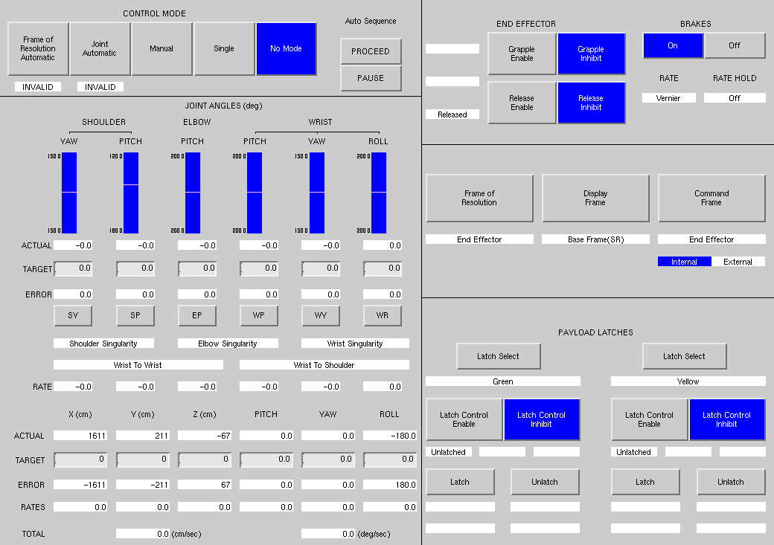
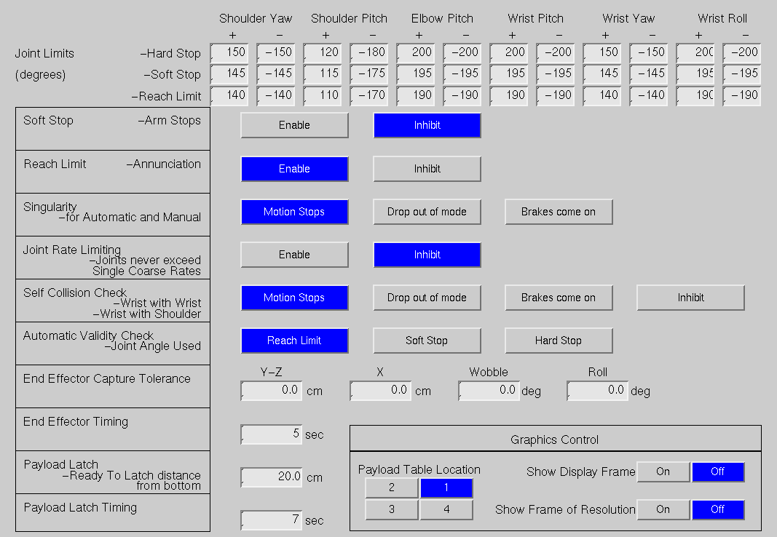
MRMDF Multithreaded Applications
BORIS is an all-in-one generic robotics trainer
Arm simulation
Operator GUIs built into the simulation

Slide 93
MRMDF Multithreaded Applications
The BORIS simulation has 2 requirements forcing a multi-threaded design
Communication deadlines to meet with the facility
Handling updates to the GUIs for operator
X-Windows event handling
Button presses
Text field updates
Window scrolling
Window resizing…
Some actions can generate thousands of events requiring seconds to complete

Slide 94
MRMDF Multithreaded Applications
BORIS requires a dual processor computer
Use one processor for keeping the simulation synchronized with the rest of the facility
Use the second to handle X-window updates through a “child” process.
Child terminology held over from when Trick used parent/child forking and execing to run multiprocess applications
Assigning job to child thread in S_define:
C1 = Assign the job to run in the first child process
asynchronous = do not worry about job completion time
0.1 sec. cycle time = when job is finished reschedule the job to run the next 0.1 second boundary
This particular job never returns so the cycle time is irrelevant
C1 (0.01, asynchronous) xgrt: grt_event_loop(…);

Slide 95
MRMDF Multithreaded Applications
Data locks or mutexes are not provided by Trick
BORIS’ main thread and child thread both make X function calls
The application will core dump if more than one thread tries to make X calls simultaneously
Added a pthread mutex that locks out other threads when making X calls
For this child job we also added code to ensure that no X updates occur once we are past 80% finished in the frame
This is to make sure that we finish all X updates in time so the main thread will only have to wait a minimal time to acquire the mutex.

Slide 96
MRMDF Multithreaded Applications
Excerpt from child process
while (1) {
/* we do not want to update the GUI if we are nearing time to call
grt_update_values, don't update if we are over 80% through the frame */
rem = fmod ( exec_get_sim_time() , job_call_time ) ;
if ( rem != 0.0 && rem < (job_call_time * 0.80)) {
/* lock the mutex if we can */
if ( pthread_mutex_trylock(&grt_info->x_lock) == 0 ) {
/* dispatch 5 events */
for ( ii = 0 ; ii < 5 ; ii++ ) {
if ( XtAppPending( grt_if->app_context ) & XtIMXEvent ){
XtAppNextEvent( grt_if->app_context , &next_event ) ;
XtDispatchEvent( &next_event ) ;
}
}
/* unlock the mutex so grt_update_values can run */
pthread_mutex_unlock(&grt_info->x_lock);
}
}
else {
/* we are nearing or on the cycle to run grt_update_values,
sleep a little to allow grt_update_values to run */
usleep(100) ;
}
}

Slide 97
MRMDF Multithreaded Applications
Partial input file parameters associated with real-time (BORIS)
#define SW_FRAME 0.0333300
sys.exec.in.rt_itimer = No ;
sys.exec.in.rt_itimer_pause = Yes ;
sys.exec.in.rt_nap = No ;
sys.exec.in.rt_itimer_frame {s} = SW_FRAME ;
sys.exec.in.rt_software_frame {s} = SW_FRAME ;
sys.exec.in.rt_enable_clock_reset = Yes ;
sys.exec.in.sync_error_terminate = 0 ;
sys.exec.in.rt_lock_to_cpu[1] = Yes ;
sys.exec.in.rt_cpu_number[1] = 1 ;
sys.exec.in.rt_lock_memory[1] = Yes ;
sys.exec.in.rt_nond_pri[1] = Yes ;
sys.exec.in.rt_priority[1] = 1 ;
sys.exec.in.rt_lock_to_cpu[2] = Yes ;
sys.exec.in.rt_cpu_number[2] = 0 ;

Slide 98
MRMDF Multithreaded Applications
Partial input file parameters associated with real-time (BORIS)
rt_cpu_number[1] = Master thread process. We assign this to processor 1 where there are no interrupts being handled. We want to make sure that the Child thread is assigned to the other processor
sys.exec.in.rt_lock_to_cpu[1] = Yes ;
sys.exec.in.rt_cpu_number[1] = 1 ;
sys.exec.in.rt_lock_memory[1] = Yes ;
sys.exec.in.rt_nond_pri[1] = Yes ;
sys.exec.in.rt_priority[1] = 1 ;
sys.exec.in.rt_lock_to_cpu[2] = Yes ;
sys.exec.in.rt_cpu_number[2] = 0 ;
> cat /proc/interrupts
CPU0 CPU1
0: 451274705 0 IO-APIC-edge timer
1: 552 0 IO-APIC-edge i8042
8: 1 0 IO-APIC-edge rtc
9: 0 0 IO-APIC-level acpi
12: 506838 0 IO-APIC-edge i8042
14: 79358 0 IO-APIC-edge ide0
…

Slide 99
MRMDF Multithreaded Applications
Using ps to confirm we are locked down on the correct processor
Use ps arguments to show extra information
PID
Process ID
All threads of same sim will show same PID
CLS
Scheduling class of the process
TS = SCHED_OTHER
FF = SCHED_FIFO (realtime scheduler)
RTPRIO
Realtime priority
For Linux 99 = highest priority
PSR
Processor that process is currently assigned to.
%CPU
Percentage of that individual CPU used
> ps -eLo pid,class,rtprio,ni,pri,psr,pcpu,stat,wchan:14,comm
PID CLS RTPRIO NI PRI PSR %CPU STAT WCHAN COMMAND
7789 FF 99 - 139 1 1.7 SLl pause S_main_Linux_3.
7789 TS - 0 20 0 0.0 SLl - S_main_Linux_3.

Slide 100
Part 2: MRMDF Real-Time Performance Analysis
Use data products to
Interpret and analyze real-time performance graphs
Pinpoint functions causing overruns

Slide 101
MRMDF Real-Time Performance
When things go right:
The printout at sim termination shows zero overruns:
SIMULATION TERMINATED IN
PROCESS: 1
JOB/ROUTINE: 1/master.c
DIAGNOSTIC:
Sim Control Shutdown.
LAST JOB CALLED: mcse.mcse_tdc_read(&mcse.mcse)
TOTAL OVERRUNS: 0
PERCENTAGE REALTIME OVERRUNS: 0.000%
SIMULATION START TIME: 0.000
SIMULATION STOP TIME: 517.755
SIMULATION ELAPSED TIME: 517.755
ACTUAL ELAPSED TIME: 517.755
ACTUAL CPU TIME USED: 57.649
SIMULATION / ACTUAL TIME: 1.000
SIMULATION / CPU TIME: 8.981
ACTUAL INITIALIZATION TIME: 0.000
INITIALIZATION CPU TIME: 0.128

Slide 102
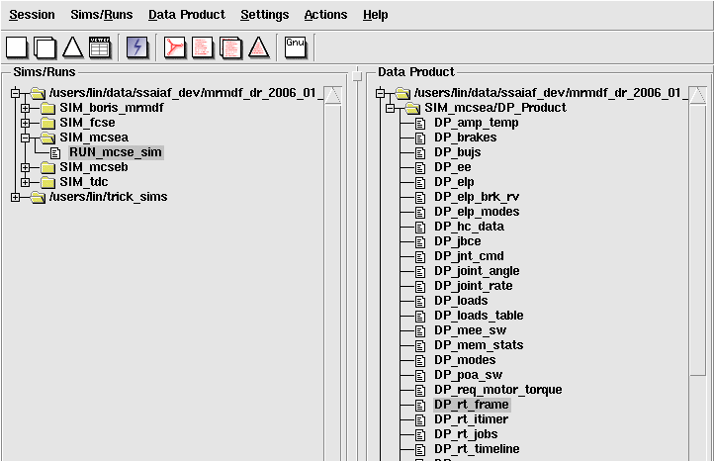
MRMDF Real-Time Performance Analysis
Each Trick sim automatically generates 4 DP files dedicated for real-time analysis: DP_rt_frame, DP_rt_itimer, DP_rt_jobs, and DP_rt_timeline

Slide 103
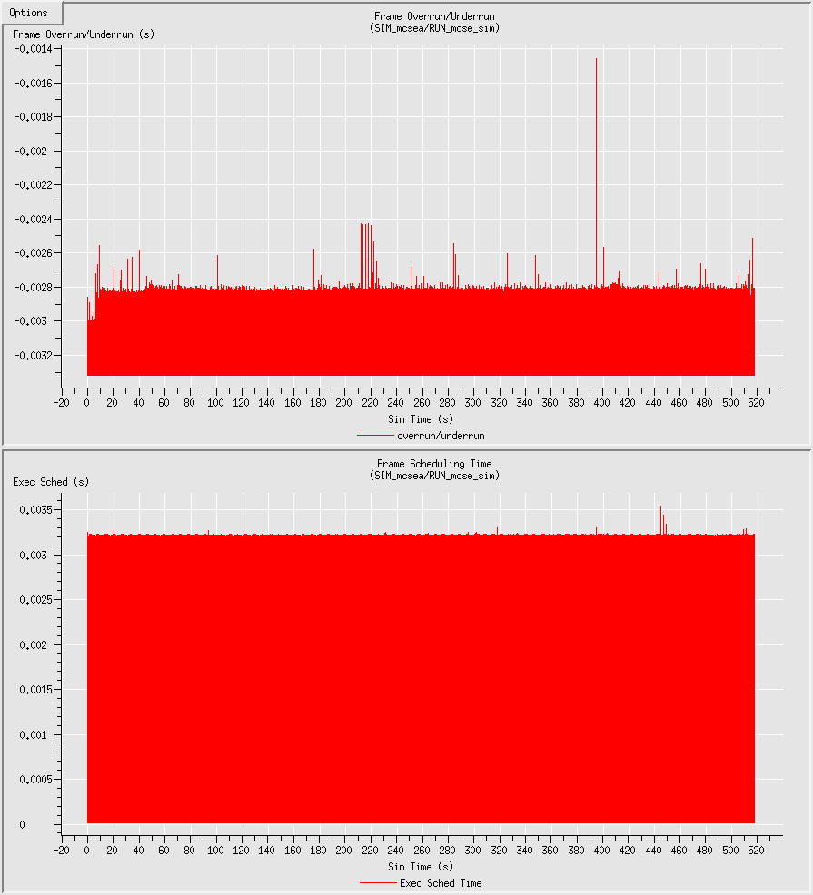
MRMDF Real-Time Performance Analysis
Selecting the DP_rt_frame graph brings up 4 pages
First graph on the first page shows Frame Overrun/Underrun times
Negative points are underruns, minimum value = -sys.exec.in.rt_software_frame (-3.333ms)
Positive points are overruns
Spike at time ~= 395, but not an overrun

Slide 104
MRMDF Real-Time Performance Analysis
The bottom graph shows how long the Trick executive took to execute each frame

Slide 105
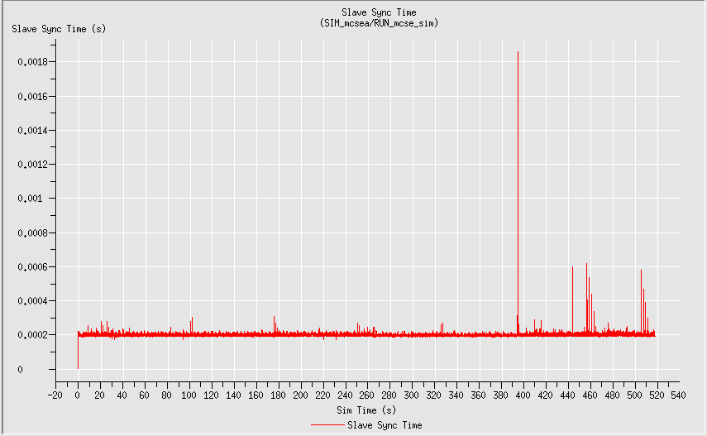
MRMDF Real-Time Performance Analysis
Another graph of interest in DP_rt_frame is the Master/Slave Sync Time graph
Normally takes 200us to sync this sim to the Master
Corresponding spike at time ~= 395

Slide 106
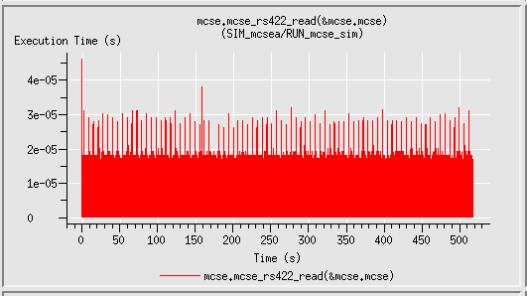
MRMDF Real-Time Performance Analysis
Selecting the DP_rt_jobs file will bring up multiple pages detailing how long each job took in each frame
On average mcse_rs422_read takes 30us or less

Slide 107
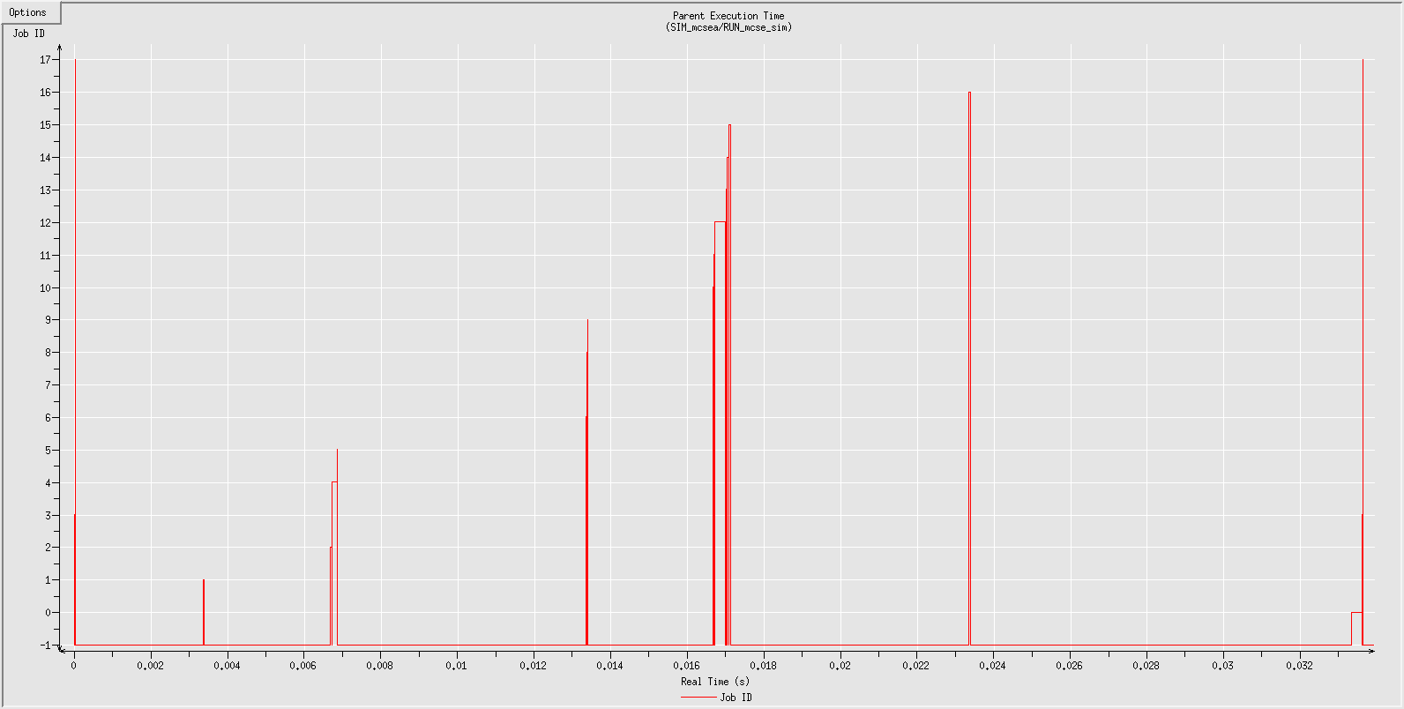
MRMDF Real-Time Performance
Selecting the DP_rt_timeline file will bring up a single graph plotting job currently executing vs. real-time
Stretched to show first 33.33ms frame

Slide 108
MRMDF Real-Time Performance
To translate Job IDs to function names see RUN_mcse_sim/S_job_execution
S_job execution lists out all jobs, their frequencies at init…
Enabled | PID | Start | Cycle | Stop | ID | Job Name
===============================================================================
automatic Jobs:
1 | 1 | 0.000000 | 0.000000 | 1e+37 | 0 | sys.input_processor(&sys.exec)
scheduled Jobs:
1 | 1 | 0.003333 | 0.033330 | 1e+37 | 1 | mcse.mcse_tdc_read(&mcse.mcse)
1 | 1 | 0.006666 | 0.033330 | 1e+37 | 2 | mcse.mcse_rs422_read(&mcse.mcse)
1 | 1 | 0.000000 | 0.033330 | 1e+37 | 3 | mcse.mcse_rs422_write(&mcse.mcse)
1 | 1 | 0.006666 | 0.033330 | 1e+37 | 4 | mcse.mcse_device_read(&mcse.mcse)
1 | 1 | 0.006666 | 0.033330 | 1e+37 | 5 | mcse.mcse_exec(&mcse.mcse)
1 | 1 | 0.013332 | 0.033330 | 1e+37 | 6 | mcse.mee_exec(&mcse.mcse)
1 | 1 | 0.013332 | 0.033330 | 1e+37 | 7 | mcse.meece_sim(&mcse.mcse)
1 | 1 | 0.013332 | 0.033330 | 1e+37 | 8 | mcse.poa_exec(&mcse.mcse)
1 | 1 | 0.013332 | 0.033330 | 1e+37 | 9 | mcse.poace_sim(&mcse.mcse)
1 | 1 | 0.016665 | 0.033330 | 1e+37 | 10 | mcse.mcse_fcse_read(&mcse.mcse)
1 | 1 | 0.016665 | 0.033330 | 1e+37 | 11 | mcse.mcse_simhost_read(&mcse.mcse)
1 | 1 | 0.016665 | 0.033330 | 1e+37 | 12 | mcse.manipulator_exec(&mcse.mcse)
1 | 1 | 0.016665 | 0.033330 | 1e+37 | 13 | mcse.jbce_sim(&mcse.mcse)
1 | 1 | 0.016665 | 0.033330 | 1e+37 | 14 | mcse.mcse_simhost_write(&mcse.mcse)
1 | 1 | 0.016665 | 0.033330 | 1e+37 | 15 | mcse.mcse_fcse_export(&mcse.mcse)
1 | 1 | 0.023331 | 0.333300 | 1e+37 | 16 | mcse.mcse_tdc_export(&mcse.mcse)
logging Jobs:
1 | 1 | 0.000000 | 0.033330 | 1e+37 | 17 | mcse.data_record_pack(&mcse.mcse)

Slide 109
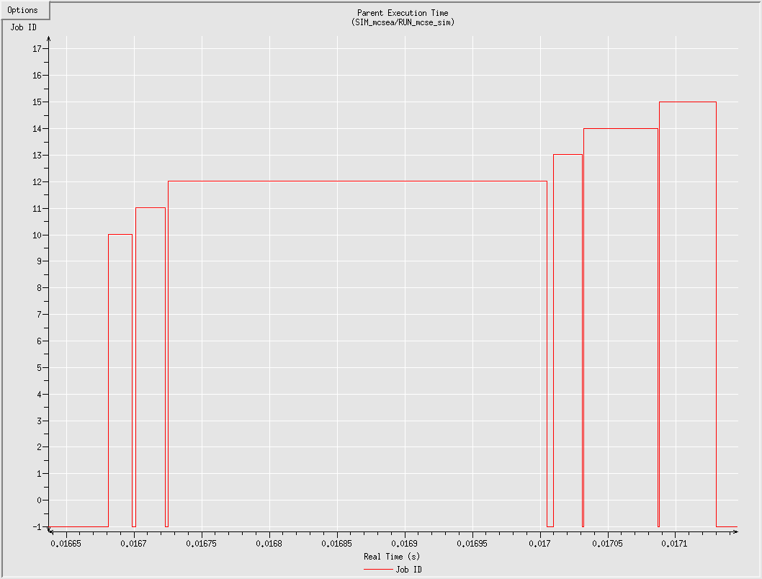
MRMDF Real-Time Performance
Close-up of the timeline near 0.016665sec
mcse_simhost_read
manipulator_exec
mcse_simhost_write
mcse_fcse_read
mcse_fcse_export
jbce_sim

Slide 110
MRMDF Real-Time Performance
When there are overruns
The printout at sim termination shows the number of overruns:
SIMULATION TERMINATED IN
PROCESS: 1
JOB/ROUTINE: 1/master.c
DIAGNOSTIC:
Sim Control Shutdown.
LAST JOB CALLED: mcse.mcse_tdc_read(&mcse.mcse)
TOTAL OVERRUNS: 6
PERCENTAGE REALTIME OVERRUNS: 0.006%
SIMULATION START TIME: 0.000
SIMULATION STOP TIME: 345.672
SIMULATION ELAPSED TIME: 345.672
ACTUAL ELAPSED TIME: 345.672
ACTUAL CPU TIME USED: 50.899
SIMULATION / ACTUAL TIME: 1.000
SIMULATION / CPU TIME: 6.791
ACTUAL INITIALIZATION TIME: 0.000
INITIALIZATION CPU TIME: 0.151

Slide 111
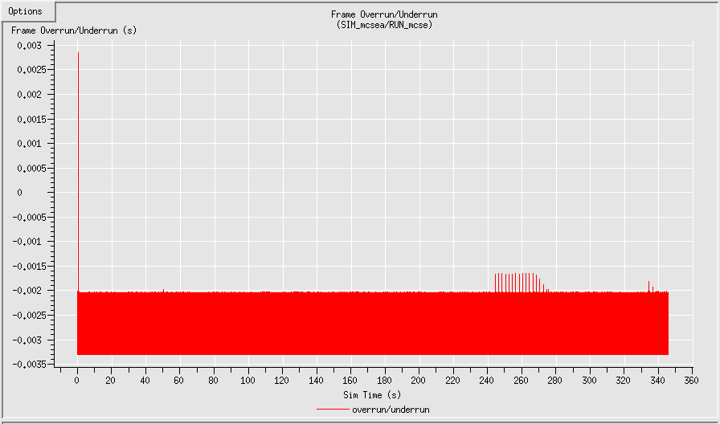
MRMDF Real-Time Performance
Selecting DP_rt_frame shows the overruns within the first second

Slide 112
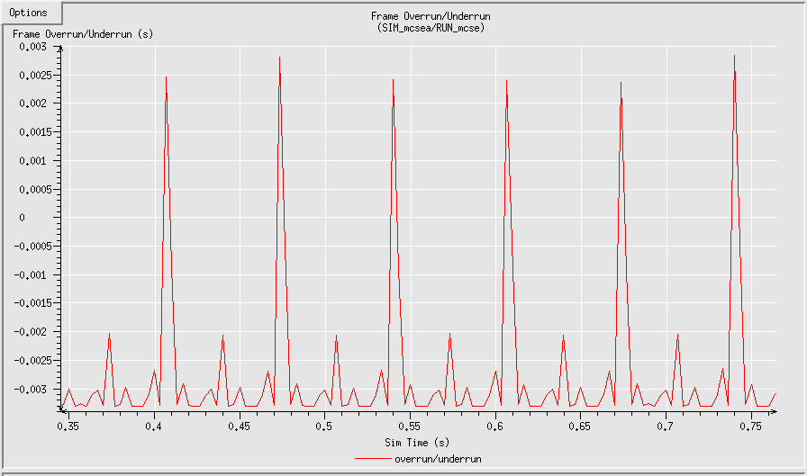
MRMDF Real-Time Performance
Close up of Frame Overrun/Underrun
About 2.5ms overruns, 5.8ms (2.5+3.33) total run time for these frames

Slide 113
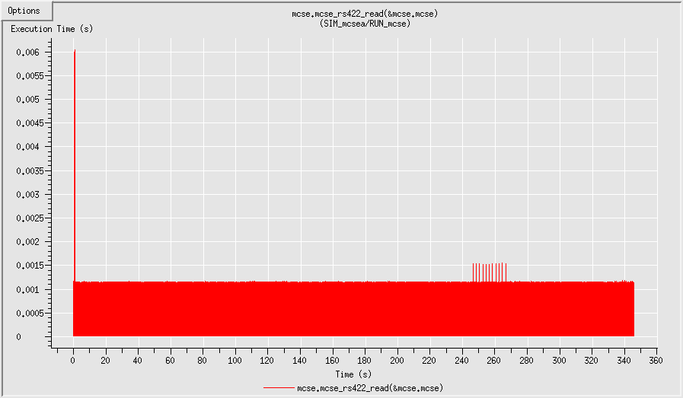
MRMDF Real-Time Performance
Looking at DP_rt_jobs at mcse_rs422_read we see the same spike

Slide 114
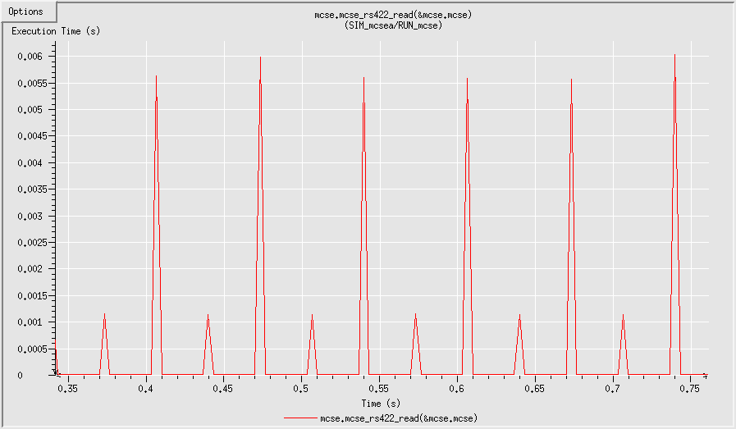
MRMDF Real-Time Performance
Close up of mcse_rs422_read
About 5.7ms running time for the overrun frames

Slide 115
MRMDF Real-Time Performance
In this case, it is known that in the first second, there are large initialization packets passed which can cause the job to take a couple of extra milliseconds to complete.

Slide 116
MRMDF Real-Time Lessons Learned
All inter-simulation communications should be non-blocking or have a time out limit.
Trick provides both non blocking sockets or ones with timed blocking
All simulations that include X-Windows GUIs should run on multi-CPU machines.
Simulation and X-event loop should be separated into 2 threads
Simulation should run on processor by itself
X-Windows event loop should be assigned to different processor
Good to run non-specialized hardware/software configurations

Slide 117
Monte Carlo

Slide 118
Overview
What is Monte Carlo?
A technique to solve mathematical problems by using random numbers and probability statistics.
For Trick – Run the simulation repeatedly varying values of user-chosen variables

Slide 119
Overview
First, we look at a spring mass damper system simulation (SIM_spring, which has now been copied as SIM_spring_mc) and allow Trick to perform Monte Carlo for two specific examples
Hard-coded input
Distribution formula to generate input
Second, we will look at how to use Monte Carlo jobs.
In Chapter 11 of the Trick Tutorial, it was shown how to use Trick to vary jet firing sequences for the cannon jet control problem, both using ‘hard-coded’ inline data and Gaussian randomly generated data.
We will modify the simulation to determine the jet firing sequence to hit a target.

Slide 120
Monte Carlo Input Variables
The following classes are used to specify which input variables are available for changing from run to run.
MonteVarFile
Pulls values from an input file.
MonteVarRandom
Auto-generate the input values using a distribution formula
Gaussian
Poisson
Flat
MonteVarFixed
Specifies a constant value
MonteVarCalculated
Calculates the values in user-created jobs.

Slide 121
Monte Carlo Input Variables (inline)
Go to the following directory
% cd $HOME/trick_sims/SIM_spring_mc/RUN_test.inline
Open the input.py file
% [vi|nedit|kate] input.py
var0 = trick.MonteVarFile(“smd.spring.input.damping”, “M_spring_inline”, 1)
trick_sys.sched.add_variable(var0)

Slide 122
Monte Carlo Input Variable (inline)
Let’s view the input file
% cd ..
% [vi|nedit|kate] M_spring_inline
0.0000 3 3.4
2.0000 4 3.5
4.0000 5 3.6
8.0000 6 3.7
16.0000 7 3.8
32.0000 8 3.9
64.0000 9 4.0
128.0000 10 4.1
256.0000 11 4.2
512.0000 12 4.3

Slide 123
Example 2 – Varying M, K, C (Gaussian)
Now let’s view the gaussian input file
% [vi|nedit|kate] RUN_test.gauss/input.py
var2 = trick.MonteVarRandom("smd.spring.input.damping", trick.MonteVarRandom.GAUSSIAN)
var2.set_seed(3)
var2.set_sigma(0.6862)
var2.set_mu(8.0)
var2.set_min(-4.0)
var2.set_min_is_relative(1)
var2.set_max(48.0)
var2.set_max_is_relative(1)
trick_sys.sched.add_variable(var2)
Here we use syntax to set up a Gaussian distribution of mass, stiffness, and damping (notice seed (initializes random number generator), sigma (std dev), mu (mean), rel_min and rel_max)
For this example, Trick randomly generates the run data through an interface to the GNU Scientific Library (trick_gsl_rand.c)

Slide 124
Monte Carlo Execution
To execute either of these examples, two variables must be set in the input file:
trick.mc_set_enabled(1)
trick.mc_set_num_runs(50)
CP the simulation
% CP
Run the sim for the first example:
% S_main_* RUN_monte.inline/input.py
Notice the new RUN_MONTE_monte.inline directory which contains the output data (can visualize multiple curves through trick_dp)

Slide 125
Monte Carlo Execution
Now run the sim for the second example:
% S_main_* RUN_monte.gauss/input
Notice the new RUN_MONTE_monte.gauss directory which contains the output data (again, multiple curves can then be visualized through trick_dp)

Slide 126
Monte Carlo Slaves
Previous examples used only a single worker
Trick’s Monte Carlo capability optimized for multiple workers
Monte Slave
Monte Slave
Monte Slave
Monte Slave
Monte Master
Monte Slave
Monte Slave
Monte Slave
Monte Slave

Slide 127
Monte Carlo Slaves
To add slaves,
Unlimited number of slaves can be specified
Trick will automatically start each slave simulation with ssh
Slaves ask the master for work when they are ready for work
Faster slave machines will do more work
You can start multiple slaves on the same machine
Useful for machines with multiple processors
slave0 = trick.MonteSlave(“localhost”)
trick_sys.sched.add_slave(slave0)
slave1 = trick.MonteSlave(“WonderWoman”)
trick_sys.sched.add_slave(slave1)
slave2 = trick.MonteSlave(“CatWoman”)
trick_sys.sched.add_slave(slave2)

Slide 128
Job Classes
Monte Carlo specific job classes to handle master/slave interations
Monte_Master_Init
Runs when master sim is initialized
Monte_Master_Pre
Runs before new data is dispatched to slave sim
Useful for calculating/optimizing next run values if desired
Monte_Master_Post
Runs after result is returned from slave
Useful for calculating statistics for returning results
Monte_Master_Shutdown
Runs when master shuts down
Monte_Slave_Init
Runs when slave sim is initialized
Monte_Slave_Pre
Runs after new data is received from master
Monte_Slave_Post
Runs after slave sim is completed (sends result to master)
Monte_Slave_Shutdown
Runs when monte carlo master comm is lost and slave shuts down

Slide 129
Monte Carlo Master/Slave Interaction
Monte Master
Start
Monte Slaves
Start
monte_master_init
class jobs
Run monte_slave_init class jobs
Start Slaves
monte_master_shutdown
Class jobs
and exit
Request work
All results returned
monte_slave_shutdown
Class jobs
and exit
Y
Any work
N
N
Any requests
Y
Y
Fork child
monte_master_pre
class jobs and
Send init data to slave
Python parse input data from master
N
Run monte_slave_pre
class jobs
N
Any Results
Y
Execute run,
monte_slave_post,
Send results
Collect results and run
Monte_master_post
Class jobs
Fork’d child
Shuts down

Slide 130
Monte Slaves
The master sets a timeout value
Default timeout is 120 seconds
User may change the value in the input file with the following function: trick.mc_set_timeout(double)
Each slave must return a result within its individually timed timeout period
If no result is returned, the slave is assumed dead and the run’s initial data is re-dispatched to the next available slave
Slaves can be “killed” and no results will be lost

Slide 131
Cannon Ball in Target Example
This is the cannonball simulation example used in the tutorial with to demonstrate Monte Carlo.
Create a monte_master_post job and a monte_slave_post job.
The monte_master_post job will read the CANNON struct information from the slave. Check if the cannon landed in the target area. Shutdown if it did, otherwise continue.
The monte_slave_post job will write the CANNON struct information to the master.

Slide 132
Cannon Ball in Target Example
% cd $HOME/trick_models/cannon
% mkdir –p monte/src
% mkdir –p monte/include
% cd monte/src
%[vi|nedit|kate] cannon_slave_post.c
/************************** TRICK HEADER ********************
PURPOSE: (Kaboom!!!)
*************************************************************/
#include "cannon/aero/include/cannon_aero.h"
#include "sim_services/MonteCarlo/include/montecarlo_c_intf.h"
int cannon_slave_post(CANNON_AERO* C)
{
mc_write((char*) C, sizeof(CANNON_AERO) );
return(0) ;
}

Slide 133
Cannon Ball in Target Example
%[vi|nedit|kate] cannon_master_post.c
/************************** TRICK HEADER ********************
PURPOSE: (Kaboom!!!)
*************************************************************/
#include "cannon/aero/include/cannon_aero.h"
#include "sim_services/MonteCarlo/include/montecarlo_c_intf.h“
int cannon_master_post()
{
CANNON_AERO C_curr ;
mc_read((char*) &C_curr, sizeof(CANNON_AERO) ) ;
if ((C_curr.pos[0] > 152) & (C_curr.pos[0] < 153)) {
exec_terminate(“cannon_master_post”,
“Cannon landed in the target!”);
}
return(0) ;
}

Slide 134
Cannon Ball in Target Example
% cd ../include
% [vi|nedit|kate] cannon_monte_proto.h
/************************** TRICK HEADER ********************
PURPOSE: (Kaboom!!!)
*************************************************************/
#ifndef _cannon_monte_proto_h_
#define _cannon_monte_proto_h_
#include "cannon/aero/include/cannon_aero.h"
#ifdef __cplusplus
extern "C" {
#endif
int cannon_master_post();
int cannon_slave_post(CANNON_AERO*);
#ifdef __cplusplus
}
#endif
#endif

Slide 135
Modify S_define
% cd $HOME/trick_sims/SIM_monte
% [vi|nedit|kate] S_define
Add the two new jobs to LIBRARY DEPENDENCIES
(cannon/monte/src/cannon_master_post.c)
(cannon/monte/src/cannon_slave_post.c)
Add the new prototype header file at the end of the ##include list
##include “cannon/monte/include/cannon_monte_protot.h”

Slide 136
Modify S_define
.
.
class MonteSimObject : public Trick::SimObject {
public:
CANNON_AERO *cannon_ptr;
MonteSimObject() {
("monte_master_post") cannon_master_post();
("monte_slave_post") cannon_slave_post(cannon_ptr);
}
};
MonteSimObject optimizer;
void create_connections() {
optimizer.cannon_ptr = &dyn.baseball;
}

Slide 137
CP and Run Simulation
Compile and Execute the simulation
% CP
% S_*exe RUN_test.gauss/input.py
.
.
|L 1|2011/08/08,10:09:09|WonderWoman| |T 0|0.00| Monte [Master] Receiving results for run 8 from WonderWoman:1.
|L 1|2011/08/08,10:09:09|WonderWoman| |T 0|0.00| Monte [Master] Dispatching run 9 to WonderWoman:1.
|L 1|2011/08/08,10:09:09|WonderWoman| |T 0|0.00| SIMULATION TERMINATED IN
|L 1|2011/08/08,10:09:09|WonderWoman| |T 0|0.00| PROCESS: 0
|L 1|2011/08/08,10:09:09|WonderWoman| |T 0|0.00| ROUTINE: cannon_master_post
|L 1|2011/08/08,10:09:09|WonderWoman| |T 0|0.00| DIAGNOSTIC: Cannon landed in the target
|L 1|2011/08/08,10:09:09|WonderWoman| |T 0|0.00| Monte [WonderWoman:1] : Shutdown command received from Master.
Shutting down.

Slide 138
Monte Carlo Notes
A dry run flag is available: trick.mc_set_dry_run(int)
Useful for generating random distributions without actually doing the runs
See monte_runs file in the MONTE_<run _directory> directory
It is also possible to run a subset of runs by using
trick.mc_add_range(<run num>)
trick.mc_add_range(<first run num>, <last run num>)
All data recording for all runs is saved.
Large data sets can generate enormous amounts of data.
Take care on what to data record

Slide 139
Monte Carlo Notes
A monte_input file is created in each RUN_* directory
Allows a user to execute a single monte carlo run by simply including the file in the input.py file.
Almost too easy to add slaves
Tendency to add machines which seem unused
Monte Carlo slaves tend to use 99.9% of CPU
Don’t use too many machines in your lab!

Slide 140
Generic Malfunction Insertion

Slide 141
Generic Malfunction Insertion
The Generic Malfunction Insertion capability allows users to override the value of any simulation variable or call a malfunction job at any time during the simulation
Two new job classes
malfunction
malfunction_trigger
Neither new class has a calling frequency
Associated with jobs within the S_define file within the malfunction definition in the input file
Called whenever associated jobs are called

Slide 142
Malfunction Syntax
Input file malfunction syntax
begin malfunction <malf_name> {
trigger {
condition: <condition> ;
or
job: “<malf_trigger name from S_default.dat>” ;
insert_(before|after): “<job from S_default.dat>” ;
hold: (Yes|No) ;
}
<param> {
insert_(before|after): “<job from S_default.dat>” ;
units: <units>
scale_factor: <value> ;
bias: <value> ;
}
call “<malf job from S_default>” (before|after) “<job from S_default>” ;
job “<job from S_default>” = (On|Off) ;
}

Slide 143
Triggers
Triggers can be either a condition statement or a call to a new class of “malfunction_trigger” class job.
malfunction_trigger jobs are faster to execute but must be compiled and declared in the S_define file
Condition statements are easily modified but suffer a performance penalty when they are parsed each time the condition is evaluated
Triggers can be associated with any job in the simulation
Triggers are evaluated each time the associated job is run
Triggers may be evaluated before or after its associated job
Triggers can be held, meaning once triggered the malfunction is always on from that point on

Slide 144
Trigger Examples
Trigger Examples
trigger {
condition: <condition> ;
or
job: “<malf_trigger name from S_default.dat>” ;
insert_(before|after): “<job from S_default.dat>” ;
hold: (Yes|No) ;
}
trigger {
condition: sys.exec.out.time >= 30.0 ;
insert_before: “dyn.cannon_integ(&dyn.cannon)” ;
hold: Yes ;
}
trigger {
job: “dyn.cannon_malfunction_trigger(&dyn.cannon)” ;
insert_after: “dyn.cannon_integ(&dyn.cannon)” ;
hold: No ;
}

Slide 145
Malfunction Syntax
Parameter example
<param> {
insert_(before|after): “<job from S_default.dat>” ;
units: <units>
scale_factor: <value> ;
bias: <value> ;
}
dyn.cannon.vel[0] {
insert_after: “dyn.cannon_integ(&dyn.cannon)” ;
units: “m/s”
scale_factor: 0.0 ;
bias: 1.0 ;
}

Slide 146
Malfunction Syntax
Calling a malfunction job
Turning jobs on/off
call “<malf job from S_default>” (before|after) “<job from S_default>” ;
call “dyn.cannon_malf(&dyn.cannon)” after “dyn.cannon_integ(&dyn.cannon)”;
job “<malf job from S_default>” = (On|Off) ;
job “dyn.cannon_abort(&dyn.cannon) = On ;

Slide 147
Malfunction Syntax
Manually turn malfunctions on/off within the input processor or commanded from a variable server client
Remove manual override and return to evaluating triggers
malfunction_cmd my_malf manual_on ;
malfunction_cmd my_malf manual_off ;
malfunction_cmd my_malf remove_manual ;

Slide 148
Units Upgrade

Slide 149
Units upgrades
Larger set units accepted in 07
Many SI prefixes accepted for metric units
Exception is kft
Meters is now “m”
“M” still accepted for meters for backwards compatibility
Multiplier operators are strongly encouraged to avoid ambiguities
e.g. Is “mm” millimeters or meters*meters?

Slide 150
ICG –u output
Trick Measurement Units Summary
-------------------------------
Time: s min hr day
Angular Displacement: r d as am rev
Voltage: v
Amperage: amp
Resistance: ohm
Sound: dB
Unitless: -- cnt one
English System Units
--------------------
Linear Displacement: ft in yd mi n.m.
Mass: sl lbm
Force: oz lbf
Temperature: R F
Metric System Units
-------------------
Linear Displacement: m
Mass: g mt
Force: N
Temperature: C K
Prefixes for Multiples and Submultiples
(Not valid for English system units)
---------------------------------------
10**-1 d 10 da
10**-2 c 10**2 h
10**-3 m 10**3 k
10**-6 u 10**6 M
10**-9 n 10**9 G
10**-12 p 10**12 T

Slide 151
Wide Character (Unicode) Support

Slide 152
Wide Character Support
For Internationalization (and/or many other Unicode characters ) :
Trick 07 supports type wchar_t .
Fully supported by Checkpoint / Reload.

Slide 153
Wide Character Support
Pre-requisite: Setup your Locale
A locale specifies the national / cultural / language conventions that you would like your (locale aware apps) to follow.
setenv LC_CTYPE en_US.utf8 ← Specifies character encoding.
setenv LC_COLLATE POSIX ← Specifies string sorting order.
LC_CTYPE is required by Trick and must specify a UTF-8 locale (at least while the input processor is running).
There are additional locale environment variables. It’s not required that you set them all. For more information: % man locale

Slide 154
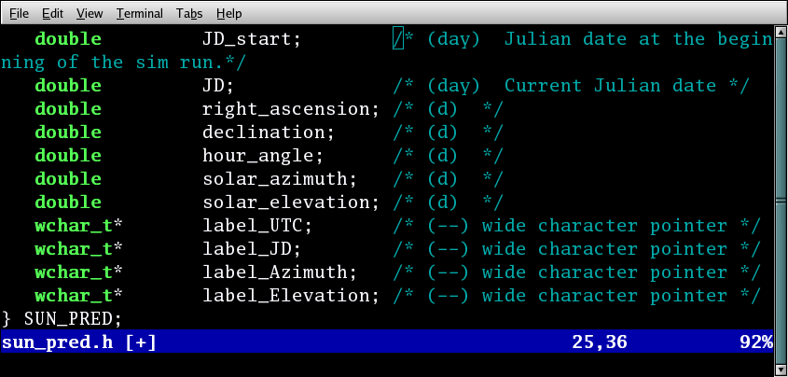
Wide Character Support
Wide-character strings in a structure definition.

Slide 155
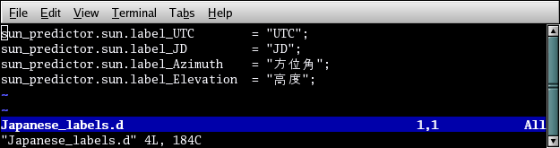
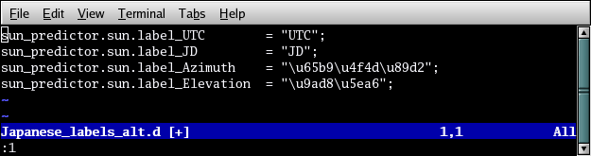
Wide Character Support
A .d file to initialize the wide-strings.
An alternate .d file which does exactly the same thing.
If you can’t remember how to enter the Unicode character in your editor.

Slide 156
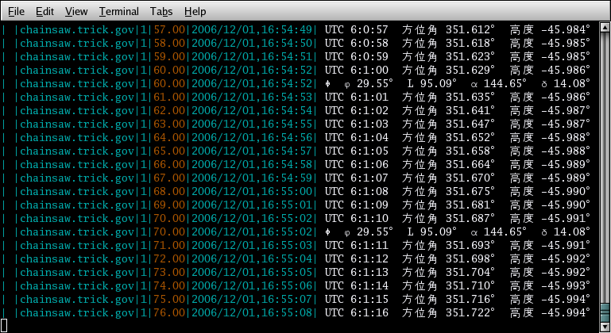
Wide Character Support
Terminal Output

Slide 157
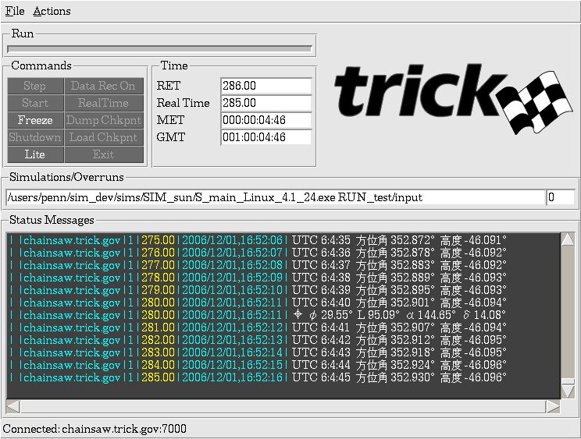
Wide Character Support
Sim Control Panel Output

Slide 158
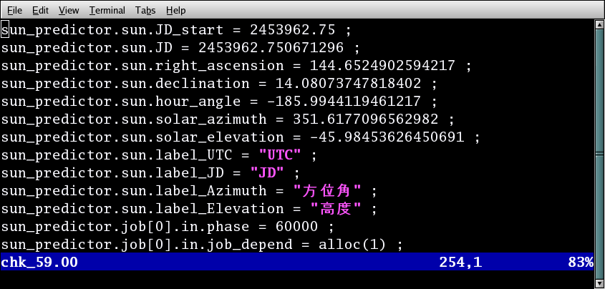
Wide Character Support
Wide character strings in a checkpoint file

Slide 159
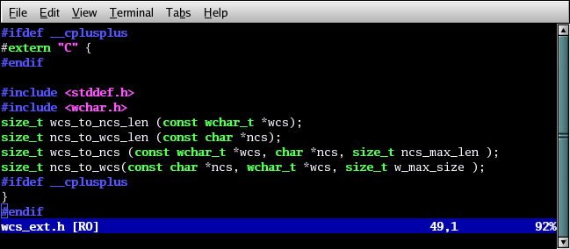
Wide Character Support
Convenience routines to convert to and from Wide-character to Narrow-character strings.

Slide 160
Additional Material

Slide 161
External Clocks and Timers

Slide 162
Clocks & Itimers
A Trick simulation can be configured with interval timers (or itimers) that use setitimer(), pause() and a signal handler to manage a “go to sleep” and “wake up” at the end of each configured itimer frame
Itimers are suited to facilitate processor sharing
This itimer frame can be larger than the RT frame, but it must be a multiple of it
Since UNIX signals (SIGALRM) are used, this feature increases executive overhead, and itimer frames smaller than 10 milliseconds are not recommended
By default, during an overrun the Trick executive logs the over run and keeps going to try to catch up to real-time.
Sim can be configured to terminate or freeze when a maximum number of over runs in a row occur, or when a single over run surpasses a specified time limit

Slide 163
Executive Clock Calls
executive clock calls
double clock_time (GMT_STRUCT*)
This function returns the simulation's current real-time clock value in total seconds from the simulations reference time mark
void clock_reset (double ref)
This function resets the simulation clock reference mark by subtracting the passed reference time (total seconds) from the current time returned by a clock_time() call.
These function also works with external clocks.

Slide 164
External Clocks/Timers
Trick supports the use of external clocks
To configure an external clock:
Input file: sys.exec.in.rt_clock = EXTERNAL ;
In an initialization job, set function pointers to user defined functions for external clock initialization and time acquisition:
sys.exec.in.trick_external_clock_init
Make necessary systems calls to initialize external clock device and load the passed argument with total seconds (gmt->y_secs), which will be used by the executive for a clock reference point. This function is of type void and the single passed argument is a pointer of type GMT_STRUCT.
void trick_external_clock_init (GMT_STRUCT * gmt)
sys.exec.in.trick_external_clock_time
Make necessary external clock calls to load the passed argument with the current time in total seconds (gmt->y_secs), which will be used by the executive for the elapsed clock time calculation (current time minus the reference point established in trick_external_clock_init()). This function is of type void and the single passed argument is a pointer of type GMT_STRUCT.
void trick_external_clock_time (GMT_STRUCT * gmt)

Slide 165
External Clocks/Timers
Trick also supports the use of external timers
To configure an external timer:
Input file: sys.exec.in.rt_exttimer = On ;
In an initialization job, set function pointers to user defined functions for external timer start, reset, stop & pause:
sys.exec.in.trick_external_timer_start
This function should make necessary systems calls to start the user defined external interval timer. The Trick executive will call this user provided function one time in initialization at the beginning of the real-time frame. The interval frame time must be defined in the Trick sys.exec.in.rt_itimer_frame variable. Trick itimers can not be used in conjunction with external timers. The trick_external_timer can be set up as a one-time timer with the next interval being reset at the end of each frame with the external function trick_external_timer_reset(), or it could be set up with reoccurring intervals without using the reset function. The function trick_external_timer_pause() will be defined by the user to wait for the timer. This function is of type void and the single passed argument is a pointer of type void. This same voided pointer argument is passed to all of the external timer routines.
void trick_external_timer_start (void *)

Slide 166
External Clocks/Timers
sys.exec.in.trick_external_timer_reset
This function should make necessary systems calls to reset the user defined external interval timer (started by trick_external_timer_start()). The Trick executive will call this user provided function to set the next timing interval after real-time has caught up in the under run condition. If the sim is in an overrun condition, this function will not be called called, but the external_timer_stop function will be called. The interval frame time must be defined in the Trick sys.exec.in.rt_itimer_frame variable. Trick itimers can not be used in conjunction with external timers. The function trick_external_timer_pause() will be defined by the user to wait for the timer. This function is of type void and the single passed argument is a pointer of type void. This same voided pointer argument is passed to all of the external timer routines.
void trick_external_timer_reset (void *)
sys.exec.in.trick_external_timer_stop
This function should make necessary systems calls to allow the external timers to recover from an overrun condition. The Trick executive will call this user provided function at the end of the simulation real-time frame when an overrun occurs. This function is of type void and the single passed argument is a pointer of type void. This same voided pointer argument is passed to all of the external timer routines.
void trick_external_timer_stop (void *)

Slide 167
External Clocks/Timers
sys.exec.in.trick_external_timer_pause
This function should make the necessary systems calls to wait for the user defined external interval timer (defined by trick_external_timer_start() and/or trick_external_timer_reset()). The Trick executive will call trick_external_timer_pause() at the end of each simulation itimer frame (defined by sys.exec.in.rt_itimer_frame) to wait for the real-time clock to catch up. When Trick is set up to use itimers, it simply uses the UNIX pause() to wait for the SIGALRM. If external timers are used, trick_external_timer_pause() is called in place of pause, which is used for Trick itimers. This wait can be implemented by what ever means are available to detect the timer from the timer device drivers. Again, external timers can not be used in conjunction with Trick itimers. This function is of type void and the single passed argument is a pointer of type void. This same voided pointer argument is passed to all of the external timer routines.
void trick_external_timer_pause (void *)

Slide 168
External Clocks/Timers
Example of initialization job setting up external clock/timer functions in SIM_master_timer/RUN_master
Let's look at the src file init_ext_clock_timers.c
View file with editor in trick_ui or terminal
Also, view S_define with trick_ui or terminal
See addition of init_ext_clock_timers() initialization job call
CP SIM_master_timer
Correct any errors
(initialization) extclocktimer: init_ext_clock_timers();

Slide 169
External Clocks/Timers
Example of initialization job setting up external clock/timer functions in SIM_master_timer/RUN_master
Add to input file
No changes necessary in slaved simulation
It will just keep syncing to master through sockets
Run SIM_master_timer /RUN_master to test external clock and external timer capability
sys.exec.in.rt_clock = EXTERNAL ;
sys.exec.in.rt_exttimer = On ;
note that itimer frame that is required is already set to 0.05 in Modified_data/realtime.d
sys.exec.in.rt_itimer = Off ;
external timers and itimers conflict with each other

Slide 170
External Libraries and the Trick Math Library

Slide 171
Set up the Environment
Objective
Setup Trick Environment
Prerequisites
Login credentials

Slide 172
Adding External Libraries
There may be situations where we want Trick just to include a pre-built library or include an entire directory with one library dependency. To accomplish that, Trick has multiple ways of including external libraries
Libraries that do not need to be compiled
Preferred: Add the library to the environment variable TRICK_USER_LINK_LIBS
Non-preferred: Add the library to the LIBRARY_DEPENDENCY list of a module included in the simulation
setenv TRICK_USER_LINK_LIBS = -L/path/to/my/lib –lmy_lib
/* TRICK_HEADER
PURPOSE: (no purpose)
LIBRARY_DEPENDENCIES: ((lib_to_include.a))
*/

Slide 173
Adding External Libraries
Libraries that do need to be compiled
Preferred: Include a file called S_overrides.mk in your sim directory that adds a dependency to your library, compiles it and includes it for linking
Great flexibility using this method, allows custom makefiles in library directories
# S_overrides.mk
TRICK_USER_LINK_LIBS += -L${HOME}/trick_models/ball/L1/object_${TRICK_HOST_CPU} -lball
${S_MAIN}: ${HOME}/trick_models/ball/L1/object_${TRICK_HOST_CPU}/libball.a
clean: clean_build_ball
${HOME}/trick_models/ball/L1/Makefile:
cd ${HOME}/trick_models/ball/L1 ; make_build lib libball.a
${HOME}/trick_models/ball/L1/object_${TRICK_HOST_CPU}/libball.a: ${HOME}/trick_models/ball/L1/Makefile
cd ${HOME}/trick_models/ball/L1 ; ${MAKE}
clean_build_ball:
cd ${HOME}/trick_models/ball/L1 ; ${MAKE} clean

Slide 174
Adding External Libraries
Libraries that do need to be compiled
Non-preferred: Add the library to the LIBRARY_DEPENDENCY list of a module included in the simulation. Include a “relative” path to the library so Trick can find it.
Trick will gather all source files in the library path and compile them to the lib name specified in the LIBRARY_DEPENDENCY
All source code in the directory must compile with standard TRICK_CFLAGS
/* TRICK_HEADER
PURPOSE: (no purpose)
LIBRARY_DEPENDENCIES: ((rel/path/to/lib/lib_to_include.a))
*/

Slide 175
Trick Math Library
The Trick mathematical support library provides numerous built-in utility functions for a variety of modeling tasks
This library can be found in the following directory:
$TRICK_HOME/trick_source/trick_utils/math/src

Slide 176
Trick Math Library (cont.)
List contents of the math library
% ls $TRICK_HOME/trick_source/trick_utils/math/src
deuler_123.c dmtxmt.c dvxm.c matxmat.c
deuler_132.c dmtxv.c dvxv_add.c matxtrans.c
deuler_213.c dmxm.c dvxv_sub.c matxvec.c
deuler_231.c dmxmt.c eigen_hh_red.c quat_mult.c
deuler_312.c dmxv.c eigen_jacobi_4.c quat_norm.c
deuler_321.c drandom_gaussian.c eigen_jacobi.c quat_norm_integ.c
dLU_Choleski.c dS_function.c eigen_ql.c quat_to_mat.c
dLU_solver.c dsingle_axis_rot.c euler_matrix.c rand_num.c
dm_add.c dv_add.c gauss_rnd_bell.c roundoff.c
dm_copy.c dv_copy.c gauss_rnd_pseudo.c tm_print_error.c
dm_ident.c dv_cross.c LU_bksb.c transxmat.c
dm_init.c dv_dot.c LU_dcmp.c transxtrans.c
dm_invert.c dv_init.c LUD_inv.c transxvec.c
dm_invert_symm.c dv_mag.c LUT_inv.c trick_gsl_rand.c
dm_orthonormal.c dv_norm.c makefile trns_fnct_1o.c
dm_print.c dv_print.c mat_copy.c trns_fnct_2o.c
dm_scale.c dv_scale.c mat_permute.c uniform_rnd_1.c
dm_sub.c dv_skew.c mat_print.c uniform_rnd_triple.c
dm_trans.c dv_store.c mat_to_quat.c vec_print.c
dmtxm.c dv_sub.c mat_trans.c wave_form.c

Slide 177
Trick Math Library Summary
Vector/Matrix algebra (3x3) – dv_*.c, dvx*.c, dm*.c and dmt*.c
Matrix algebra (nxn) – mat_*.c, matx*.c and transx*.c
Linear equation solvers - dLU*.c, dm_invert*.c, and LU*.c
Euler transformations – euler_matrix.c, deuler_*.c, and dsingle_axis_rot.c
Quaternion transformations – quat_*.c
Eigensolvers - eigen_*.c
Random number generation – drandom_gaussian.c, gauss*.c, rand*.c, trick_gsl_rand.c, and uniform*.c
Other odds and ends functions (e.g., wave form generator)

Slide 178
Trick Math Library Summary (cont.)
Access to the Trick math library can be achieved by adding the following prototype definition to the your source code:
#include “trick_utils/math/include/trick_math_proto.h”
Several other library type routines exist throughout the suite of Trick-based sim packages (e.g., robotics, GN&C, mechanisms) and are planned to be folded back into this library for upcoming Trick releases
Additional capabilities/requests are always welcome!

Slide 179
Trick Math Headers
Perhaps as important as the individual math subroutines is the functionality provided through the Trick math header files
Macros were originally created to provide execution speed over their subroutine counterparts (using the C preprocessor for inline code expansion)
% ls -1 $TRICK_HOME/trick_source/trick_utils/math/include
complex.h
matrix_macros.h
quat_macros.h
rand_generator.d
rand_generator.h
reference_frame.h
trick_math_error.h
trick_math.h
trick_math_proto.h
vector_macros.h
wave_form.h

Slide 180
Trick Math Headers (cont.)
In addition to early speed benefits, many Trick math models were implemented through macros to make code more readable as well as provide easy mapping back to formulation/equations (e.g., refer to the matrix_macros and vector_macros headers)
Euler and Quaternion transformations rely on both the reference_frame.h and quat_macros.h header files, respectively
Access to the Trick math headers can be achieved by adding the following to your source code:
#include "trick_utils/math/include/trick_math.h”

