Slide 1
Trick 13 Simulation Environment: Tutorial Review
Hong Chen (L-3Com/ER7)
Alex Lin (NASA/ER7)
John Penn (L-3Com/ER7)
Danny Strauss(L-3Com/ER7)
Notes:
1

Slide 2
Tutorial Review Agenda
Setting up the Environment
Introduction to the cannon ball (Trick-less)
Build a Trick cannon ball simulation
Run cannon ball simulation in real-time
Simulation Architecture (S_define syntax)
Input Processor (Python)
Viewing data with trick_dp

Slide 3
Setting up the Environment

Slide 4
Set up the Environment
Objective
Setup Trick Environment
Prerequisites
Login credentials
Trick Training CD login automatic

Slide 5
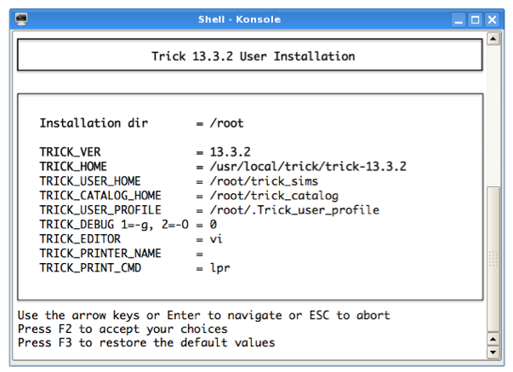
Set up the Environment
% cd $HOME
% install_user
Set TRICK_EDITOR to editor of choice (e.g. vim, emacs, nedit, etc.)
Follow the on-screen instructions

Slide 6
Set up the Environment
csh/tcsh
% vi .cshrc
source $HOME/.Trick_cshrc_13.##.#
(Where ##.# is the Trick version number)
% vi .Trick_user_cshrc
setenv TRICK_CFLAGS "$TRICK_CFLAGS –Wall –g" optional
setenv TRICK_CFLAGS "$TRICK_CFLAGS -I$HOME/trick_models"
% source .cshrc
bash
% vi .profile
. $HOME/.Trick_profile_13.##.#
% vi .Trick_user_profile
TRICK_CFLAGS="$TRICK_CFLAGS -Wall -g" optional
TRICK_CFLAGS="$TRICK_CFLAGS -I$HOME/trick_models"
export TRICK_CFLAGS
% . .profile

Slide 7
Trick Environment
Running "gte" will give you a list of Trick environment variables
% gte
TRICK_CATALOG_HOME=/root/trick_catalog
TRICK_CAT_MGR_HOME=/usr/local/trick/trick-13.3.2/catalog
TRICK_CC=cc
TRICK_CFLAGS= -Wall -g -I/root/trick_models
TRICK_CONVERT_SWIG_FLAGS=
TRICK_CPPC=c++
TRICK_CXXFLAGS=
TRICK_DEBUG=0
TRICK_EDITOR=vi
TRICK_EXEC_LINK_LIBS=
TRICK_FORCE_32BIT=0
TRICK_GTE_EXT=
TRICK_HOME=/usr/local/trick/trick-13.3.2
TRICK_HOST_CPU=Linux_4.7
TRICK_HOST_CPU_USER_SUFFIX=
TRICK_HOST_TYPE=Linux
TRICK_ICG_EXCLUDE=
TRICK_ICG_NOCOMMENT=
TRICK_LDFLAGS=
TRICK_MAKE=
TRICK_PATH=/usr/local/trick/trick-13.3.2/bin_Linux_4.7:/usr/local/trick/trick-13.3.2/bin
TRICK_PRINTER_NAME=
TRICK_PRINT_CMD=lpr
TRICK_SFLAGS=
TRICK_SWIG_EXCLUDE=
TRICK_USER_CSHRC=/root/.Trick_user_cshrc
TRICK_USER_HOME=/root/trick_sims
TRICK_USER_LINK_LIBS=
TRICK_USER_PROFILE=/root/.Trick_user_profile
TRICK_VER=13.3.2
XML_CATALOG_FILES=/usr/local/trick/trick-13.3.2/trick_source/data_products/DPX/XML/catalog.xml

Slide 8
Introduction to the cannon ball

Slide 9
Trickless Cannonball
Objective :
Show a standalone C program to simulate a cannon ball
Notes:
9

Slide 10
Cannonball Problem Statement
A cannonball at initial position (0,0) is shot at initial velocity (v₀) and initial angle (θ). How far does the cannonball travel?
The analytical solution:
Horizontal
Vertical
Initial position
p_{x0} = 0
p_{y0} = 0
Initial velocity
v_{x0} = v₀cos(θ)
v_{y0} = v₀sin(θ)
Acceleration
a_{x} = 0
a_{y} = -9.81
Velocity
v_{x} = v_{x0} + a_{x}t
v_{y} = v_{y0} + a_{y}t
Position
p_{x} = p_{x0} + v_{x0}t + ½a_{x}t²
p_{y} = p_{y0} + v_{y0}t + ½a_{y}t²

Slide 11
Trickless Cannonball – Sample Problem
Example: cannon_ball.c
Standalone C program to simulate a cannon ball.
Program’s components:
Declarations
Default Data
Initialization
Executive
Shutdown
Notes:
11

Slide 12
Trickless Cannonball - Declarations
Declarations
#include <stdio.h>
#include <math.h>
int main() {
/* Declare variables used in simulation */
double pos[2]; /* p_{x} and p_{y} */
double pos_orig[2] ; /* p_{x0} and p_{y0} */
double vel[2]; /* v_{x} and v_{y} */
double vel_orig[2] ; /* v_{x0} and v_{y0} */
double acc[2]; /* a_{x} and a_{y} */
double init_angle ; /* θ */
double init_speed ; /* v₀ */
double time ;
Notes:
12

Slide 13
Trickless Cannonball – Default Data
Default Data
/* Initialize data */
acc[0] = 0.0 ;
acc[1] = -9.81 ;
time = 0.0 ;
init_angle = M_PI/6.0 ;
init_speed = 50.0 ;
Notes:
13

Slide 14
Trickless Cannonball - Initialization
Initialization
/* Do initial calculations */
pos_orig[0] = 0 ;
pos_orig[1] = 0 ;
vel_orig[0] = cos(init_angle)*init_speed ;
vel_orig[1] = sin(init_angle)*init_speed ;
Notes:
14

Slide 15
Trickless Cannonball - Executive
Executive
/* Run simulation */
while ( pos[1] >= 0.0 ) {
acc[0] = 0.0 ;
acc[1] = -9.8 ;
vel[0] = vel_orig[0] + acc[0]*time ;
vel[1] = vel_orig[1] + acc[1]*time ;
pos[0] = pos_orig[0] + vel_orig[0]*time +
(0.5)*acc[0]*time*time ;
pos[1] = pos_orig[1] + vel_orig[1]*time +
(0.5)*acc[1]*time*time ;
time += 0.01 ;
}
Notes:
15

Slide 16
Trickless Cannonball - Shutdown
Shutdown
/* Shutdown simulation */
printf("Impact time=%lf position=%lf\n",
time, pos[0]);
return 0 ;
}
Notes:
16

Slide 17
Full Standalone Simulation Components
int main () {
double pos[2]; double pos_orig[2] ;
double vel[2]; double vel_orig[2] ;
double acc[2]; double init_angle ;
double init_speed ;
double time ;
acc[0] = 0.0 ;
acc[1] = -9.81 ;
time = 0.0 ;
init_angle = M_PI/6.0 ;
init_speed = 50.0 ;
pos_orig[0] = 0 ; pos_orig[1] = 0 ;
vel_orig[0] = cos(init_angle)*init_speed ;
vel_orig[1] = sin(init_angle)*init_speed ;
while ( pos[1] >= 0.0 ) {
acc[0] = 0.0 ; acc[1] = -9.8 ;
vel[0] = vel_orig[0] + acc[0]*time ;
vel[1] = vel_orig[1] + acc[1]*time ;
pos[0] = pos_orig[0] + vel_orig[0]*time +
(0.5)*acc[0]*time*time ;
pos[1] = pos_orig[1] + vel_orig[1]*time +
(0.5)*acc[1]*time*time ;
time += 0.01 ;
}
printf("Impact time=%lf position=%lf\n", time, pos[0]);
return 0 ;
}
Data Declarations
Default Data
Initialization
Executive
Shutdown
Notes:
17

Slide 18
Running the Trickless Cannonball
Results
% cc cannon_ball.c -lm
% ./a.out
Impact time=5.120000 position=221.269491

Slide 19
Trickless Cannonball - Shortcomings
There are some problems with the previous simulation
Not scalable or modular
No data recorded
No notion of real-time
Can't change initial state without recompiling
All variables are unitless
Position is a function of time (no state integration)
Cannonball impact inaccurate (impact event occurs between steps)
Notes:
19

Slide 20

Trickless Cannon – Generalized To Trick
int main () {
double pos[2]; double pos_orig[2] ;
double vel[2]; double vel_orig[2] ;
double acc[2]; double init_angle ;
double init_speed ;
double time ;
pos[0] = 0.0 ; pos[1] = 0.0 ;
vel[0] = 0.0 ; vel[1] = 0.0 ;
acc[0] = 0.0 ; acc[1] = -9.81 ;
time = 0.0 ;
init_angle = M_PI/6.0 ; init_speed = 50.0 ;
pos_orig[0] = pos[0] ; pos_orig[1] = pos[1] ;
vel_orig[0] = cos(init_angle)*init_speed ;
vel_orig[1] = sin(init_angle)*init_speed ;
while ( pos[1] >= 0.0 ) {
acc[0] = 0.0 ; acc[1] = -9.8 ;
vel[0] = vel_orig[0] + acc[0]*time ;
vel[1] = vel_orig[1] + acc[1]*time ;
pos[0] = pos_orig[0] + vel_orig[0]*time +
(0.5)*acc[0]*time*time ;
pos[1] = pos_orig[1] + vel_orig[1]*time +
(0.5)*acc[1]*time*time ;
time += 0.01 ;
}
printf("Impact t=%lf pos=%lf\n", time, pos[0]);
return 0 ;
}
Data declarations are in headers
Defaults for data are specified in routines classed as "default_data"
Initialization calculations occur in routines classed as "initialization"
Executive functioning is managed by Trick and configurable through input files. Run-time routines are called by Trick’s engine. And are ordered based on a user given class.
Shutdown routines are called by Trick’s executive after the main run-time loop.
Notes:
20

Slide 21
Build a Trick Cannon Ball Simulation

Slide 22
Build a Trick Simulation
Objective
Creating the directory system for cannon ball simulation
Build a "Trickified" cannon ball simulation
Putting the models together with the S_define
Creating a Run Input File
Adding Derivative and Integration Jobs
Prerequisites
Trick environment set up correctly
TRICK_CFLAGS must contain –I${HOME}/trick_models

Slide 23
TRICK_CFLAGS & TRICK_CXXFLAGS
IMPORTANT !!
TRICK_CFLAGS – C files are compiled with flags in this environment variable.
TRICK_CXXFLAGS – C++ files are compiled with flags in this environment
variable. If TRICK_CXXFLAGS is empty, TRICK_CFLAGS is used instead.
Both TRICK_CFLAGS and TRICK_CXXFLAGS should contain “-I” directives
that refer to your models-directory(s).

Slide 24
Simulation Code Organization
models
IMPORTANT:
$TRICK_CFLAGS and
$TRICK_CXXFLAGS should
refer to this directory
simulations
e.g. “trick_models”
e.g. “trick_sims”
simulation
model
simulation
Name must
begin with “SIM_”
e.g. “gravity”
e.g. “SIM_cannon”
src
include
RUN
S_define
RUN
Name must
begin with “RUN_”
e.g. “RUN_test”
.c,.cpp
.h,.hh
input.py
These files implement the
“job” functions that will be
called from the S_define file.
Notes:
24

Slide 25
Creating A Directory System for Cannon Ball Simulation
% cd $HOME
% mkdir -p trick_sims/SIM_cannon_example
% mkdir -p trick_models/example/gravity/src
% mkdir -p trick_models/example/gravity/include

Slide 26
Data Declaration - cannon.h
Declarations
Structures/Classes expected in header files (*.h)
Trick parses the header files keying on special comments
See section 3.4 of Trick tutorial for more information
/************************************************
PURPOSE: (Cannonball Structure)
************************************************/
#ifndef _cannon_h_
#define _cannon_h_
typedef struct {
double pos[2] ; /* M test */
double vel[2] ; /* M/s test */
double acc[2] ; /* M/s2 test */
double init_speed ; /* *i M/s test */
double init_angle ; /* *i r test */
} CANNON ;
#endif
/************************************************
PURPOSE: (Cannonball Structure)
************************************************/
#ifndef _cannon_h_
#define _cannon_h_
typedef struct {
double pos[2] ; /* (m) test */
double vel[2] ; /* (m/s) test */
double acc[2] ; /* (m/s2) test */
double init_speed ; /* *i (m/s) test */
double init_angle ; /* *i (r) test */
} CANNON ;
#endif
keyword to trigger Trick processing
optional input/output specification
i/o code generated
for each param
i/o code generated
for each param
units
description used for auto-doc
description used for auto-doc
Notes:
26

Slide 27
Create cannon.h
% cd $HOME/trick_models/example/gravity/include
% vi cannon.h <edit as below & save> OR
% cp $HOME/trick_models/copies/gravity/include/cannon.h .
/**************************************************************************
PURPOSE: (My first cannon test)
**************************************************************************/
#ifndef _cannon_h_
#define _cannon_h_
typedef struct {
double pos0[2]; /* *i (m) Init position of cannonball */
double vel0[2]; /* *i (m/s) Init velocity of cannonball */
double acc0[2]; /* *i (m/s2) Init acceleration of cannonball */
double pos[2]; /* (m) xy-position */
double vel[2]; /* (m/s) xy-velocity */
double acc[2]; /* (m/s2) xy-acceleration */
double init_speed; /* *i (m/s) Init barrel speed */
double init_angle; /* *i (r) Angle of cannon */
} CANNON;
#endif

Slide 28
Default Data Job – cannon_default_data()
Default Data
Default data no longer found in data files (*.d)
No automatic unit conversions with "{ }" notation
"default data" job classes called prior to initialization job classes
/************************************************
PURPOSE: (Default data for cannonball)
************************************************/
#include "../include/cannon.h"
#include "trick_utils/units/include/constant.h"
int cannon_default_data( CANNON* C ) {
C->pos[0] = 0.0 ;
C->pos[1] = 0.0 ;
C->acc[0] = 0.0 ;
C->acc[1] = -9.81 ;
C->init_angle = -30.0 * DTR ;
C->init_speed = 50.0 ;
return 0 ;
}
Notes:
28

Slide 29
Create cannon_default_data.c
% cd ../src
% vi cannon_default_data.c <edit as below and save> OR
% cp $HOME/trick_models/copies/gravity/src/cannon_default_data.c .
/*************************************************************************
PURPOSE: (Default data for cannonball)
*************************************************************************/
#include "../include/cannon.h"
#include "trick_utils/units/include/constant.h"
int cannon_default_data( CANNON* C)
{
C->pos[0] = 0.0 ;
C->pos[1] = 0.0 ;
C->acc[0] = 0.0 ;
C->acc[1] = -9.81 ;
C->init_angle = 30.0 * DTR ;
C->init_speed = 50.0 ;
return 0 ;
}

Slide 30
Initialization Job – cannon_init()
Module files
Trick searches for header to use for auto documentation as well as "LIBRARY DEPENDENCIES"
Trick searches for function entry points
Keyword to trigger Trick processing
Trick header used for auto-doc
/****************************************************
PURPOSE: (Initialize the cannonball)
LIBRARY_DEPENDENCIES: ((cannon_init.o))
****************************************************/
#include <math.h>
#include "../include/cannon.h"
int cannon_init(
CANNON* C )
{
C->vel[0] = C->init_speed*cos(C->init_angle);
C->vel[1] = C->init_speed*sin(C->init_angle);
return 0 ;
}
other objects not in the S_define that this module depends on (self dependency optional)
entry point
Notes:
30

Slide 31
Create cannon_init.c
% vi cannon_init.c <edit as below and save> OR
% cp $HOME/trick_models/copies/gravity/src/cannon_init.c .
/**************************************************************
PURPOSE: (Initialize cannonball)
**************************************************************/
#include <stdio.h>
#include <math.h>
#include "../include/cannon.h"
int cannon_init( CANNON* C)
{
C->pos0[0] = C->pos[0];
C->pos0[1] = C->pos[1];
C->vel[0] = C->init_speed * cos(C->init_angle);
C->vel[1] = C->init_speed * sin(C->init_angle);
C->vel0[0] = C->vel[0];
C->vel0[1] = C->vel[1];
C->acc0[0] = C->acc[0];
C->acc0[1] = C->acc[1];
return 0;
}

Slide 32
Create cannon_analytic.c
% vi cannon_analytic.c <edit as below and save> OR
% cp $HOME/trick_models/copies/gravity/src/cannon_analytic.c .
/************************TRICK HEADER*************************
PURPOSE: : (Initialize cannonball)
*************************************************************/
#include "../include/cannon.h"
int cannon_analytic( CANNON* C)
{
static double time = 0.0;
C->vel[0] = C->vel0[0] + C->acc0[0] * time;
C->vel[1] = C->vel0[1] + C->acc0[1] * time;
C->pos[0] = C->pos0[0] + C->vel0[0] * time + (0.5) * C->acc0[0] * time * time;
C->pos[1] = C->pos0[1] + C->vel0[1] * time + (0.5) * C->acc0[1] * time * time;
time += 0.01;
return 0;
}

Slide 33
Simulation Definition - S_define
Trick uses a simulation definition file, or S_define, to pull all of the model pieces together into a simulation
S_define contains
data structure instantiations
default data jobs to call
model jobs to call
model job frequencies
model job classes
importing/exporting data to other simulations
freeze cycles
integration frequencies
collect statements to gather a list of parameters into a single variable

Slide 34

Simulation Definition - S_define
Mandatory include containing Trick sim_objects
/*******************TRICK HEADER********************
PURPOSE:
(S_define Header)
****************************************************/
#include "sim_objects/default_trick_sys.sm"
##include "example/gravity/include/cannon.h”
##include ”example/gravity/include/cannon_proto.h"
Denote location of class/structure/function definitions that
will be referenced by the S_define so Trick will process
trick
dyn
cannon

Slide 35
Simulation Definition – S_define (continued)
Arbitrary name of a derived SimObject class
...
class CannonSimObject : public Trick::SimObject {
public:
CANNON cannon ;
CannonSimObject() {
("default_data") cannon_default_data( &cannon ) ;
("initialization") cannon_init( &cannon ) ;
("scheduled") cannon_calc_drag( &cannon ) ;
}
} ;
CannonSimObject dyn ;
This is the name of the typedef-ed structure in cannon.h
Derived sim_object constructor with job declarations
Name of CANNON instantiation
Job class
Actual C/C++ arg passed to job
Name of function to call (job name)
Instantiate SimObect
trick
dyn
cannon
Notes:
35

Slide 36
Create S_define for cannonball simulation
% cd $HOME/trick_sims/SIM_cannon_example
% vi S_define <edit as below and save>
/************************TRICK HEADER*************************
PURPOSE:(Simulate a cannon)
*************************************************************/
#include "sim_objects/default_trick_sys.sm"
##include "example/gravity/include/cannon.h"
##include "example/gravity/include/cannon_proto.h"
continued on next page

Slide 37
Create S_define for cannonball simulation (continued)
continued from previous page
class CannonSimObject : public Trick::SimObject {
public:
CANNON cannon ;
CannonSimObject() {
("default_data") cannon_default_data( &cannon ) ;
("initialization") cannon_init( &cannon ) ;
(0.01, "scheduled") cannon_analytic( &cannon ) ;
}
} ;
CannonSimObject dyn ;

Slide 38
cannon_proto.h
% cd $HOME/trick_models/example/gravity/include/
% vi cannon_proto.h <edit as below and save> OR
% cp $HOME/trick_models/copies/gravity/include/cannon_proto.h .
/****************************** TRICK HEADER **************************
PURPOSE: (CANNON PROTOTYPES HEADER)
LIBRARY_DEPENDENCIES: ((cannon_analytic.o) (cannon_init.o)
(cannon_default_data.o))
**********************************************************************/
#include "cannon.h"
#ifdef __cplusplus /* If this is a C++ compiler, use C linkage */
extern "C" {
#endif
int cannon_analytic(CANNON*) ;
int cannon_init(CANNON*) ;
int cannon_default_data(CANNON*);
#ifdef __cplusplus
}
#endif

Slide 39
Compile the Cannonball Simulation
% cd $HOME/trick_sims/SIM_cannon_example
% CP
Abbreviated output to terminal
…
Generating S_sie.resource…
./S_main_Linux_4.2_27.exe sie
Created S_sie.resource file.
…
=== Simulation make complete ===

Slide 40
CP Auto Generated Files
CP auto-generates the following files:
S_source.cpp
This file contains all the model-specific simulation source code for run-time. Code that is common to all simulations can be found in: $TRICK_HOME
Makefile, Makefile_sim & Makefile_swig
This file contains all the Gnu-make rules for building and re-making the simulation

Slide 41
CP Auto Generated Files
CP auto-generated files (continued)
S_library_list
This file contains a list of the model files that CP processed
.auto_checksums
checksum calculation
S_sie.resource
This file contains XML formatted code describing all simulation variables (used for various Trick displays)
CP_out & MAKE_out
This file contains text output showing configuration processing (CP) step by step (also echoed to the screen when CP is executed)

Slide 42
Additional Auto Generated Files
CP calls several other autocode applications when building the simulation:
ICG – Interface Code Generator
Generates header file I/O source code for use with Trick’s memory management and data recording (ATTRIBUTES structure)
see io_src directories in model directories
Notes:
42

Slide 43
Input File
Trick simulations can use a input file
The input file is interpreted
No need to recompile the simulation after changing the file
The syntax for the input file will be discussed later in the day.
By convention, the input file is placed in a RUN_* directory

Slide 44
Create Input File & Run Simulation
% mkdir RUN_test
% cd RUN_test
% vi input.py <edit as below and save> OR
% cp $HOME/trick_sims/SIM_cannon_copy/RUN_test/input.py .
my_event = trick.new_event("impact")
my_event.set_cycle(0.01)
my_event.condition(0,"""trick.exec_get_sim_time() > 1.0 and \
dyn.cannon.pos[1] <= 0.0""")
my_event.action(0,"""print 'impact time: %f X-position: %s Y-position: %s' \
% (trick.exec_get_sim_time(), dyn.cannon.pos[0], \
dyn.cannon.pos[1])""")
trick.add_event(my_event)
my_event.activate()
trick.stop(5.2)
% cd ..
% ./S_main_*exe RUN_test/input.py
impact time: 5.110000 X-position: 220.836 m Y-position: -0.07905 m

Slide 45
Trick State Integration

Slide 46
Trick’s Integration Capabilities
Trick provides a common interface for different integration algorithms. Available algorithms are listed in section 7.11 of the User’s Guide.
Trick provides derivative and integration job classes to calculate the next simulation state from the previous.
Trick calls the derivative and integration jobs multiple times, depending on the chosen integration algorithm. For example: Runge_Kutta_4 calls them four times for each simulation time step.
Derivative jobs supply the derivatives to be integrated.
Integration jobs :
Load the state and state derivatives into the integrator.
Call the integrate() function and then
Unload the results.
Tell the integration scheduler whether integration for the current time step is complete. That is: return the value returned by integrate().

Slide 47
Cannonball using Trick’s Integration Capabilities
In the cannonball simulation, the cannonball state : (velocity, position) will be periodically updated by integrating the following state derivatives (acceleration, velocity).
The acceleration will be fixed: (0, -9.81m/s2).
The velocity will obtained by the previous integration of acceleration.

Slide 48
cannon_deriv()
Derivative Job
/***********************************************
PURPOSE: (Try Trick Integration)
***********************************************/
#include "../include/cannon.h"
int cannon_deriv(
CANNON* C)
{
C->acc[0] = 0.0 ;
C->acc[1] = -9.81 ;
return(0);
}

Slide 49
cannon_integ()
Integration Job
/*********************** TRICK HEADER**************************
PURPOSE: (Cannon integration)
***************************************************************/
#include "sim_services/Integrator/include/integrator_c_intf.h"
#include "../include/cannon.h"
#include <stdlib.h>
int cannon_integ( CANNON *C)
{ int ipass ;
load_state( &C->pos[0], &C->pos[1],
&C->vel[0], &C->vel[1], NULL);
load_deriv( &C->vel[0], &C->vel[1],
&C->acc[0], &C->acc[1], NULL);
ipass = integrate();
unload_state( &C->pos[0], &C->pos[1],
&C->vel[0], &C->vel[1], NULL);
return(ipass);
}
Load State
Integration Step
Unload State
Tell if we’re done

Slide 50
Create cannon_proto.h
% cd $HOME/trick_models/example/gravity/include
% vi cannon_proto.h <edit as below & save>
Change LIBRARY_DEPENDENCIES as shown, remove cannon_analytic(), and add cannon_integ() and cannon_deriv().
/**************************************************************************
PURPOSE: (Cannon Prototypes)
LIBRARY_DEPENDENCIES: ((cannon_integ.o) (cannon_deriv.o)
(cannon_init.o) (cannon_default_data.o))
**************************************************************************/
#ifndef _cannon_proto_h_
#define _cannon_proto_h_
#include <stdio.h>
#include "cannon.h"
#ifdef __cplusplus
extern "C" {
#endif
int cannon_integ(CANNON*) ;
int cannon_deriv(CANNON*) ;
int cannon_init(CANNON*) ;
int cannon_default_data(CANNON*) ;
#ifdef __cplusplus
}
#endif
#endif

Slide 51
Create cannon_deriv.c
% cd $HOME/trick_models/example/gravity/src
% vi cannon_deriv.c <edit as below and save> OR
% cp $HOME/trick_models/copies/gravity/src/cannon_deriv.c .
/**********************************************************************
PURPOSE: (Try Trick Integration)
**********************************************************************/
#include "../include/cannon.h"
int cannon_deriv ( CANNON* C)
{
C->acc[0] = 0.0;
C->acc[1] = -9.81;
return 0;
}

Slide 52
Create cannon_integ.c
% vi cannon_integ.c <edit as below and save> OR
% cp $HOME/trick_models/copies/gravity/src/cannon_integ.c .
/*********************************** TRICK HEADER **************************
PURPOSE: (Cannon integration)
***************************************************************************/
#include "sim_services/Integrator/include/integrator_c_intf.h"
#include "../include/cannon.h"
#include <stdlib.h>
int cannon_integ( CANNON *C)
{
int ipass ;
load_state( &C->pos[0], &C->pos[1],
&C->vel[0], &C->vel[1],
NULL);
load_deriv( &C->vel[0], &C->vel[1] ,
&C->acc[0], &C->acc[1] ,
NULL);
ipass = integrate();
unload_state( &C->pos[0], &C->pos[1] ,
&C->vel[0], &C->vel[1] ,
NULL);
return(ipass);
}

Slide 53
Update S_define
% cd $HOME/trick_sims/SIM_cannon_example
% vi S_define <edit as below and save>
/**************************** Trick Header *********************************
PURPOSE: (S_define Header)
***************************************************************************/
#include "sim_objects/default_trick_sys.sm"
##include "example/gravity/include/cannon.h"
##include "example/gravity/include/cannon_proto.h"
class CannonSimObject : public Trick::SimObject {
public:
CANNON cannon ;
CannonSimObject() {
("default_data") cannon_default_data( &cannon ) ;
("initialization") cannon_init( &cannon ) ;
(0.01, "scheduled") cannon_analytic( &cannon ) ;
("derivative") cannon_deriv(&cannon) ;
("integration”) trick_ret = cannon_integ(&cannon) ;
}
} ;
CannonSimObject dyn ;
IntegLoop dyn_integloop (0.01) dyn;

Slide 54
Explanation of S_define Updates
class CannonSimObject : public Trick::SimObject {
public:
CANNON cannon ;
CannonSimObject() {
("default_data") cannon_default_data( &cannon ) ;
("initialization") cannon_init( &cannon ) ;
("derivative") cannon_deriv(&cannon) ;
("integration”) trick_ret = cannon_integ(&cannon) ;
}
} ;
CannonSimObject dyn ;
IntegLoop dyn_integloop (0.01) dyn;
Integration
loop
Unique name
Add the jobs required for integration.
Integration rate
List of sim objects whose
integration this IntegLoop
Controls. (comma delimited)

Slide 55
Instantiate an Integrator Object
% cd $HOME/trick_sims/SIM_cannon_example/RUN_test
% vi input.py <edit as below and save>
dyn_integloop.getIntegrator(trick.Runge_Kutta_4, 4)
my_event = trick.new_event("impact")
my_event.set_cycle(0.01)
my_event.condition(0,"""trick.exec_get_sim_time() > 1.0 and \
dyn.cannon.pos[1] <= 0.0""")
my_event.action(0,"""print 'impact time: %f X-position: %s Y-position: %s' \
% (trick.exec_get_sim_time(), dyn.cannon.pos[0], \
dyn.cannon.pos[1])""")
trick.add_event(my_event)
my_event.activate()
trick.stop(5.2)

Slide 56
Re-Compile Trick Simulation and Run
% cd ..
% make clean
% CP
% ./S_main_*exe RUN_test/input.py
impact time: 5.100000 X-position: 220.836 m Y-position: -0.07905 m

Slide 57
Running Cannonball Simulation in Real Time

Slide 58
Real Time
Objective
Create a real-time input file
Get-to-know the Simulation Control Panel
Prerequisites
Trick environment set up correctly
TRICK_CFLAGS must contain –I${HOME}/trick_models
Previous section’s cannon ball simulation compiles and runs

Slide 59
Create Real Time Input File
% cd $HOME/trick_sims/SIM_cannon_example
% mkdir Modified_data
% cd Modified_data
% vi realtime.py <edit as below and save> OR
% cp $HOME/trick_sims/SIM_cannon_copy/Modified_data/realtime.py .
trick.frame_log_on()
trick.real_time_enable()
trick.exec_set_software_frame(0.1)
trick.itimer_enable()
trick.exec_set_enable_freeze(True)
trick.exec_set_freeze_command(True)
trick.sim_control_panel_set_enabled(True)

Slide 60
Update Input File and Run Executable
% cd ../RUN_test
% vi input.py <edit as below and save>
execfile("Modified_data/realtime.py")
.
.
.
trick.stop(5.2)
% cd ..
% ./S_main*exe RUN_test/input.py &

Slide 61
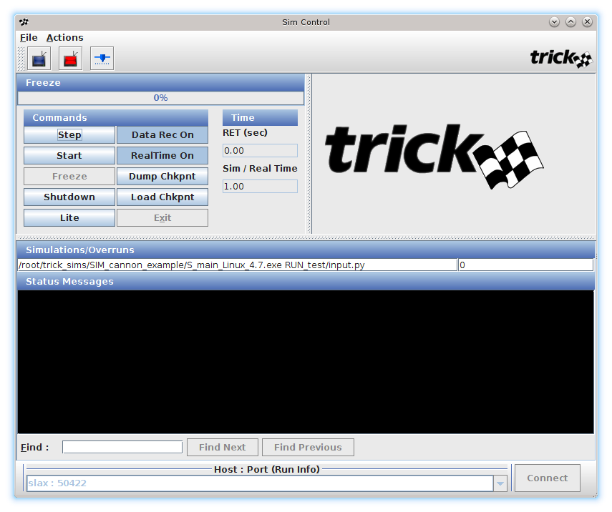
Simulation Control Panel
Provides control and status of a realtime simulation.

Slide 62
Simulation Control Panel
Current Simulation Run Status

Slide 63
Simulation Control Panel
Simulation Control Buttons

Slide 64
Simulation Control Panel
Simulation Time & Time Ratio

Slide 65
Simulation Control Panel
Simulation that is controlled by the panel

Slide 66
Simulation Control Panel
Simulation Overrun Count

Slide 67
Simulation Control Panel
Simulation Status Messages

Slide 68
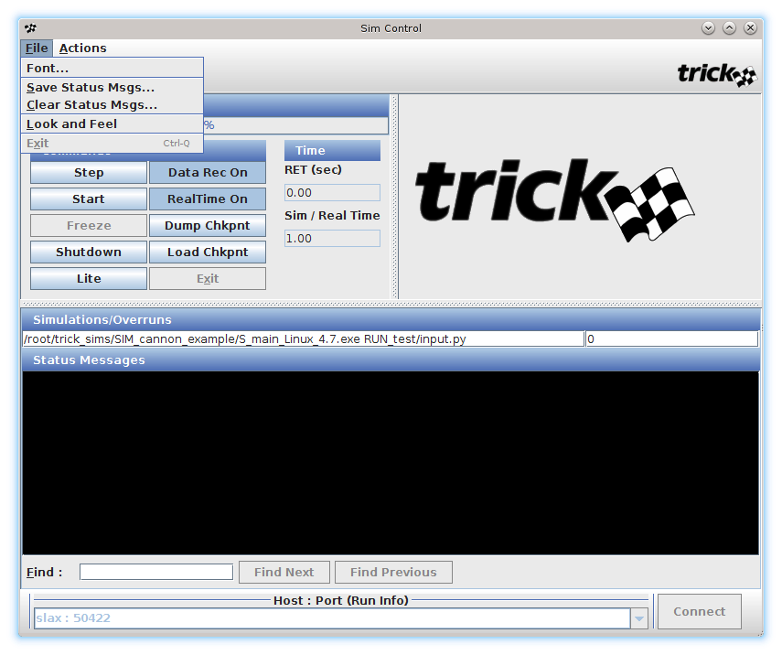
Simulation Control Panel
File Menu

Slide 69
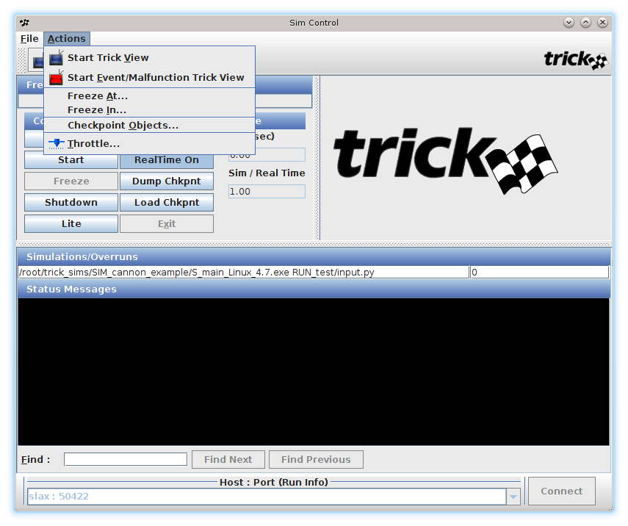
Simulation Control Panel
Actions Menu

Slide 70
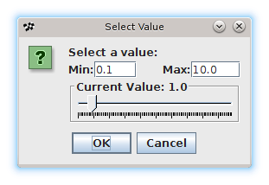
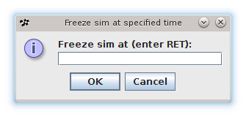
Simulation Control Panel
Throttle
Only available when itimers are off
See real time presentations and User’s
Guide for itimer information
Allows sim to run a multiple of realtime
Freeze Popup
Freeze at = absolute time
Freeze in = relative time

Slide 71
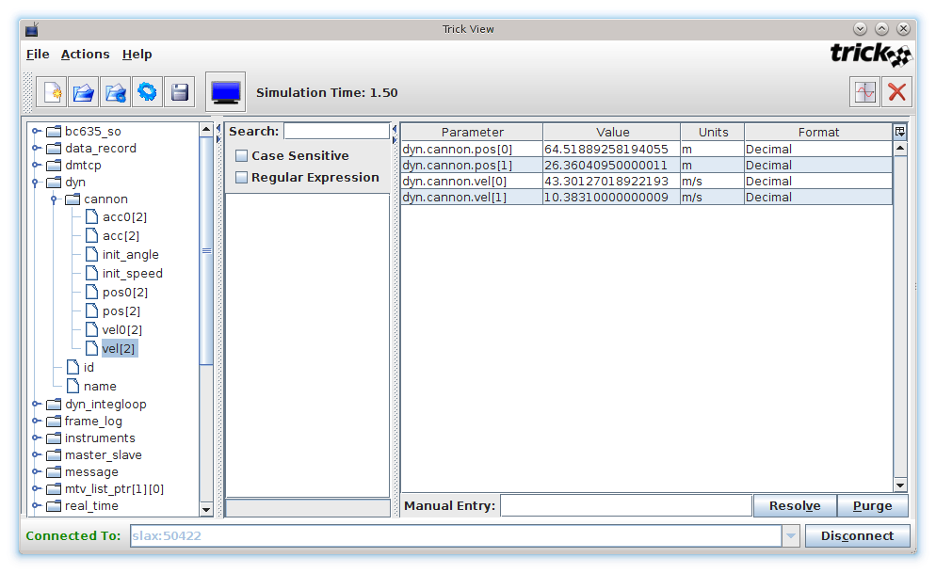
Trick View (TV)
Allows a user to see and set the variables of a running simulation.

Slide 72
Trick View (TV)
Hierarchal Variable Chooser
Double-click variable to add to
Variable Display Area.
Variable Display Area

Slide 73
Trick View (TV)
Values are automatically updated. Click on cell to set value.

Slide 74
Trick View (TV)
Variable Units
Click on cell to change units.

Slide 75
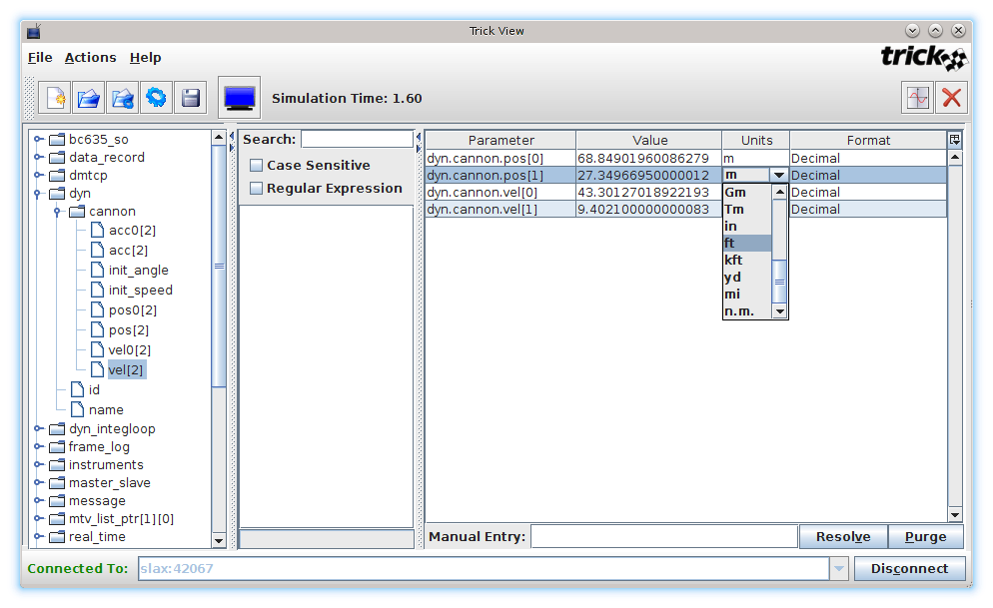
Trick View (TV)
Drop-down Units selection list

Slide 76
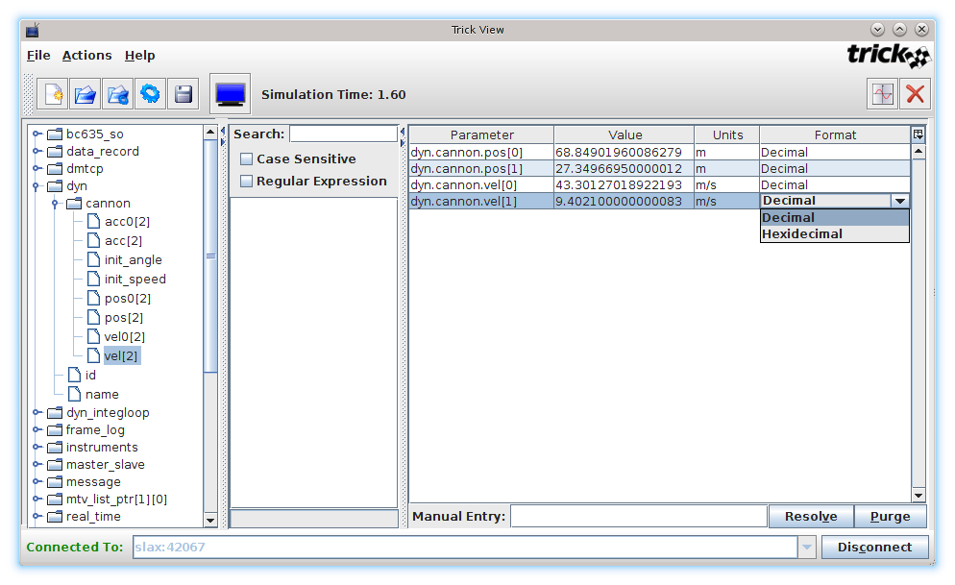
Trick View (TV)
Drop-down Format selection list

Slide 77
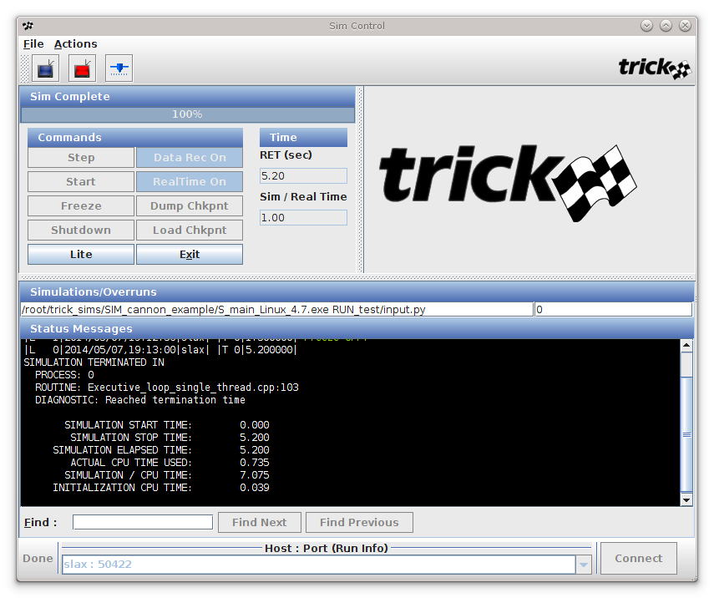
Running Simulation in Real-Time
Done
Flag stops waving
Disconnected

Slide 78
Simulation Architecture

Slide 79
Simulation Architecture
Objective
Job Scheduling
Job Classes
Job Frequencies and offsets
Phasing
Threading simulations
Integration and Collect statements
Prerequisites
Trick environment set up correctly
TRICK_CFLAGS must contain –I${HOME}/trick_models

Slide 80
Job Classes
Jobs classes
Each S_define level job is required to have a job class
The job class determines the order of the module calls when the job is scheduled to run
Trick has many different job classes
class CannonSimObject : public Trick::SimObject {
public:
CANNON cannon ;
CannonSimObject() {
("default_data") cannon_default_data( &cannon ) ;
("initialization") cannon_init( &cannon ) ;
("derivative") cannon_deriv(&cannon) ;
("integration”) trick_ret = cannon_integ(&cannon) ;
}
} ;
CannonSimObject dyn ;

Slide 81
Job Classes
Job Classes - Initialization
"default_data"
Module executed only once.
The only class called before the input file is read.
"initialization"
Module executed only once, at simulation time = 0. Is called after the input file is read.
"restart"
Run once after a checkpoint file is loaded or sim is started from checkpoint file.

Slide 82
Job Classes
Job Classes – Executive
"environment" (e.g., atmosphere, third body gravitation)
"sensor" (e.g., Gyros, Accelerometers, Vision)
"sensor_emitter" (e.g., radar, laser )
"sensor_reflector" (e.g., surfaces)
"sensor_receiver" (e.g., radar receiver, laser receiver)
"scheduled" (Default scheduled job class)
"effector" (e.g., RCS, servo motors, flaps)
"effector_emitter" (e.g., plume, active magnetic fields)
"effector_receiver" (e.g., experiences effects from receivers)
"automatic_last" (e.g., self scheduling, but runs last)
"logging" (Sim data logging functions, Trick internal job class)
"end_of_frame"
Trick executes all of these jobs in the same loop in the above order. Their position in the list is what really distinguishes these job classes.
most common executive class

Slide 83
Job Classes
Job Classes – Integration
"derivative"
Equations of motion (EOM) derivative function.
"integration"
EOM state integration function.
"dynamic_event"
Provides a continuous time dependent equation whose root defines a discontinuous event in the system EOM. Evaluation of function returns an estimated delta time to reach the root.
"post_Integration"
Runs after the integration loop is finished
These job classes are not run at simulation time = 0. The exception is that a derivative job can be configured to run at time 0.

Slide 84
Job Classes
Job Classes – Freeze and Checkpointing
"freeze_init"
Run once when entering freeze.
"freeze"
Cyclically called while in freeze.
"unfreeze"
Run once when returning to Run.
"checkpoint"
Run before a checkpoint is taken.
"preload_checkpoint"
Run before a checkpoint is loaded.
"post_checkpoint"
Run after a checkpoint is loaded.

Slide 85
Job Classes
Job Classes – Other
"automatic"
Self scheduling job class. Job is expected to reschedule itself via its job control inputs.
"random"
Execution occurs at a specified delta time plus or minus 1 sigma random time.
"shutdown"
Run when sim is exiting.

Slide 86
Job Classes
Job Classes – Monte Carlo
"monte_master_init"
Runs when master sim is initialized
"monte_master_pre"
Runs before new data is dispatched to slave sim
"monte_master_post"
Runs after result is returned from slave
"monte_master_shutdown"
Runs when master shuts down
"monte_slave_init"
Runs when slave sim is initialized
"monte_slave_pre"
Runs after new data is received from master
"monte_slave_post"
Runs after slave sim is completed (sends result to master)
"monte_slave_shutdown"
Runs when monte carlo master comm is lost and slave shuts down

Slide 87
Job Frequencies
Derivative and Integration jobs inherit their frequencies from the IntegLoop statement
class CannonSimObject : public Trick::SimObject {
public:
CANNON cannon ;
CannonSimObject() {
("initialization") cannon_init( &cannon ) ;
("default_data") cannon_default_data( &cannon ) ;
("derivative") cannon_deriv(&cannon) ;
("integration”) trick_ret = cannon_integ(&cannon) ;
(0.015, "scheduled") cannon_calc_drag( &cannon ) ;
}
}
CannonSimObject dyn ;
IntegLoop dyn_integloop (0.01) dyn;
Notes:
87

Slide 88
SIM_cannon_L4
To illustrate job frequencies let’s run SIM_cannon_L4
% cd $HOME/trick_sims/SIM_cannon_L4
% CP
% ./S_main_${TRICK_HOST_CPU}.exe RUN_grav/input.py

Slide 89
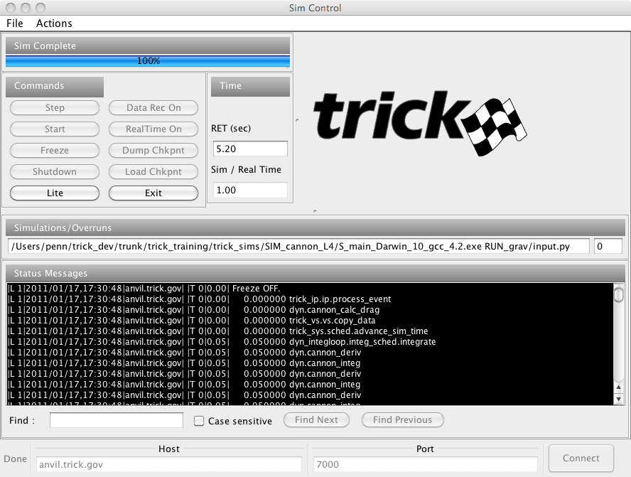
SIM_cannon_L4
Job echoing was turned on with trick.echo_jobs_on().
Time stamped
job calls

Slide 90
Analyze Echo Job Output
Various init jobs above
0.000000 dyn.cannon_deriv
0.000000 trick_ip.ip.process_event
0.000000 dyn.cannon_calc_drag
0.000000 trick_vs.vs.copy_data
0.000000 trick_sys.sched.advance_sim_time
0.010000 dyn_integloop.integ_sched.integrate
0.010000 dyn.cannon_deriv
0.010000 dyn.cannon_integ
0.010000 dyn.cannon_deriv
0.010000 dyn.cannon_integ
0.015000 dyn.cannon_calc_drag
0.020000 dyn_integloop.integ_sched.integrate
0.020000 dyn.cannon_deriv
0.020000 dyn.cannon_integ
0.020000 dyn.cannon_deriv
0.020000 dyn.cannon_integ
0.030000 dyn_integloop.integ_sched.integrate
0.030000 dyn.cannon_deriv
0.030000 dyn.cannon_integ
0.030000 dyn.cannon_deriv
0.030000 dyn.cannon_integ
0.030000 dyn.cannon_calc_drag
The time stamp shown is the simulation time, not "wall clock" time

Slide 91
Job Frames
Various init jobs above
0.000000 dyn.cannon_deriv
0.000000 trick_ip.ip.process_event
0.000000 dyn.cannon_calc_drag
0.000000 trick_vs.vs.copy_data
0.000000 trick_sys.sched.advance_sim_time
0.010000 dyn_integloop.integ_sched.integrate
0.010000 dyn.cannon_deriv
0.010000 dyn.cannon_integ
0.010000 dyn.cannon_deriv
0.010000 dyn.cannon_integ
0.015000 dyn.cannon_calc_drag
0.020000 dyn_integloop.integ_sched.integrate
0.020000 dyn.cannon_deriv
0.020000 dyn.cannon_integ
0.020000 dyn.cannon_deriv
0.020000 dyn.cannon_integ
0.030000 dyn_integloop.integ_sched.integrate
0.030000 dyn.cannon_deriv
0.030000 dyn.cannon_integ
0.030000 dyn.cannon_deriv
0.030000 dyn.cannon_integ
0.030000 dyn.cannon_calc_drag
Trick cyclically creates a queue of jobs and executes them in an order determined by job class and S_define order
Trick prepares a job queue at times when any job needs to execute
Higher frequency jobs mostly determine the granularity of job queue creation
Job frames have no notion of real-time synchronization

Slide 92
Job Frames (Initialization)
Various init jobs above
0.000000 dyn.cannon_deriv
0.000000 trick_ip.ip.process_event
0.000000 dyn.cannon_calc_drag
0.000000 trick_vs.vs.copy_data
0.000000 trick_sys.sched.advance_sim_time
0.010000 dyn_integloop.integ_sched.integrate
0.010000 dyn.cannon_deriv
0.010000 dyn.cannon_integ
0.010000 dyn.cannon_deriv
0.010000 dyn.cannon_integ
0.015000 dyn.cannon_calc_drag
0.020000 dyn_integloop.integ_sched.integrate
0.020000 dyn.cannon_deriv
0.020000 dyn.cannon_integ
0.020000 dyn.cannon_deriv
0.020000 dyn.cannon_integ
0.030000 dyn_integloop.integ_sched.integrate
0.030000 dyn.cannon_deriv
0.030000 dyn.cannon_integ
0.030000 dyn.cannon_deriv
0.030000 dyn.cannon_integ
0.030000 dyn.cannon_calc_drag
Initialization
During initialization, initialization and derivative class jobs are called
Initialization jobs may be ordered with the S_define P# syntax

Slide 93
Job Frames (Time Zero)
Various init jobs above
0.000000 dyn.cannon_deriv
0.000000 trick_ip.ip.process_event
0.000000 dyn.cannon_calc_drag
0.000000 trick_vs.vs.copy_data
0.000000 trick_sys.sched.advance_sim_time
0.010000 dyn_integloop.integ_sched.integrate
0.010000 dyn.cannon_deriv
0.010000 dyn.cannon_integ
0.010000 dyn.cannon_deriv
0.010000 dyn.cannon_integ
0.015000 dyn.cannon_calc_drag
0.020000 dyn_integloop.integ_sched.integrate
0.020000 dyn.cannon_deriv
0.020000 dyn.cannon_integ
0.020000 dyn.cannon_deriv
0.020000 dyn.cannon_integ
0.030000 dyn_integloop.integ_sched.integrate
0.030000 dyn.cannon_deriv
0.030000 dyn.cannon_integ
0.030000 dyn.cannon_deriv
0.030000 dyn.cannon_integ
0.030000 dyn.cannon_calc_drag
Job Frame 1
Integration class jobs are not called at time=0.0
ALL other run-time jobs are called at time zero. If this is undesired, use an offset

Slide 94
Job Frames (Second)
Various init jobs above
0.000000 dyn.cannon_deriv
0.000000 trick_ip.ip.process_event
0.000000 dyn.cannon_calc_drag
0.000000 trick_vs.vs.copy_data
0.000000 trick_sys.sched.advance_sim_time
0.010000 dyn_integloop.integ_sched.integrate
0.010000 dyn.cannon_deriv
0.010000 dyn.cannon_integ
0.010000 dyn.cannon_deriv
0.010000 dyn.cannon_integ
0.015000 dyn.cannon_calc_drag
0.020000 dyn_integloop.integ_sched.integrate
0.020000 dyn.cannon_deriv
0.020000 dyn.cannon_integ
0.020000 dyn.cannon_deriv
0.020000 dyn.cannon_integ
0.030000 dyn_integloop.integ_sched.integrate
0.030000 dyn.cannon_deriv
0.030000 dyn.cannon_integ
0.030000 dyn.cannon_deriv
0.030000 dyn.cannon_integ
0.030000 dyn.cannon_calc_drag
Job Frame 2
Integration class jobs follow derivative class jobs at the top of the job frame. If they are in a job queue, they are executed first.
In this example, derivative and integration jobs are called twice. This is because we are running with Runge Kutta 2 which requires two passes.
cannon_calc_drag() is not queued since its freq doesn't match the 0.010

Slide 95
Job Frames (Third)
Various init jobs above
0.000000 dyn.cannon_deriv
0.000000 trick_ip.ip.process_event
0.000000 dyn.cannon_calc_drag
0.000000 trick_vs.vs.copy_data
0.000000 trick_sys.sched.advance_sim_time
0.010000 dyn_integloop.integ_sched.integrate
0.010000 dyn.cannon_deriv
0.010000 dyn.cannon_integ
0.010000 dyn.cannon_deriv
0.010000 dyn.cannon_integ
0.015000 dyn.cannon_calc_drag
0.020000 dyn_integloop.integ_sched.integrate
0.020000 dyn.cannon_deriv
0.020000 dyn.cannon_integ
0.020000 dyn.cannon_deriv
0.020000 dyn.cannon_integ
0.030000 dyn_integloop.integ_sched.integrate
0.030000 dyn.cannon_deriv
0.030000 dyn.cannon_integ
0.030000 dyn.cannon_deriv
0.030000 dyn.cannon_integ
0.030000 dyn.cannon_calc_drag
Job Frame 3
No other jobs have frequencies that fall on 0.015, so cannon_calc_drag() is alone in the job queue
The speed of job queue creation is dependent on the number of jobs available. Bear this in mind before making a job with a weird frequency that forces continual job queueing

Slide 96
Job Frames (Fourth)
Various init jobs above
0.000000 dyn.cannon_deriv
0.000000 trick_ip.ip.process_event
0.000000 dyn.cannon_calc_drag
0.000000 trick_vs.vs.copy_data
0.000000 trick_sys.sched.advance_sim_time
0.010000 dyn_integloop.integ_sched.integrate
0.010000 dyn.cannon_deriv
0.010000 dyn.cannon_integ
0.010000 dyn.cannon_deriv
0.010000 dyn.cannon_integ
0.015000 dyn.cannon_calc_drag
0.020000 dyn_integloop.integ_sched.integrate
0.020000 dyn.cannon_deriv
0.020000 dyn.cannon_integ
0.020000 dyn.cannon_deriv
0.020000 dyn.cannon_integ
0.030000 dyn_integloop.integ_sched.integrate
0.030000 dyn.cannon_deriv
0.030000 dyn.cannon_integ
0.030000 dyn.cannon_deriv
0.030000 dyn.cannon_integ
0.030000 dyn.cannon_calc_drag
Job Frame 4
Queue is identical to 0.010

Slide 97
Job Frames (Fifth)
…
0.010000 dyn_integloop.integ_sched.integrate
0.010000 dyn.cannon_deriv
0.010000 dyn.cannon_integ
0.010000 dyn.cannon_deriv
0.010000 dyn.cannon_integ
0.015000 dyn.cannon_calc_drag
0.020000 dyn_integloop.integ_sched.integrate
0.020000 dyn.cannon_deriv
0.020000 dyn.cannon_integ
0.020000 dyn.cannon_deriv
0.020000 dyn.cannon_integ
0.030000 dyn_integloop.integ_sched.integrate
0.030000 dyn.cannon_deriv
0.030000 dyn.cannon_integ
0.030000 dyn.cannon_deriv
0.030000 dyn.cannon_integ
0.030000 dyn.cannon_calc_drag
Job Frame 5
Here we hit the LCM of 10 & 15, so all jobs are called and deriv-integ are called first

Slide 98
Job Frames (Notes On Time Stamp)
Various init jobs above
0.000000 dyn.cannon_deriv
0.000000 trick_ip.ip.process_event
0.000000 dyn.cannon_calc_drag
0.000000 trick_vs.vs.copy_data
0.000000 trick_sys.sched.advance_sim_time
0.010000 dyn_integloop.integ_sched.integrate
0.010000 dyn.cannon_deriv
0.010000 dyn.cannon_integ
0.010000 dyn.cannon_deriv
0.010000 dyn.cannon_integ
0.015000 dyn.cannon_calc_drag
0.020000 dyn_integloop.integ_sched.integrate
0.020000 dyn.cannon_deriv
0.020000 dyn.cannon_integ
0.020000 dyn.cannon_deriv
0.020000 dyn.cannon_integ
0.030000 dyn_integloop.integ_sched.integrate
0.030000 dyn.cannon_deriv
0.030000 dyn.cannon_integ
0.030000 dyn.cannon_deriv
0.030000 dyn.cannon_integ
0.030000 dyn.cannon_calc_drag
The frequency of a job tells Trick when to run it, NOT how long to run it
The stamps are simulation time and have no relation to a wall clock
"Real-time" can only occur (or make any sense definition-wise) if we decide to synchronize the simulation time with external real-time source

Slide 99




Real-Time Frame
0.000000 dyn.cannon_calc_drag()
0.010000 dyn.cannon_deriv()
0.010000 dyn.cannon_integ()
0.015000 dyn.cannon_calc_drag()
0.020000 dyn.cannon_deriv()
0.020000 dyn.cannon_integ()
0.030000 dyn.cannon_deriv()
0.030000 dyn.cannon_integ()
0.030000 dyn.cannon_calc_drag()
0.040000 dyn.cannon_deriv()
0.040000 dyn.cannon_integ()
0.045000 dyn.cannon_calc_drag()
0.050000 dyn.cannon_deriv()
0.050000 dyn.cannon_integ()
0.060000 dyn.cannon_deriv()
0.060000 dyn.cannon_integ()
0.060000 dyn.cannon_calc_drag()
0.070000 dyn.cannon_deriv()
…
This echo assumes single-step integration
It also assumes a real-time frame of 0.01
0.01
0.02
The real-time frame is the frequency at which Trick synchronizes with the wall clock
The wall clock is either the system clock, interval timer signal or user defined clock
All job frames within a RT frame run back to back
Once all job frames are complete within each RT frame, a check is done on progress. If ahead of schedule, a wait is performed. If behind, the next software frame is immediately executed in an attempt to "catch up".
0.03
0.04
0.05
0.06
0.07
Notes:
99

Slide 100
Job Offset
Job Offset syntax
What if we changed the offset to cannon_calc_drag to 0.005
(<frequency>, <offset>, <job class>) cannon_calc_drag( &cannon);
(0.015, 0.005, "scheduled") cannon_calc_drag( &cannon);
Notes:
100

Slide 101
Job Offsets
…
0.00000 dyn.cannon_deriv()
0.00500 dyn.cannon_calc_drag()
0.01000 dyn.cannon_deriv()
0.01000 dyn.cannon_integ()
0.01000 dyn.cannon_deriv()
0.01000 dyn.cannon_integ()
0.02000 dyn.cannon_deriv()
0.02000 dyn.cannon_integ()
0.02000 dyn.cannon_deriv()
0.02000 dyn.cannon_integ()
0.02000 dyn.cannon_calc_drag()
0.03000 dyn.cannon_deriv()
0.03000 dyn.cannon_integ()
0.03000 dyn.cannon_deriv()
0.03000 dyn.cannon_integ()
0.03500 dyn.cannon_calc_drag()
cannon_calc_drag is offset by 0.005 seconds
Notes:
101

Slide 102
Job Phasing
Phasing
Allows a user to reorder the jobs of the same class.
Originally used to reorder initialization jobs, but now extends to all job classes
Phase number ranges from 0 to 65534, default phase is 60000
P20 (0.015, "scheduled") cannon_calc_drag(…);
P10 (0.015, "scheduled") run_me_first(…);
0.00000 dyn.cannon_deriv()
0.00000 dyn.run_me_first()
0.00000 dyn.cannon_calc_drag()
0.01500 dyn.run_me_first()
0.01500 dyn.cannon_calc_drag()
0.03000 dyn.run_me_first()
0.03000 dyn.cannon_calc_drag()

Slide 103
Threading
Threading in Trick 10 and 13 works differently than in Trick 7.
C1 (1.0, "scheduled") slow_job(…);
C# identifies the thread in which a scheduled job runs.
The process type of each thread may be set in the input file:
trick.exec_set_thread_process_type(1, trick.PROCESS_TYPE_ASYNC_CHILD)
There are three process types:
PROCESS_TYPE_SCHEDULED - (the default) the child thread synchronizes with the main simulation thread at every time step.
PROCESS_TYPE_ASYNC_CHILD - the thread does not synchronize with the main thread unless it ends.
PROCESS_TYPE_AMF_CHILD specifies that the child thread periodically synchronizes with the main thread as specified in the input file:
trick.exec_set_thread_amf_cycle_time(1, 10.0)

Slide 104
Input Processor

Slide 105
Input Processor
Objective
Describe how the input processor works with a Trick simulation.
Show examples of how the input file can affect the simulation
Prerequisites
None

Slide 106
Input Processor
The input processor is a Python intrepreter that "knows" about your
simulation’s sim objects.
A simulation input file is simply a Python script. It is typically named input.py.
Typical invocation of a simulation is :
% ./S_main*.exe RUN_test/input.py
The input processor runs input.py to completion before user’s initialization jobs are run.
There is an online Python Tutorial at:
http://docs.python.org/tutorial/

Slide 107
Input Processor
Assign Values :
dyn.cannon.pos[0] = 0.0
dyn.cannon.pos[1] = 0.0
dyn.cannon.acc[0] = 0.0
dyn.cannon.acc[1] = -9.81
dyn.cannon.init_angle = trick.attach_units("d",30.0)
dyn.cannon.init_speed = 50.0
Units Conversion
Tell the sim to stop after 300 seconds :
trick.exec_set_terminate_time(300.0)
An alternate way of stopping:
trick.stop(300.0)

Slide 108
Input Processor – Writing Checkpoint Files
How to write a :
Pre-initialization checkpoint :
trick.checkpoint_pre_init(True)
Post-initialization checkpoint :
trick.checkpoint_post_init(True)
Checkpoint at 120 seconds:
trick.checkpoint(120.0)
Post-Run Checkpoint :
trick.checkpoint_end(True)

Slide 109
Input Processor – Providing Simulation Interface GUIs
How to provide a :
Sim Control Panel :
trick.sim_control_panel_set_enabled(1)
Trick View:
trick.trick_view_set_enabled(1)
Stripchart:
trick_vs.stripchart.set_input_file("cannon.sc")
trick.stripchart_set_enabled(1)
Monte Carlo Monitor :
trick.monte_monitor_set_enabled(1)
Malfunctions Panel:
trick.malfunctions_trick_view_set_enabled(1)

Slide 110
Input Processor – Sim Objects & Jobs
How to :
Set the job rate:
trick.set_job_cycle( char* job_name, double in_cycle)
Turn a job on/off
trick.exec_set_job_onoff(char * job_name , int on_off)
Turn a sim object on/off
trick.exec_set_sim_object_onoff( char* sim_obj_name, int on_off)
Turn echo jobs on/off.
trick.echo_jobs_on()

Slide 111
Input Processor – Creating an Integrator
Create a Runge_Kutta_2, four element state integrator whose default
integration rate is 0.01 seconds :
integ_loop_object.getIntegrator( trick.Runge_Kutta_2, 4)
Create a Runge_Kutta_4, eight element state integrator whose default
integration rate is 0.01 seconds :
integ_loop_object.getIntegrator( trick.Runge_Kutta_4,8)

Slide 112
Add_read
Executing Python code at a specific time using add_read():
% cd $HOME/trick_sims/SIM_cannon_L4
% vi RUN_grav/input.py
Uncomment the code below
#add_read example
read = 2.3
trick.add_read(read,"""print "hello, the sim time is: " , trick.exec_get_sim_time()""")
read = 3.4
trick.add_read(read,"""print "howdy, the sim time is: " , trick.exec_get_sim_time()""")
Comment-out the line below and save
#trick.echo_jobs_on()
Re-run the sim.
% ./S_main_${TRICK_HOST_CPU}.exe RUN_grav/input.py
On your terminal, you should see:
hello, the sim time is: 2.3
howdy, the sim time is: 3.4

Slide 113
Input Processor – Events
Now, let’s add an event :
% cd $HOME/trick_sims/SIM_cannon_L4
% vi RUN_grav/input.py <uncomment the code below and save>
# --- Event Example ---
ceiling = 25.0
event_1 = trick.new_event("event_1")
event_1.set_cycle(0.01)
event_1.condition(0, """dyn.cannon.pos[1] > ceiling""")
event_1.action(0, """print 'Hit the ceiling at', trick.exec_get_sim_time(),\
'seconds.'""")
trick.add_event(event_1)
event_1.activate()
Re-run the sim.
% ./S_main_${TRICK_HOST_CPU}.exe RUN_grav/input.py
You should see:
Hit the ceiling at 1.37 seconds

Slide 114
Re-activating an Event
Like a mousetrap, once an event is triggered, it is no longer active. To
Reset the event, use: event.activate() in the event.action string:
# --- Event Example #2 ---
event_2 = trick.new_event("event_2")
event_2.set_cycle(0.01)
event_2.condition(0, """((dyn.cannon.pos[1] > ceiling) and\
(dyn.cannon.pos[1] – float(dyn.cannon.vel[1] * 0.01)) < ceiling) or\
((dyn.cannon.pos[1] < ceiling) and\
(dyn.cannon.pos[1] – float(dyn.cannon.vel[1] * 0.01)) > ceiling)""")
event_2.action(0, """print 'Hit the ceiling at', trick.exec_get_sim_time(),\
'seconds.', event_2.activate() """)
trick.add_event(event_2)
event_2.activate()
Reactivating an event

Slide 115
Input Processor – Stripcharting
Now let’s stripchart the cannonball trajectory:
A stripchart configuration file specifies what our stripchart will contain
(note, parameters with the equal sign are optional):
FILE
cannon.sc :
Stripchart:
title = "Cannon Trajectory"
geometry = 800x800+300+0
x_min = 0.0
x_max = 250.0
y_min = 0.0
y_max = 40.0
x_variable = dyn.cannon.pos[0]
dyn.cannon.pos[1]
% cd $HOME/trick_sims/SIM_cannon_L4
% vi RUN_grav/input.py <uncomment the code below and save>
trick_vs.stripchart.set_input_file("cannon.sc")
trick.stripchart_set_enabled(1)

Slide 116
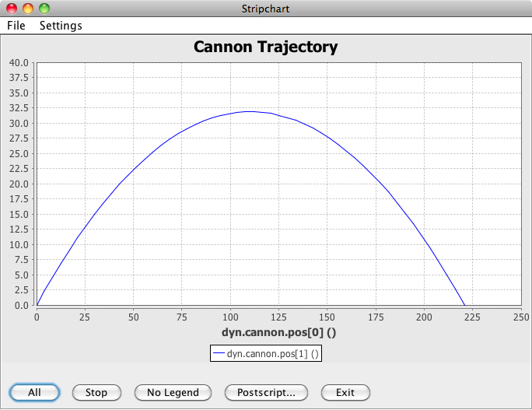
Input Processor – Events Example
Re-run the sim.
% ./S_main_${TRICK_HOST_CPU}.exe RUN_grav/input.py
You should see a stripchart
similar to this, produced during
the simulation:

Slide 117
Trick DP (DP = Data Products)

Slide 118
Trick DP Advanced Topics
Objective
Create new pages/plots
Create and save DP "sessions"
Prerequisites
Data recorded when simulation run
Trick Basic Training
118
Notes:
118

Slide 119
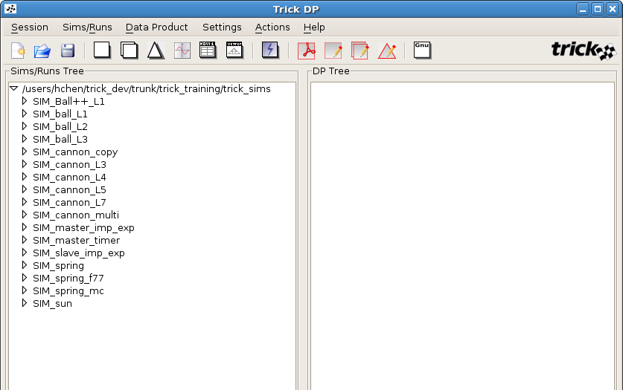
trick_dp
Start trick_dp
% cd $HOME/trick_sims/SIM_cannon_L7
% trick_dp &
Sims initially appear unexpanded.
Double clicking sims or single clicking the node icon on the left will show runs contained in that sim
Runs in black contain data
Runs in grey do not contain data
Trick Basic Training
119
Notes:
119

Slide 120
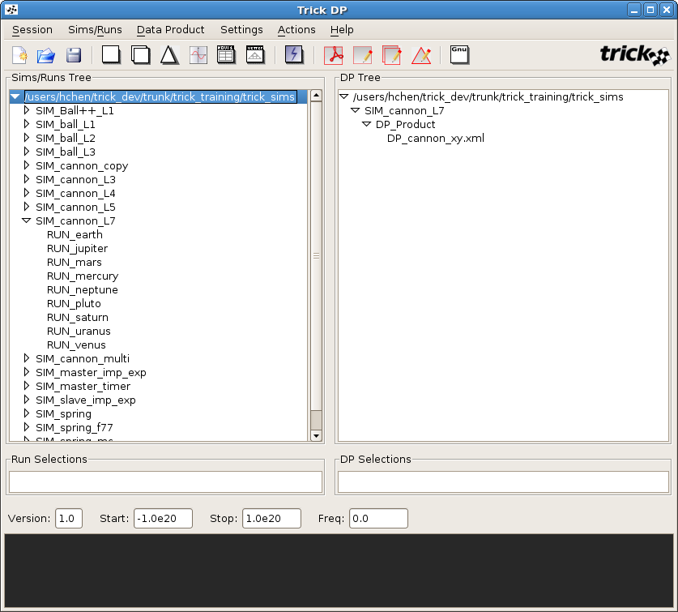
trick_dp
Open SIM_cannon_L7
Double click "SIM_cannon_L7" or single click the node icon
When a sim is selected, DP files within the
DP_Product directory appear to the right
Trick Basic Training
120
Notes:
120

Slide 121
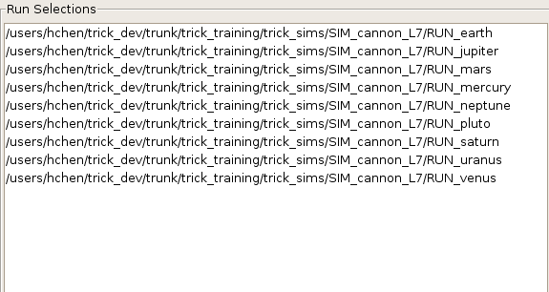
trick_dp
Select all runs in the SIM by double clicking each one or by right-clicking the SIM folder and clicking "Add run(s)"
1. Select all runs
1. All runs appear in box below
Trick Basic Training
121
Notes:
121

Slide 122
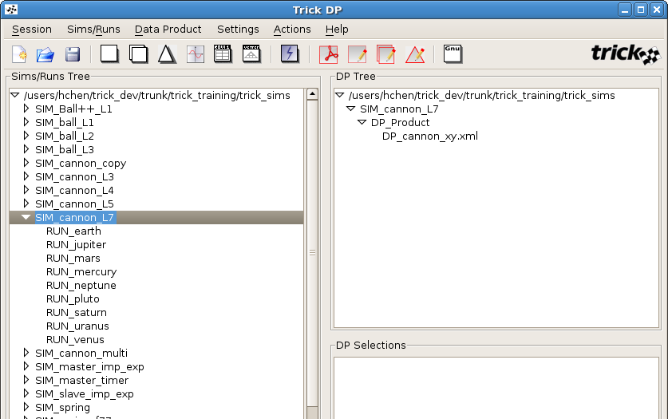
trick_dp
Start Quickplot
Start QuickPlot. Quickplot is the
plot/table builder application
Trick Basic Training
122
Notes:
122

Slide 123
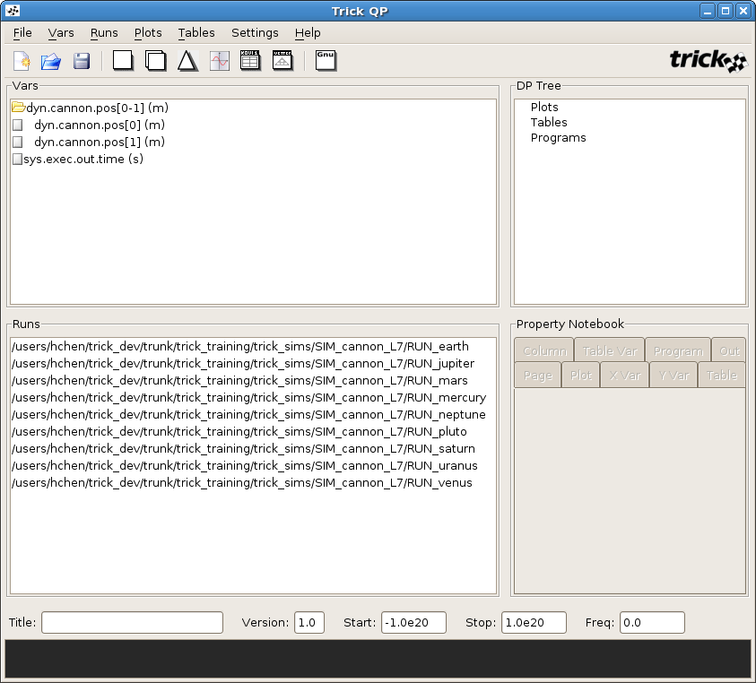
Creating a DP File
Variables in black are present in all selected runs
Variables in red are not present in all runs
Right-click variable folder to expand
Trick Basic Training
123
Notes:
123

Slide 124
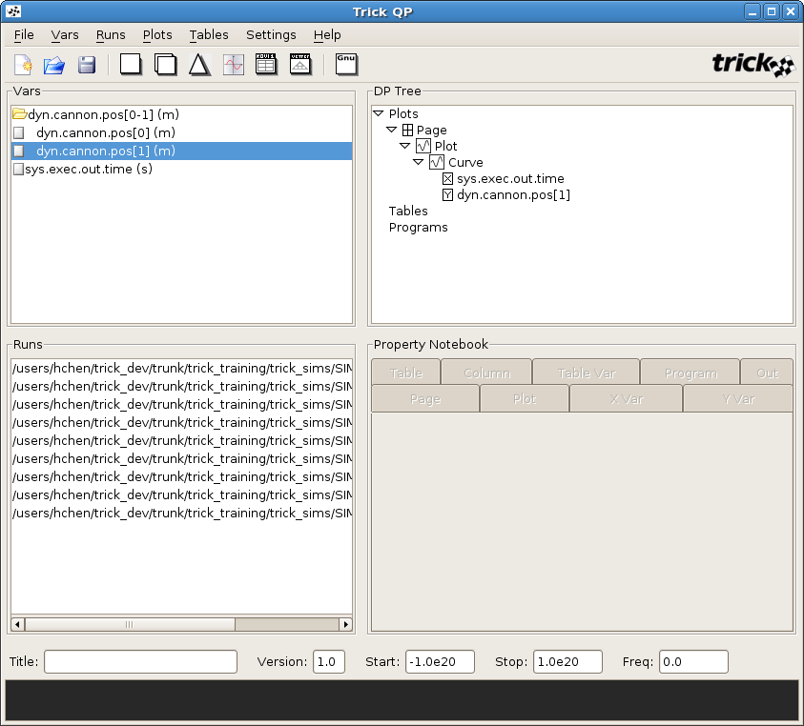
Creating a DP File
1. Double Click dyn_cannon_pos[1] (m)
A new page and plot created automatically
with the default x variable set to
sys.exec.out.time. The y variable is set to
dyn.cannon.pos[1].
Pages can have multiple plots. To add more plots,
left click the page to select it, right click to bring
up a menu to add and remove plots
Plots can have multiple curves. Drag more variables
onto the plot icon. Or select the plot and double-
click more variables
Trick Basic Training
124
Notes:
124

Slide 125
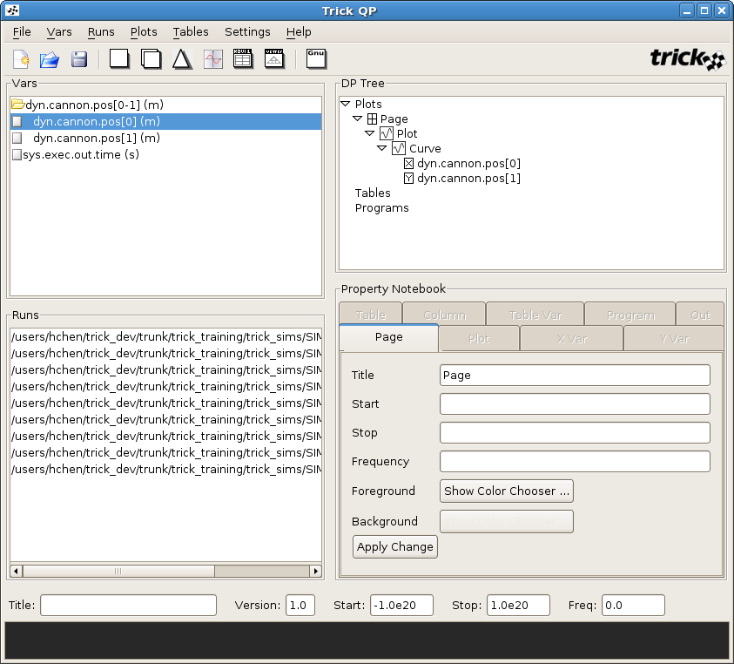
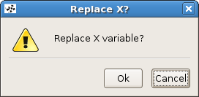
Creating a DP File
We want to make an XY plot where
dyn.cannon.pos[0] is the x variable:
Drag dyn.cannon.pos[0] on top of
sys.exec.out.time (Answer Ok to the popup)
Trick Basic Training
125
Notes:
125

Slide 126
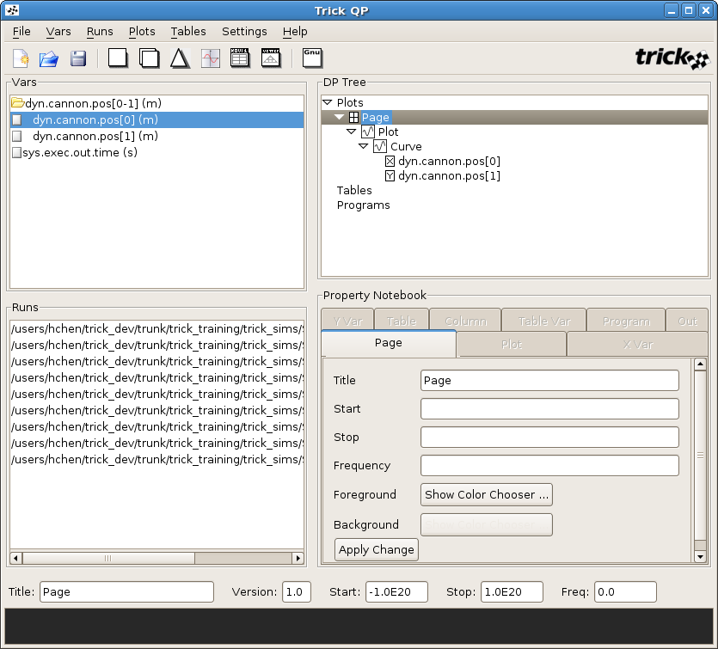
Creating a DP File
To change the page title
1. Click on Page
2. Change the Page title to "Planet Analysis"
3. Click Apply Change button to save the
change
Trick Basic Training
126
Notes:
126

Slide 127
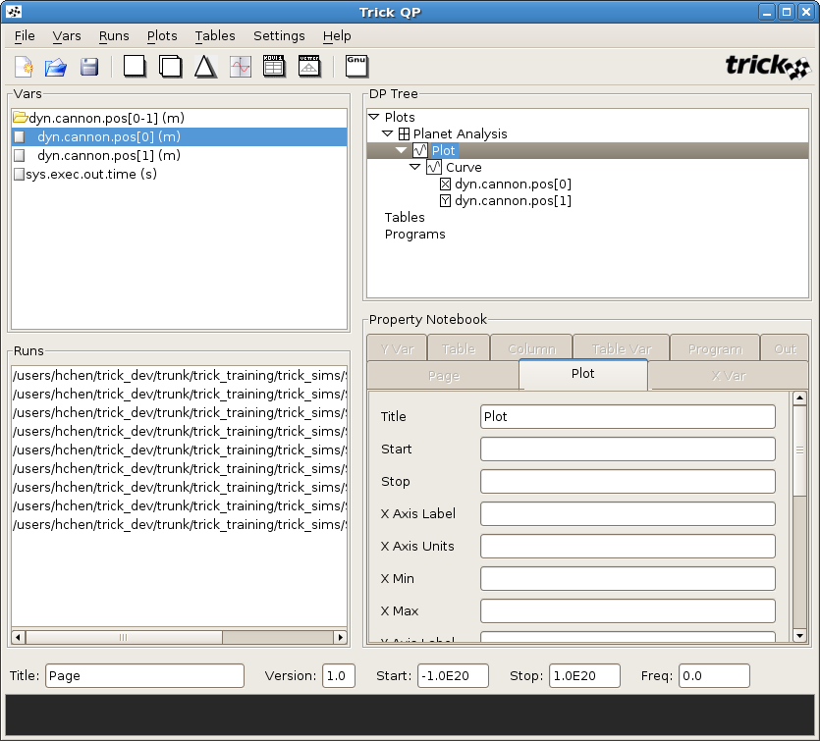
Creating a DP File
To change a plot title
1. Click on Plot
2. Change the Plot title to "Planet Trajectories"
3. Change Font to DejaVu Sans, Size 10
4. Click Apply Change button to save
the change
Trick Basic Training
127
Notes:
127

Slide 128
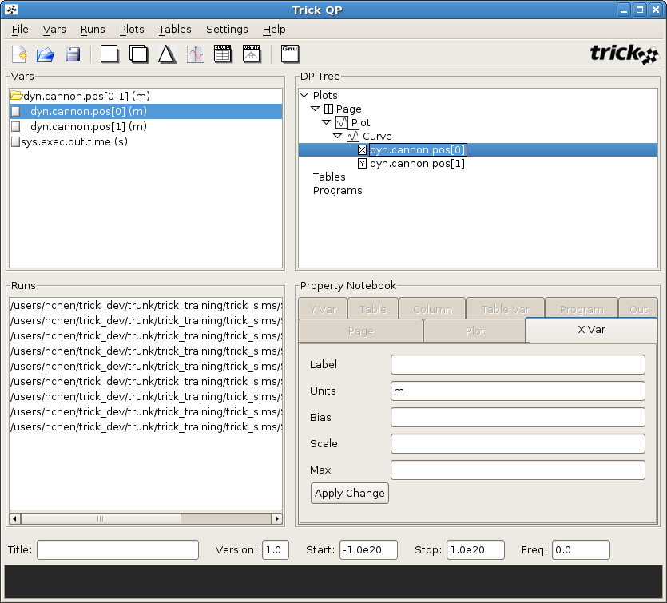
Creating a DP file
To change x variable properties
1. Click on the x variable
2. Change its properties
3. Click Apply Change button
to save changes
Trick Basic Training
128
Notes:
128

Slide 129
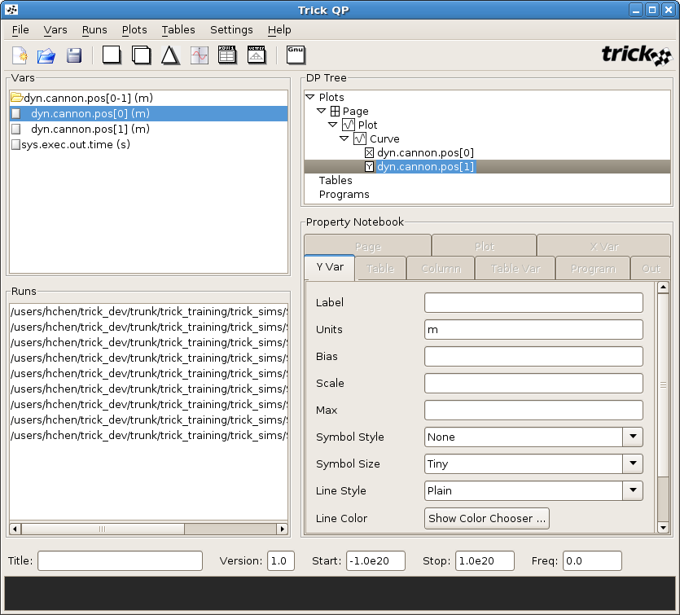
Creating a DP file
To change y variable properties
1. Click on the y variable
2. Change properties
3. Click Apply Change button
to save changes
Trick Basic Training
129
Notes:
129

Slide 130
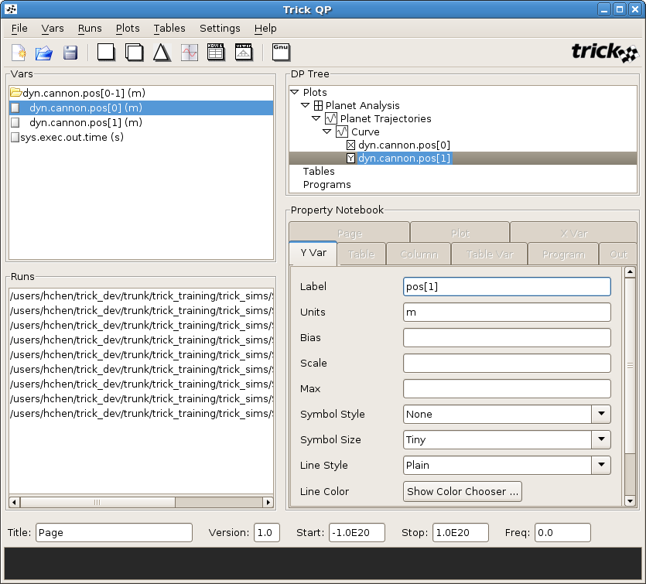
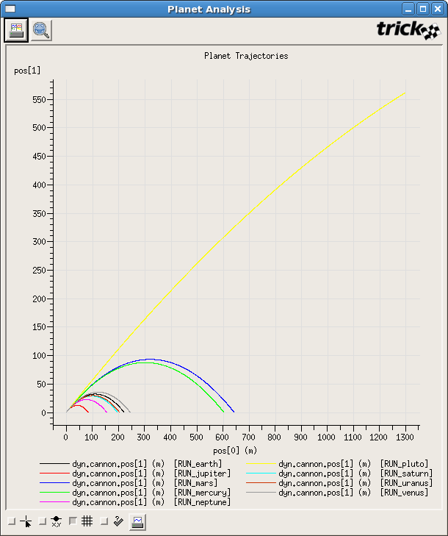
Creating a DP File
Test Comparison Plot
Trick Basic Training
130
Notes:
130

Slide 131
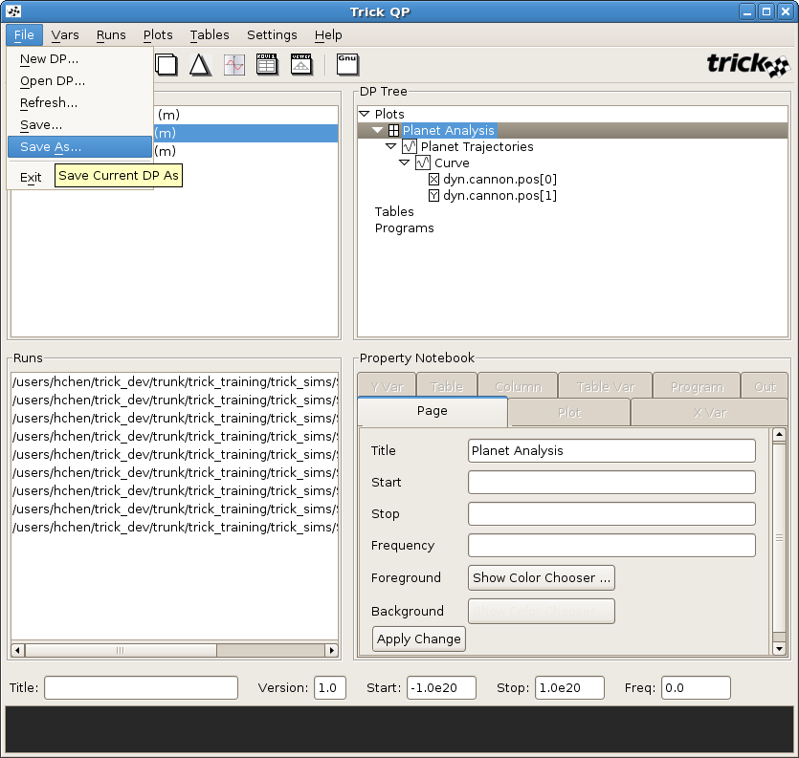
Creating a DP File
Save As "DP_trajectory"
Trick Basic Training
131
Notes:
131

Slide 132
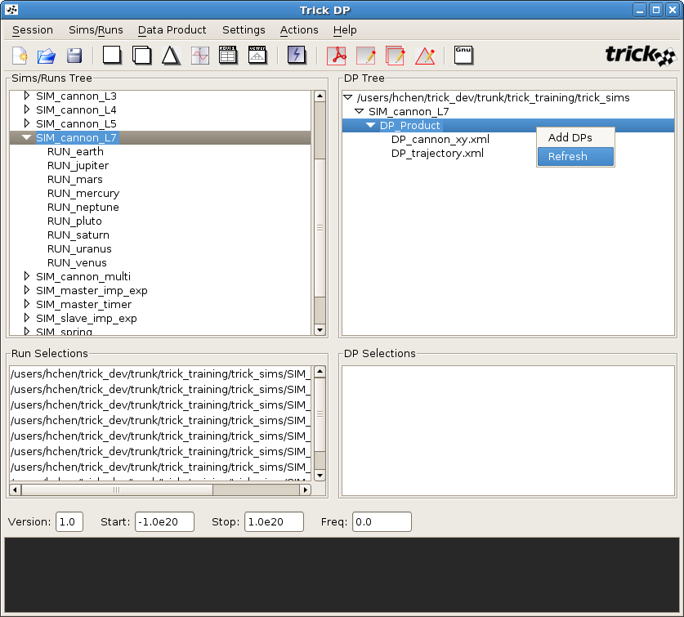
Creating a DP File
Right click DP_Product and
Select Refresh and notice
DP_trajectory.xml appears
Trick Basic Training
132
Notes:
132

Slide 133
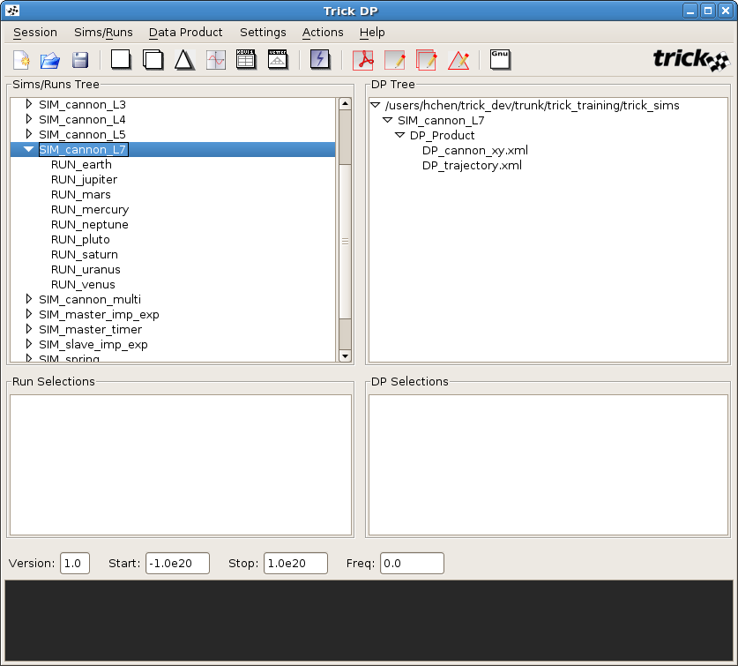
Plotting
Use icons for single, comparison, and error plots
Trick Basic Training
133
Notes:
133

Slide 134
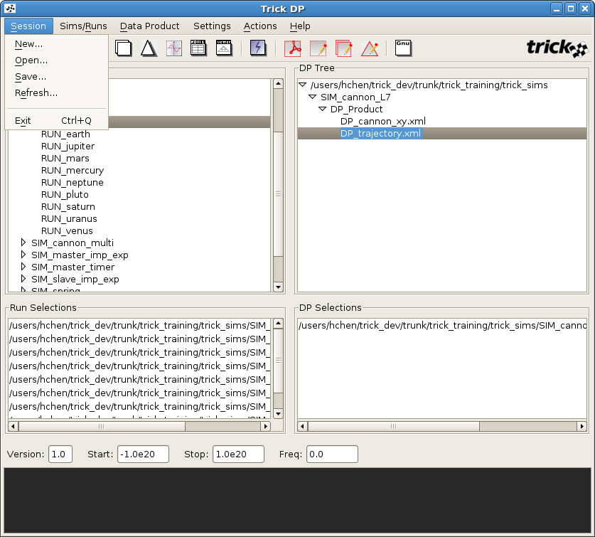
Saving DP Session
Select “DP_trajectory.xml”.
It should then appear in DP
Selections box below.
Save the Session as "Session_trajectory"
Trick Basic Training
134
Notes:
134

Slide 135
Command Line Data Products
Plotting from the command line
Plotting from the command line
(Session_trajectory.xml is saved by default in you SIM_ directory)
% fxplot Session_trajectory.xml (fxplot uses enhanced Fermi-lab X-widget)
Trick Basic Training
135
Notes:
135
135

Slide 136
Data Recording
How do you set up the sim data used by Data Products?
Create a data recording file using data recording editor (dre)
You need to be in the directory that contains the S_sie.resource file created by CP in order to launch dre successfully
% cd $HOME/trick_sims/SIM_cannon_example <if your not already in this directory>
% dre
Trick Basic Training
136
Notes:
136

Slide 137
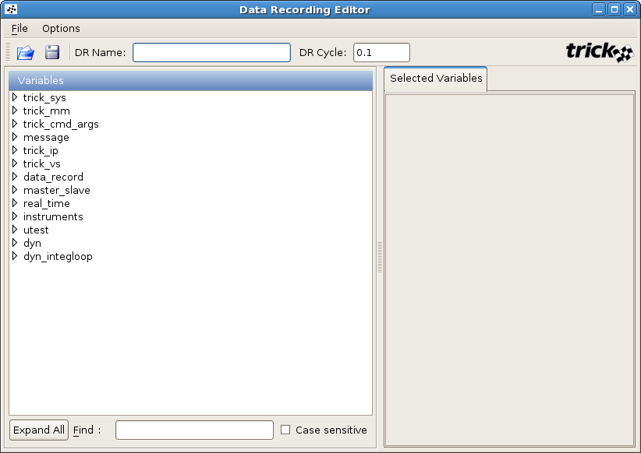
Data Recording
Set recording format (DR_Binary, Dr_ASCII, & DR_HDF5), frequency (DR_Always, DR_Changes, and DR_Step_Changes), buffering(DR_Buffer, DR_No_Buffer, DR_Ring_Buffer) under Options
Click on hierarchy in left window to find variables to record
Double click variables on left adds to the references in right Selected Variables window
Double click "dyn" or single click the node icon
Give this recording group a name and the cycle time to record
In DR Name put "my_cannon"
Change DR Cycle to "0.01"
Trick Basic Training
137
Notes:
137

Slide 138
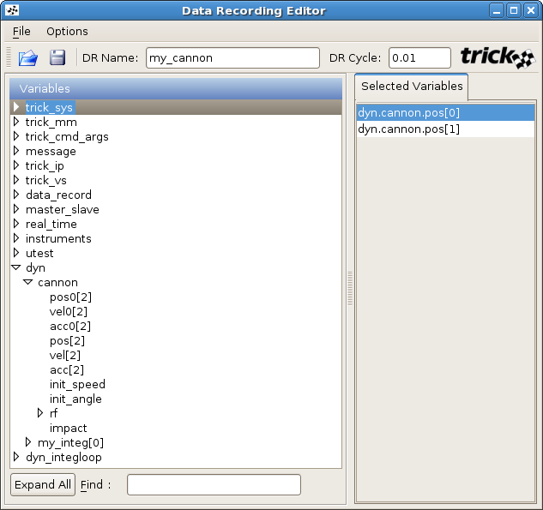
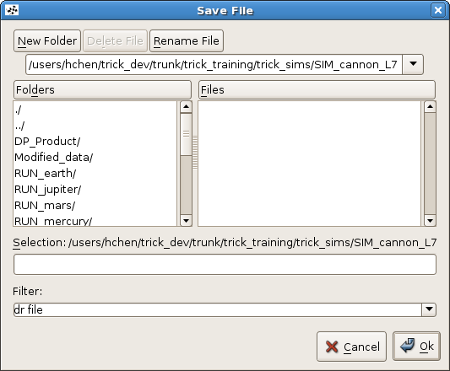
Data Recording
Click "File" & "Save" or save button
Save as cannon.dr in directory Modified_data/
Select "cannon"
Select "pos[2]"
Trick Basic Training
138
Notes:
138

Slide 139
Data Recording
Data Recording auto-generated file
[ see Trick User’s Guide § 7.8 ]
global DR_GROUP_ID
global drg
try:
if DR_GROUP_ID >= 0:
DR_GROUP_ID += 1
except NameError:
DR_GROUP_ID = 0
drg = []
drg.append(trick.DRBinary("my_cannon"))
drg[DR_GROUP_ID].set_freq(trick.DR_Always)
drg[DR_GROUP_ID].set_cycle(0.01)
drg[DR_GROUP_ID].set_single_prec_only(False)
drg[DR_GROUP_ID].add_variable("dyn.cannon.pos[0]")
drg[DR_GROUP_ID].add_variable("dyn.cannon.pos[1]")
trick.add_data_record_group(drg[DR_GROUP_ID], trick.DR_Buffer)
drg[DR_GROUP_ID].enable()
Trick Basic Training
139
Notes:
139

Slide 140
Data Recording
% vi RUN_test/input.py <edit as below and save>
execfile("Modified_data/cannon.dr")
execfile("Modified_data/realtime.py")
dyn_integloop.getIntegrator(trick.Runge_Kutta_4, 4)
my_event = trick.new_event("impact")
my_event.set_cycle(0.01)
my_event.condition(0,"""trick.exec_get_sim_time() > 1.0 and \
dyn.cannon.pos[1] <= 0.0""")
my_event.action(0,"""print 'impact time: %f X-position: %s Y-position: %s' \
%(trick.exec_get_sim_time(), dyn.cannon.pos[0], \
dyn.cannon.pos[1])""")
trick.add_event(my_event)
my_event.activate()
trick.stop(5.2)
% ./S_main*exe RUN_test/input.py &
% trick_dp &
Trick Basic Training
140
Notes:
140

Slide 141
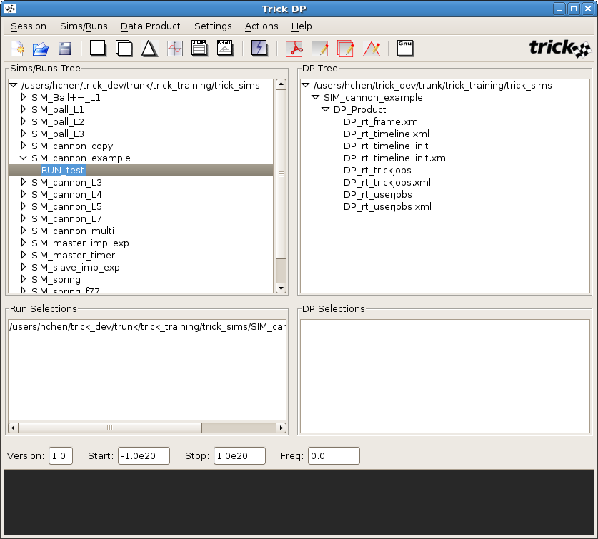
Data Recording
Double Click SIM_cannon_example in the Sims/Runs window
Double click RUN_test
Push the Quick Plot button
Trick Basic Training
141
Notes:
141

Slide 142
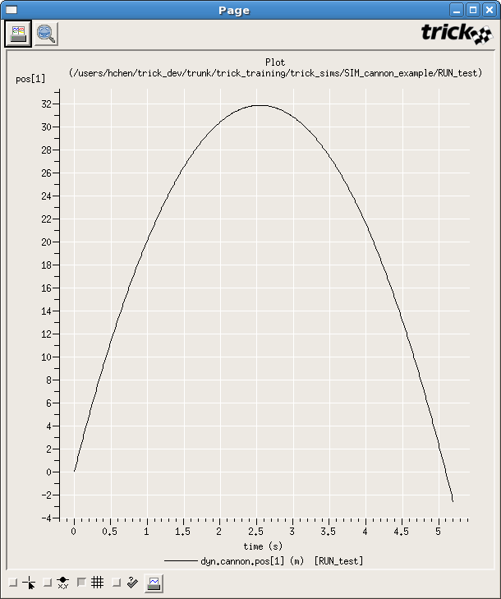
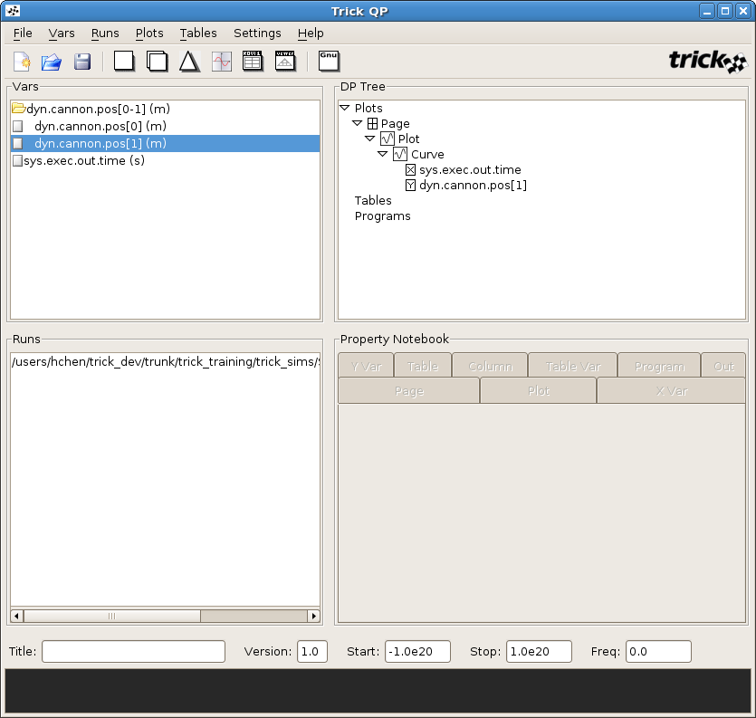
Data Recording
Double Click dyn.cannon.pos[1] (m) – note, right-click to expand
Push the Single Plot button
Trick Basic Training
142
Notes:
142

Slide 143
Data Recording Formats
When Trick sims log data they can use 3 recording formats
DRBinary format (the default) --> <filename>.trk
DRAscii --> <filename>.csv
DRHDF5, readable by Matlab --> <filename>.h5
Logged data files are placed in the RUN directory
Use DRAscii or DRHDF5 recording to export Trick data to other programs
Trick data products can read data from
Trick native formats: Trick Binary, CSV, HDF5
Trick Basic Training
143
Notes:
143

Slide 144
Trick Documentation
$TRICK_HOME/docs
Trick User’s Guide
firefox index.html
Trick Tutorial
tutorial.pdf

Slide 145
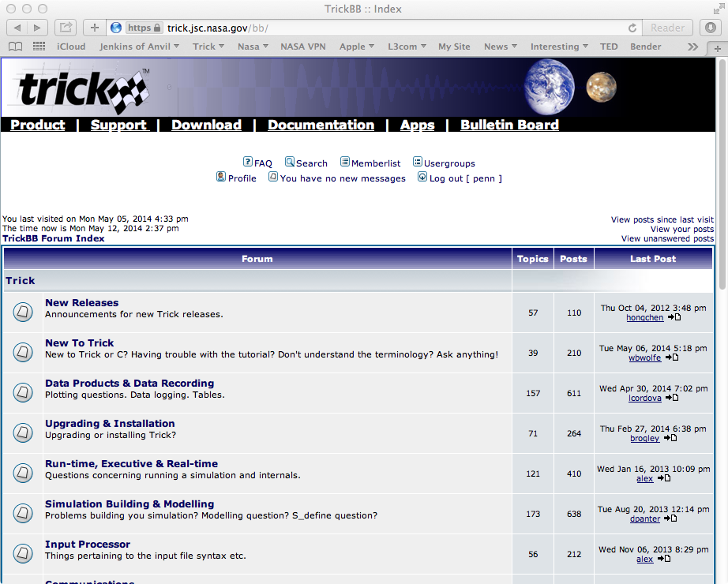
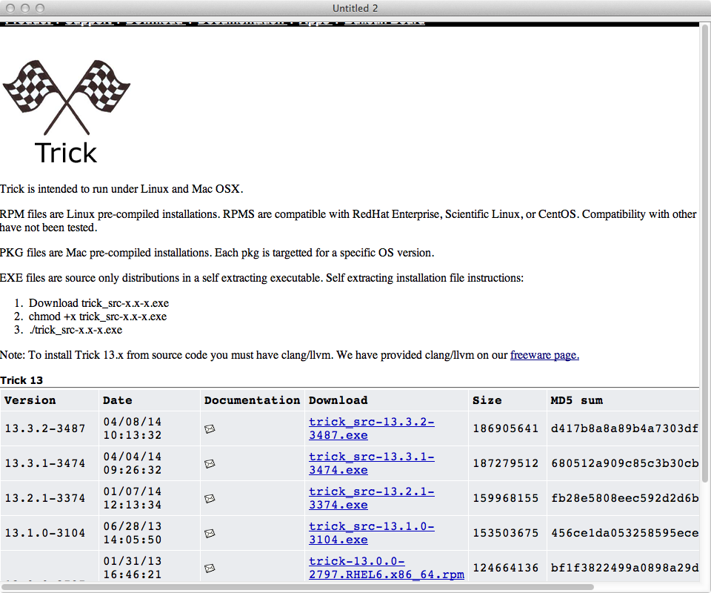
Trick Website
http://trick.jsc.nasa.gov/

Slide 146
End of Day 1
You have made it through the Basic Tutorial Class!
The Source and Include files can be found on the CD
root/trick_models/copies/gravity/include
root/trick_models/copies/gravity/src
The simulation files can be found on the CD
root/trick_sims/SIM_cannon_copy/*

