Slide 1
EC4206 Software Testing and Quality Assurance
SHIMRIN SM.
EG/2022/5346

Slide 2
1.1Test-Driven Development (TDD)
Red: Failing test proves test is valid.
Green: Code works, test passes.
Refactor: Clean, maintainable solution while keeping tests green.
Two core features:
User Signup
User Login

Slide 3
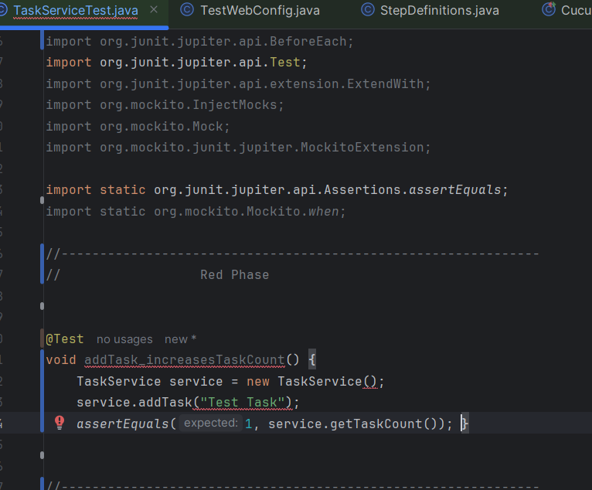
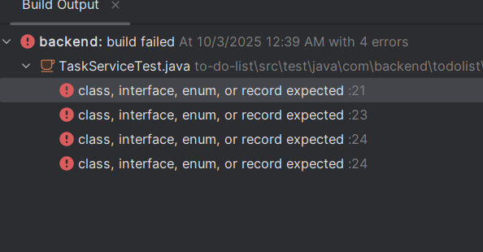
RED (Failing test)

Slide 4
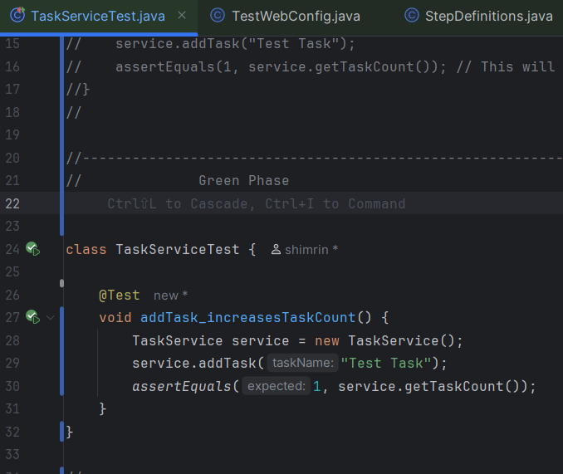
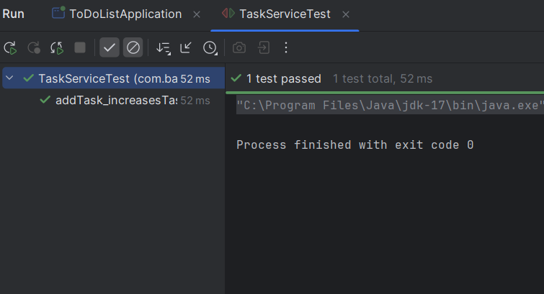
green (Passing test)

Slide 5
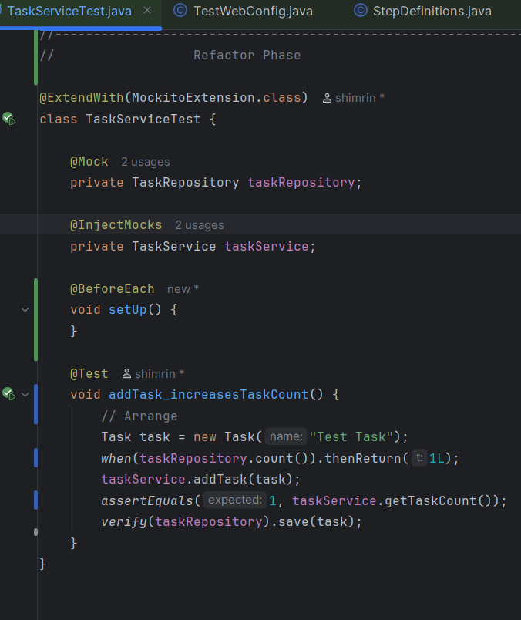
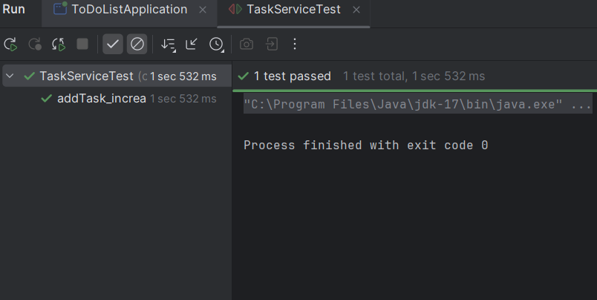
Refactor phase

Slide 6
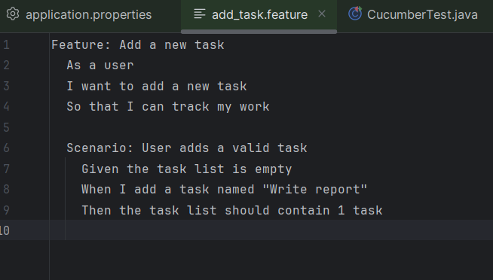
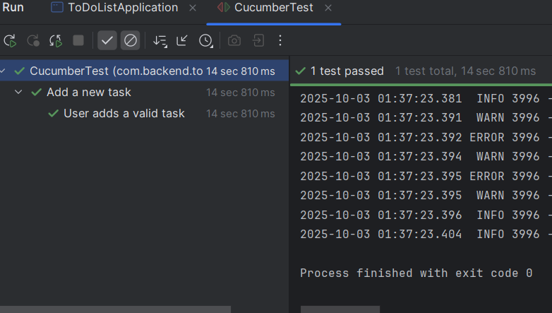
1.2 Behavior-Driven Development (BDD)

Slide 7
2.1Test Automation Summary UI Tests: Selenium
Scenarios tested
Successful Signup – fill form with valid inputs
Invalid Username Signup – form shows error message
Brief explanation of test scripts
Setup: Open Chrome browser using Selenium WebDriver.
Test 1: Enter valid name, password → click signup → check redirect to login page
Test 2: Enter invalid Username → check for error messages or browser validation → ensure no redirection.
Error Handling: Script checks multiple selectors for error messages and captures screenshot if test fails

Slide 8
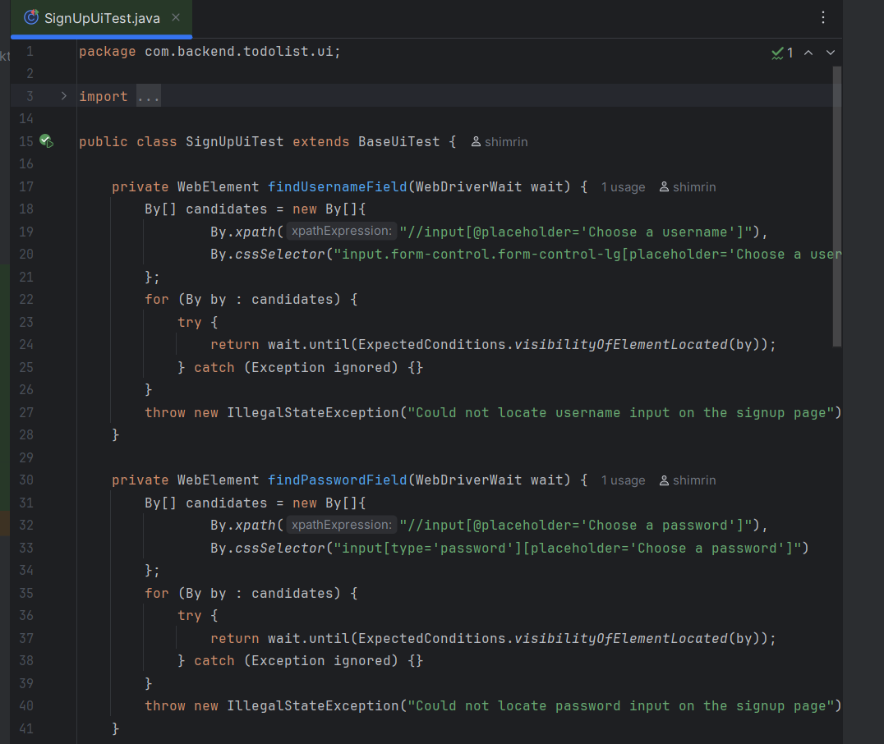
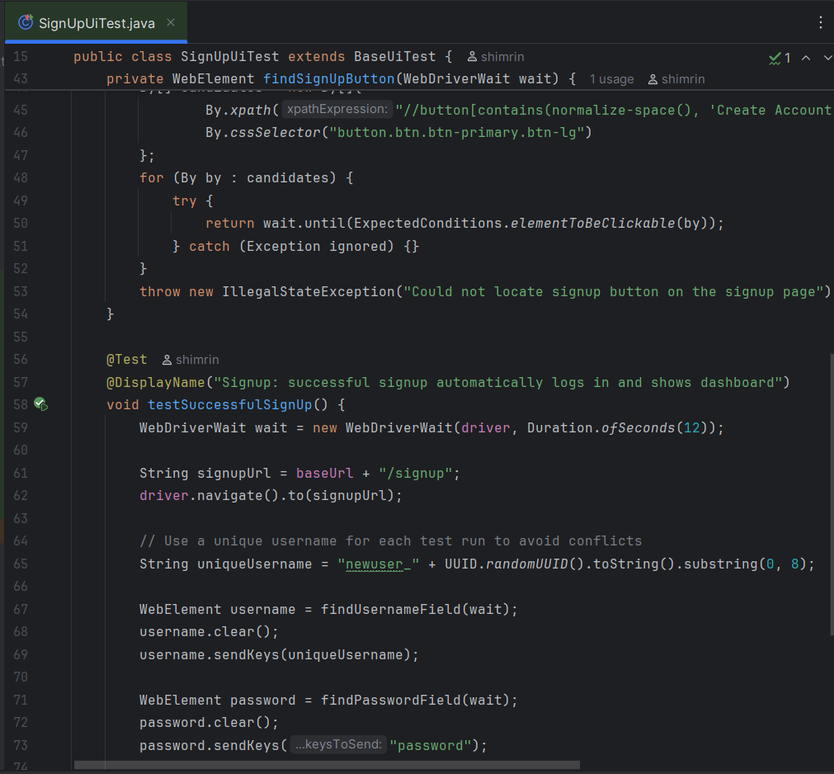
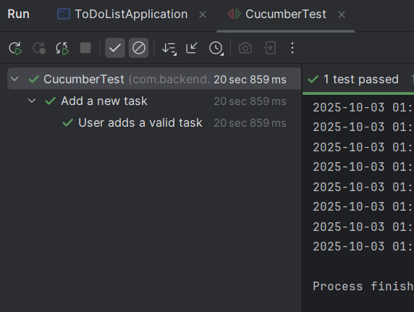
Test SIGNUP Summary

Slide 9
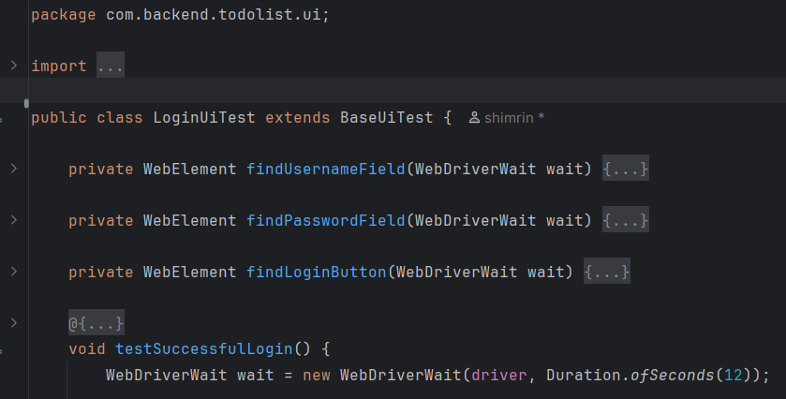
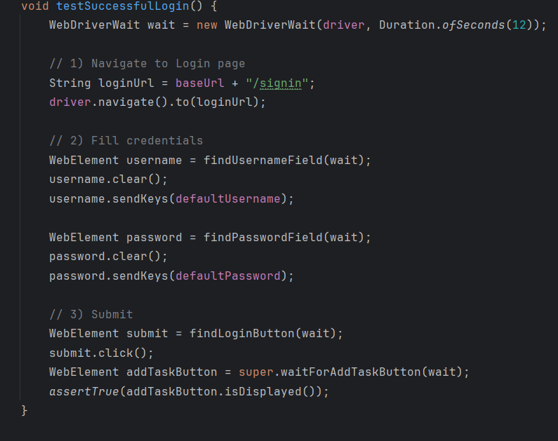
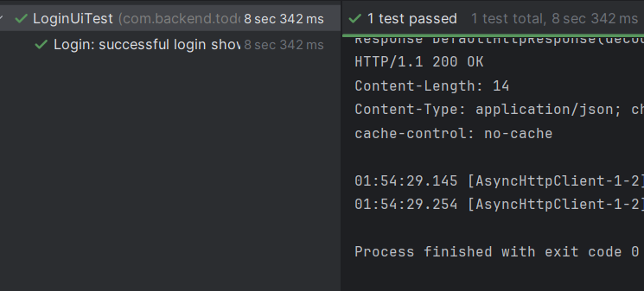
Test LOGIN Summary

Slide 10
2.2Test Automation Summary - API Tests: Postman
Endpoints tested
POST /SignUp – Create new user
POST /Login – Authenticate user
Assertions made
Response Code : 201 Created ------ for successful signup
200 OK ------ for successful login
400 Bad Request ------ for invalid inputs
Payload Validation : Signup response contains confirmation message / UserId
Login response contains authentication token(JWT )

Slide 11
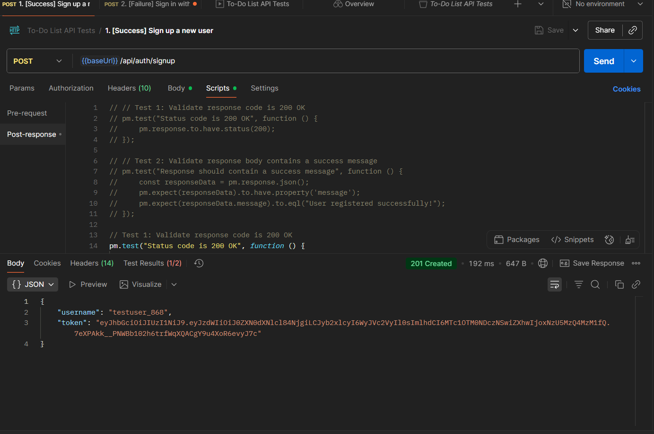
Test Automation Summary:201

Slide 12
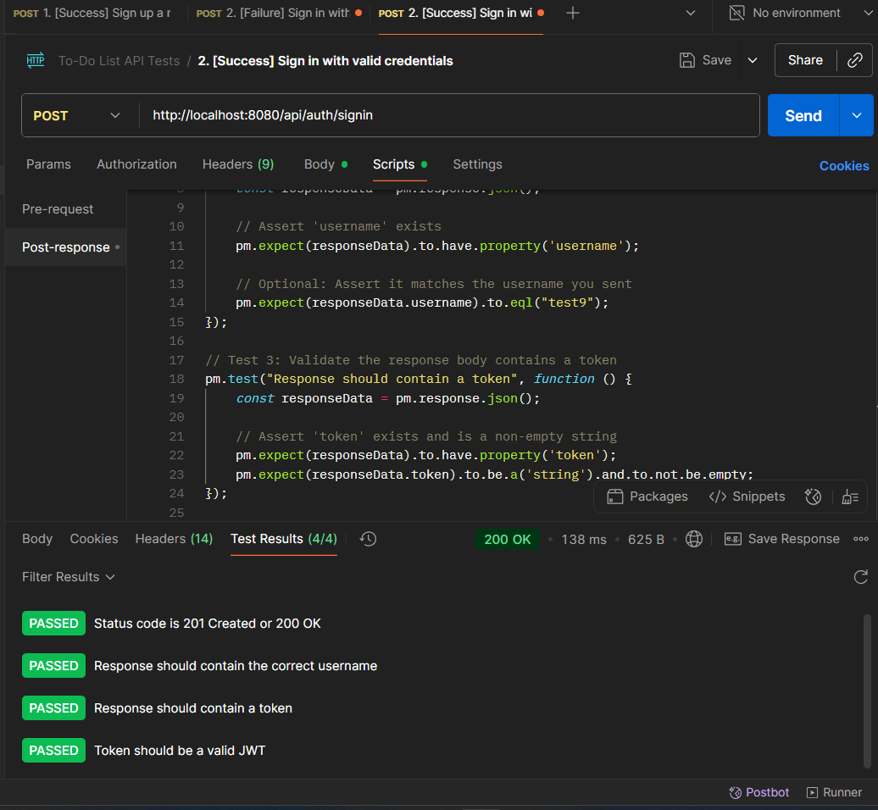
Test Automation Summary:200

Slide 13
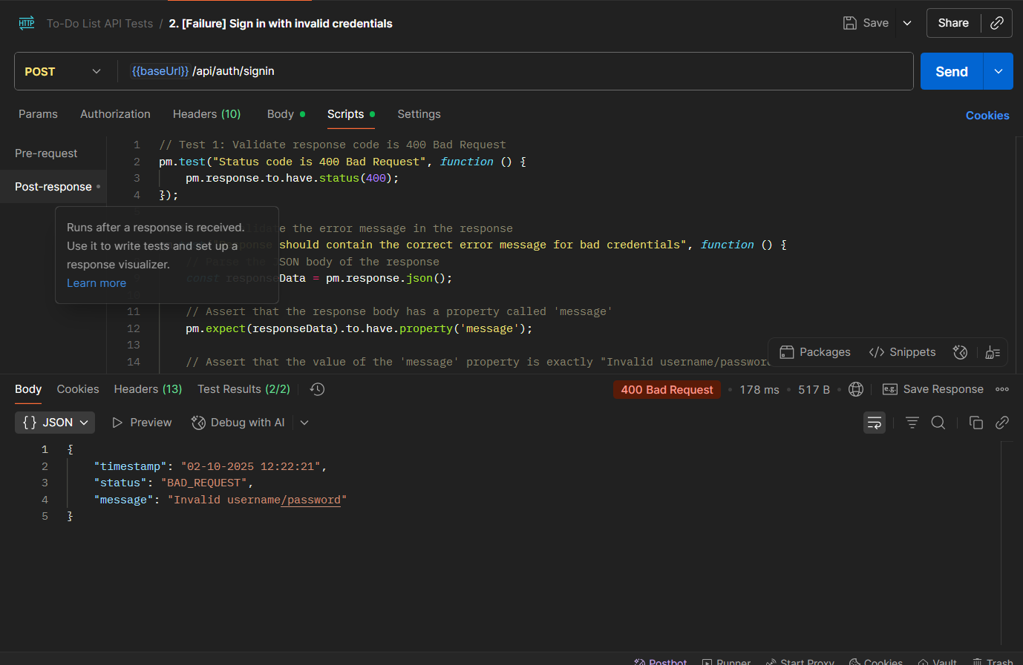
Test Automation Summary:400

Slide 14
2.3Test Automation Summary - Unit Tests
Summary of unit tests
Tested : Login signup Validation function
Test Cases : Pass for Valid signup – return true
Pass for Valid Login details – return true
Fail for Invalid Login details – return true
Framework Used : Mocha + Chai

Slide 15
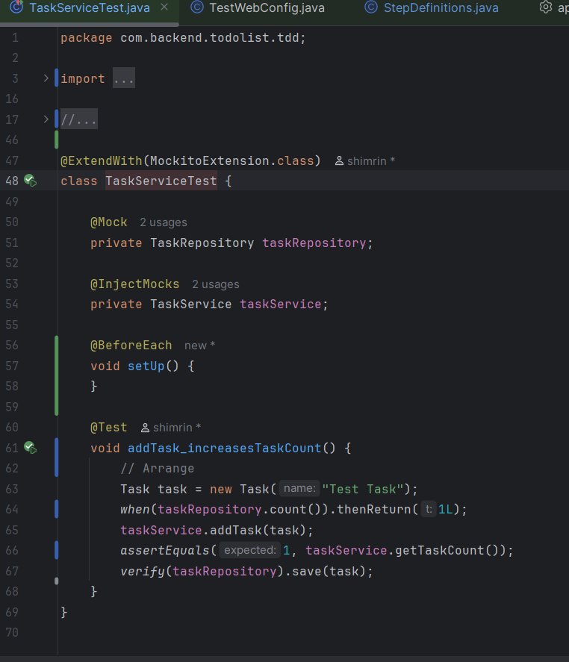
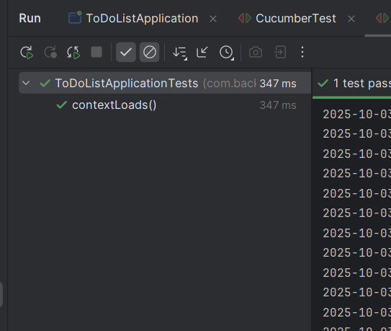
Test unit test Summary

Slide 16
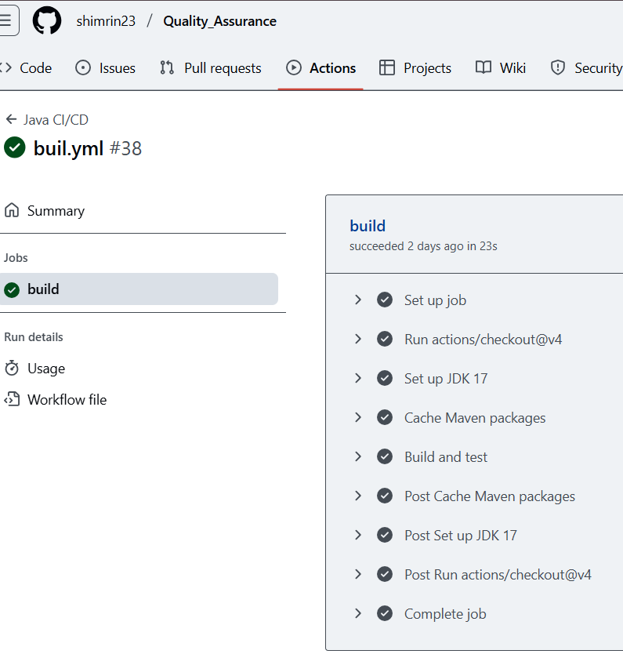
2.4 CI/CD Pipeline
Key steps in pipeline
Build : Install dependencies & compile project
Test : Run unit tests (Mocha/Chai) & UI/API tests
Analysis : Linting / code quality checks
Deploy : Deploy app after all tests pass

Slide 17
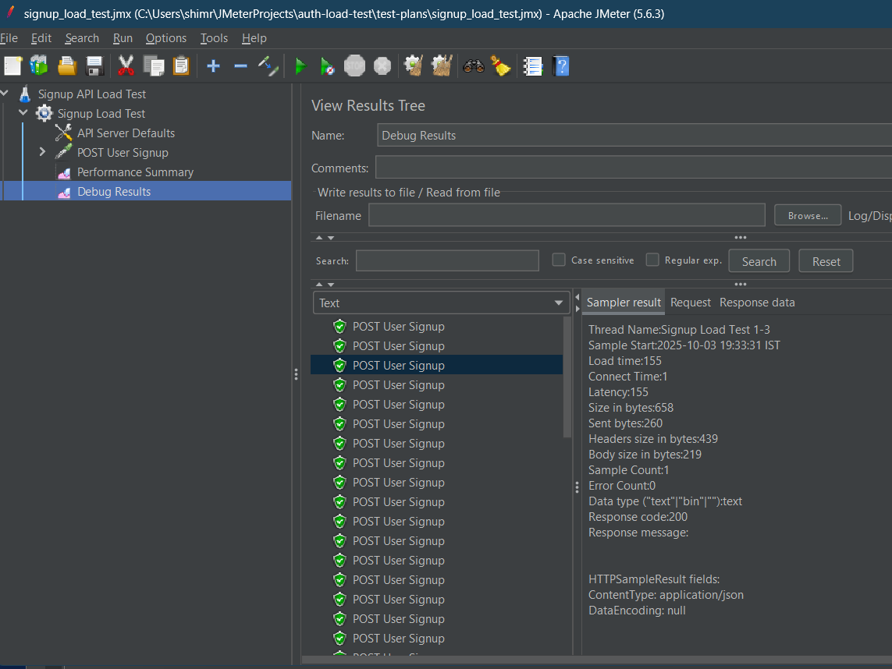
3.1Load Testing with JMeter
JMeter Test Plan summary
Simulated concurrent users hitting the API endpoint
collected metrices : response time, throughput, errors
Target API endpoint
POST /register – signup user authentication

Slide 18
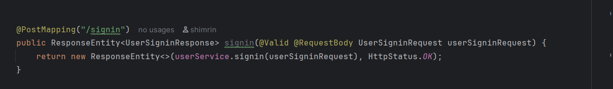
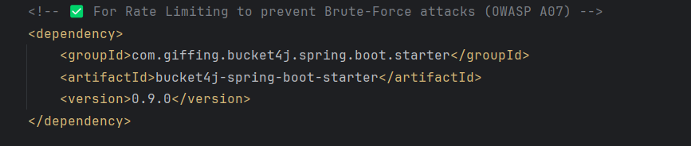
3.2Security Testing
Issue:
api/auth/signin endpoint allows unlimited requests.
Attackers can brute-force passwords.
High risk of unauthorized access and denial of service.
Fix:
Implement rate limiting on sensitive endpoints.
Bucket4j library for request throttling.
Configure a filter to intercept and limit repeated login attempts.

Slide 19
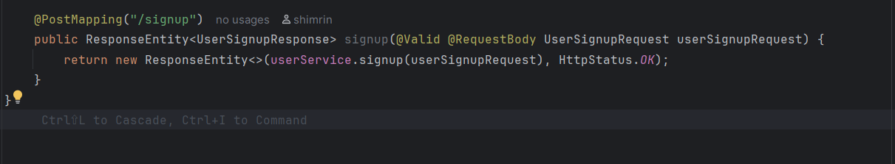
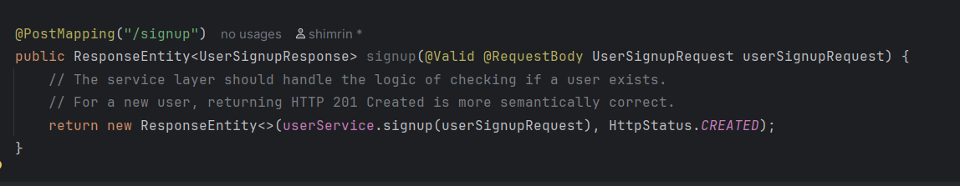
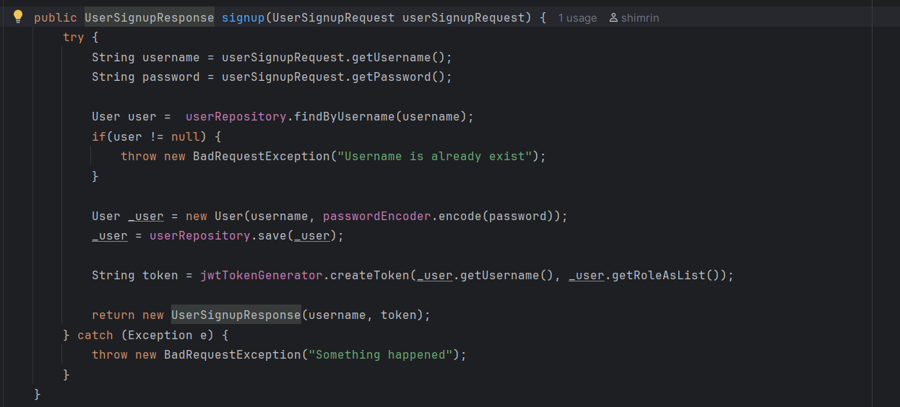
Issue:
OWASP A07:2021 – Identification & Authentication Failures
/api/auth/signup returns generic HttpStatus. OK or exposes 500 Internal Server Error.
ackers can perform user enumeration (discover which emails are registered).
Explanation:
Return HttpStatus.CREATED (201) for successful signup.
Return HttpStatus.OK / CONFLICT with a generic message if user already exists.
Fix:
Ensure UserService does not throw exceptions for duplicates, but returns a response object.
Prevents information disclosure & user enumeration attacks.

Slide 20
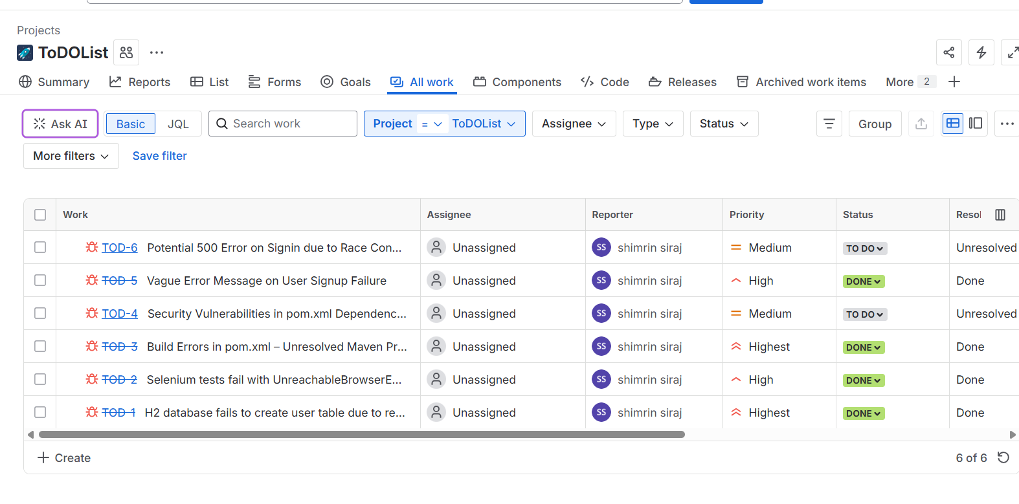
4.1Defect Tracking and Bug Management-Jira

Slide 21
4.2 root cause analysis
Why it Happened
Generic catch (Exception e) used
Threw vague "Something happened" message
Hid actual error → hard to debug
How it was Fixed
Handled specific exceptions
Left unexpected ones for global handler
Clear error messages + proper logging
Prevention
Don’t catch generic Exception
Use global exception handler
Log details for debugging
Code reviews on exception handling

Slide 22
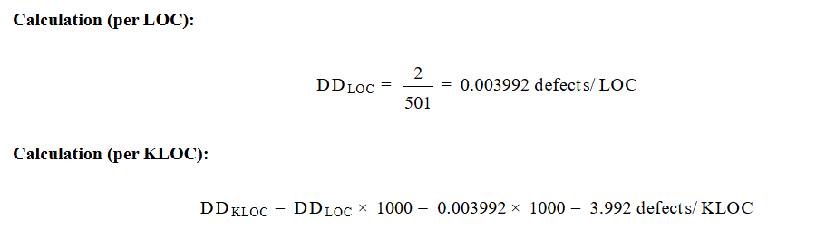
5.1Defect Density
Defect Count
Source: Jira Bug Tracking System
Total Defects: 2
Location: UserService.java
Severity:
Bug 1 → Major (Transactional Failure)
Bug 2 → Major (Race Condition)
Defect Density

Slide 23
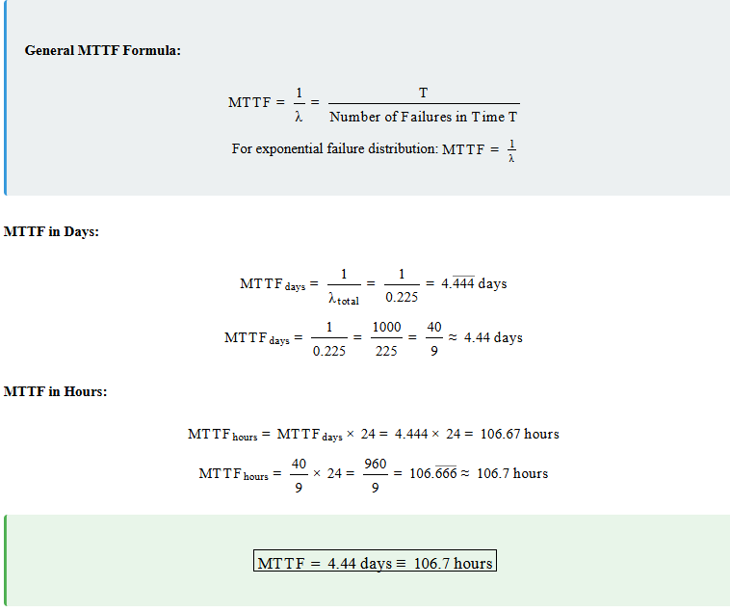
5.2Mean Time to Failure (MTTF)

Slide 24
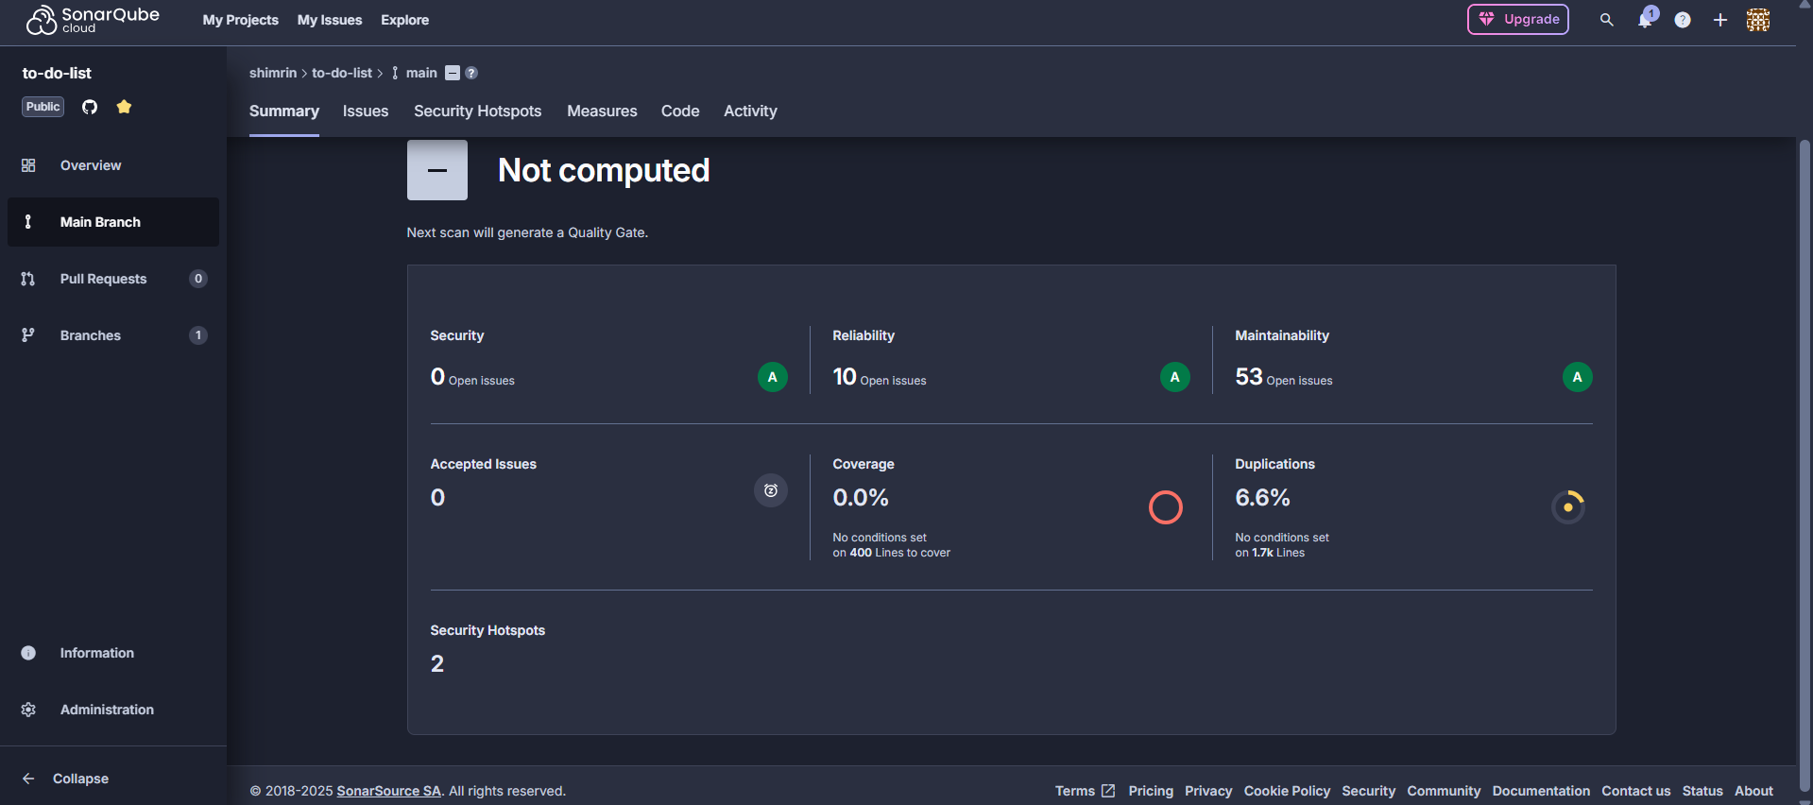
5. 3SonarQube Analysis

