Slide 1
AppSus
Home | MissKeep | MisterEmail | MissBook | About
IMG
MissKeep
MisterEmail
MissBook

Slide 2
MisterEmail
compose
search
Inbox (Show unread emails count)
Sent
Trash
Email1 (read/unread, from, subject, time, hover)
Email2
Email3
compose
To:
Subject:
body:
Open received email
(Reply – allows editing, adding “Re:” to subject,delete...)
Subject:
From (time):
Body:

Slide 3
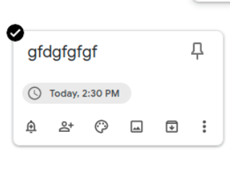
MissKeep
search
default =Take a note… (image, video, list)
Pinned
Other (un-pinned)
New item = edit item
Notes
Reminders
Edit Labels
Archive
Trash

