Slide 1
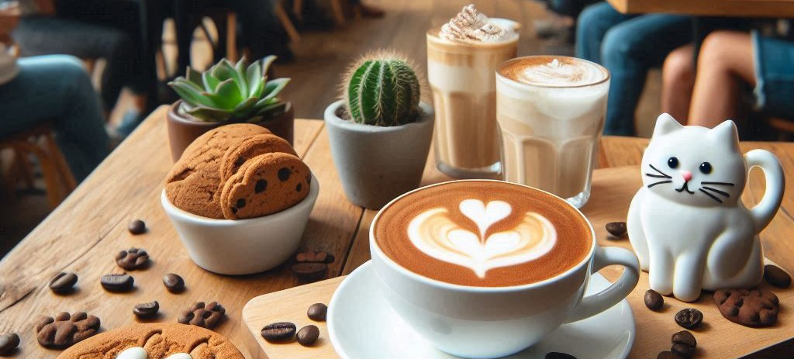
Final Exam Project Yume Neko Café Webpage
By: Pataki Dóra, Horváth Cintia

Slide 2
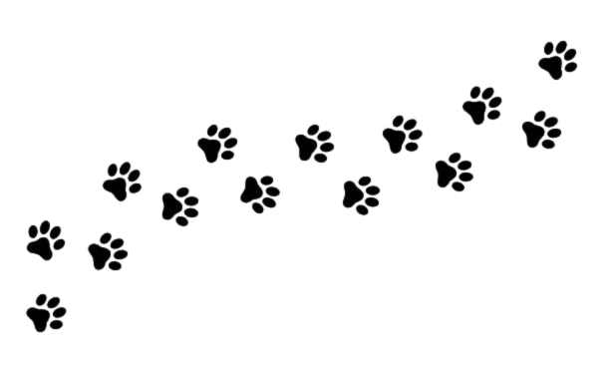

Project idea showcase
Why was this website made?
Due to high demand from regular customers
Why did we choose this project?
Because we love cats and the atmosphere of coffee shops
Dreams and Cats
What inspired us?
Yume Neko Café = Dream Cat Café

Slide 3
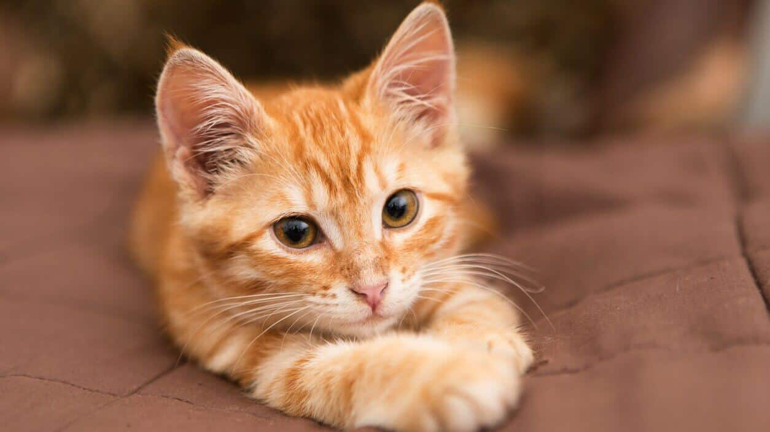
Real-life problem solving
Social responsibility:
All our cats are rescues, and we promote responsible pet care.
The problem:
Many get pets without giving them proper care.
Post-Covid social struggles.
The solution:
We take in cats from owners who can't care for them.
A relaxing space to socialize and make friends.

Slide 4

Design breakdown - Logo
Main Logo:
Title: meaning - Dream Cat
Cat: The main figure of the logo
Stars and Moon: it’s the symbol for dreams and a calm atmosphere

Slide 5


Design breakdown– Colour palette
Coffee and latte shades
Home Page
Warm beige and brown shades
Menu Page

Slide 6
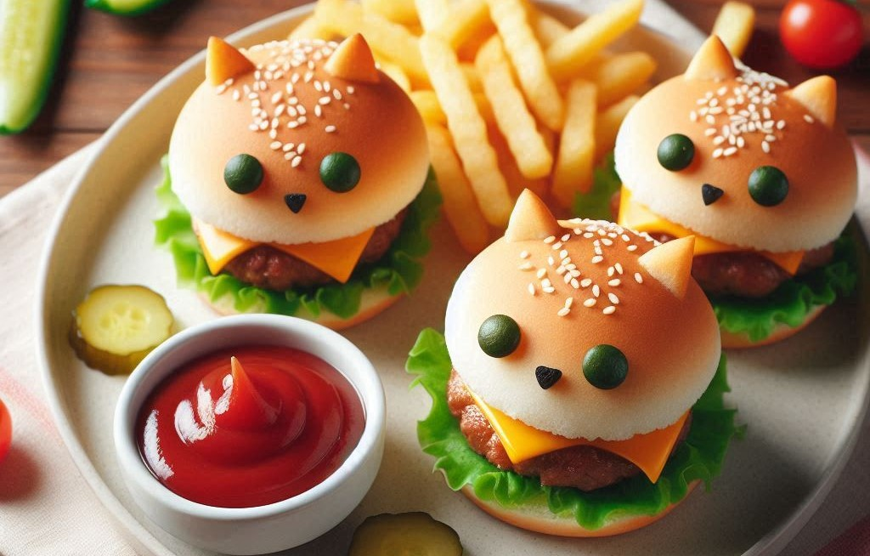

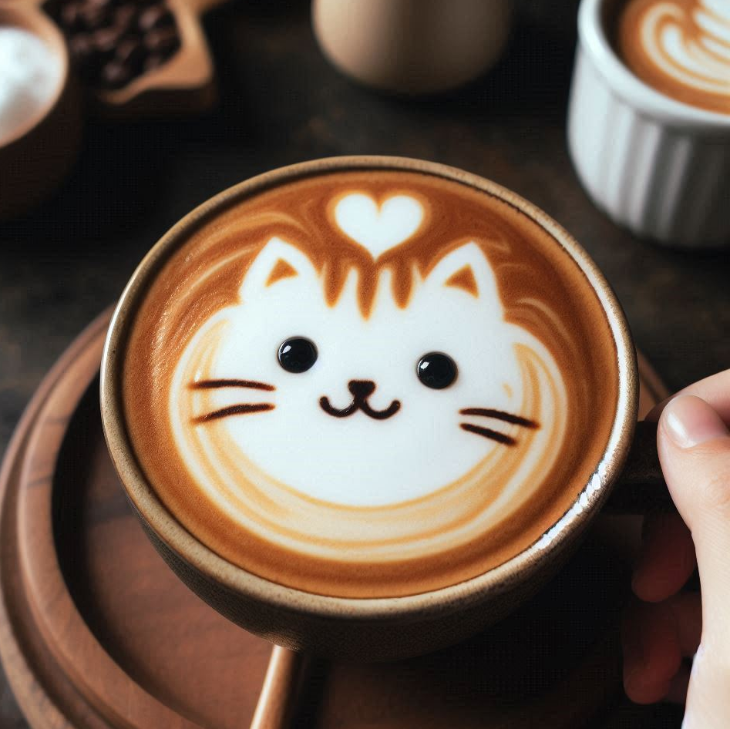
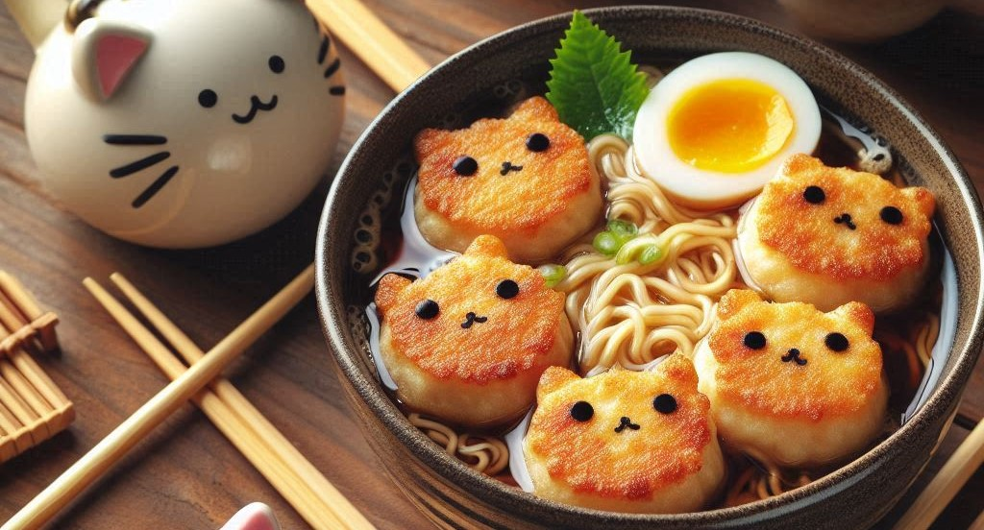
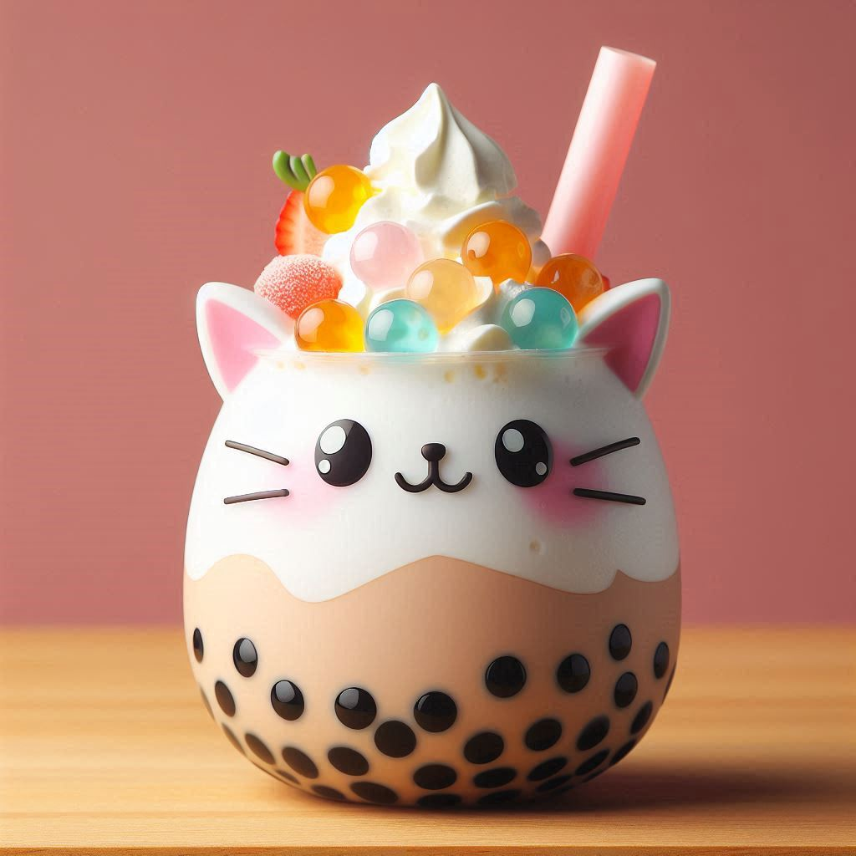

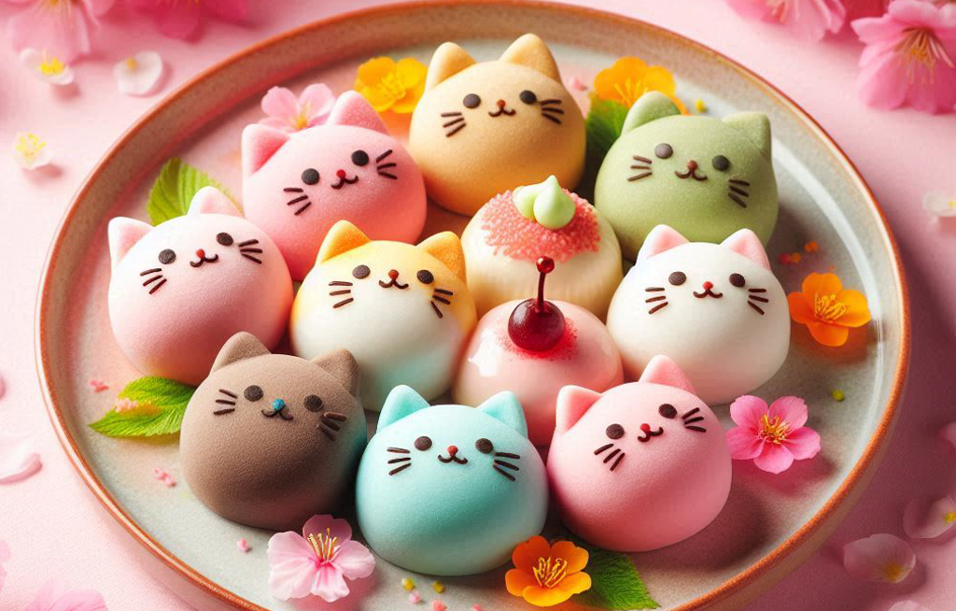
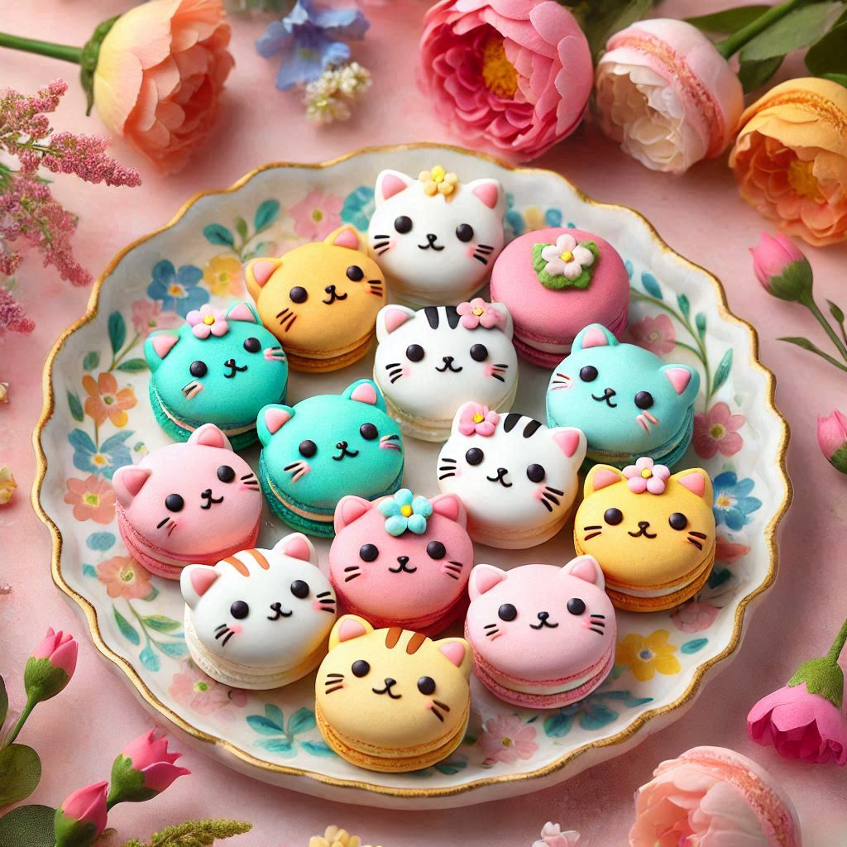
Design breakdown – Items
. .

Slide 7
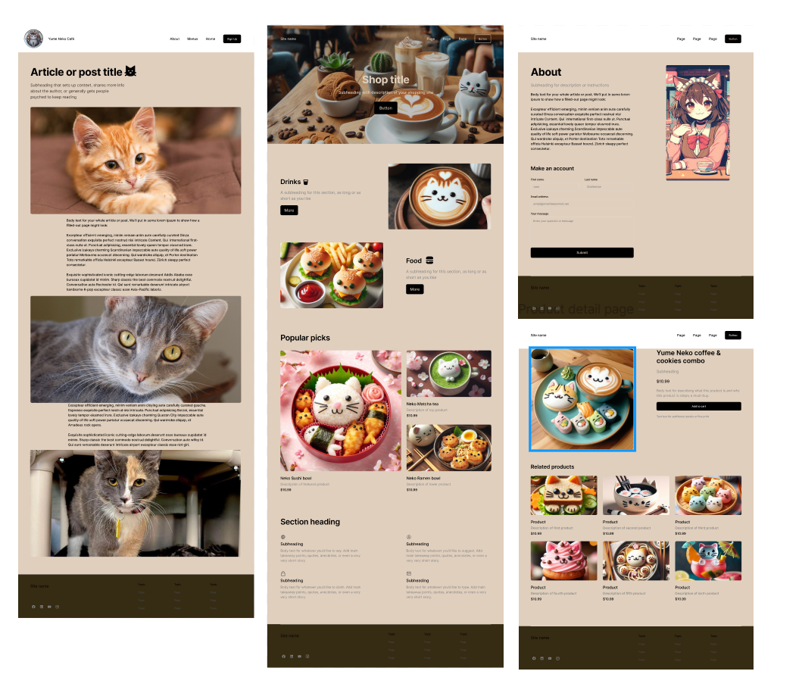
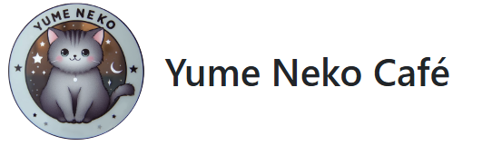
Figma design

Slide 8
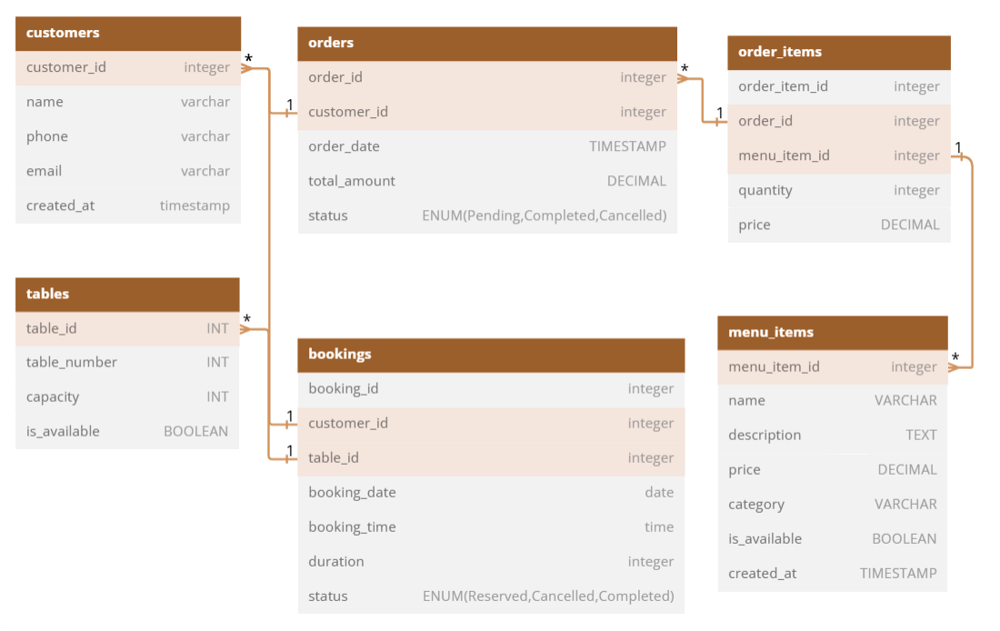

Database planning

Slide 9


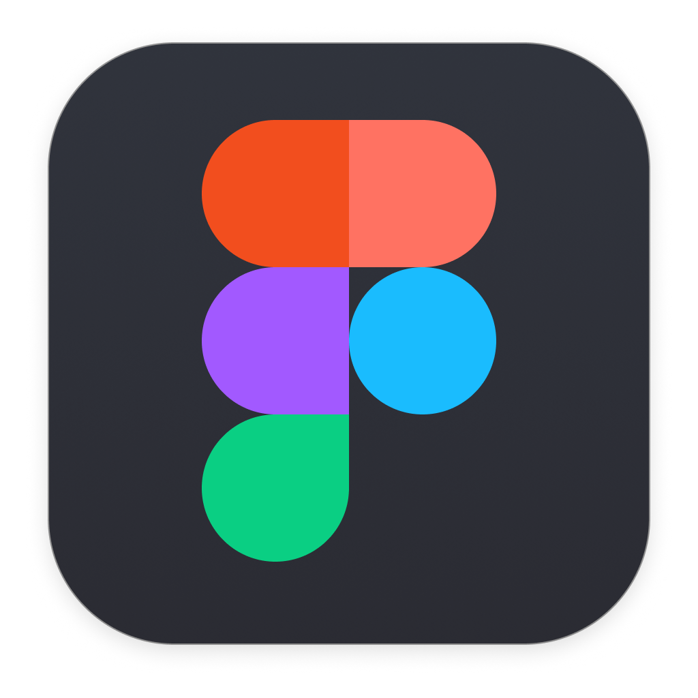







Technological stack
Frontend: VS code, Figma, Bootstrap
Backend: Neatbeans, Php, Postman
Database: MySQL, MAMP
Account authentication: JWT

Slide 10
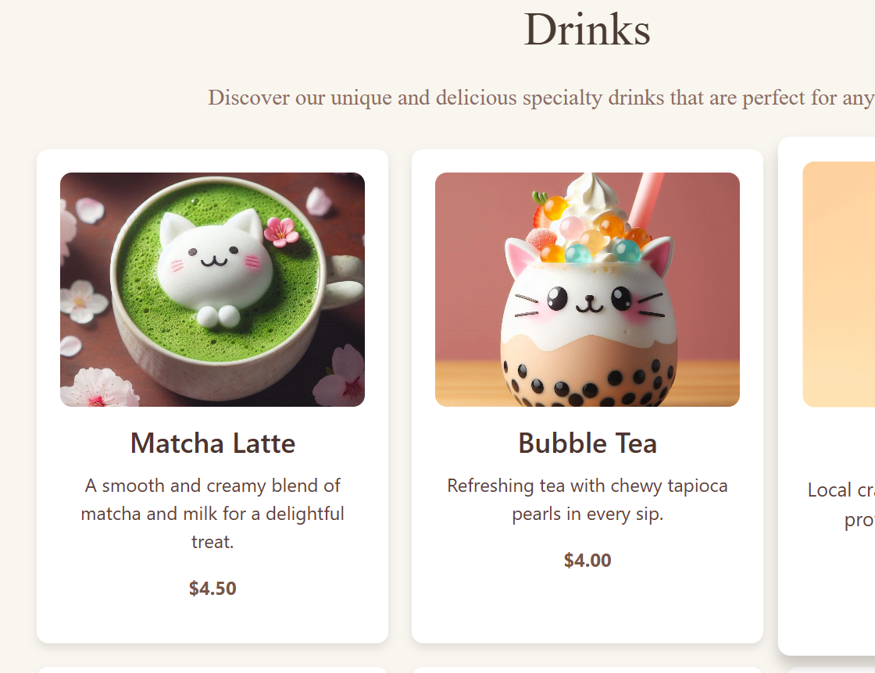
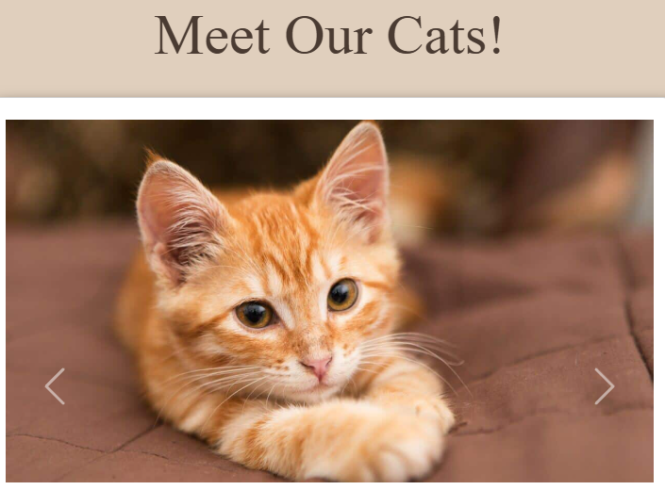
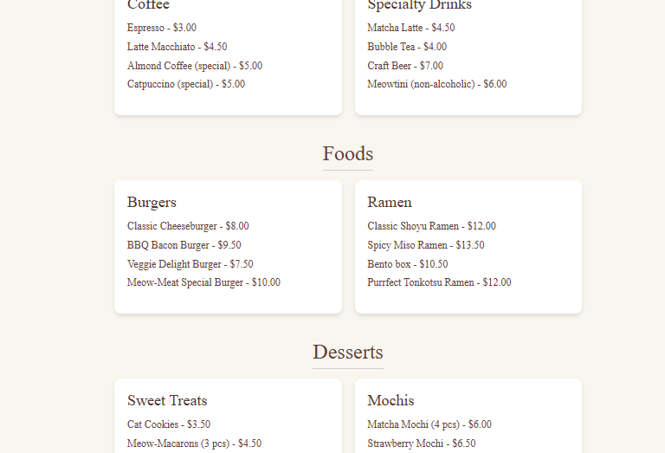
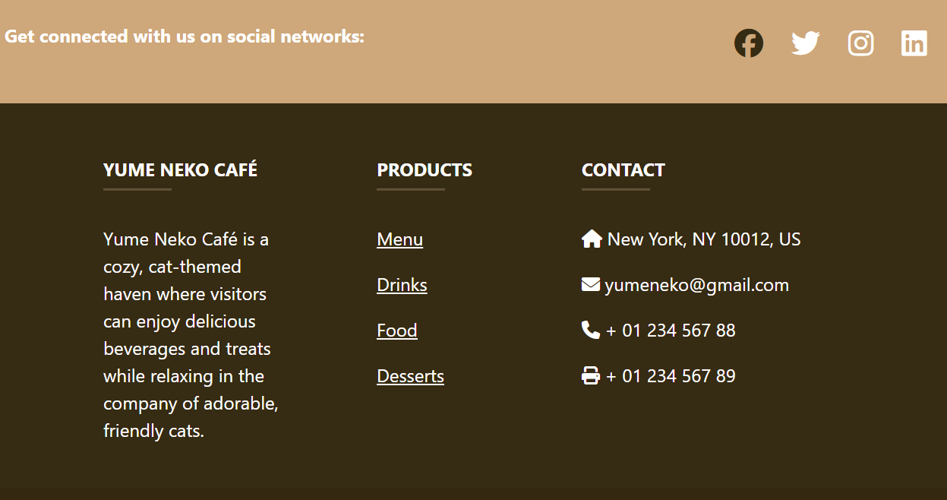
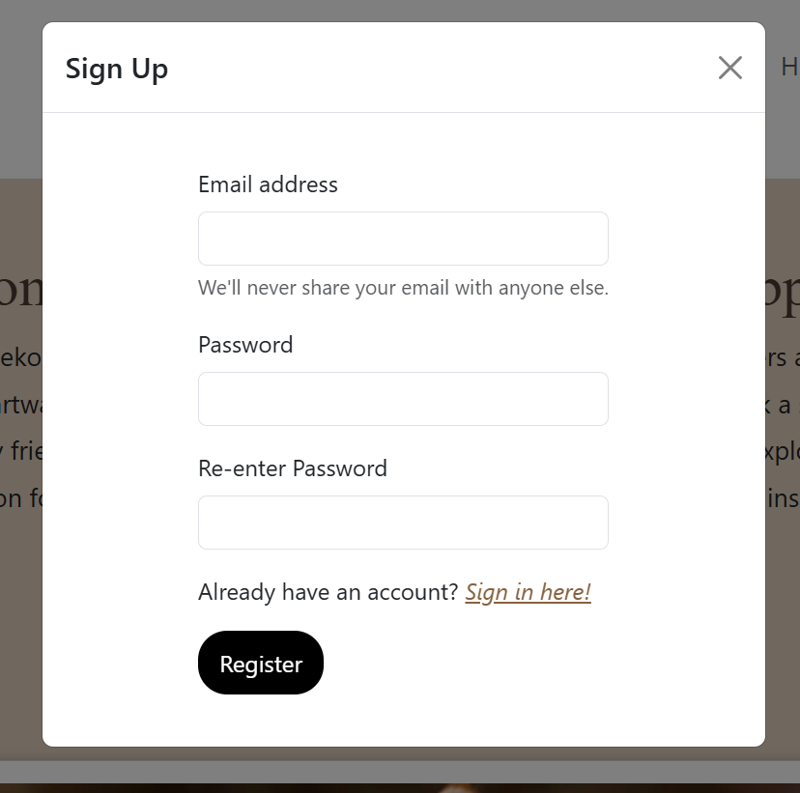
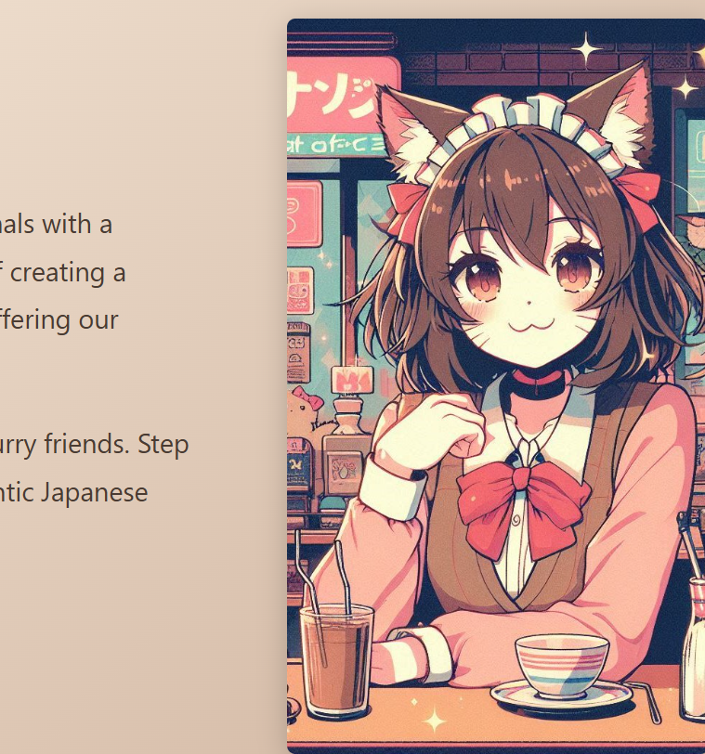
The website's functionality
Registrations and logging in
Viewing menus
Cat introductions
Admin Function

Slide 11
Live Demo

Slide 12
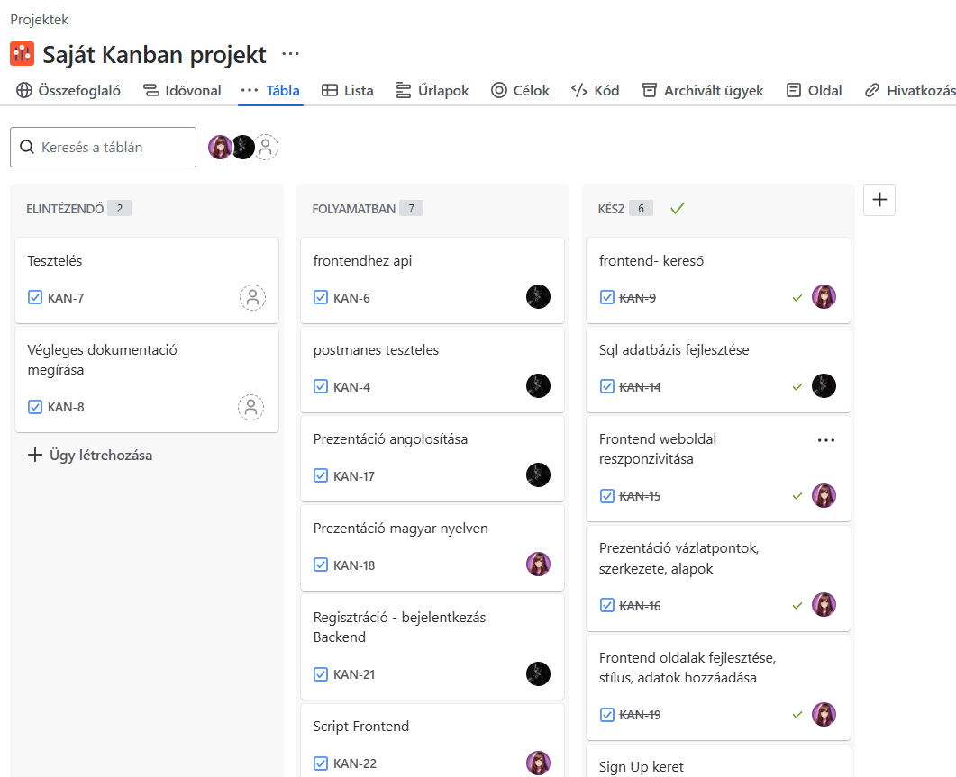
Dev cycle - Jira and GitHub

Slide 13
Thank you for your attention!

