Slide 1
TraceRight-SPROUT Consortium
End-to-End Digital MRV and EUDR-Compliant Traceability for African Agriculture
Shimeles Tadesse Zelelew | Project SPROUT | November 19, 2026

Slide 2
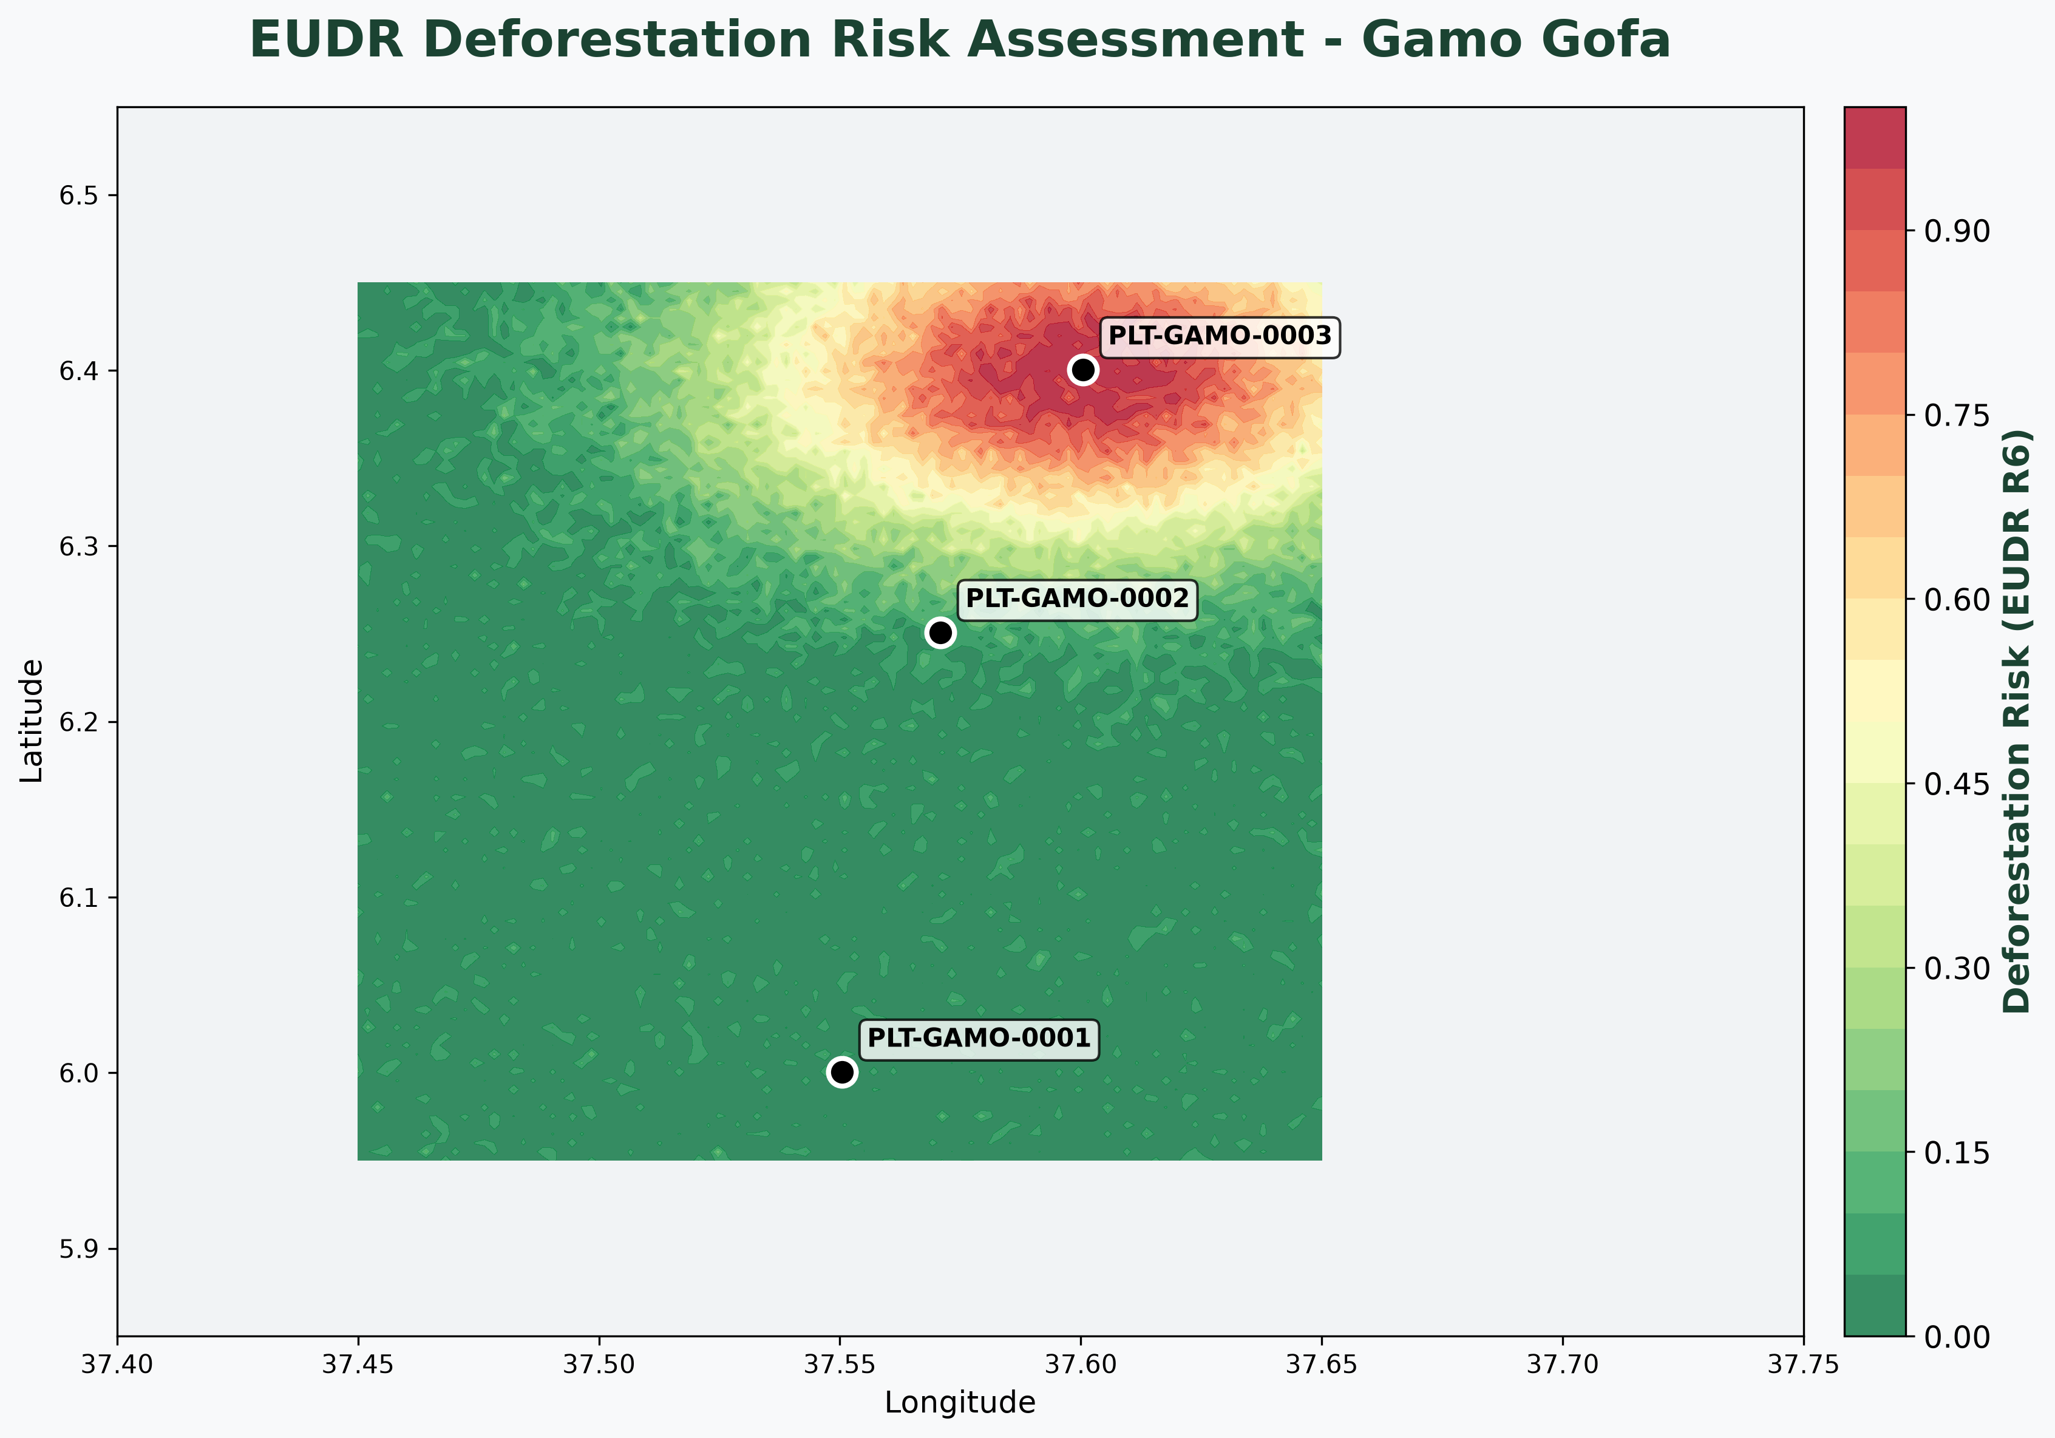

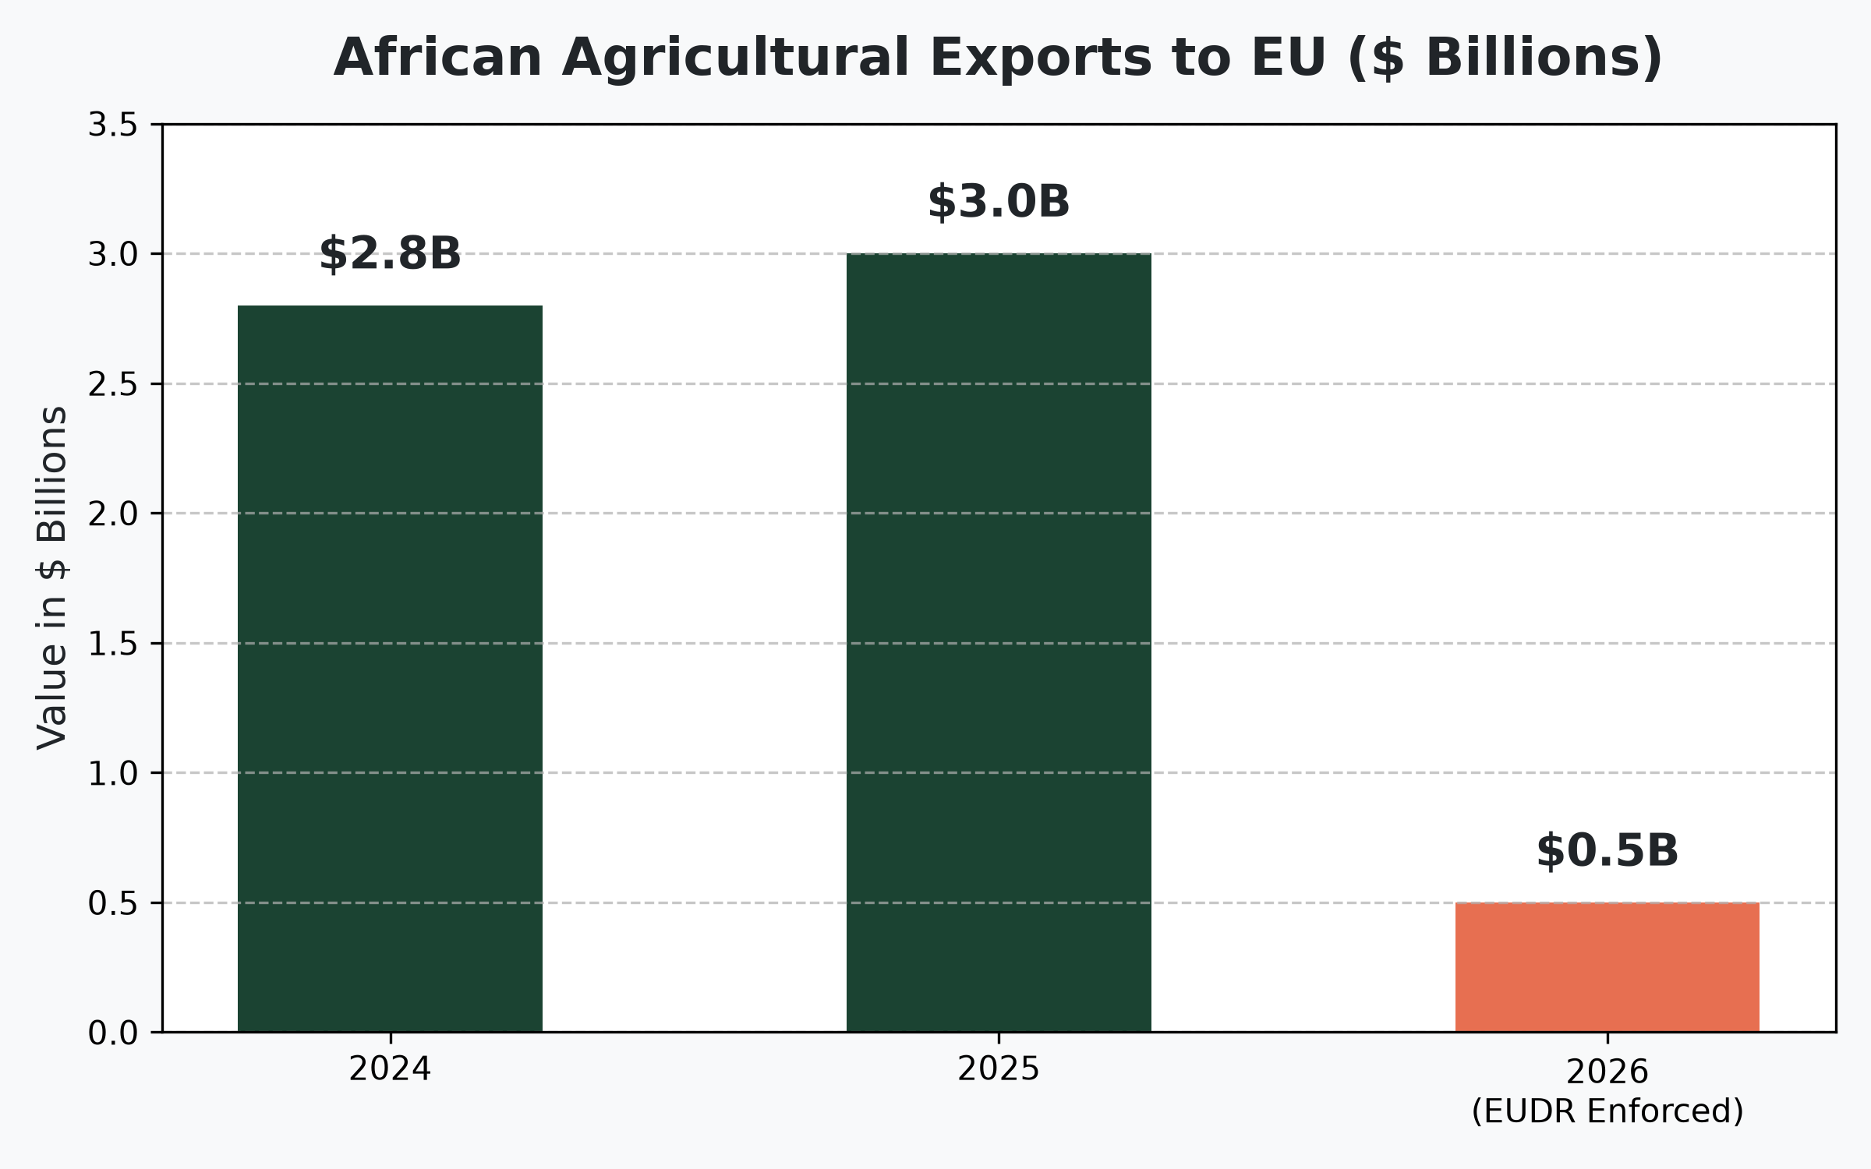
The $3B Problem
The Compliance Gap Facing African Agriculture
Regulatory Crisis: EUDR (Dec 2026) requires 6-decimal GPS precision. Most smallholders lack this.
MRV Inefficiency: Traditional carbon credit verification is slow, expensive, and prone to fraud.
Data Fragmentation: Farm data is siloed between ECTMS, buyers, and carbon registries.

Slide 3
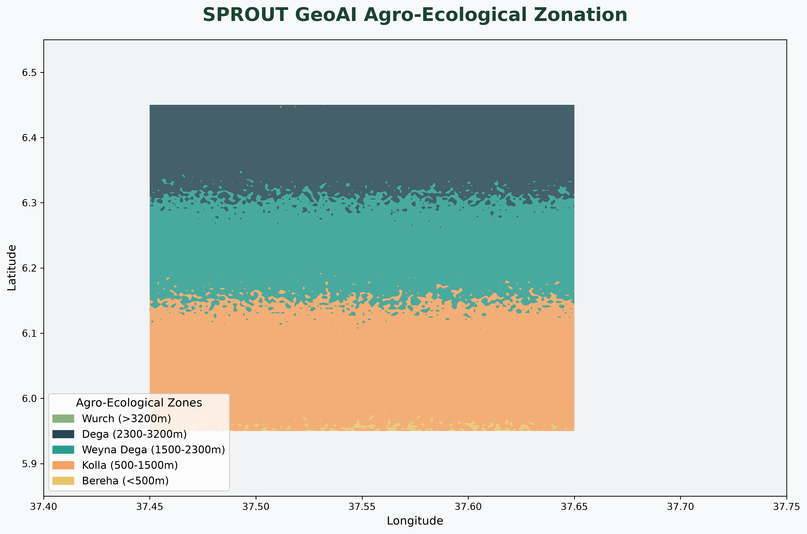
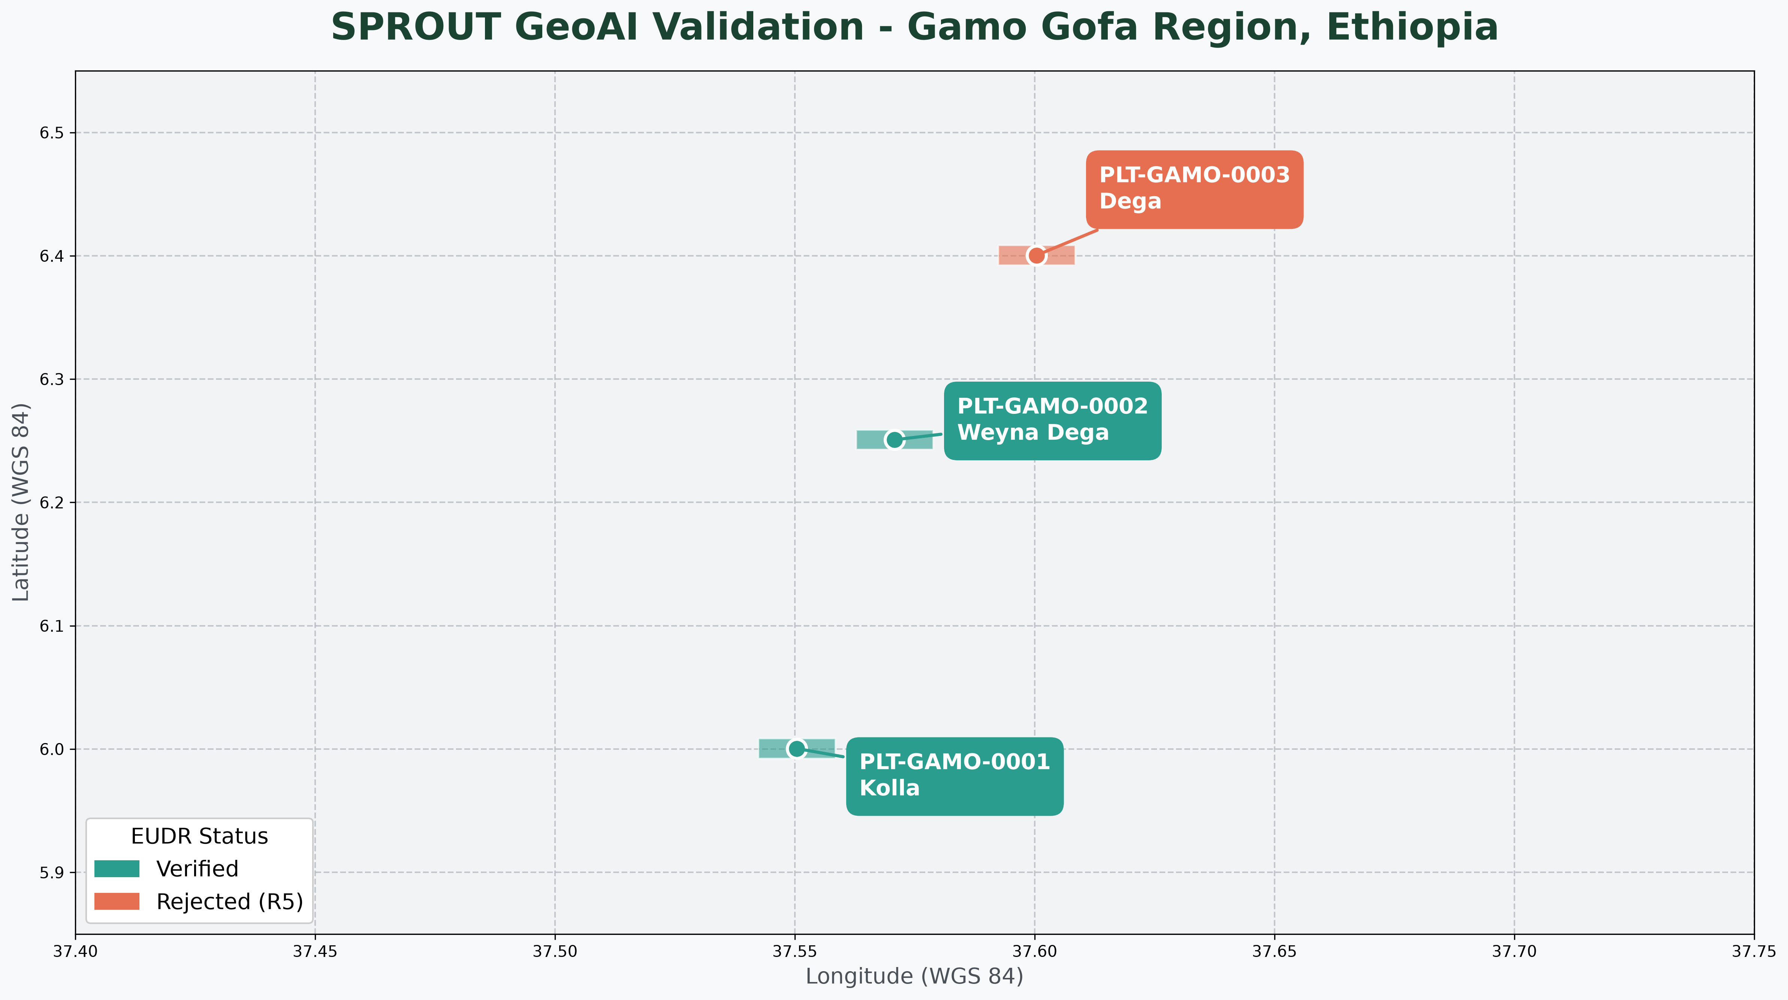
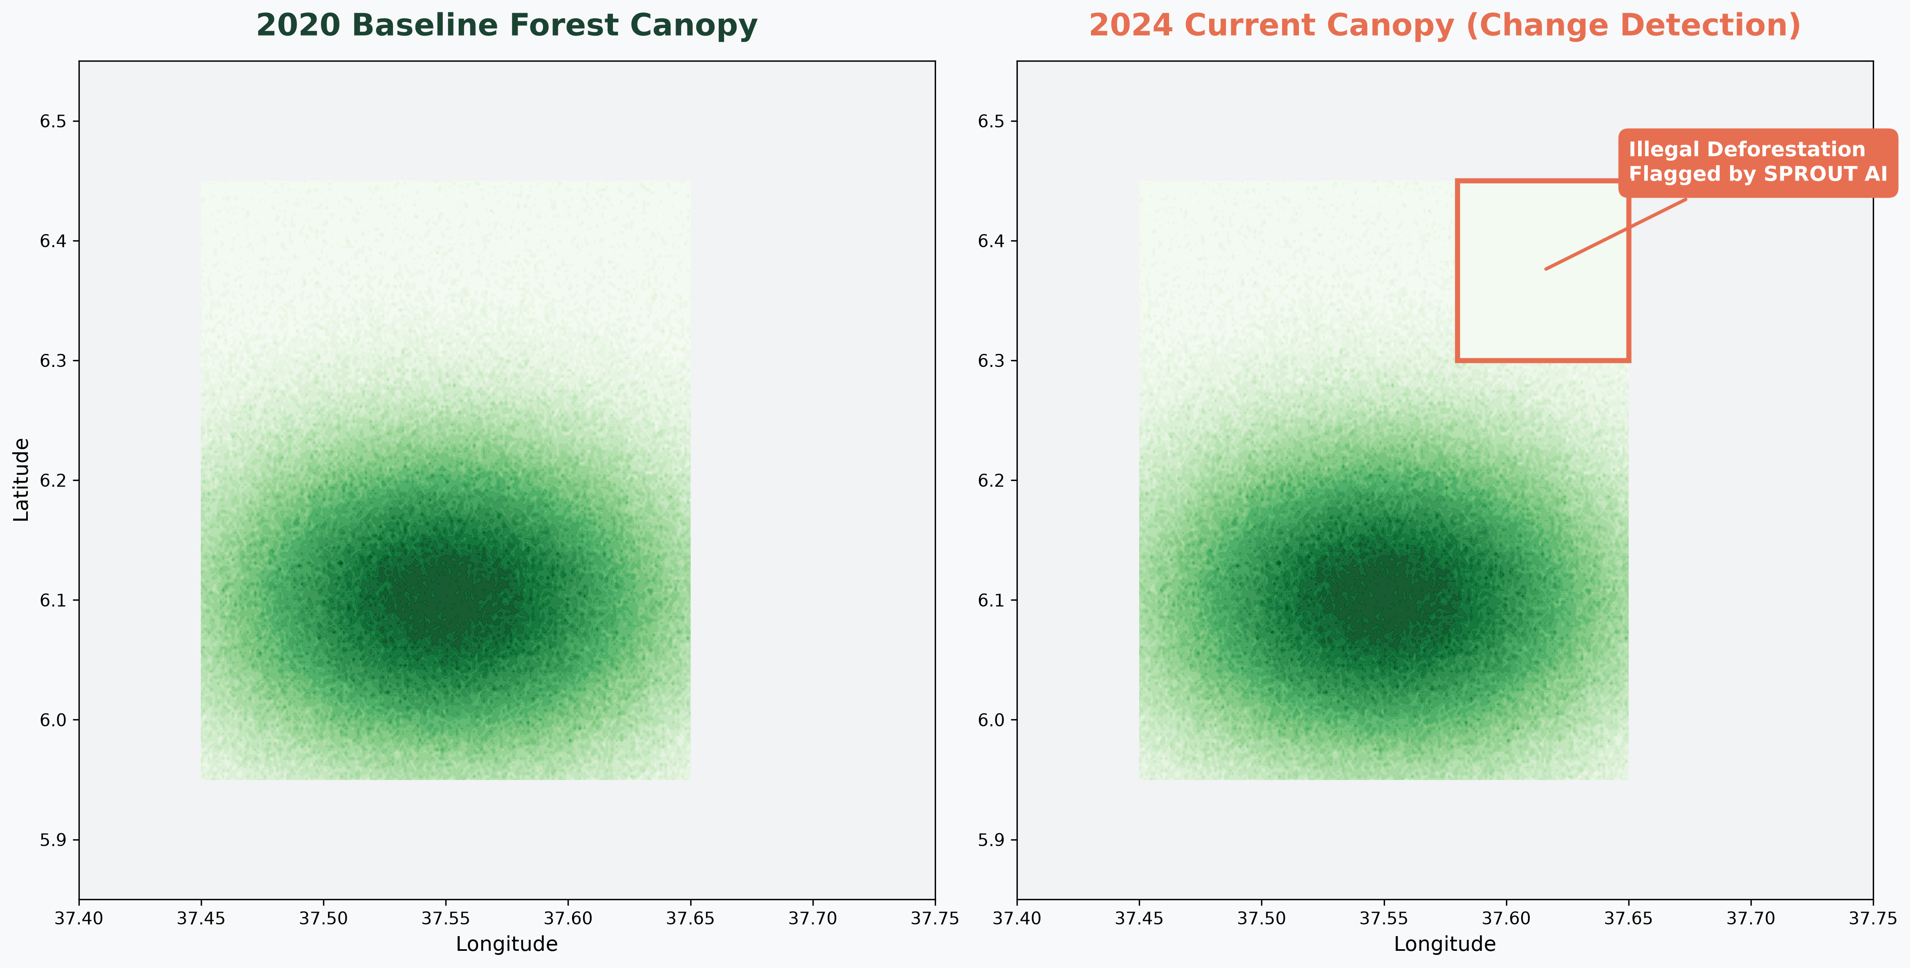
The TraceRight-SPROUT Architecture
A 4-Layer System Connecting Farmers to Global Markets
Layer 1: Mobile Data Capture
IME & Qonnect Origin (Offline-first)
Layer 2: Fair AI Spatial Verification
SPROUT GeoAI (Sentinel-1/2, GEDI)
Layer 3: Permissioned Ledger
Hyperledger Fabric (Smart Contracts)
Layer 4: Public Ledger
Polygon (NFT Passports, tCO2 Tokens)

Slide 4
Proven Technical Readiness (TRL 7)
The SPROUT AI Layer is Already Built and Operational
Live API (FastAPI): Returns 6-decimal EUDR GeoJSON in milliseconds.
Cryptographic Hash: SHA-256 Fabric integration already implemented.
EUDR Gatekeeping: Automatically rejects non-compliant data before it hits the ledger.
Open Source Core: Transparent, auditable, and ready for scale.
LIVE LINKS
Dashboard:
sprout-qonnect-clnhwfubq2y6y9bafzg.streamlit.app
Codebase:
github.com/shimtad2001g/SPROUT-Qonnect

Slide 5
LIVE DEMO
TraceRight Consortium Portal
Switching to browser now...

Slide 6
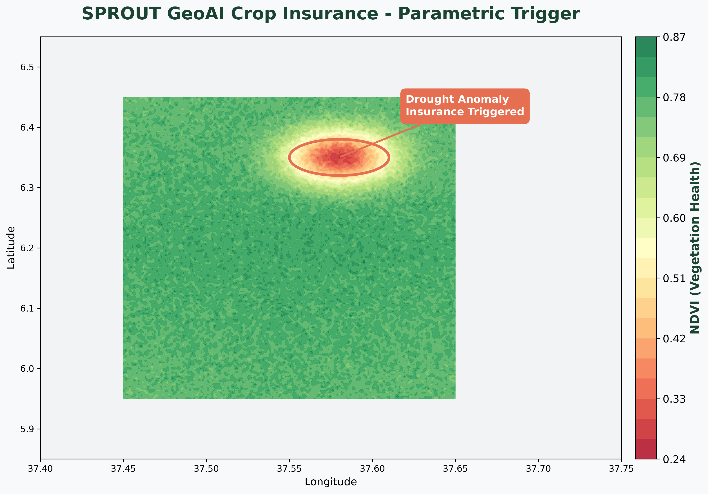
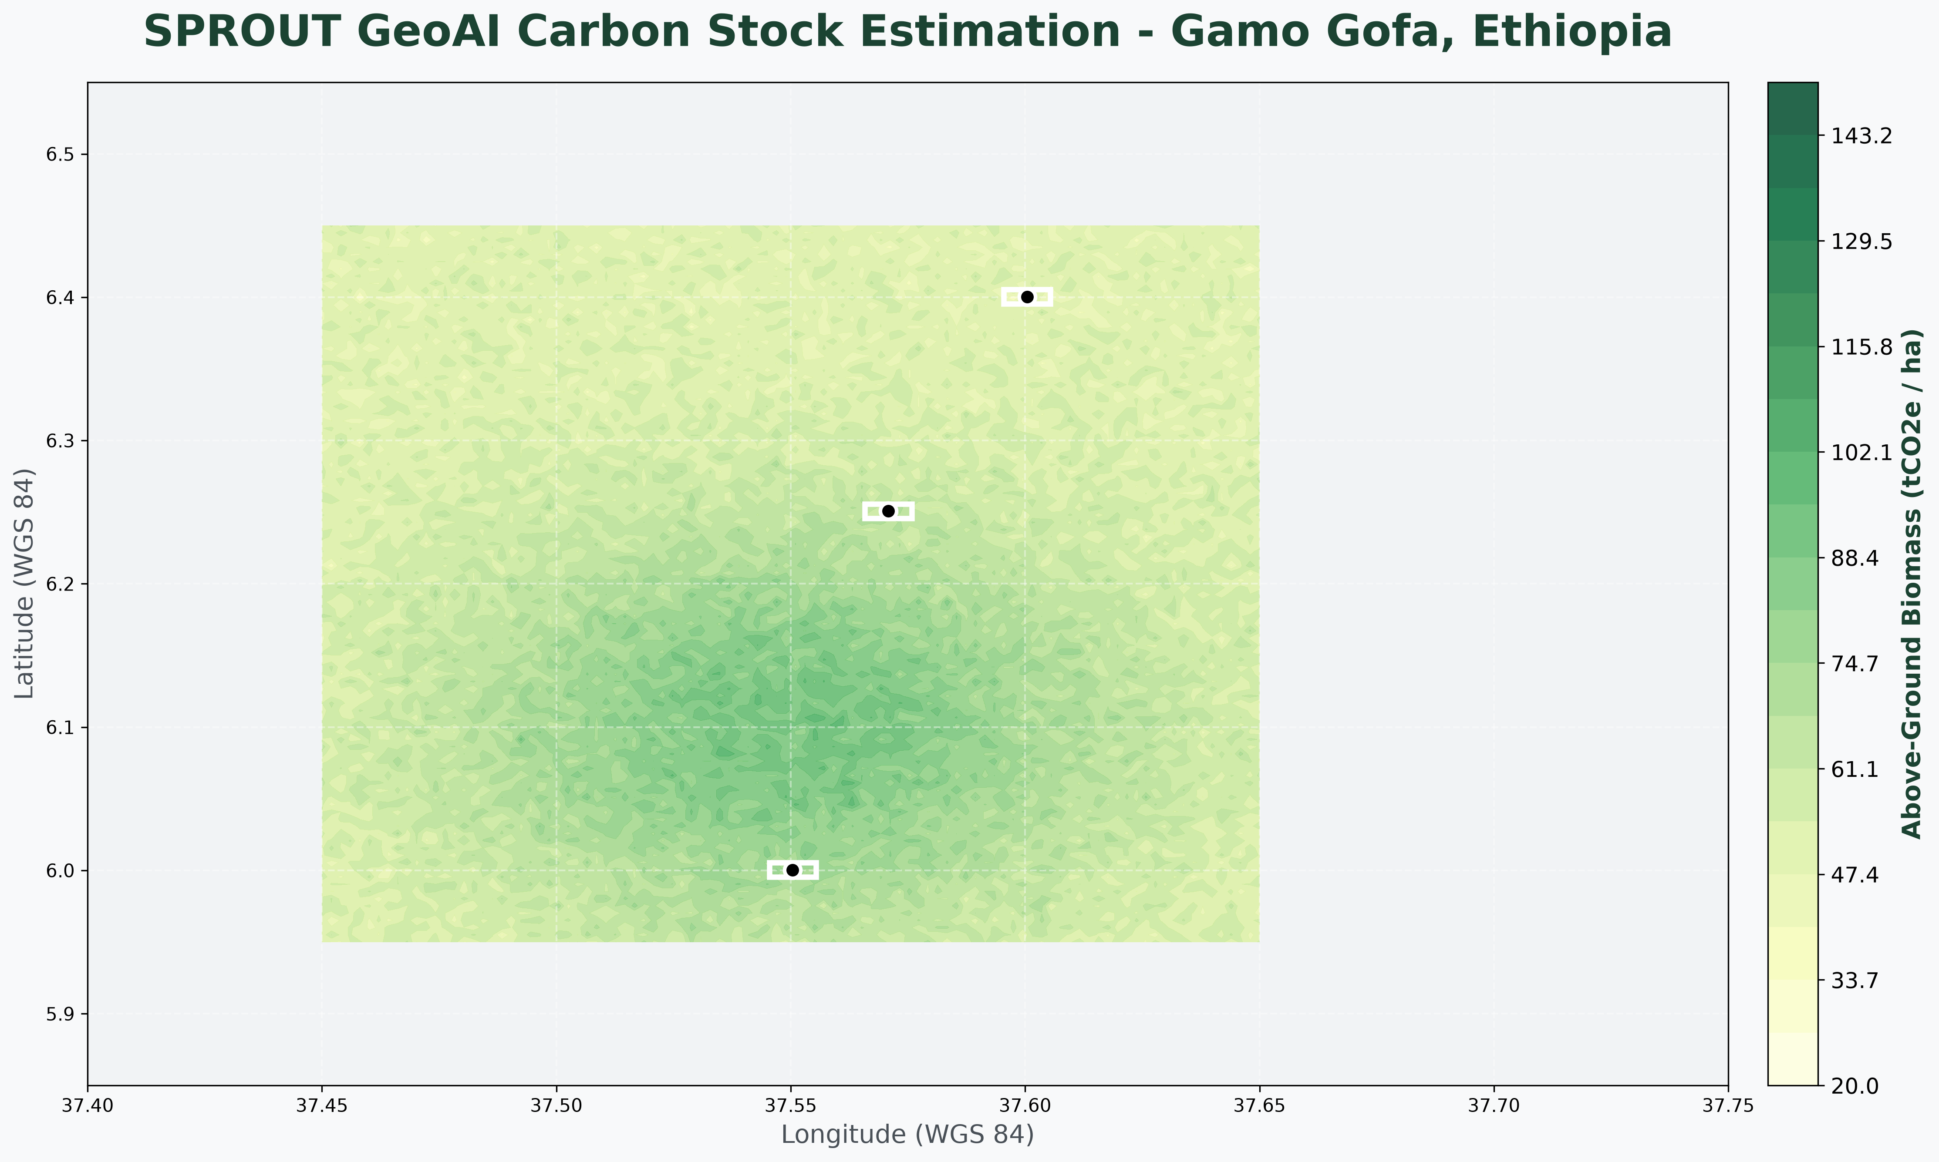
The Business Model
1. EUDR Traceability
Geolocation & compliance
2. Climate Finance
Bankable green credit
3. Crop Insurance
Satellite triggers
4. Carbon Trade
tCO2 tokens via Verra
5. E-commerce
Direct farmer-to-buyer

Slide 7
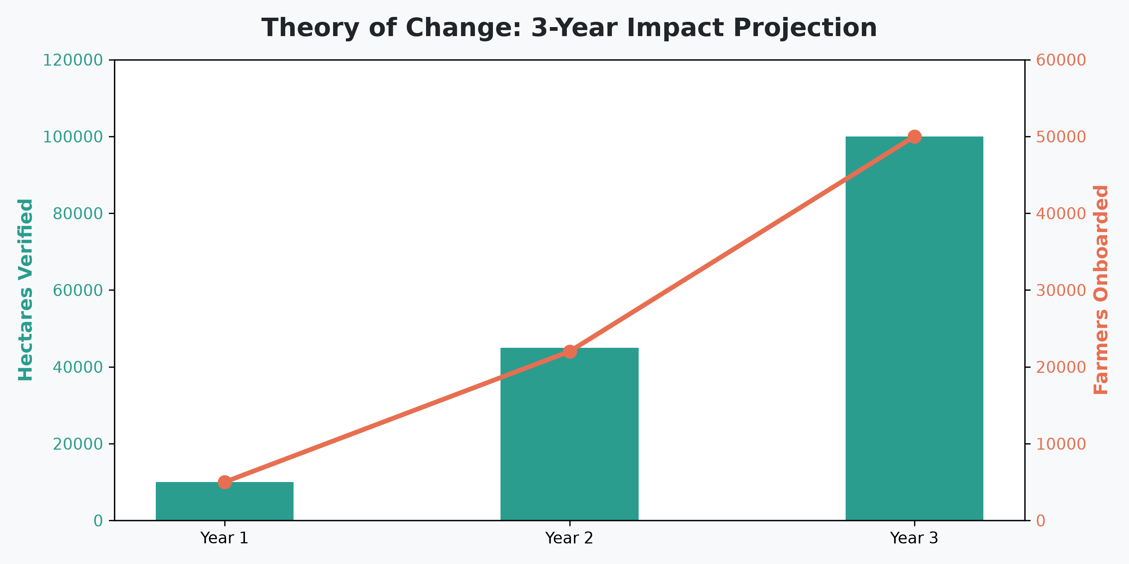
Theory of Change
Measurable Impact by Year 3

Slide 8
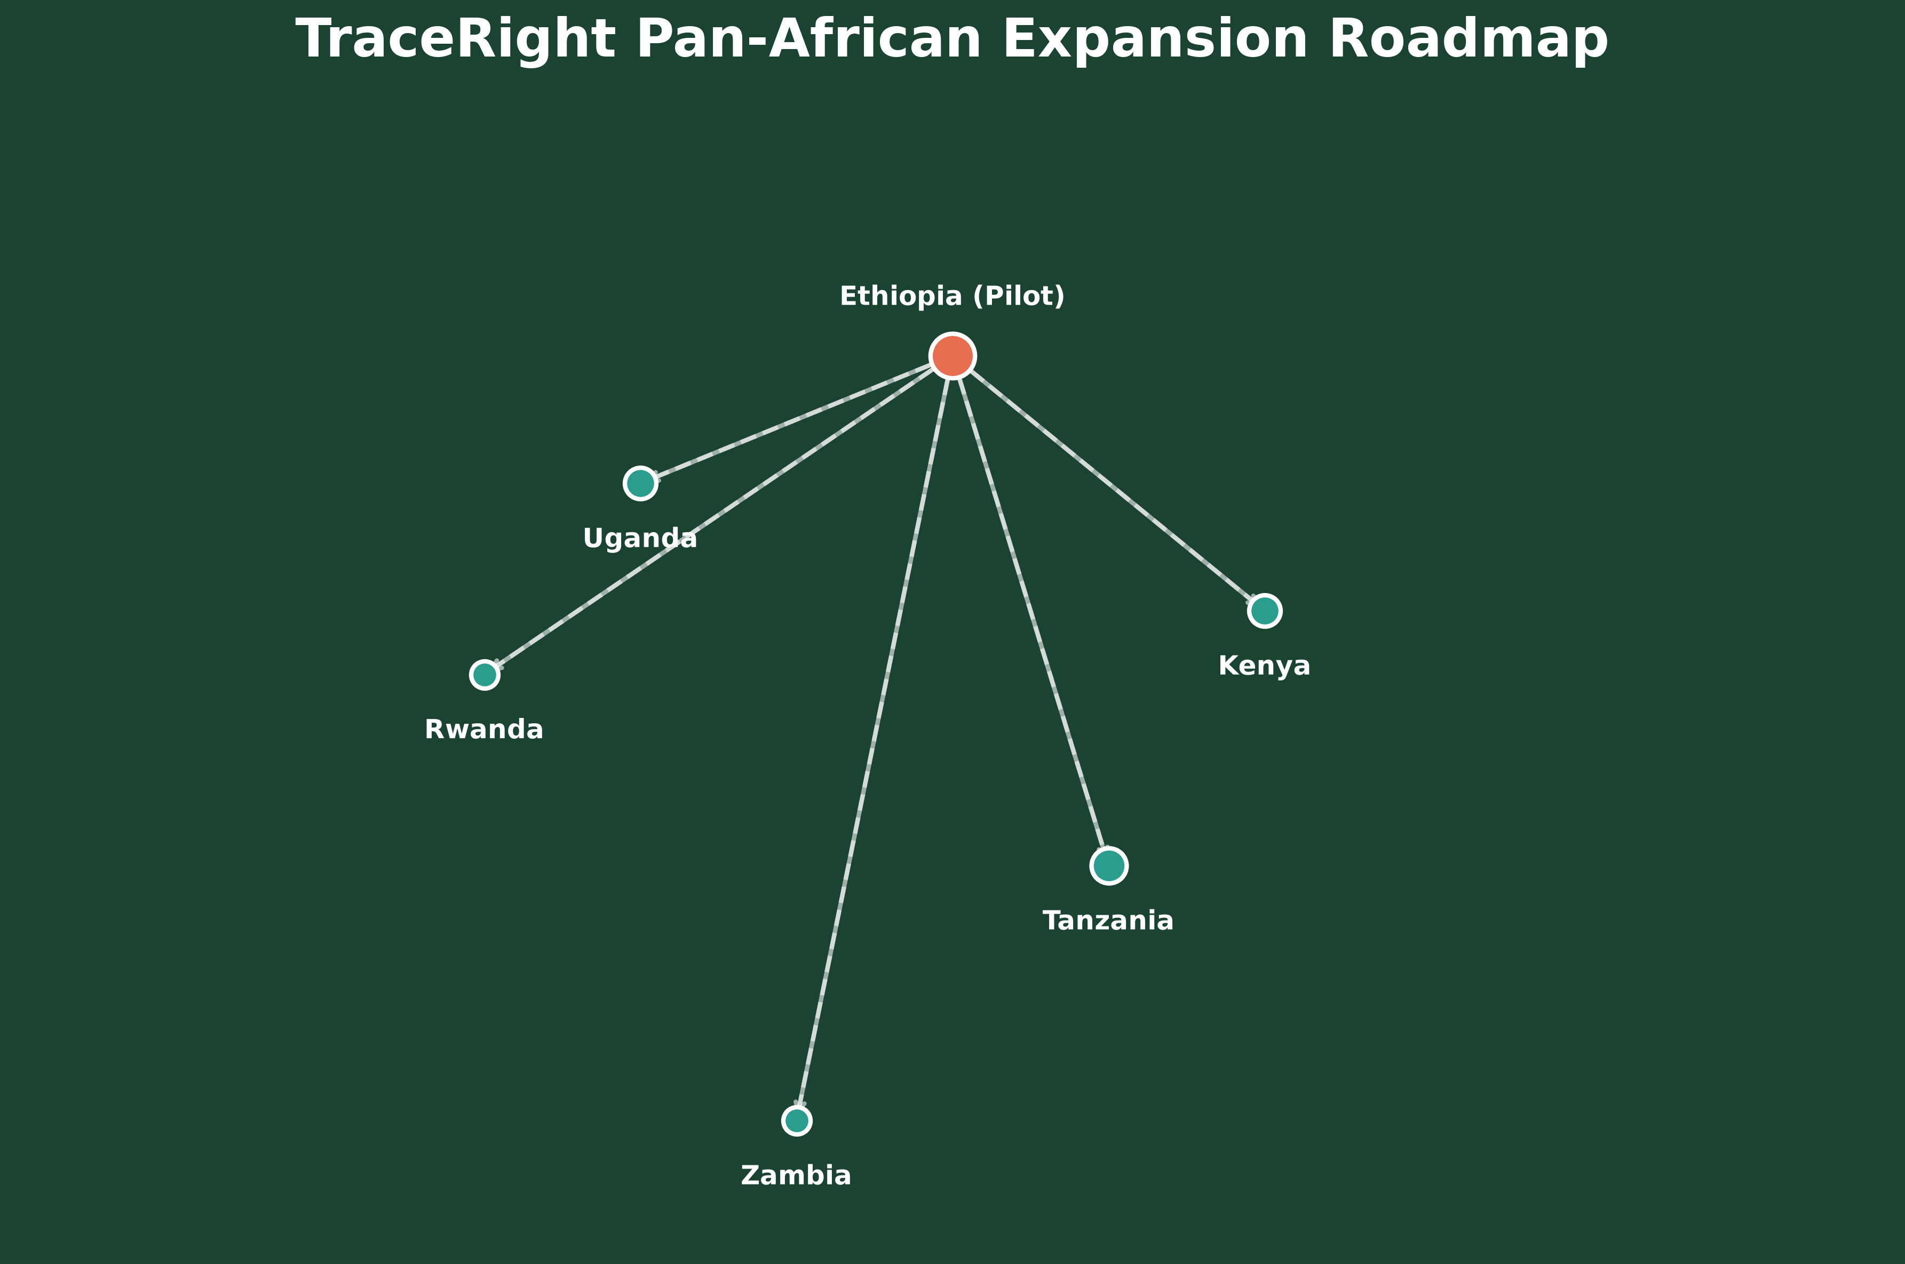
Accelerated Roadmap
Built Ahead of Schedule, Ready to Scale

Slide 9
The Consortium
Ethiopian Innovation + International Architecture
SPROUT Lead
Shimeles Tadesse Zelelew
GeoAI and spatial architecture expert. Built the live API, EUDR validator, and dashboard.
TraceRight Consortium
NADAR Satellite & Qonnect
Blockchain, satellite intelligence, and regulatory compliance experts.

Slide 10
Immediate Next Steps
Five Actions to Integrate Systems
1. Nominate a technical counterpart for integration.
2. Confirm the commercial model (Licensed API vs. Embedded Module).
3. Share ECTMS and Hyperledger Fabric documentation.
4. Confirm the first commercial target (EU Buyer, Carbon, or Insurance).
5. Schedule the inception meeting to sign the alignment contract.

Slide 11
Thank You
Questions & Discussion
Live Dashboard: sprout-qonnect-clnhwfubq2y6y9bafzg.streamlit.app
GitHub: github.com/shimtad2001g/SPROUT-Qonnect

