Slide 1
ECOMMERCE COMPANY TASK
Harvey Schneider

Slide 2
KEY POINTS
Data Tidying
Trends Across Regions and Month
Loyalty Scheme
National Spring Clean Promotion
GL and WM Promotion
Summary
Recommendations
All code is available at https://github.com/shimthal61/grayce_task

Slide 3
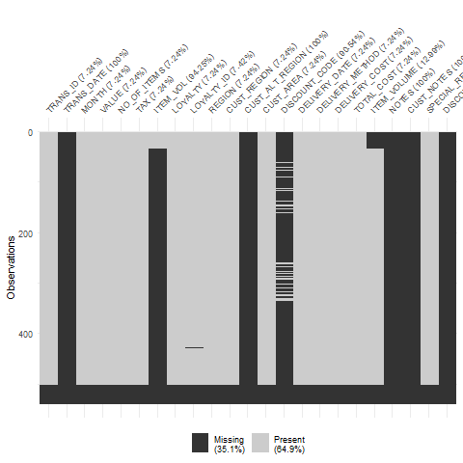
DATA TIDYING
I created a
visualisation displaying
all the missing data.
Some of the columns
are missing all their data.
The final rows in the data
are all missing.

Slide 4
DATA TIDYING
I formatted the data set so that it contained only the first 500 rows of present data.
I moved the data from MONTH into TRANS_DATE, then removed the MONTH column so there weren’t duplicates.
I removed all the columns which contained 100% NA data.
The data in LOYALTY contained a mix of lower-case and upper-case values, so I transformed them all to upper case.
I ran a script that identified any columns which contained identical data. To prevent redundancies, I removed CUST_AREA and CUST_REGION, which contained identical data to the column REGION.

Slide 5
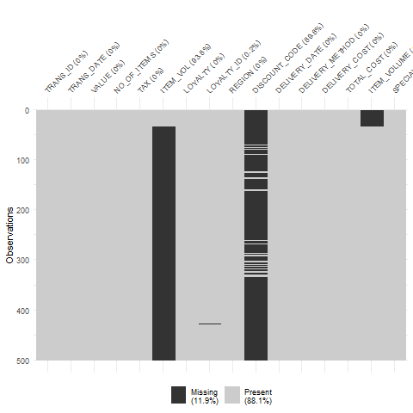
DATA TIDYING
None of the columns are
missing all their data.
There are 500 rows.
There are no longer
redundant columns.

Slide 6
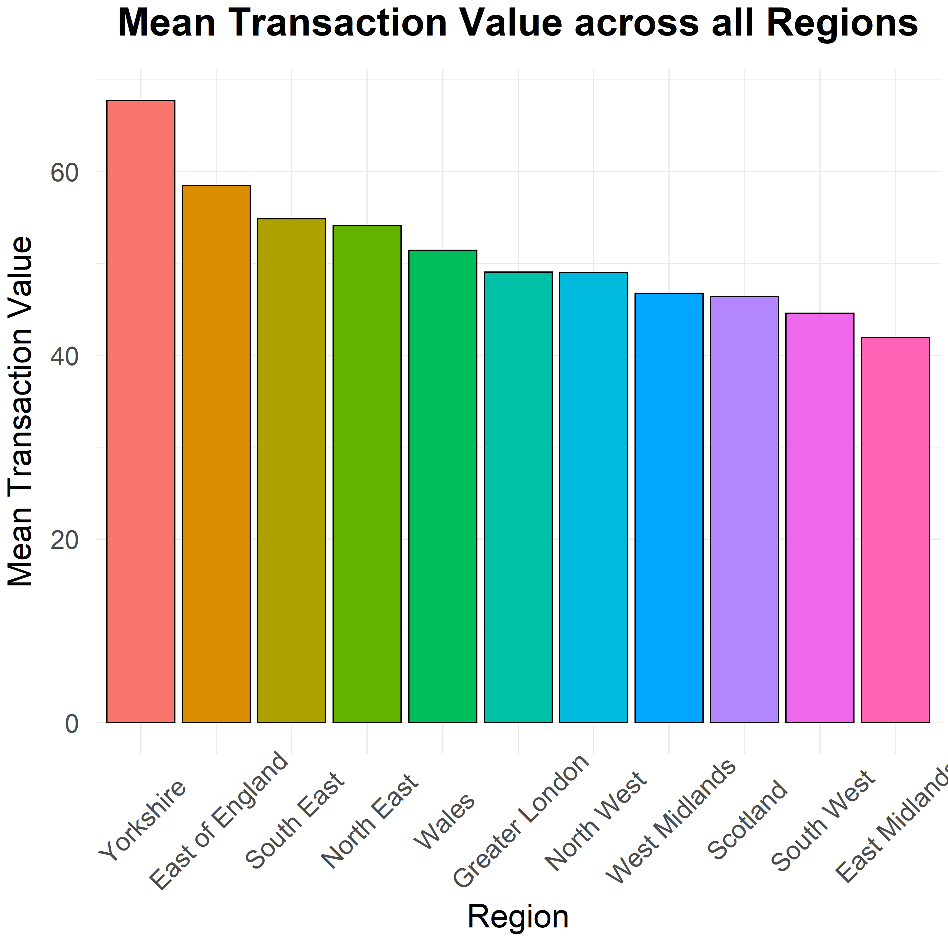
REGIONS
I first had a look at the mean transaction value and how it differed across regions.
It looks as though Yorkshire is the largest spending Region, and the East Midlands is the least.

Slide 7
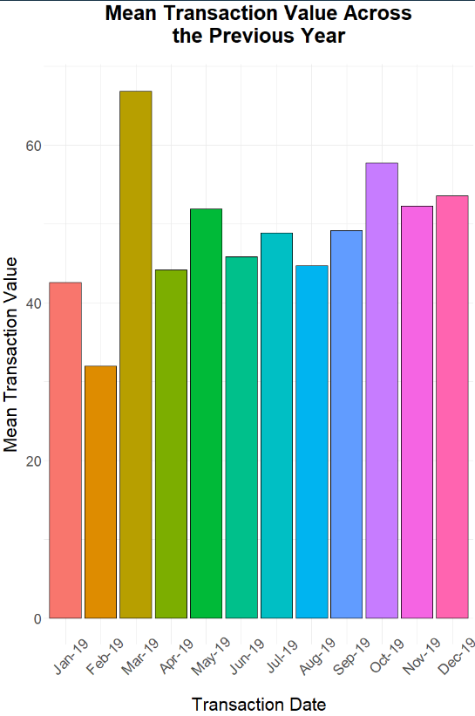
THE PREVIOUS YEAR
This plot shows the mean transaction value across the previous year.
It is difficult to find any correlations, although customers appear more spend more per transaction during the month of March.

Slide 8
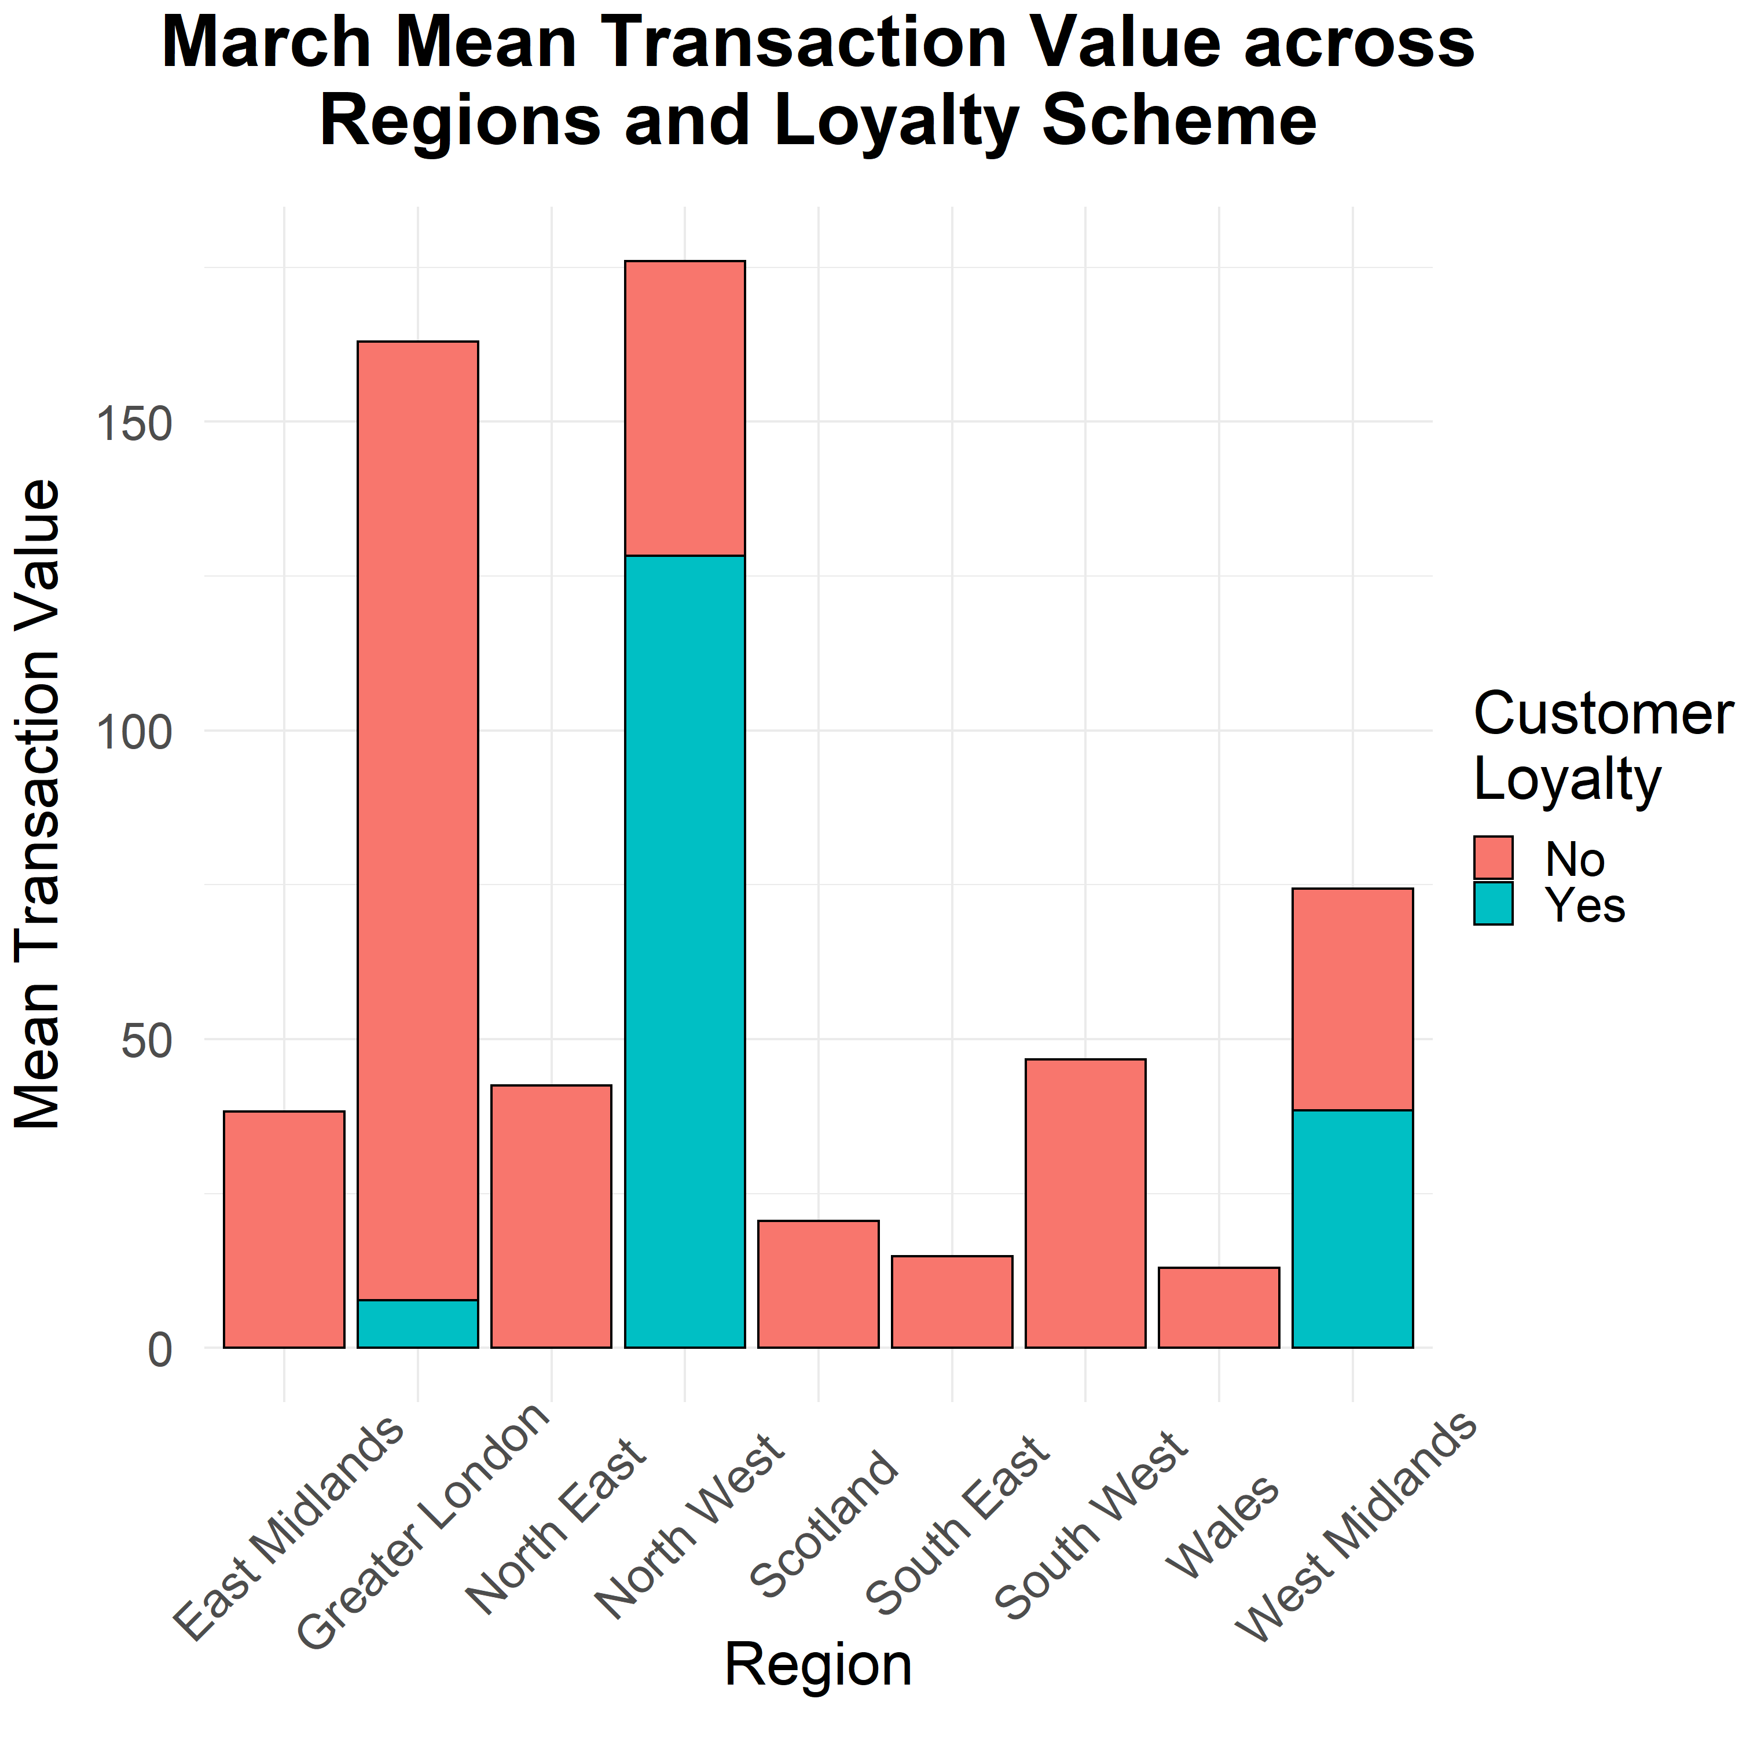
MARCH TRANSACTIONS
To further investigate what drove the high transaction values in March-19, I plotted the transactions across each region, including customer Loyalty Scheme.
The regions driving the high transactions were Greater London and The North west.
The majority of transactions were carried out by non-Loyalty Scheme customers, except for the North West.

Slide 9
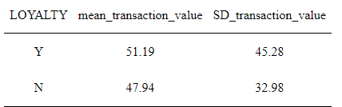
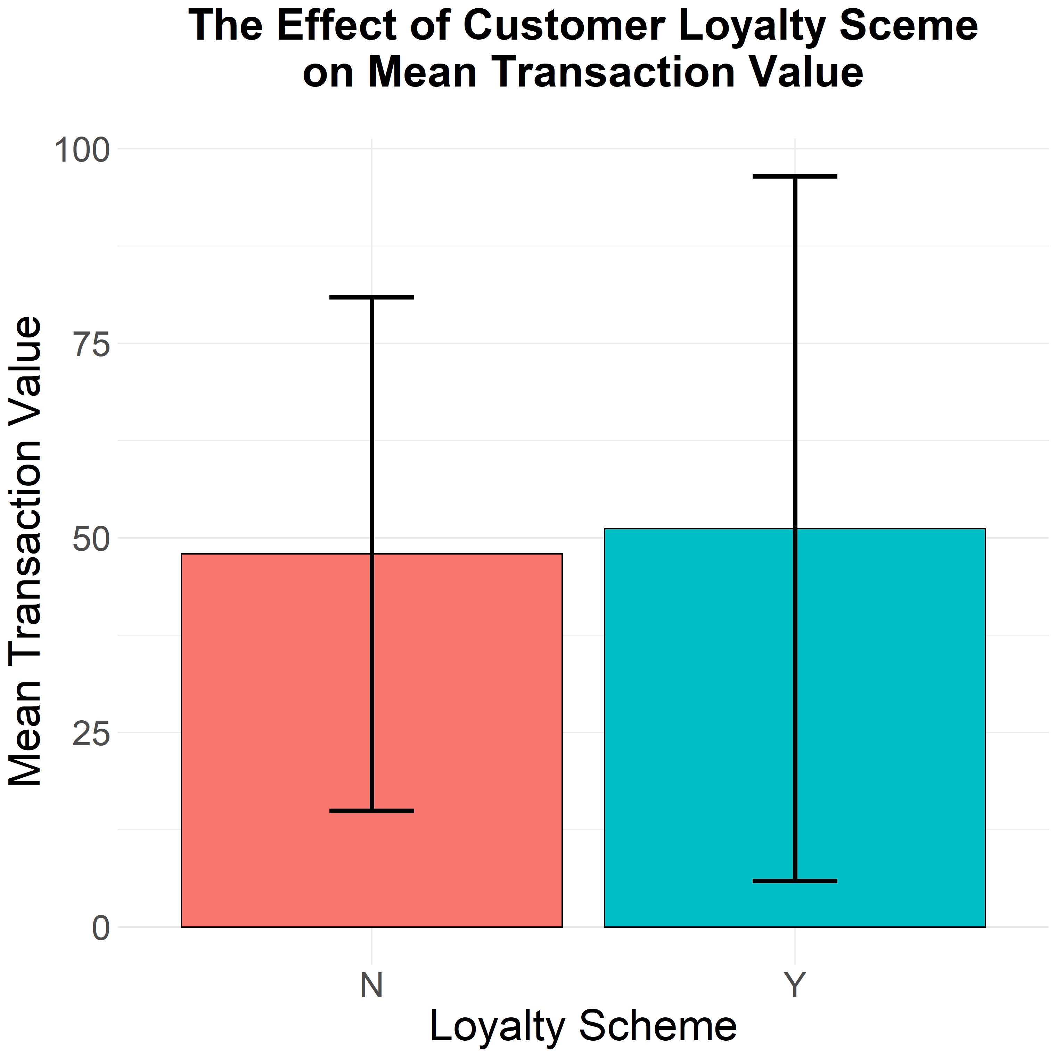
LOYALTY SCHEME
I first investigated whether
the Customer Loyalty Scheme
resulted in greater
individual transactions.
It looks as though customers
subscribing to the Loyalty Scheme
spent more per individual
transaction.

Slide 10
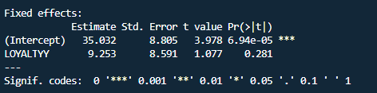
LOYALTY SCHEME ANALYSES
I built a model which investigated
the effect of the Loyalty Scheme on
transaction value.
For the Loyalty Scheme to have
a significant impact, the value in
the highlighted box must be 0.05 or less
Crucially, it appears as though the
Loyalty Scheme did NOT have a
significant effect on transaction value.

Slide 11
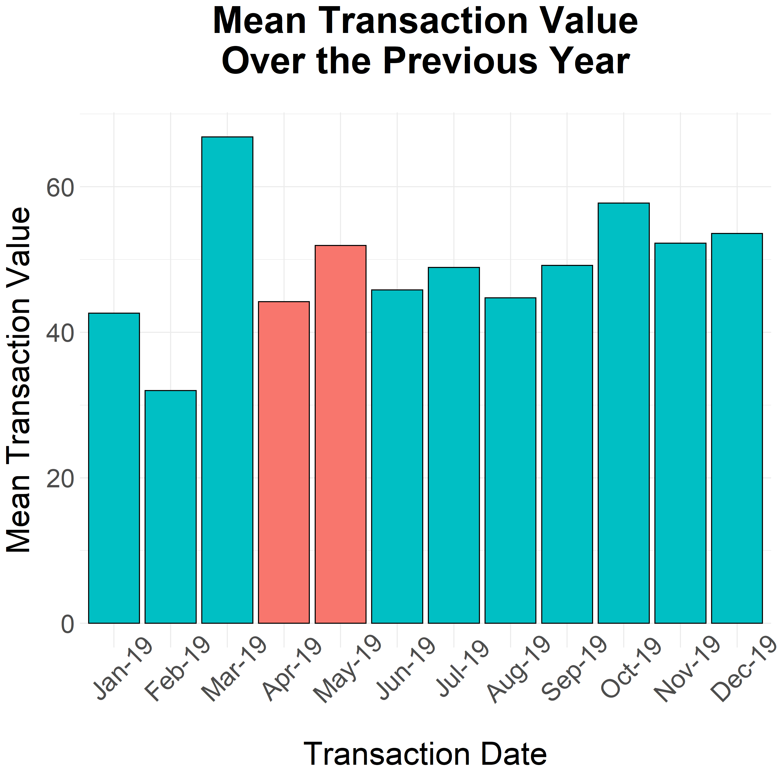
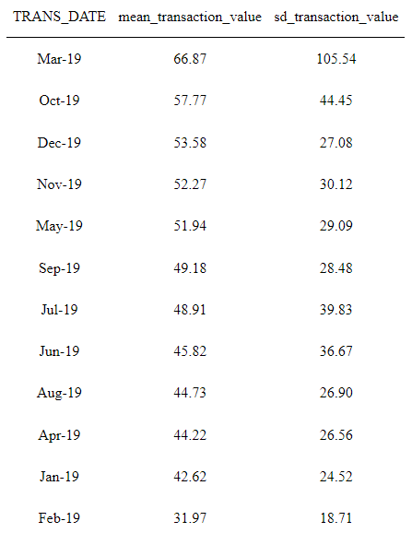
NATIONAL ‘SPRING SALE’ PROMOTION
I next investigated
the effectiveness of
the National ‘Spring Sale’
Promotion.
The highlighted bars
represent the months
which held the National
Promotion.

Slide 12
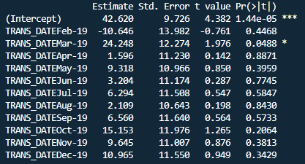
NATIONAL ‘SPRING SALE’ PROMOTION ANALYSES
I again built a model which
investigated transaction value
across the months of the
previous year.
The only month which differed
significantly from the others was
March-19.
It appears as though the National
Promotion did not have a significant
impact on transaction value.

Slide 13
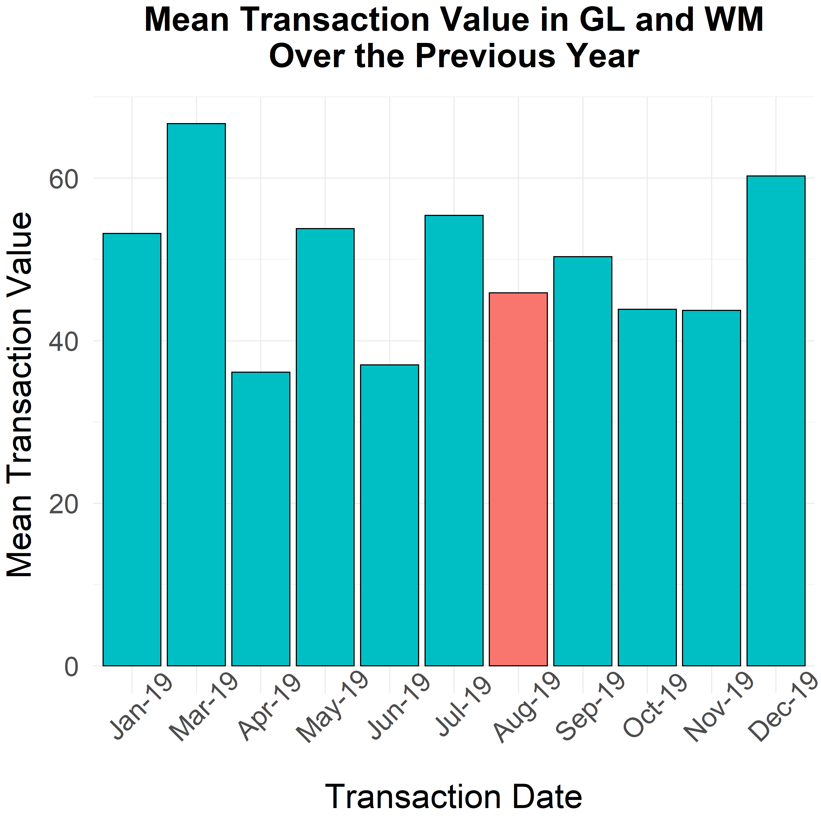
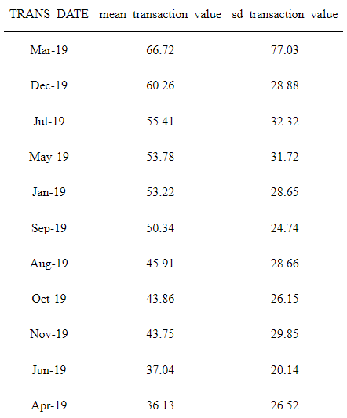
GL & WM PROMOTION
The plot displays the mean transaction values over the past year for the GL and WM regions.
The highlighted bar
represents the month
which held the promotion.

Slide 14
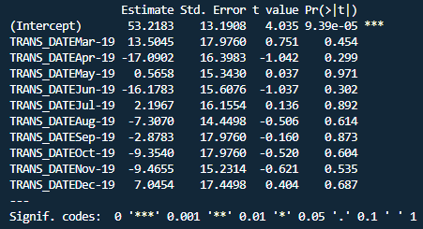
GL & WM PROMOTION ANALYSES
This model investigates whether any of the months differed significantly from each other
We are particularly interested in August-19
It appears the GL & WM promotion did not lead to a difference in transaction value compared to other months

Slide 15
SUMMARY
Customers who subscribe to the Customer Loyalty Scheme do not spend a greater amount per transaction
Neither the National Promotion nor the GL & WM Promotion led to a increased transaction amounts in the months they were held
During March 2019, Greater London and the North West spent a significantly greater amount of money. This was particularly true of customers in the North West who subscribed to the Customer Loyalty Scheme.

Slide 16
RECOMMENDATION
It may be worth carrying out promotions in the Yorkshire region, since customers in that region tend to spend more.
Similarly, it may be worth carrying out less promotions in the East Midlands, since customers in that region spend less per transaction.
In March, customers spent significantly more money than in other months. This was in large part contributed by the Greater London and North West Regions. You may want to considers promoting your products within these regions during the months of Feb and March.
Moreover, the transactions in the North West during March were primarily carried out by customers subscribed to the Loyalty Scheme. You could potentially try to promote the Loyalty Scheme in this region during Feb and March.

