Slide 1

Capstone Project Presentation
Supervised By
Rashedul Amin Tuhin
Senior Lecturer
Department of Computer Science and Engineering
CSE 400A
Summer 2025

Slide 2
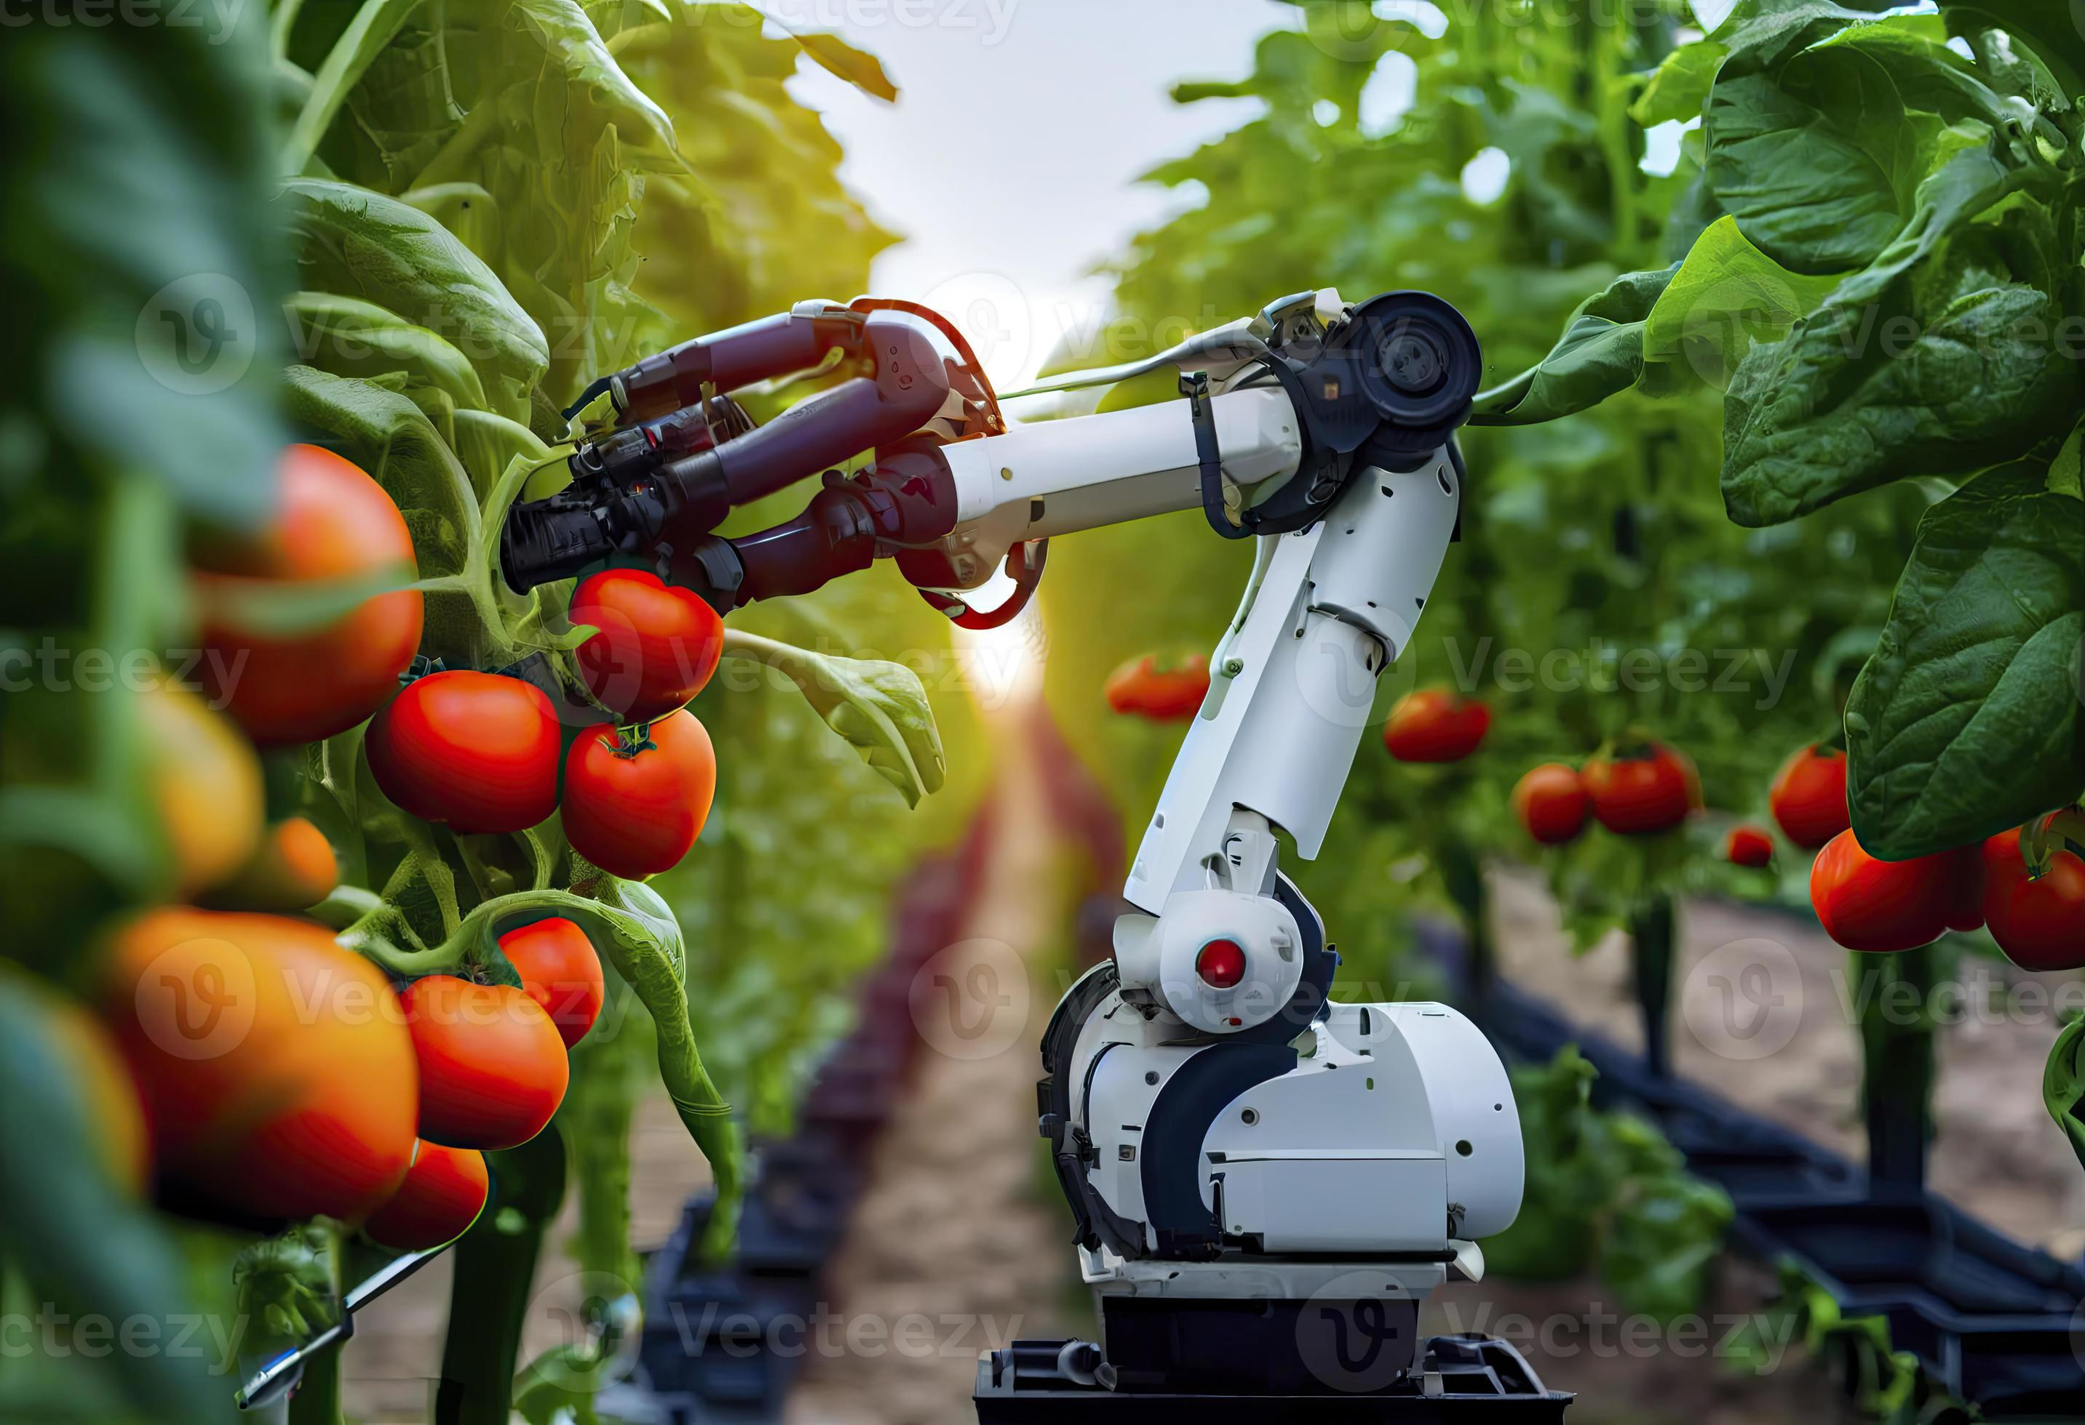
Real-Time Automated Vegetable Sorting: AI Agent System with Robotic Arm

Slide 3
Let’s Introduce ourselves
Name | ID
Fathhur Rahaman Sams | 2022-2-60-041
Sanjana Kazi Supti | 2022-2-60-036
Md. Junaeid Ali | 2022-2-60-127
Mahfuj Alam Imon | 2022-2-60-131

Slide 4
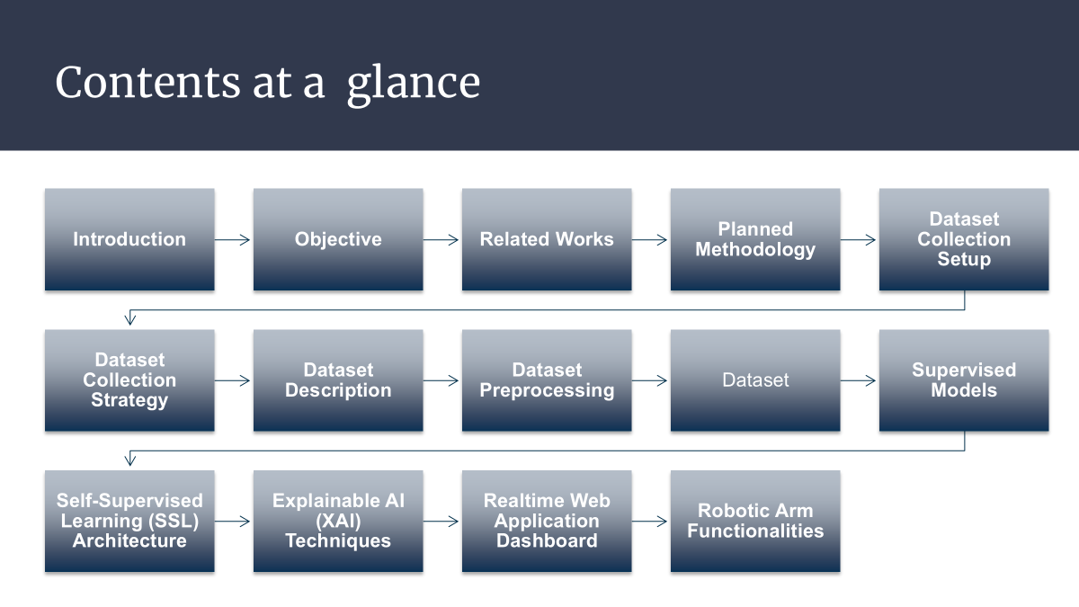
Contents at a glance
1. Introduction
1.1 Objective
2. Related Works
3. Planned Methodology
3.1 Dataset Collection Setup
3.2 Dataset Collection Strategy
Dataset Description
Dataset Preprocessing
Supervised Models
Self-Supervised Learning (SSL) Architecture
Explainable AI (XAI) Techniques
Realtime Web Application Dashboard
Robotic Arm Functionalities

Slide 5
Introduction
Background
In modern agriculture, vegetable sorting is still mostly done by hand, making the process slow and inaccurate. This leads to mistakes, higher costs, and food waste. Since vegetables spoil quickly, there is a strong need for a faster and more reliable automated system to sort them by freshness and quality.

Slide 6
Introduction
Objective
Develop a self-supervised learning model for multi-class vegetable freshness detection with minimal labeled data.
2. Optimize AI architecture for real-time performance and integration with xArm 1s robotic arm to achieve >95% sorting accuracy.
3. Analyze environmental impacts (lighting, conveyor speed) and propose adaptive solutions for improved reliability and scalability.
Research Question
How can SSL improve freshness detection with minimal labels?
2. How can AI models sustain > 95% accuracy in real-time?
3. How can an AI–robotic arm cooperate efficiently?
4. How do environmental factors affect system reliability?

Slide 7
Related Works
Reviewed 30 studies on fruit, vegetable, and crop detection/classification using datasets like FRUVEG67, FV40, Fruits-360, and Fresh Carrot.
2. Models include YOLO, DETR, MobileNetV2, CL-ViT, and SSL frameworks, improving detection with minimal labeled data.
3. Common challenges addressed: small/occluded objects, class imbalance, subtle defects, and real-time efficiency, showing that efficient models with robust datasets enable scalable agricultural monitoring.

Slide 8
Citation No | Author Name | Title | Best Model | Accuracy
[12] | Khanna et al | Enhancing Fruit and Vegetable Detection in Unconstrained Environment with a Novel Dataset | FVDNet (YOLOv8n) | 0.82 mAP
[13] | Li and Shi et al | A DETR-like Detector-Based Semi-Supervised Object Detection Method for Brassica Chinensis Growth Monitoring | DETR-like SSOD | 0.741 mAP
[14] | Bu et al. | Fast and Accurate Detection of Forty Types of Fruits and Vegetables: Dataset and Method | FVRT-DETR-L | 0.805 mAP
[15] | Rezeliet et al | Semi-Supervised Deep Learning and Low-Cost Cameras for the Detection of Grapevine Leaf Diseases | U-Net semi-supervised | 0.92 Dice
[16] | Ahmed et al | Efficient Iterative Semi-Supervised Object Detection Training for Counting of Fruits and Vegetables | EfficientDet D0 | 83% counting

Slide 9

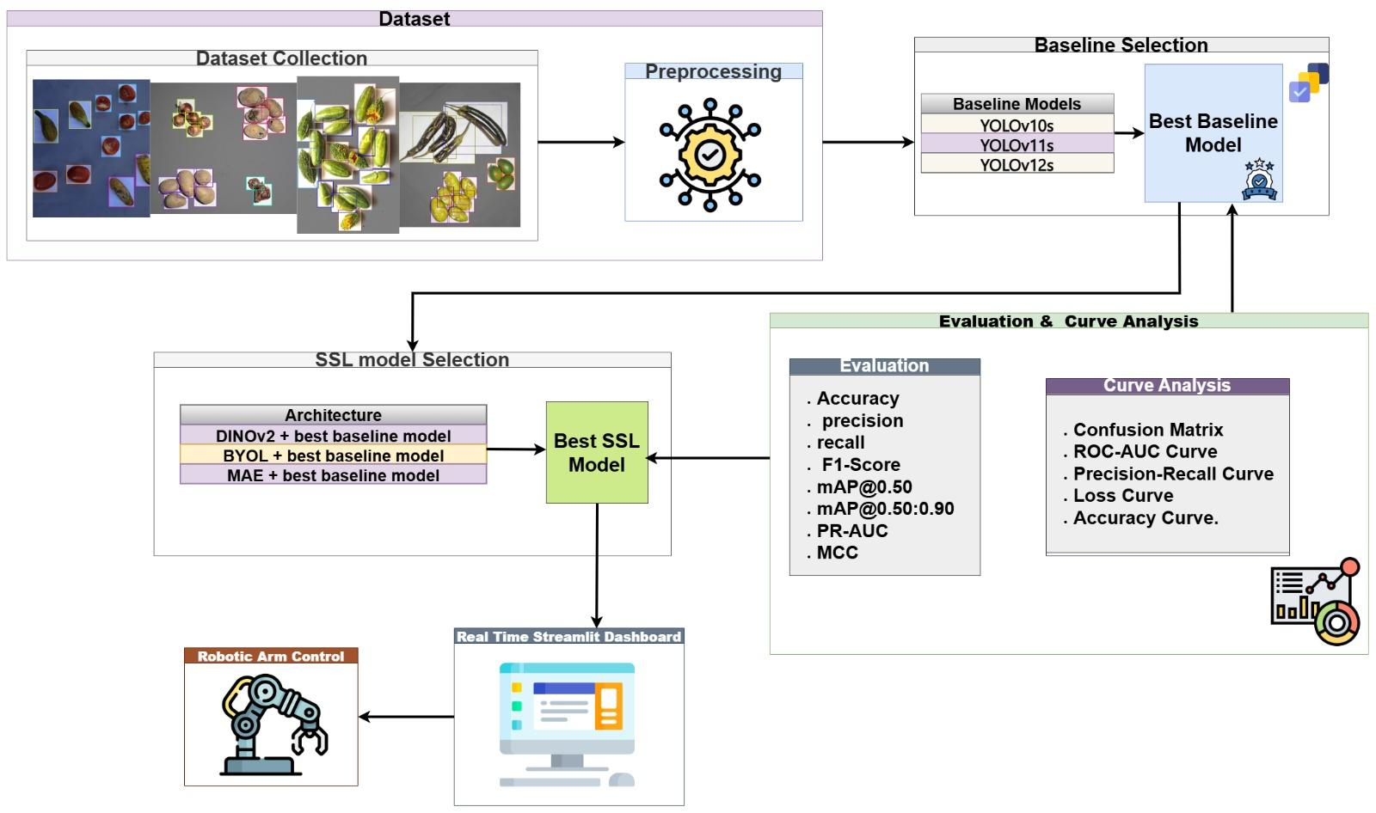
Planned Methodology
Figure : Workflow Diagram

Slide 10

Dataset Collection SetUp
Diverse Mobile Capture: Images taken using Pixel 9, Galaxy S23, Vivo Y22s, Galaxy A55, iPhone 15 Pro Max for varied imaging conditions.
Controlled Background: White art paper to minimize noise and ensure consistent contrast.
Spatial & Visual Variability: Vegetables posed sparsely and structured; captured in fresh vs damaged states.
Robust Dataset: Setup ensures generalizability for multi-class classification and computer vision tasks.

Slide 11

Dataset Collection Strategy
Vegetables Covered: 8 types × 2 conditions (Fresh & Damaged) → 16 sub-classes.
Single-Class Images: 50 per subclass; neutral background & controlled lighting; one instance per image → 800 images.
Combinational Single-Class Images: 210 per subclass (scattered & organized arrangements) to capture spatial variability.
Multi-Class Subset: 4 vegetable pairs; fresh & damaged → 120 images per pair; dominance variation added for realism
Assumed Total Dataset: 4,640 images, perfectly balanced for robust multi-class classification and detection.

Slide 12
Dataset Overview & Distribution
Balanced Dataset for Classification & Detection → Single-class & Multi-class images
Single-Class Images: 8 vegetable types × 2 conditions (Fresh/Damaged) → 4,270 images
Multi-Class Images: 4 vegetable pairs in quadrates → 531 images
Annotated Detection Split: 70% Train | 15% Test | 15% Validation
Histogram Analysis: Shows well-balanced distribution across all classes

Slide 13
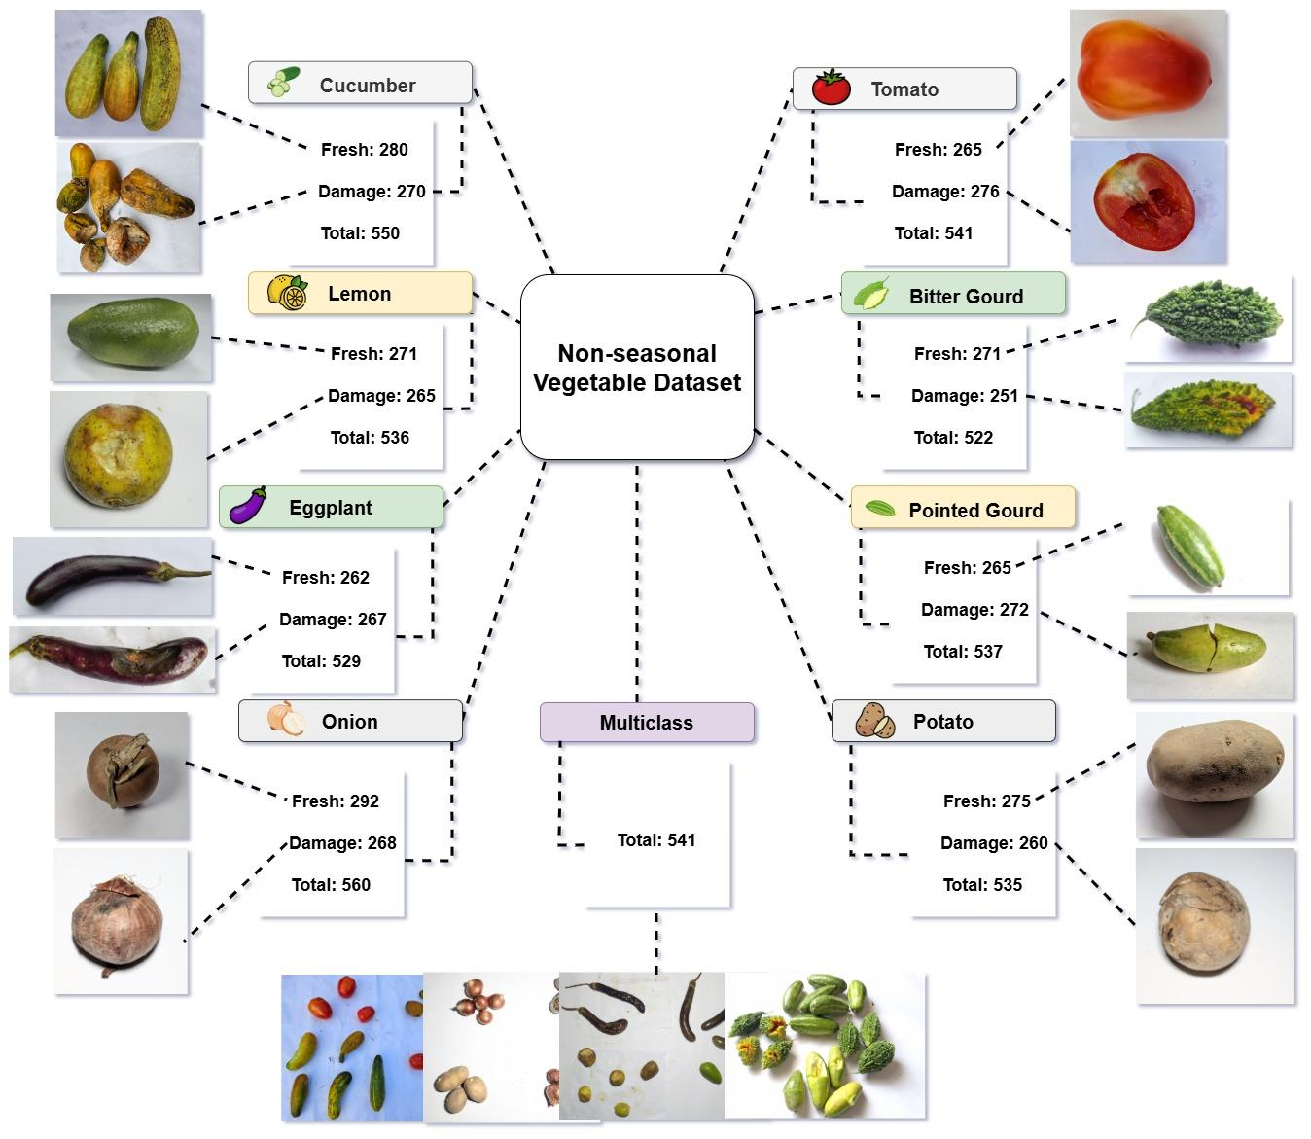
Figure : Dataset Workflow

Slide 14
Dataset distribution table for Single Class images
Dataset Overview & Distribution
Class | Fresh | Damaged | Total
Cucumber | 280 | 270 | 550
Tomato | 275 | 260 | 535
Bitter Gourd | 271 | 251 | 522
Pointed Gourd | 265 | 272 | 537
Potato | 275 | 260 | 535
Onion | 262 | 268 | 530
Eggplant | 262 | 267 | 529
Lemon | 271 | 265 | 536
Total |  |  | 4270

Slide 15
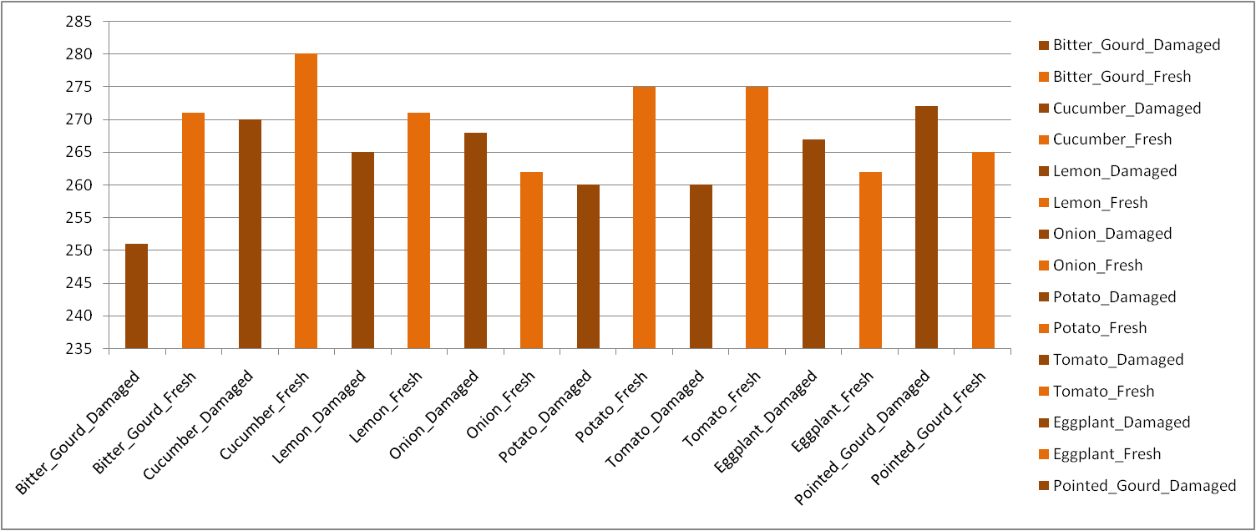
Histogram of the Dataset Distribution

Slide 16

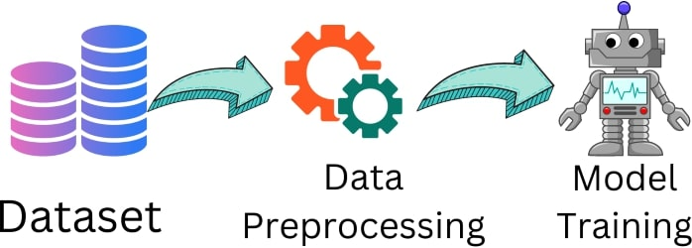
Dataset Preprocessing
Image Standardization
  All images resize to 640 × 640 pixels
  Ensures uniform input dimensions for the model
Data Augmentation
  Applied simple yet effective techniques:
  • Horizontal Flip
Dataset Splitting
  Divided into:
  • 70% Training
  • 15% Validation
  • 15% Testing
  Ensured class balance between fresh and damaged vegetables

Slide 17
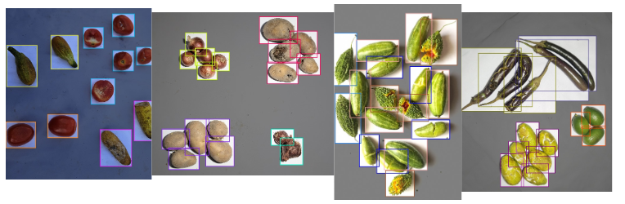
Dataset Preprocessing
Preprocessed Data
8 vegetable classes + 1 multiclass (mixed)
Total: 4,797 images
Each image annotated with bounding boxes + class labels

Slide 18
Supervised Models
The objective is to establish a robust baseline for real-time vegetable detection in an automated sorting system.
Chosen Models
YOLOv10
YOLOv11
YOLOv12
→ Chosen for high precision, speed, and efficiency in object detection.

Slide 19

Supervised Models
Training Setup
Transfer Learning: Pre-trained on COCO dataset transferred to YOLO
Optimizer: AdamW + Cosine Annealing scheduler
Loss: Localization + Confidence + Classification
Target: mAP@0.5 ↑, IoU > 0.7

Slide 20
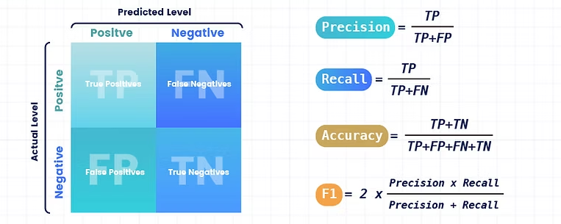
Supervised Models
Evaluation Metrics
Evaluation: Accuracy, Precision, Recall, F1-score, mAP@0.5, mAP@0.50:0.90, PR-AUC, MCC
Curve Analysis: ROC-AUC Curve, Precision-Recall Curve, Loss Curve, Accuracy Curve.
→ Compare YOLOv10, YOLOv11 & YOLOv12 performance

Slide 21
SSL Architecture
The objective is to improve detection accuracy & robustness with minimal labeled data (~4,797 vegetable images).
Chosen SSL Methods:
DINOv2 Style: Student-teacher network → learns invariant features (outlines, color, texture) → fine-tuned for detection.
BYOL: Predicts target network outputs from augmented views → computationally efficient → robust bounding boxes & class predictions.
MAE: Masks ~75% of image → learns global semantic structures → resilient to occlusion, lighting, and background noise.

Slide 22
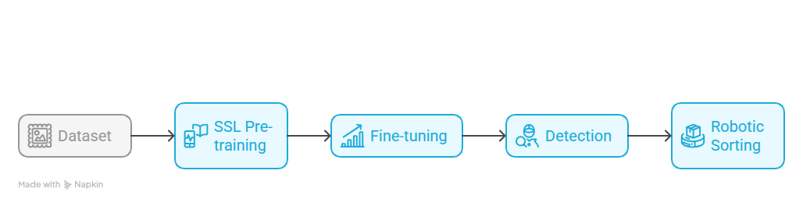
SSL Architecture
Evaluation: Compare SSL models vs YOLO baselines using mAP, IoU, Precision, Recall, F1-score
Integration: Best SSL model powers real-time robotic pick-and-place, streamed to web dashboard via ROS.

Slide 23
Explainable AI techniques
To understand how AI detects fresh and damaged vegetables.
Proposed Techniques:
Grad-CAM:
Produces heatmaps → highlights areas influencing predictions (damaged spots, color patterns).
LIME:
Tests local changes → identifies which features (color, texture) impact individual predictions.

Slide 24
Realtime Web Application Dashboard
Platform: To built it on Streamlit (interactive, user-friendly interface)
Core Features
Image & Video Detection
Annotation & Saving
Dynamic Visualization
SSL-based Classification
Explainable AI
Automation

Slide 25
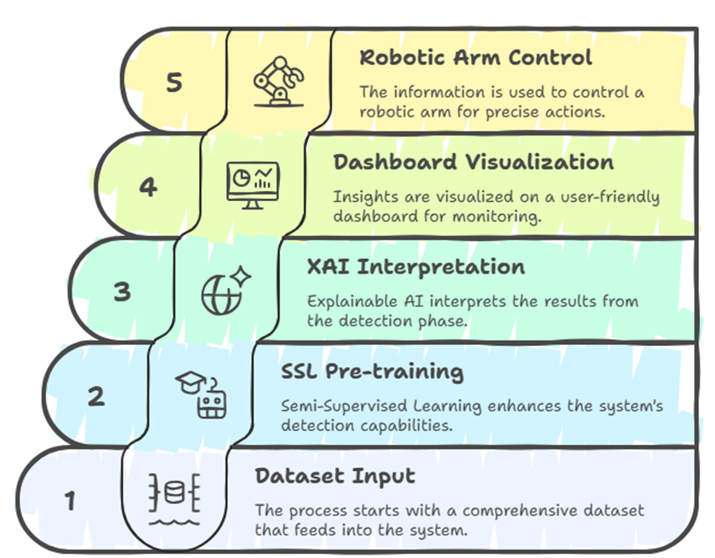
Realtime Web Application Dashboard

Slide 26
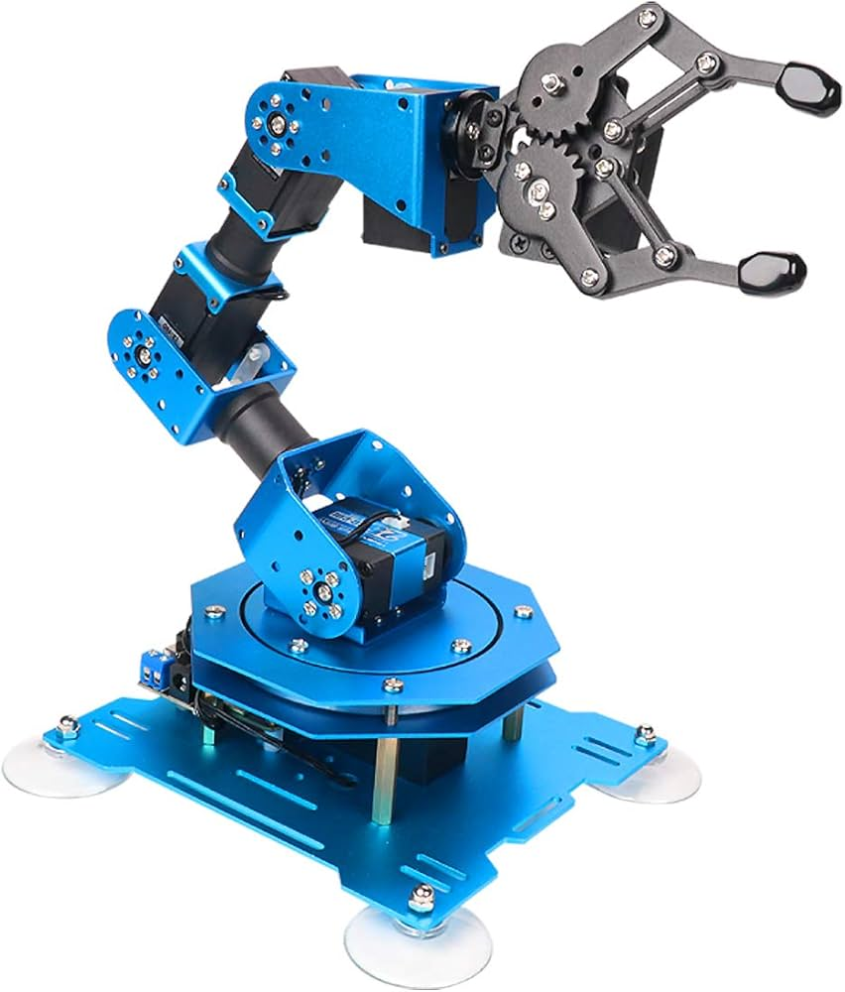
Robotic Arm Functionalities
Robot Arm: xArm 1s with top-mounted mobile camera for workspace monitoring.
Detection: Camera feed → analyzed in real-time using SSL model (best-performing weights).
Pick-and-Place Automation: Arm moves only when vegetable is in range of camera, deposits in class-specific container.
Continuous Operation: Sequentially processes multiple vegetables → maintains accuracy and speed.
End-to-End Integration: Real-time perception, detection, and robotic actuation for fully automated sorting.

Slide 27


