Slide 1
OCRT
Optical Character Recognition to Text APP
Gustavo Kang Shim
T00659719

Slide 2
What is OCR?
Optical character recognition or optical character reader is the electronic or mechanical conversion of images of typed, handwritten or printed text into machine-encoded text, whether from a scanned document, a photo of a document, a scene-photo or from subtitle text superimposed on an image.

Slide 3
Goal
I don’t wanna type

Slide 4
Video of App
https://youtu.be/tqFX9tzPsh8

Slide 5
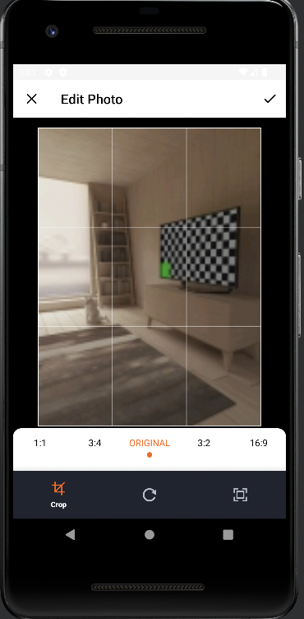
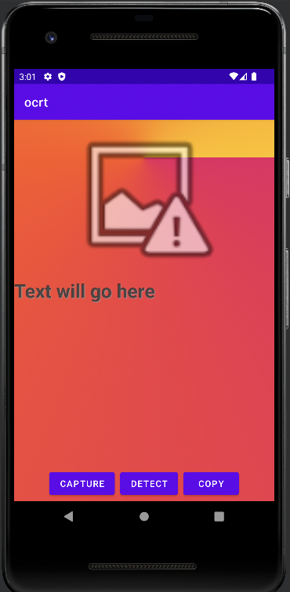
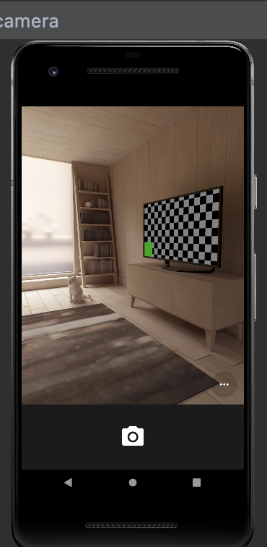
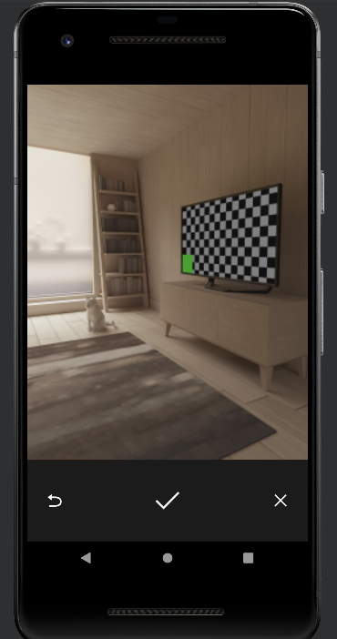

Slide 6
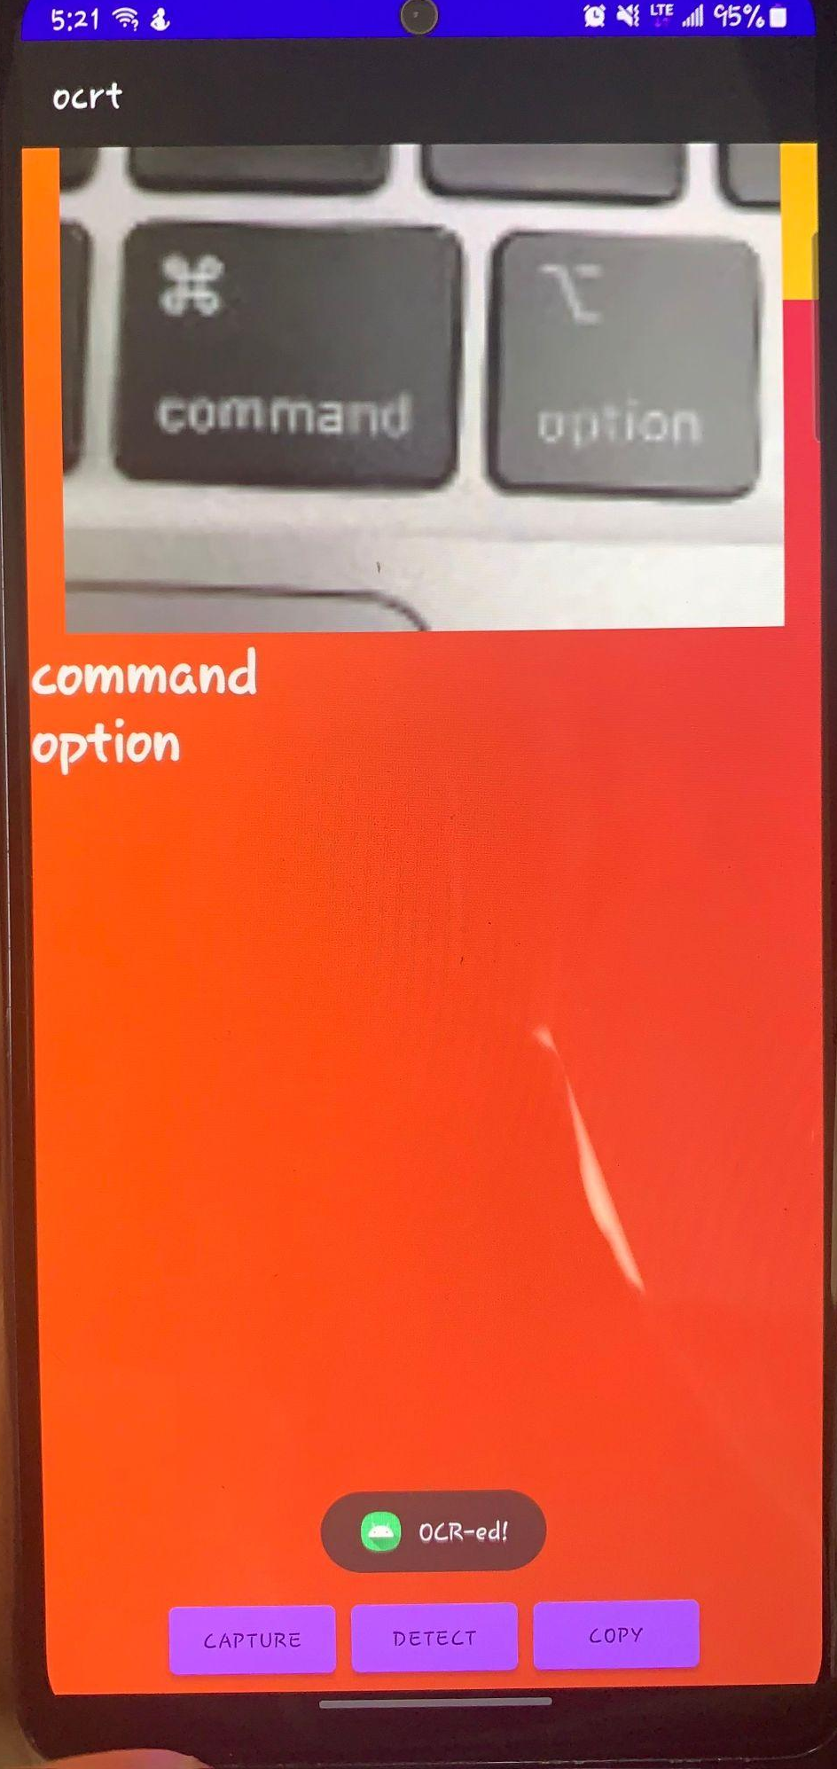
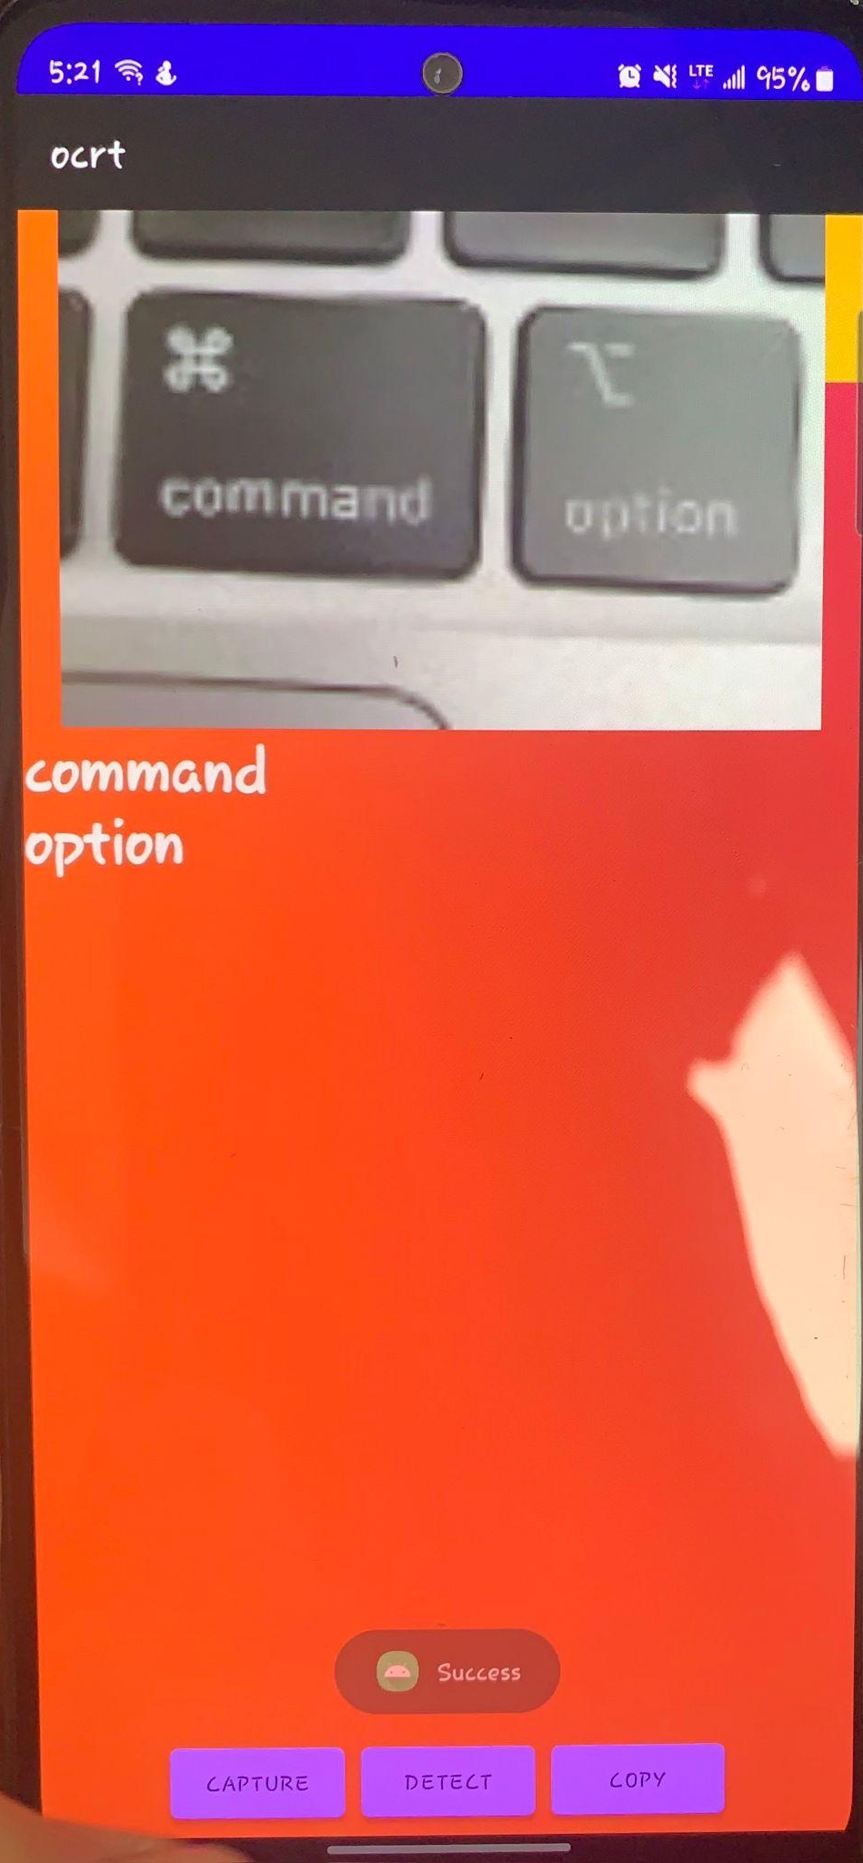

Slide 7
Dependencies
OCR Made with Text Recognition from MLKIT developed by Google
Cropping function made with Ucrop
Copy to clipboard made with Clipboard Manager class

Slide 8
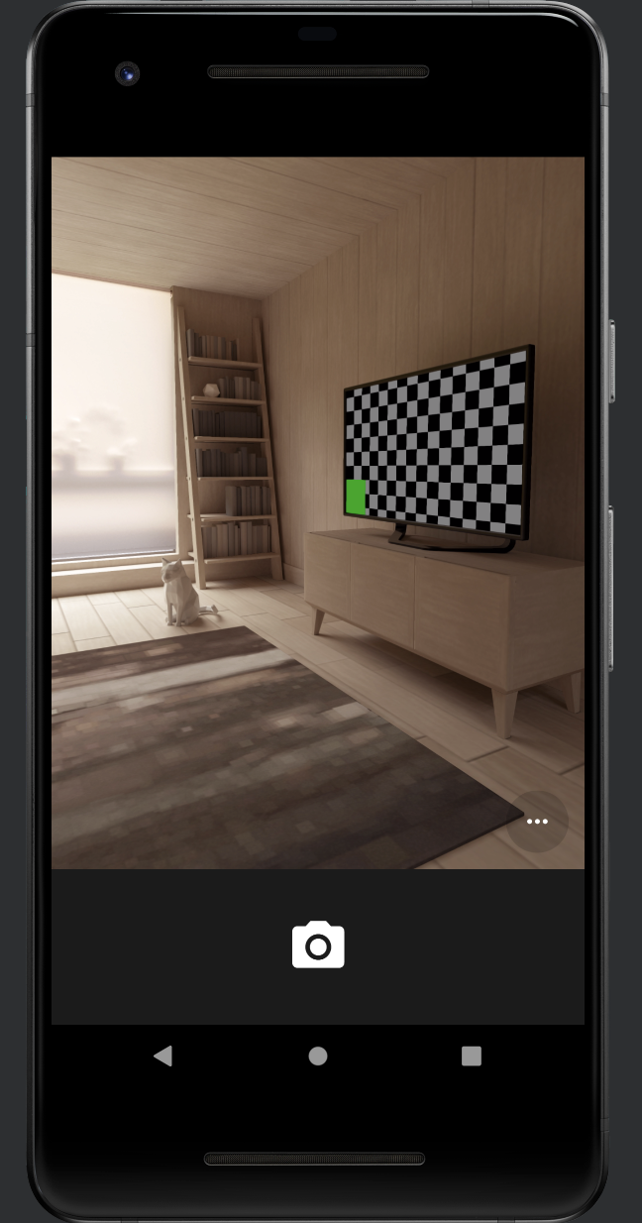
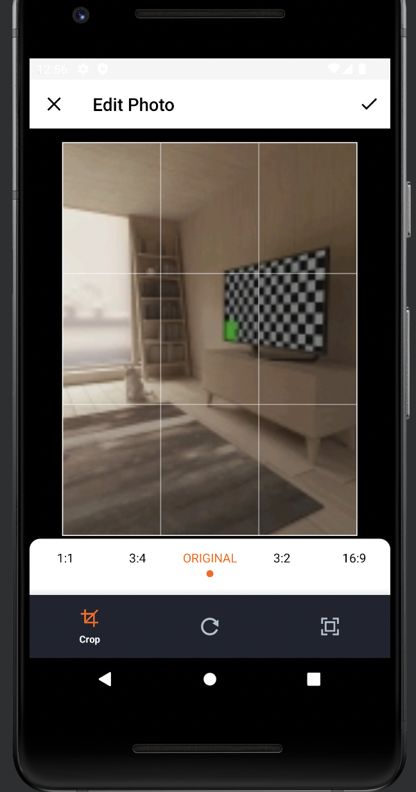
Known issues
No request for permission to use camera implemented
Ucrop dependency makes the resolution of the image worse.
======>

Slide 9
Difficulties
Deprecated APIs from android studio
API Documentations not really helpful at all
Kotlin: I never used it before, only for this assignment

Slide 10
Features for the future
Database with list activity, where you are able to check, delete or copy to clipboard previous entries
Save and database buttons in main activity
Implement google maps to the app

Slide 11
References & QA
Google :)

