Slide 1
Explorer: building “classifiers”
Classifiers in WEKA are models for predicting nominal or numeric quantities
Implemented learning schemes include:
  Decision trees and lists, instance-based classifiers, support vector machines, multi-layer perceptrons, logistic regression, Bayes’ nets, …
“Meta”-classifiers include:
  Bagging, boosting, stacking, error-correcting output codes, locally weighted learning, …
University of Waikato

Slide 2
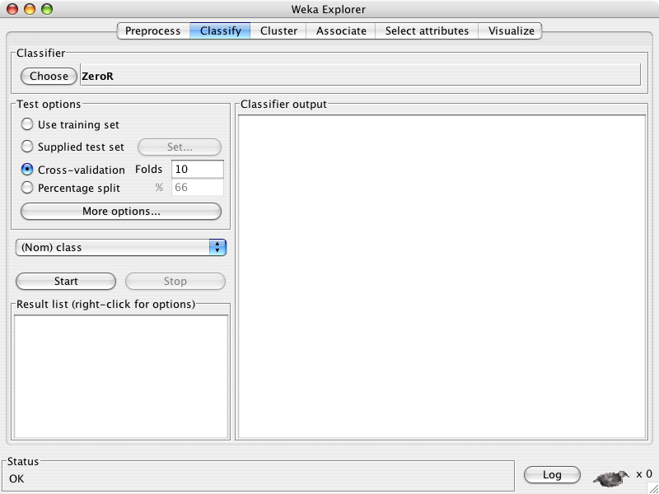
University of Waikato

Slide 3
University of Waikato

Slide 4
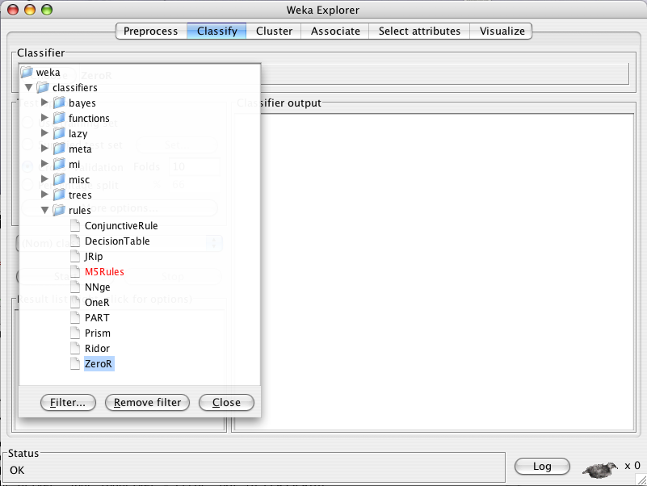
University of Waikato

Slide 5
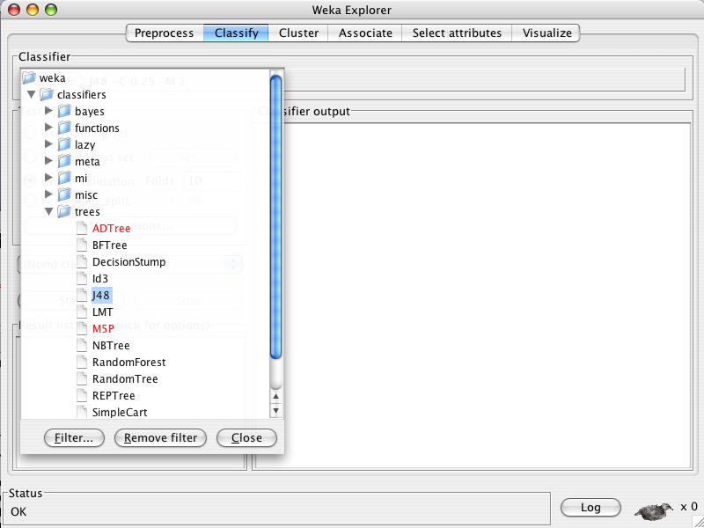
University of Waikato

Slide 6
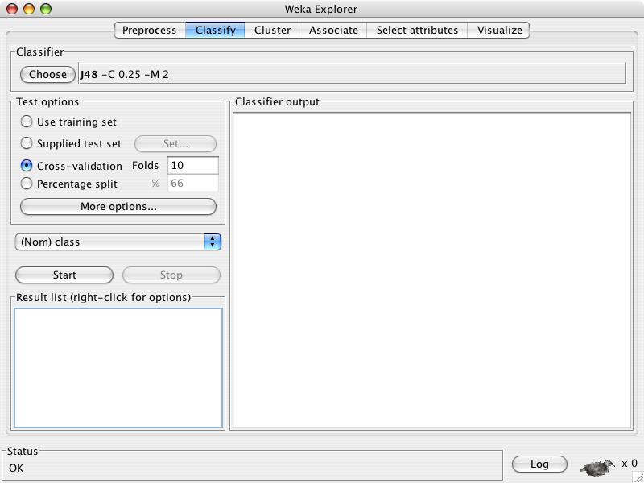
University of Waikato

Slide 7
University of Waikato

Slide 8
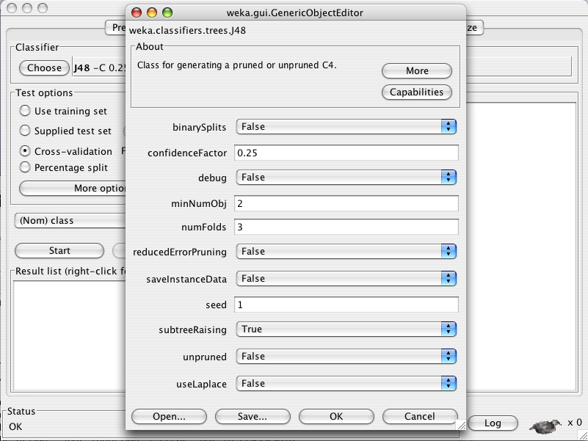
University of Waikato

Slide 9
University of Waikato

Slide 10
University of Waikato

Slide 11
University of Waikato

Slide 12
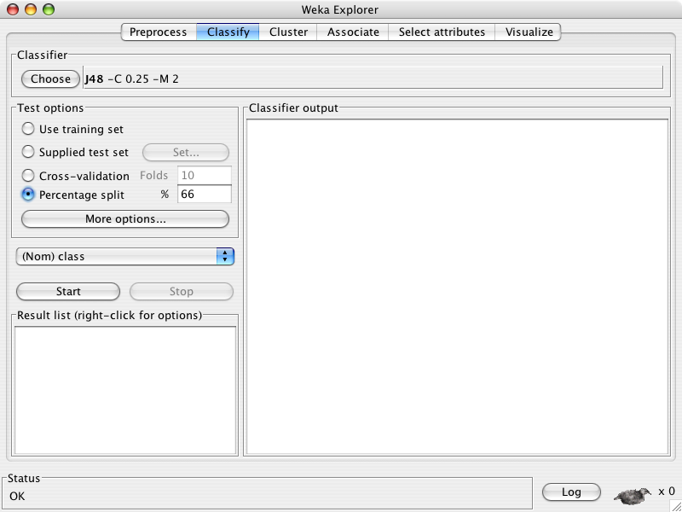
University of Waikato

Slide 13
University of Waikato

Slide 14
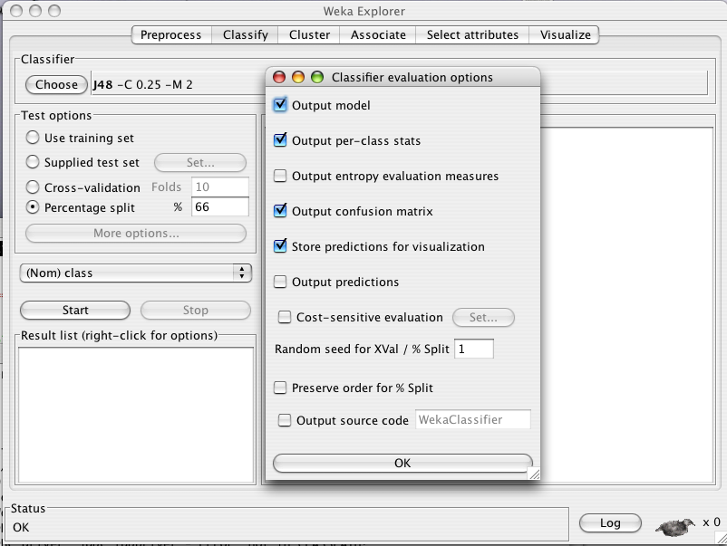
University of Waikato

Slide 15
University of Waikato

Slide 16
University of Waikato

Slide 17
University of Waikato

Slide 18
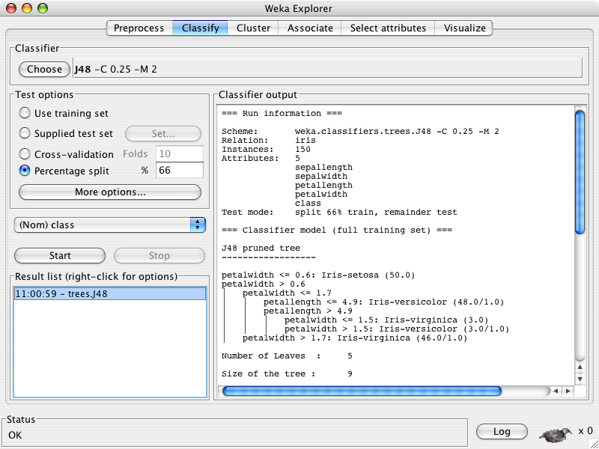
University of Waikato

Slide 19
University of Waikato

Slide 20
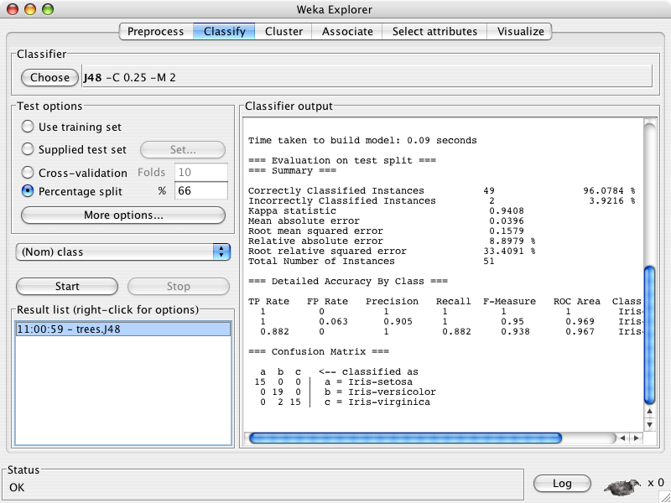
University of Waikato

Slide 21
University of Waikato

Slide 22
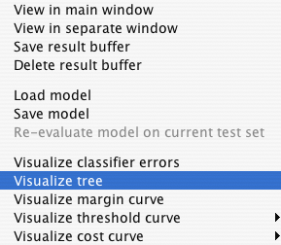
University of Waikato

Slide 23
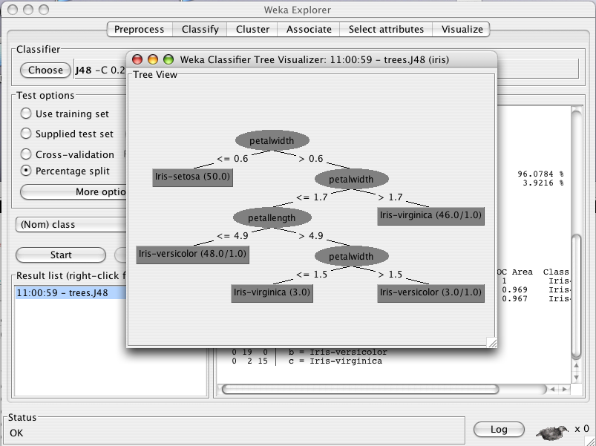
University of Waikato

Slide 24
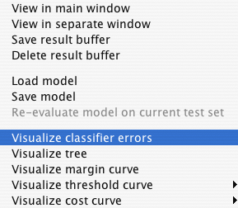
University of Waikato

Slide 25
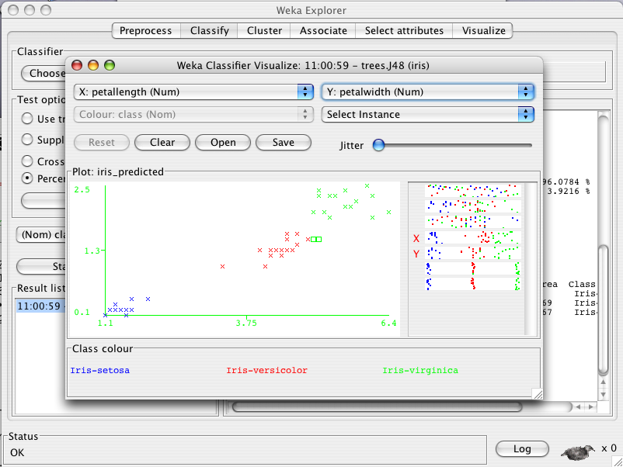
University of Waikato

Slide 26
University of Waikato

Slide 27
University of Waikato

Slide 28
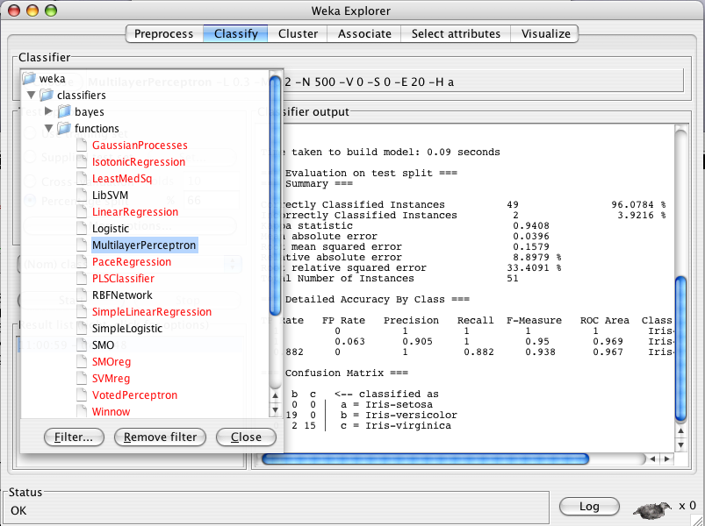
University of Waikato

Slide 29
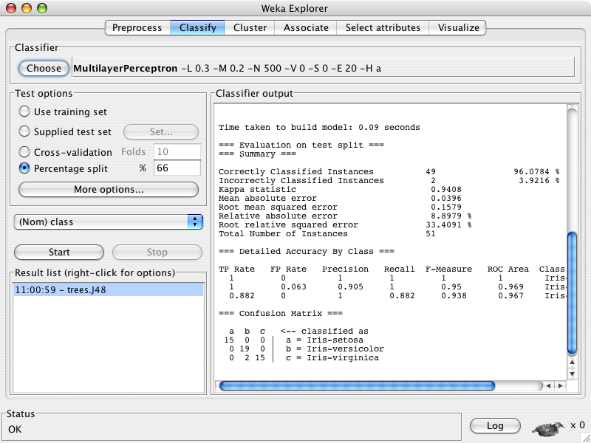
University of Waikato

Slide 30
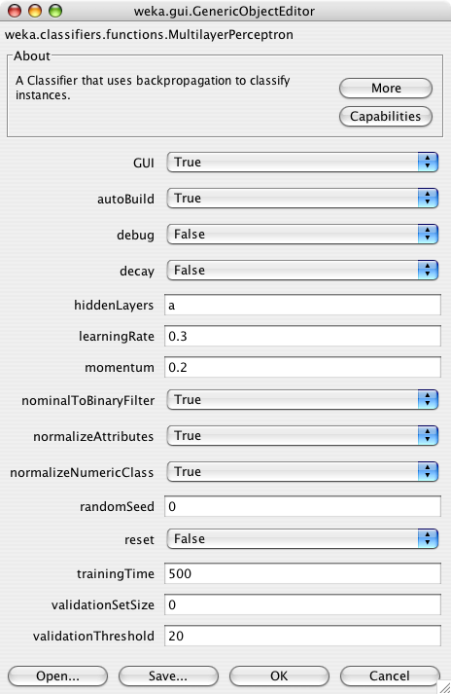
University of Waikato

Slide 31
University of Waikato

Slide 32
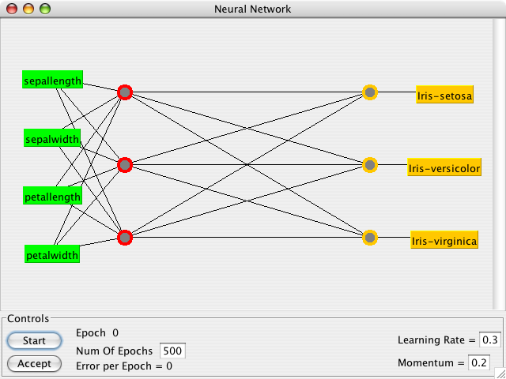
University of Waikato

Slide 33
University of Waikato

Slide 34
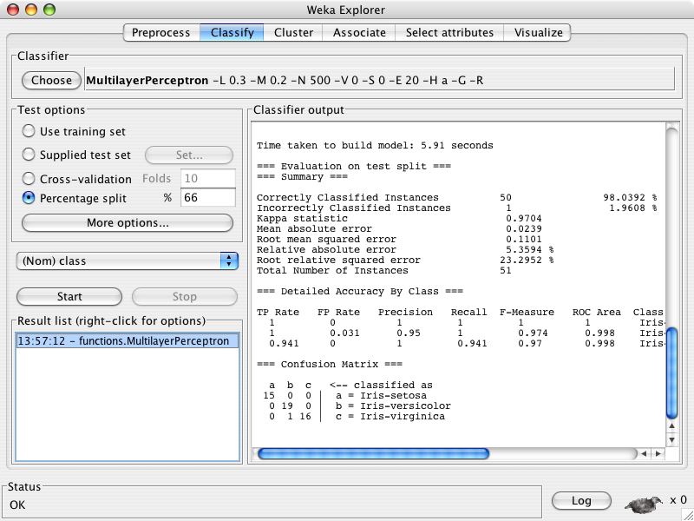
University of Waikato

Slide 35
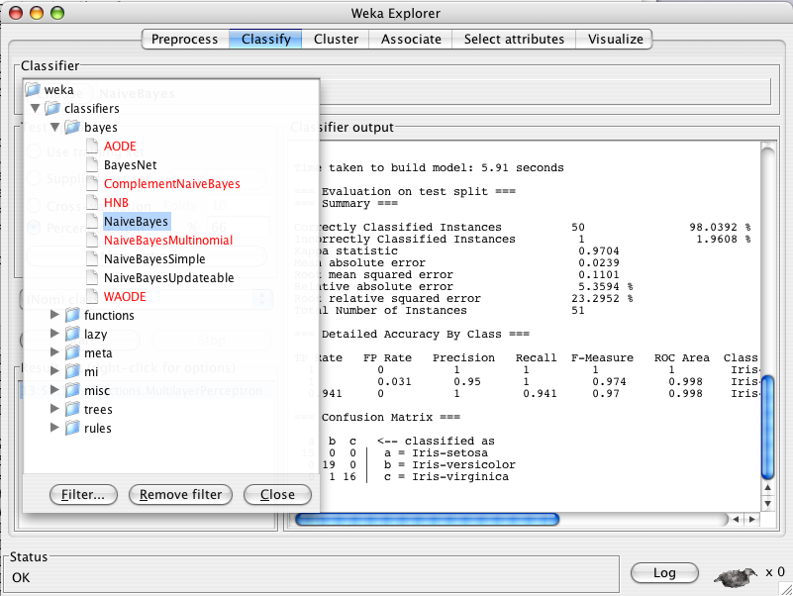
University of Waikato

Slide 36
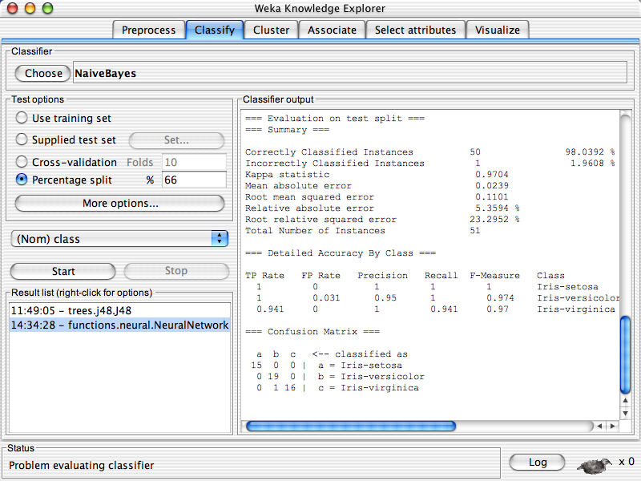

University of Waikato

Slide 37
University of Waikato

Slide 38
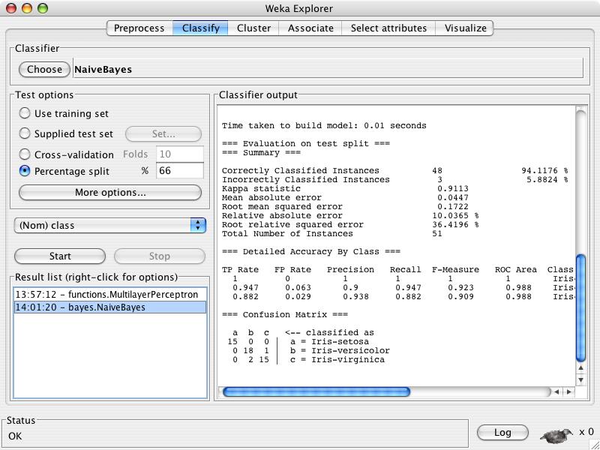
University of Waikato

Slide 39
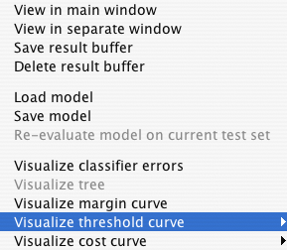

University of Waikato

Slide 40
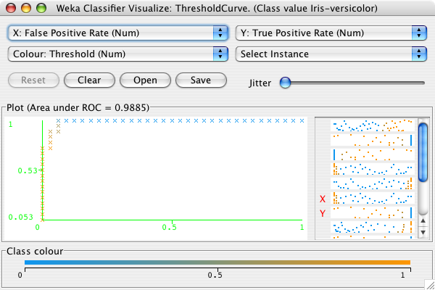
University of Waikato

Slide 41
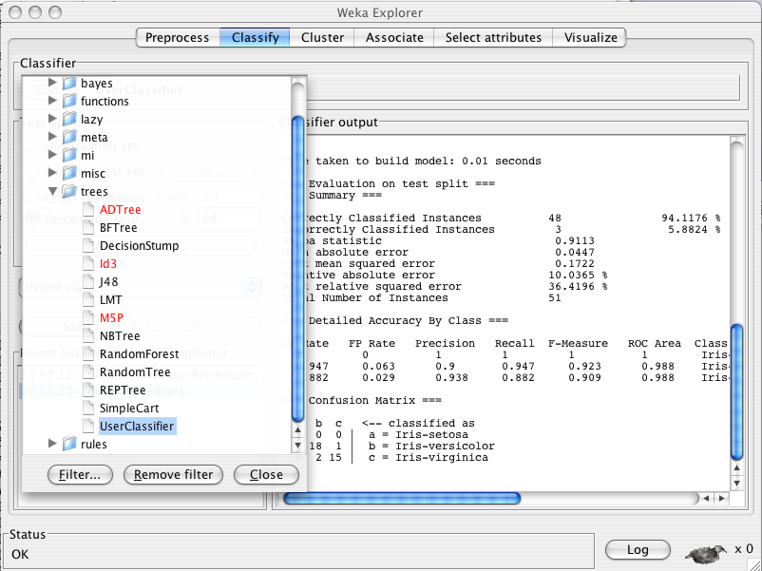
University of Waikato

Slide 42
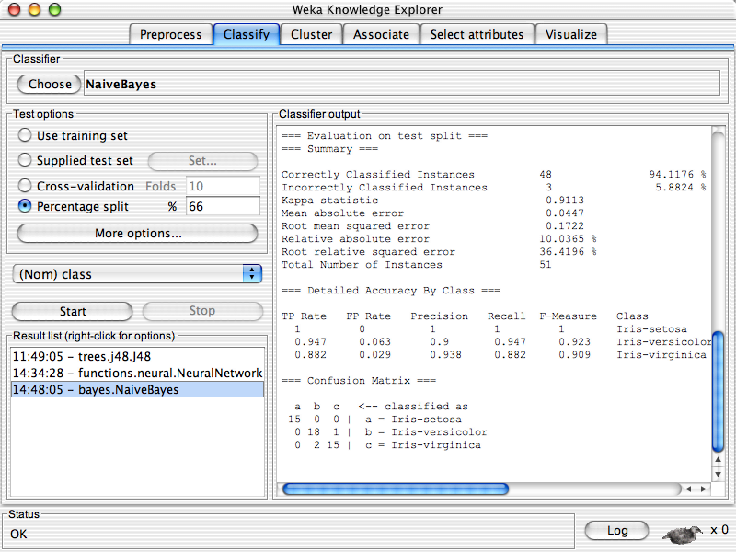

University of Waikato

Slide 43
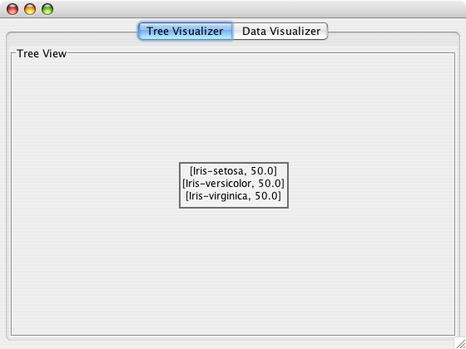
University of Waikato

Slide 44
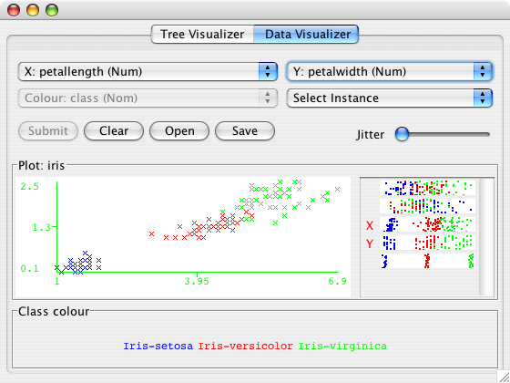
University of Waikato

Slide 45
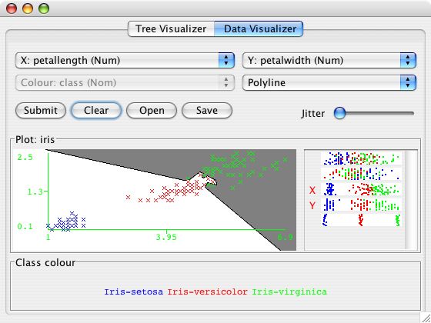
University of Waikato

Slide 46
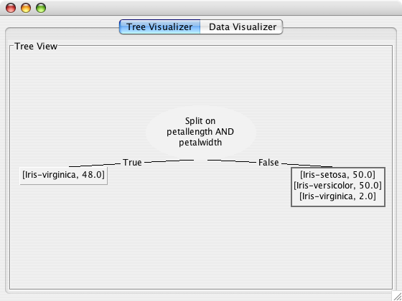
University of Waikato

Slide 47
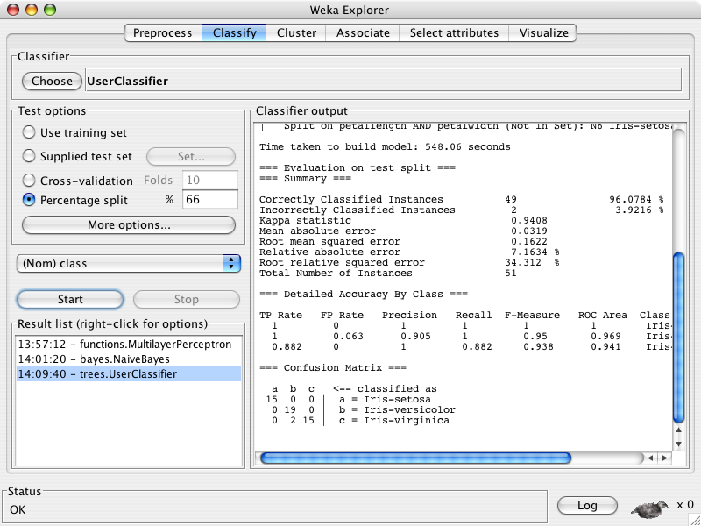
University of Waikato

Slide 48
University of Waikato

Slide 49
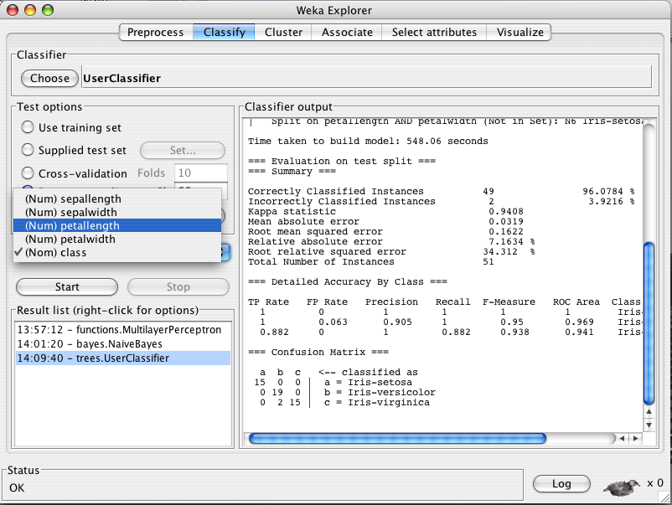
University of Waikato

Slide 50
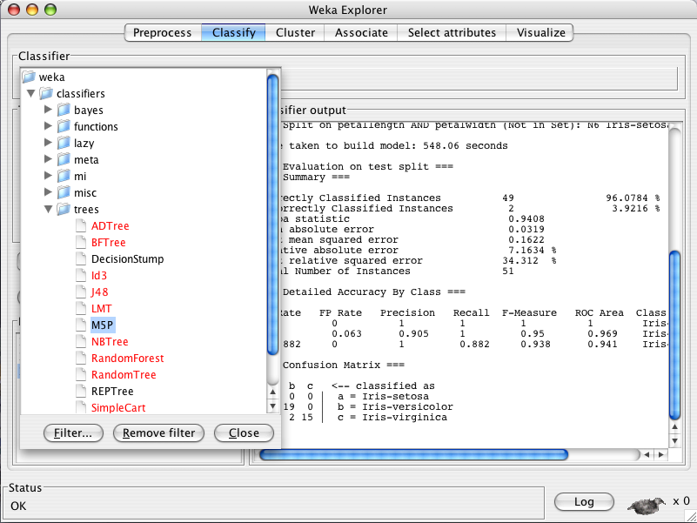
University of Waikato

Slide 51
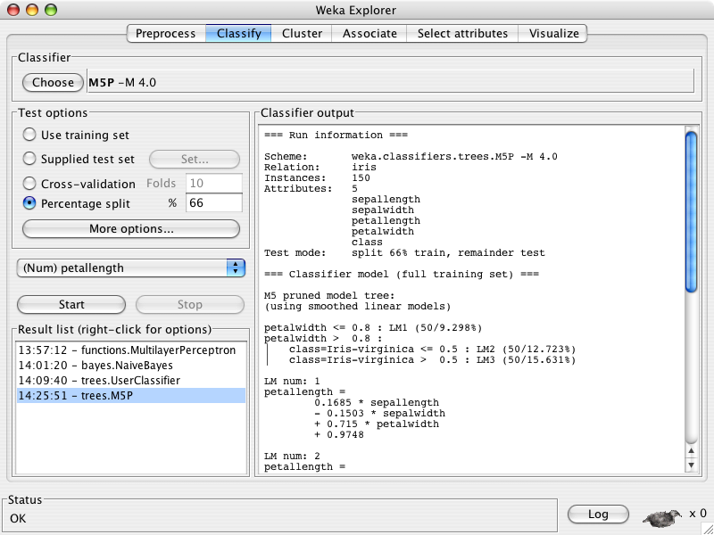
University of Waikato

Slide 52
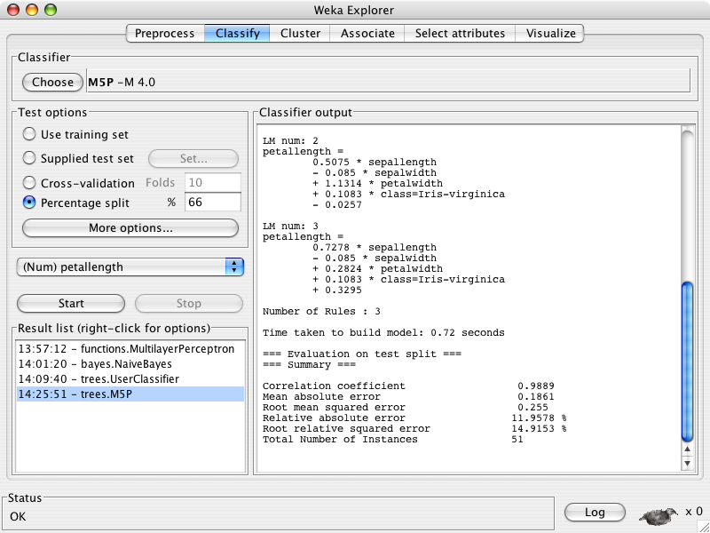
University of Waikato

Slide 53
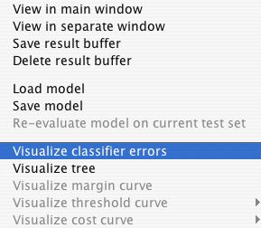
University of Waikato

Slide 54
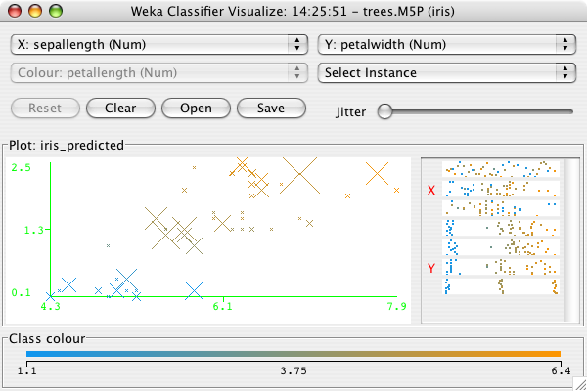
University of Waikato

Slide 55
University of Waikato

Slide 56
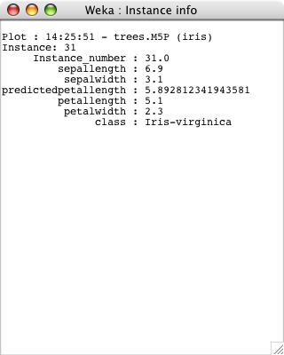
University of Waikato

