Slide 1

Introduction to Machine Learning September 2014 Meetup
Rahul Jain
@rahuldausa
Join us @ For Solr, Lucene, Elasticsearch, Machine Learning, IR
http://www.meetup.com/Hyderabad-Apache-Solr-Lucene-Group/
http://www.meetup.com/DataAnalyticsGroup/
Join us @ For Hadoop, Spark, Cascading, Scala, NoSQL, Crawlers and all cutting edge technologies.
http://www.meetup.com/Hyderabad-Programming-Geeks-Group/

Slide 2
Agenda
Introduction
Basics
Classification
Clustering
Regression
Use-Cases

Slide 3
Quick Questionnaire
How many people have heard about Machine Learning
How many people know about Machine Learning
How many people are using Machine Learning

Slide 4
About
subfield of Artificial Intelligence (AI)
name is derived from the concept that it deals with “construction and study of systems that can learn from data”
can be seen as building blocks to make computers learn to behave more intelligently
It is a theoretical concept. There are various techniques with various implementations.
http://en.wikipedia.org/wiki/Machine_learning

Slide 5
In other words…
“A computer program is said to learn from experience (E) with some class of tasks (T) and a performance measure (P) if its performance at tasks in T as measured by P improves with E”

Slide 6
Terminology
Features
The number of features or distinct traits that can be used to describe each item in a quantitative manner.
Samples
A sample is an item to process (e.g. classify). It can be a document, a picture, a sound, a video, a row in database or CSV file, or whatever you can describe with a fixed set of quantitative traits.
Feature vector
is an n-dimensional vector of numerical features that represent some object.
Feature extraction
Preparation of feature vector
transforms the data in the high-dimensional space to a space of fewer dimensions.
Training/Evolution set
Set of data to discover potentially predictive relationships.

Slide 7
Apple
Let’s dig deep into it…
What do you mean by

Slide 8
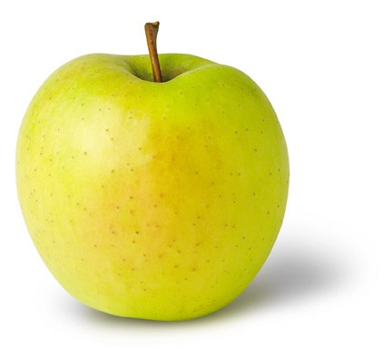
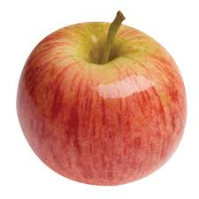

Learning (Training)
Features:
1. Color: Radish/Red
2. Type : Fruit
3. Shape
etc…
Features:
1. Sky Blue
2. Logo
3. Shape
etc…
Features:
1. Yellow
2. Fruit
3. Shape
etc…

Slide 9
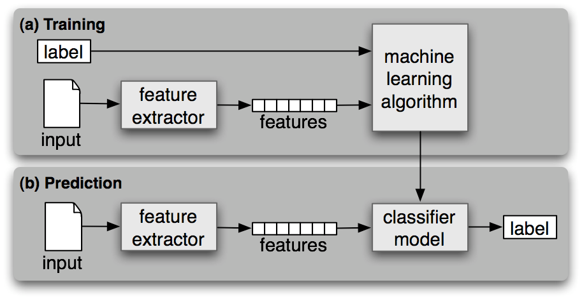
Workflow

Slide 10
Categories
Supervised Learning
Unsupervised Learning
Semi-Supervised Learning
Reinforcement Learning

Slide 11
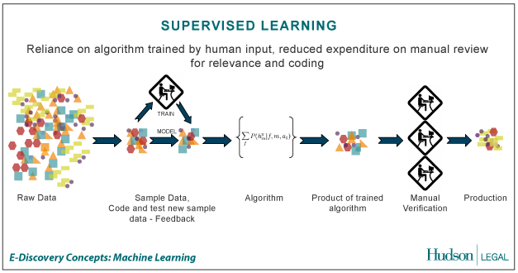
Supervised Learning
the correct classes of the training data are known
Credit: http://us.hudson.com/legal/blog/postid/513/predictive-analytics-artificial-intelligence-science-fiction-e-discovery-truth

Slide 12
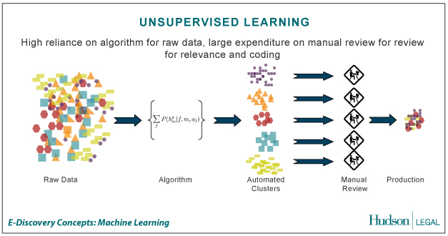
Unsupervised Learning
the correct classes of the training data are not known
Credit: http://us.hudson.com/legal/blog/postid/513/predictive-analytics-artificial-intelligence-science-fiction-e-discovery-truth

Slide 13
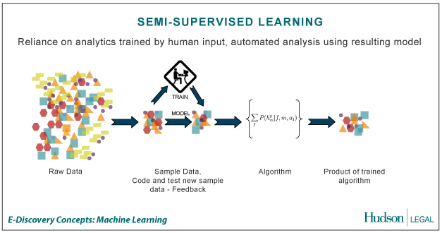
Semi-Supervised Learning
A Mix of Supervised and Unsupervised learning
Credit: http://us.hudson.com/legal/blog/postid/513/predictive-analytics-artificial-intelligence-science-fiction-e-discovery-truth

Slide 14
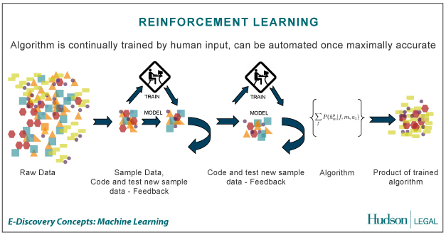
Reinforcement Learning
allows the machine or software agent to learn its behavior based on feedback from the environment.
This behavior can be learnt once and for all, or keep on adapting as time goes by.
Credit: http://us.hudson.com/legal/blog/postid/513/predictive-analytics-artificial-intelligence-science-fiction-e-discovery-truth

Slide 15
Machine Learning Techniques

Slide 16
Techniques
classification: predict class from observations
clustering: group observations into “meaningful” groups
regression (prediction): predict value from observations

Slide 17
Classification
classify a document into a predefined category.
documents can be text, images
Popular one is Naive Bayes Classifier.
Steps:
Step1 : Train the program (Building a Model) using a training set with a category for e.g. sports, cricket, news,
Classifier will compute probability for each word, the probability that it makes a document belong to each of considered categories
Step2 : Test with a test data set against this Model
http://en.wikipedia.org/wiki/Naive_Bayes_classifier

Slide 18
Clustering
clustering is the task of grouping a set of objects in such a way that objects in the same group (called a cluster) are more similar to each other
objects are not predefined
For e.g. these keywords
“man’s shoe”
“women’s shoe”
“women’s t-shirt”
“man’s t-shirt”
can be cluster into 2 categories “shoe” and “t-shirt” or “man” and “women”
Popular ones are K-means clustering and Hierarchical clustering

Slide 19
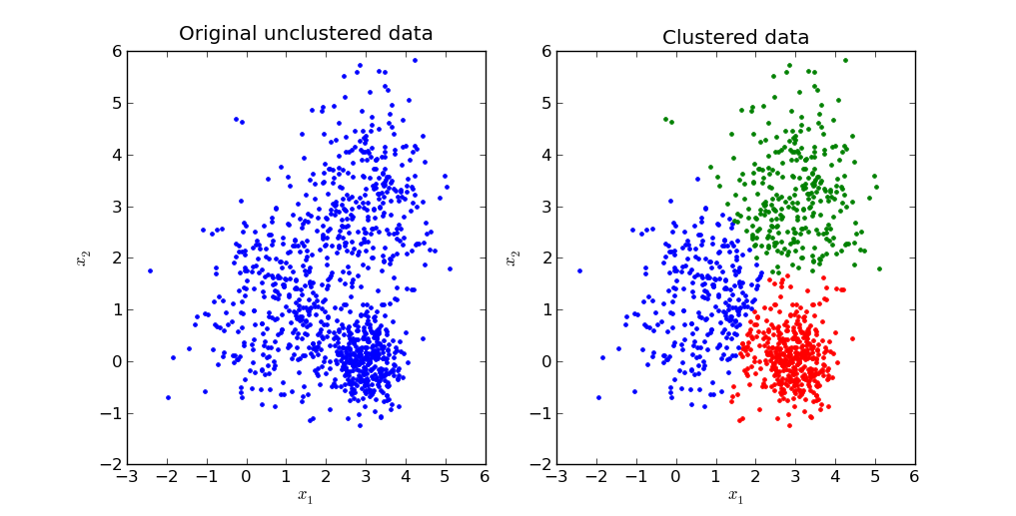
K-means Clustering
partition n observations into k clusters in which each observation belongs to the cluster with the nearest mean, serving as a prototype of the cluster.
http://en.wikipedia.org/wiki/K-means_clustering
http://pypr.sourceforge.net/kmeans.html

Slide 20
Hierarchical clustering
method of cluster analysis which seeks to build a hierarchy of clusters.
There can be two strategies
Agglomerative:
This is a "bottom up" approach: each observation starts in its own cluster, and pairs of clusters are merged as one moves up the hierarchy.
Time complexity is O(n^3)
Divisive:
This is a "top down" approach: all observations start in one cluster, and splits are performed recursively as one moves down the hierarchy.
Time complexity is O(2^n)
http://en.wikipedia.org/wiki/Hierarchical_clustering

Slide 21
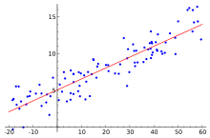
Regression
is a measure of the relation between the mean value of one variable (e.g. output) and corresponding values of other variables (e.g. time and cost).
regression analysis is a statistical process for estimating the relationships among variables.
Regression means to predict the output value using training data.
Popular one is Logistic regression (binary regression)
http://en.wikipedia.org/wiki/Logistic_regression

Slide 22
Classification vs Regression
Classification means to group the output into a class.
classification to predict the type of tumor i.e. harmful or not harmful using training data
if it is discrete/categorical variable, then it is classification problem
Regression means to predict the output value using training data.
regression to predict the house price from training data
if it is a real number/continuous, then it is regression problem.

Slide 23
Let’s see the usage in Real life

Slide 24
Use-Cases
Spam Email Detection
Machine Translation (Language Translation)
Image Search (Similarity)
Clustering (KMeans) : Amazon Recommendations
Classification : Google News
continued…

Slide 25
Use-Cases (contd.)
Text Summarization - Google News
Rating a Review/Comment: Yelp
Fraud detection : Credit card Providers
Decision Making : e.g. Bank/Insurance sector
Sentiment Analysis
Speech Understanding – iPhone with Siri
Face Detection – Facebook’s Photo tagging

Slide 26
Classification in Action isn’t it easy?

Slide 27
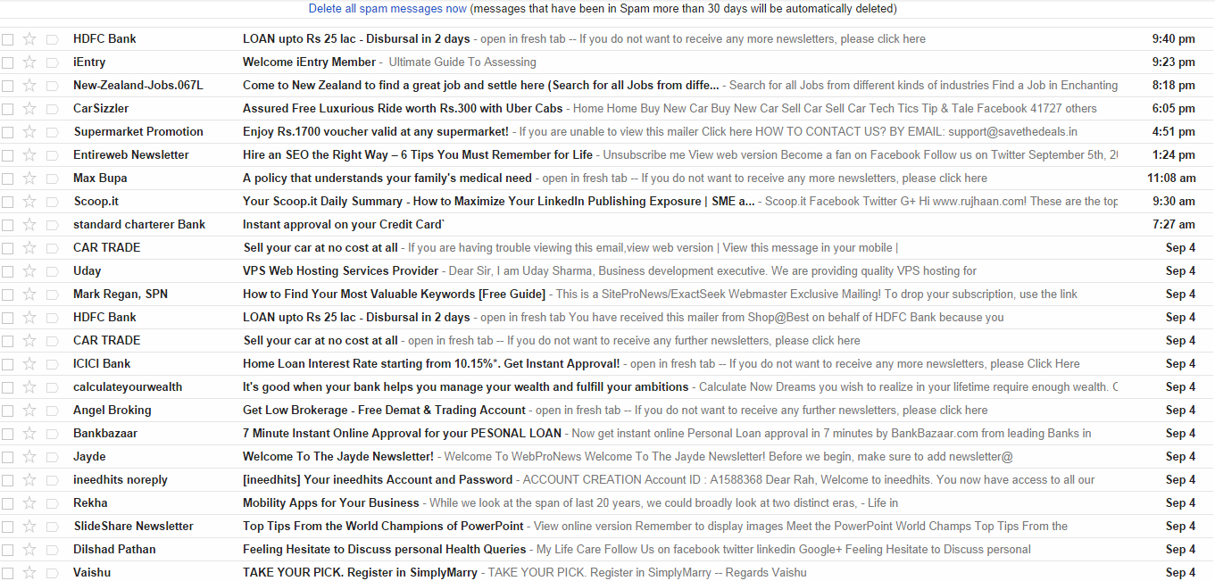
it’s not (Snapshot of Spam folder)
Not a Spam
Not a Spam

Slide 28
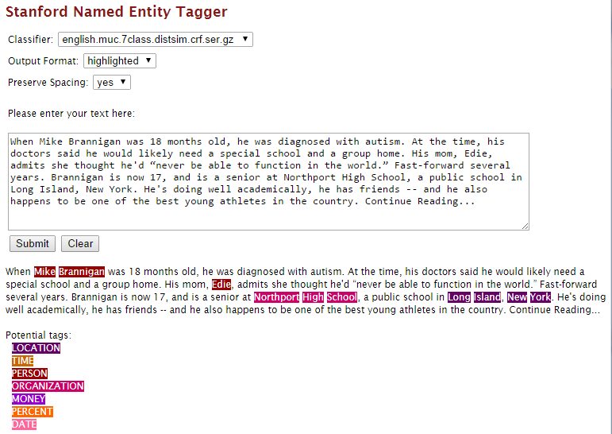
NER (Named Entity Recognition)
http://nlp.stanford.edu:8080/ner/process

Slide 29
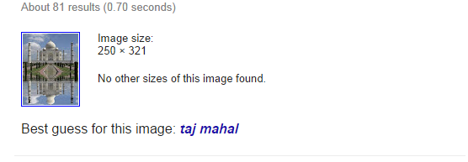
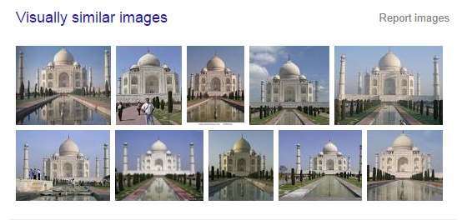
Similar/Duplicate Images
Remember
Features ?
(Feature Extraction)
Can be :
Width
Height
Contrast
Brightness
Position
Hue
Colors
Check this :
LIRE (Lucene Image REtrieval) library -
https://code.google.com/p/lire/
Credit: https://www.google.co.in/

Slide 30
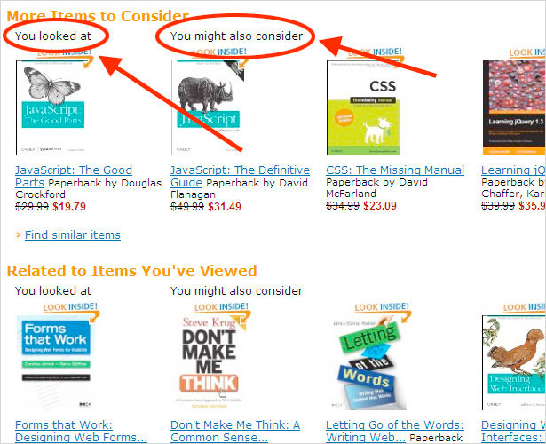
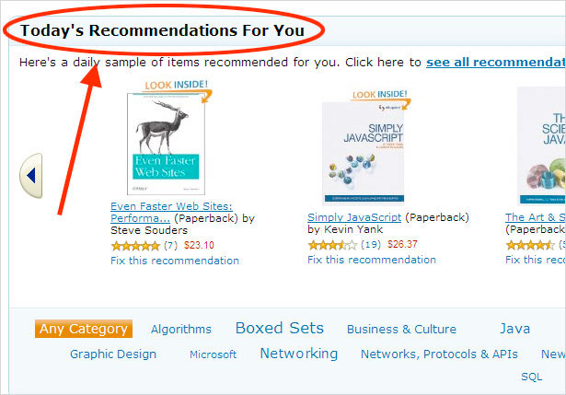
Recommendations
http://www.webdesignerdepot.com/2009/10/an-analysis-of-the-amazon-shopping-experience/

Slide 31
Popular Frameworks/Tools
Weka
Carrot2
Gate
OpenNLP
LingPipe
Stanford NLP
Mallet – Topic Modelling
Gensim – Topic Modelling (Python)
Apache Mahout
MLib – Apache Spark
scikit-learn - Python
LIBSVM : Support Vector Machines
and many more…

Slide 32
Advanced concepts (related to IR)
Topic Modelling
Latent Dirichlet allocation (LDA)
Latent semantic analysis (LSA/LSI) - Semantic Search
Singular Value Decomposition (SVD)
Summarization (without Training)

Slide 33
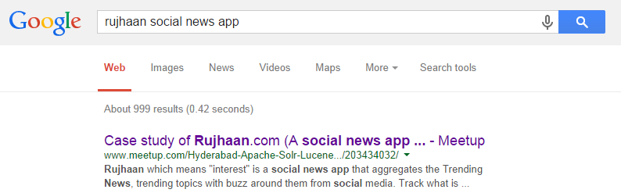
Solr/Lucene Meetup
Case study of Rujhaan.com
(A social news app )
Saturday, Sep 27, 2014 10:00 AM
IIIT Hyderabad
URL: http://www.meetup.com/Hyderabad-Apache-Solr-Lucene-Group/events/203434032/
OR
Search on Google …
Topics of Talk
Crawler(Crawler4j)
MongoDB
Solr
Nginx, ApacheTomcat
Redis
Machine Learning
1. Classification - Classification of News, Tweets - Lingpipe
2. Clustering, - Similar Items - carrot2 (Near Future: Hadoop and Apache Spark )
3. Summarization - Extracting the main text with Automatic Summary of article
4. Topics Extraction from text

Slide 34
Questions ?

Slide 35
Thanks! @rahuldausa on twitter and slideshare http://www.linkedin.com/in/rahuldausa
Interested in Search/Information Retrieval ?
Join us @ http://www.meetup.com/Hyderabad-Apache-Solr-Lucene-Group/

