Slide 1
Cloud Computing
Sec-3

Slide 2
Agenda
1- Cloud Computing vs Virtualization. 2- EXSI Hypervisor 3- vSphere Client
4- vCenter VMware
5-Enroll on Hands On Labs.

Slide 3
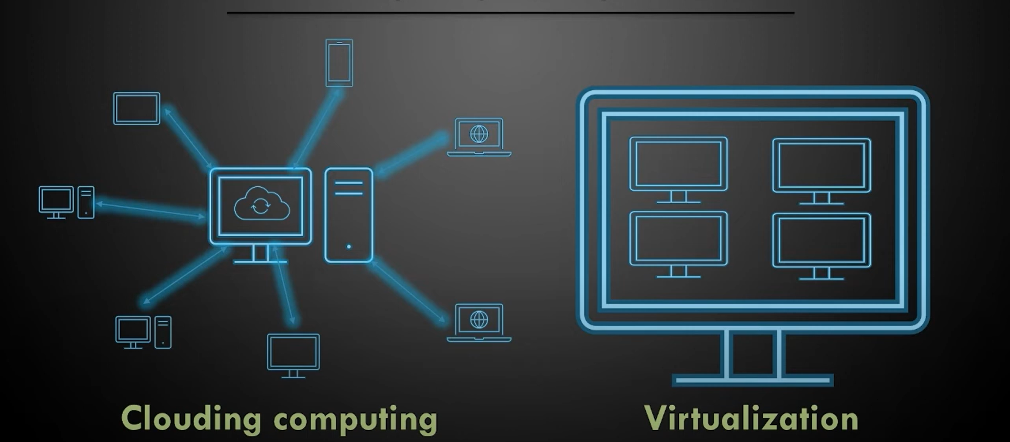

Slide 4
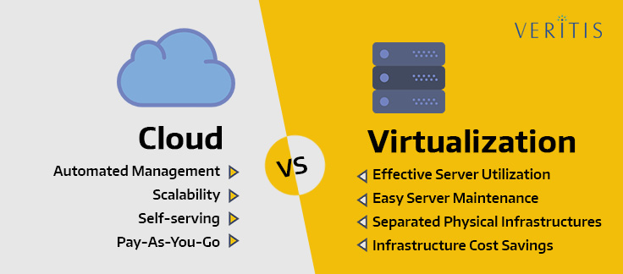
Self-Service in cloud computing refers to the capability for customers to access and manage cloud resources as needed .
Server maintenance is a process of keeping a server software updated and running smoothly so that a computer network function properly and avoids downtime or loss of data.

Slide 5
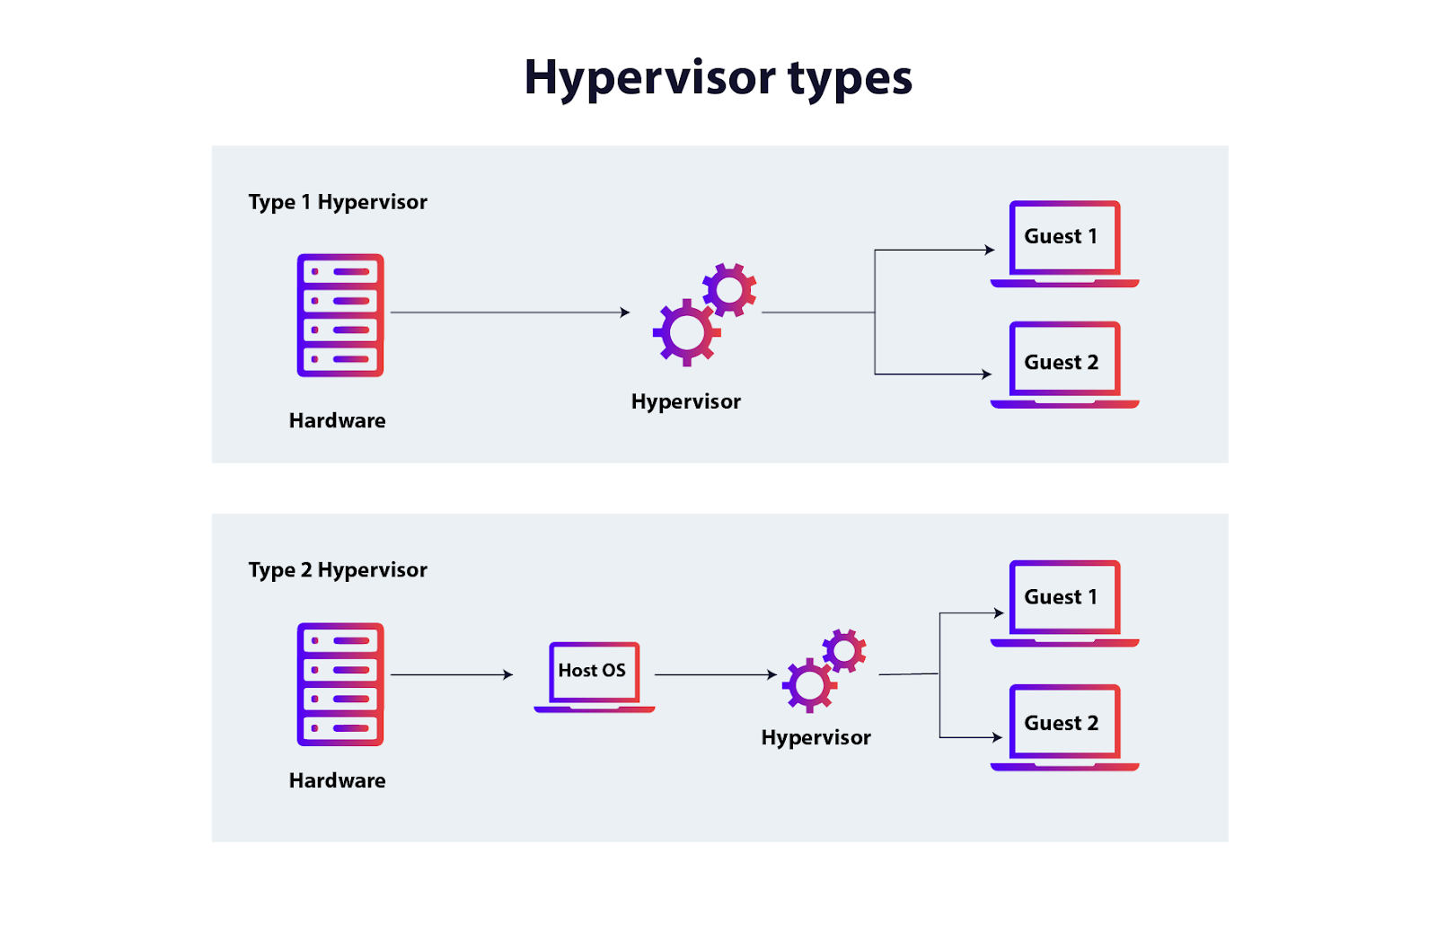
EXSI Hypervisor

Slide 6
EXSI Hypervisor
This type of hypervisor installs directly onto a physical machine and creates the separation necessary to divide it into one or more virtual machines. it requires minimal system resources for itself, leaving more for the VMs to use.
One of Benefits
stable performance: The hypervisor supports the applications of any size with the ability to deploy the powerful virtual machines (up to 128 vCPUs, 6 TB of RAM, and 120 devices) for meeting the needs of the different applications.

Slide 7
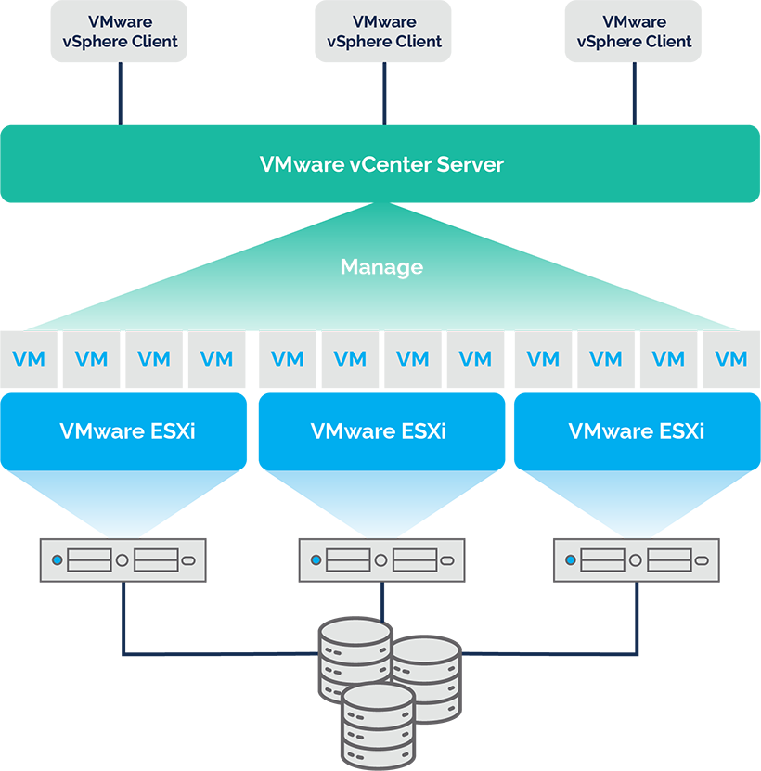

Slide 8
vSphere Client
The vSphere Client acts as an administrative interface to access and manage VMware hosts.
Benefits
Easily creates and manages multiple virtual machines.
Migrates workloads and data center maintenance live and avoid downtime.
Manages offices remotely with few or no local IT admins.

Slide 9
vCenter VMware
VMware vCenter Server is a centralized management platform for configuring, controlling and monitoring VMware vSphere virtual environments.
Benefits
VMotion
Distributed Resource Schedule ( Load Balancing )
Fault Tolerance (Shadow instance)

Slide 11
Enroll on “Hands On Labs”
https://labs.hol.vmware.com/HOL/maintenance
https://labs.hol.vmware.com/HOL/login
10 benefits of hands-on virtual training labs - Skillable

Slide 12


