Slide 1

Customer
Segmentation Project
Presented By:
Anena Girish
Prem sai pagadala
Ushir Mrunmayi Pramodkumar
Akansha Ambadas Shinde
Malli Neeraja
Group No. 2

Slide 2
INTRODUCTION
Objective: To identify distinct customer groups based on demographics and spending behavior.
Dataset: Marketing campaign data containing demographics, spending, and response behavior.
Goal: Enhance targeted marketing and customer understanding using data-driven insights.

Slide 3
Data Loading and Overview
Data Source: marketing_campaign.xlsx
Tools & Libraries : Python, pandas, NumPy , matplotlib, seaborn, scikit-learn, tkinter for GUI, and joblib for model persistence.
Initial Size: 2,240 records across 29 columns.
Key Columns : Age, Income, Education, Marital Status, Spending categories(Wines, Fruits, Meat, Fish, Sweet, Gold).
5)Data Modeling

Slide 4
Data Cleaning and Preparation
Missing Values: Only the 'Income' column had missing values (1.12%). These were imputed using the median to maintain data quality and avoid data loss.
Duplicate Records: No duplicate rows were found.
Outlier Handling: Extreme outliers in 'Income' were capped using the Interquartile Range (IQR) method to ensure robust statistical analysis.

Slide 5
Feature Engineering
New features were derived to improve the relevance of the data for segmentation:
- Age: Calculated from 2025 - Year_Birth.
- TotalChildren: Sum of Kidhome and Teenhome.
- TotalSpend: Sum of all six product spending columns (The primary segmentation variable).
- FamilySize: Calculated as TotalChildren + (Customer) + IsPartner.

Slide 6
Univariate Analysis
Income & TotalSpend: Both show a right-skewed distribution, indicating most customers have lower to moderate income/spending, but a long tail exists for high-value customers.
Education: Graduation is the most prevalent education level.
Marital Status: The majority of customers are either Married or Together.

Slide 7
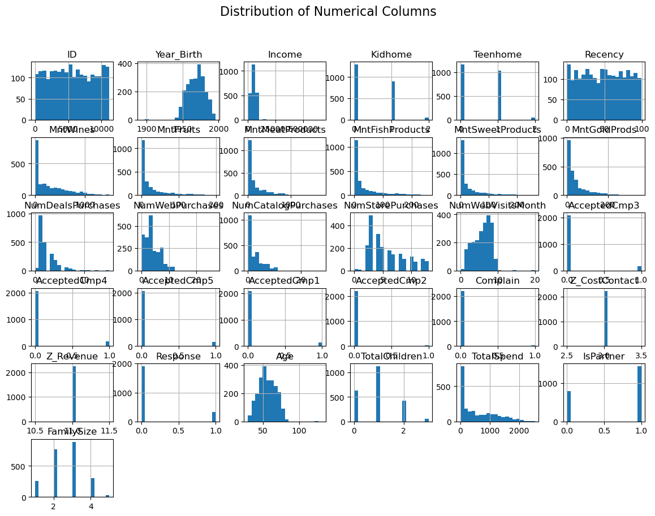
Univarient Analysis

Slide 8
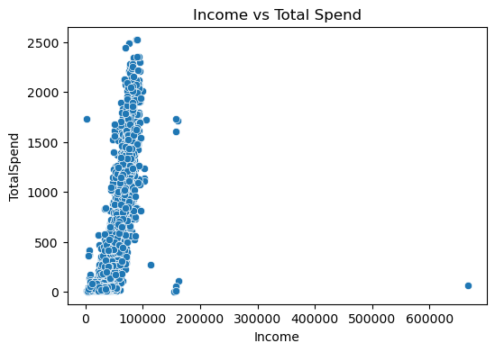
Bivariate Analysis
Insight: A strong, clear positive correlation exists between Income and TotalSpend.
Observation: The scatterplot shows a clear linear trend, confirming that high spenders are generally high earners.

Slide 9
Correlation Analysis
Key Finding: TotalSpend exhibits a very high correlation with MntWines and MntMeatProducts, confirming these are the biggest contributors to overall spending.
Highly correlated spending columns suggest potential multicollinearity, which PCA will address.

Slide 10
Outlier Detection and Handling
Detected outliers in Income and TotalSpend using boxplots.
Used IQR method to cap extreme values.
Ensured data consistency and reduced skewness.

Slide 11
Feature Selection and Scaling
Encoded categorical variables using LabelEncoder.
Scaling: All features were scaled using StandardScaler (Z-Score) to ensure all variables contribute equally to the distance calculations during clustering.
Clustering Features: The most informative variables were selected: Income, Age, TotalChildren, FamilySize, TotalSpend, and Recency.

Slide 12
Principal Component Analysis (PCA)
Purpose: To reduce the dimensionality of the scaled data while retaining most of the variance.
Result: PCA was configured to retain 95% of the total variance, resulting in a reduction from 26 numerical features to 11 Principal Components.
Benefit: This reduces noise, speeds up computation, and mitigates the effect of multicollinearity.

Slide 13
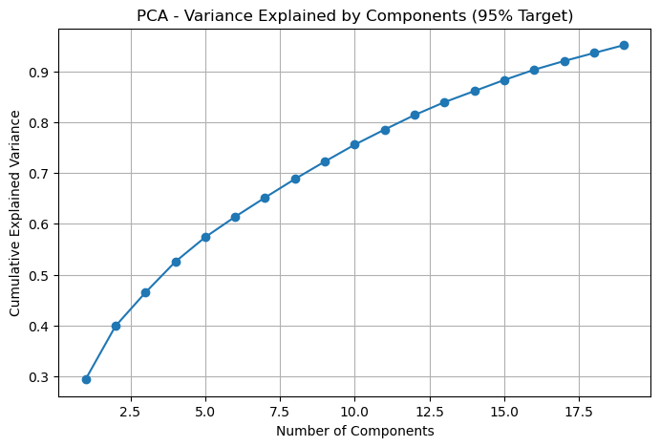
Principal Component Analysis (PCA)

Slide 14
Customer Segmentation (Clustering)
Applied K-Means clustering on preprocessed data.
Used Elbow Method to determine optimal number of clusters.
Result: The "elbow" point, where the decrease in inertia starts to slow down, is observed around K=4 or K=5.
Decision: K=4 was chosen as the optimal number of clusters for initial K-Means segmentation.
Segmented customers into groups based on spending and demographics.

Slide 15
Summary of Other Clustering Methods
Model | Characteristic | Key Result | Why it wasn't chosen
MiniBatch KMeans | Uses data subsets (mini-batches) to train faster. | Scores were nearly identical to standard KMeans (Silhouette: 0.237, Calinski-Harabasz: 763.04). | Excellent, but only preferred over KMeans for significantly larger datasets due to speed.
Agglomerative (Hierarchical) | A bottom-up method that merges clusters iteratively. | Scores were slightly lower than KMeans across all metrics (Silhouette: 0.230, Calinski-Harabasz: 734.16). | Less computationally efficient than KMeans and didn't provide better quality clusters.
DBSCAN | Density-based clustering that identifies crowded regions and marks sparse areas as noise (-1). | Achieved the highest Silhouette Score (0.355) but the lowest Calinski-Harabasz score (15.27). | Labeled too many customers as noise, making it poor for comprehensive market segmentation of the entire base.
Gaussian Mixture Model (GMM) | A probabilistic model that assumes data points are generated from a mixture of Gaussian (bell-curve) distributions. | Had the worst Silhouette Score (0.158) of all models. | The underlying assumption of Gaussian-shaped clusters did not fit the customer data well.

Slide 16
Cluster Insights
Clustering Performance Comparison:
---------------------------------------------------------------------------------------------------
Model Silhouette Davies-Bouldin Calinski-Harabas
----------------------------------------------------------------------------------------------------
KMeans 0.238120 1.500809 771.065905
Agglomerative 0.229845 1.525626 734.1599
DBSCAN 0.354577 2.569263 15.272652
GMM 0.157871 1.806847 435.983432
MiniBatchKMeans 0.211935 1.553719 712.786333

Slide 17
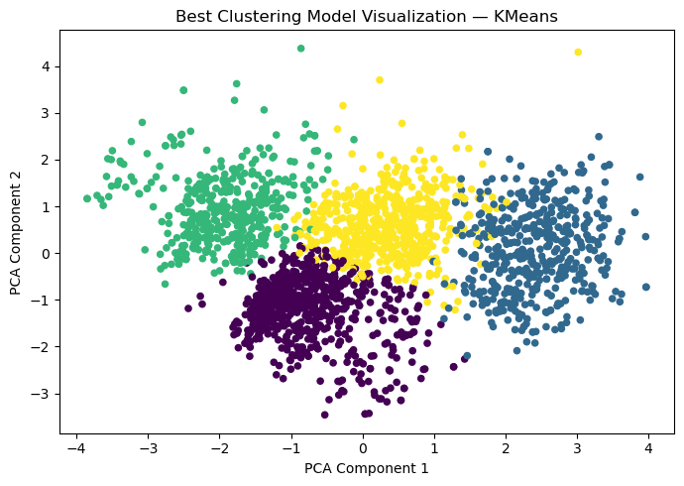
Best Model Selected
KMeans (Overall Score: 0.867)

Slide 18
Deployment Summary
Built a Customer Segmentation model using K-Means clustering to group customers based on behavior and demographics.
Performed data preprocessing and feature scaling for accurate clustering results.
Developed an interactive Streamlit web app to visualize customer segments and insights.
Deployed the solution to showcase real-world ML application and business decision support.

Slide 19
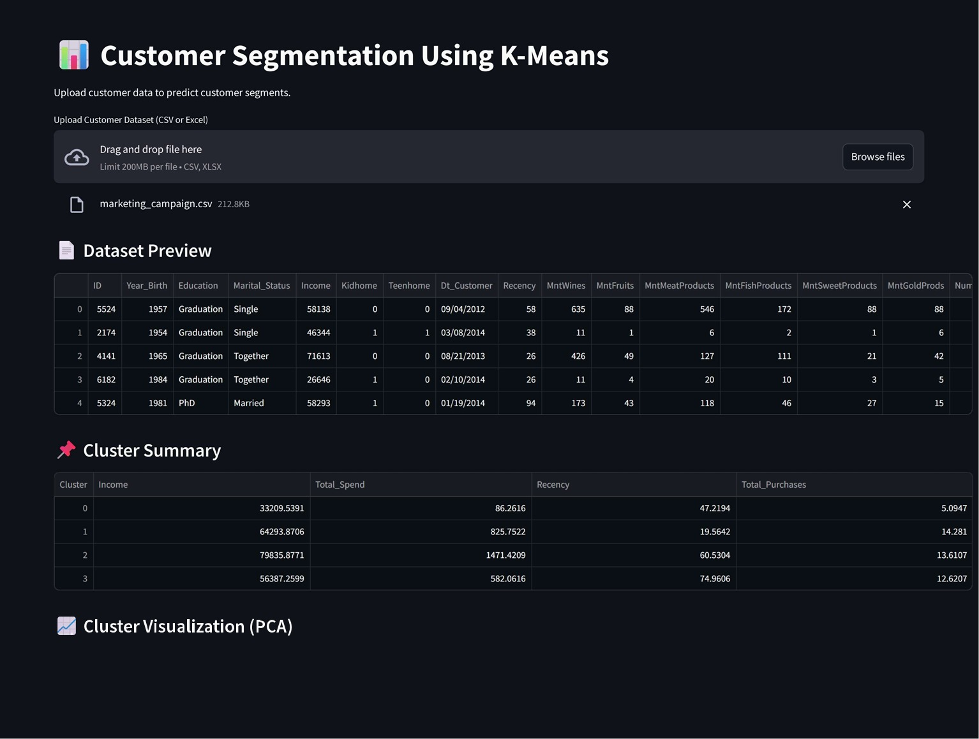
Outputs

Slide 20
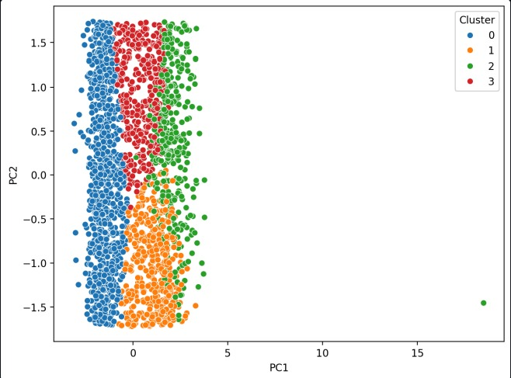

Slide 21
Conclusion
Customer segmentation revealed distinct behavioral groups.
Marketing can be optimized for each segment’s characteristics.
Data-driven strategies improve retention and campaign efficiency.

Slide 22
Future Work
Incorporate additional customer engagement metrics.
Improve GUI design & performance.
Automate periodic segmentation updates.
Integrate insights with CRM systems.

Slide 23
THANK YOU

