Slide 1
Emotion Analyzer To predict emotions of textual input
| Persistent University
Notes:
Research is going on in area of human emotion analysis since 1984. Till now much work has been done, and result is not much away from the reality. Many people in industry are working on this from last few years. We too tried to give our contribution in this research work. We have developed a text-based emotion analyzer system to detect emotions from the words, sentences. This product is developed on the top of the research that has been done till date, with few more extra contribution from our side. We take words, set of words, sentences, text based smileys or paragraphs as input. Apply our algorithm over that input and come with result in form of emotions out of joy, fear, sad or anger along with polarity value in eye-catchy style, displaying result in graphical format in gauge (speedometer format) design.

Slide 2
Why do we need Emotion Analyzer?
If we publish a product to customers, and we need to check, do customers liked our product or not?
For that we would collect feedback from the customers about the product. But we need to analyze all those feedbacks manually.
Even though, if we pick up few random feedback and try to predict users’ happiness, how we can say that we would get right result?
Even we use many other analyzers, we would get only positive or negative polarity of the feedbacks. We wont get actual emotions and happiness factor from those analyzers.
To resolve all those type of issues, our system is pretty much useful.

Slide 3
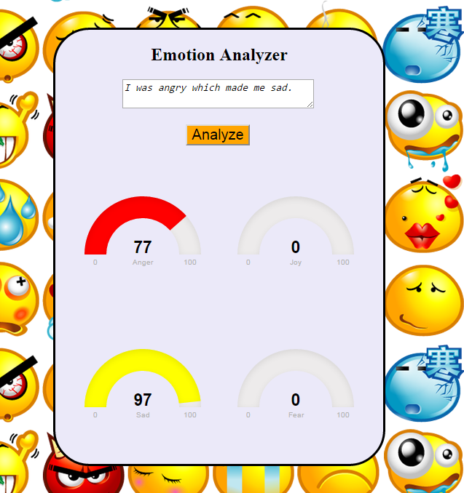
Text-based Emotion Analyzer
When you give feedback, our system will give you response as which emotion is present out of sad, anger, fear or joy along with percentage value in it.

Slide 4
How it works ?
This is a Classification problem as we need to classify sentence into 4 categories : joy, anger, sad, fear
Inputs:
Input in form of words, sentences, textual smileys or paragraphs.
Our system treat this data as raw input.
By applying PoS tagging, we will get our actual input data.
Algorithm:
We have developed a dictionary of words which contains words, impact score and emotions.
Impact score : weight of the word over sentence
Few rules are designed and applied to analyze the sentence more deeply.
Final score value is calculated for each sentences and then classified into 4 categories sad, anger, joy and fear.
From classified data, our system will generate graphical output.
Notes:
Over the existing research to improve confidence factor, we come with a new approach. We have designed few rules as per basic English communicative language. We have analyzed near about 15000 – 20000 sentences and developed a rich dictionary of 1700 words along with the impact score for these words. Few more other approaches are also used to get the better results. Previous research is used to tag sentence as per parts of speech and this data is used in our algorithm, that means input from user is just a raw data for us, after tagging we get our actual input and is further passed to the system. Many more manipulations are done over input while modulating it in system, at last we get final values for emotions. With the help of those values, output is designed.

Slide 5
How it Emotion analysis is done ?
Being supervised learning we know the emotions for words e.g. We know emotions for the words in dictionary when we got words which are not present in dictionary, we will train our system for those situations.
Joy
Sad
Anger
Fear

Slide 6
Limitations
Fails in case where words are of different meanings in different situations.
Limited scope, works in very restricted and supervised conditions.
Fails in case where words are not found in bag of words.
Fails in case of phrases and idioms.
Notes:
We are only on the tip of the iceberg when it comes to machine human interaction, but cognitive computing technologies like these are exciting steps toward creating true machine emotional intelligence. It is tested in very restricted and supervised environment where it is proven that it works fine and gives expressive results. But, out of the boundaries it might fumbles, or give expected result. We also strive to spread our boundaries. As it is very less evolved field of artificial intelligence, research is going on. Our system is also in state of under-construction. To get much accurate result it might need much more research which may take long time. It was very good learning experience for all of us that we came across the new ideas of machine learning and now way is clear to us, we can lead in this direction and can come with very impressive results in future if research will goes on.

