Slide 1
GWP Stress test statistics

Slide 2
Stress test configuration
GWP 5.1.0 b40
Product | SBC | H.W. | Ver. | Stable | Unstable | Total #
G4K | VM New | Virtual | V3.1 b24 | 4 | 9 | 13
G4K | VM OLD | Virtual | V3.1 b24 | 1 | 3 | 4
G5K | VM | Virtual | V1.1 b177 | 4 | 4 | 8
G5K | VM | Virtual | V1.2 b149 | 3 | 4 | 7
Server | G8 | Virtual | 5.1.0 b40 | 1 | N/A | 1

Slide 3
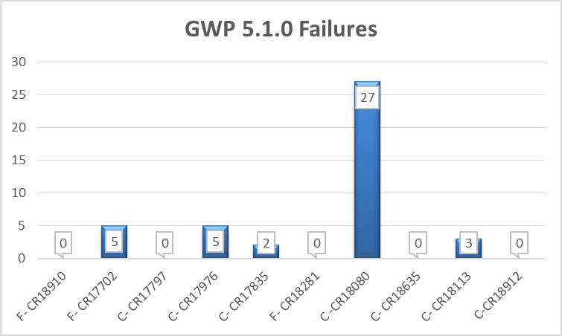
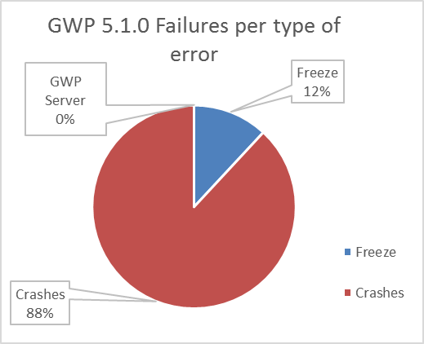
Failures and Frequency - GWP 5.1.0 b40
By type of error
0 | F- CR18910 | G4K - UI Freeze | Stucks in please wait message.
5 | F- CR17702 | G4K - UI Freeze | UI screen freeze
0 | C- CR17797 | G4K- 3005 Error | Analyzer out of memory
5 | C- CR17976 | G4K - 3206 Errors | Error with disconnection scripts
2 | C- CR17835 | G4K- 3006 Errors | Error 3006
0 | F- CR18281 | G5K - UI Freeze | Freeze during CVP run.
27 | C -CR18080 | G5K - 3006 Errors | Various errors thrown in close succession
0 | C- CR18635 | G5K- 3009 Error | Error 3009
3 | C- CR18113 | G5K - 3206 Errors | Error 3206 thrown twice in Ready State
0 | C-CR18912 | GWP Server Error | Error 3009
0 | C-CR18878 | GWP Server Error | Error 3009 after db restore

Slide 4
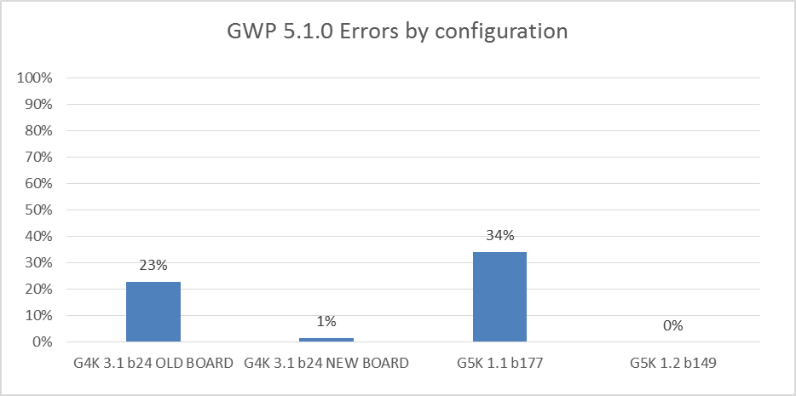
Failures and Frequency - GWP 5.1.0 b40
By Configuration
 | G4K 3.1 b24 OLD BOARD | G4K 3.1 b24 NEW BOARD | G5K 1.1 b177 | G5K 1.2 b149
Freeze | 5 | 0 | 0 | 0
Crashes | 5 | 2 | 30 | 0
GWP Server | 0 | 0 | 0 | 0
Total error | 10 | 2 | 30 | 0
# Instruments | 4 | 13 | 8 | 7
Errors / board-day | 23% | 1% | 34% | 0%

Slide 5
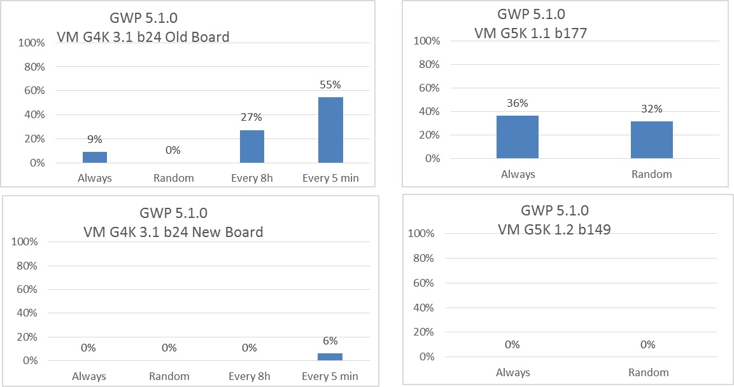
Failures and Frequency - GWP 5.1.0 b40
By network stability and Configuration
Included Last month

Slide 6
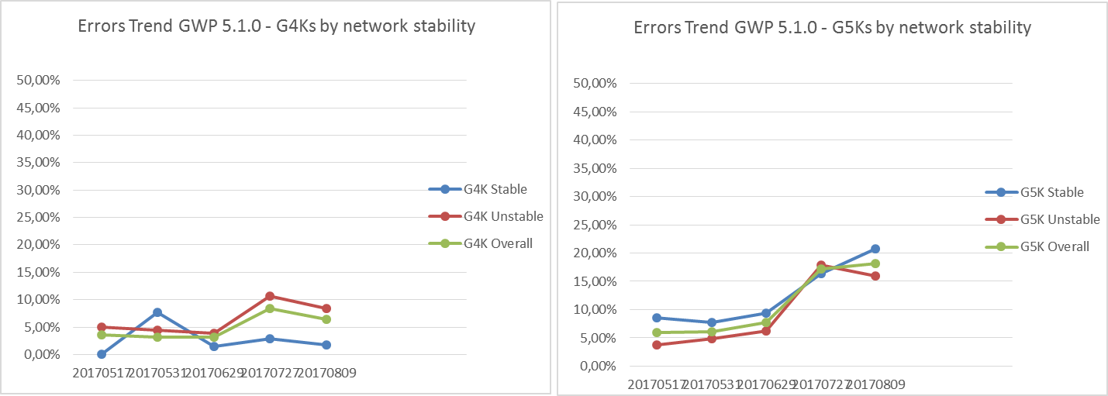
Failure Trend Rate - GWP 5.1.0 b40
Errors Ratio GWP 5.1.0 b40 / G4K | 20170517 | 20170531 | 20170629 | 20170727 | 20170809
G4K stable | 0,00% | 7,69% | 1,54% | 2,86% | 1,82%
G4K unstable | 5,00% | 4,49% | 3,85% | 10,71% | 8,33%
G4K Overall | 3,53% | 3,17% | 3,17% | 8,40% | 6,42%
Errors Ratio GWP 5.1.0 b40 / G5K | 20170517 | 20170531 | 20170629 | 20170727 | 20170809
G5K stable | 8,57% | 7,69% | 9,34% | 16,33% | 20,78%
G5K unstable | 3,75% | 4,81% | 6,25% | 17,86% | 15,91%
G5K Overall | 6,00% | 6,15% | 7,69% | 17,14% | 18,18%

