Slide 1
GWP Stress test statistics

Slide 2
Stress test configuration
GWP 5.2 b9
Product | SBC | H.W. | Ver. | Stable | Unstable | Total #
G4K | VM New | Virtual | V3.2 b1 | 3 | 9 | 12
G4K | VM OLD | Virtual | V3.2 b1 | 1 | 1 | 2
G5K | VM | Virtual | V1.2 b149 | 3 | 6 | 9
G5K | VM | Virtual | V1.3 b30 | 3 | 6 | 9
Server | G8 | Virtual | 5.2.0 b9 | 1 | N/A | 1

Slide 3
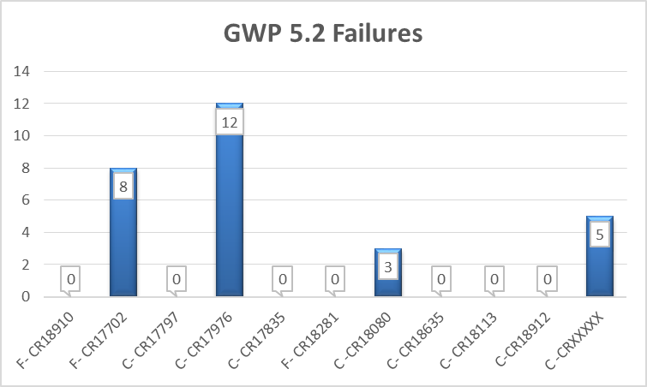
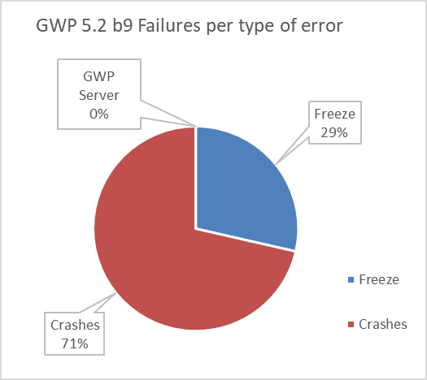
Failures and Frequency - GWP 5.2 b9
By type of error
0 | F- CR18910 | G4K - UI Freeze | Stucks in please wait message.
8 | F- CR17702 | G4K - UI Freeze | UI screen freeze
0 | C- CR17797 | G4K- 3005 Error | Analyzer out of memory
12 | C- CR17976 | G4K - 3206 Errors | Error with disconnection scripts
0 | C- CR17835 | G4K- 3006 Errors | Error 3006
0 | F- CR18281 | G5K - UI Freeze | Freeze during CVP run.
3 | C -CR18080 | G5K - 3006 Errors | Various errors thrown in close succession
0 | C- CR18635 | G5K- 3009 Error | Error 3009
0 | C- CR18113 | G5K - 3206 Errors | Error 3206 thrown twice in Ready State
0 | C-CR18912 | GWP Server Error | Error 3009
0 | C-CR18878 | GWP Server Error | Error 3009 after db restore
5 | C -CRXXXXX | G5K- 3206 Error | Error 3206 under investigation

Slide 4
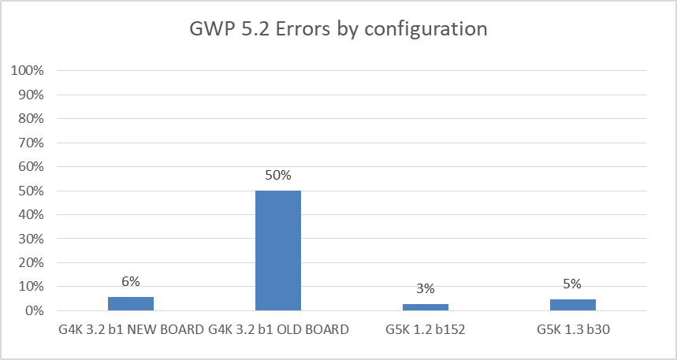
Failures and Frequency - GWP 5.2 b9
By Configuration
 | G4K 3.2 b1 NEW BOARD | G4K 3.2 b1 OLD BOARD | G5K 1.2 b152 | G5K 1.3 b30
Freeze | 0 | 8 | 0 | 0
Crashes | 8 | 4 | 3 | 5
GWP Server
Total error | 8 | 12 | 3 | 5
# Instruments | 12 | 2 | 9 | 9
Errors / board-day | 6% | 50% | 3% | 5%

Slide 5
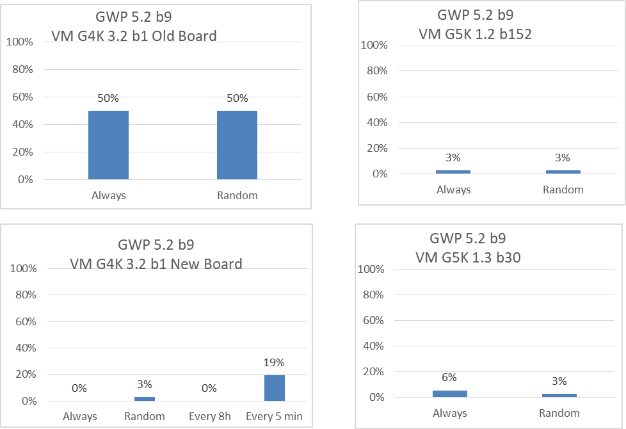
Failures and Frequency - GWP 5.2 b9
By network stability and Configuration

Slide 6
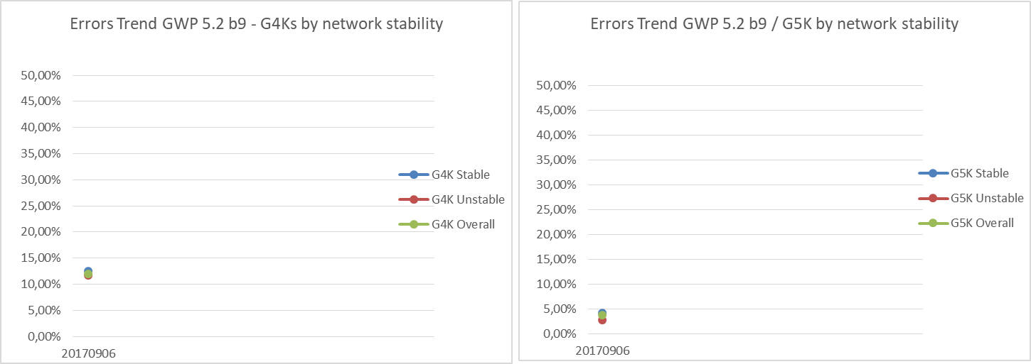
Failure Trend Rate - GWP 5.2 b9

Slide 7
Stress test configuration
GWP 5.1.0 b40 Release
Product | SBC | H.W. | Ver. | Stable | Unstable | Total #
G4K | VM New | Virtual | V3.1 b24 | 4 | 9 | 13
G4K | VM OLD | Virtual | V3.1 b24 | 1 | 3 | 4
G5K | VM | Virtual | V1.1 b177 | 2 | 2 | 4
G5K | VM | Virtual | V1.2 b149 | 3 | 4 | 7
G5K | VM | Virtual | V1.3 b30 | 2 | 2 | 4
Server | G8 | Virtual | 5.1.0 b40 | 1 | N/A | 1

Slide 8
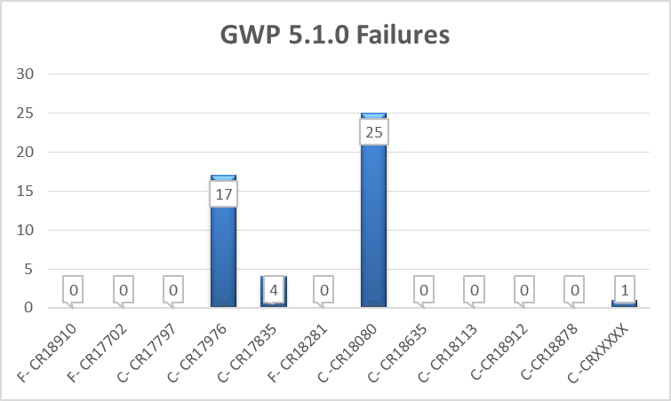
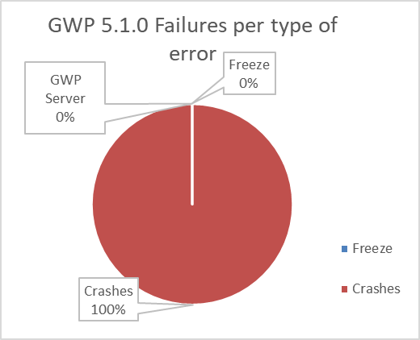
Failures and Frequency - GWP 5.1.0 b40
By type of error
0 | F- CR18910 | G4K - UI Freeze | Stucks in please wait message.
0 | F- CR17702 | G4K - UI Freeze | UI screen freeze
0 | C- CR17797 | G4K- 3005 Error | Analyzer out of memory
17 | C- CR17976 | G4K - 3206 Errors | Error with disconnection scripts
4 | C- CR17835 | G4K- 3006 Errors | Error 3006
0 | F- CR18281 | G5K - UI Freeze | Freeze during CVP run.
25 | C -CR18080 | G5K - 3006 Errors | Various errors thrown in close succession
0 | C- CR18635 | G5K- 3009 Error | Error 3009
0 | C- CR18113 | G5K - 3206 Errors | Error 3206 thrown twice in Ready State
0 | C-CR18912 | GWP Server Error | Error 3009
0 | C-CR18878 | GWP Server Error | Error 3009 after db restore
1 | C -CRXXXXX | G5K- 3206 Error | Error 3206 under investigation

Slide 9
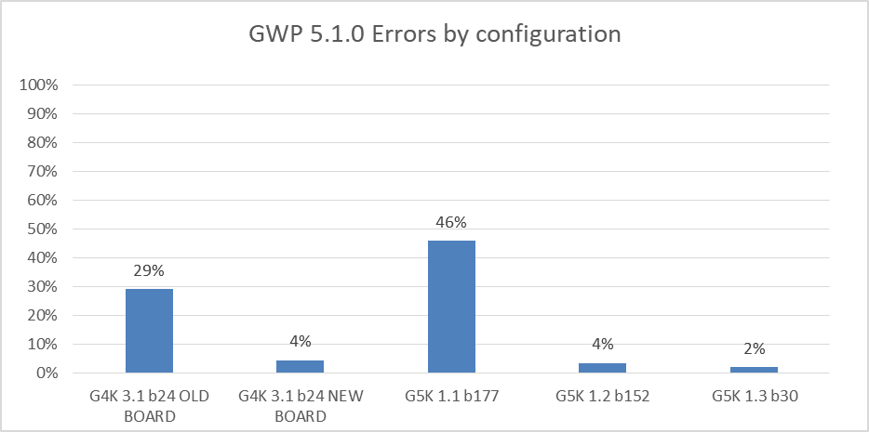
Failures and Frequency - GWP 5.1.0 b40
By Configuration
 | G4K 3.1 b24 OLD BOARD | G4K 3.1 b24 NEW BOARD | G5K 1.1 b177 | G5K 1.2 b152 | G5K 1.3 b30
Freeze | 0 | 0 | 0 | 0 | 0
Crashes | 14 | 7 | 22 | 3 | 1
GWP Server | 0 | 0 | 0 | 0 | 0
Total error | 14 | 7 | 22 | 3 | 1
# Instruments | 4 | 13 | 4 | 7 | 4
Errors / board-day | 29% | 4% | 46% | 4% | 2%

Slide 10
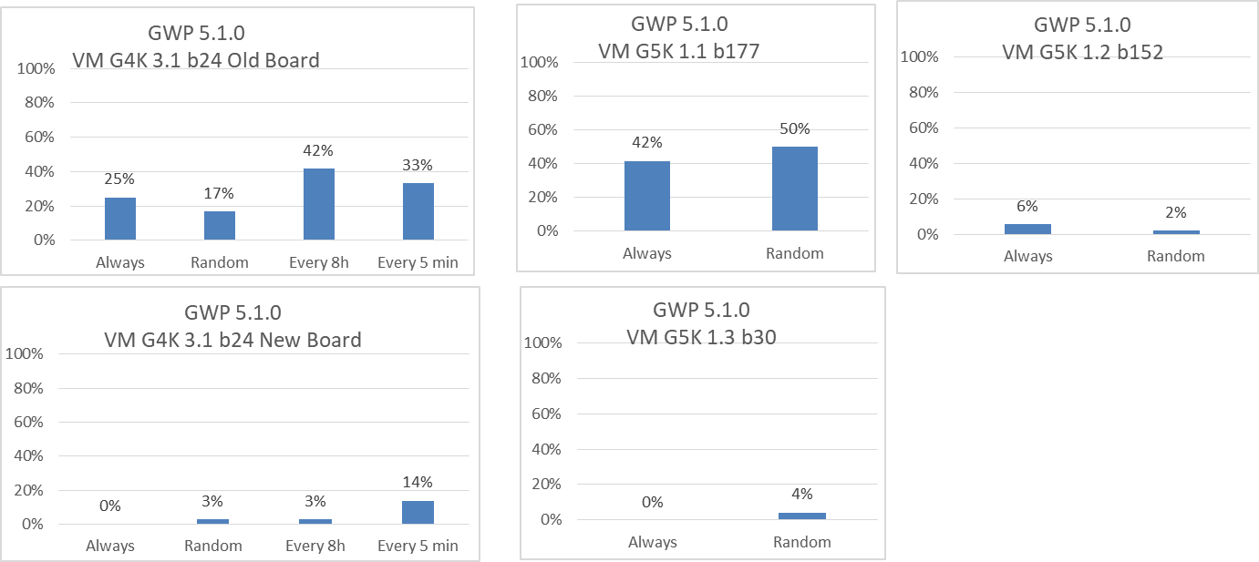
Failures and Frequency - GWP 5.1.0 b40
By network stability and Configuration

Slide 11
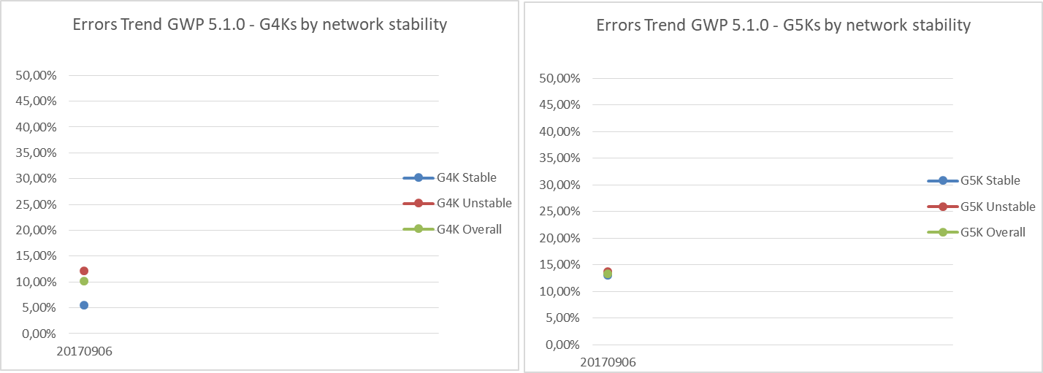
Failure Trend Rate - GWP 5.1.0 b40

