Slide 1
MNIST DIGIT
CLASSIFICATION
Using Neural Networks
Google Colab • Python • TensorFlow/Keras • OpenCV
Academic Project Presentation

Slide 2
Project Overview
1
• Build a neural-network based system that recognizes handwritten digits.
• Use the MNIST dataset for model training and evaluation.
• Provide a practical prediction pipeline for an external digit image.
• Run the complete workflow in Google Colab without local Python setup.
MNIST Digit Classification using Neural Networks
2

Slide 3
Problem Statement & Objectives
2
• Handwritten digits vary in shape, size, thickness and writing style.
• Manual recognition is slow and difficult to scale.
• Objective: learn visual patterns from labelled digit images.
• Objective: convert a new image into a predicted class from 0–9.
• Objective: document a reproducible Colab-based workflow.
MNIST Digit Classification using Neural Networks
3

Slide 4
Technology Stack
3
• Python 3 — implementation language
• TensorFlow / Keras — neural-network training and inference
• NumPy — numerical operations and reshaping
• OpenCV — image reading, grayscale conversion and resizing
• Matplotlib / Seaborn — visualization
• Google Colab — execution environment
MNIST Digit Classification using Neural Networks
4

Slide 5
MNIST Dataset
4
• MNIST is a standard handwritten-digit image dataset.
• Each sample represents one digit from 0 to 9.
• Images are processed into a 28×28 representation for the model.
• Pixel normalization makes the input suitable for neural-network training.
• The dataset provides labelled examples for supervised learning.
MNIST Digit Classification using Neural Networks
5

Slide 6
End-to-End System Workflow
5
• Dataset → preprocessing → model construction → training → evaluation
• External image → image loading → grayscale conversion
• Resize to 28×28 → normalize → reshape
• Model prediction → argmax → predicted digit
• The same pipeline can be reused for additional handwritten samples.
MNIST Digit Classification using Neural Networks
6

Slide 7
Data Preprocessing
6
• Load image data and prepare the required input arrays.
• Normalize pixel values to a consistent numeric range.
• Convert external input images to grayscale.
• Resize the external image to 28×28 pixels.
• Reshape the image to match the trained model input.
MNIST Digit Classification using Neural Networks
7

Slide 8
Neural Network Approach
7
• Input layer receives the processed digit image.
• Hidden layers learn useful representations from pixel patterns.
• Output layer represents ten digit classes: 0–9.
• Softmax-style class probabilities can be converted to a label using argmax.
• The trained model is reused during prediction.
MNIST Digit Classification using Neural Networks
8

Slide 9
Training Methodology
8
• Split data into training and test/evaluation sets.
• Feed normalized images and their labels to the neural network.
• Optimize the model using a suitable loss function and optimizer.
• Monitor training behaviour through the notebook outputs.
• Save or reuse the trained model state for prediction.
MNIST Digit Classification using Neural Networks
9

Slide 10
Evaluation & Performance
9
• Model performance should be measured on unseen test data.
• Useful metrics include accuracy, loss and a confusion matrix.
• Prediction test completed in the Colab notebook: 3-digit.PNG was recognized as digit 3.
• No formal accuracy value is stated here because it was not visible in the supplied project screenshots.
• Future documentation can add the exact training/test metrics from the notebook.
MNIST Digit Classification using Neural Networks
10

Slide 11
External Image Prediction Module
10
• The notebook prompts for the path of the image to be predicted.
• OpenCV reads the image from the Colab file system.
• The image is converted to grayscale and resized to 28×28.
• Pixels are normalized and reshaped before inference.
• model.predict() generates class probabilities; argmax() selects the predicted class.
MNIST Digit Classification using Neural Networks
11

Slide 12
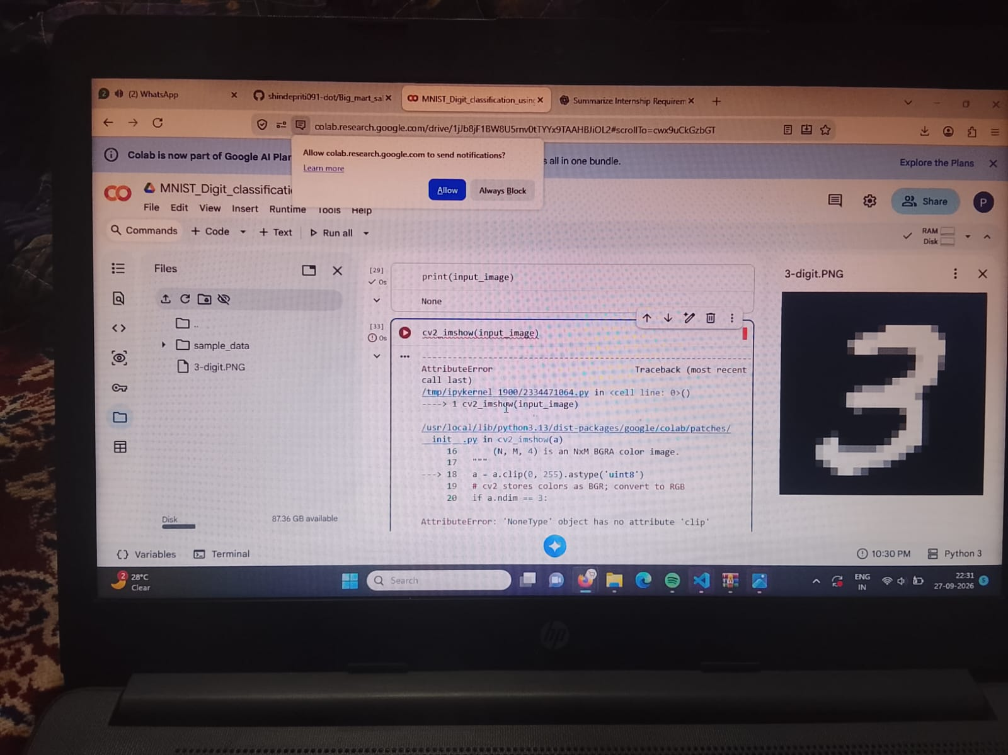
Google Colab Implementation
11
• Upload the .ipynb notebook to Google Colab.
• Open the Files panel and upload 3-digit.PNG.
• Run the notebook cells in sequence.
• For a directly uploaded image, use /content/3-digit.PNG as the image path.
• Google Drive mounting is optional unless files are stored in Drive.
MNIST Digit Classification using Neural Networks
12

Slide 13
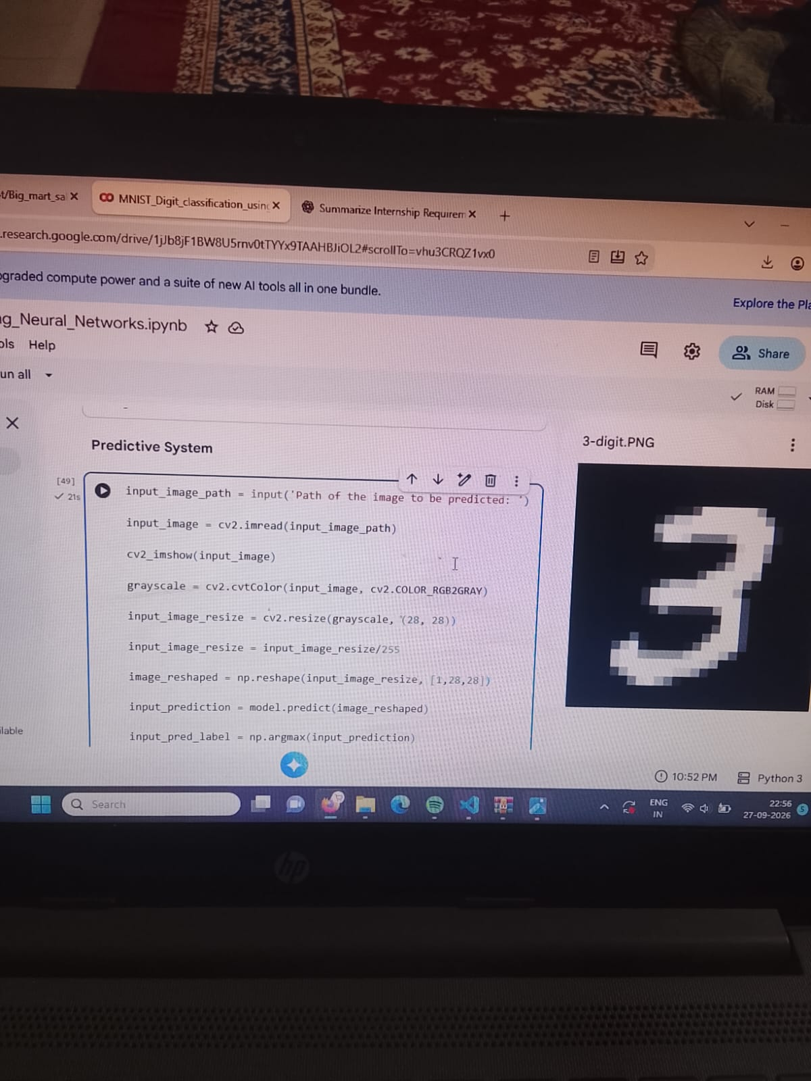
Challenges & Solutions
12
• Image loading returned None when the file path was incorrect.
• Solution: upload the image to Colab and use the correct /content/ path.
• cv2_imshow failed when the input image variable was None.
• Solution: verify cv2.imread() succeeded before displaying or preprocessing.
• Keep the notebook runtime active so trained model variables remain available.
MNIST Digit Classification using Neural Networks
13

Slide 14
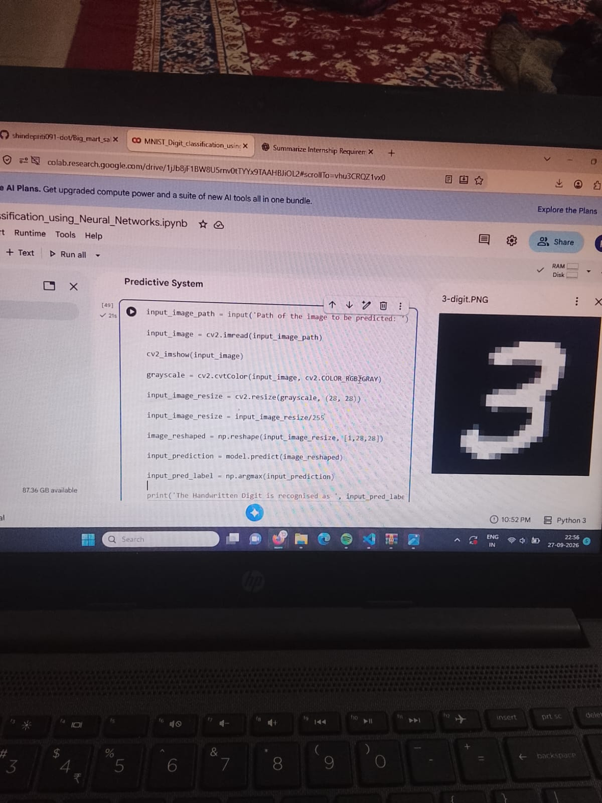
Results & Future Scope
13
• Successful demonstration: the supplied handwritten 3 was predicted as 3.
• Future scope: add confusion matrix, accuracy/loss plots and classification report.
• Upgrade to a CNN for stronger image-feature learning.
• Create a simple web UI or drawing canvas for real-time digit input.
• Add batch prediction and model export for deployment.
MNIST Digit Classification using Neural Networks
14

Slide 15
Conclusion & Submission Package
14
• The project demonstrates a complete handwritten-digit classification workflow.
• Neural networks can learn digit patterns from labelled image data.
• OpenCV connects the trained model with a real external image.
• Google Colab makes the project easy to reproduce and share.
• Submission package: README.md, requirements.txt, PROJECT_REQUIREMENTS.md and this 15-slide presentation.
MNIST Digit Classification using Neural Networks
15

