Slide 1

Project Name:
TOOLMATE
Group Members:
Dhiraj Pramod Andhere (2131913)
Shubham Shubhash Shinde(2131964)
Omkar Vilas Telange(2131972)
Under the Guidance of:
Mr. Pravin Hanpude

Slide 2
Content
Introduction
Problem Statement
Existing System
Flowchart Diagram
Entity Relationship Diagram
Use Case Diagram

Slide 3
Introduction
TOOLMATE, as the name says, it is a website which enables a person to sell-out his academic as well as other. The stuff is taking unnecessary space and one don’t have any idea what to do about it.
This website will provide a mean to do something about it, which will be helpful and beneficial to both parties (seller and buyer).
Instead of buying a new product, if one have an option to get it from someone who doesn’t need it anymore within affordable or even half of actual price then it is useful
Limited premises

Slide 4
Problem Statement
There are many engineering tools like drafter which after a year are not useful rather than it becomes unnecessary stuff for the student which is from the department where it is no further use of it. For first year students buying a new tool and using it just for one year is unnecessary wastage of money. Rural areas are not well reached as the urban areas.

Slide 5
Existing System
There are many such websites like olx, quickr which are used for buying and selling used products, but many people are still not aware of how to use it.

Slide 6
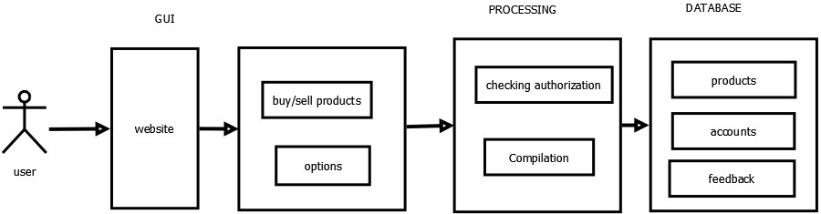
System Architecture

Slide 7
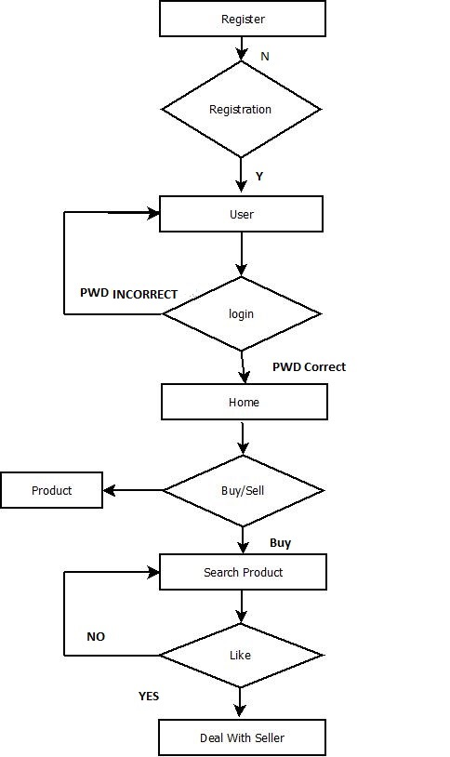
Flow Chart

Slide 8
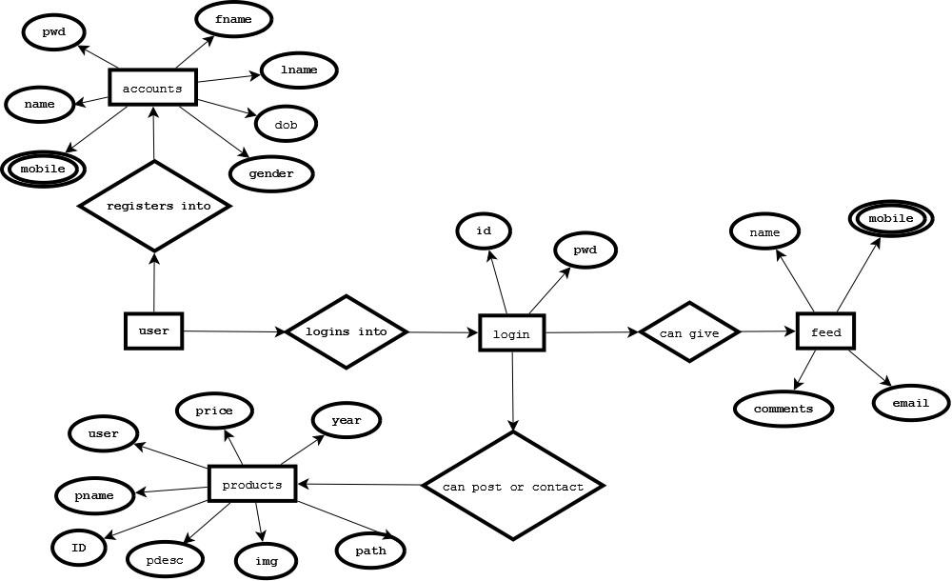
Entity Relationship Diagram:

Slide 9
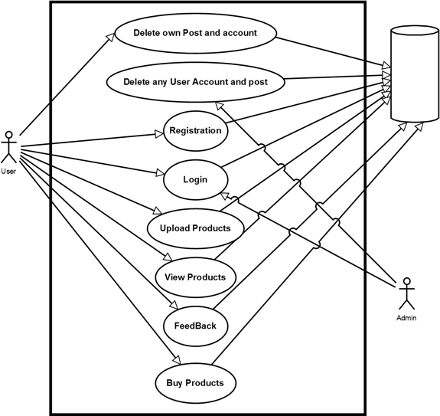
Use Case Diagram:

Slide 10
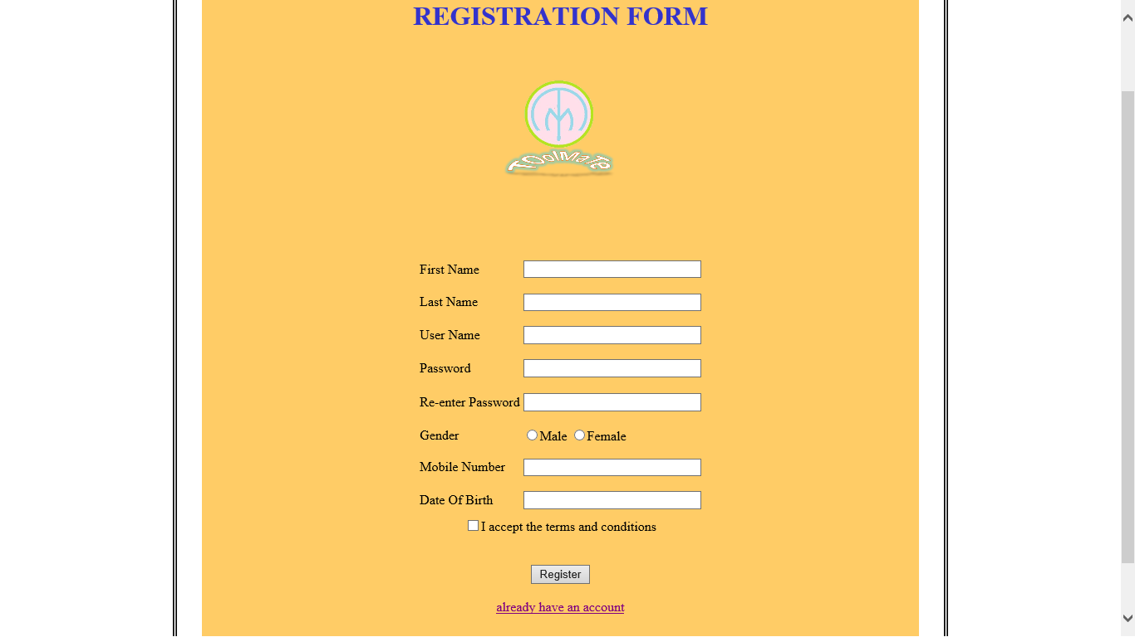

Slide 11
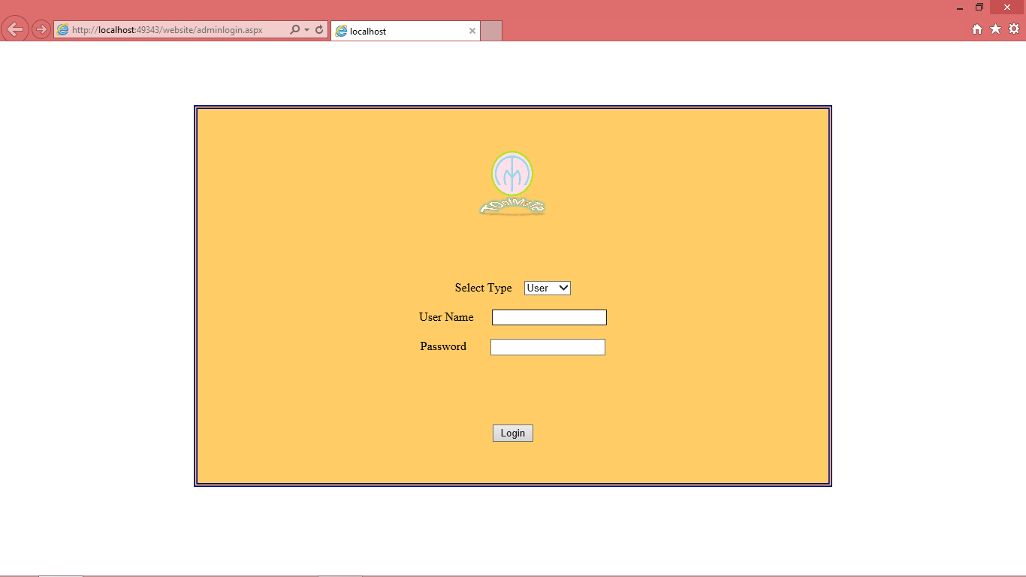

Slide 12
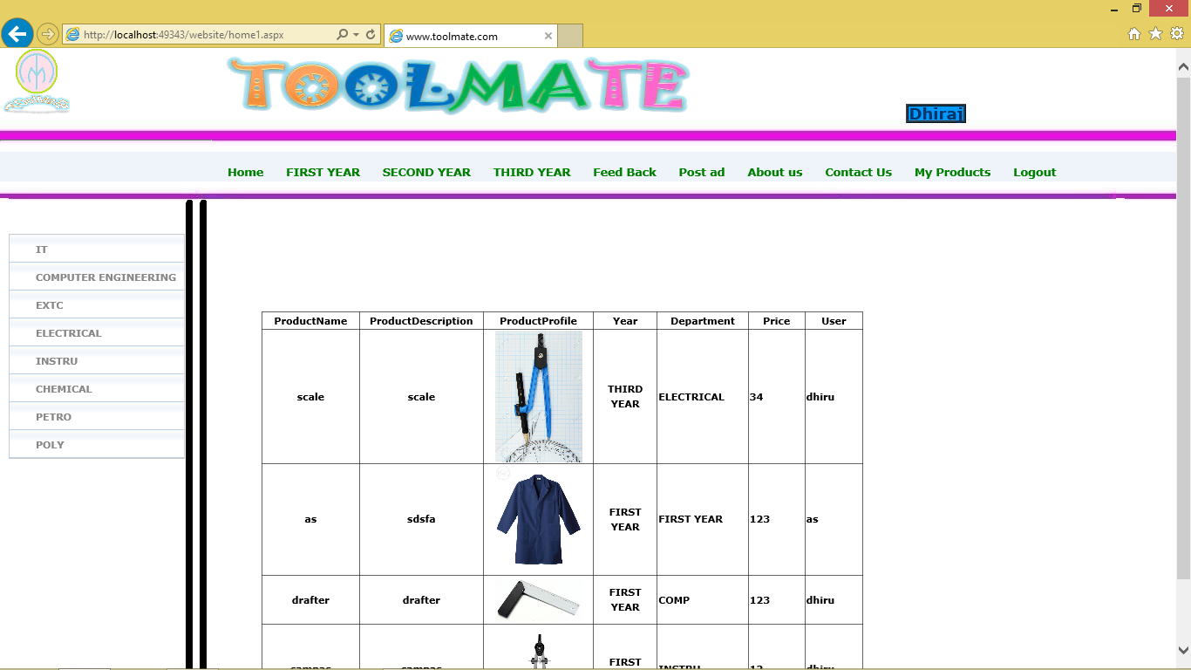

Slide 13
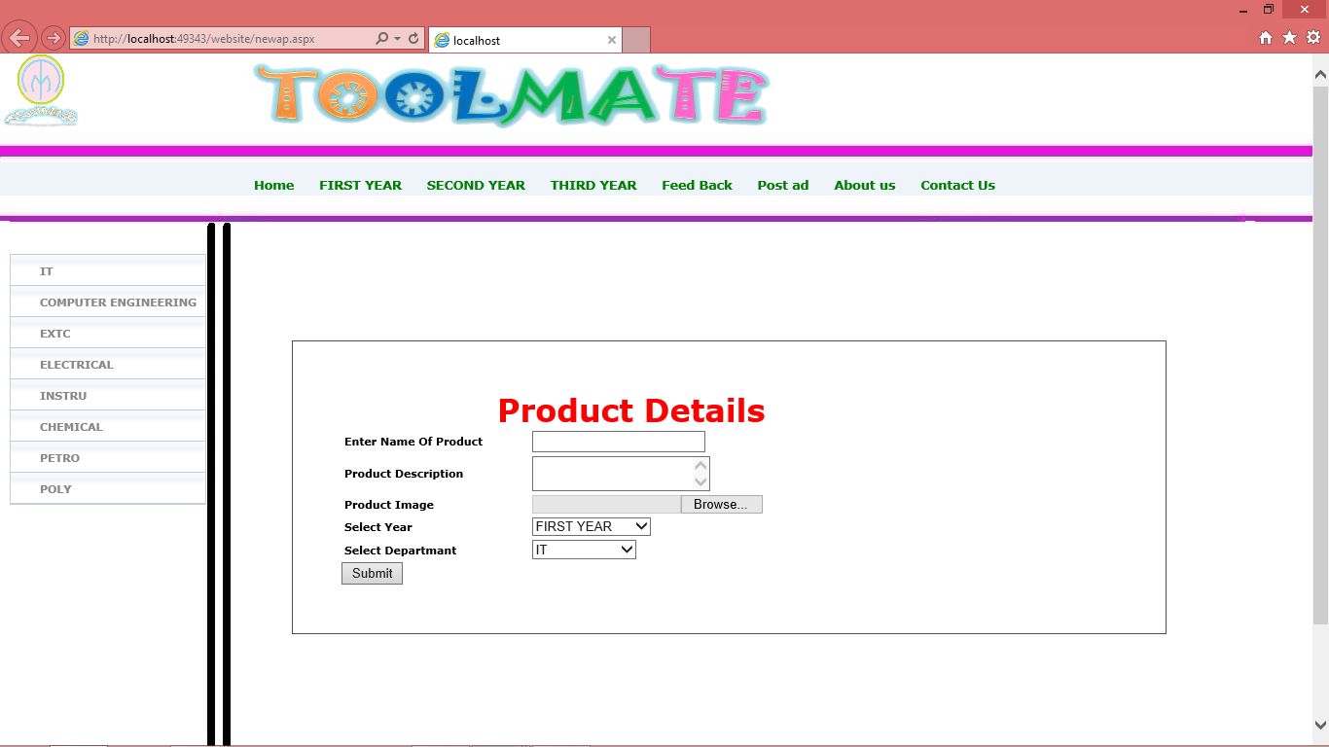

Slide 14
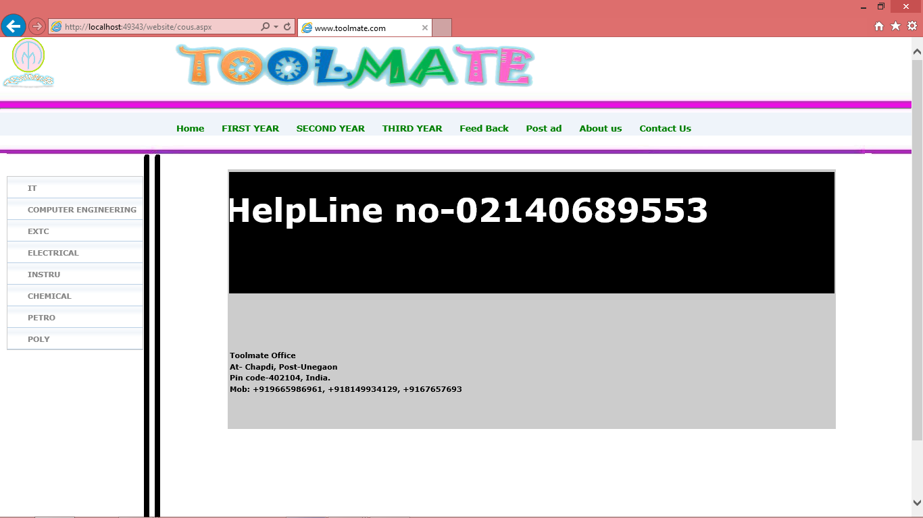

Slide 15
Thank you

