Slide 1

HEALTHCARE SERVICES DATA WAREHOUSE
Team #10 TecHuskies2.0

Slide 2
Objective
Following are the objectives of this project:
To develop data warehouse comprising of various healthcare related datasets taken from cms.org
To create a Data Model for healthcare datasets used using ER Studio.
To deliver insights of number of services, Medicare payment amounts, number of beneficiaries, the number of APC services, hospitals' average total estimated submitted charges.
Insights about the payment services used and charges in healthcare domain over United States.
Discover relatability between suppliers, providers and medical equipment, prosthetics, orthotics, and supplies.
Visualize the relationships on analytical tool such as Tableau.

Slide 3
Progress Flow
Data Profiling
SSMS/SSDT
Talend
Extract, Load, and Transfer Processes
ER Studio
Data Model Preparation
SSAS
Visualizations
Tableau Prep Builder
Building OLAP cubes and Datamart
Tableau Desktop
Data Wrangling and Cleaning

Slide 4
Dataset Overview
The Physician and Other Supplier Public Use File
This dataset contains columns such as variety and number of services, Medicare payment amounts. It provides information on services and procedures provided to Medicare beneficiaries by physicians and other healthcare professionals
3. The Inpatient Utilization and Payment Public Use File
The Inpatient PUF includes information on utilization, payment (total payment and Medicare payment), and hospital-specific charges for the more than 3,000 U.S. hospitals that receive Medicare Inpatient Prospective Payment System (IPPS) payments.
2. The Outpatient Hospital Utilization and Payment Public Use File
The Outpatient Hospital PUF presents information on the number of beneficiaries, the number of APC services, hospitals' average total estimated submitted charges, the average Medicare allowed charges.
4. Durable Medical Equipment, Prosthetics, Orthotics and Supplies (DMEPOS) National Aggregate table This table presents information on DMEPOS products and services provided to Medicare beneficiaries ordered by physicians and other healthcare professionals.

Slide 5
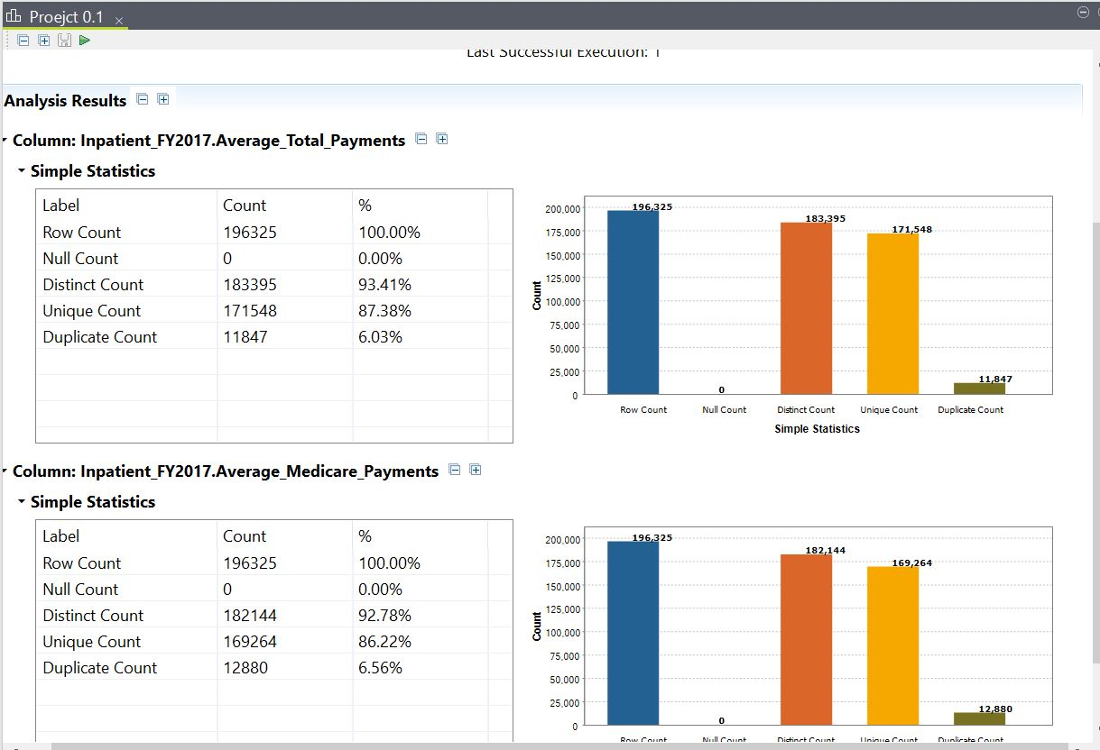
Data Profiling Using Talend
Performed basic profiling on datasets
Calculated NULL values
Performed EDA on a large-scale healthcare dataset
Extracted counts of distinct, unique, duplicate

Slide 6
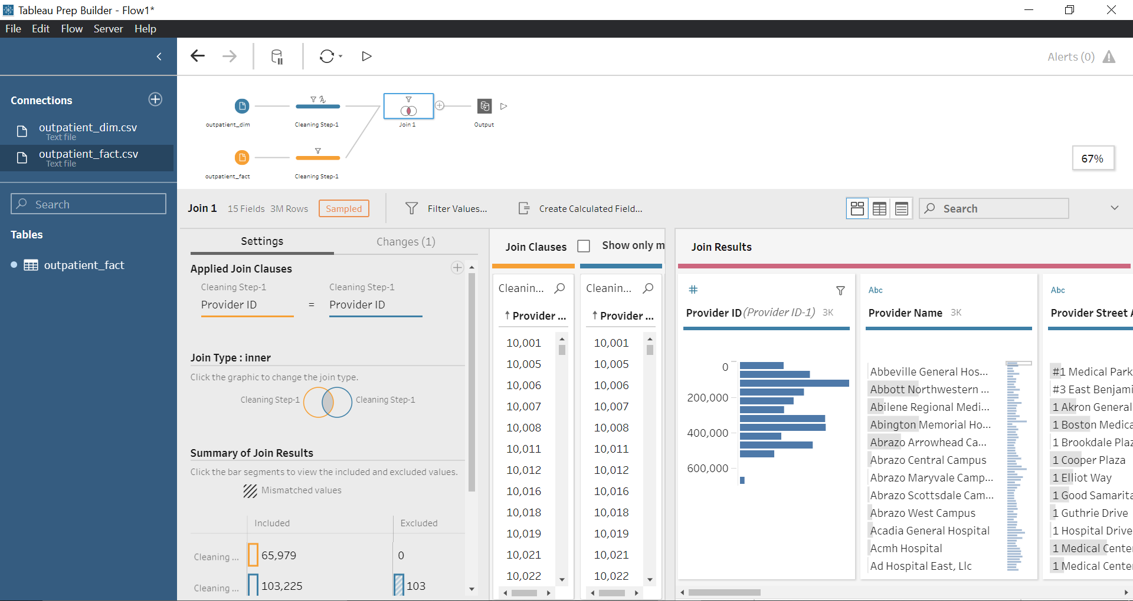
Data Wrangling & Cleaning using Tableau Prep Builder
Performed basic cleaning on datasets
Removed NULL values and eliminated anomalies
Imported various tables as a flat file
Performed Join operations to get combined datasets

Slide 7

Integration Diagram, SSDT Mapping, and ERD

Slide 8
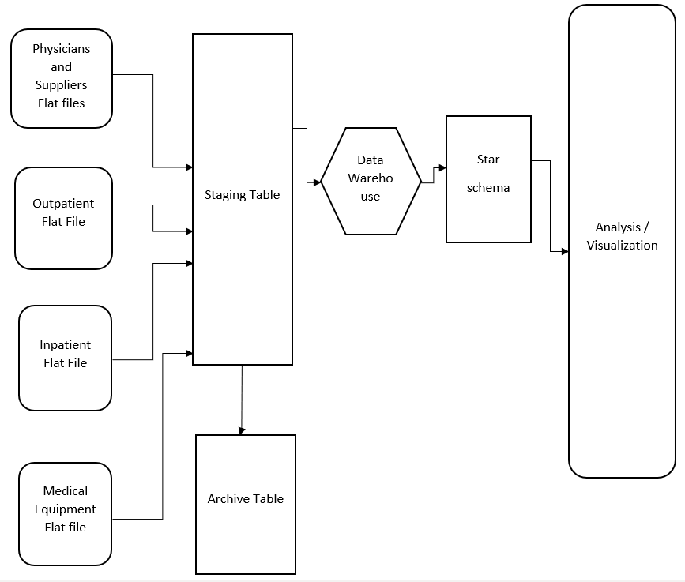
Integration Diagram

Slide 9
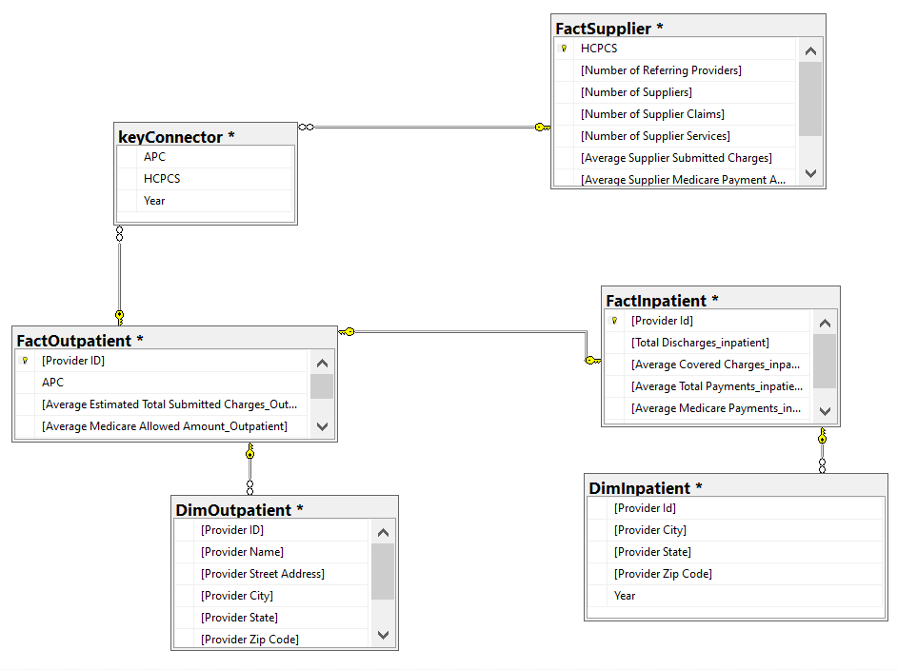
Dimensional Model

Slide 10
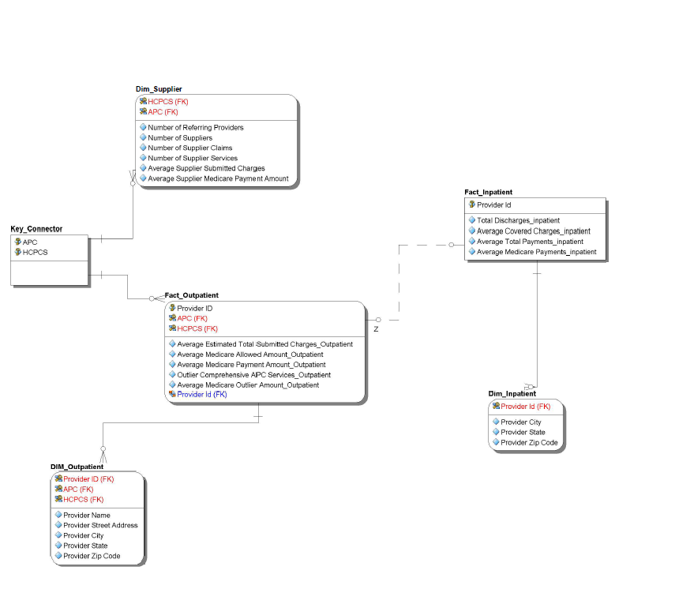
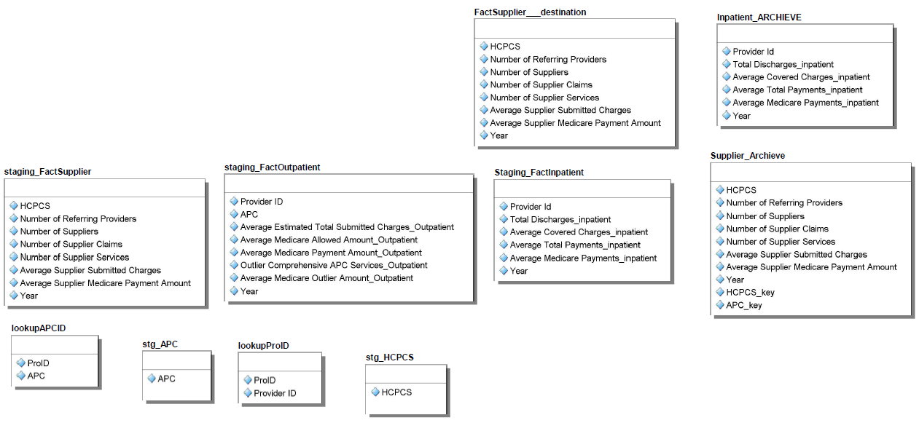
Entity Relationship Diagram

Slide 11

Staging, Archive, and Lookup Tables

Slide 12
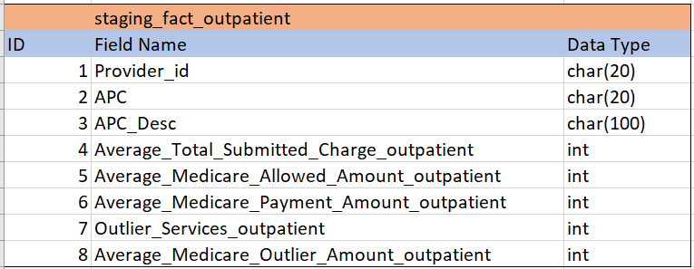
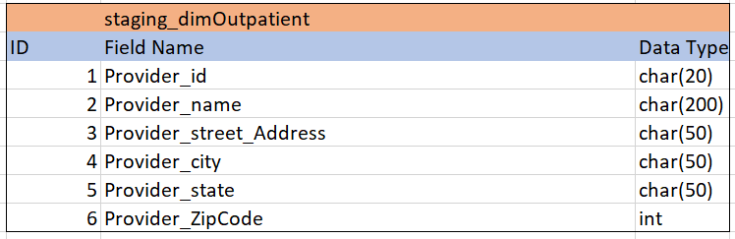
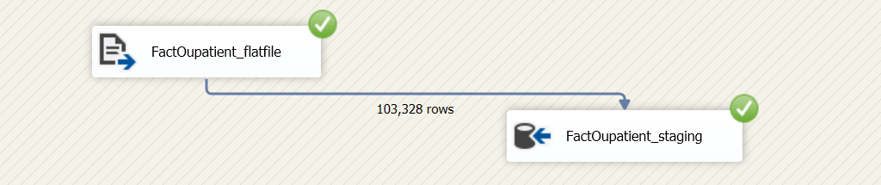
fact_outpatient
dim_outpatient
Staging Tables

Slide 13
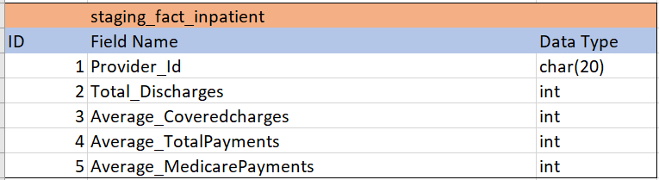
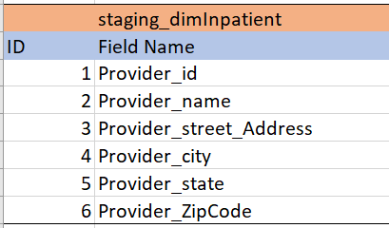
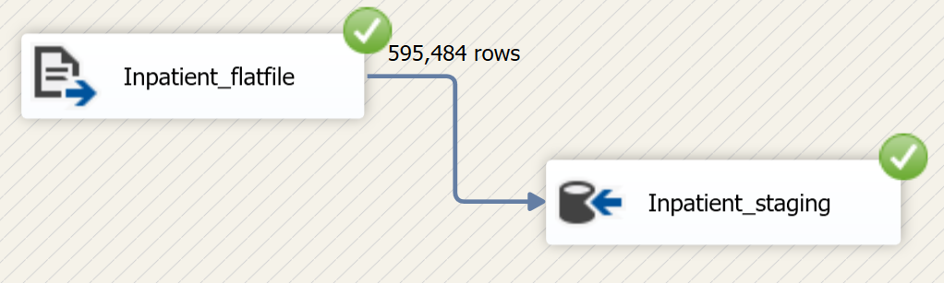
Fact_inpatient
dim_inpatient
Staging Tables

Slide 14
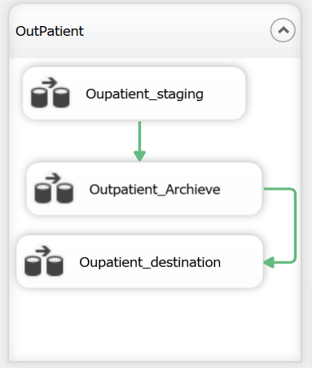
Archive: Outpatient
Archive Table

Slide 15
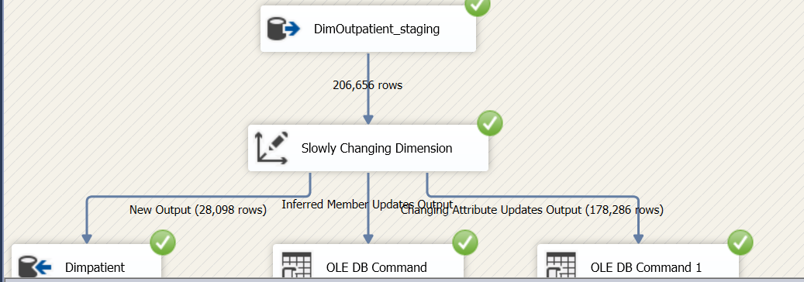
SCD: Dim_Outpatient
Slowly Changing Dimensions

Slide 16
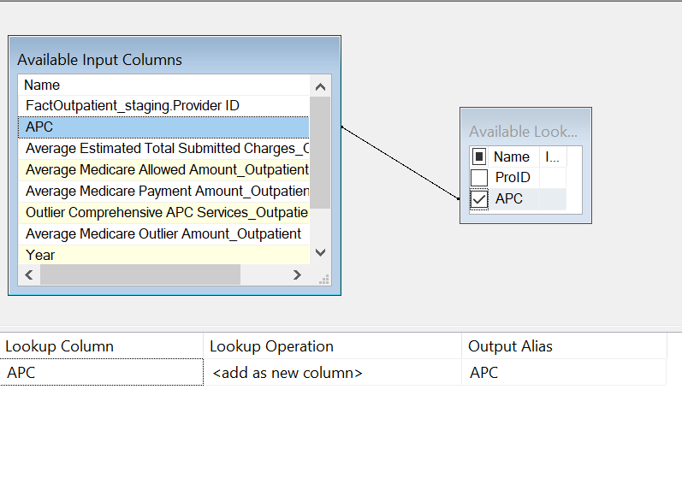
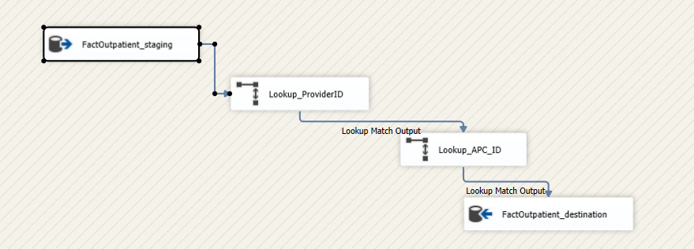
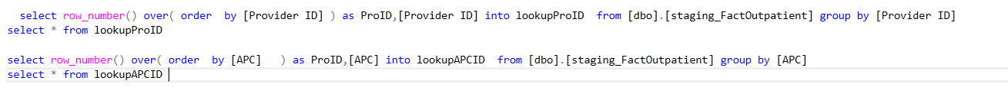
Lookup: Fact_Outpatient
Lookup + APCID
LOOKUP TABLES

Slide 17

OLAP Cubes

Slide 18
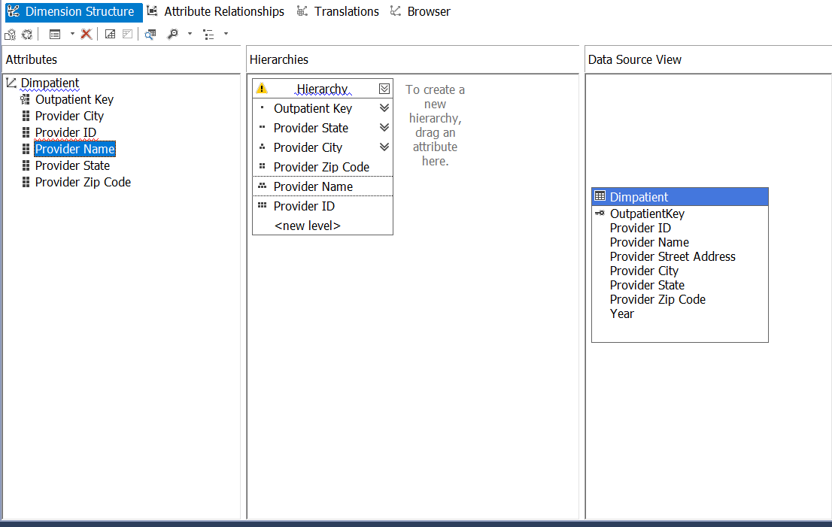
Hierarchy
Cubes

Slide 19
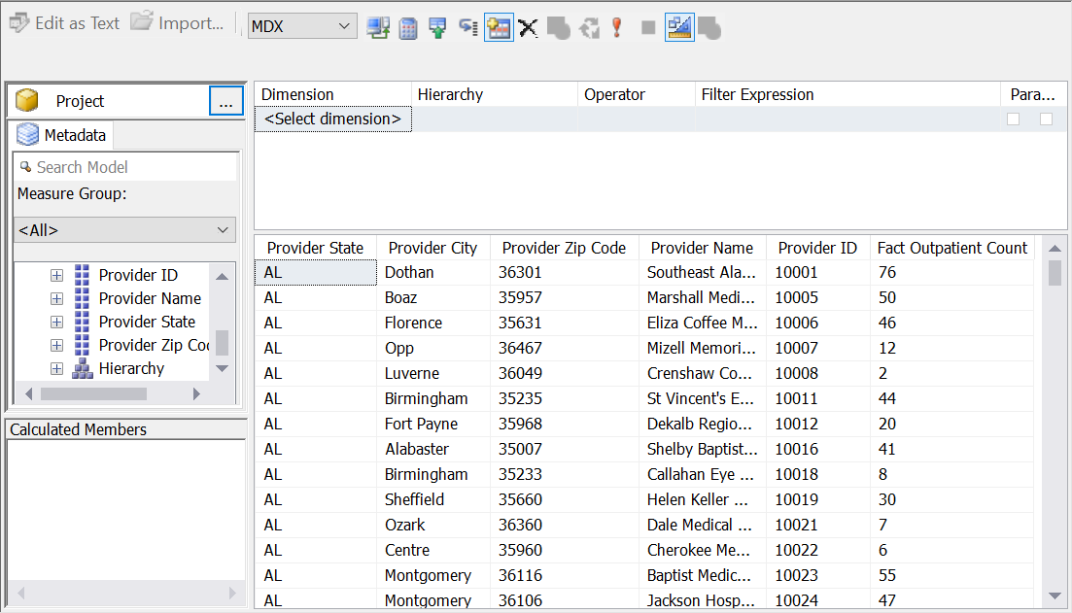
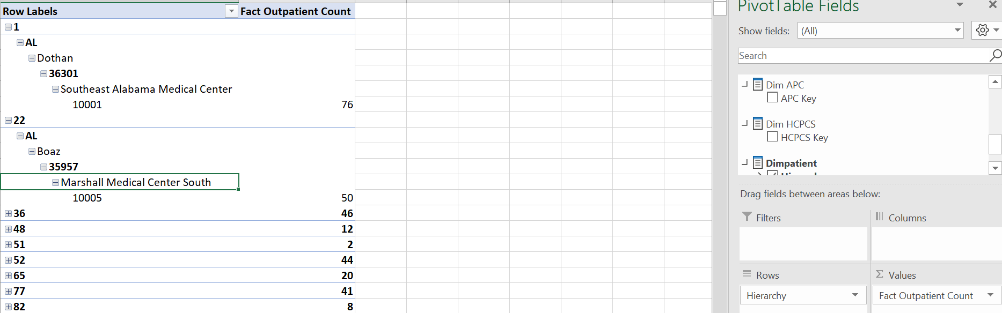
Cubes

Slide 20
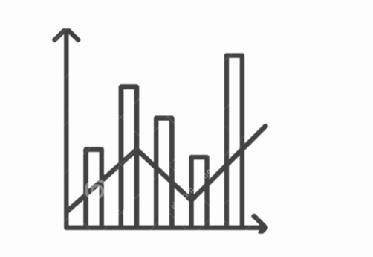
Visualizations

Slide 21
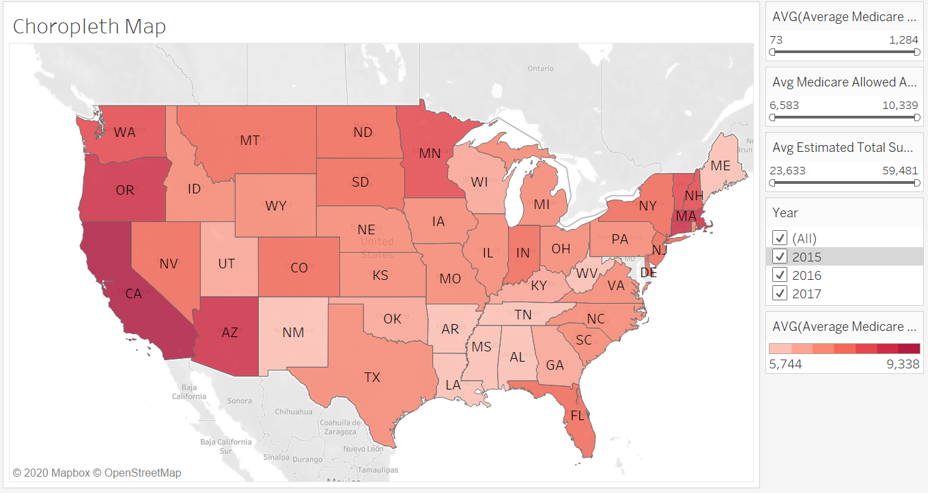
Outpatient Choropleth Graph
The following choropleth graph represents average values of Medicare payment amt, Medicare allowed amt, Total submitted charges, Outlier amount. For Outpatient

Slide 22
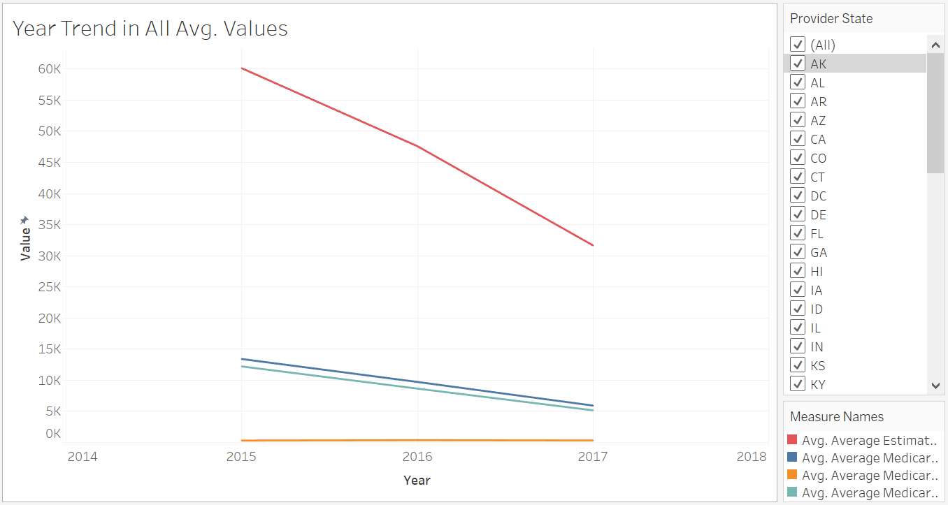
Year Trend in All Avg. Values
The following Line graph represents average values of Medicare payment amt, Medicare allowed amt, Total submitted charges, Outlier amount. For Outpatient trends over year 2015, 2016, and 2017 for Outpatient.

Slide 23
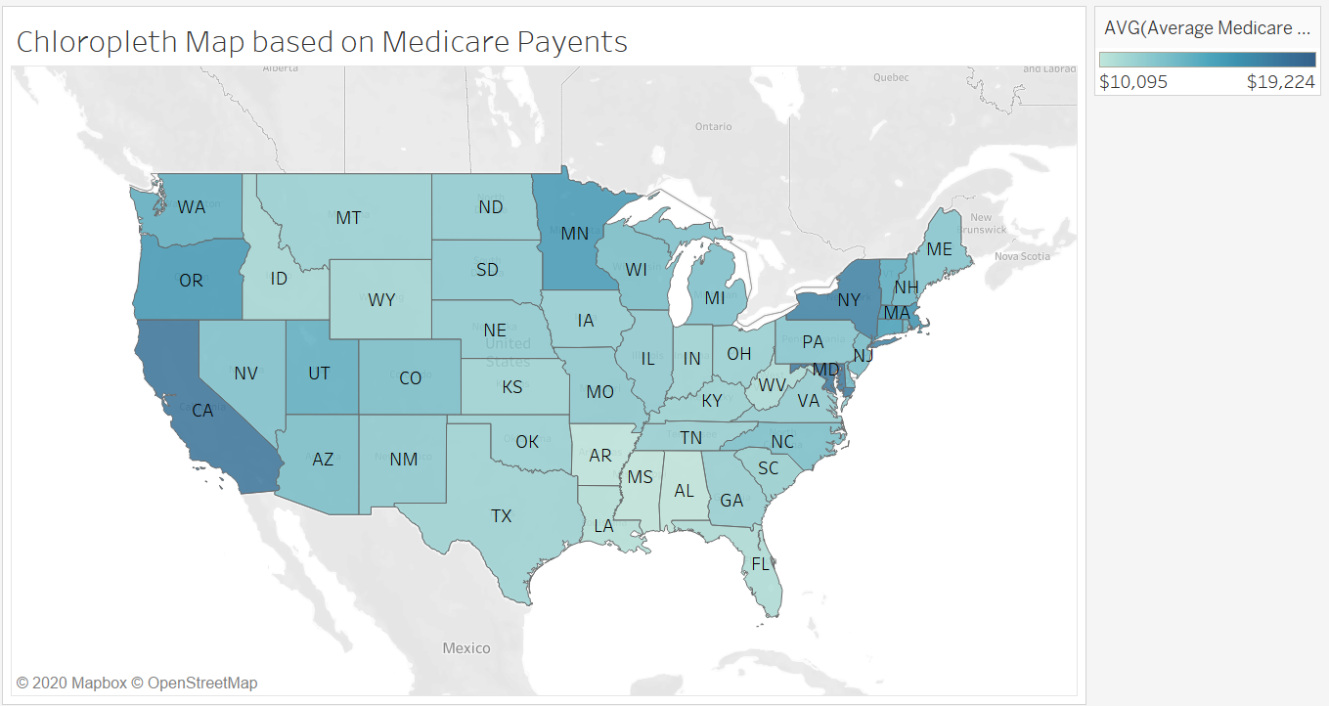
Choropleth Map based on Medicare Payments
The following choropleth graph represents average values of Medicare payment amt, Medicare payment, Total Payments, Total Discharges for inpatient.

Slide 24
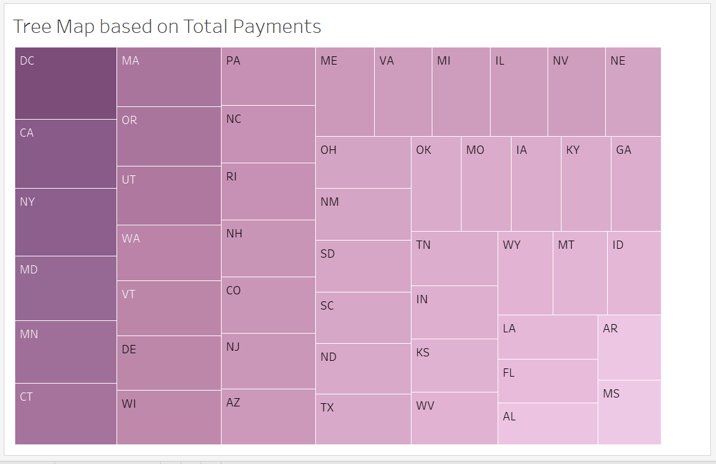
Tree- Map sorted by Total payment
The following Tree-map represents average values of Total Payment inpatient and sorted color gradient according to states

Slide 25
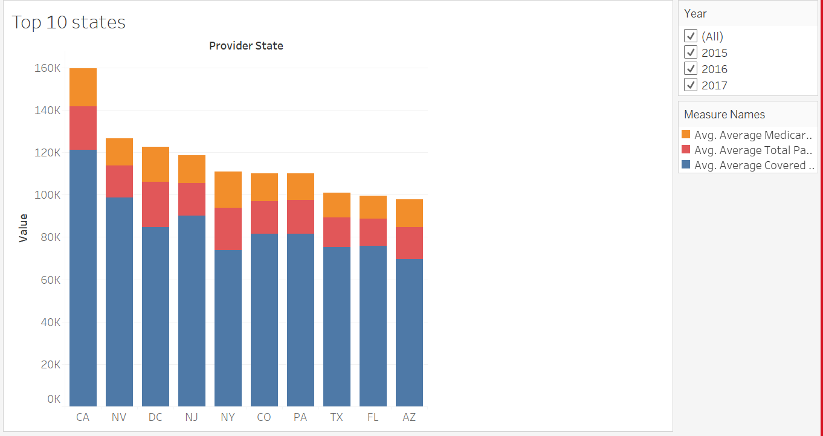
Stacked bar chart
The following Stacked Bar Chart represents average values of Medicare payments, Total Payments, covered charges inpatient top 10 states in The US

Slide 26
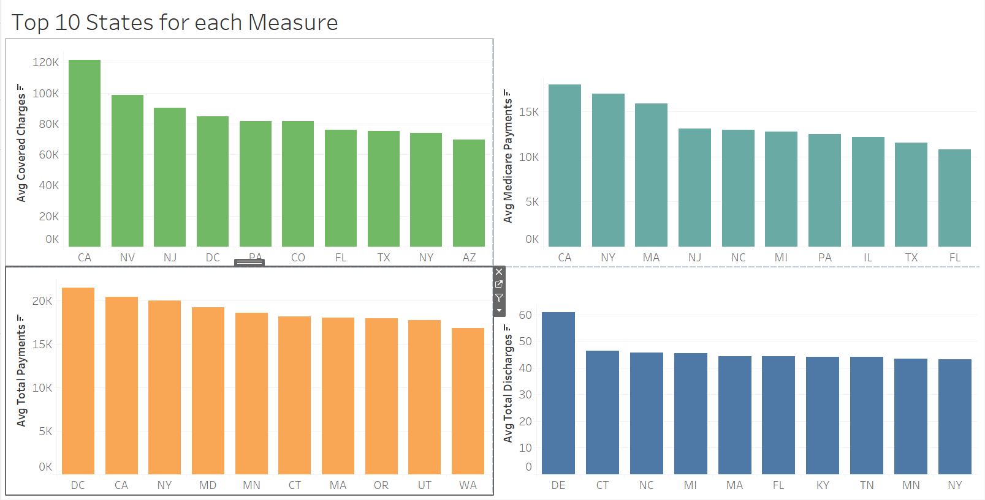
Bar graph for Top 10 states in US Outpatient
The following bar graph dashboard represents average values of Medicare payment amt, Medicare allowed amt, Total submitted charges, Outlier amount. For Outpatient

Slide 27

Swapnil Deshpande
Shashank Sahu
Jay Suvarna
Yash Shinde
TEAM #10 TECHUSKIES 2.0
NUID: 001475204 Deshpande.sw@husky.neu.edu
NUID: 001473999 sahu.s@husky.neu.edu
NUID: 001496317 suvarna.j@husky.neu.edu
NUID: 001493321 shinde.y@husky.neu.edu

Slide 28

― Michael Pollan, Food Rules: An Eater's Manual
As grandmothers used to say, 'Better to pay the grocer than the doctor’

