Slide 1
Music Genre Classification
Can audio features and song lyrics predict music genre?
Sam Shindich · Cade Miller · Larry Li | CSCI 467

Slide 2
Why Genre Classification?
Motivation & research goals
Real-world impact
Streaming platforms (Spotify, Apple Music) rely on genre tags for recommendations and discovery.
The problem
Manual genre labelling is expensive and subjective — artists often span multiple genres.
Research question
How accurately can we predict genre from audio features alone? From lyrics? Which modality wins?
Goal
Train and compare Logistic Regression, KNN, and XGBoost across both modalities on 6 balanced genres.

Slide 3
Datasets
Two independent data sources
🎵 Spotify SQLite
📝 Genius Lyrics
Source Normalized SQLite DB — tracks, audio_features, artists, genres
Size ~300K tracks after joining & filtering (popularity ≥ 10)
Features 9 audio features: danceability, energy, loudness, speechiness, acousticness, instrumentalness, liveness, valence, tempo
Genre Resolved from micro-genre tags via substring matching → 6 labels
Source Kaggle — Genius Song Lyrics (~5M songs, ~9 GB CSV)
Filtered to English-only, music tags (no 'misc'), 50–2,000 words
Sampled 300K rows for tractable training
Features TF-IDF (10K terms, unigrams+bigrams) + 10 lyric numeric features (vocab diversity, repetition ratio, line count, etc.)

Slide 4
Pipeline & Feature Engineering
Two independent modalities
AUDIO MODE
LYRICS MODE
① Load Spotify SQLite → cached parquet
① Stream Genius CSV in 500K-row chunks
② Map micro-genres to 6 canonical labels
② Language filter → English only
③ Undersample to 4,000 samples / class
③ Clean lyrics (ftfy + regex, remove [Chorus] tags)
④ Stratified 70 / 15 / 15 split
④ Map Genius tags to canonical genres
⑤ StandardScaler (fit on train only — no leakage)
⑤ TF-IDF (10K features, 1–2 grams, sublinear TF)
⑥ 9 dense audio features per track
⑥ 10 lyric numeric features + undersample + split

Slide 5
Models & Hyperparameters
Mode-specific tuning via randomized search
Model
Audio Hyperparameters
Lyrics Hyperparameters
Logistic Reg.
lbfgs · L2 · C=1.0 · max_iter=10K
lbfgs · L2 · C=2.0 · max_iter=50K
K-Nearest Neighbour
k=15 · Euclidean distance
k=11 · Cosine distance
XGBoost
depth=4 · lr=0.05 · 500 trees · sub=0.8
depth=3 · lr=0.08 · 700 trees · col=0.3
Val vs test gap < 2% on all models — no significant overfitting observed.

Slide 6
Results Summary
Test-set accuracy · all models & modes
Model
Audio Accuracy
Lyrics Accuracy
XGBoost
54.3%
61.6%
Logistic Regression
47.2%
61.4%
KNN
47.0%
42.9%
Random baseline
16.7% (6 classes)
20.0% (5 classes)
★ XGBoost wins both modes. Lyrics overall stronger, but electronic is absent from Genius data.

Slide 7
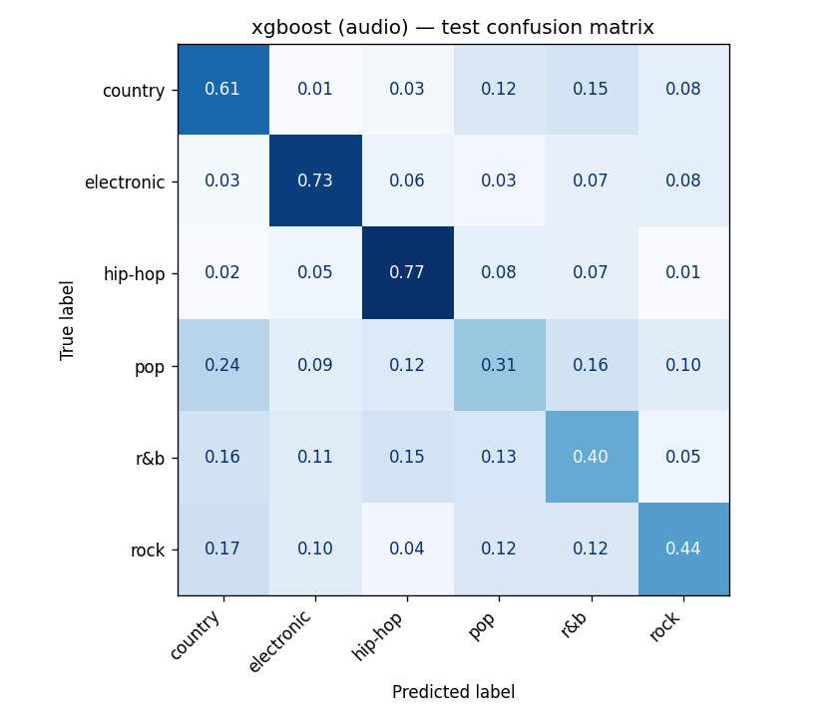
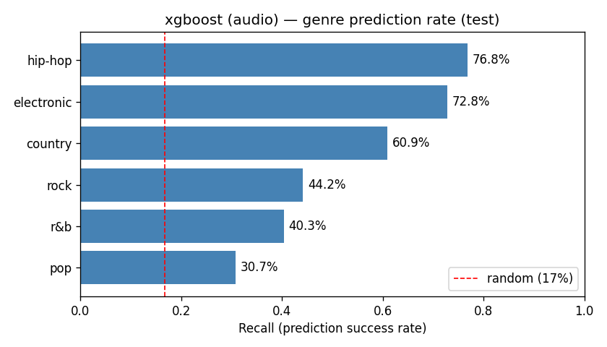
Audio Mode — XGBoost
Test accuracy: 54.3% · Macro F1: 0.535

Slide 8
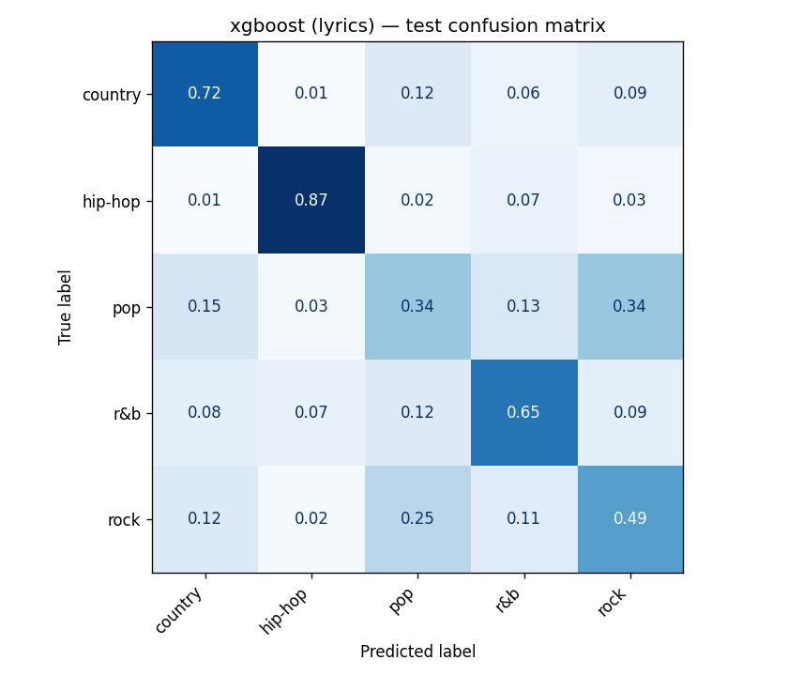
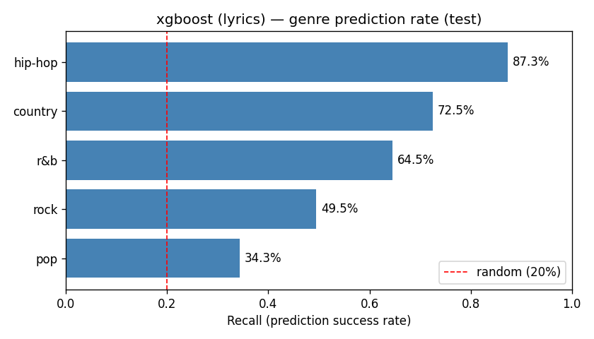
Lyrics Mode — XGBoost
Test accuracy: 61.6% · Macro F1: 0.613

Slide 9
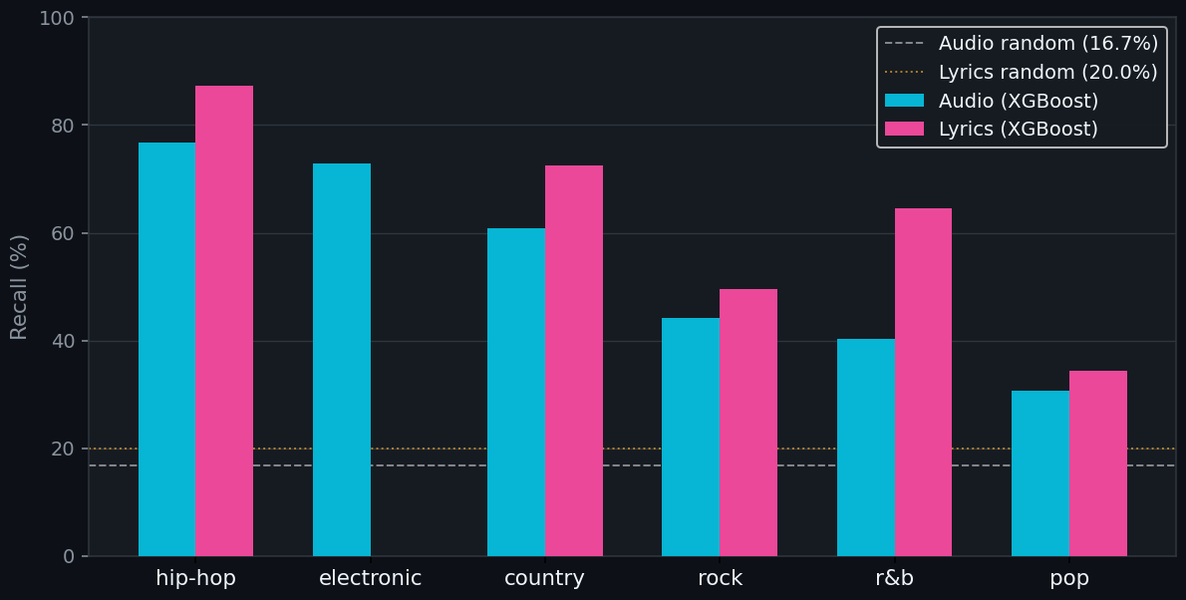
Audio vs Lyrics — Per-Genre Recall
XGBoost · test set
Lyrics win
Hip-hop +10%, R&B +24%, Country +12%
Audio wins
Electronic (N/A in Genius data)
Both struggle
Rock & Pop — genre overlap is real

Slide 10
Key Findings
Best model
Audio strength
XGBoost on lyrics — 61.6% accuracy (vs 20% random on 5 classes)
Electronic (72.8%) and hip-hop (76.8%) are cleanly separable by sound alone
Lyrics strength
Pop is hardest
Hip-hop vocabulary dominates: 87.3% recall — the clearest genre signal
Both modalities struggle: pop borrows vocabulary and sound from every genre
Electronic gap
No overfitting
Genius has too few electronic tracks → audio is the only viable path
Val / test gap < 2% across all 6 model-mode combos

Slide 11
Future Work
Fusion model
Combine audio + lyrics features — should push accuracy past 65%
Transformer embeddings
Replace TF-IDF with BERT / RoBERTa for richer lyric representations
Electronic fix
Supplement Genius with Last.fm or Discogs to recover electronic lyrics
Neural audio
Fine-tune a spectrogram CNN (MFCCs) as a stronger audio baseline
Expand taxonomy
Test on 10-genre taxonomy to find where classification breaks down

