Slide 1



Slide 2
1. Kaldi
(https://github.com/kaldi-asr/kaldi)
2. Zeroth
(https://github.com/goodatlas/zeroth)
3. Kaldi GStreamer Server
(https://github.com/alumae/kaldi-gstreamer-server)

Slide 3
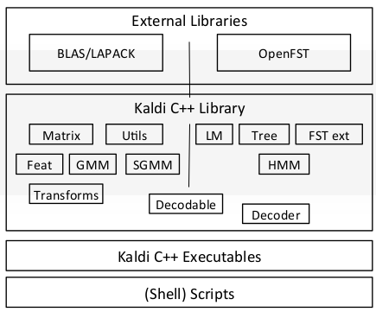
Kaldi : Step 0 - Installing Kaldi
Toolkit for speech recognition
Requirements
- Ubuntu >= 16.04 with CUDA >= 8.0
- install git wget bash perl gawk grep make python
- git clone https://github.com/kaldi-asr/kaldi.git

Slide 4
Kaldi : Step 0 - Installing Kaldi
Kaldi Root
Compilation
cd tools; make;
cd src; make;
egs
src
tools
wsj
zeroth
s5
s5
run.sh
run.sh

Slide 5
Kaldi : Step 1 – Acoustic Data Preparation
Kaldi Root
wav.scp
<file_id> <path of wave filenames OR command to get wave file>
segments
<utt_id> <file_id> <start_time> <end_time>
text
<utt_id> <transcript>
spk2utt
<speaker_id> <utt_id1> <utt_id2> <utt_id3> …
utt2spk
<utt_id> <speaker_id>
spk2gender
<speaker_id> <gender>
egs
src
tools
wsj
zeroth
s5
conf
local
data
exp
steps
utils
data_prep.sh
train
wav.scp
segments
text
spk2utt
utt2spk
spk2gender

Slide 6
Kaldi : Step 1 – Feature Extraction
Kaldi Root
feats.scp
<utt_id> <path of raw mfcc feature file>:<position>
cmvn.scp
<speaker_id> <path of cmvn file>:<position>
mfcc
MFCC feature files of training dataset
egs
src
tools
wsj
zeroth
s5
conf
local
data
exp
steps
utils
mfcc
mfcc.conf
train
make_mfcc.sh compute_cmvn_stats.sh
*.ark, *.scp
feats.scp
cmvn.scp

Slide 7
Kaldi : Step 2 – Language Data preparation
Kaldi Root
phones.txt
<phone>
lexicon.txt
<word> <phone1> <phone2> <phone3> …
silence_phones.txt
<silence phone>
nonsilence_phones.txt
<nonsilence phone>
Extra_questions.txt
<silence phone1> <silence phone2> <silence phone3> …
<nonsilence phone1> <nonsilence phone2> <nonsilence phone3> …
egs
src
tools
wsj
zeroth
s5
conf
local
data
exp
steps
utils
local
lang
phones.txt
lexicon.txt
silence_phones.txt
nonsilience_phones.txt
extra_questions.txt

Slide 8
Kaldi : Step 2 – Dictionary Conversion
Kaldi Root
oov.txt
<garbage phone>
phones.txt
<phone> <symbol of phone>
words.txt
<word> <symbol of word>
context_indep.txt
<non-real phone>
- silence.txt
<silence phone>
nonsilence.txt
<non-silence phone>
sets.txt
<phone group name> <phone1> <phone2> …
word_boundary.txt
<phone> <position in an word>
silence (SIL), spoken noise (SPN), non-spoken noise (NSN), laughter (LAU)
begin (_B), internal (_I), end (_E), singleton (_S)
egs
src
tools
wsj
zeroth
s5
conf
local
data
exp
steps
utils
local
lang_nosp
prepare_lang.sh
lang
L.Fst
L_disambig.fst
oov.txt
phones.txt
words.txt
topo
context_indep.txt
silence.txt
nonsilence.txt
disambig.txt
optional_silence.txt
sets.txt
extra_questions.txt
word_boundary.txt
roots.txt
phone

Slide 9
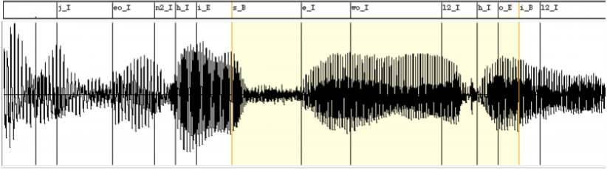
Kaldi : Step 3 – monophone model training and aligning
Kaldi Root
mono
trained monophone acoustic model
mono_ali
Result of aligning training data using trained monophone acoustic model
egs
src
tools
wsj
zeroth
s5
conf
local
data
exp
steps
utils
train
lang_nosp
train_mono.sh
align_si.sh
mono
mono_ali

Slide 10
Kaldi : Step 3 – delta + delta-delta triphones model training and aligning
Kaldi Root
tri1
trained delta + delta-delta triphones acoustic model
tri1_ali
Result of aligning training data using trained delta + delta-delta triphones acoustic model
delta features : first order derivatives of the features
delta-delta features : second order derivatives of the features
egs
src
tools
wsj
zeroth
s5
conf
local
data
exp
steps
utils
train
lang_nosp
train_deltas.sh
align_si.sh
tri1
tri1_ali

Slide 11
Kaldi : Step 3 – LDA-MLLT triphones model training and aligning
Kaldi Root
tri2
trained LDA-MLLT triphones acoustic model
tri2_ali
Result of aligning training data using trained LDA-MLLT triphones acoustic model
Linear Discriminant Analysis : reduced feature space
Maximum Likelihood Linear Transform : speaker normalization for minimizing differences among speakers
egs
src
tools
wsj
zeroth
s5
conf
local
data
exp
steps
utils
train
lang_nosp
train_lda_mllt.sh
align_fmllr.sh
tri2
tri2_ali

Slide 12
Kaldi : Step 3 – SAT triphones model training
Kaldi Root
tri3
trained SAT triphones acoustic model
Speaker Adaptive Training : speaker and noise normalization for minimizing effects of speaker and recording environment
egs
src
tools
wsj
zeroth
s5
conf
local
data
exp
steps
utils
train
lang_nosp
train_sat.sh
tri3

Slide 13
Kaldi : Step 3 – SAT triphones model aligning
Kaldi Root
tri3_ali
Result of aligning training data using trained SAT triphones acoustic model
egs
src
tools
wsj
zeroth
s5
conf
local
data
exp
steps
utils
train
lang
align_fmllr.sh
tri3
tri3_ali

Slide 14
Kaldi : Step 4 – Create New Dictionary based on trained SAT triphones model
Kaldi Root
Lang
New Dictionary by computing pronunciation and silence probabilities of training data based on trained SAT triphones acoustic model
egs
src
tools
wsj
zeroth
s5
conf
local
data
exp
steps
utils
train
lang
prepare_lang.sh

Slide 15
Kaldi : Step 3 – SAT triphones model training and aligning
Kaldi Root
tri4
trained SAT triphones acoustic model
tri4_ali
Result of aligning training data using trained SAT triphones acoustic model
Feature Space Maximum Likelihood Linear Regression : removing speaker identity from features before alignment
egs
src
tools
wsj
zeroth
s5
conf
local
data
exp
steps
utils
train
lang
train_sat.sh
align_fmllr.sh
tri4
tri4_ali
final.mdl (GMM-HMM based model)

Slide 16
Kaldi : Step 5 – Create language models
Kaldi Root
G.fst
3-gram grammer based on small corpus dataset
G.carpa
4-gram grammer based on large corpus dataset
egs
src
tools
wsj
zeroth
s5
conf
local
data
exp
steps
utils
lang
build_const_arpa_lm.sh
Lang_test_tgsmall
Lang_test_fglarge
G.fst
G.carpa

Slide 17
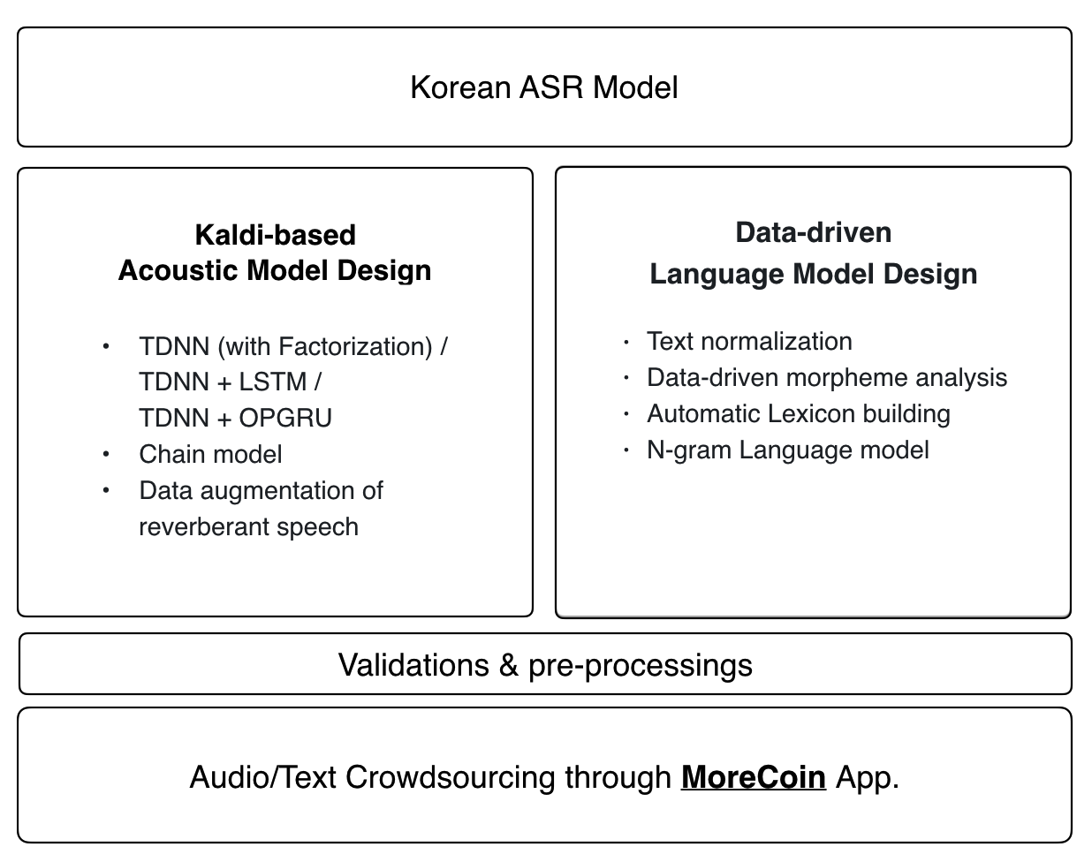
Zeroth : Step 0 - Installing Zeroth
Recipe for Korean ASR
Requirements
- install flac
- git clone https://github.com/goodatlas/zeroth.git

Slide 18
Zeroth : Step 6 – ivector extractor training
zeroth
train_sp
Augmented training dataset
mfcc_perturbed
MFCC feature files of augmented training dataset
s5
conf
local
data
exp
steps
utils
mfcc_perturbed
train
train_sp
perturb_data_dir_speed_3way.sh
make_mfcc.sh
compute_cmvn_stats.sh

Slide 19
Zeroth : Step 6 – ivector extractor training
zeroth
train_sp_hires
Copied augmented training dataset
train_sp_hires/data
High dimentional MFCC feature files of Copied augmented training dataset
s5
conf
local
data
exp
steps
utils
mfcc_hires.conf
train_sp
train_sp_hires
copy_data_dir.sh
make_mfcc.sh
compute_cmvn_stats.sh
log
data

Slide 20
Zeroth : Step 6 – ivector extractor training
zeroth
pca_transform
Dimension reduced training dataset based on PCA
diag_ubm
Result of training Diagonal Universal Background Gaussian Mixture Model
s5
conf
local
data
exp
steps
utils
train_sp_hires
get_pca_transform.sh
train_diag_ubm.sh
nnet3
pca_transform
diag_ubm

Slide 21
Zeroth : Step 6 – ivector extractor training
zeroth
extractor
ivector extractor
ivector_train_sp_hires
Result of extracting ivector of training dataset
s5
conf
local
data
exp
steps
utils
train_sp_hires
train_ivector_extractor.sh
extract_ivectors_online.sh
nnet3
diag_ubm
extractor
ivector_train_sp_hires
final.mat
global_cmvn.stats
Final.dubm
Final.ie
ivector_extractor.conf
online_cmvn.conf
splice.conf

Slide 22
Zeroth : Step 7 – DNN acoustic model training
zeroth
tri4_trans_sp_lats
Result of extracting lattices based on trained SAT triphones acoustic model
tri4_ali_train_sp
Result of aligning training data using trained SAT triphones acoustic model
s5
conf
local
data
exp
steps
utils
train_sp
lang
align_fmllr_lats.sh
align_fmllr.sh
build_tree.sh
chain
tri4
tri4_ali_train_sp
tri4_train_sp_lats
tree_a

Slide 23
Zeroth : Step 7 – DNN acoustic model training
zeroth
final.mdl
trained Deep Neural Network acoustic model
s5
conf
local
data
exp
steps
utils
train_sp_hires
train.py
nnet3
chain
ivector_train_sp_hires
tree_a
tri4_train_sp_lats
tdnn1a_sp
final.mdl

Slide 24
Zeroth : Step 8 – Create dictionary model
zeroth
HCLG.fst
H : multiple HMM states -> context dependent triphone symbols
C : context dependent triphone symbols -> monophone symbols
L : monophone symbols ->word symbols
G : n-gram grammer
s5
conf
local
data
exp
steps
utils
Lang_test_tgsmall
mkgraph.sh
chain
tree_a
graph_tgsmall
HCLG.fst
words.txt
phones.txt
word_boundary.int

Slide 25
Zeroth Trained Model
- Acoustic Model
exp/chain/tdnn1a_sp/final.mdl
conf/mfcc_hires.conf
- Dictionary Model
exp/chain/tree_a/graph_tgsmall/HCLG.fst
exp/chain/tree_a/graph_tgsmall/words.txt
exp/chain/tree_a/graph_tgsmall/phones.txt
exp/chain/tree_a/graph_tgsmall/phones/word_boundary.int
- Language Model
data/lang_test_tgsmall/G.fst
data/lang_test_fglarge/G.carpa
- ivector extractor
exp/nnet3/ivectors_train_clean_sp_hires/conf/ivector_extractor.conf
exp/nnet3/ivectors_train_clean_sp_hires/conf/online_cmvn.conf
exp/nnet3/ivectors_train_clean_sp_hires/conf/splice.conf
exp/nnet3/extractor/final.mat
exp/nnet3/extractor/global_cmvn.stats
exp/nnet3/extractor/final.dubm
exp/nnet3/extractor/final.ie

Slide 26
Kaldi GStreamer Server : Step 0 - Installing gstreamer server
Server for Kaldi ASR models
Requirements
- pip install tornado ws4py==0.3.2 pyyaml pyjson
- install gstreamer1.0-plugins-bad gstreamer1.0-plugins-base gstreamer1.0-plugins-good gstreamer1.0-pulseaudio gstreamer1.0-plugins-ugly gstreamer1.0-tools libgstreamer1.0-dev libjansson-dev
- git clone https://github.com/alumae/kaldi-gstreamer-server.git
- git clone https://github.com/alumae/gst-kaldi-nnet2-online.git
Server
Worker Pool
REST
Kaldi
ASR
Model
Web Socket

Slide 27
Kaldi GStreamer Server : Step 0 - Installing gstreamer server
Compilation
- GST Plugin for GMM models
cd KALDI/src
configure –shared
make ext
cd gst-plugin
make depend
make
export GST_PLUGIN_PATH=KALDI/src/gst-plugin
Worker
Kaldi
ASR
Model
GST Plugin
- GST Plugin for DNN models
cd KALDI/tools/gst-kaldi-nnet2-online
KALDI_ROOT=KALDI make depend
KALDI_ROOT=KALDI make
export GST_PLUGIN_PATH=KALDI/tools/gst-kaldi-nnet2-online/src

Slide 28
Kaldi GStreamer Server : Step 1 – Create .yaml conf file
- GMM model
decoder:
model : zeroth/final.mdl
feature-type : mfcc
mfcc-config : zeroth/conf/mfcc.conf
fst : zeroth/HCLG.fst
word-syms : zeroth/words.txt
phone-syms : zeroth/phones.txt
word-boundary-file : zeroth/word_boundary.int
lm-fst : zeroth/G.fst
big-lm-const-arpa : zeroth/G.carpa
silence-phones: "1:2:3:4:5:6:7:8:9:10"
- TDNN + chain model
use-nnet2: True
decoder:
nnet-mode : 3
model : zeroth/final.mdl
feature-type : mfcc
mfcc-config : zeroth/conf/mfcc.conf
fst : zeroth/HCLG.fst
word-syms : zeroth/words.txt
phone-syms : zeroth/phones.txt
word-boundary-file : zeroth/word_boundary.int
lm-fst : zeroth/G.fst
big-lm-const-arpa : zeroth/G.carpa
ivector-extraction-config : zeroth/conf/ivector_extractor.conf
endpoint-silence-phones : "1:2:3:4:5:6:7:8:9:10"
min-active : 200
max-active : 7000
beam : 15.0
lattice-beam : 6.0
acoustic-scale : 1.0
traceback-period-in-secs : 0.25
chunk-length-in-secs : 0.25
frame-subsampling-factor: 3

Slide 29
Kaldi GStreamer Server : Step 2 - Run server and worker
- Run Master Server
python kaldigstserver/master_server.py --port=host_port
- Run worker for GMM model
python kaldigstserver/worker.py -u ws://localhost:host_port/worker/ws/speech -c zeroth_korean.yaml
- Run worker for DNN model
python kaldigstserver/worker.py -u ws://localhost:host_port/worker/ws/speech -c zeroth_korean_nnet3.yaml

Slide 30
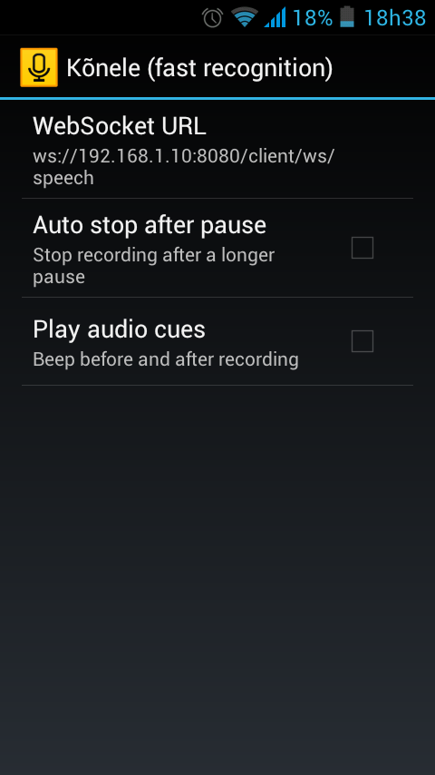
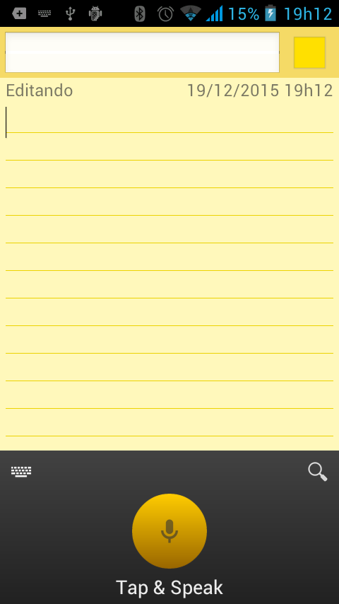
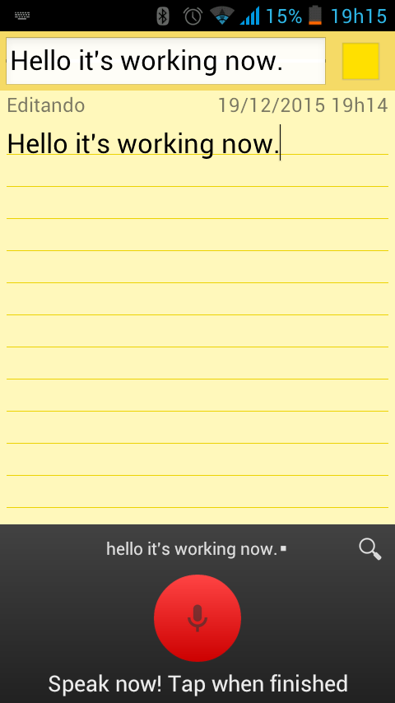

Kaldi GStreamer Server : Step 3 - Run client
- Send audio to Server
curl -T test/data/english_test.wav "http://host_ip:host_port/client/dynamic/recognize"
- Send audio stream to Server
ws://host_ip:host_port/client/ws/speech
- Using Konele Android Keyboard App

