Slide 1


Slide 2
Computer Logic
Condition
a = 5
b = 7
If a>b then Print a
else Print b
Result -> 7

Slide 3
Computer Logic
Condition
a = 5
b = 7
c = 3
If a>b and a>c then Print a
If b>c and b>a then Print b
If c>a and c>b then Print c
Result -> 7 because 2nd condition is correct

Slide 4
Computer Logic
Condition
We have 3 main conditions
AND Both condition must true then answer is true
OR Any one is true then answer is true
NOT No one is true then answer is true
(opposite of AND)

Slide 5
Computer Logic
Condition
We know computer is working on electric. Means present and absent or electric
Present = 1
Absent = 0
So now we will show our condition by electric cercit

Slide 6
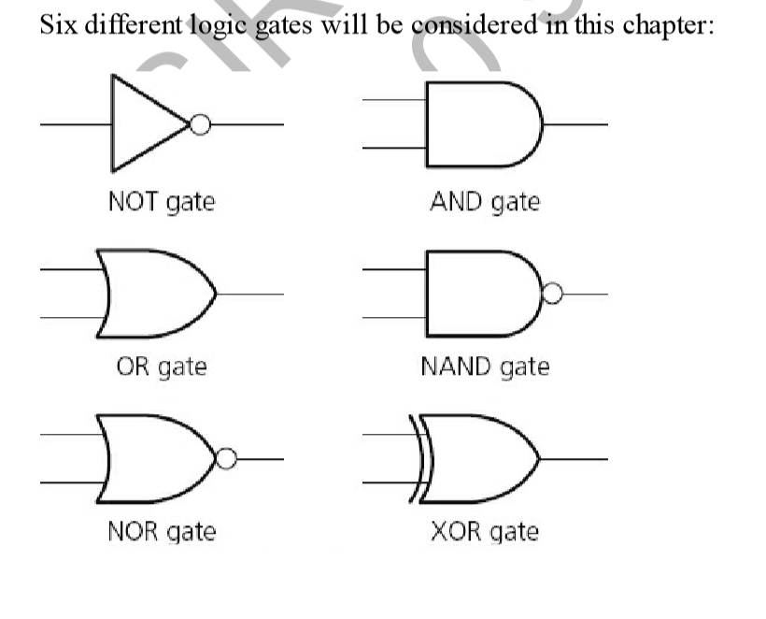

Slide 7


AND Gate
A
B

Slide 8
Computer Logic
Condition
Means both are on true answer is true

Slide 9
Computer Logic
Condition
Means both are on then answer is on

Slide 10
OR Gate
A
B

Slide 11
Computer Logic
Condition
Means any one true then answer is true

Slide 12
Computer Logic
Condition
Means any one true then answer is true

Slide 13
NOT Gate
A

Slide 14
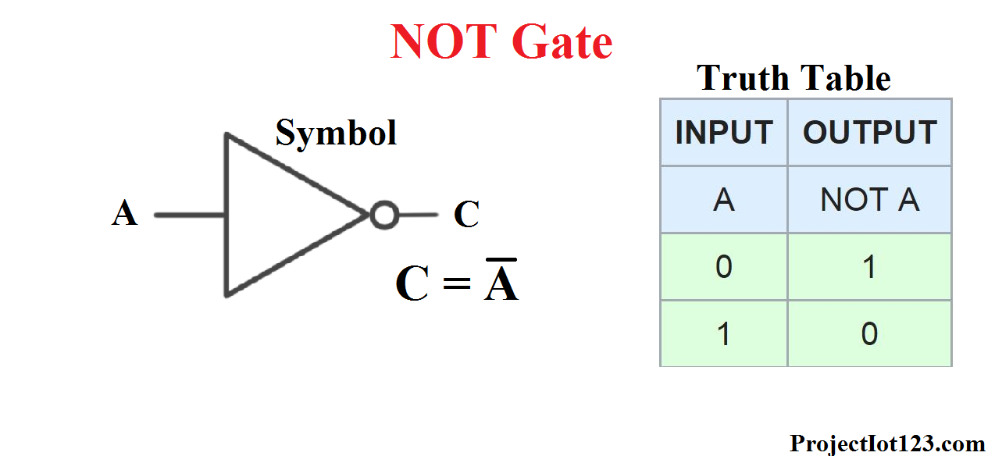

Slide 19
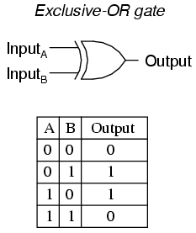

Slide 20
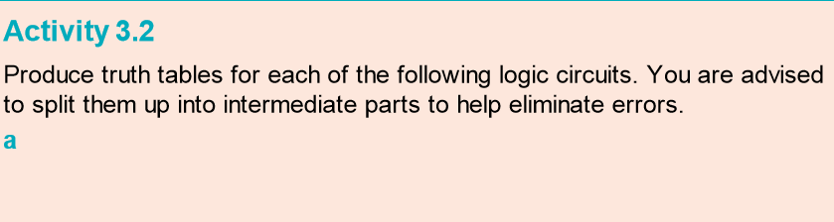
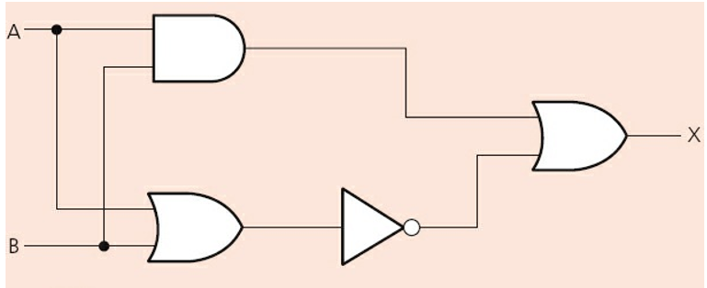

Slide 21
INPUT |  | Intermediate Values |  |  | Result
A | B | A AND B | A OR B | A OR B (A OR B NOT) | A AND B or A OR B
0 | 0 | 0 | 0 | 1 | 1
1 | 0 | 0 | 1 | 0 | 0
0 | 1 | 0 | 1 | 0 | 0
1 | 1 | 1 | 1 | 0 | 1

Slide 22
